Slide 1
PPT writing workshop
Eileen Comerford
aUgust 28, 2017
Notes:
Audience: PPT department (Jessie, Erin, Kurt, Carly, Andrew, Ben, Jordan); Key Accounts dpt. (Jeff); others interested in joining
Objective: sharpening of writing techniques (and praising current strengths) to improve quality control for documents from the PPT department
Audience to bring:
Pen and highlighter
Copy (printed or digital) of something you’ve written (individually or collaboratively)
Examples: I.E., D.E., Screening, something similar (preferably something that hasn’t been edited by me yet)

Slide 2
Outline
Part I: Talk about writing
Part II: Workshop
Notes:
Broken into two parts:
Talk about writing (laid-back chat about what you write, how you write, what your relationship with writing is, and recap from Erin’s Tech Writing 101 pres.)
Workshop (this is when you’ll use the document you brought. The presentation will go through about 7 tasks to apply to your document)

Slide 3
Part I
TALK ABOUT WRITING

Slide 4
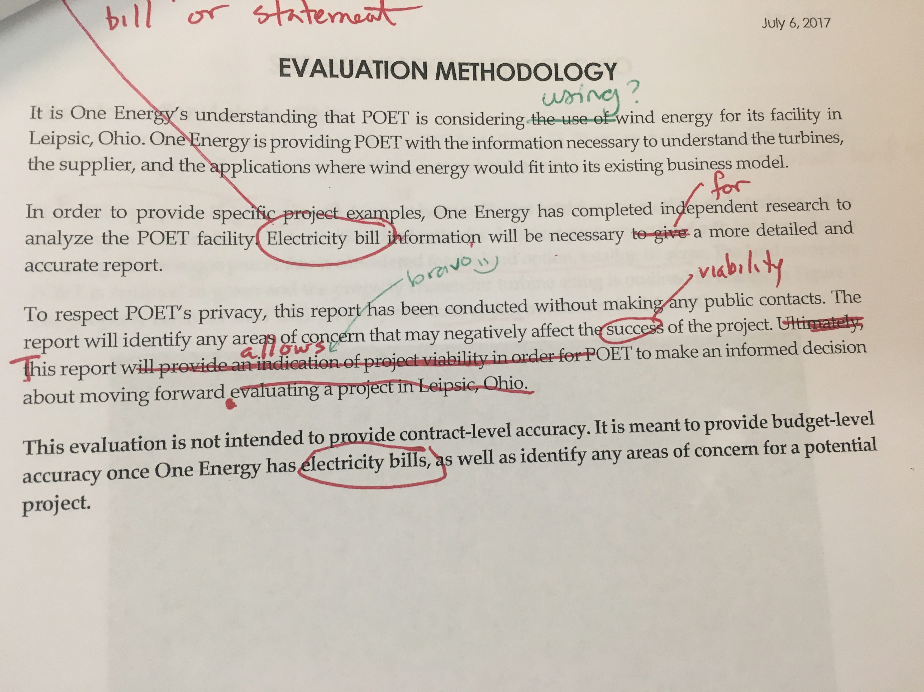
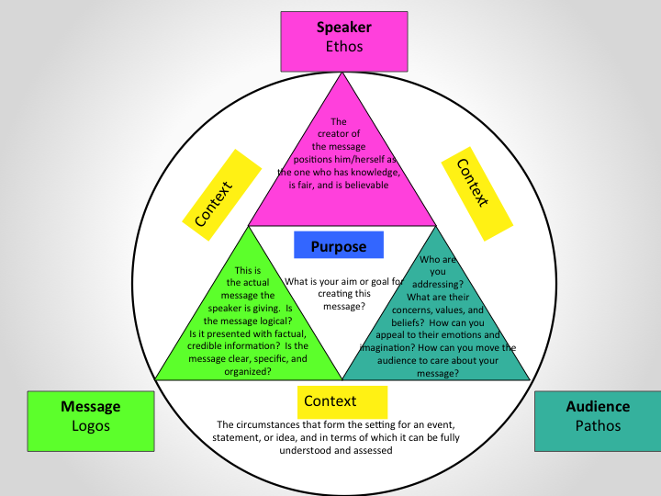
Tech writing 101 recap
write, proofread, edit
tech writing ≠ creative writing
know the nuances of your document type
make outlines
proofread
repeat
Notes:
Intro/basic recap: Erin had a Tech Writing 101 presentation a while ago, which was great and covered the basics of Tech Writing; if you haven’t watched, definitely do so. For now, a recap:
3 general steps for a completed written product: write, proofread, edit
tech writing≠creative writing; be direct, brief, and consistent (e.g. John’s edit of POET I.E.)
don’t include anything that doesn’t actively support your main topic/intention
know nuances of your type of document: tone, audience, purpose
see rhetorical triangle: every piece of communication uses these elements (even technical documents produced in PPT)
make outlines (!!!!)
proofreading
Copy Editor will be able to review higher-level issues and go through the quality control process much more efficiently if you’ve re-read your content first
Also: check figures and specific content that Copy Editor won’t know is correct
repeat (writing is an iterative process)

Slide 5
Content
What writing do you produce at One Energy?
Notes:
Content: what do you write at OE?
Keep in mind when talking about your writing

Slide 6
Process
What is your writing process?
Notes:
Process: what is your writing process?
example of mine: prewrite+write+review/revise
talk to people to gather necessary info/brainstorm (not in that order; sometimes brainstorm first, then talk; sometimes it’s an iterative process)
listen to spotify “instrumental study shit” playlist
make outline
draft; review; seek review from others; revise; repeat

Slide 7
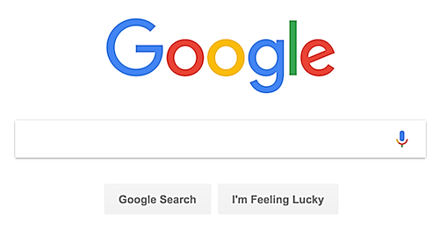

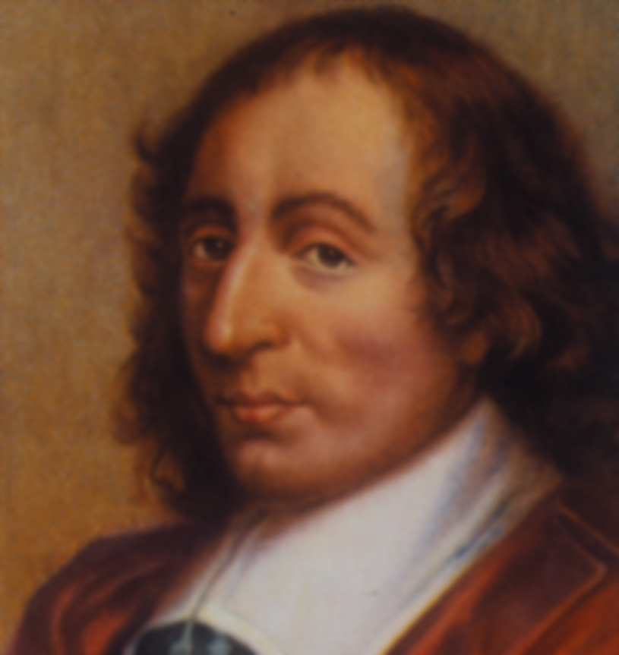
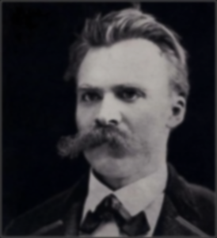

Golden rules
When in doubt, google it. Still in doubt, be consistent.
Brevity is clarity.
There is no good or bad writing;
there is only early and revised writing.
“Brevity is the soul of wit.”
– William Shakespeare
“I have only made this letter longer because I have not had the time to make it shorter.“ – Blaise Pascal
“It is my ambition to say in ten sentences what others say in a whole book.”
― Friedrich Nietzsche
Notes:
Golden Rules
when in doubt, google it. Still in doubt, be consistent
If there’s no straightforward answer, it might be a decision you can make - as long as you’re consistent throughout the entire document
Brevity is clarity
cut and revise; if a message can be communicated in a briefer form, communicate it in a briefer form (if it can be cut, cut it)
There is no good or bad writing; there is only early and revised writing.
A draft is never “finished” – simply “polished”; writing can always improve

Slide 8
Part II
WORKSHOP
Notes:
PART II: Workshop - now that we’ve talked about writing and we understand the kind of writing the you produce, let’s go through your documents together to see how we can identify the their strengths and weaknesses
7 tasks overall

Slide 9
What’s your point?
Notes:
What’s your point?
every piece of writing makes an argument – even technical documents that seem straightforward
however subtle and however obvious, anything you write is you trying to convince your reader of something
example: initial evaluation=convincing reader their site is or is not viable for a Wind for Industry project.

Slide 10
What’s your point?
Task 1: identify your thesis/main idea and underline it
  Can’t find one? Create one!
Notes:
Task 1: identify your thesis/argument/main idea in your document and underline it (1-3 minutes)
if you don’t have a thesis, create one
Identifying your thesis is important because the thesis guides the whole paper. If you don’t have a thesis, your reader will get lost.

Slide 11
Search, find, cut
Task 2: search your writing for any of the following words, circle them, and try to cut them:
THIS, THAT, IT, THESE, THOSE, THEM
IS, WAS, WERE, BE, BEEN, BEING, AM, ARE
Notes:
Task 3: search your writing for any of the following words, circle them, and try to cut them (even if that means rearranging or re-wording the sentence):
this, that, it, these, those, them
avoid vague pronouns - what are you referring to? e.g. I.E.: “This allows for” --> “This model allows for”
“this [what?] will result in a…”
“so that” - yuck
is, was, were, be, been, being, am, are
Explain why
Kind of annoying arbitrary “professional level” writing preference, but also somehow works
These are weak verbs; can you think of stronger verbs/ways to phrase the sentence without these?
this will help with brevity, but also with turning passive phrases to active (something Erin stressed in her presentation)

Slide 12
Passive to active voice
Task 3: Using your previous search for IS, WAS, WERE, BE, BEEN, BEING, AM, ARE, focus on changing passive sentences to active sentences.
1. The site is serviced by AEP Ohio and is subject to state Net Metering laws.
AEP Ohio currently services the site, so state Net Metering laws apply.
2. There are two parcels of land owned by POET incorporated into the City of Leipsic, a zoned community.
POET owns two parcels of land incorporated into the City of Leipsic, a zoned community.
MISPLACED MODIFIERS
Notes:
Task 3: Using your previous search for IS, WAS, WERE, BE, BEEN, BEING, AM, ARE, focus on changing passive sentences to active sentences
Bonus! Second sentence: also solves the misplaced modifier problem: try to keep modifiers as close to the item they’re modifying as possible
“incorporated” coming after “POET” is confusing. When I first read this sentence, I was inclined to read “POET, inc.” → if rearranged, confusion is settled because “incorporated” is back to modifying “parcels of land” instead of “POET”
Bonus task: search for misplaced modifiers in your document and circle with a heart and do-not-enter symbol

Slide 13
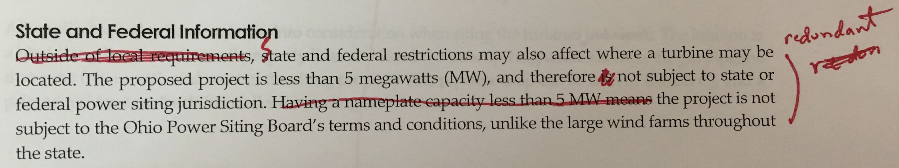
Redundancies
Task 4: Search for redundancies and label with a star. Cut and rearrange as necessary.
Notes:
Task 4: Search for redundancies and label with a star. Cut and rearrange as necessary
re: John’s “redundant” edit on IE and PPT team’s beautiful re-wording

Slide 14
Big picture revisions
Developing paragraph structure
The Uneven U
OSIE
Notes:
Developing paragraph structure
You may be familiar with how entire papers are set up with hourglass-like shape for intro, body, and conclusion: general main point, details to support main point, wrapping up and reminding of general main point – “We did an IE and determined you should get a DE and turbines; here are pages of details for why we think that; again, get a DE and turbines.”
each paragraph is also set up that way!! so fun
Uneven U and OSIE are helpful formulas for such structure
We’ll talk about them both, then you’re going to use them in your own documents

Slide 15
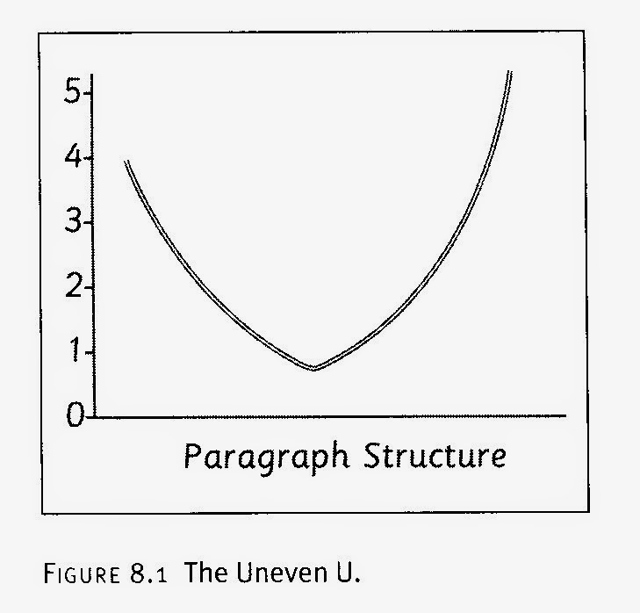
paragraphs
The Uneven U
Eric Hayot (2014) argues paragraphs should make an “uneven U”:
E.) Connect whole paragraph
back to your thesis
A.) Start with observation
B.) Narrow observation
C.) Introduce evidence
D.) Provide evidence
Notes:
Uneven U:
You’ll find most published paragraphs end up following this structure

Slide 16
paragraphs
Sample Uneven U
A.) Start with observation
LEVEL 4
B.) Narrow observation
LEVEL 3
C.) Introduce
evidence
LEVEL 2
D.) Provide evidence
LEVEL 1
E.) Connect whole paragraph
back to thesis
LEVEL 5
Notes:
Sample uneven U paragraph:
This paragraph from the POET Leipsic IE is doing almost everything a paragraph should do (see slide 19 for how it can improve).

Slide 17
paragraphs
OSIE
OBSERVE: | State an observation. What is the main point of this paragraph?
SUPPORT: | Support that observation/main point with some type of evidence. Why should your audience believe you?
INTERPRET: | Interpret your support in your own words. What do you want your audience to know from that evidence?
EVALUATE: | Evaluate how that source supports your initial observation. How does this whole paragraph support your overall thesis of the document?
Notes:
OSIE:
OSIE is another option (my favorite) for formulating paragraphs
Note: these formulas represent the general structure of paragraphs; pattern can vary, but these elements should be present
Each element can be more than one sentence

Slide 18
paragraphs
Sample OSIE
O
S
I
E
Notes:
Sample OSIE paragraph:
This is the same paragraph we used for the Uneven U sample. Our ability to apply both formulas to this paragraph shows its high quality.
Again, slide 19 shows one way this paragraph can improve.

Slide 19
paragraphs
Together: develop topic sentence
Siting Restrictions
Local Information
The land owned by POET is located in Van Buren Township, a zoned community. A zoned community is a municipality that has specific restrictions on building within the community limits. The Van Buren Township Zoning Resolution does not have a specific wind ordinance. The land proposed for turbine siting is zoned “Agricultural”. According to the zoning ordinance, tall structures such as radio or television towers are not allowed to be built on Agricultural land. If a wind turbine is similarly classified as a tall structure, this land may require rezoning to “Industrial”. This rezoning would require approval by the Board of Township Trustees after recommendation by the Zoning Commission. Because Van Buren Township has a 60-foot height restriction on all structures, this project will need approval and a variance from the Zoning Commission prior to construction of a turbine.
Notes:
Together: develop a topic sentence (or phrase attached to the beginning of the first sentence)
While this paragraph shows the aspects of OSIE and the Uneven U, the topic sentence could be stronger.
Since the main idea of this paragraph is that this project needs approval and a variance to continue, that idea should be communicated at the very beginning, then the following sentences should support it
In this instance, this is an easy fix, since all other sentences in this paragraph already support that idea

Slide 20
PARAGRAPHS
Task 5: Identify the elements of either the Uneven U or OSIE in one of your paragraphs.
Label with numbers 1-5 or letters O, S, I, and E
  Too easy? Identify the elements in all your paragraphs!
  Can’t find any? Start rewriting paragraphs to include elements.
OBSERVE: | State an observation. What is the main point of this paragraph?
SUPPORT: | Support that observation/main point with some type of evidence. Why should your audience believe you?
INTERPRET: | Interpret your support in your own words. What do you want your audience to know from that evidence?
EVALUATE: | Evaluate how that source supports your initial observation. How does this whole paragraph support your overall thesis of the piece of writing?
A.) Start with observation
LEVEL 4
E.) Connect whole paragraph
back to your thesis
LEVEL 5
B.) Narrow observation
LEVEL 3
C.) Introduce evidence
LEVEL 2
D.) Provide evidence
LEVEL 1
Notes:
Task 5: Identify the elements of either the Uneven U or OSIE in one of your paragraphs. Label with numbers 1-5 or letters O, S, I, and E
Too easy? Identify the elements in all your paragraphs!
Can’t find any? Start rewriting paragraphs to include elements.

Slide 21
sentence revisions
Task 6: read the entire piece through. Highlight the three worst sentences you can find (unclear, too long, messy).
Swap papers with someone nearby and have them rewrite your sentences.
  Working alone? Copy sentences onto a separate piece of paper and revise until you’re satisfied.
Notes:
Task 6: read the entire piece through. Highlight the three worst sentences you can find
swap papers
rewrite sentences

Slide 22
Final revisions
Task 7: Read your whole document as a final product
  Pay attention to details, like:
    Is everything spelled correctly?
    Is there only one space after each period?
    Are the page numbers consistent with the Table of Contents?
    Are tables, charts, and graphs together on the page they’re listed on in the TOC?
    Is your thesis apparent throughout?
  Apply revisions, print, and repeat task 7 until satisfied
Notes:
Task 7: Read your whole document as a final product, keeping in mind common errors

Slide 23
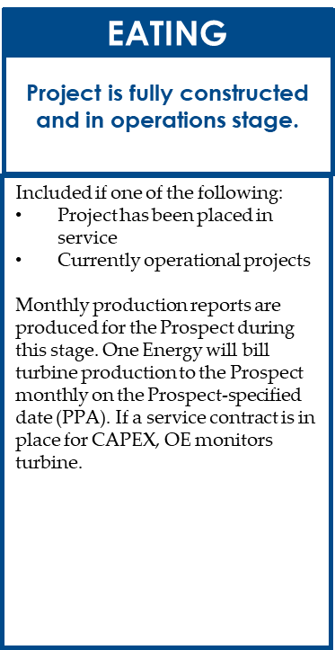
While we’re here
Things I notice/have been asked about:
  When to hyphenate
    e.g. “behind-the-meter installation” vs. “installation of one or more utility-scale wind turbines behind the meter”
  When to capitalize directions
    Direction: lowercase – “Adjacent property to the north has been chosen…”
    Region: capitalized – “…located in North Findlay…”
  No space between slashes and words
    Incorrect: this / that
    Correct: this/that
  Parallelism:
Included if one of the following:
Project has been placed in service
Project is currently operational
Notes:
Things I notice/have been asked about:
Hyphenate phrases when they’re used as one idea modifying a noun
North, south, east, and west are sometimes capitalized and sometimes not. See the above link for an explanation. The almost definitive standard is: capitalize when describing a region; lowercase when describing a direction. If you can’t figure out what to do after reviewing this link, the best method would be to choose an option and be consistent throughout your document.
Sometimes I see spaces between words and forward slashes. Unless a specific style guide requires that practice, make sure there are no spaces and the forward slash simply replaces the space between the two words
Parallelism: when producing a list, make sure all items in the list are in parallel structure.
For example, the above sample from an early draft of the Whaleboard definitions shows two items in a list. The first item in the list is a complete sentence and the structure is basically [subject]+[verb]+[object], while the second item is just a phrase with a structure of [adverb]+[adjective]+[noun]. See the link for a better explanation.

Slide 24
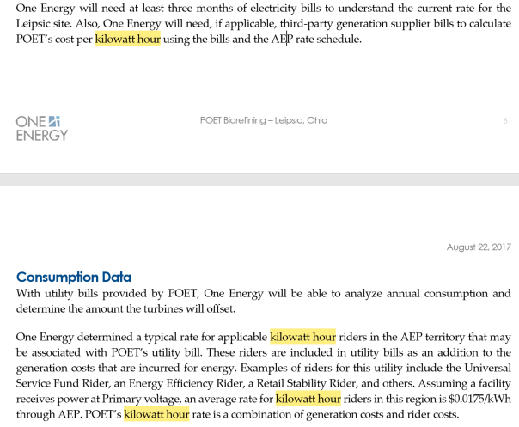
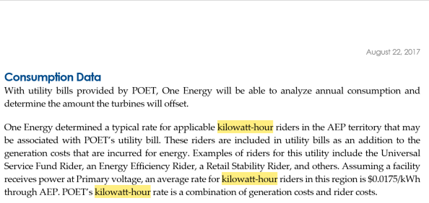
terminology
Common abbreviations:
MW: megawatt
MWh: megawatt hour
kW: kilowatt
kWh: kilowatt hour
Hyphenate when used as a single idea modifying a noun:
kilowatt-hour riders
List of terminology location:
Dropbox(OEE)/
Marketing – Approved Documents/
Wind Education/
References – OE Resources and Tools/
Wind Terminology and Acronyms 2017
Notes:
Terminology
These are a few terms that get confusing. A list of more terms is located in Dropbox within Marketing – Approved Documents

Slide 25
Templates
Initial Evaluation templates
  Types:
    Energy co-op
    PPA
    CAPEX
Detailed Evaluation language models
  Sections:
    (what to say if…)
Notes:
Templates?
New project: “templates” for different documents (IEs, etc.)
different templates for different types (e.g. PPA, CAPEX, energy co-op, etc.)
I can edit the templates to start making sure consistency is maintained, instead of writer copying and pasting from previous versions (and possibly copying and pasting errors in those documents), this can be a way of maintaining quality control

Slide 26
Any questions?
Notes:
Thank you! Sharpening writing techniques is an important step in maintaining quality control and increasing our expertise here at OE.
Any questions?

