Slide 1
The grid and pjm
Meredith wirth
April 5th 2022

Slide 2
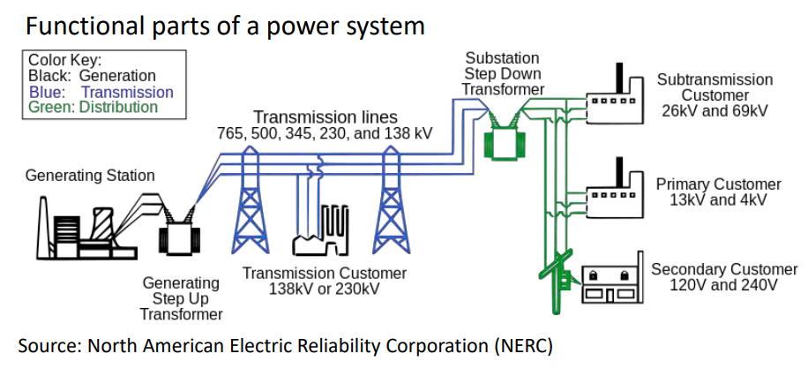
overview the grid

Slide 3
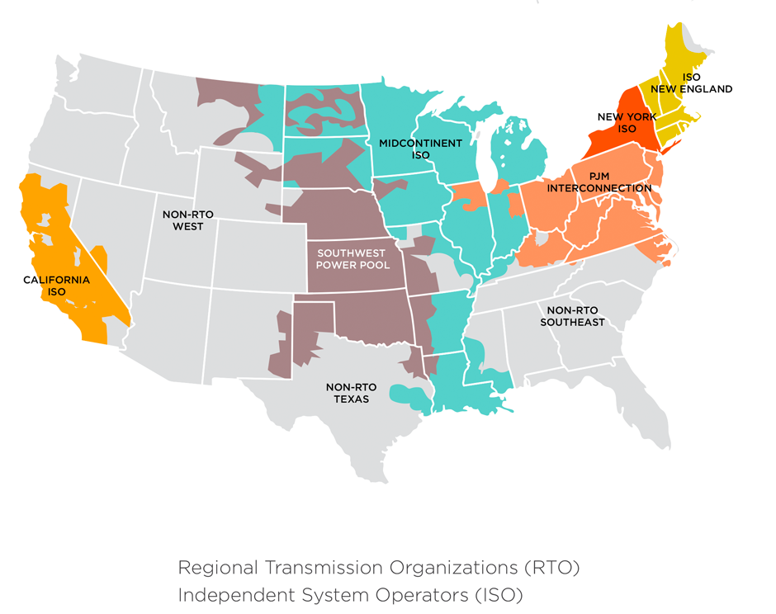
Overview the grid
REGIONAL TRANSMISSION ORGANIZATION (RTO)/ INDEPENDENT SYSTEM OPERATOR (ISO)
Primary responsibility of maintaining grid reliability
RTOs and ISOs coordinate, control, and monitor electric grids within the regions; administers region’s wholesale markets
ISOs have jurisdiction in one state or a smaller region while RTOs have jurisdiction in a larger region. ISOs must meet certain regional standards to be considered an RTO.
Both are regulated by the Federal Energy Regulatory Commission (FERC)

Slide 4
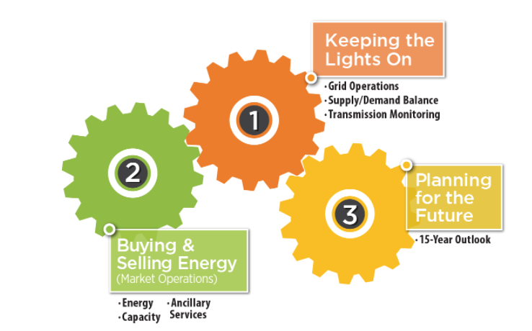
Overview
PJM
THREE RESPONSIBILITIES

Slide 5
Pjm
Keeping the lights on
SUPPLY MUST MEET DEMAND AT ALL TIMES
PJM achieves this with an auction to fill the anticipated load for the following day
Recall that RTOs/ISOs are like air traffic controllers. PJM directs generators when to turn on and off and determines how many MW a generator plant needs to produce to meet real-time demand
PJM uses algorithms to perform ‘what if’ scenarios to assess the condition of the grid during the day
Power grid operators make real-time decisions that balance supply and demand

Slide 6
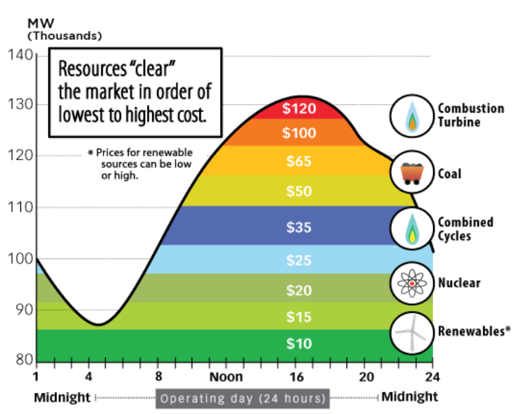
Pjm
Keeping the lights on
Notes:
Concept of economic dispatch – PJM dispatches the least expensive resource first and then dispatches the next least expensive and so forth until the projected load is met (plus some reserve amount). These resources are said to be “cleared”. The cost of the last cleared resource is considered to be the wholesale price. This affects the Locational Marginal Price (LMP).
PJM then takes the cleared resources and creates a generation schedule for the next day.

Slide 7
Pjm
LMPs
System Marginal Price
Transmission Congestion Price
LMP
=
+
+
Marginal Losses Price
Physical, flow-based pricing system
Cost of last “cleared” generation resource
Cost of re-dispatching a more expensive resource
System losses causes by increases in power injection/withdrawal
Notes:
Congestion is an economic issue, not a reliability issue. PJM always prioritizes grid reliability and cannot wait for less expensive generation resource to ramp up to meet demand, thus the re-dispatching of a more expensive generation resource.

Slide 8
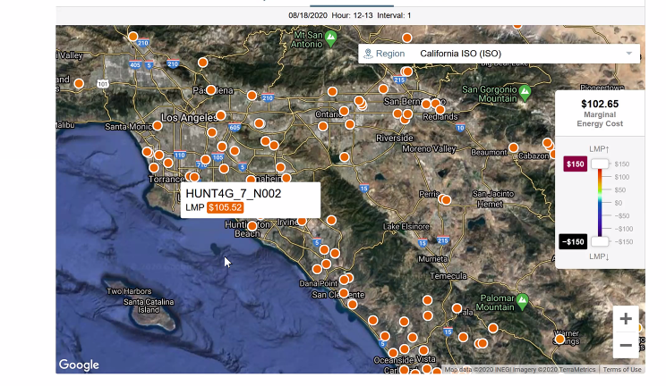
LMP Time variation
Why does congestion really matter?

Slide 9
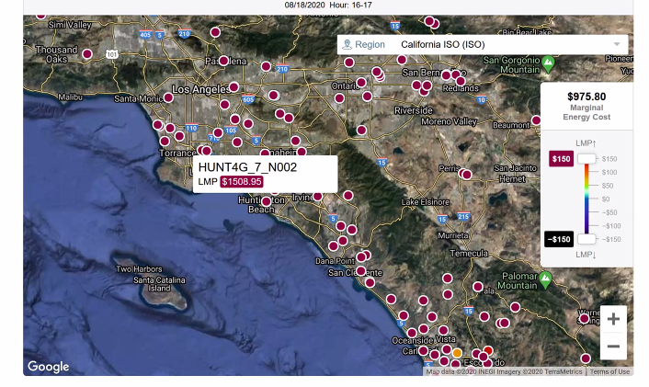
LMP Time variation
Why does congestion really matter?

Slide 10
Pjm buying and selling energy
1.) Energy Market
  Ensures demand is met in real-time and the immediate future
a.) Real-Time Market (“Spot” Market) – Actual Demand
* 5-minute LMPs based on grid operating conditions
* Transactions settled hourly based on real-time LMPs
b.) Day-Ahead Market (“Forward Market) – Scheduled Demand
* Hourly LMPs based on day ahead transactions
2.) Capacity Market – Reliability Pricing Model (RPM)
  Ensures demand is met for the next three years
  * “Pay-for-performance” model
  * Competitive auction
3.) Ancillary Services Market
  Ensures demand is met while maintaining a system frequency of 60 Hz
  a.) Regulation – resolves differences between load and generation
  b.) Reserves – makes up for potential generation deficiencies
Notes:
FOR ENERGY MARKET -
FOR CAPACITY MARKET - PJM compares capacity to a business parking lot. There are enough spaces for normal business hours, but also enough parking spaces to meet high demand during the holidays (especially Black Friday).
FOR ANCILLARY SERVICES MARKET-
Regulation keeps the system’s area control error (ACE) within acceptable bounds. ACE is the difference between the projected and actual electrical generation (while taking variations of the system’s frequency into account). Some resources within the regulation market include steam, combustion turbines, hydro, storage and demand response.
Demand response is described as end user’s reducing electricity use based on power grid conditions and hourly wholesale electricity costs. It is basically an incentive for the end user to curtail their usage
There are two types of automated signals PJM sends out.
Regulation D – fast, dynamic signal; requires instantaneous response
Regulation A – slower signal; recovers larger, longer fluctuations

Slide 11
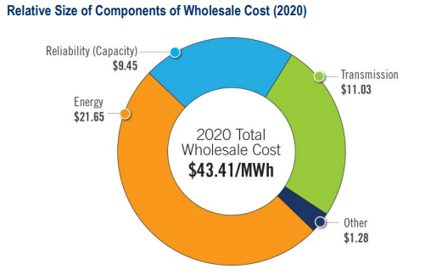
Pjm buying and selling energy

Slide 12
Pjm planning for the future
Annual Regional Transmission Expansion Plan
  Detailed changes necessary for transmission grid in next 5 years
  Projected changes for transmission grid in next 15 years
Generation interconnection studies
  New/retiring generation plants
    Can the transmission grid support new generation plants? What upgrades are needed?
    Can the transmission grid still meet demand with retiring generation plants?
Coordination with neighboring RTOs/ISOs
  Mitigating adverse impacts to neighboring systems
  Upgrades around shared borders

Slide 13
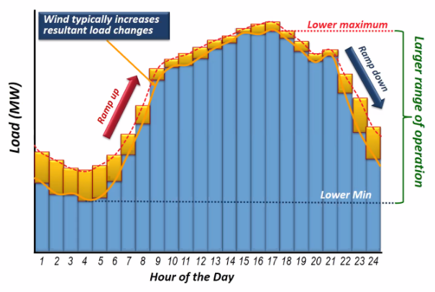
Putting it all together
UNDERSTANDING HOW RENEWABLES AFFECT THE POWER GRID
Notes:
The yellow bars represent wind energy production throughout a given day. The yellow line represents the net load curve (demand load – wind production load) while the red line represents the original load curve.

Slide 14
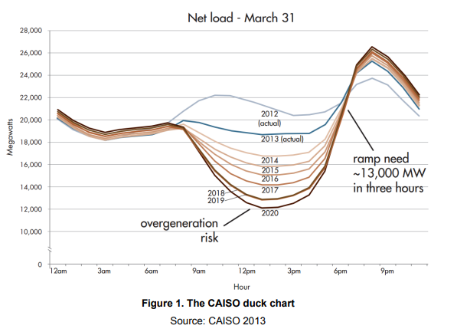
Putting it all together
UNDERSTANDING HOW RENEWABLES AFFECT THE POWER GRID
THE SOLAR “DUCK” CURVE
Notes:
The normal load curve with conventional generational sources changes with as variable generation sources (wind and solar) start to become more prevalent. The graph above shows the specific impact of solar generation on the load curve. From 2012 to 2020, we see a significant decrease in the net load during the day when the sun is out. When the sun sets, the net load increases since solar generation can’t meet the demand anymore. Utilities must fall back to dispatching conventional generation sources (that are also more expensive).
The integration of renewable generation resources has a direct impact on the LMPs. Wind/solar ramping events can lead to LMPs dipping and sometimes becoming negative. So conventional generators are paying to put energy on the grid while renewables are benefitting from RECs. When wind and solar can’t meet demand, re-dispatching occurs to meet increased demand thus increasing the transmission congestion cost portion of the LMP.
Utilities curtail wind and solar generation during overgeneration periods thus decreasing overgeneration and the ramping need.
With a greater renewable generation load, the power grid needs to be more flexible.

Slide 15
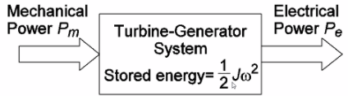
Putting it all together
UNDERSTANDING HOW RENEWABLES AFFECT THE POWER GRID
SYSTEM FREQUENCY – “PULSE” RATE
Concept of inertia and system frequency
  Alternating current (AC) grid
  Conventional synchronous generators vs. inverter-based resources
Solutions:
1.) Grid-following inverter-based resources
2.) Grid-forming inverter-based resources
3.) Fast frequency response (FFR) resources
Notes:
Synchronous generators have stored kinetic energy (inertia) that provides the grid with time to respond to system frequency imbalances.

Slide 16


How does One energy fit IN?
DIST GRID
End-User Meter
Notes:
Generating resources connected to the distribution network are considered demand reducing assets in the perspective of RTOs/ISOs. Even though we install our projects to offset one load entity, the turbine energy production still offsets the energy demanded from transmission networks.
Remember our definition of LMP is the sum of the system marginal price (the price of the last “cleared” generation resource) plus the transmission congestion price and any marginal losses. With the net zero projects, we would have wind and solar generation leading to a more balanced profile and more of an affect on transmission congestion and the system marginal price.
What we are doing is not on the scale of large wind/solar farms, but still lends to ensuring the most economical delivery of electricity.
With behind-the-meter projects, we are not subject to grid curtailment.

Slide 17
[Name]
[Date]

