Slide 1
2024 Market Analysis
(Total addressable Market/TAM)
Will Kiffmeyer
5/20/25
Notes:
Have you heard of TAM/know what it is?
Make informed strategic decisions and identify opportunities for growth.
Ask questions whenever!!!
What is TAM and why do we do it?
Determining Our Market
Scenario Analyses
Expansion Strategy
Takeaways

Slide 2
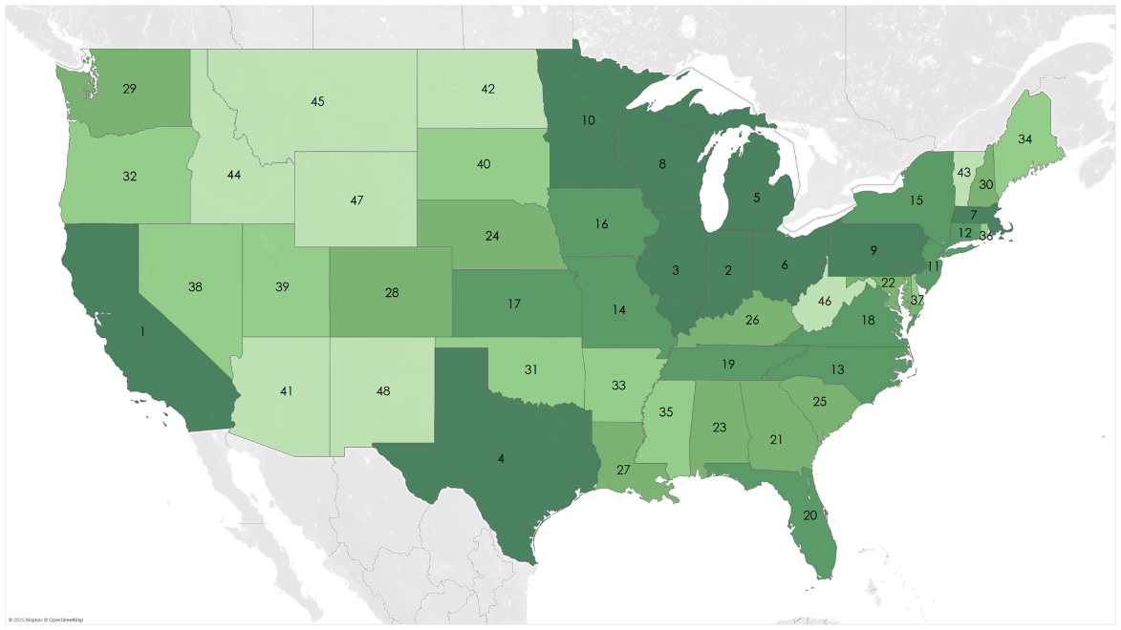
Results
0% ITC
~9,000 facilities
~$92 billion
30% ITC
~10,500 facilities
~$108 billion
Notes:
we determined… serviceable right now
High value of WFI in the Midwest states

Slide 3
What is TAM and why do we do it?
What?
Wind for Industry
Total Addressable vs Serviceable Market
Evaluate Potential Market Growth
ITC Impact
Why?
Determine where to focus our project development resources
Express value to investors
Notes:
TAM = Technically viable, SM = Economically viable
Growth: Turbine efficiency, Company efficiency, grid inflation
Value expressed as Deployable Capital. Revenue/Profit not a key aspect of this analysis

Slide 4
What’s New
New Turbines
Screenings
Grid Inflation
GDP Growth
Notes:
From 2.35 to 4.8 MW, larger setbacks, greater costs, faster wind speeds, more viable locations right now
10 year grid inflation up to 16% from 8%
California and Texas ran away with Manu GDP, minimize outlier effect

Slide 5
Data Used
Sector Reports
Wind Speed
Electricity Prices
Manufacturing data
Notes:
Slight decrease in manufacturing leading to a smaller extrapolation

Slide 6
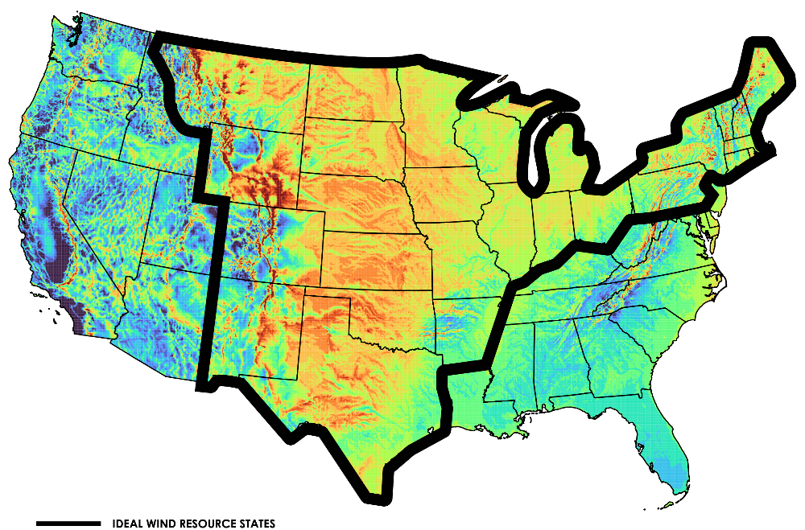

Reference Maps

Slide 7
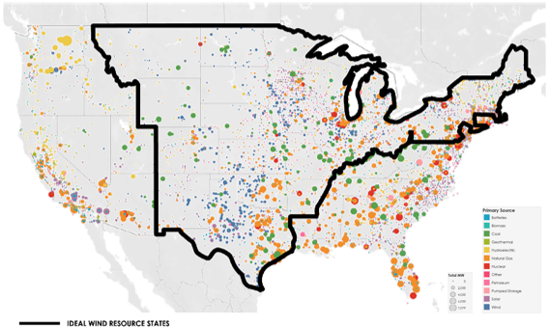
Reference Maps

Slide 8
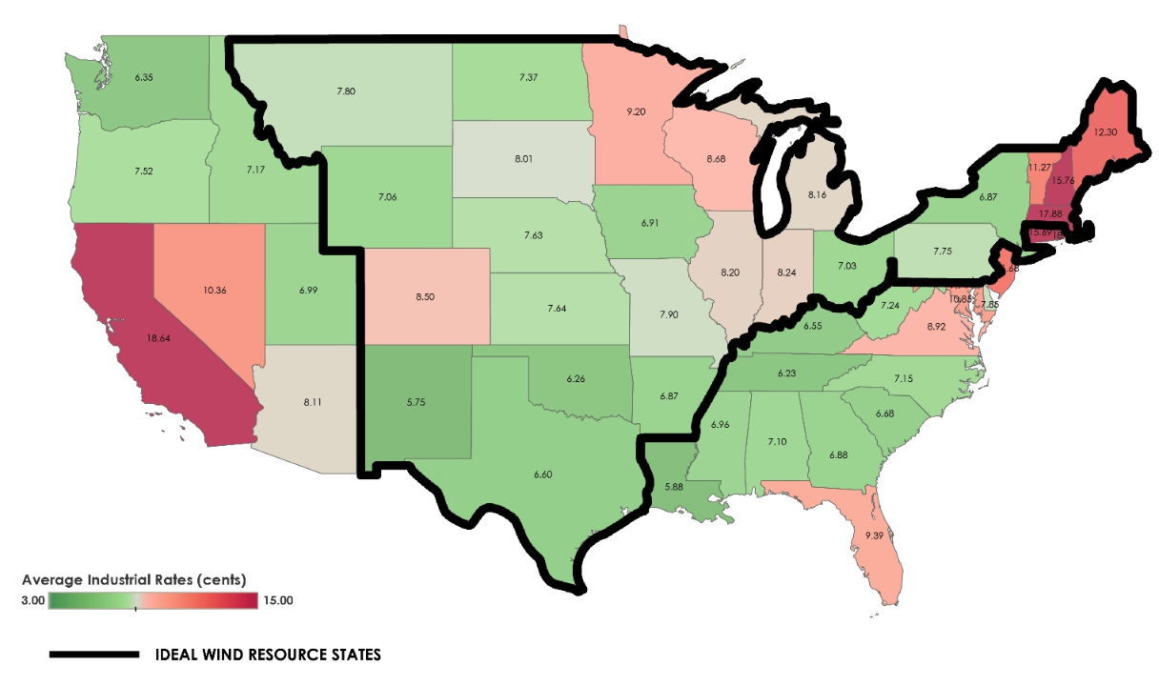
Reference Maps

Slide 9
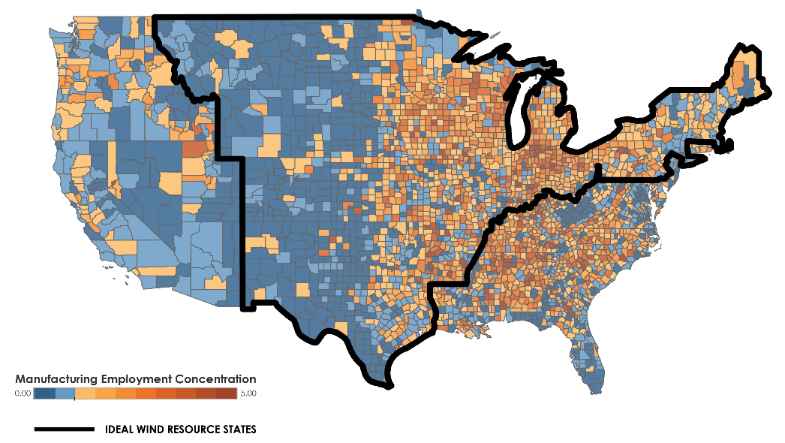
Reference Maps

Slide 10
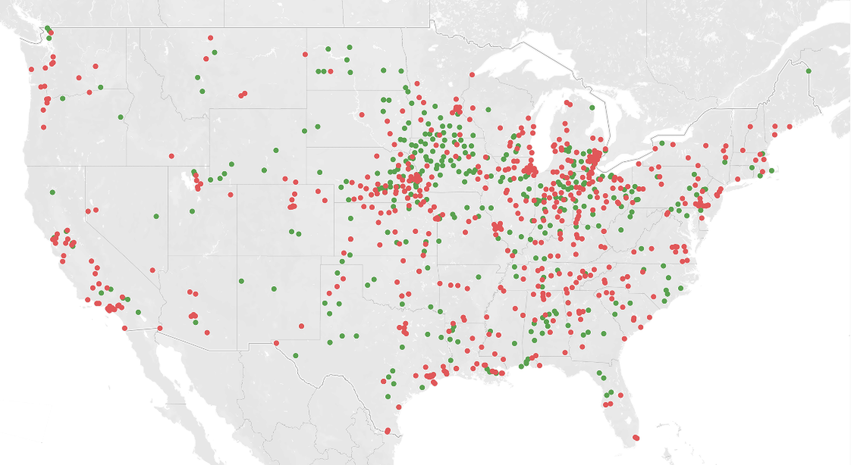
Determining Our “TAM”
1,233 facilities
10+ sectors
  General Industry
  Energy Intensive
Contiguous U.S.
Notes:
Red not viable, green viable

Slide 11
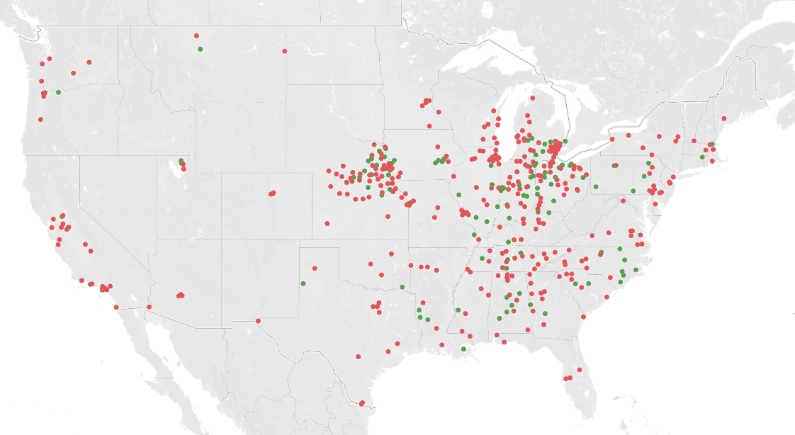
General Industry
Notes:
GI = Ford and other auto, Ball Metal, International Paper, Whirlpool, P&G
Increased from 269 to 682

Slide 12
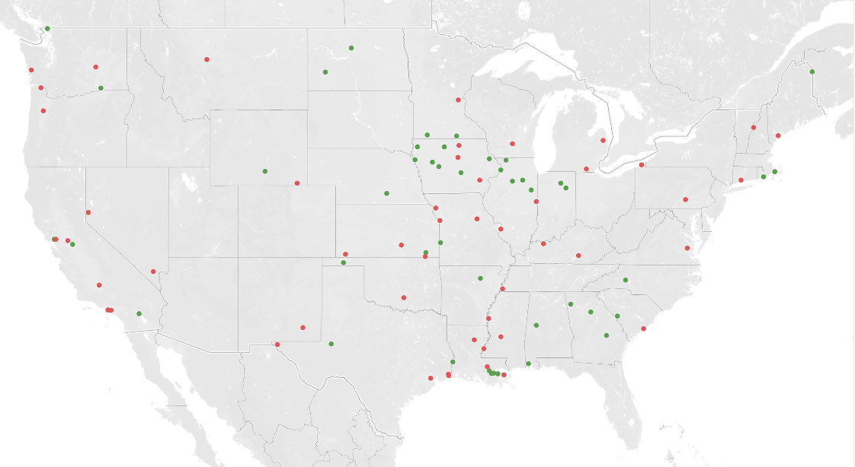
Biodiesel and Renewable Diesel
Notes:
Cargill, ADM, Marathon, and a lot of smaller names

Slide 13
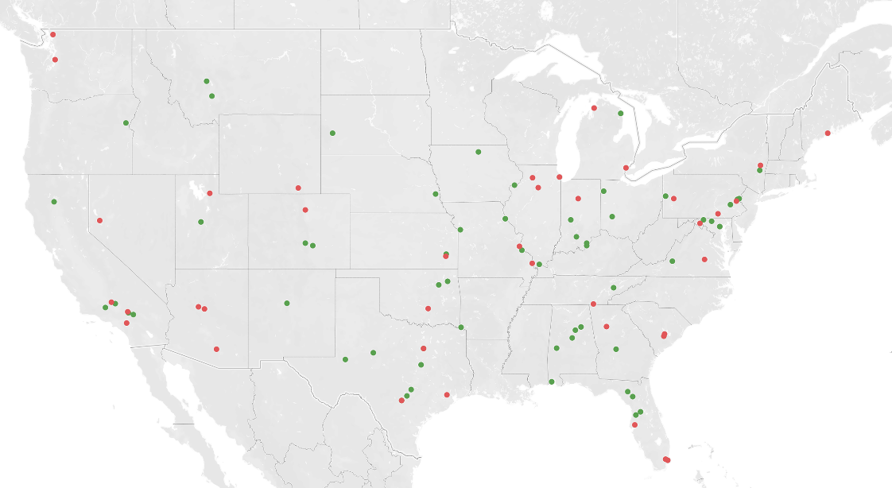
Cement
Notes:
Holcim, Martin Marietta,

Slide 14
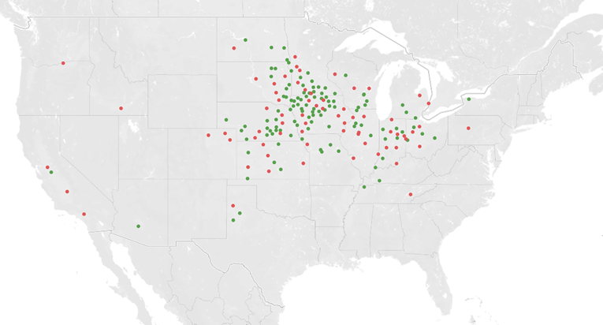
Ethanol
Notes:
ADM, Green Plains, POET, Valero

Slide 15
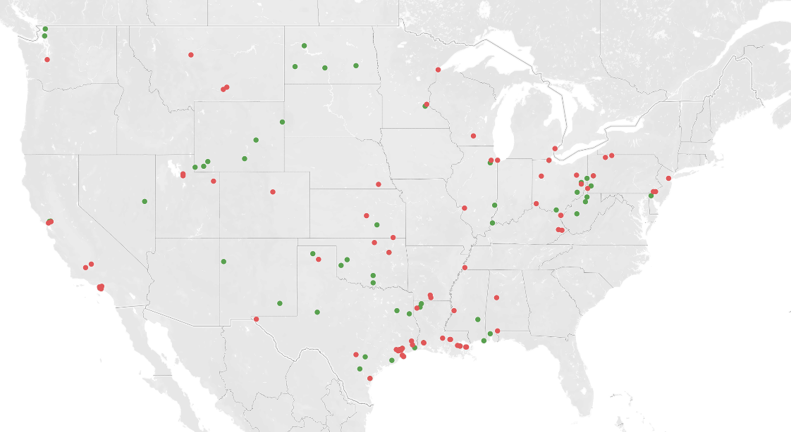
Refining
Notes:
Marathon, Valero, Phillips 66, Exxon, Shell
Renamed to refining to include Marathon Natural Gas facilities

Slide 16
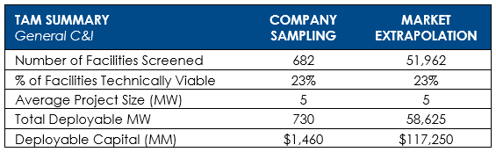
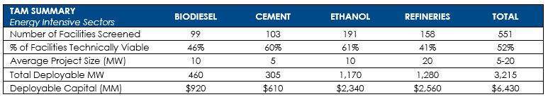
Determining Our “TAM”
Assumptions
Extrapolate screening results
  (Total manufacturing – Energy Intensive) * (% Viable of GI)
Notes:
52,513 total manufacturing
Assume sample is representative and manufacturing is evenly distributed
Estimated 12k tech viable facilities in the US (excluding current projects)

Slide 17
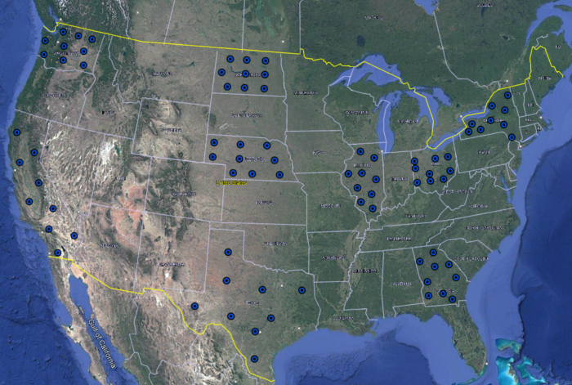
Determining our “SM”
81 ERA5 nodes from 9 states
Wind Summaries
NREL Data
Estimated REA
Notes:
30 years of data from ERA5, run wind summary to develop a relationship between wind speed and production/CF
Download NREL data for county AVG -> compare estimated REA to state grid rate for viability

Slide 18
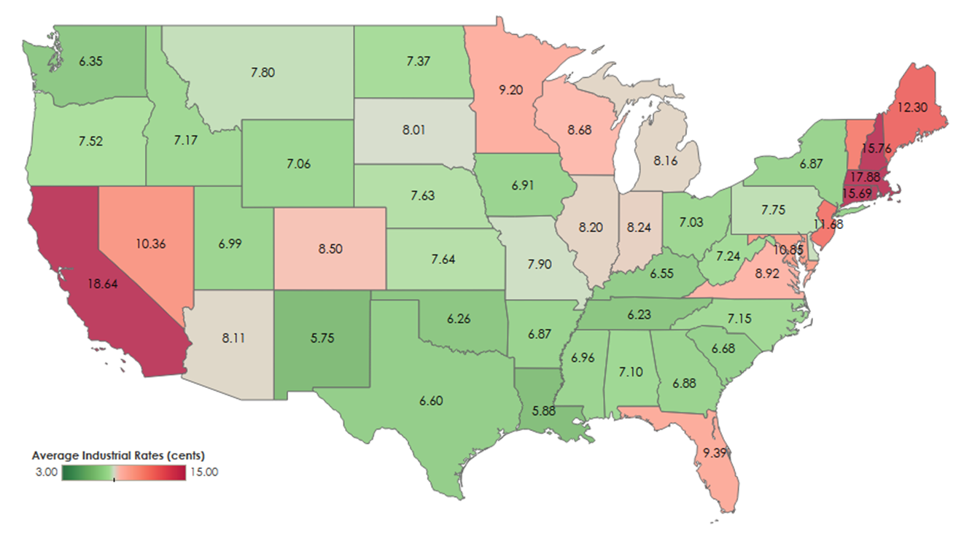
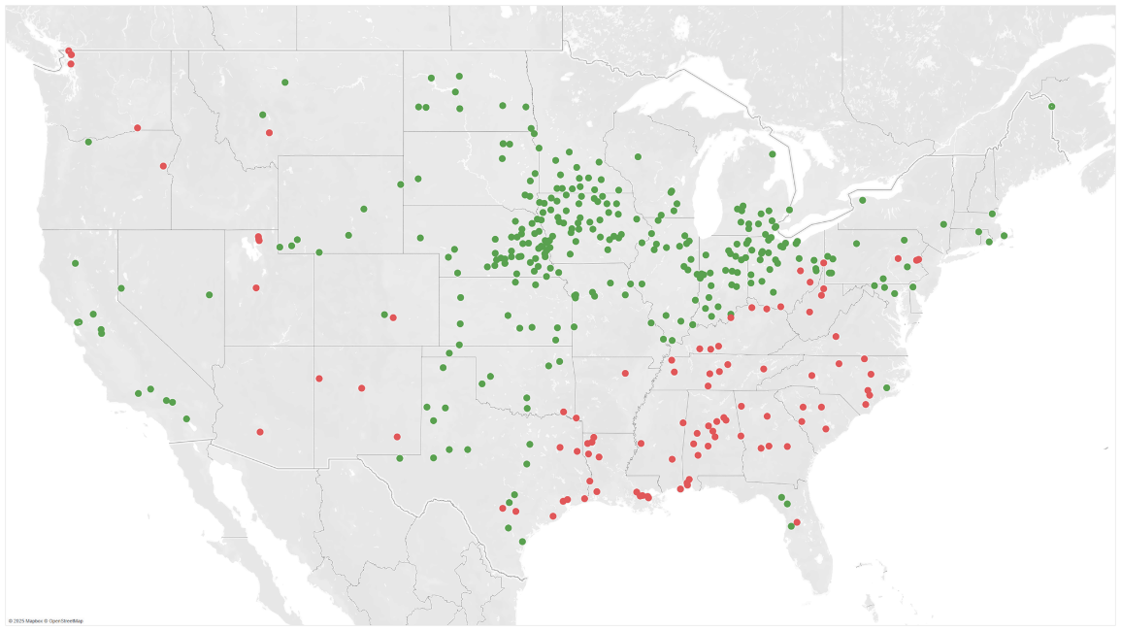
Determining Our “SM”
Notes:
Higher grid rates and wind speed make Midwest more viable
Southeast lower grid rates and wind speeds make it less viable
20% CF is viable in CA due to Grid rate

Slide 19
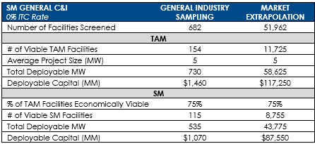
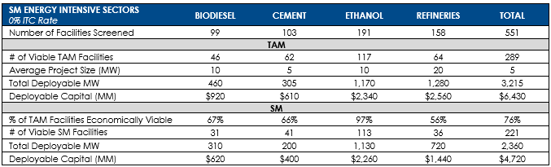
Serviceable Market
Notes:
Narrowing down, 682 to 154 to 115
Where 9000 and 92 Billion come from

Slide 20
SM Results
0% ITC
~9,000 facilities
~$92 billion
30% ITC
~10,500 facilities
~$108 billion
Notes:
Using the combo of this data we can determine… serviceable right now
High value of WFI in the Midwest states

Slide 21
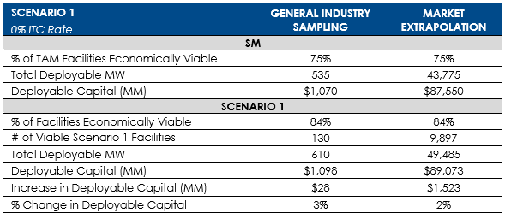
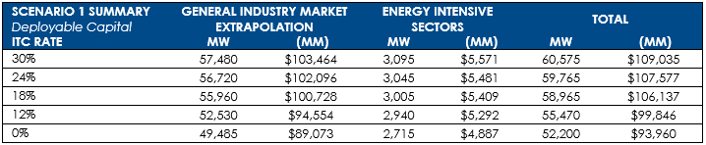
SM Growth – Scenario 1
10% Decrease in Cost
10% Increase in CF
Notes:
10 year forward looking
15 more viable facilities (13%)
Greater profit margins not recognized

Slide 22
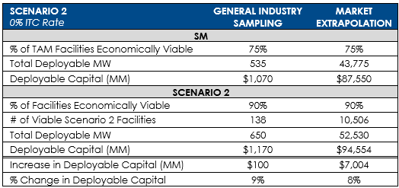
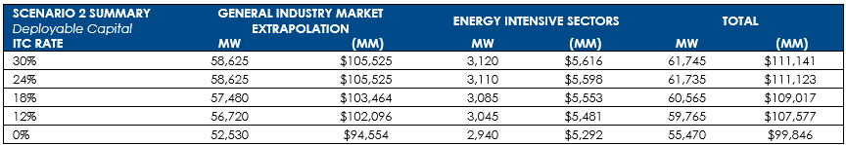
SM Growth – Scenario 2
10% Decrease in Cost
10% Increase in CF
10% Grid Inflation

Slide 23
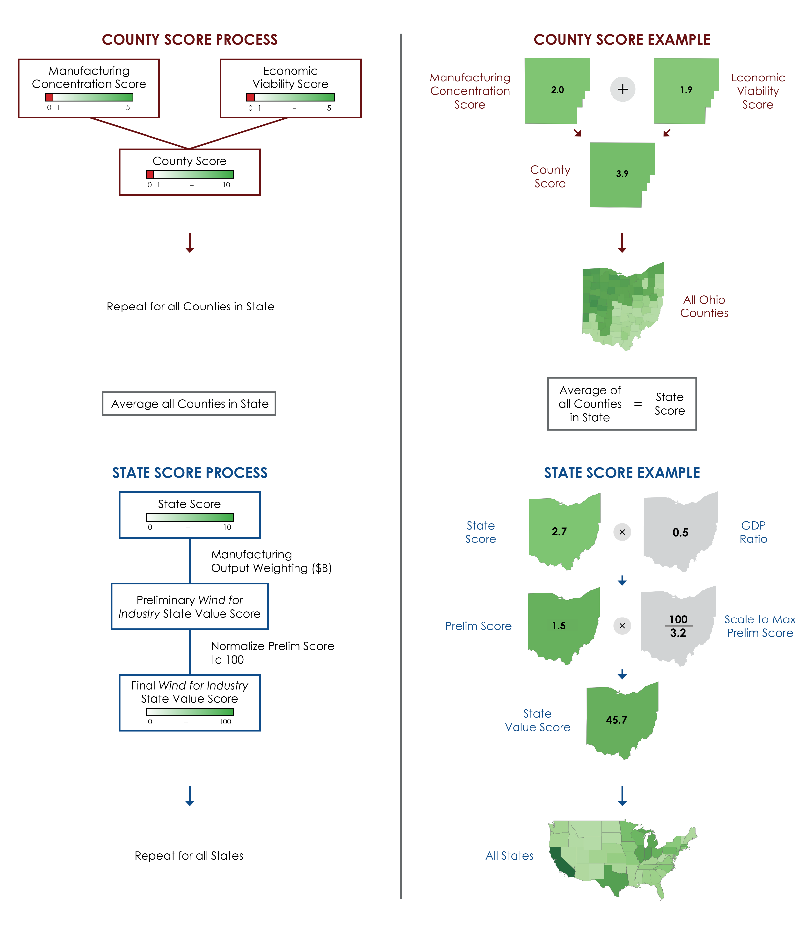
Expansion Strategy
Manufacturing Score
Economic Score
State Score
GDP Weighting
State Value Score
Notes:
Manu: if greater than .75, scaled from 1-5, otherwise 0 (Calhoun, Ark 9.27->5)
Econ: if REA less than Grid, scaled from 1-5, otherwise 0 (Nantucket, Mass 75%->5)
Hancock: 2.92 - .75 = 2.17/(9.27-.75)=.255*(5-1)+1
CA GDP = $411B, capped at $247, OH = $134B

Slide 24
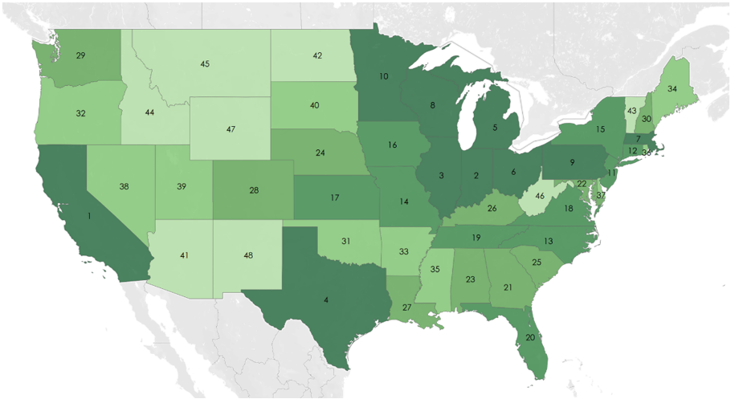
Expansion Strategy

Slide 25
TAKEAWAYS
$92.2 Billion at 0% ITC
$107.7 Billion at 30% ITC
Midwest holds 1/3 of the value
ITC is not critical to success
Notes:
Use screenings, wind, electricity, and manufacturing data to place value on business
Show value to investors/outsiders
Make good decisions for project development (sales)

Slide 26
Next Steps
Publish this version
Biannual data updates
  2026 TAM
Additional aspects of the business
  Solar/ Net Zero
  MHV
  MW Hubs

