Slide 1
Surveying
Brandon Ewing
7/12/2022

Slide 2
agenda
What is Surveying
Understanding a Legal Description
Converting DMS <-> Decimal
Calculating Grade Basics
What are Geodetic Datums
How GNSS Surveying works
What One Energy Uses
How to use them
Demonstrations

Slide 3

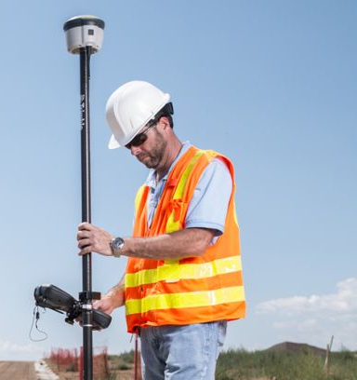
What is surveying
Surveying is a method used to determine the 3D location of points and the distances and angles between them.
  Examples: property boundaries, buildings, roads, drainage, etc.

Slide 4
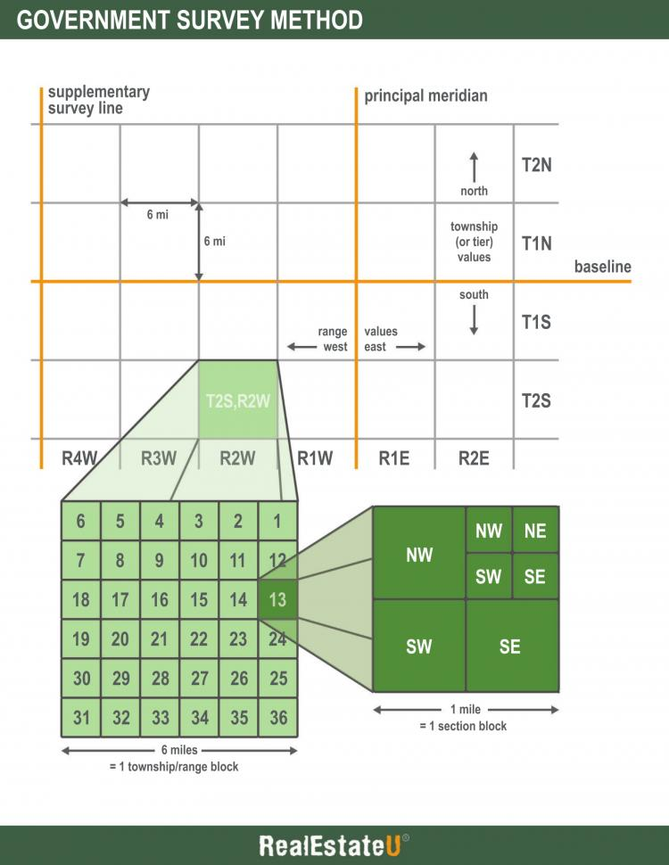
TOWNSHIP SECTION BREAKDOWN
Understanding a legal description

Slide 5
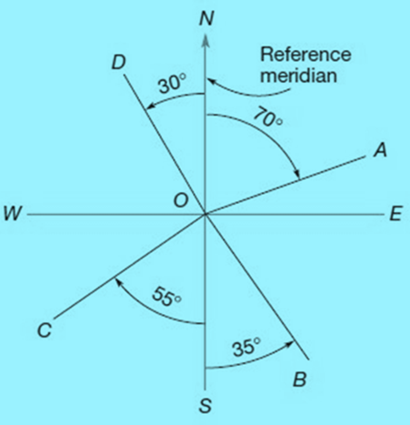
Understanding a Legal description
Basics of Bearings
ON = N 0° E or W
OA = N 70° E
OE = N or S 90° E
OB = S 35° E
OS = S 0° E or W
OC = S 55° W
OW = N or S 90° W
OD = N 30° W

Slide 6
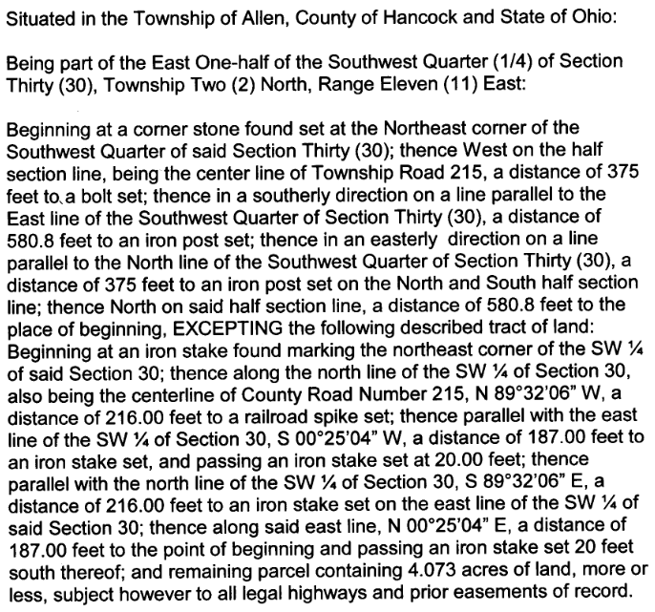
OEE warranty deed
Understanding a legal description
Review OEE Warranty Deed for the 4.073 AC. That the office is located on.

Slide 7
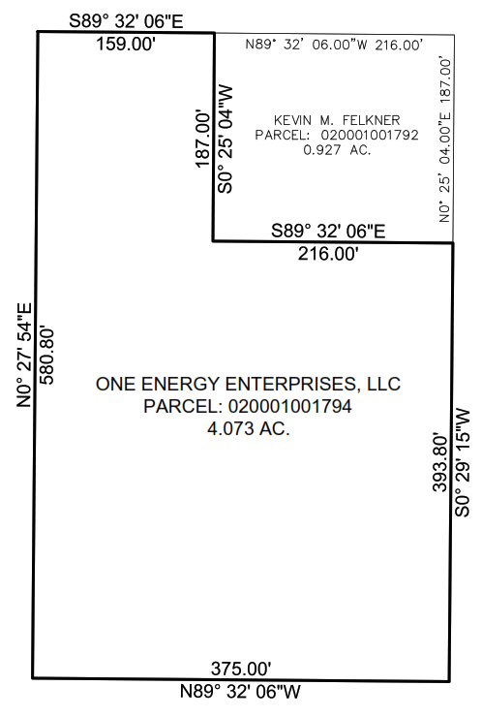
OEE BOUNDARY
Understanding a legal description

Slide 8
CONVERTING DMS TO DECIMAL
60 minutes in 1 degree
3600 seconds in 1 degree
Decimal degrees = Degrees + (Minutes / 60) + (Seconds / 3600)
Example: 41° 10’ 20.00” to Decimal degrees
  10’ / 60 = 0.166667°
  20.00” / 3600 = 0.005556°
  0.166667° + 0.005556° = 0.172223°
  41° + 0.172223° = 41.172223°

Slide 9
CONVERTING DECIMAL to DMs
60 minutes in 1 degree
3600 seconds in 1 degree
DMS = Degrees = Degrees
Minutes = (Decimal * 60)
Seconds = (Remaining decimal * 60)
Example: 41.172223° to DMS
  0.172223° * 60 =10.33338’ or 10’
  0.33338 * 60 = 20.0028” or 20.00”
  41° 10’ 20.00”

Slide 10
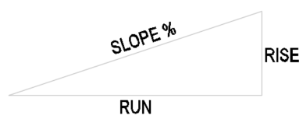
Calculating grade basics
Rise/Run = Slope %
Example: 1’ / 100’ = 1.00%
Slope % * Run = Rise
Example: 1.00% * 100’ = 1’
Rise / Slope % = Run
Example: 1 / 1.00% = 100’

Slide 11
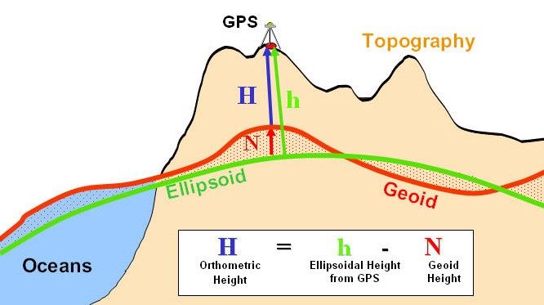
What are geodetic datums?
What are Geodetic Datums?
This Photo by Unknown Author is licensed under CC BY-SA

Slide 12
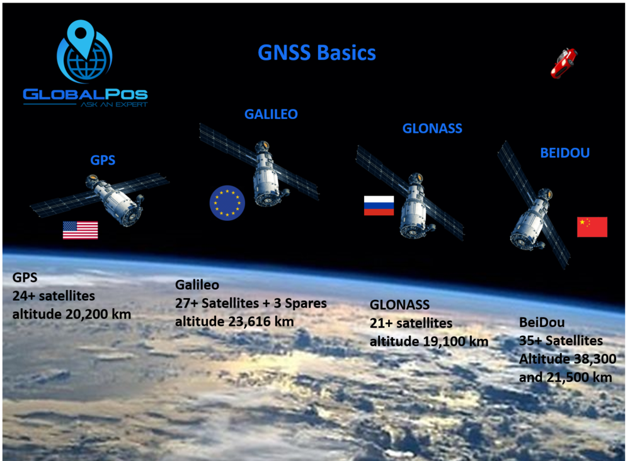
How gnss survey works
GNSS (Global Navigation Satellite System) is a constellation of satellites providing signals for positing and timing data.
GPS: USA
GALILEO: Europe
GLONASS: Russia
BEIDOU: China

Slide 13
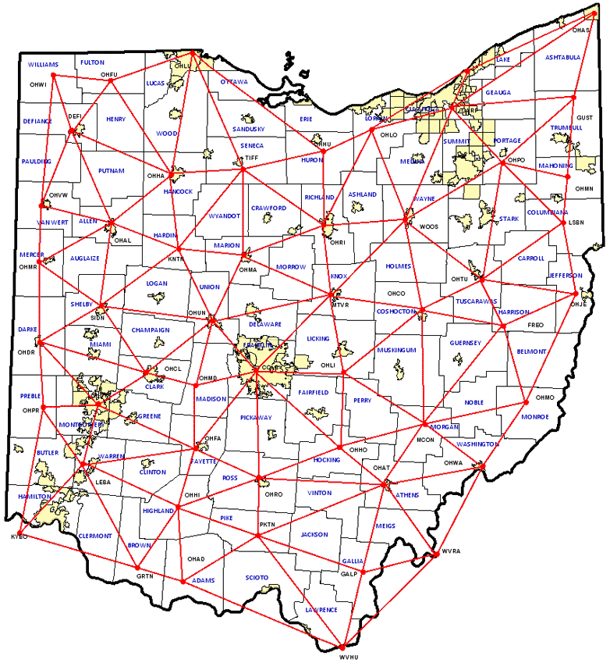
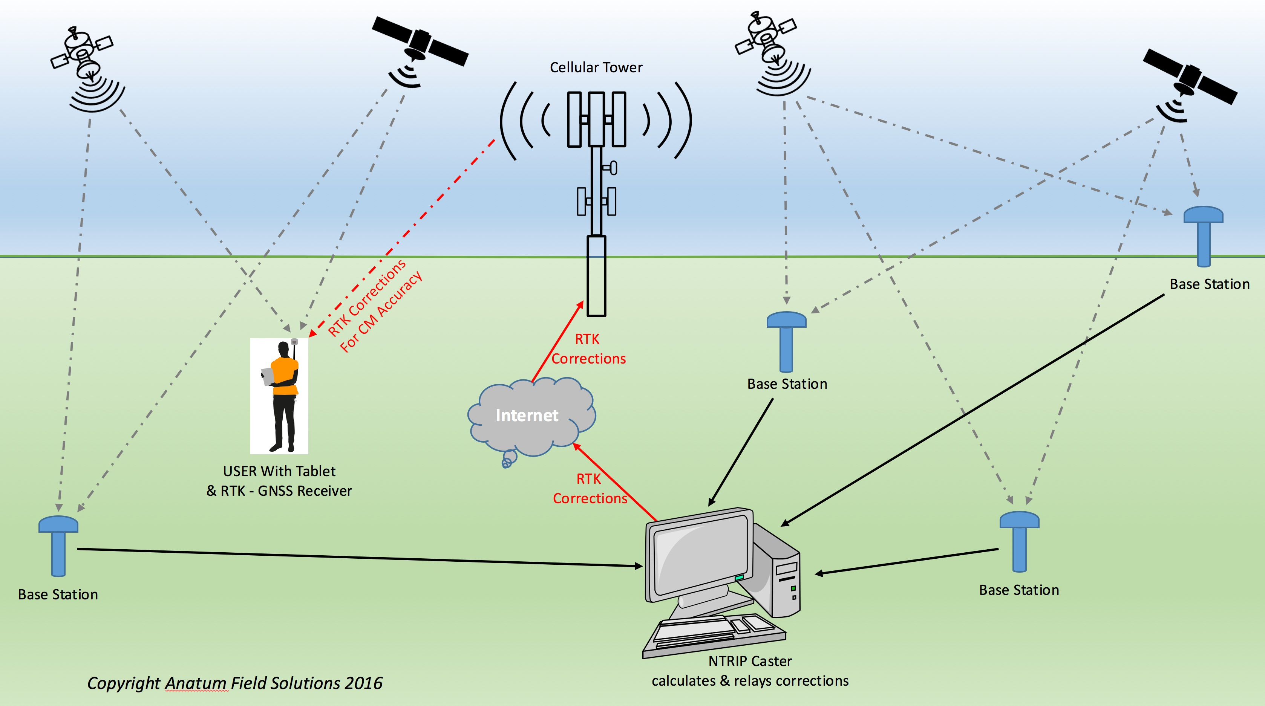
How GNSS SURVEY WORKS (CONT.)
The Trimble R1 and R2 use those satellite constellations together to get an accurate position on earth.
VRS/CORS (Virtual Reference Station/Continuously Operating Reference Station) is a network of reference base stations through out the state of Ohio. This is for a more precise accuracy down to the inch of accuracy. GNSS Video

Slide 14
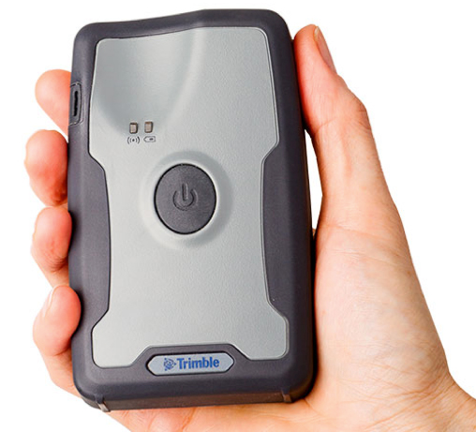
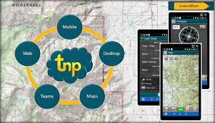
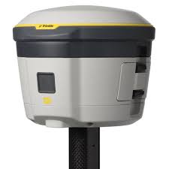
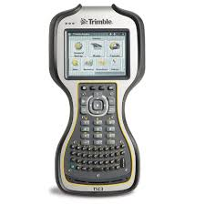
What one energy uses
What we use here:
  GNSS Receiver with Tablet/Mobile
    Trimble R1 (2’: Max Precision)
      Terrain Navigator Pro Software
  GNSS Receiver with TSC3 Data Collector
    Trimble R2 (0.39” H / 0.78” V: Max Precision)
      Trimble Access Software

Slide 15
How to use them
Trimble R1 with Tablet/Mobile
  Power On both units
  Connect the Tablet/Mobile with GNSS Status App
  Connect via Bluetooth to the Trimble R1
  Verify that SBAS corrections are being used
  Open the Terrain Navigator Pro App
  If navigating to a Marker press the Go To icon, then choose the Marker.
  If marking a location, press the “Mark” icon then Marker icon.
    Then fill out description and LAT. and LONG. Coordinates, then Save.
  You can create new projects, use the compass, and current information.

Slide 16
How to use them (CONT.)
Trimble R2 with TSC3 Data Collector
  Setup and power On both units
  Open the WIFI icon and connect to a Mobile Hotspot
  Open the Trimble Access program
  Create a new or open a current job
  Choose to Measure or Stake out points
  Enter the Rod height to 2M
  Take your shots to Measure or Stake out points to navigate to.
  Once completed you can export your points to AutoCAD.

Slide 17
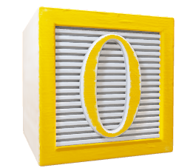

Demonstrations
R1 with Tablet
R2 with TSC3

Slide 18

Questions?

