Slide 1
Substations 101
Juan reimondo
03/01/2022

Slide 2
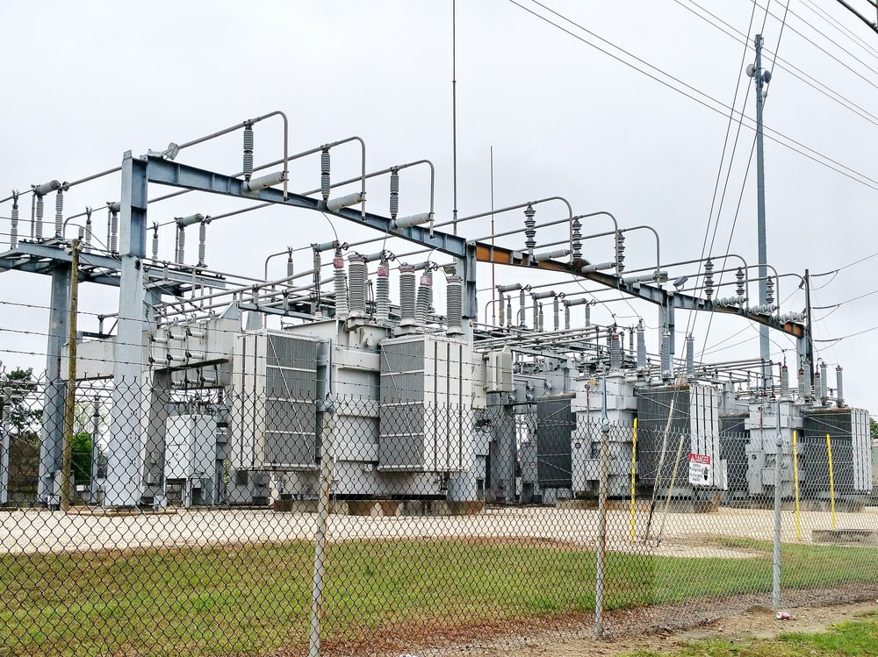
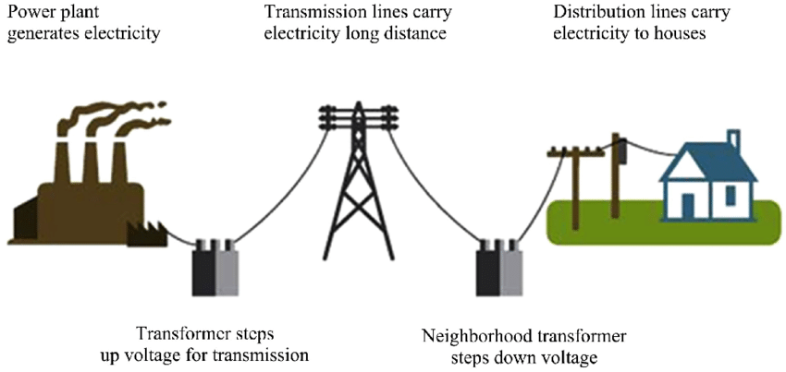
Definition
Substation is an assemblage of equipment for purposes other than generation or utilization, through which electric energy in bulk is passed for purpose of switching or modifying its characteristics. “The Authoritative Dictionary of IEEE Standard Terms”
Substation is a site with electrical equipment that acts as a linkage for parts of the power grid and is responsible for the distribution and/or modification of electrical energy. “My humble definition”
Power Plant Transmission Lines Distribution Lines
Substations

Slide 3
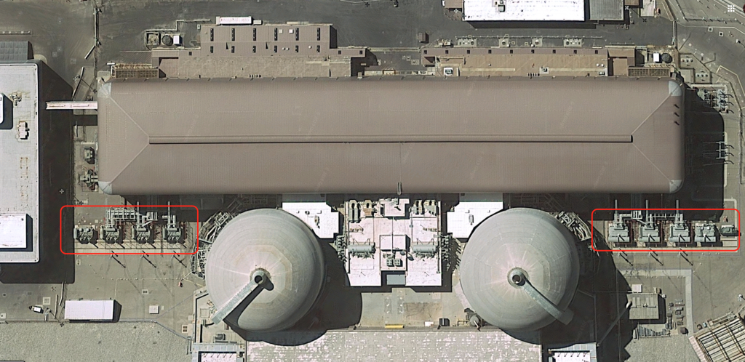

Introduction
Electricity generated in power plants needs to “travel” long distances before reaching customers. High voltage transmission lines are used.
Why high voltage?
1) Joule’s Law 2) Resistance Loss
$P=VI$ $P(loss)=I^{2}R$
Improve efficiency and reduce energy losses.
A Substation with a transformer that steps up the voltage at the power plant can be used for this purpose. (Think of OE’s turbines and their step-up transformers).
Another important consideration is that current determines the size of the conductor (cable) needed.
I α Size Cable
Step-up XFMRs
Step-up XFMRs

Slide 4

Introduction
Once electricity reaches its destination, it needs to be adjusted to meet the customer’s needs.
This is the substation’s purpose.
Substations have multiple configurations but there are 5 major pieces of equipment common to all of them:
1- CTs
2- VTs
3- Circuit Breaker
4- Main Power Transformer
5- Voltage Regulators

Slide 5
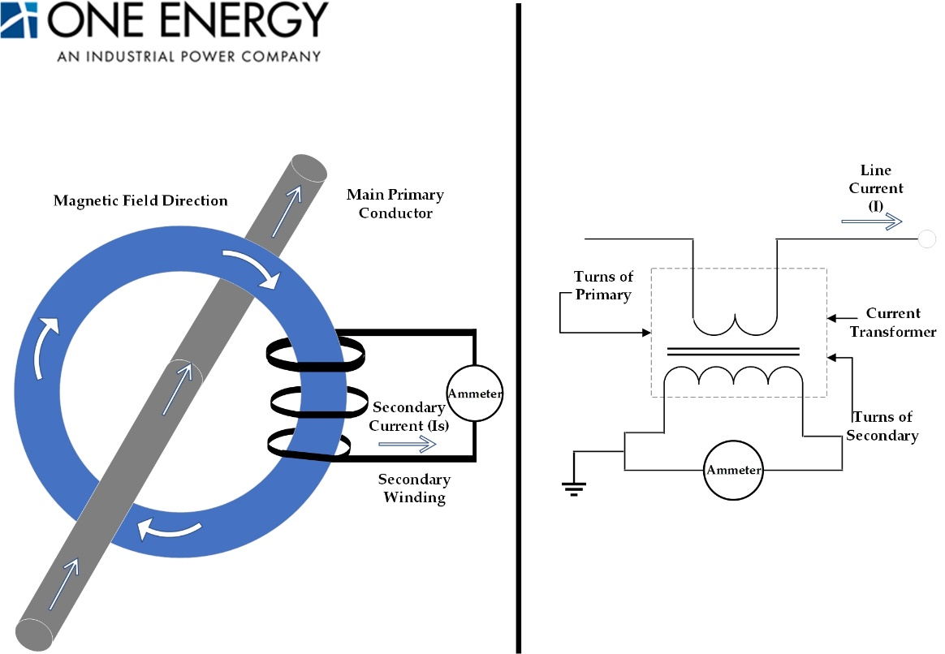
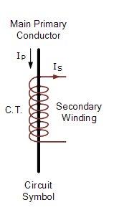
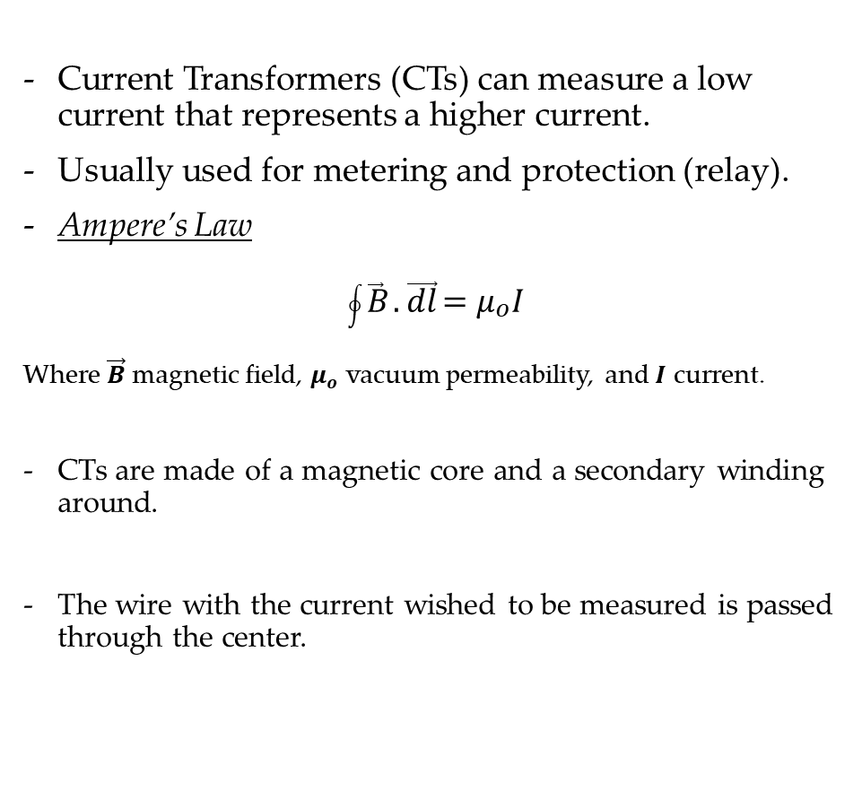
CTs
Current Transformers (CTs) can measure a low current that represents a higher current.
Usually used for metering and protection (relay).
Ampere’s Law
$$\oint{\vec{B}}.\vec{dl}=μ_{o}I$$
Where $\vec{B}$ magnetic field, $μ_{o}$ vacuum permeability, and $I$ current.
CTs are made of a magnetic core and a secondary winding around.
The wire with the current wished to be measured is passed through the center.

Slide 6
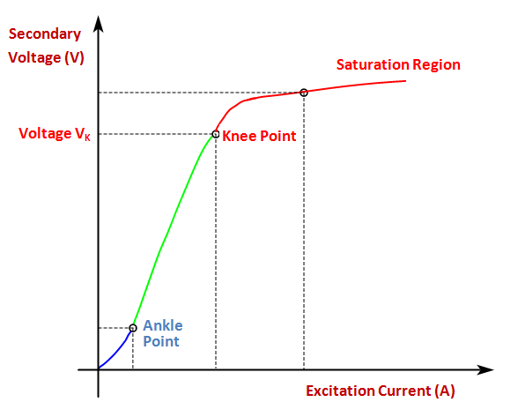
CTs
CTs ratings are given in ratios i.e. 200:1
If 200 amps flow in primary conductor, 1 amp would flow on the secondary.
CTs operational range is where the magnetic flux is proportional to ampere-turn.
After a certain point, saturation is reached, and reading can not be considered accurate

Slide 7
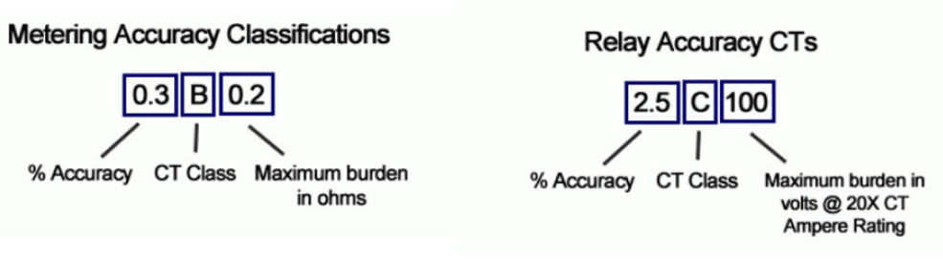
CTs
Metering (Billing)
VS
Protection (Relay)
Less accurate
Used in combination with relays to trip breaker
CT Class – C/T/H/L
Burden expressed as VA
Extremely accurate (revenue grade)
CT Class – B
Burden expressed as ohms impedance
Which one is more accurate?
Ground fault protection achieved by passing all the phases and neutral* conductors through a “ground fault” CT. It determines if any residual current exists.

Slide 8
CTs
Sample Calculation for Secondary burden
Assume that we have a relay that has a resistance (R) of 0.4Ω, the connecting wires have 0.3 Ω, and the secondary winding resistance of the CT is also 0.3 Ω. The rated secondary current (I) of the CT is 5 amp. What is the secondary burden (VA) for this CT?
Total burden of the CT = 0.3 Ω + 0.3Ω + 0.4Ω = 1.0 Ω
Secondary voltage = Secondary Current (I) X Resistance = 5*1.0= 5 V
Secondary burden (VA) = CT Secondary Current X CT Secondary Voltage = 5*5= 25 VA
Ohm’s Law
V=I x R
VA=Volts∙amps

Slide 9
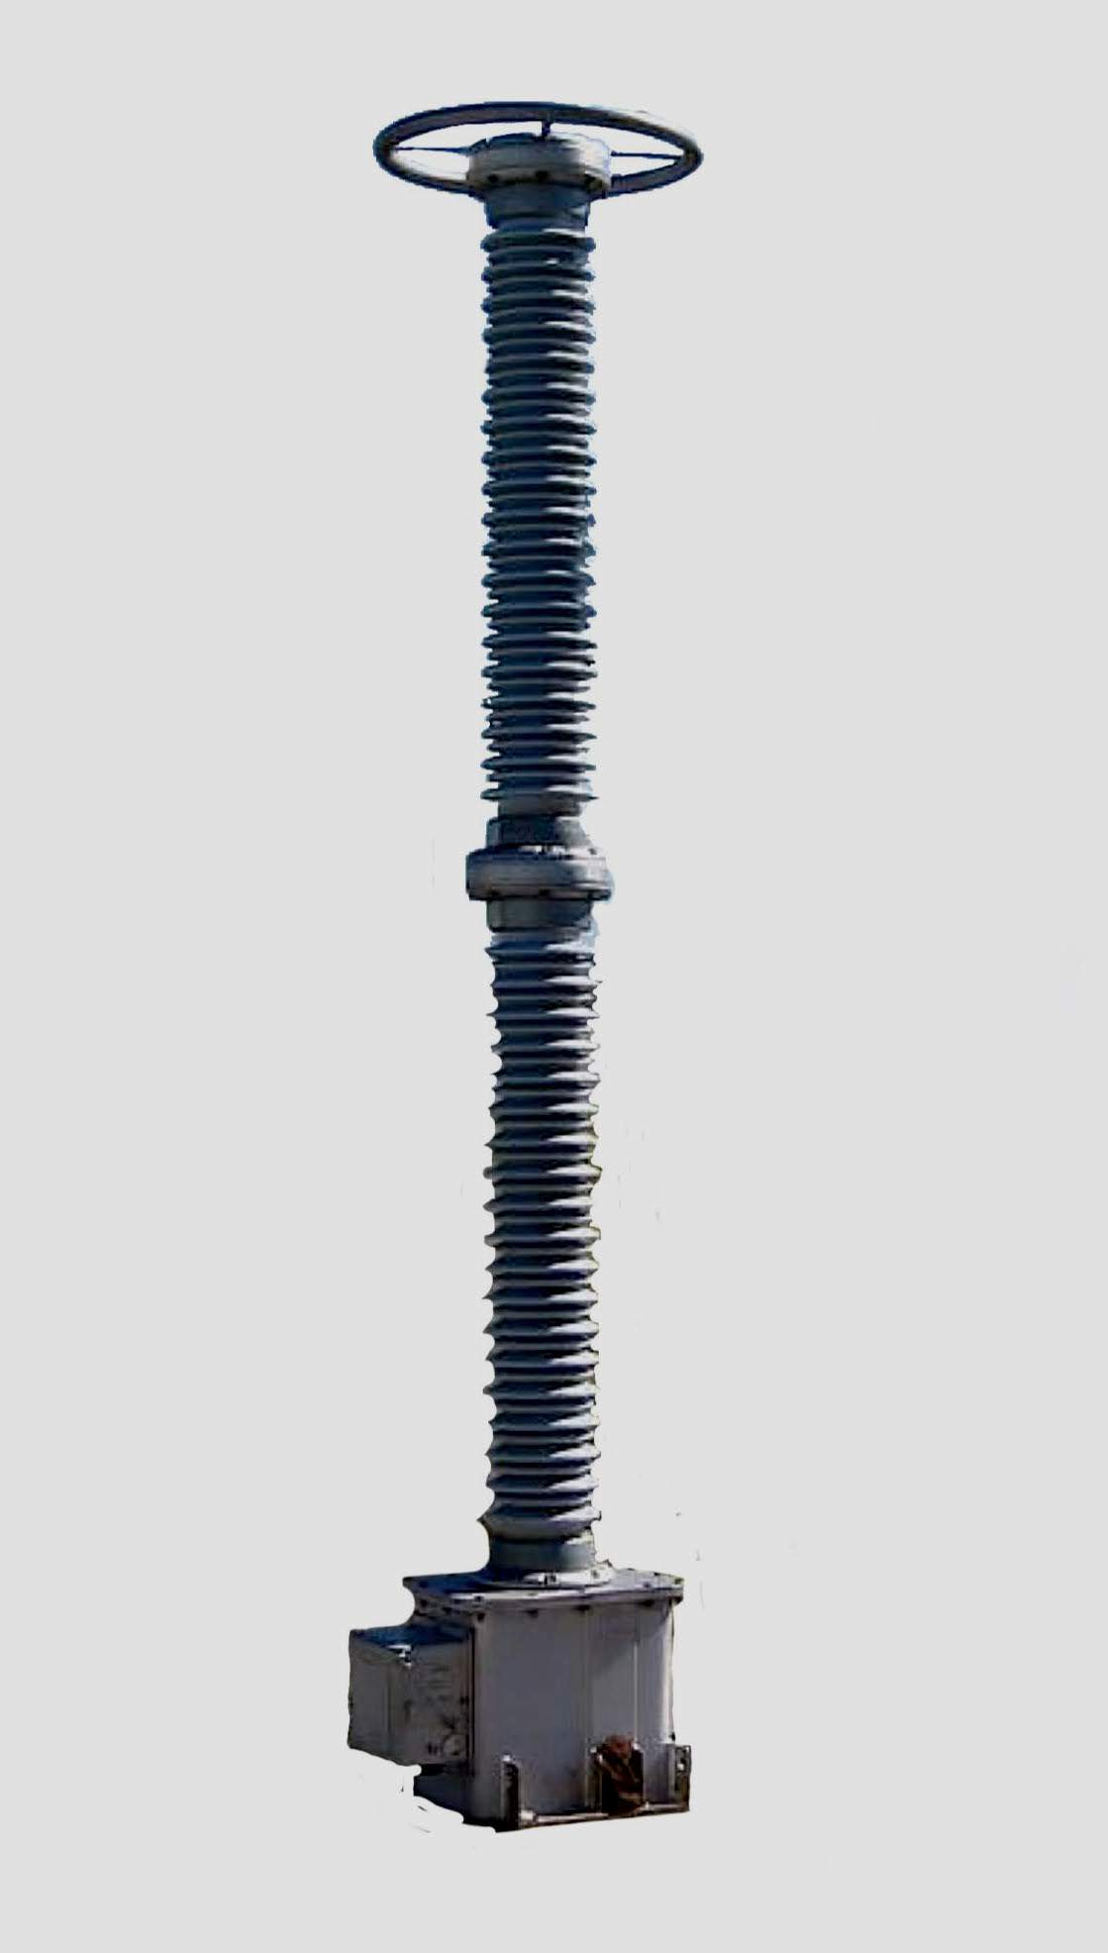
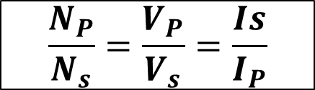
VTs
VTs are used to measure the phase voltage in the conductors of a substation.
Like CTs, also used for protection and metering purposes.
Primary Winding
Secondary Winding
Np
Ns
~
V
Source
Voltmeter
$$\frac{N_{P}}{N_{s}}=\frac{V_{P}}{V_{s}}=\frac{Is}{I_{P}}$$
  CT/VT instead of just CT to make safer conditions for metering
  If a service has both CTs and VTs, then the two values are multiplied together to give the billing multiplier. For example, if 200:5 CT and 2.4:1 VT, the multiplier will be (40x2.4)= 96.

Slide 10
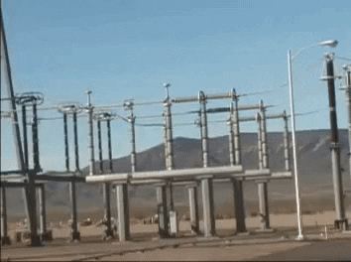
Circuit breaker
There are many situations (security, maintenance…) in which power needs to be interrupted.
For this purpose, we can use circuit breakers.
They can interrupt the power flow and contain the arcing generated and extinguish it.
Arcing is defined as flow of current from one conductor to another, where air works as a medium for the current.
This causes the air to literally “breakdown/burn” and produce plasma.
Circuit breakers have different ways to extinguish arc.
Change the medium of their tank to SF6 or a vacuum circuit. Higher thermal conductivity and dielectric strength.

Slide 11
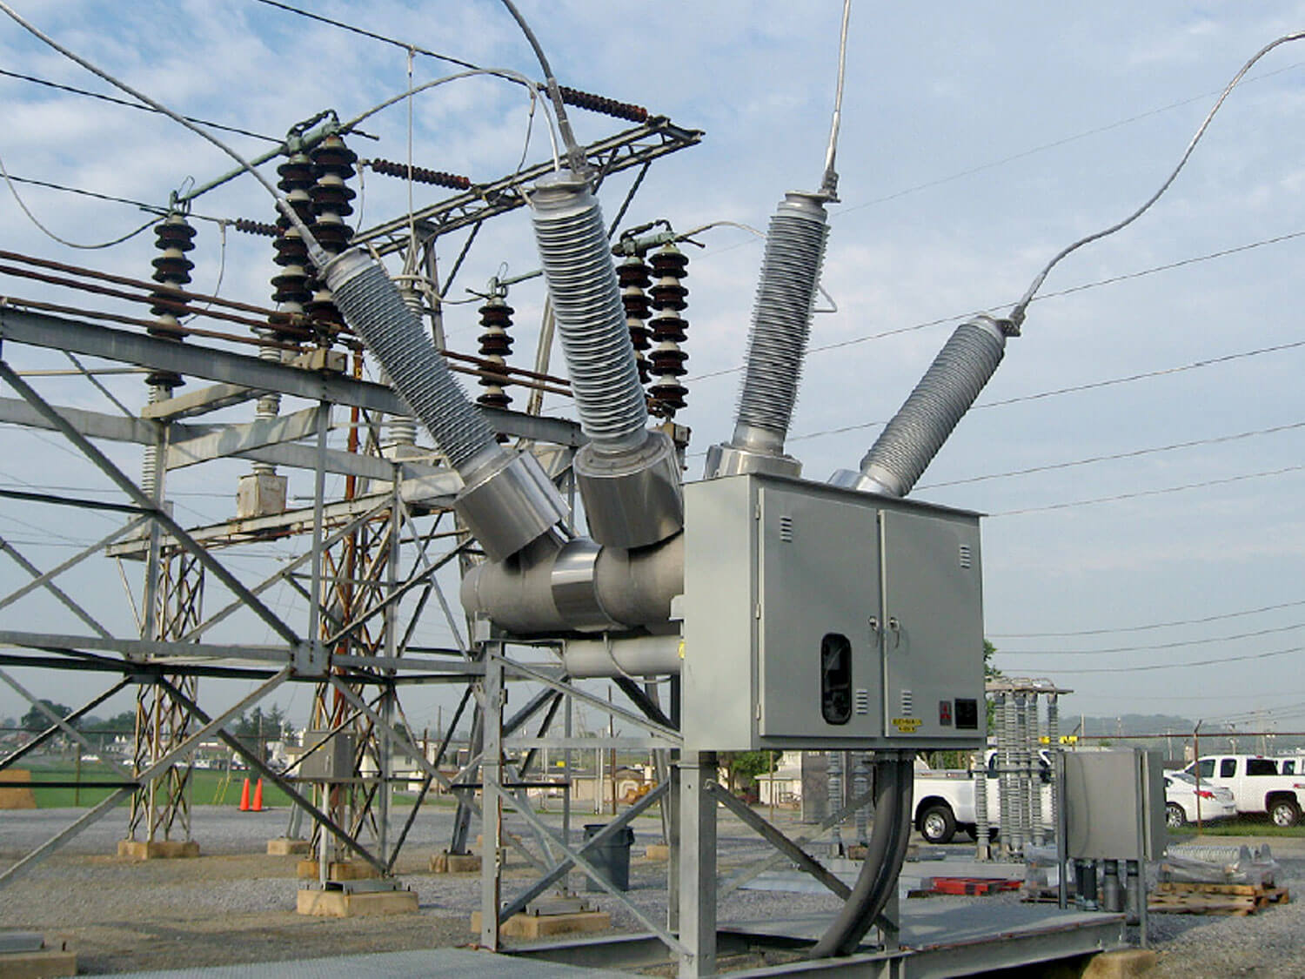
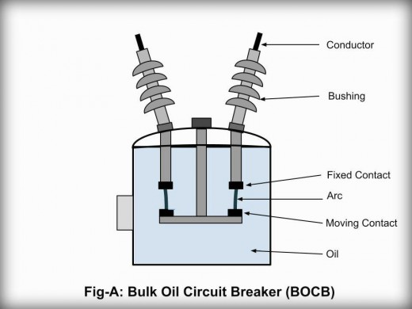
Circuit breaker
Combination of CTs and/or VTs can be used to monitor lines on both sides of the circuit breaker
Needed between Power lines and Main Power Transformer

Slide 12
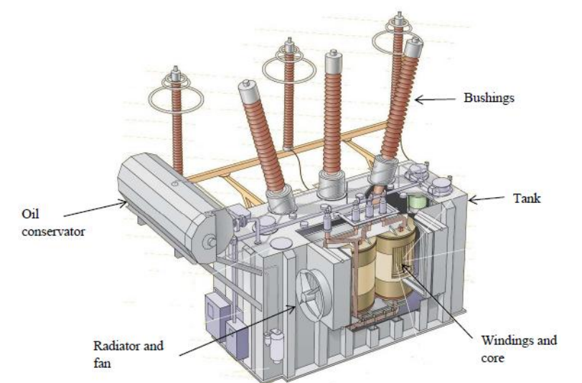
Main Power Transformer
Depending on the purpose of the substation the main power transformer(XFMR) will need to either step-up or step-down the voltage.
In a distribution substation it will usually step-down the voltage to a level easier to manage.
Usually most expensive part i.e., ~$1M for a 30000 kVA 138kV/34.5kV 200kV BIL
Some substation have two main power transformers in parallel to reduce downtime in case of faults.

Slide 13
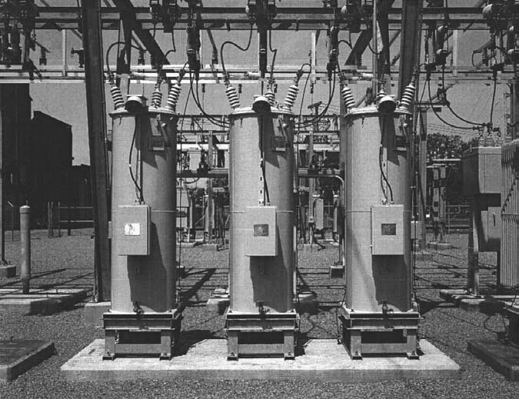
Voltage regulators
After continuous use, line losses, and change in loads can result in a voltage drop.
Unregulated voltage can cause overheat and premature failure of equipment.
Voltage regulators can maintain the line within a decent range that supports proper operations.
They are able to add or subtract voltage to guarantee consistent voltage levels.
Think about it as an ‘auto’ transformers.
Multiple types: multi-phase, single-phase...

Slide 14
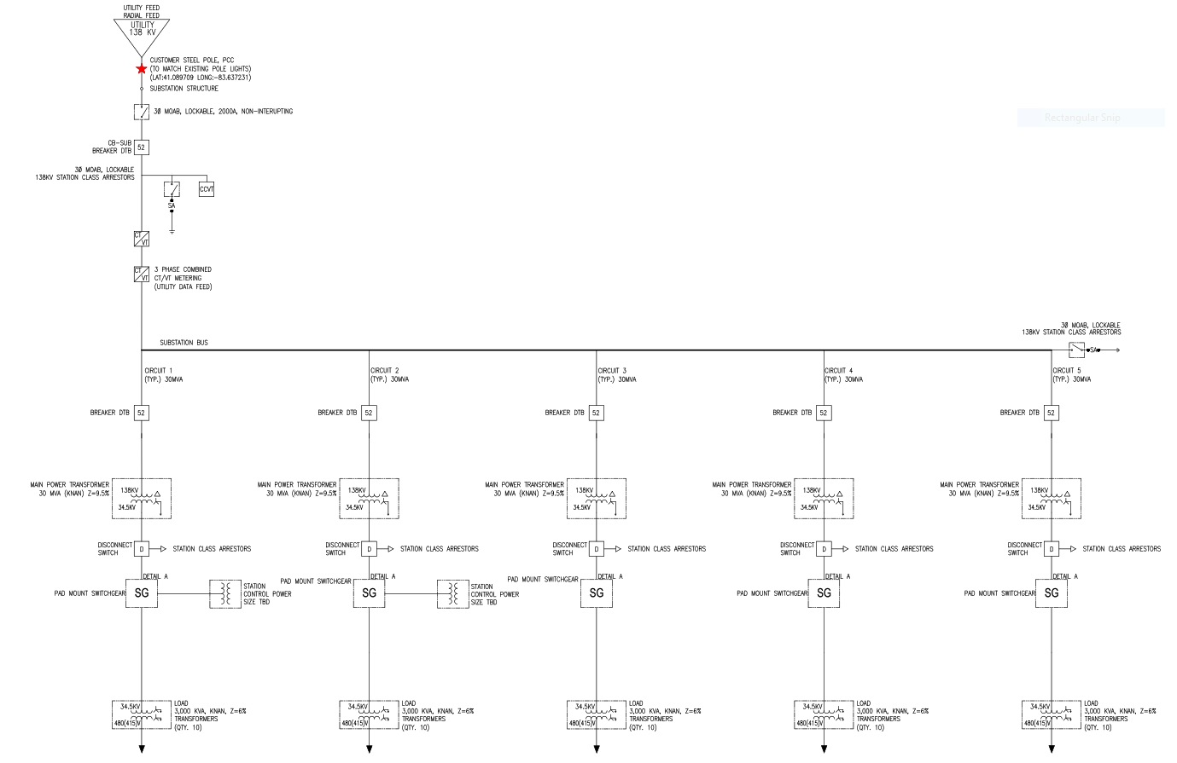
One-line Diagram

Slide 15
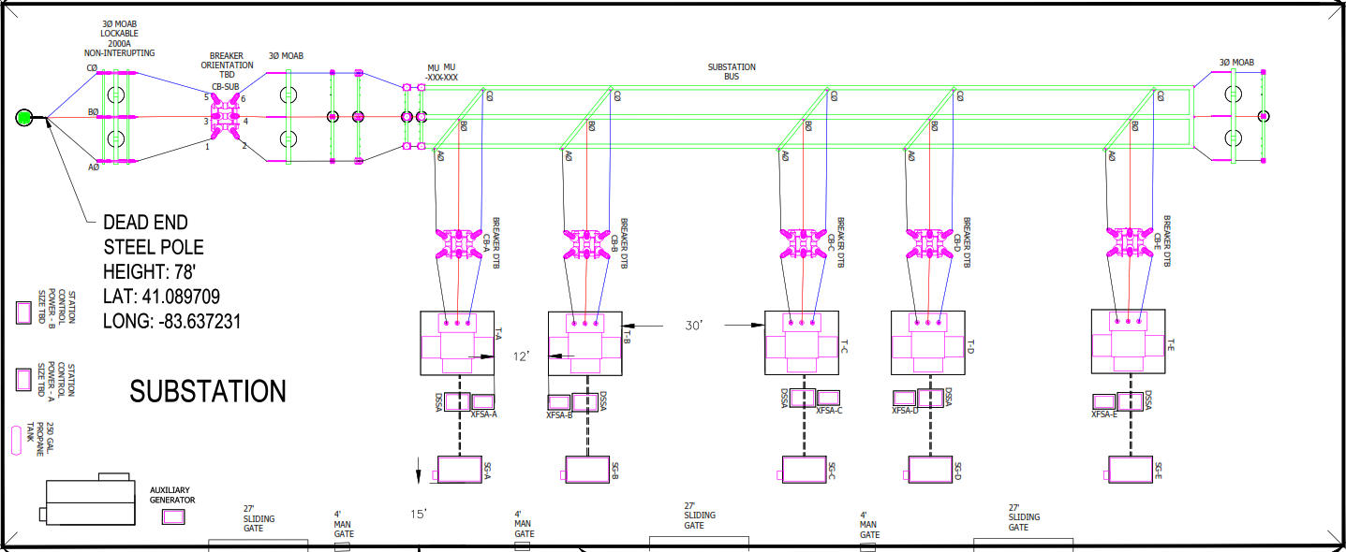

Slide 16
Questions?

