Slide 1
Renewable hydrocarbon fuels
Rachel Warne
10/11/22

Slide 2
What are they?
Fuels made from renewable sources
Example feeds:
  Vegetable Oils (Corn, Soy, Sunflower, ect)
  Tallow
  Cooking Grease
  Algae
  Crop Residue
  Woody Biomass

Slide 3
Introduction
What type of fuel does Dickinson make?
  Renewable Diesel
What is Renewable Diesel?
  Diesel produced from renewable feed stocks
  Chemically identical to ULSD
How does it differ from Biodiesel?
  Let’s talk about that

Slide 4
Processes
Renewable Diesel:
Hydrotreating
  Heat, pressure, solid catalyst to crack longer hydrocarbon molecules into smaller ones
Biodiesel:
Transesterification
  Acid, base, or enzymes used as a catalyst to accomplish change

Slide 5
Cloud Point
What is Cloud Point?
  Temperature at which wax crystals start to form in the fuel
Why is this important?
  Determines viability for fuels at lower temperatures
Do Renewable Diesel and Biodiesel have different cloud points?
  Yes, typically renewable diesel has a lower cloud point
How do these compare to ULSD?
  Depending on feed stocks used and specific process setpoints, cloud point can differ.
  Generally: ULSD </≈/> Renewable Diesel < Biodiesel

Slide 6
Existing Infrastructure
How are Renewable Diesel and Biodiesel transported?
  Renewable Diesel is chemically identical to ULSD and can use existing infrastructure
  Biodiesel is more corrosive and causes cracking in steel
    Is not transported in pipelines
What does that mean for existing diesel engines?
  Renewable Diesel is a 1-1 replacement (or drop-in) fuel
    Can be used in existing engines without causing damage
  Biodiesel must be mixed for most existing diesel engines

Slide 7
Renewable vs bio
Renewable Diesel and Biodiesel are different
 | Renewable | Bio
Process | Hydrotreating | Transesterification
Cloud Point | Low | Higher
Transport | Uses existing infrastructure | Needs separate storage and handling
Uses | 1-1 replacement fuel | Must be mixed with other fuel source
Cost | Higher | Lower

Slide 8
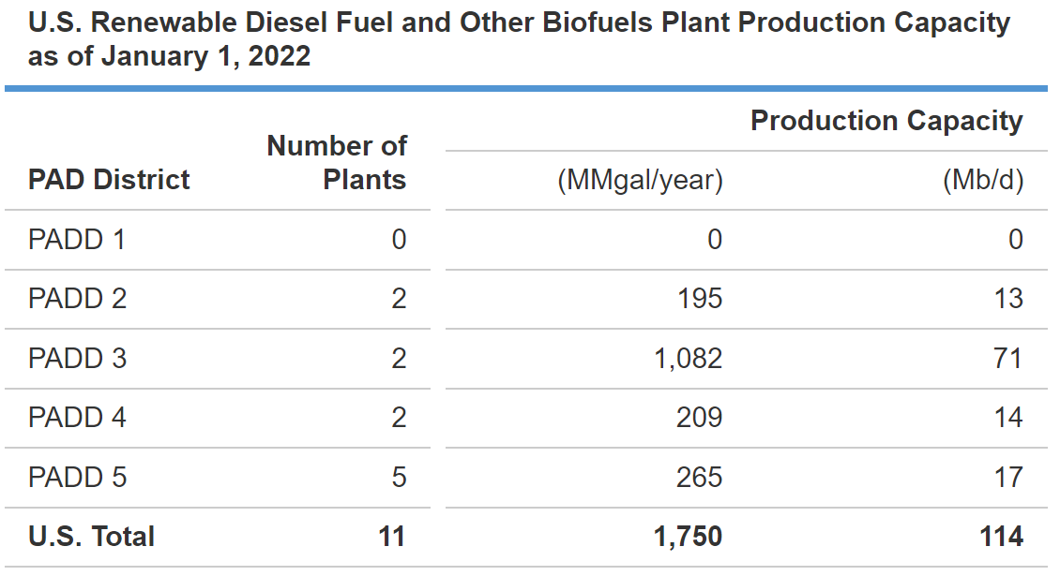
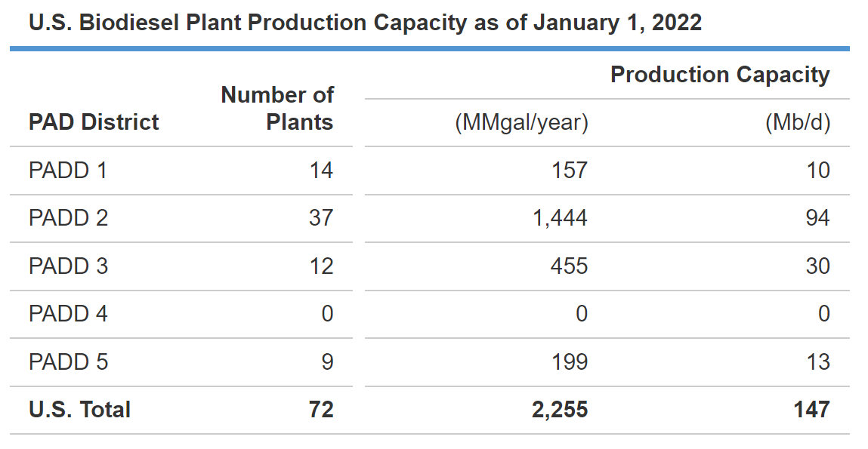
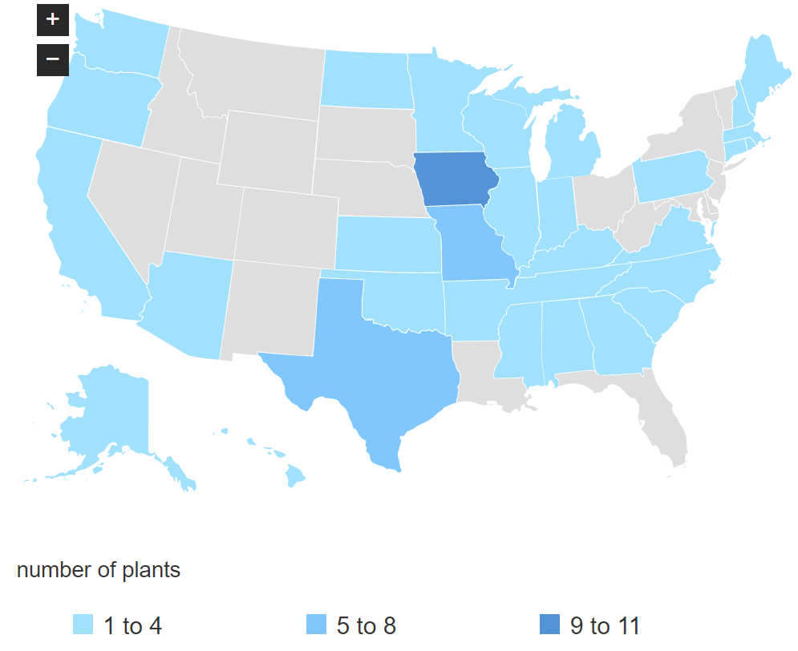
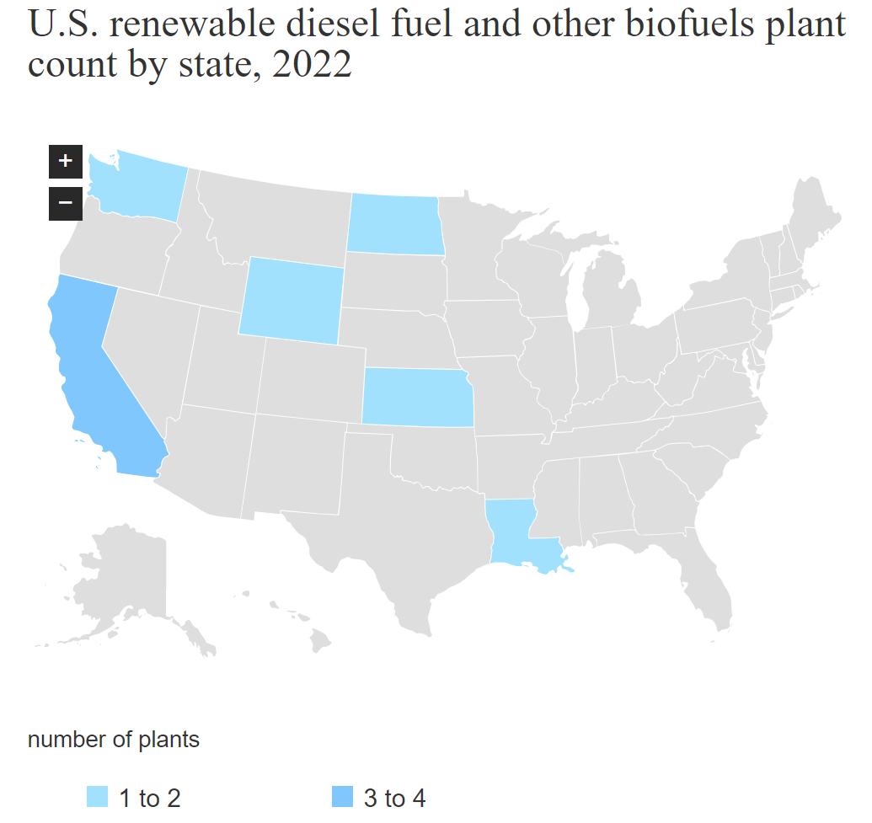
Production in USa
Note: Excludes biodiesel
Source: eia.gov

Slide 9
Final notes
Why did we talk about this?
  Important to know what our customers’ businesses are so you do not say something incorrect and accidentally spread misinformation
  Understand that terms that are colloquially interchangeable may not be scientifically interchangeable
  When in doubt, check you are using the correct terms and wording statements in the way our customers want

Slide 10
To Wrap Up
Questions?

Slide 11
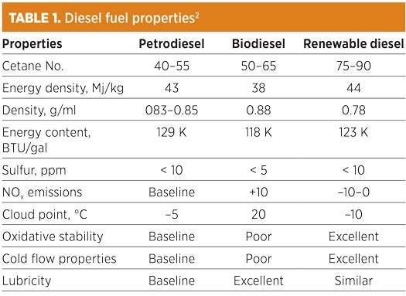
APpendix

