Slide 1
Basic Programming Techniques and Best Practices
Eathan Baumgartner
10/25/22

Slide 2
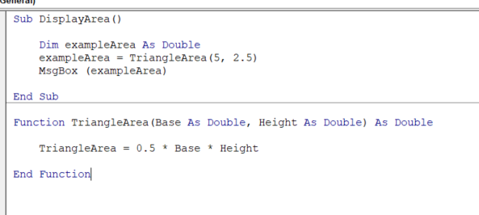
Types of programming
Procedural Programming
Program is divided into procedures and functions.
Examples:
  COBOL
  ALGOL
  BASIC
  C

Slide 3
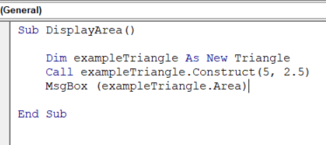
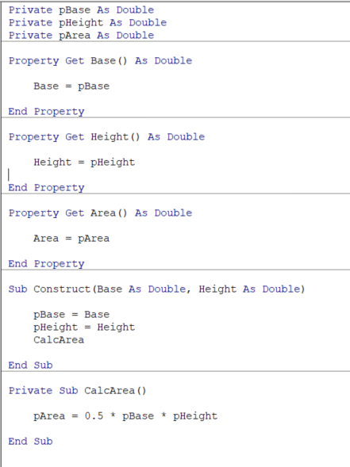
Types of Programming
Object Oriented Programming
Program is divided into “objects” (classes).
Examples
  Python
  Ruby
  Scala
Triangle Class
Triangle Object

Slide 4
Types of Programming
Multi-Paradigm Programming
Program features components of multiple paradigms such as procedural and object oriented. Most common “high-level” languages are technically multi-paradigm.
Examples
  VB & VBA
  C++
  C#
  Java
  R

Slide 5

Types of Programming
What Style is Best?

Slide 6
Types of Programming
What Style is Best?
It Depends!

Slide 7
Procedural Vs Object Oriented
General Rules of Thumb
  Procedural approach is faster and simpler for a very basic program, but will become confusing and difficult to maintain as the scope of the program increases.
  Object-oriented approach improves readability and maintainability, but often requires more lines of code and takes longer to build. Better suited to tasks of medium and higher complexity.

Slide 8
Object-Oriented Basics
Classes
  Can be a template for an object or simply a grouping of similar variables and procedures (depending on language).
  Groups related variables and methods (C#) or subs and functions (VBA).
  Can be declared to become an object, kind of like a primitive variable (integer, string, double, etc.).
  Has components which are accessed by referencing the object, unlike a primitive variable.

Slide 9
Object-Oriented Basics
Fields
Class Components
  Fields
  Properties
  Methods (C#)
  Constructors (C#)
  Subs and Functions (VBA)
Properties
Subs

Slide 10

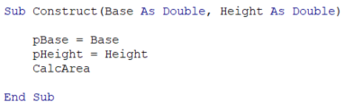
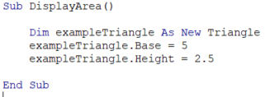


Object-Oriented Basics
Fields
  Essentially variables declared directly in a class, but outside methods (C#) or subs and functions (VBA).
  Can be accessed only from within the class if private, or anywhere in the project if public.
Triangle Class Module
Triangle Class Module
Another Module

Slide 11
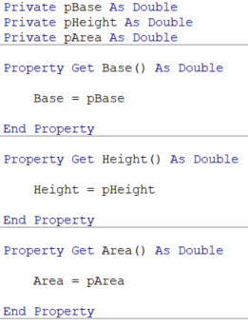

Object-Oriented Basics
Properties
  Intermediate of a field and a method (C#) or sub (VBA).
  Can be used to define how a field can be accessed.
  Can be used to interject actions in between returning or setting a value.
Base, height, and area only modifiable from within the Triangle Class.
Operations can be programmed directly into properties, in this case a specific sub for calculating area is unnecessary, although the calculation will be run every time the triangles area is requested. Useful in some cases (when the value is never constant or to run calculations only if the variable is requested).
Triangle Class
Notes:
Properties can be used for data validation

Slide 12

Object-Oriented Basics
Subs, Functions and Methods
  Where the “stuff” happens.
  Subs and Functions used in VBA, Methods used in C#.
  Subs do not return anything, just perform an action.
  Functions both perform actions and return something.
  Methods may perform the job of both subs and functions in C#.

Slide 13
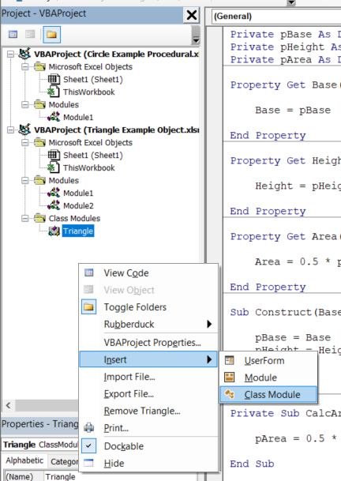
Object-Oriented Basics
Creating a class in VBA
  Right click in project window -> Insert -> Class Module.
  Class name is the name of the module.
  Everything within the module is a part of the class.

Slide 14
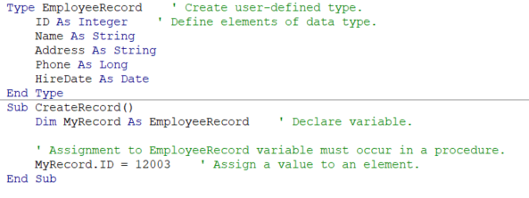
Structs and types
Classes Lite™
Structs (C#) Types (VBA)
Used to group variables when other functions of classes are not needed.
Easier to read and use for grouping related data than vectors.

Slide 15
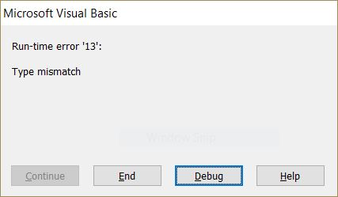
Best Practices
Validate inputs
  Make sure input data is within possible ranges and correct data type.
    Sometimes Datasets use unreasonable or impossible values to identify errors.
    Users may accidentally provide unexpected input.
  Can be accomplished multiple ways.

Slide 16
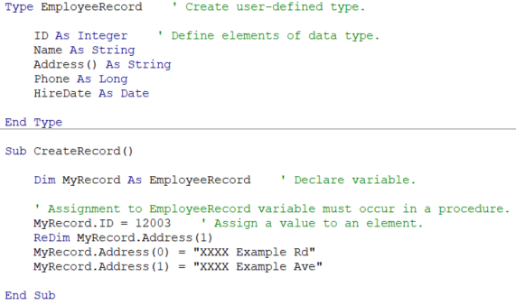
Best Practices
Organize the Program
  Split related methods/subs/functions and variables into classes for object-oriented components or modules for procedural components.
  Use structs to organize/group common fields/variables.
  Use arrays and collections to group a list of variables of the same type from the same source.

Slide 17
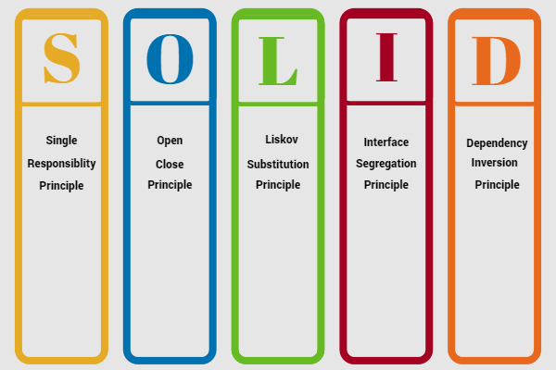
Best Practices
Follow Solid Principles (where applicable)

Slide 18
Best Practices
Single Responsibility Principle
  A class or module should have only one responsibility.
  Therefore, a class or module only needs to change for one reason.
  Helps keep program separated into chunks of digestible size.
  Helps keep program maintainable.
  Can generally be applied to methods / subs / functions. Try to keep each method / sub / function as short and simple as possible.

Slide 19
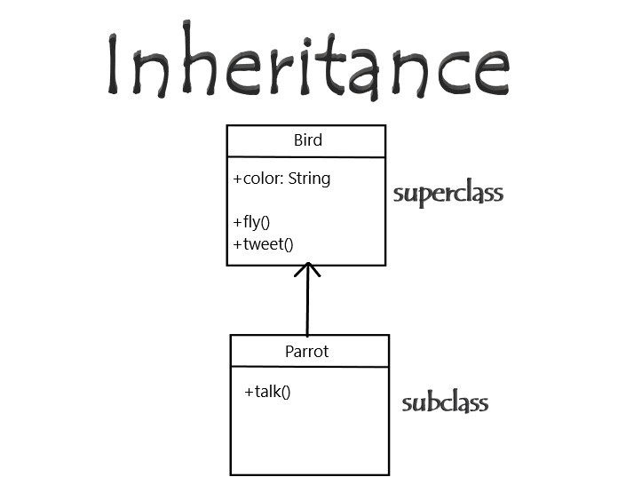
Best Practices
The OLID Principles
  A little more difficult to explain.
  Based on the concept of inheritance (so is the SRP technically), which VBA does not support.
  Should read about if working in a language that supports inheritance (like C#).

Slide 20

Best Practices
Test Your Program
  Run program and make sure it is functioning properly.
  Develop Unit Tests for complex programs.

Slide 21

Best Practices
Unit Tests
  Programmed tests which validate the output of a method / sub / function.
  Many IDEs have built in unit testing functionality.
  The free Excel addon “Rubberduck” can be used to Unit Test in VBA.

Slide 22
Best Practices
Unit Tests
  Determine all the possible inputs, outputs, or functionality that needs to be checked.
  Code tests for each case.
  Some people recommend only testing public classes / methods / subs / functions.
  If the component being checked is refactored, the test can be run again to ensure it is still operating properly.

Slide 23
Best Practices
Unit Tests
  Three main components: Arrange, Act, Assert.
  Arrange: Set up any variables or data needed for the test.
  Act: Perform the action being tested.
  Assert: Determine if the test resulted in the desired outcome.

Slide 24
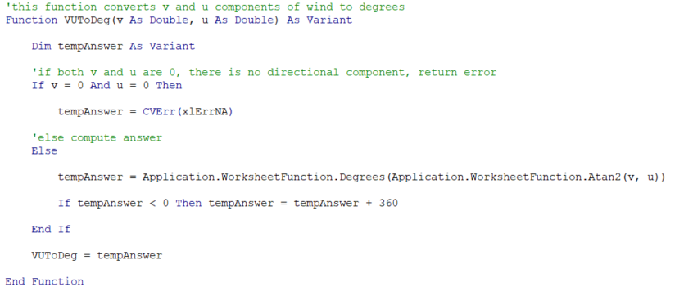
Best Practices
Example Unit Test
  VUToDeg returns the direction in degrees of a given v and u component of wind.

Slide 25
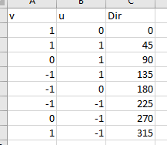
Best Practices
Example Unit Test
  The u and v combination of (0,0) does not translate to a direction.
  Need to test a variety of valid u and v components, say in each quadrant, and the case (0,0).
  A series of valid test data was made to read in.

Slide 26
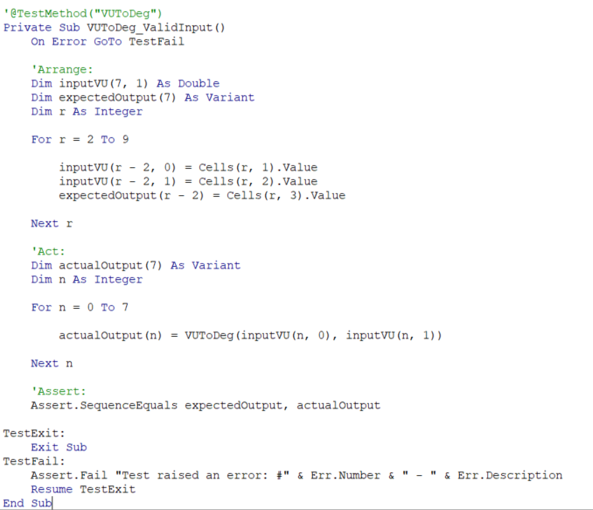
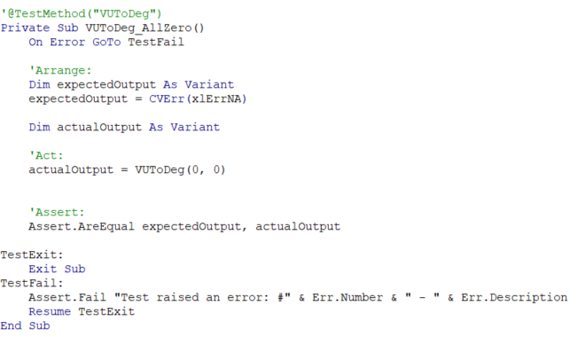
Best PRactices
Example Unit Test
  Two tests were made.
  One reads in the expected output and checks it against running with that input.
  One checks to make sure the combination (0,0) returns an error.

Slide 27
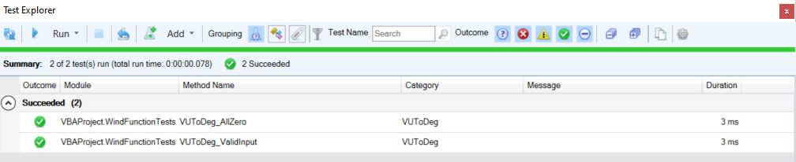
Best Practices
Example Unit Test
  Tests were successful.

Slide 28
Questions?

Slide 29
[Name]
[Date]

