Slide 1
Power & Energy Buying 101
For your home
6/15/2023
CONFIDENTIAL

Slide 2
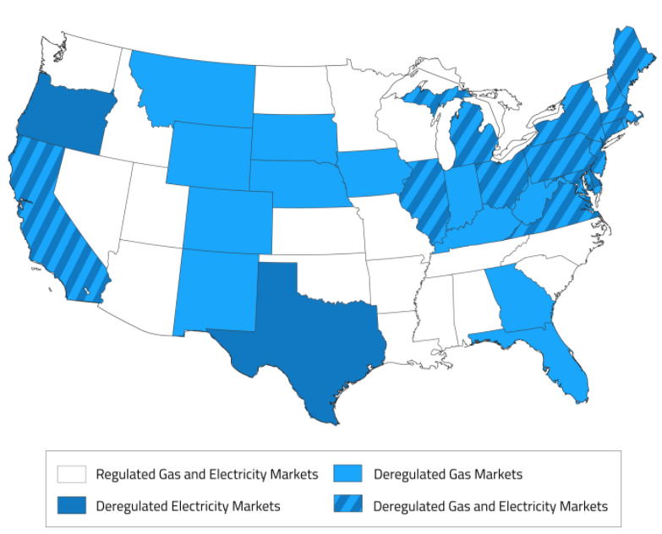
background
Regulated vs Deregulate
Gas + Electricity Deregulated
What does that mean for me?
You have the opportunity to “shop” for the electricity and gas commodity, but the utilities will still charge you to get the commodity to you
Can still get electricity and gas commodity through the utility, but it’s the idea of having the choice to pick where you get that commodity

Slide 3






background
Regulated vs Deregulated
OK to Shop for Energy

Slide 4
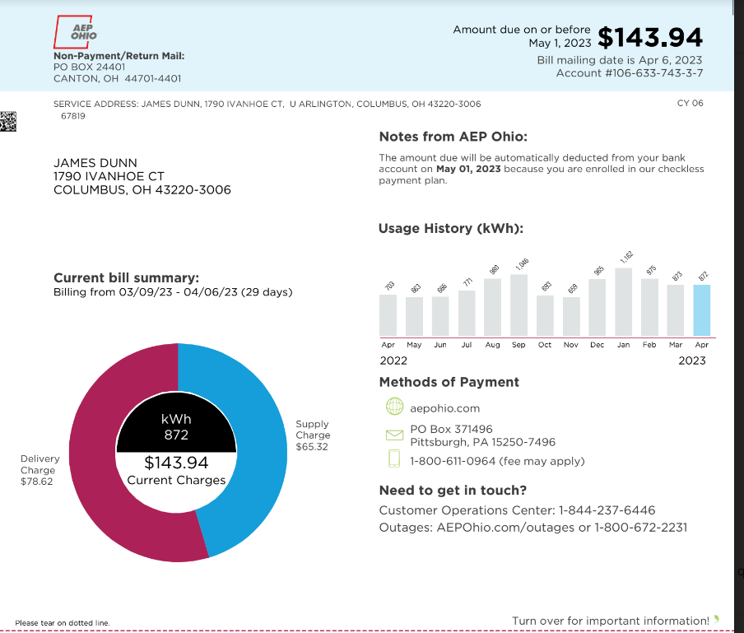
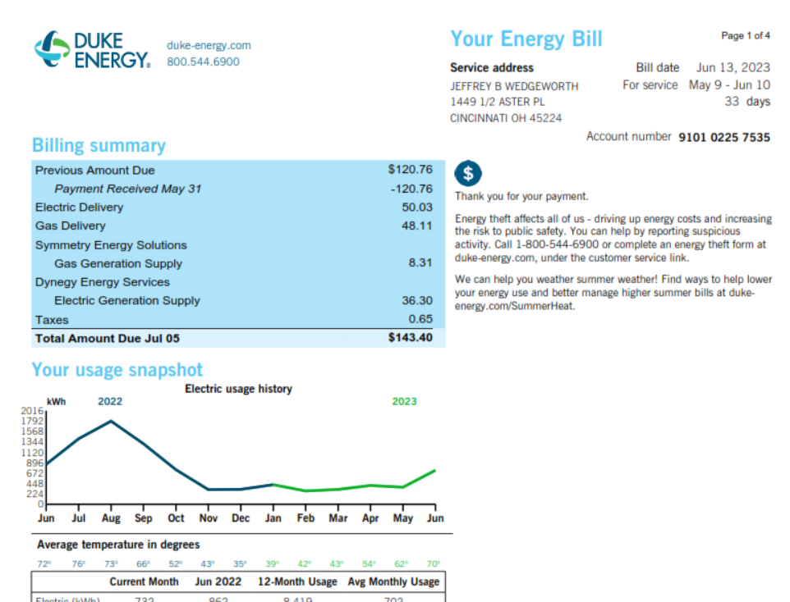
Electric Invoice

Slide 5
Shopping
AEP Customer
  Spent $143.94 total
  $143.94/872 kWh = $0.164/kWh
  Total all in delivered rate
  $65.32 is supply or generation charges
  $65.32/872 = $0.075/kWh
  This is known as the Price-To-Compare
  This is what you will be shopping

Slide 6
Shopping
Duke Customer
  Spent $86.33 total
  $86.33/732 kWh = $0.118/kWh
  Total all in delivered rate
  $36.30 is supply or generation charges
  $36.30/732 = $0.0496/kWh
  This is known as the Price-To-Compare
  This is what you will be shopping

Slide 7









Shopping
100+ suppliers serving Ohio

Slide 8
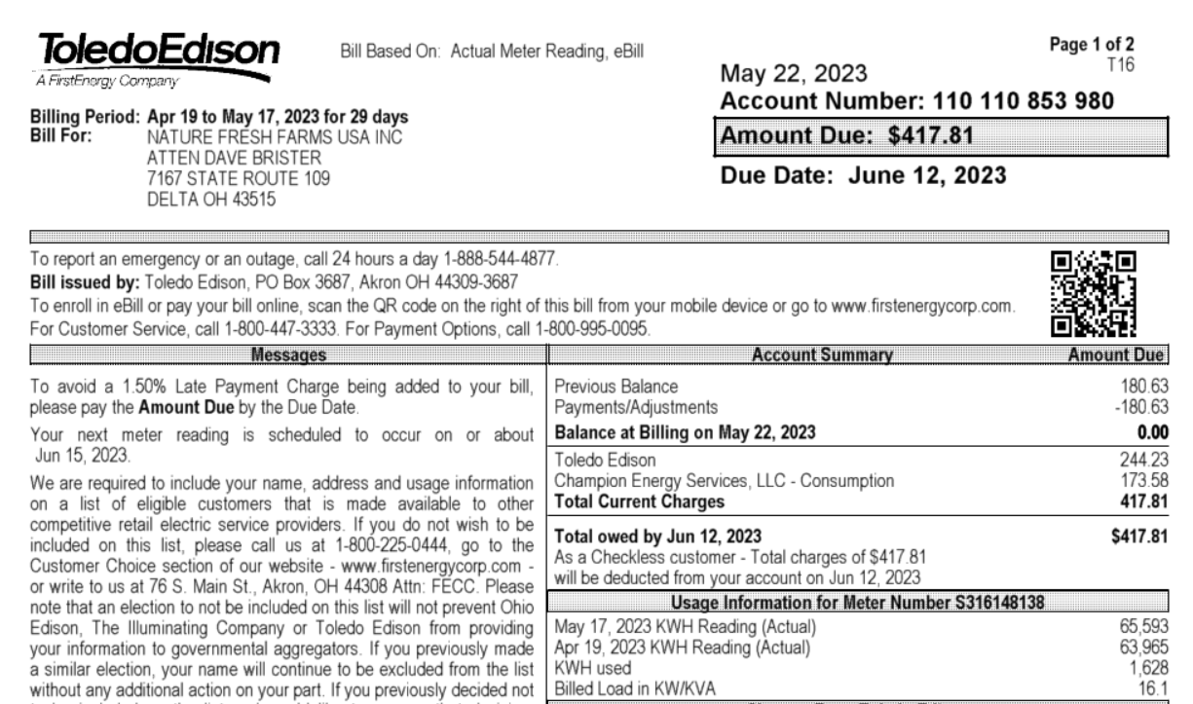
Shopping

Slide 9
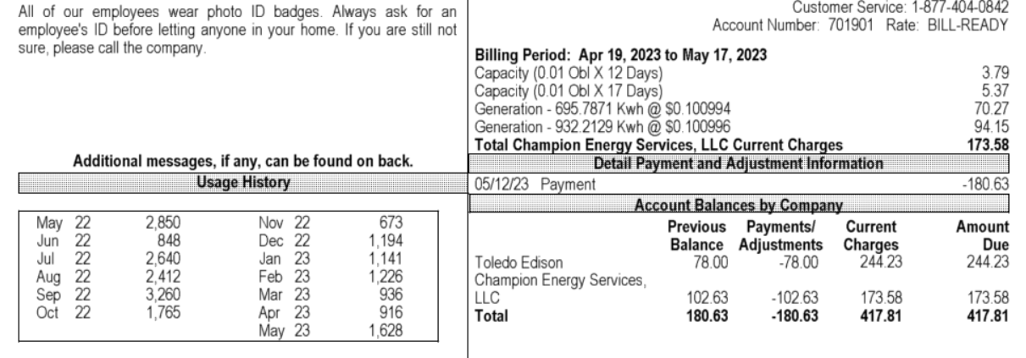

Shopping
Forced a contract onto an accounting person
4 year contract @ over $0.10/kWh

Slide 10
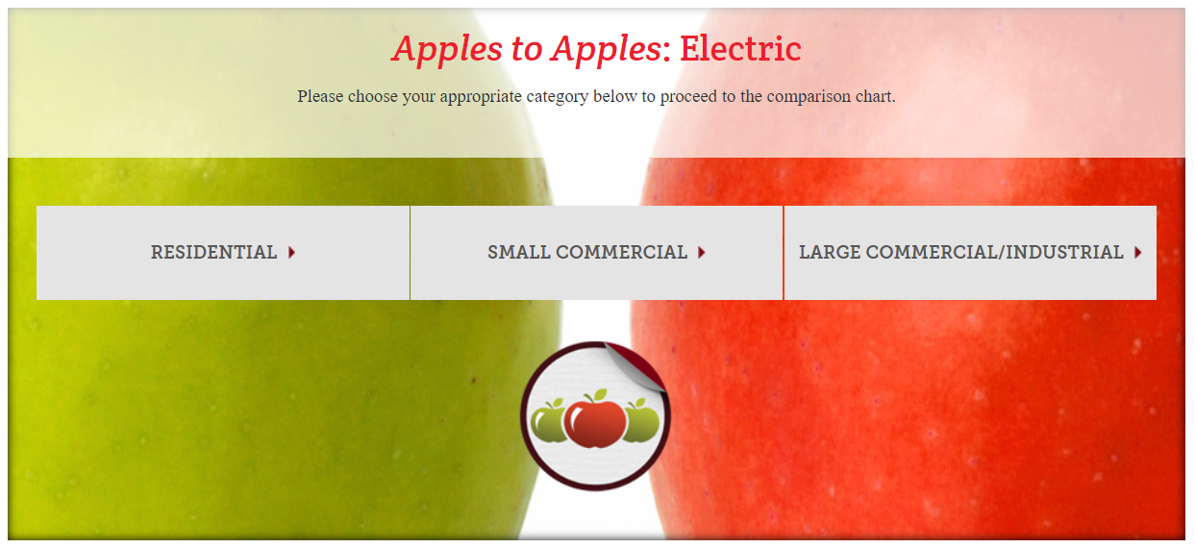
Shopping
Apple-to-Apple website
https://www.energychoice.ohio.gov/ApplesToApplesCategory.aspx?Category=Electric

Slide 11
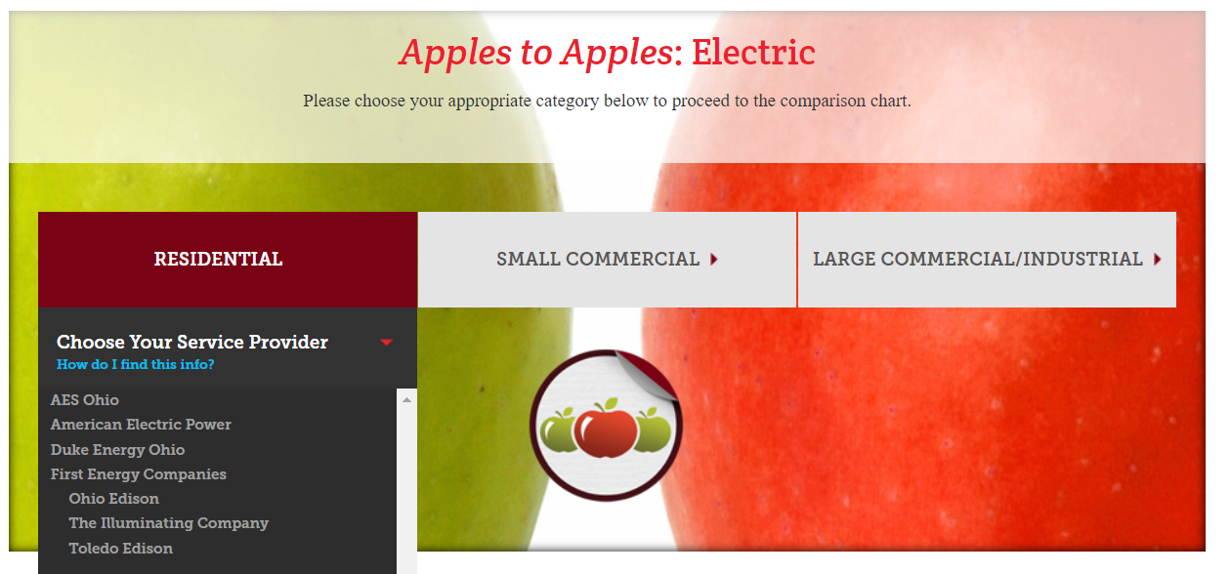
Shopping

Slide 12
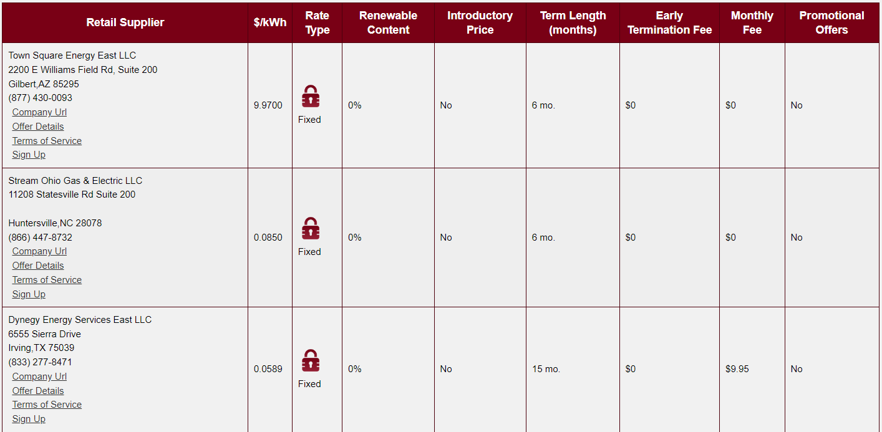
Shopping
$10/Month @1000kWh = $0.01/kWh
$0.0689

Slide 13
Shopping
Three Options
  Do nothing
  Sign with a supplier
  Let government aggregation take care of it

Slide 14
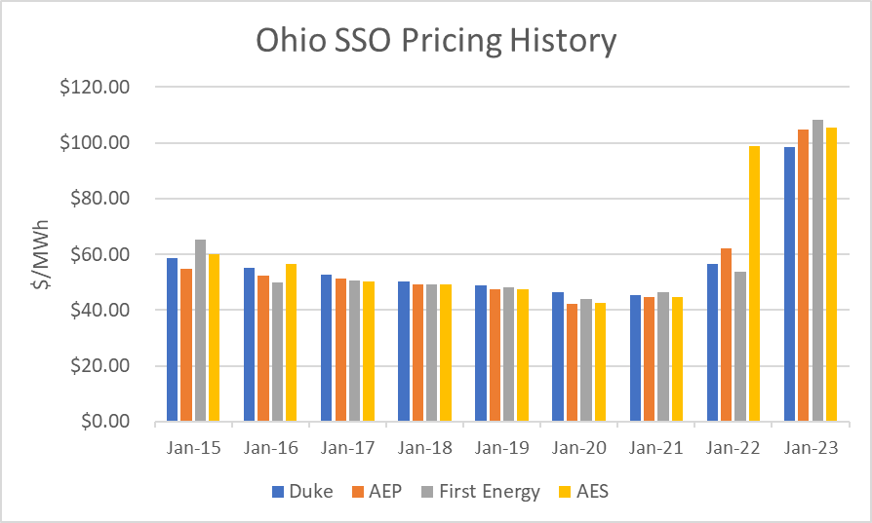
Shopping
Do Nothing
Simplest Action
Likely the most expensive
Subject to slamming

Slide 15
Shopping
Do Nothing
A typical house uses 1,000 kWh/month
A current supply rate is about $0.06/kWh
The difference is about $40/month

Slide 16
Shopping
Sign with a supplier
Use Apples-to-Apples website to find a supplier
  Keep to shorter terms between 12 and 24 months
  Only use reputable supplier from earlier slide
  CHECK THE TERMS CAREFULLY
IGS has offered Friends and Family rate
  Offers both gas and electric along with home warranty
  Market rate with some buffering
  Historical rates from 2022 were very good
  Have your utility bill(s) handy as you will need these
Click on link: https://www.igs.com/landing-page/friends-family

Slide 17

Shopping
Sign with a supplier

Slide 18
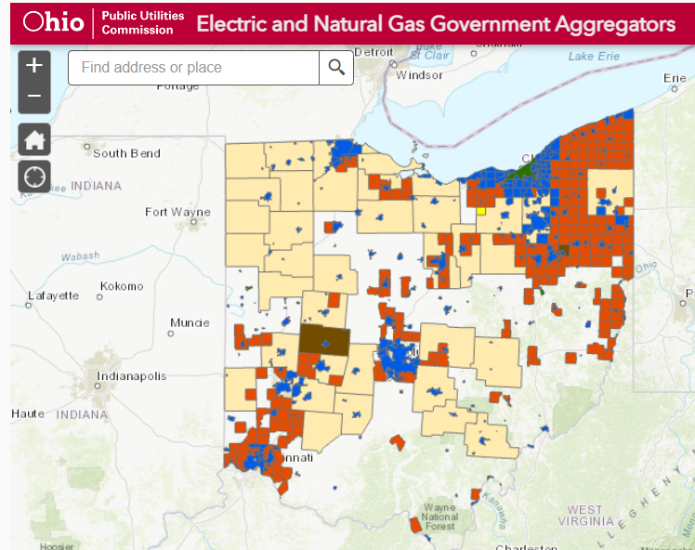
Shopping
Government Aggregation
PUCO interactive Aggregation map
https://puco.ohio.gov/utilities/utility-maps/all-government-aggregators-web-application

Slide 19
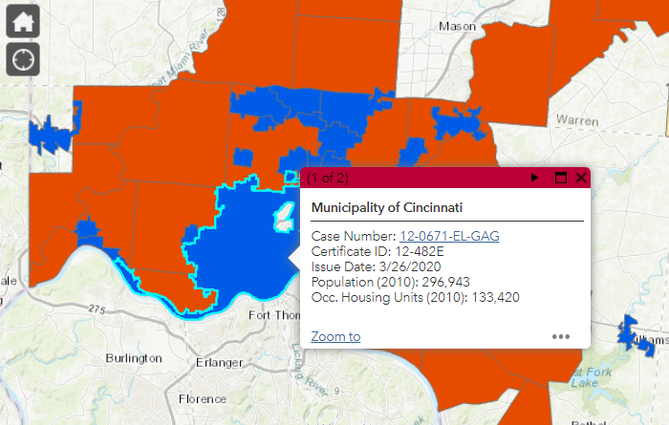
Shopping
Government Aggregation

Slide 20
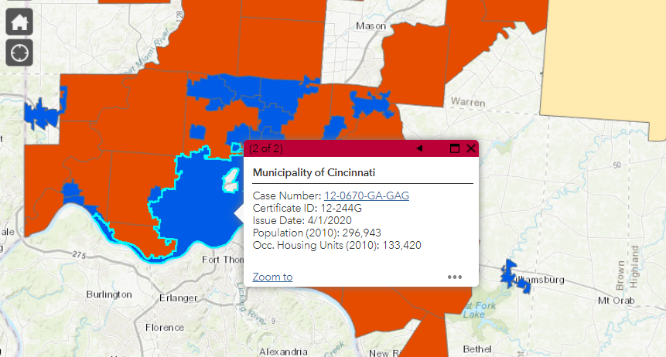
Shopping
Government Aggregation

Slide 21
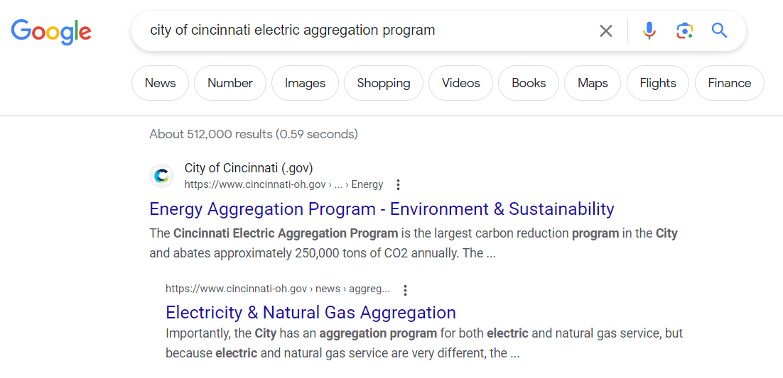
Shopping
Government Aggregation

Slide 22
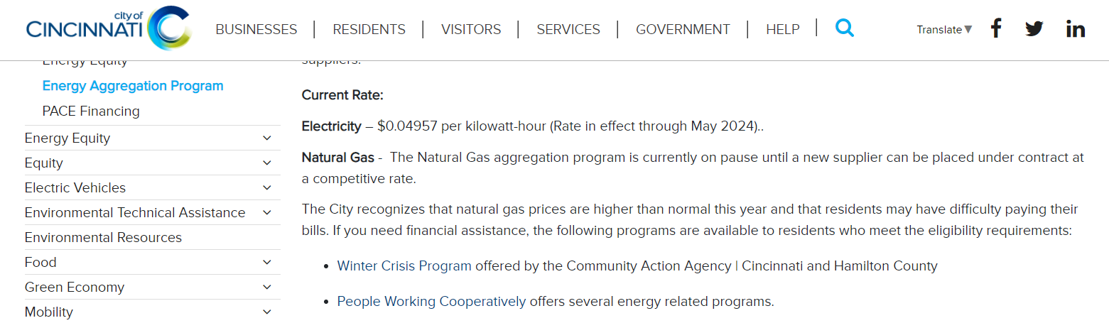
Shopping
Government Aggregation

Slide 23
Shopping
Know your options – Take time to educate yourself
If you have questions – Reach out to your OEA team: We are here to help
RICH BOHON
VP, Head of Analytics
bohon@oneenergyllc.com
Direct: 513-505-7733
SCOTT ERICKSON
Director of Analytics
erickson@oneenergyllc.com
Direct: 513-503-0985
JEFF WEDGEWORTH
Principal Energy Advisor
jeff@oneenergyllc.com
Direct: 513-235-2200
ERIN ROEKLE
Principal Energy Advisor
erin@oneenergyllc.com
Direct: 567-800-9063

