Slide 1
One Energy Operations
Erica Johnson
6/8/2021

Slide 2
Overview
Operations
  Turbine Info
  Project Info
  Service Schedules
  SOPs
  Production Reports
System Operations
  Overview
Safety & Quality
  NCRs
  Mistakes & Mishaps
  Training
Future Functions

Slide 3
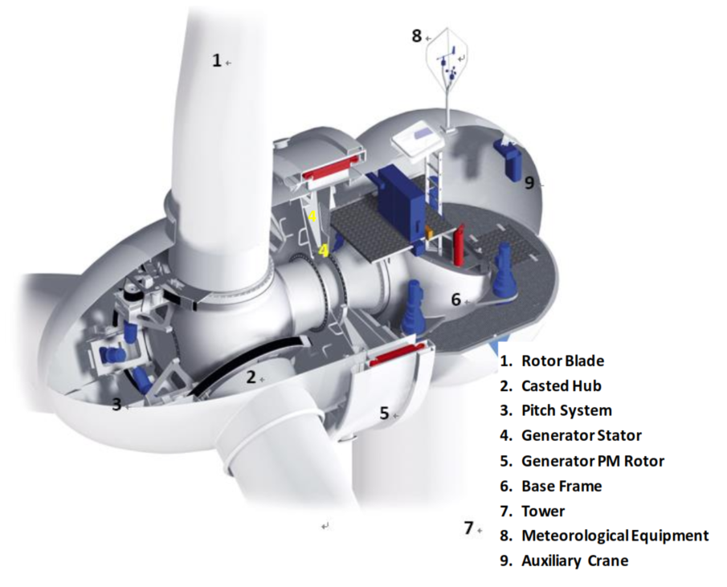
Turbine Info
Goldwind 1.5 MW Permanent Magnet Direct Drive
  Full power conversion
  Generator driven by rotor

Slide 4
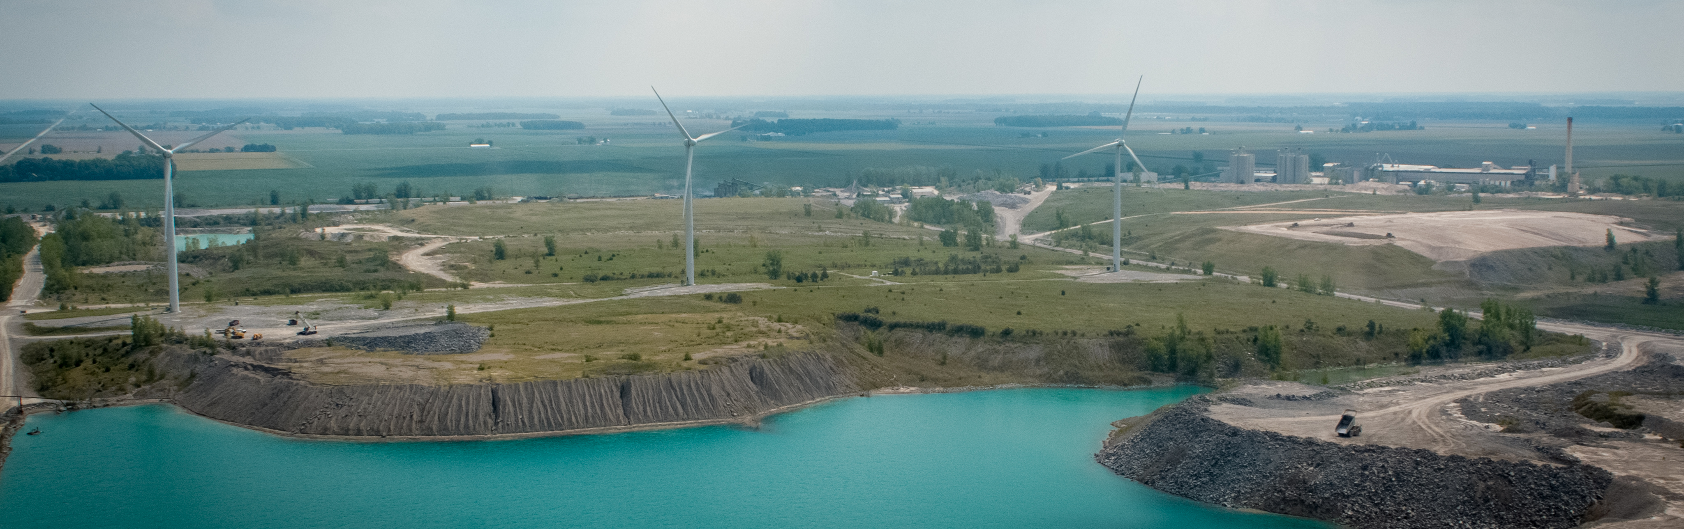
Project Info
NUMBER | PROJECT | LOCATION | SIZE | YEAR INSTALLED | DELIVERY METHOD
S014 | Haviland Plastics | Haviland, OH | 4.5 MW | 2012 | CAPEX
S015 | Cooper Farms | Van Wert, OH | 4.5 MW | 2011/2012 | CAPEX
S017 | MPC Harpster | Harpster, OH | 1.5 MW | 2016 | REA
S019 | Zephyr 1.0 | Findlay, OH | 4.5 MW | 2016 | REA
S020 | Whirlpool Findlay | Findlay, OH | 3.0 MW | 2016 | REA
S023 | Whirlpool Marion | Marion, OH | 4.5 MW | 2017 | REA
S024 | Whirlpool Ottawa | Ottawa, OH | 1.5 MW | 2018 | REA
S025 | Valfilm | Findlay, OH | 3.0 MW | 2018 | REA
S026 | Whirlpool Greenville | Greenville, OH | 4.5 MW | 2018 | REA
S027 | Autoliv | Findlay, OH | N/A | N/A | N/A
S028 | LafargeHolcim | Paulding, OH | 4.5 MW | 2020 | REA
S030 | Zephyr 2.0 | Findlay, OH | 4.5 MW | 2020 | REA

Slide 5
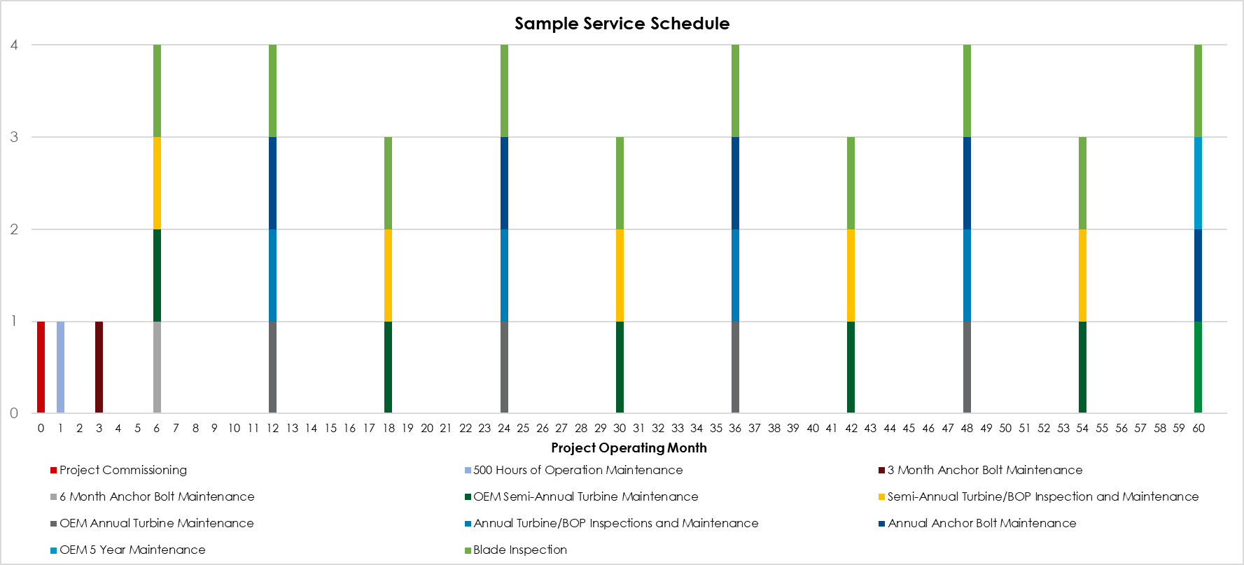
Service Schedules
Performed semi-annually, both OE and Goldwind at REA projects
OE not responsible for maintenance at CAPEX projects; audit climbs and blade inspections only

Slide 6
Goldwind Maintenance
500 Hour Maintenance
  Detailed maintenance on systems including converter, yaw, pitch, cooling, heating, auto lubrication
Semi-Annual Maintenance
  Component inspection, bearings greased, visual inspection of bolted connections, function test turbine auxiliary systems
Annual Maintenance
  10% check of bolted connections, general inspection, bearings greased, function test cooling/heating systems, yaw system test, generator test

Slide 7
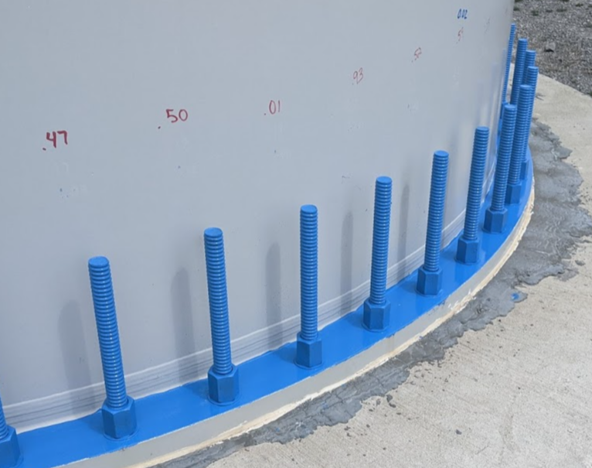
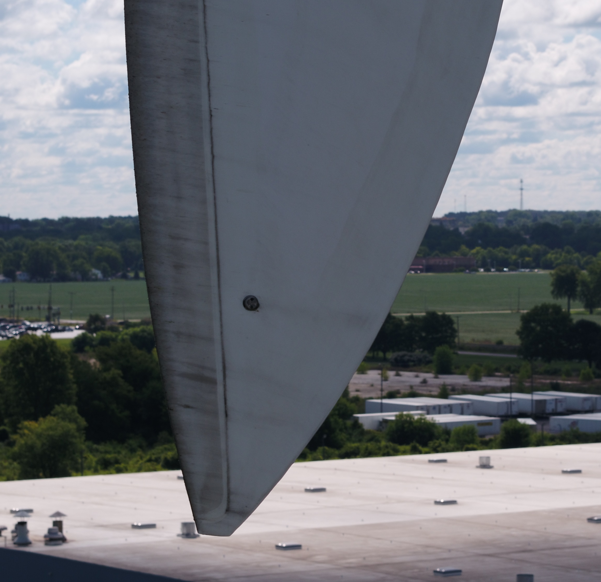
One Energy Maintenance
Anchor bolt 10% tensioning
  3 months, 6 months, yearly thereafter
  10% of bolts are tensioned to verify tightness
Semiannual Inspection
  Quality control inspection – full turbine system, BOP equipment, project site
Annual Inspection
  Quality control inspection – full turbine system, BOP equipment, project site
  Detailed BOP inspection – electrical and CEE
Blade Inspections
  Semiannual drone inspection of blades, root to tip
  Goal is quarterly inspections

Slide 8
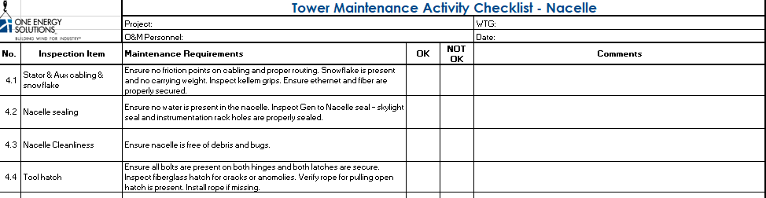
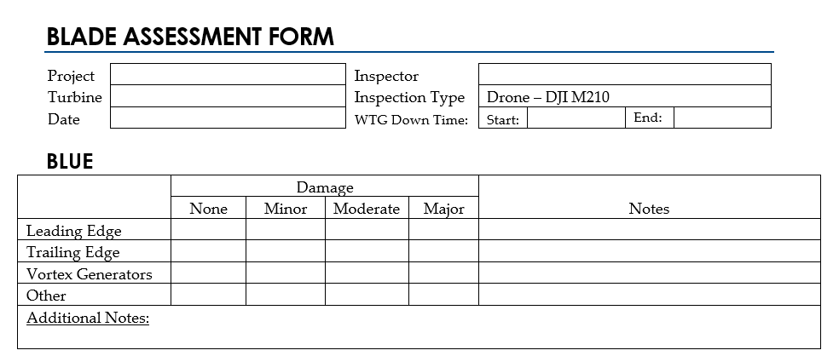
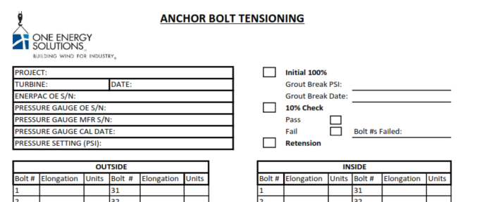
One Energy Maintenance

Slide 9
Maintenance Documentation
One Energy
  Completed checklists are used to compile punchlists for OE and OEM
  PDF’d Reports – Dropbox\Projects Operating\[Project]\Maintenance & Inspection
  Inspection photos – saved in NoteVault
  Blade Inspection photos – saved in Photos – Project Specific
  Completed reports are uploaded to Fixx
OEM
  Reports uploaded to DataRoom by the OEM

Slide 10
Standard Operating Procedures (SOPs)
Still in progress
Safety/LOTO
  Turbine Operation
  Turbine Rotor
  Project Primary Feed Switchgear LOTO
  Turbine Pad-Mount LOTO
Turbine Maintenance
  Anchor Bolt Tensioning
  Tower Torquing
  Nacelle Torquing
  Generator Torquing
  Rotor Torquing
  Generator Insulation Testing
  Turbine Emergency Pitch System 90° Test
  Overtwist Protection System Test
  Pitch System Capacitor Emergency Pitch Test
  Checking Blade 0 Procedure
  Mechanically Locking Blade
  Replacing Pitch Belt
Blade Maintenance
  Aerial Drone Inspection
  Rope Access Inspection/Repairs
  Platform Access Inspection Repairs
Balance of Plant (BOP) Equipment Maintenance
  Transformer Oil Sampling

Slide 11
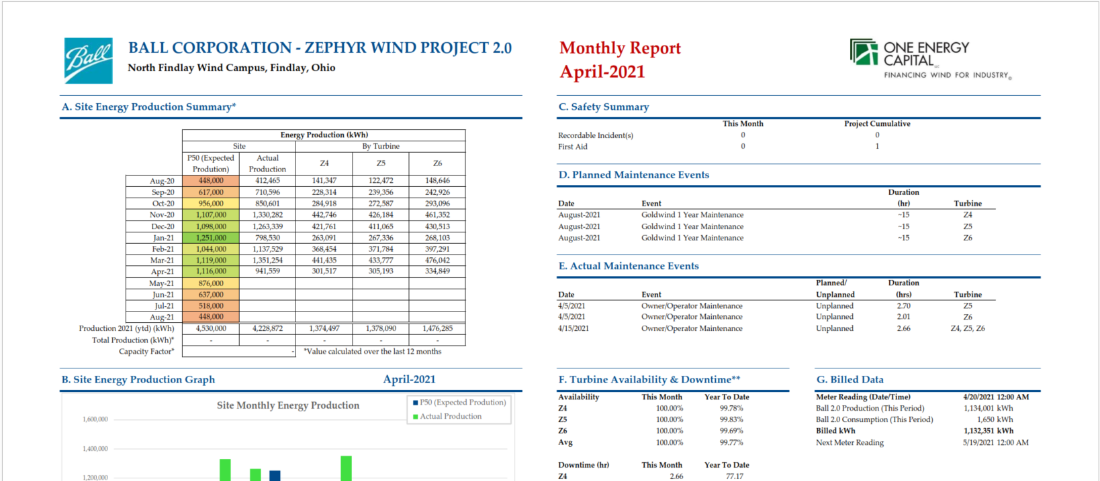
Production Reports
Monthly
  Sent to customer, uploaded to Athena & MyWindProject
  Production, downtime, availability, metering info (if applicable)
  SCADA Data + metering sheet

Slide 12
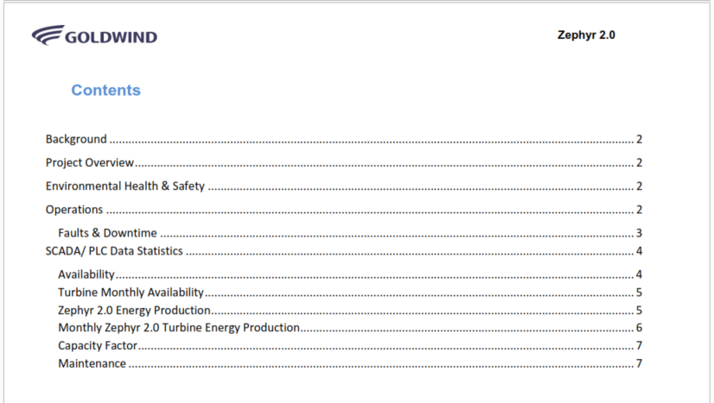
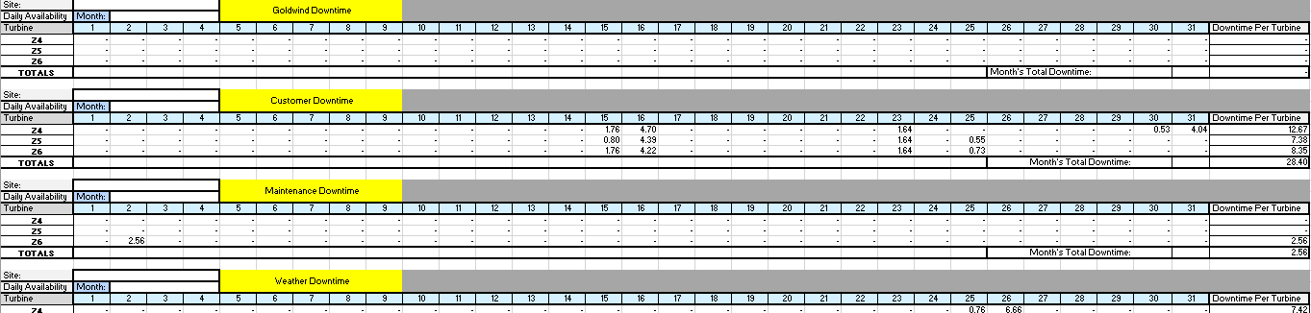
Production Reports
Monthly Goldwind Report
  PDF report and Excel availability tracker
  PDF uploaded to Athena
  SCADA Data

Slide 13
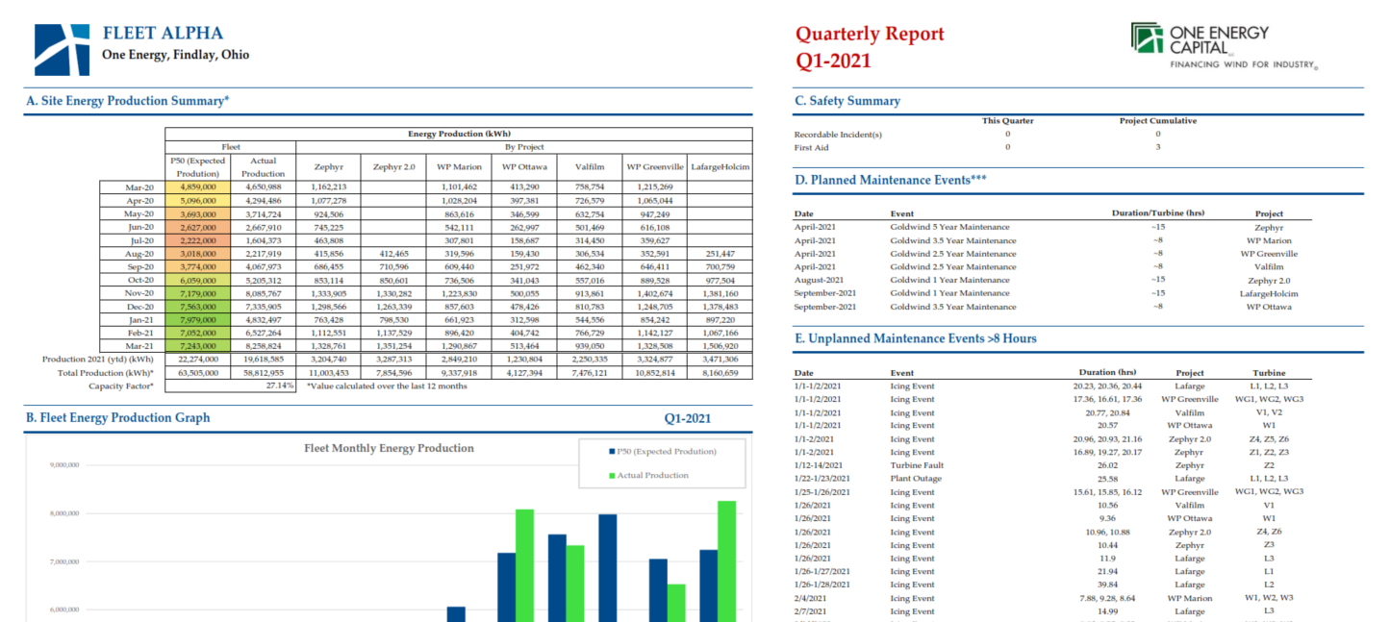
Production Reports
Quarterly Report
  Prepared for Fleet Alpha (Rosemawr) each quarter
  Multiple components: Legal, Technical, Financial
  Operating project data used to create summary sheets
  Safety and insurance stats
  Monthly reports included

Slide 14
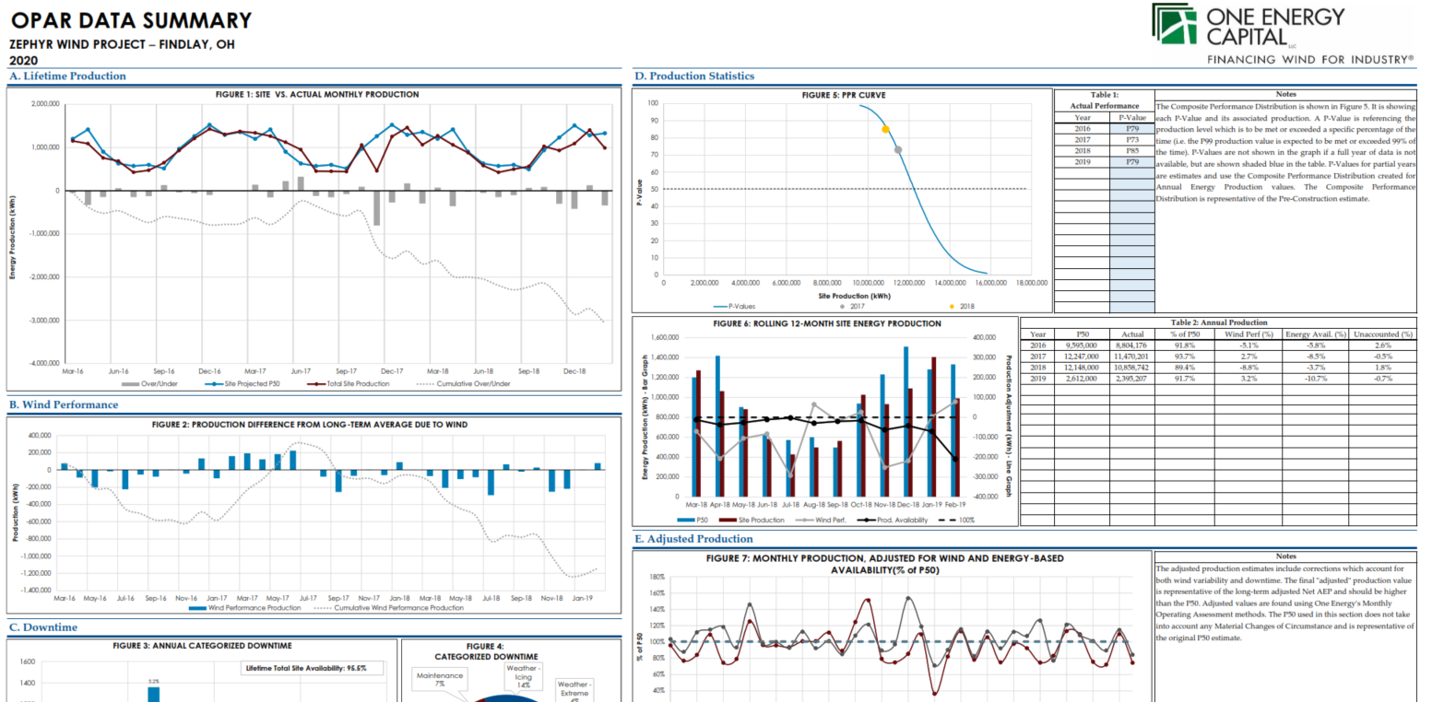
Production Reports
OPAR
  Currently a PPT function
  Analyzes the first 14 months of operation of a project
  Uses SCADA data and MERRA2 data to determine wind performance
  Reforecasts the production estimate – Operating P50

Slide 15
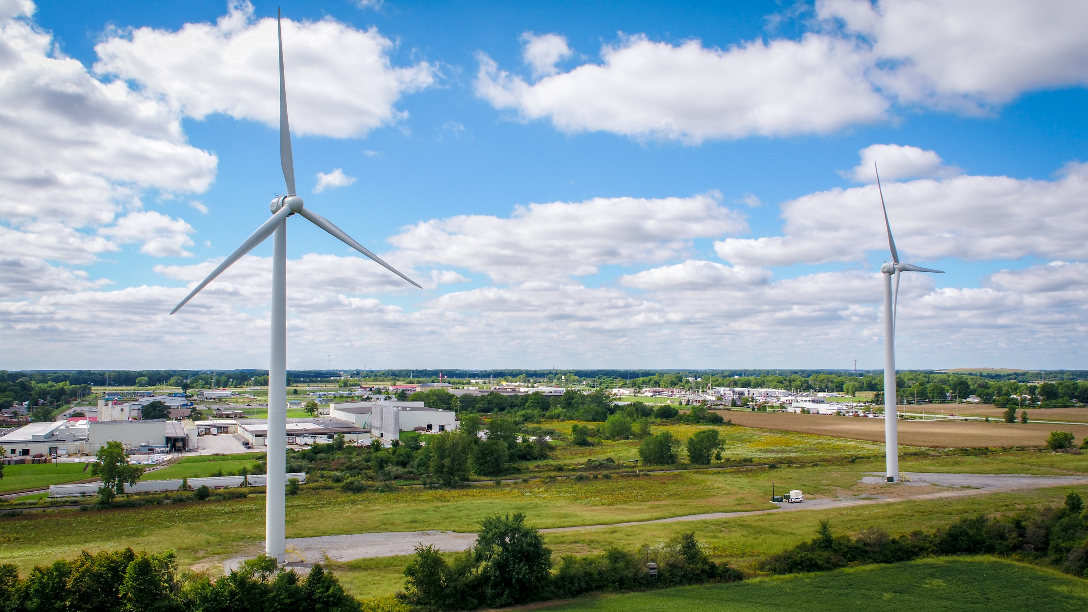
System Ops
Rotating teams – weekly rotation
Respond to grid events, weather events, comms, planned outages, etc.
More fun details at an SO training near you

Slide 16
Safety & Quality
Accident/incident reporting
  NCRs
  M&Ms
Training

Slide 17
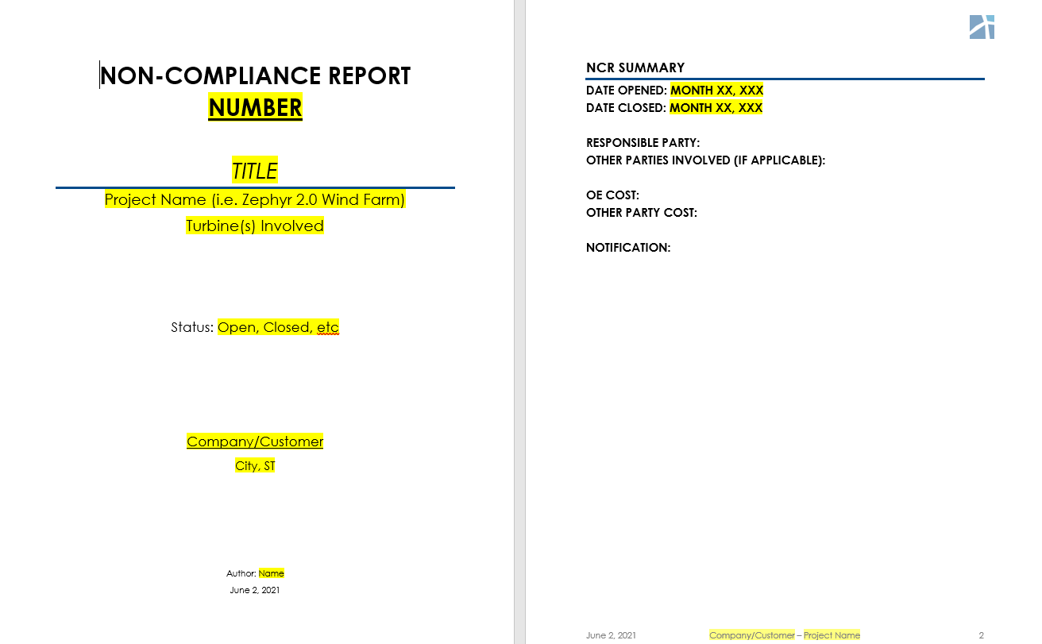
NCRs
Created for quality issues that impact a project, whether construction or operation
Includes dates issue identified/corrected, parties responsible and involved, cost, analysis
Example: Rail bracket bolt repair

Slide 18
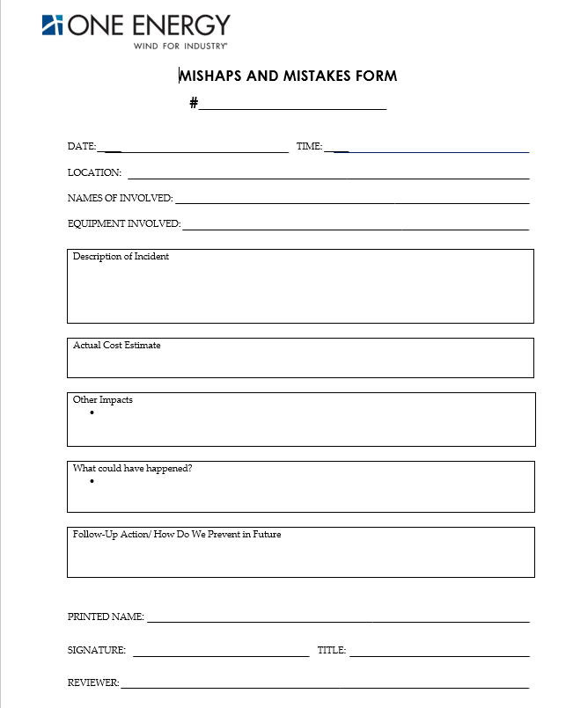
Safety
Near Miss
  Something could have happened
Recordable
  OSHA definitions
M&Ms (Mishaps & Mistakes)

Slide 19
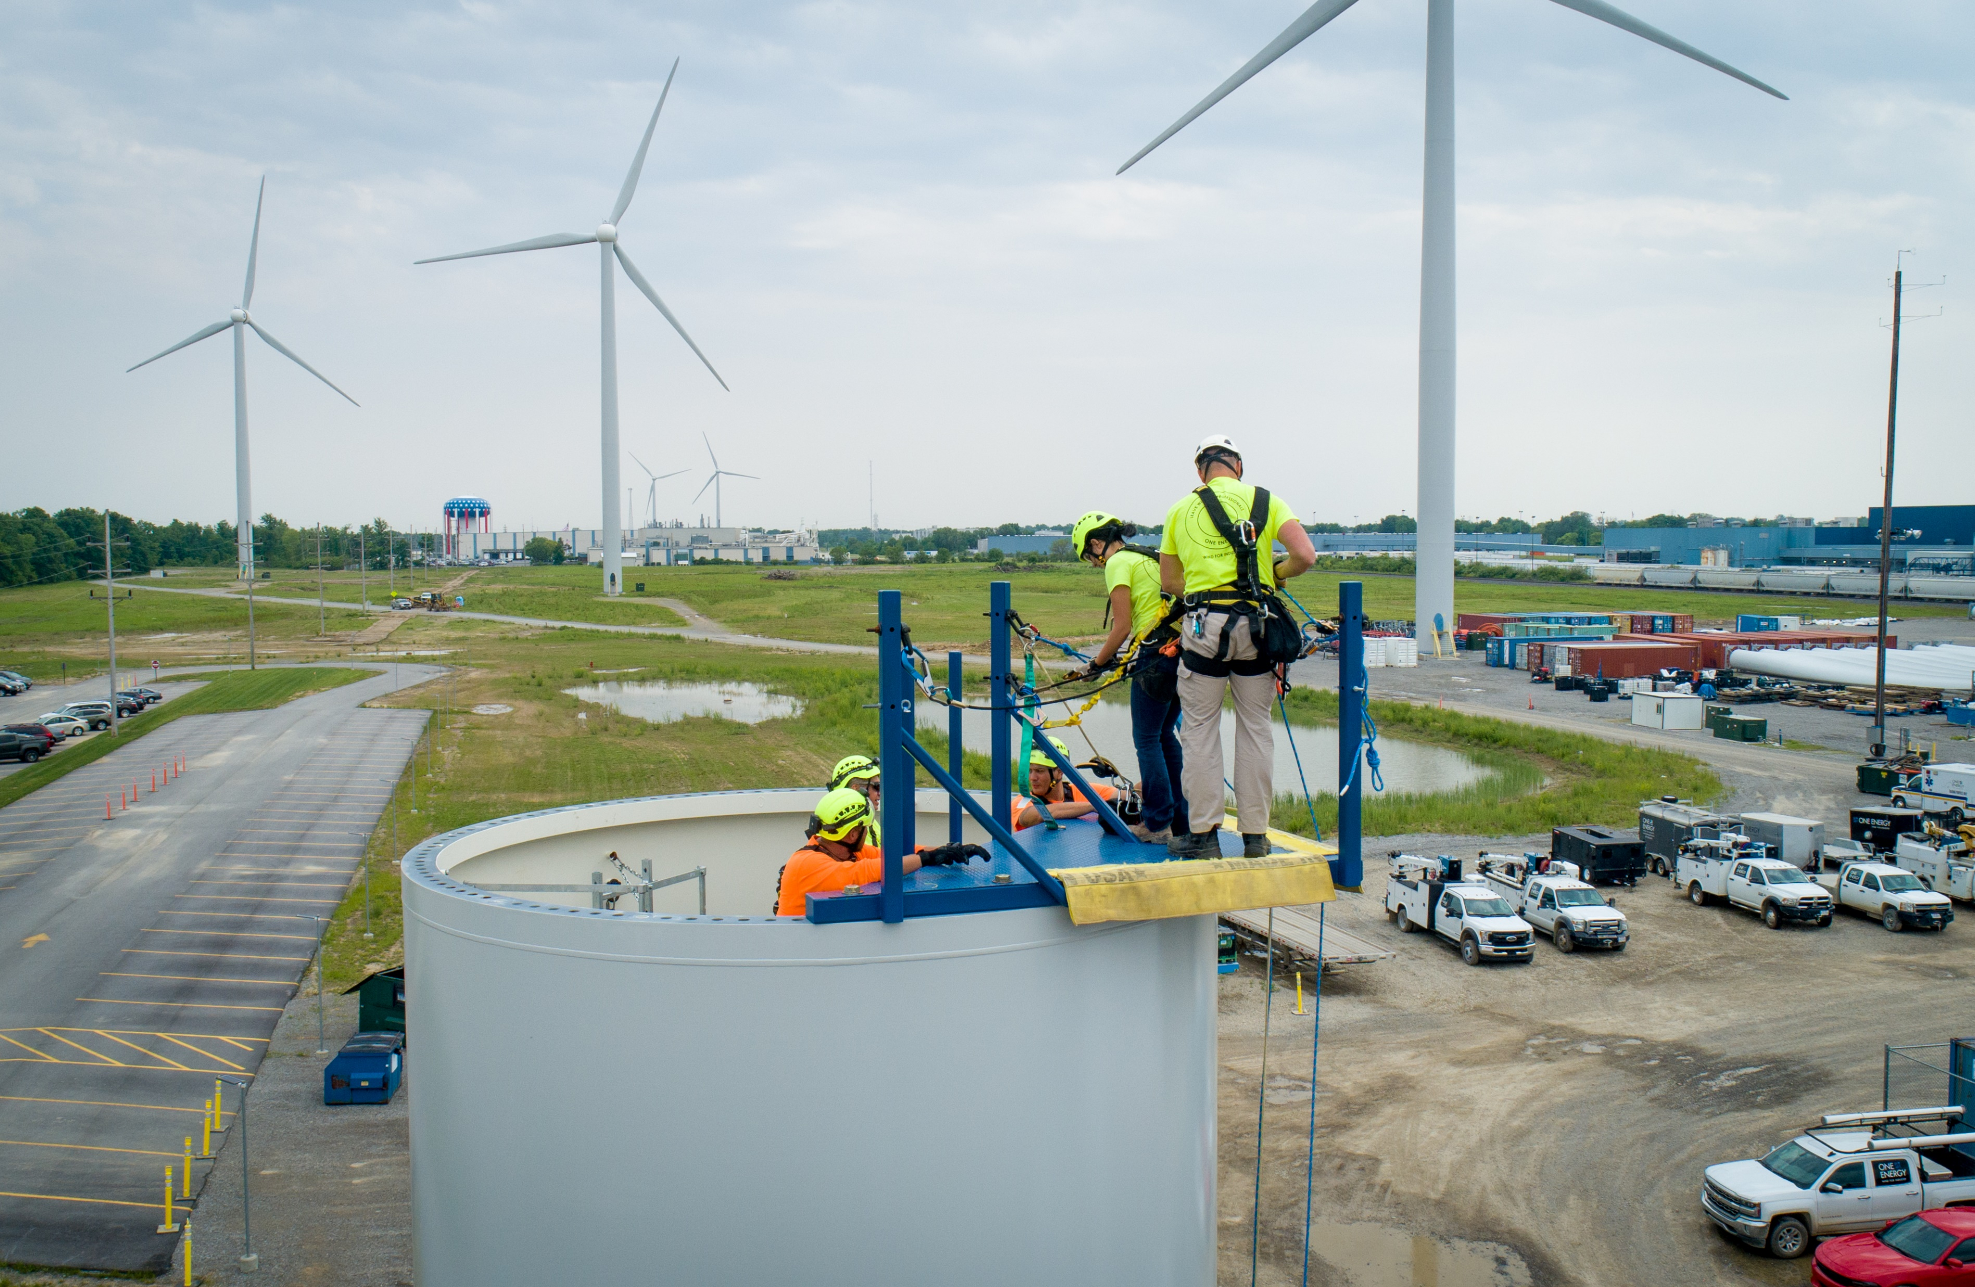
Training
EMT/AEMT
Tower Rescue
Local Fire Department Training

Slide 20
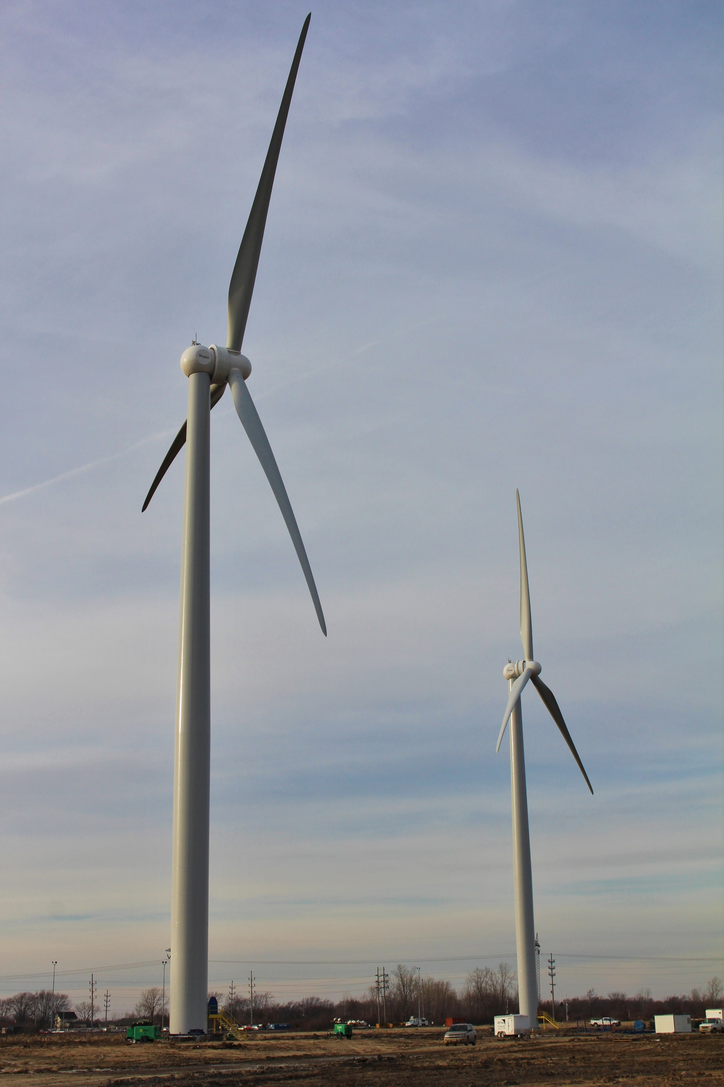
Future Ops functions
Meter reads
OPARs
Blade Inspections
System Ops
Planned outages
ManagedHV maintenance/inspection/operations

