Slide 1
OE Knowledge Night:
FAA and Aviation
May 25, 2021

Slide 2
Outline
The FAA Filing Process
14 CFR Part 77 Definitions
ODOT Process
Examples

Slide 3
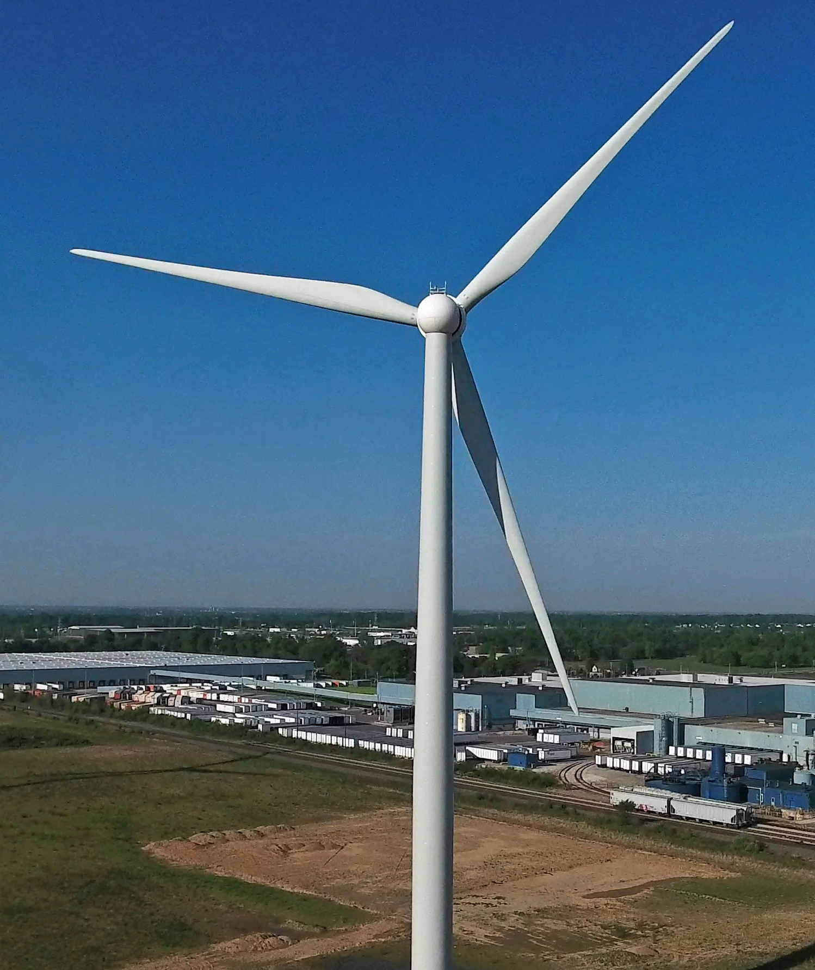
14 CFR Part 77
Part 77: Safe, Efficient Use, and Preservation of the Navigable Airspace
  (c) The process for aeronautical studies of obstructions to air navigation or navigational facilities to determine the effect on the safe and efficient use of navigable airspace, air navigation facilities or equipment; and

Slide 4
14 CFR Part 77 and the FAA
Part 77 Allows the FAA to:
  Evaluate
    The effect of proposed construction or alteration on safety in air commerce
    The efficient use and preservation of the navigable airspace of the airport traffic capacity at the public use airports
  Determine
    Whether a proposed construction or alteration a HAZARD to air navigation
    Determine appropriate marking and lighting recommendations, using FAA Advisory Circular 70/7460-1, Obstruction Marking and Lighting
    Other appropriate measures to be applied for continued safety of air navigation
  Notify
    The aviation community of construction or alteration of objects that affect navigable airspace, including revision of aeronautical charts
https://youtu.be/5To849M7f1k

Slide 5
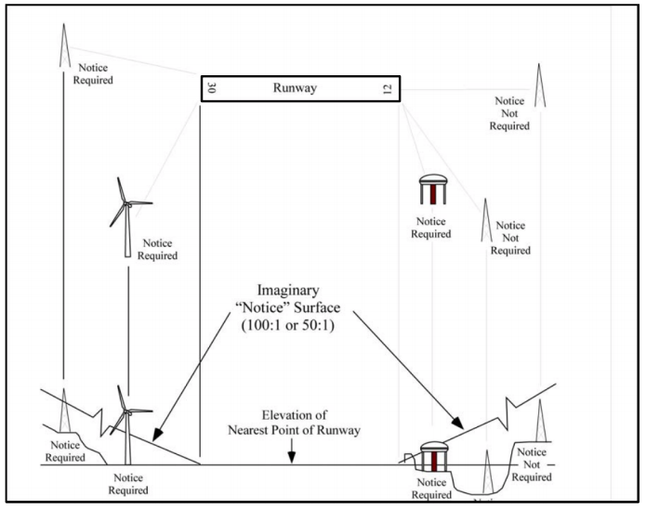
STEP 1: Notice Criteria
“Notice Criteria”: when you need to file a new construction or alteration with the FAA (https://oeaaa.faa.gov/oeaaa/external/gisTools/gisAction.jsp?action=showNoNoticeRequiredToolForm)
  If you propose any construction or alteration described in §77.9, you must provide adequate notice to the FAA of that construction or alteration.
  200 Feet above ground level
  In excess of established notification standards (lower heights, closer to an airport)
  Must file a “7460-1” 45 days prior to construction

Slide 6
Step 2: Initial Review
A specialist from the Obstruction Evaluation Group will be assigned to the project
  The specialist acts as the “Judge”, who's job it is to collect all of the necessary information and rule impartially
  Usually a former Air Traffic Controller
Technicians from 10 groups will review each point to ensure the proposed project does not interfere with their areas of responsibility
The specialist compiles the comments from all 10 groups

Slide 7
Step 2: Initial Review
The specialist consults at least 10 groups including:
  Airports
  Instrument Flight Procedures Impact Team
  Flight Standards
  Technical Operations
  Frequency Management
  Air Force
  Navy
  Army
  Department of Defense Siting Clearing House
  Department of Homeland Security
Within the FAA
Outside the FAA
Hundreds of people within the FAA are involved in a filing.

Slide 8
STEP 3: Preliminary Results
DEFINITIONS:
  Obstruction To Air Navigation: Any object the FAA determined must be properly marked, lighted, and identified on aeronautical publications so it may be easily recognized by aircraft navigating through the airspace.
  Hazard to Air Navigation: An obstruction or other adverse object that FAA aeronautical study concludes would have a “substantial adverse effect” to a “significant volume of aeronautical operations.”

Slide 9
Step 3: Preliminary Results
The Specialist will issue either:
  Determination of No Hazard
  Notice of Presumed Hazard
This is based on the results from each of the 10 departments
A “Notice of Presumed Hazard” means the FAA has identified a potential issue and the project will require further study (an Aeronautical Study) to determine if the project will pose a hazard to air navigation
Usually, all “obstructions” are initially issued a Notice of Presumed Hazard (14 CFR Part 77.17: Obstruction Standards)
Not all obstructions are hazards…

Slide 10
Step 4: Further Study
If the project owner agrees, the project will be “circularized” for public comment
During this 37-day public comment period, the FAA can collect information regarding the actual impact on the local flying community including:
  The airport
  The pilots
  Military Operations
  Local aviation groups
    Private Jets
    Regional Airlines Association
    National Business Aviation Association
    Other lobbying groups
They will also conduct a deeper study into the potential issue:
  Technical Operations Detailed Study (VOR)
  General rule: if one flight per day would be impacted by the proposed structure then it will be considered “significant adverse effect.”
Big question: the project has an effect on air navigation, but is it significant? Is the obstruction a hazard to safe air navigation?

Slide 11
Step 5: Final Determination
The Specialist will issue either:
  Determination of No Hazard to Air Navigation
    “The aeronautical study revealed that the structure would have no substantial adverse effect on the safe and efficient utilization of the navigable airspace by aircraft or on the operation of the air navigation facilities.”
  Determination Of Hazard to Air Navigation
The letter issued will include the comments the FAA received during the public circularization period and their responses to those comments (if any).

Slide 12
14 CFR Part 77
Notification Criteria
Obstruction Standards
Imaginary Surfaces
… These are all very different

Slide 13



Notification Requirements
200 ft AGL
On Airport
100:1 or 50:1
100:1 or 50:1
20,000 ft
Runway
Requires Filing
Does not Require Filing
10,000 ft
= Must File 7460-1 with FAA at least 45 days prior to construction
*Image not to scale

Slide 14
Obstruction Standards
CFR Part 77.17 (A)(1)/(a)(2)
499 ft AGL
499 ft AGL
400 ft AGL
400 ft AGL
300 ft AGL
300 ft AGL
200 ft AGL
200 ft AGL
150 ft AGL
3 NM (18,228 ft)
10,000 ft
4,000 ft
4 NM (24,304 ft)
Part 77.17(a)(1) Obstruction Standards
5 NM (30,380 ft)
Part 77.17(a)(2) Obstruction Standards
6 NM (36,456 ft)
Part 77.19 Imaginary Surfaces

Slide 15
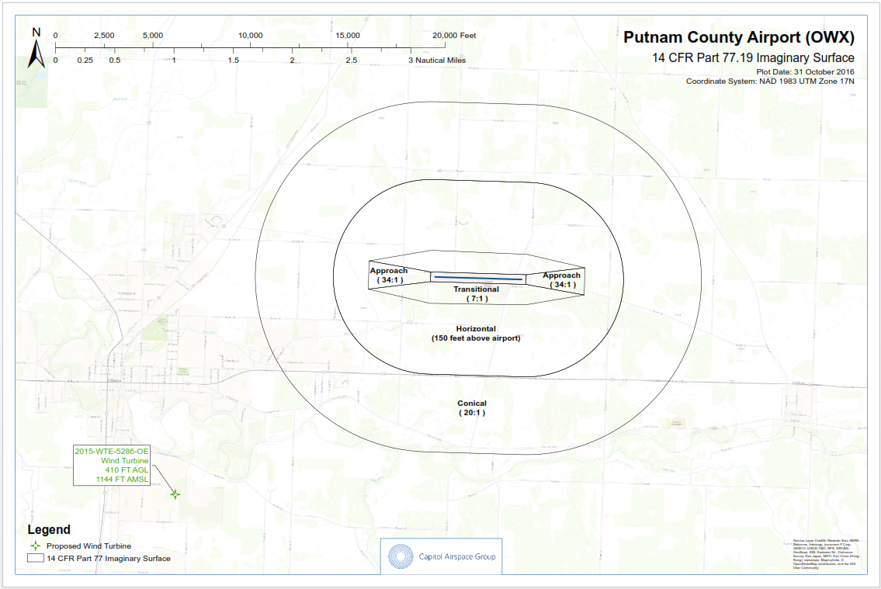
77.19 Imaginary Surfaces
14 CFR Part 77.19 Imaginary Surfaces
Horizontal Surface
  5,000 or 10,000 ft from airport depending on runway type
Conical Surface
  4,000 feet past the horizontal surface
Primary Surface
  200-1000 ft depending on runway type
Approach Surface
  Width: 1,250 ft – 16,000 ft depending on runway type
  Distance:
    5,000 – 10,000 for non precision instrument runways
    50,000 for precision instrument runways
Transitional Surface
  Connects the primary, approach, and conical surfaces at a slope of 7:1.
Referenced in the Ohio Revised Code

Slide 16
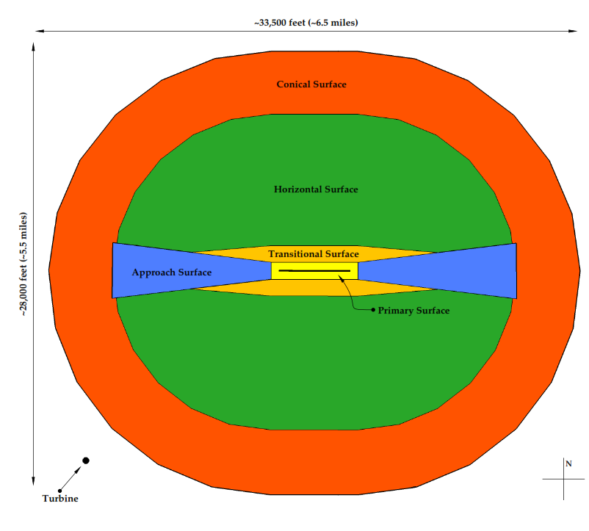
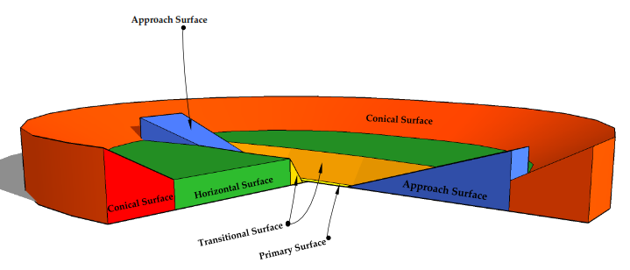
Imaginary Surfaces

Slide 17
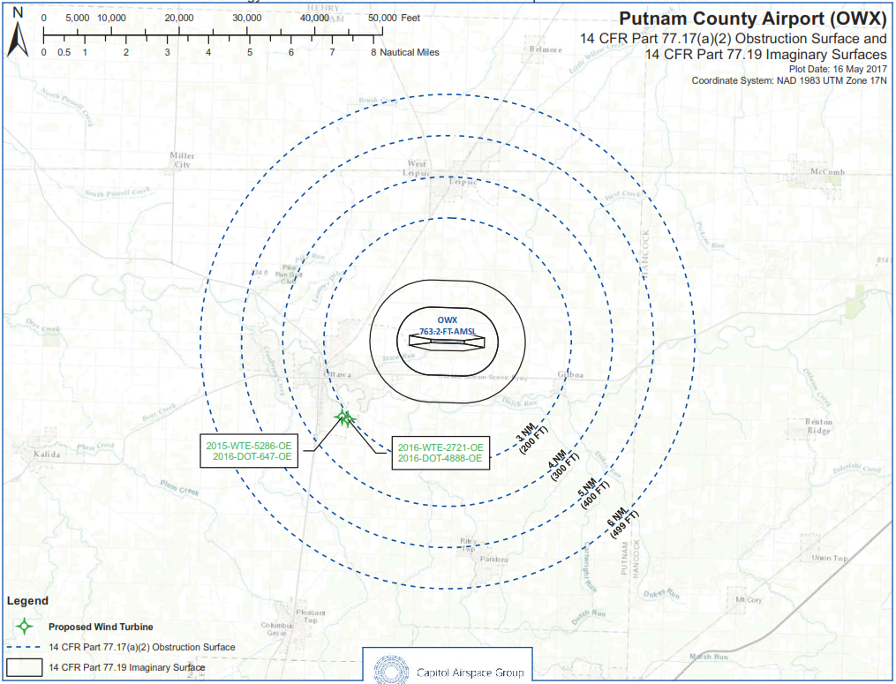
Imaginary Surfaces + Part 77
OCR 6 Imaginary Surfaces + 14 CFR Part 77.17(a)(2)

Slide 18
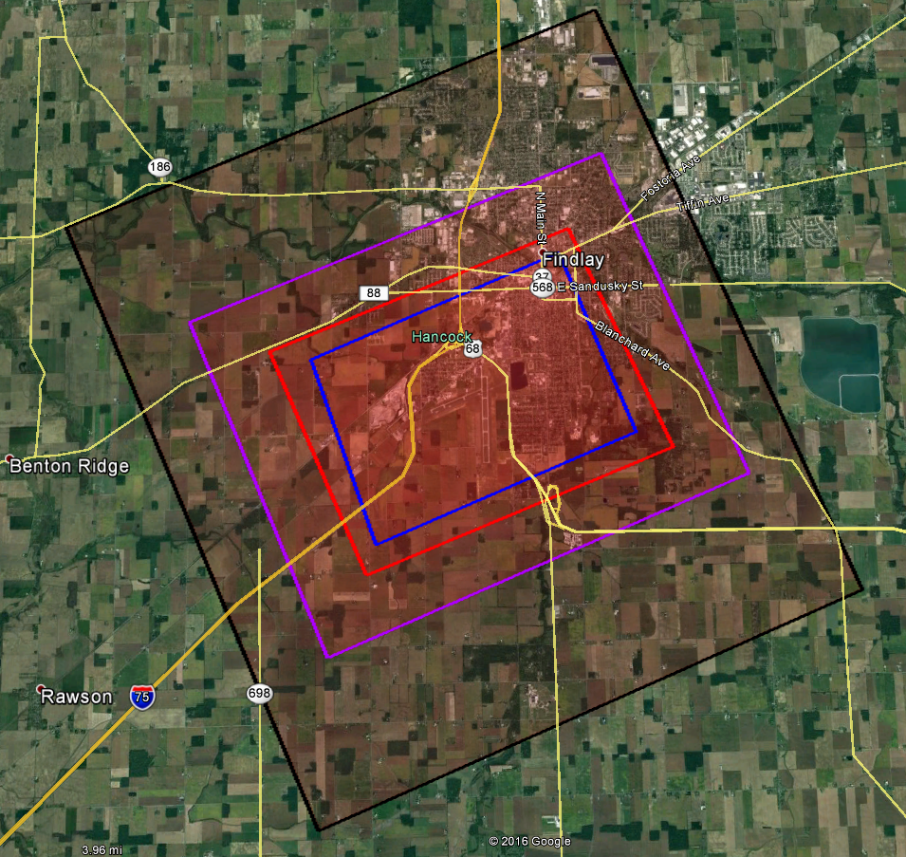
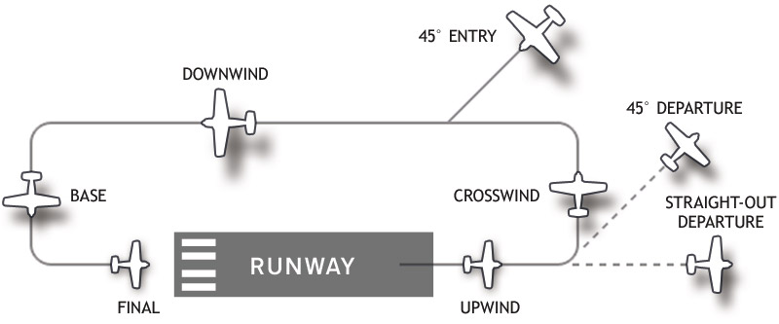
Other Parts of Part 77: VFR Traffic Patterns
Visual Flight Rules: regulations under which a pilot operates an aircraft in weather conditions generally clear enough to allow the pilot to see where the aircraft is going
Traffic Pattern: standard path for coordinating air traffic. Allows pilots to know from where to expect other air traffic.
Category: A-D
D
C
B
A

Slide 19
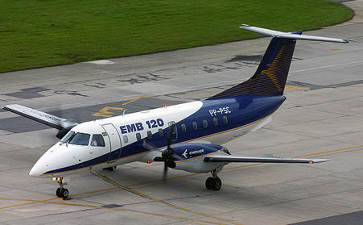
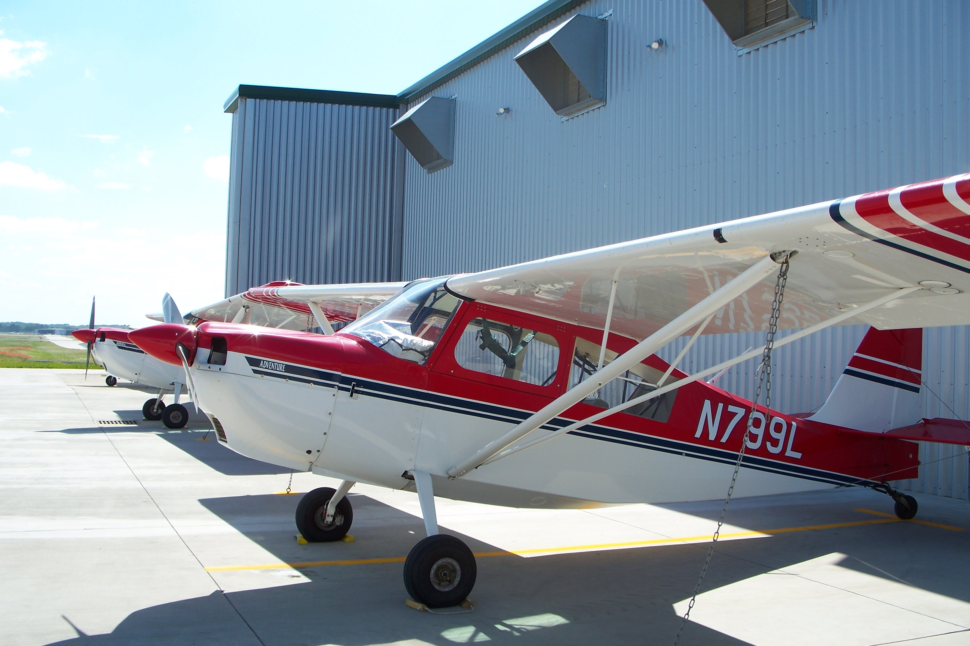


VFR: Categories
VFR Traffic Patterns Vary based on the runway design and the allowable approach speeds for safe landing. Aircraft are categorized by approach speed:
Category B: 91 – 120 knots
Commuter aircraft, business jets
Category A: <91 knots
Small single engine airplanes
Category D: 141 – 165 knots
Heavy Range commercial and heavy transport
Category C: 121 – 140 knots
Medium range commercial planes
19

Slide 20
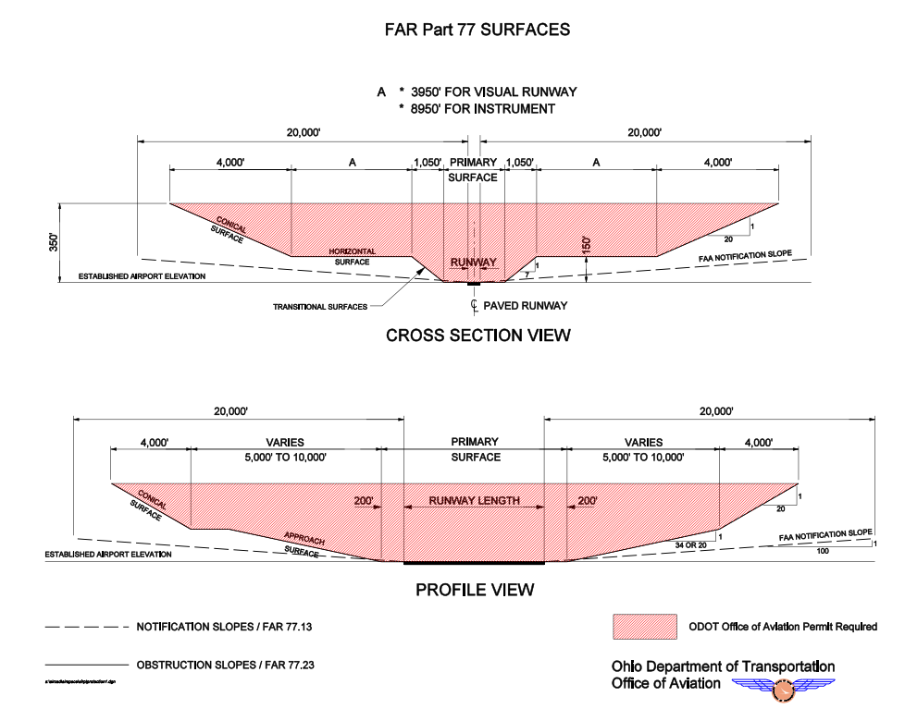
ODOT Process
ODOT automatically retrieves filings from FAA system.
The ORC gives ODOT authority to issue/deny a permit within the 6 imaginary surfaces. (See 4561.31(a))
However, ODOT has recently taken the position that all obstructions under Part 77 should be denied permits.

Slide 21
ODOT Process
1 - 2 people within ODOT and one outside consultant that handle all airspace evaluation matters (compared to hundreds at the FAA)
  ODOT usually no prior experience in airspace matters
  Consultant only screens for Part 77.17 (a)(1)/(a)(2) obstructions
Only one group within ODOT (compared to 10 at the FAA)
ODOT has then the position that it will deny permits for any structure that penetrates any Part 77 surface
Does not conduct an “Aeronautical Study”
Obstructions = Hazards

Slide 22
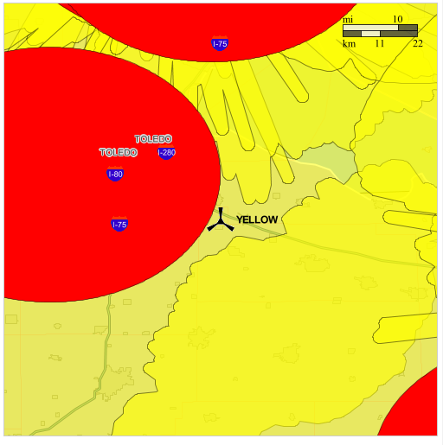
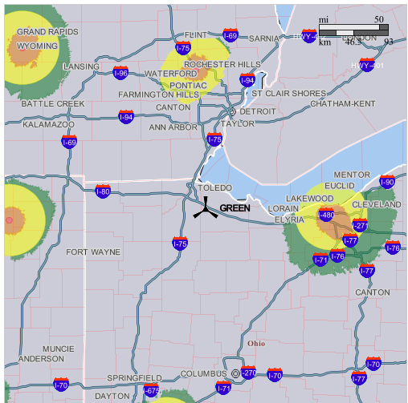
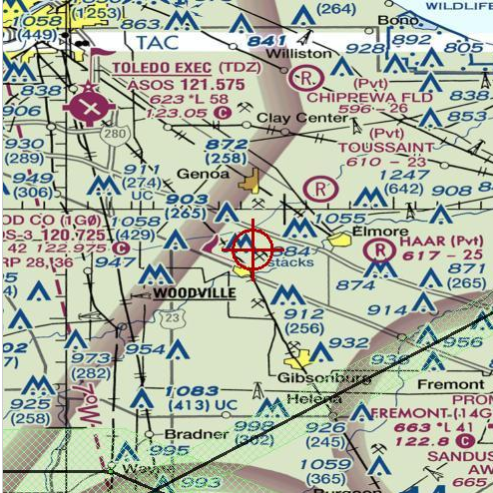
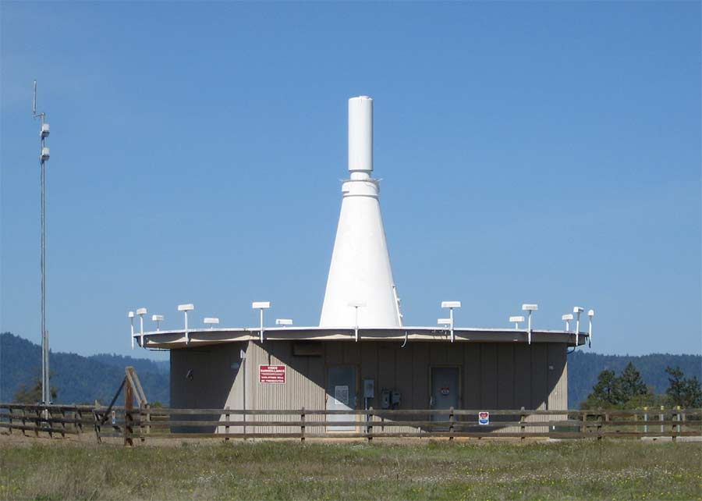
Other Things to Consider
Department of Defense
  Long Range Radar
  NEXRAD Radar
  Military Operations
Navigation Aids

Slide 23
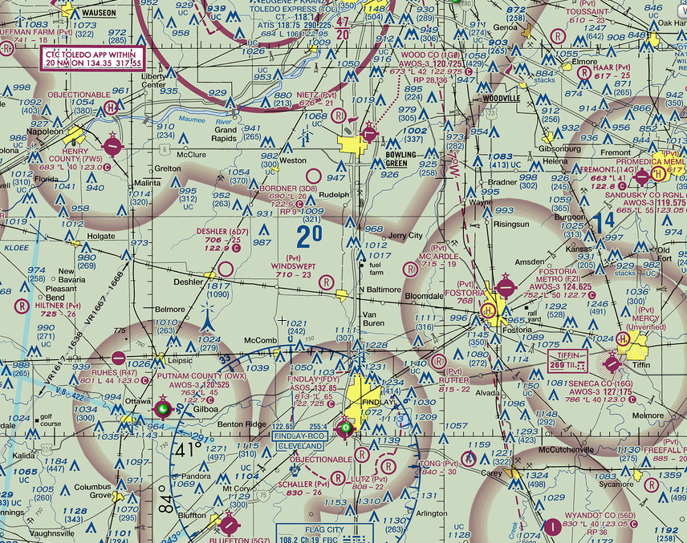
Aeronautical Charts
Shows pilots the location of tallest structures in an area
Shows location of:
  Airports
  Navigation Aids
  Flight paths
  Military airspace
  Among other things

Slide 24
Example 1: Ottawa, Ohio
Ottawa, Ohio turbine
  >16,900 feet from Putnam County Airport
  Exceeds Part 77.17 (a)(2) by 167 ft
  Received a “Notice of Presumed Hazard” from the FAA
    It was classified as an “obstruction” that needed further study
  Aeronautical study was conducted and public comment period was opened
  Conclusion: Determination of No Hazard to Air Navigation

Slide 25
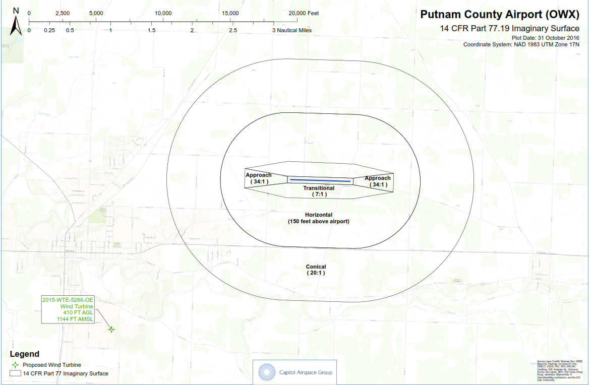
Example 1: OTTawa, Ohio
FAA: Determination of No Hazard
ODOT: Denial
Obstruction = Hazard

Slide 26
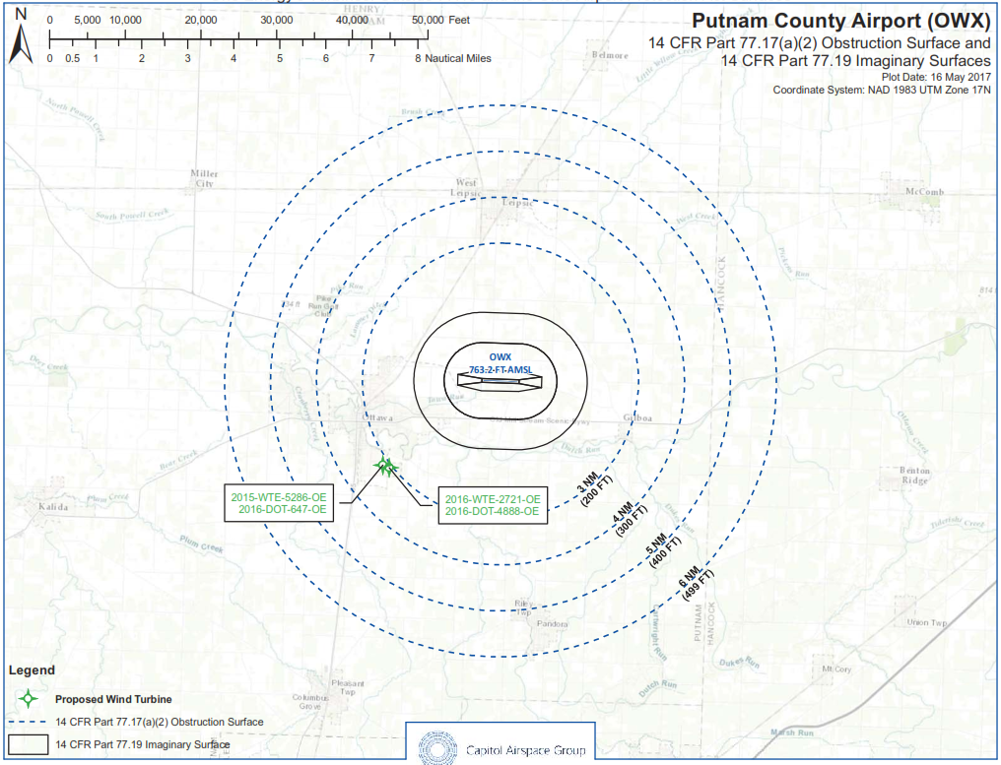
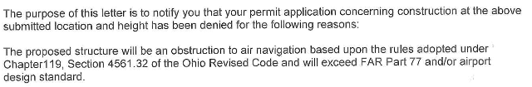
Example 1: Ottawa, Ohio
ODOT: Denial
Penetrates Part 77.17(a)(2) surface

Slide 27
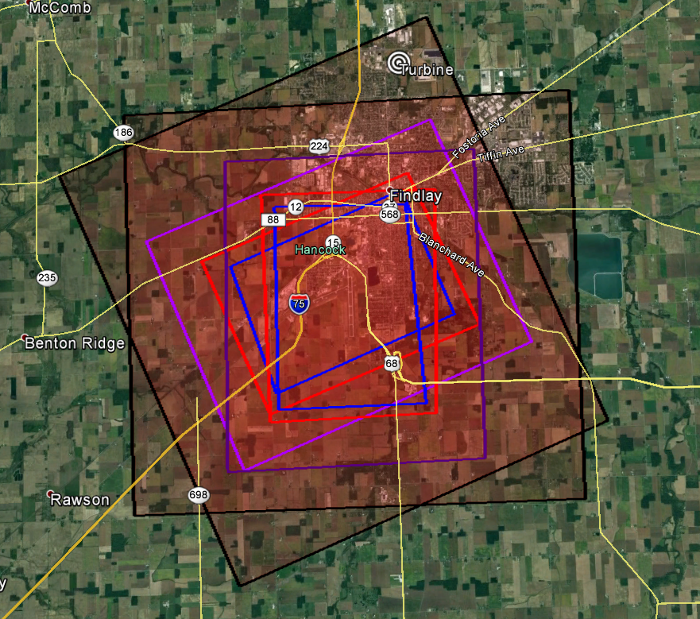
Example 2: Findlay Airport
Findlay, Ohio Turbine
  >24,000 ft to Findlay Airport
  Exceeds 77.17(a)(2) as applied to a visual approach runway by 57 feet (Category D Airpsace)
  Received a “Notice of Presumed Hazard” from the FAA
    It was classified as an “obstruction” that needed further study
  Aeronautical study was conducted and public comment period was opened
    The Aeronautical Study concluded Category D aircraft do not use the aircraft at least once per day
  Conclusion: Determination of No Hazard to Air Navigation

Slide 28
Impact to Projects
When to File
The FAA can take 60 days, 90 days, 180 days+ to respond to a Notice of Proposed Construction, depending on how busy they are
If multiple departments (like the DoD) need to weigh in, it can take longer
Filing as early as possible for our projects is important so the FAA doesn’t hold up the process
We can’t file for locations on land the customer owns unless we have permission
We CAN file for locations on land that we would have to purchase for the project without permission
Head of PPT’s decision on when to file

Slide 29
How to FIle
https://oeaaa.faa.gov/oeaaa/external/portal.jsp
Login to our account: filings@oneenergyllc.com
“Add new case (off airport)”
  Notice of: Construction
  Duration: pick a long time period or leave blank
  Work Schedule: leave blank
  State filing: leave blank
  Structure height: 410 feet
  Requested marking/lighting: white pant/synchronous red lights
  Description of land: “Agricultural/undeveloped land outside/near ______”
  Description of proposal: “Private wind turbine.”
  Structure type: Wind turbine
  Structure name: XX-WTG## …where “XX” is the first letter(s) of the company and ## is the turbine number
  Don’t worry about any of the frequency stuff
If filing for 3+ turbines, you must add “Multiple Cases”
  Fill out OECaseDataSpreadsheet V2.0
  Due Diligence – Resources / Aviation (there’s also a link on the website)

Slide 30
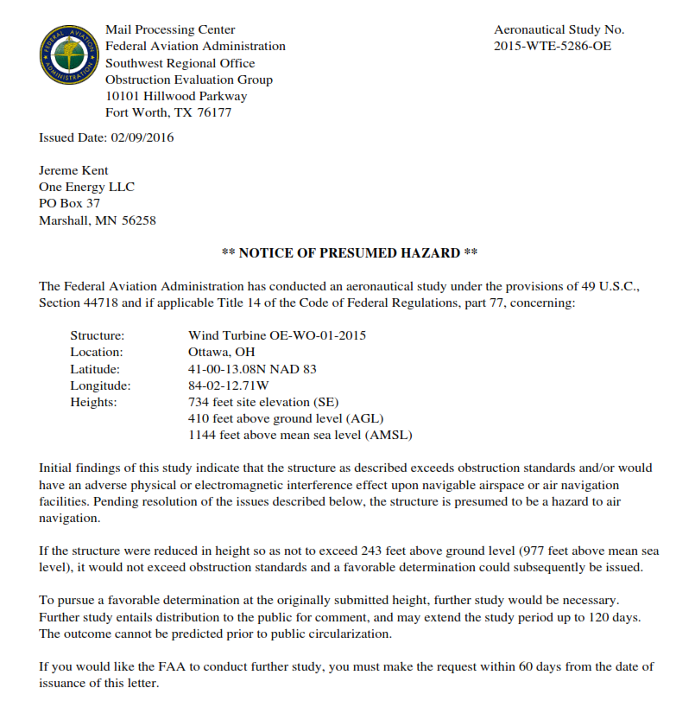
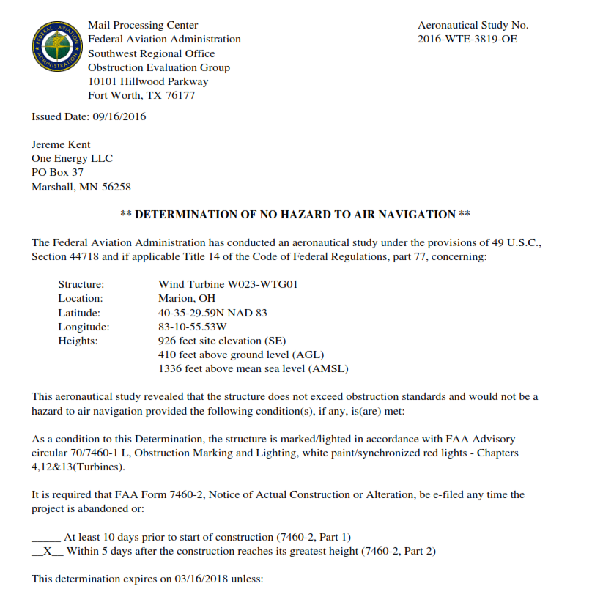
Documents

Slide 31
7460-2
After Turbine is Built
Within 5 days of the turbine reaching its max height we have to file the 7460-2 with the FAA
If the turbine as-built location is within 1 arc second of the filed location and overall height of the turbine has not increased:
  Input as-built turbine locations and ground elevation
  Attach site drawing with coordinates
If the turbine as-built location is outside 1 arc second or total height has increased:
  FAA will prompt you to refile the structure
  (this is NOT what we want)
Keep tabs on when turbine lat/lons have changed and how they compare to the coordinates we filed with the FAA
If turbine siting changes, update the FAA filing prior to the 7460-2
Check off task on project master in Taskworld

Slide 32
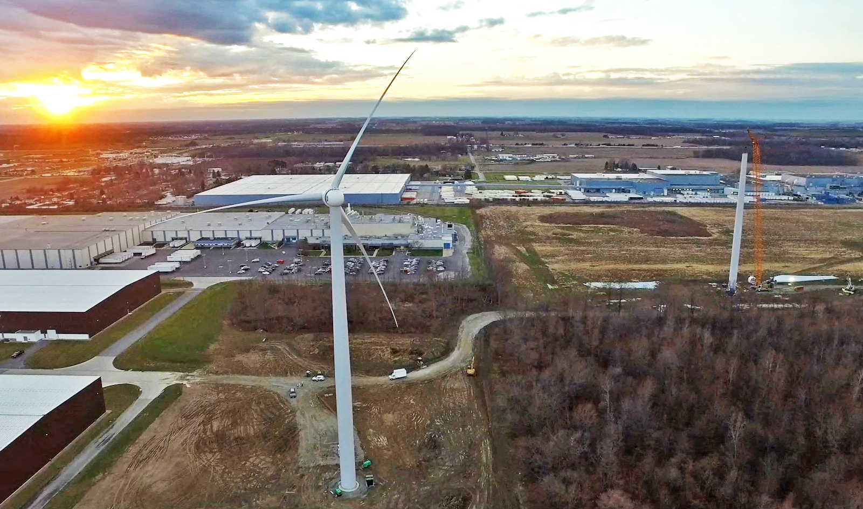
Questions?

Slide 33
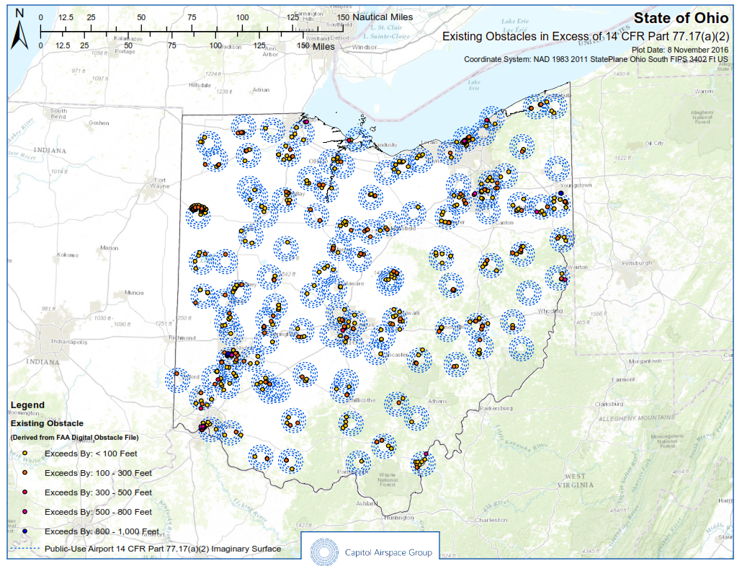
Existing Structures in Ohio
Structures existing in Ohio that violate the (a)(2) surface of airports

Slide 34
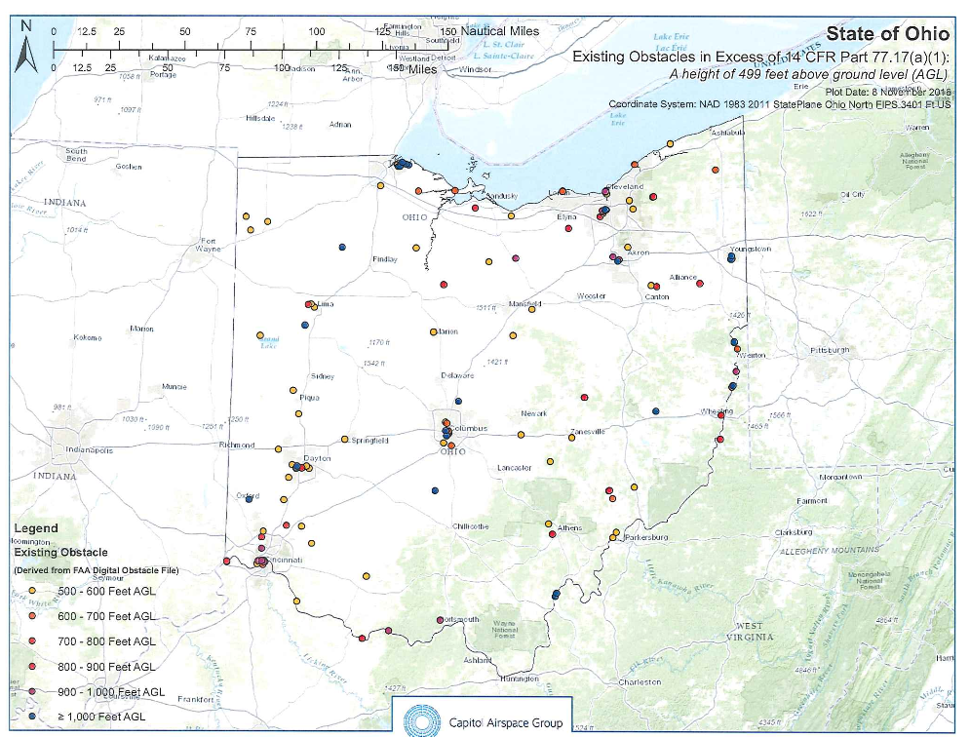
Existing Structures in Ohio
Structures existing in Ohio that violate the (a)(1) surface (>499 feet)

Slide 35
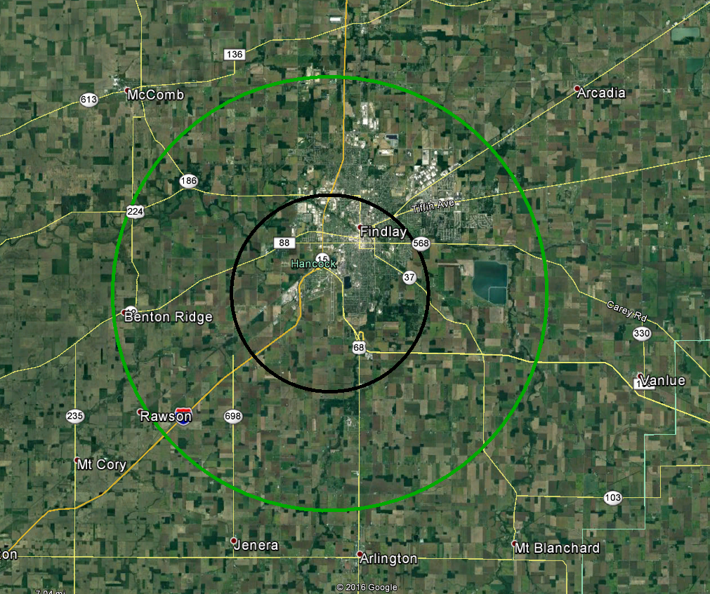
Comparison: Findlay Airport
Key | Farthest Point | Distance | Square Miles
 | ORC 6 Imaginary Surfaces | 3 miles | 28 miles²
 | Part 77.17 (a)(2) Obstruction Standard | 7 miles | 150 miles²
*Height restrictions vary within the areas.

Slide 36
Comparison: What about All of Ohio?
ODOT Permit Requirement | Square Miles | % of Ohio*
Current ODOT ORC Permit Area: 6 Imaginary Surfaces | 3,950 miles² | ~10%
Proposed ODOT Permit area: 14 CFR Part 77.17 (a)(2) | 19,107 miles² | ~40%
Proposed ODOT Permit area: 14 CFR Part 77.17(a)(1) (>499 ft) | 44,825 miles² | 100%
*Does not exclude overlapping surfaces, assuming mid-size airports

Slide 37
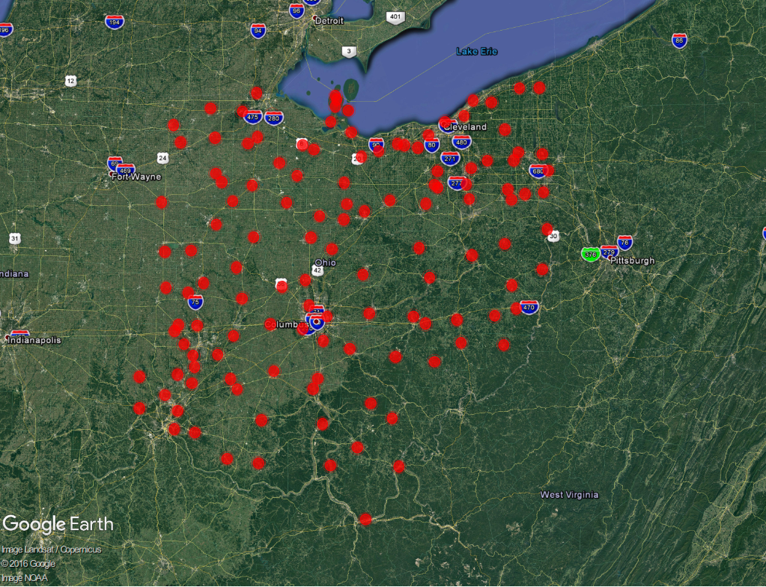
Imaginary Surfaces In Ohio
ORC 6 Imaginary Surfaces
3,900 mi²
9.5% of Ohio

Slide 38
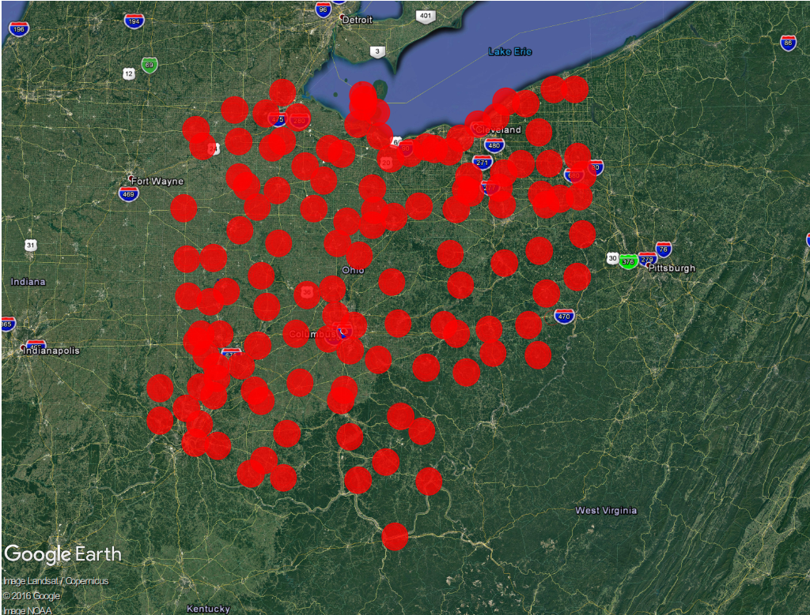
Part 77.17(a)(2)
Part 77.17(a)(2)
>19,000 mi²
46% of Ohio

Slide 39
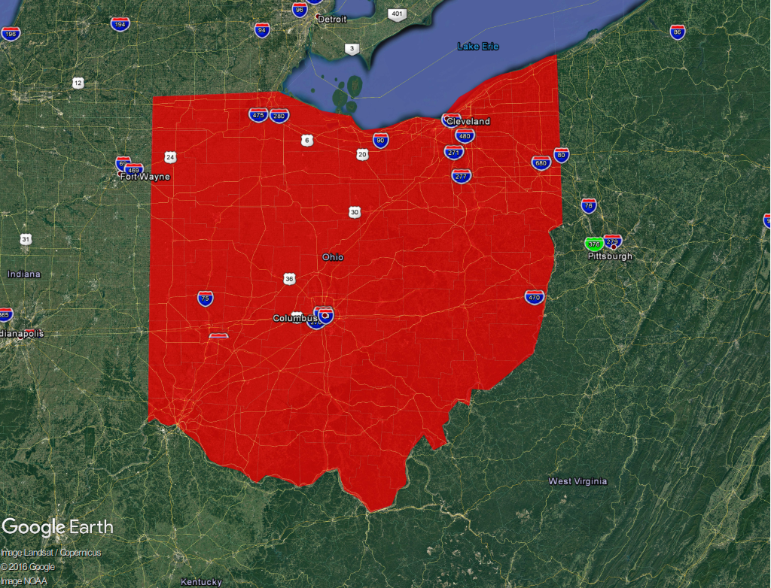
Part 77.17(a)(1)
Part 77.17(a)(1)
44,825 mi²
100% of Ohio
Everything over 499 ft

