Slide 1
OE Blade Inspection Program

Slide 2
Drone Regulations
Two use types: Commercial and Recreational
Commercial: CFR Part 107 (Small Unmanned Aircraft Systems)
Recreation: CFR Part 101 (Special Rule for Model Aircraft)
Simple Interpretation: If its for money or for a business, its commercial
  Selling photos or videos taken from a UAS
  Using UAS to provide contract services, such as industrial equipment or factory inspection
  Using UAS to provide professional services, such as security or telecommunications
  Using UAS to monitor progress of work your company is performing
All drones operating under Part 107 must be registered (.55 – 55 pounds)
Notes:
- Part 107 in effect since August 29, 2016

Slide 3
Part 107
Notable operational limitations applicable when operating under 14 CFR Part 107 include:
  Visual line-of-sight of the remote pilot in command or visual observer
  UAS may not operate over any persons not directly participating in the operation
  Daylight operations only, or civil twilight
  Maximum altitude of 400 ft. AGL, or if higher than 400 ft., remain within 400 ft. of structure
  Maximum ground speed of 100 mph
  Operations in Class B, C, D and E airspace are allowed with the required ATC permission

Slide 4
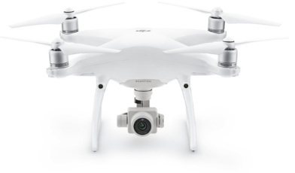
Phantom 4 Pro
Phantom 4 Pro Specs
Price | $1,500
Weight | 1.4 kg
Max Payload | .5 kg
Gimbals | 1 downward
Flight Time | 30 min
Features
Dedicated FPV Camera
Front, back, side, downward sensors
~8”
~11.5”
~11.5”

Slide 5
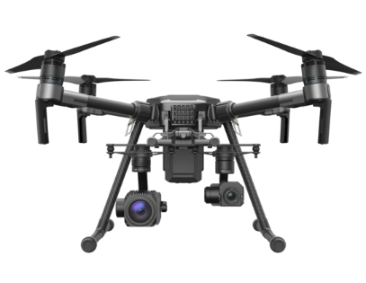
DJI M210/DJI M210-RTK
M210 Specs
Price | $7,999 ($11,299 w/ RTK)
Weight | 3.5-4.5 kg
Max Payload | 2.3 kg
Gimbals | 2 downward/1 upward
Flight Time | 11-38 min
Features
Weather-Proof
2 Controllers
Dedicated FPV Camera
Front/Bottom/Downward Sensors
Real-Time Manned Operations Info
Optional RTK
~15’’ (9”)
~35”
(9”)
~35” (folded: 28”)

Slide 6
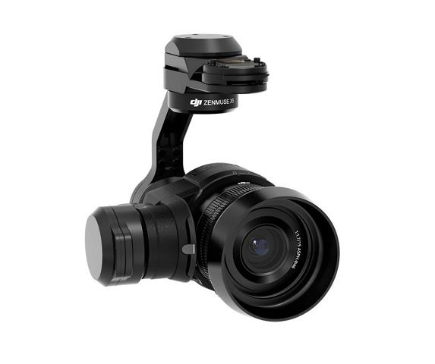
DJI Zenmuse X5S
Inspire 2 Specs
Price | $1800
Weight | .46 kg
Sensor | 4/3”
Resolution | 20.8 MP Effective
Focal Length | 9mm – 45mm
Features
Improved Color Sensitivity
5.2k 30fps Video
For High End Professional Aerial Imaging

Slide 7
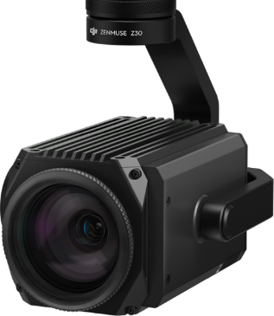
DJI Zenmuse Z30
Inspire 2 Specs
Price | $9000
Weight | .56 kg
Sensor | 1/2.8”
Resolution | 2.13 MP Effective
Focal Length | 9mm – 45mm
Features
30x Optical Zoom
6x Digital Zoom
For Inspection

Slide 8
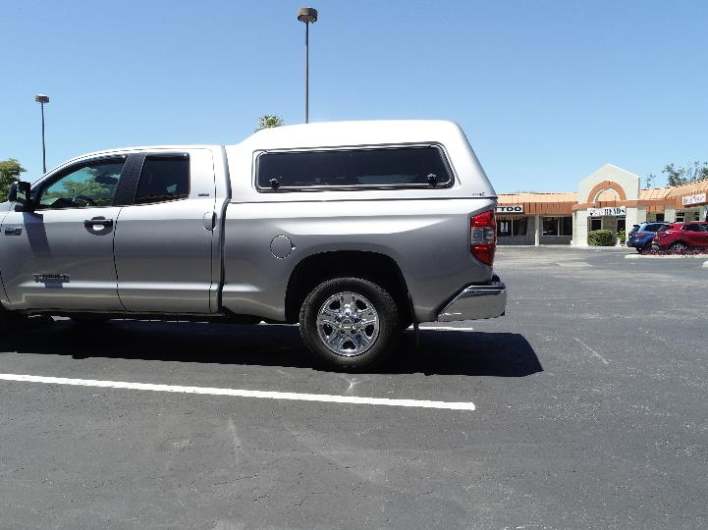
P4Pro
Each photo of this car was taken at the exact same distance and under the same conditions

Slide 9
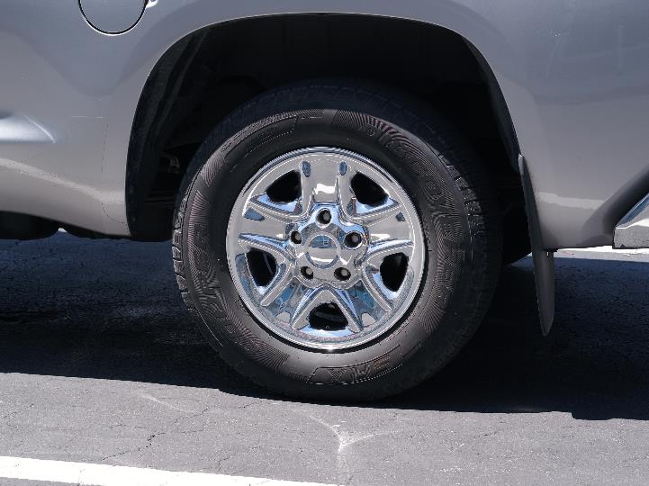
X5S (45mm)

Slide 10
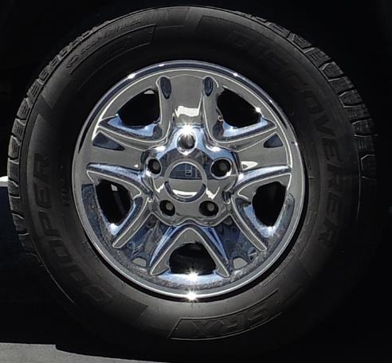
P4Pro

Slide 11
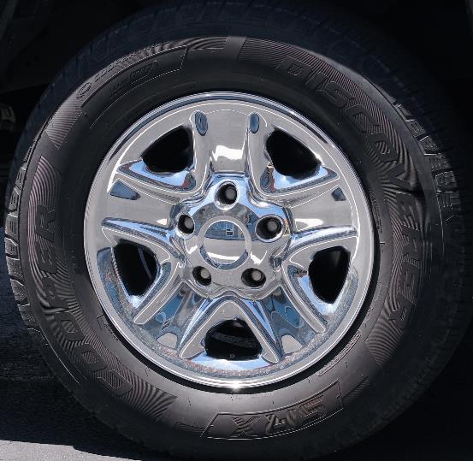
X5S (45mm)

Slide 12
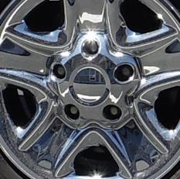
P4Pro

Slide 13
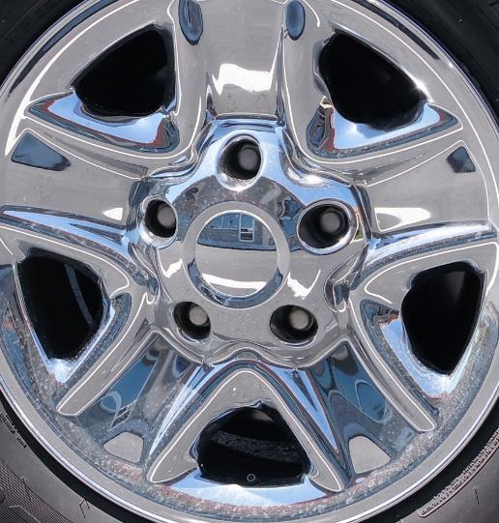
X5S (45mm)

Slide 14

P4Pro

Slide 15
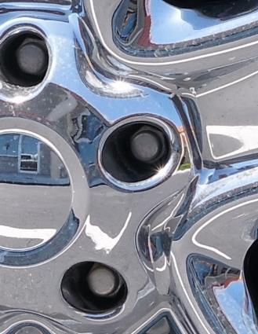
X5S (45mm)

Slide 16
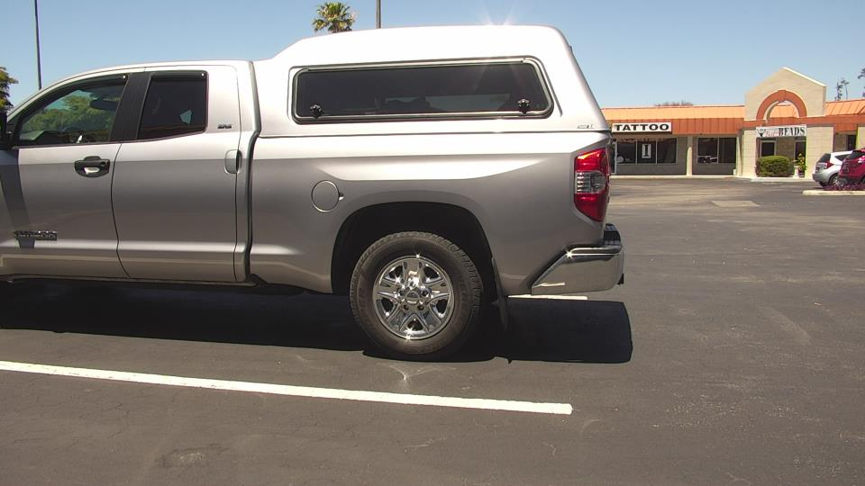
Z30

Slide 17
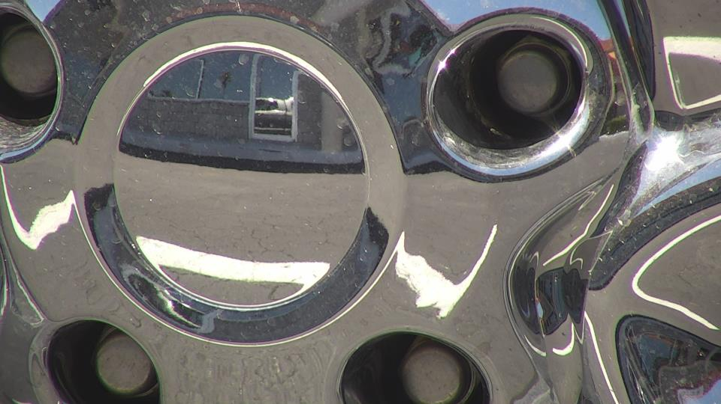
Z30

Slide 18
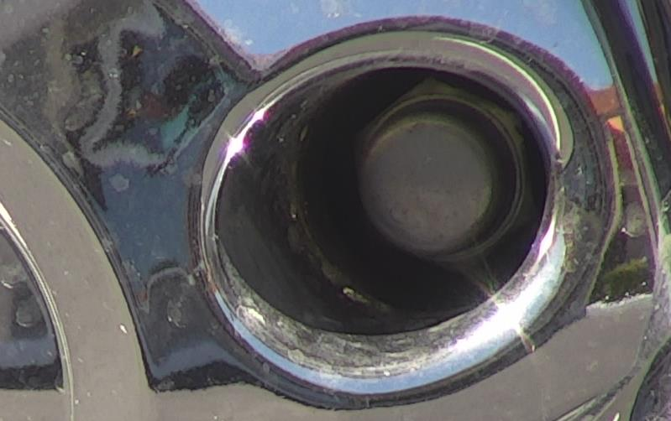

Slide 19
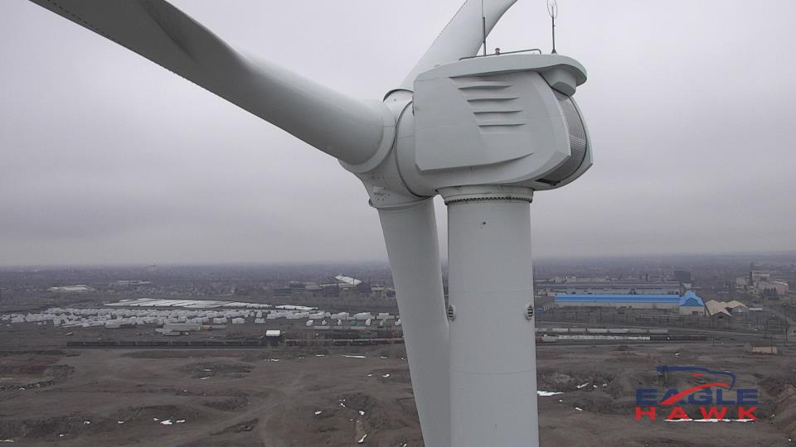
Z30

Slide 20
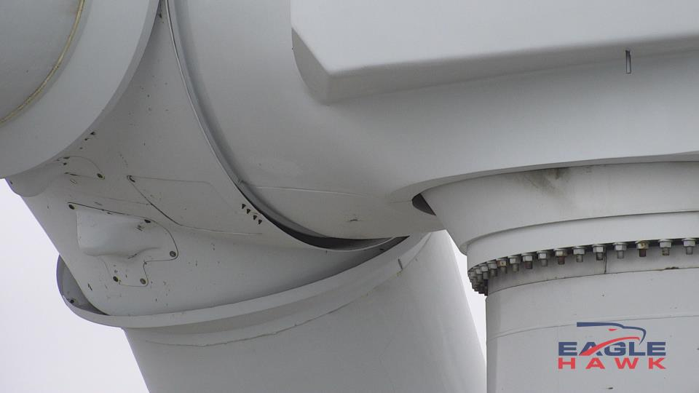
Z30

Slide 21
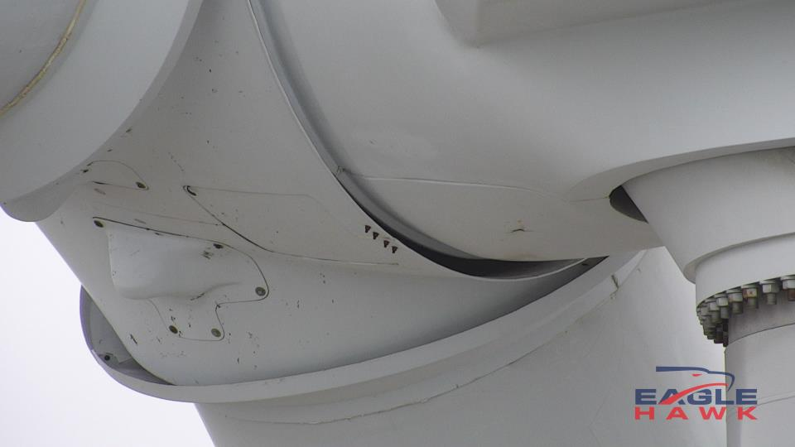
Z30

Slide 22
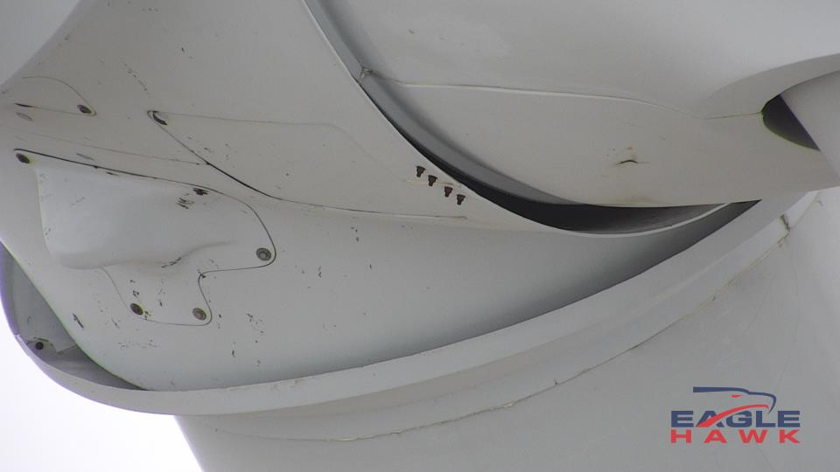
Z30

Slide 23
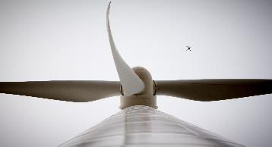
One Energy Blade Inspection Overview
One Energy performs in-house turbine blade inspections using drones equipped with high-resolution cameras
  Allows for consistent blade condition monitoring
  Early-detection of damage
  Allows One Energy to be proactive in responding to observed damage at an early stage
One Energy owns and operates its drones
  Allows inspections to be performed with minimal lead time
A full drone inspection of a turbine takes 45-60 minutes
Not enough of the One Energy team is experienced in safely and efficiently flying drones and performing blade inspections

Slide 24
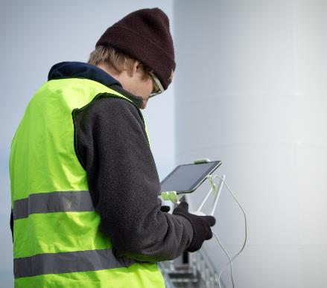
Performing Inspections
Inspections are performed:
  Twice annually, on every blade in the OE operating fleet
    Spring months are preferred; full repairs (if necessary) need warm weather to fully cure
  On recently repaired blades to monitor the progress of the repair
  On blades with suspected damage
Clear days with low wind are preferred for the best possible picture and video quality

Slide 25
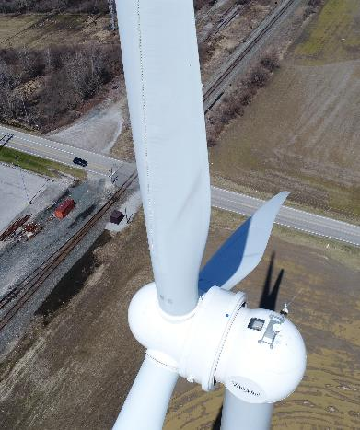
Inspection Procedure
Preparing the Turbine:
  The turbine must be shut down
  The turbine rotor is braked, whenever possible, forcing the blades to be stationary
  Blade of interest stopped in an upwards vertical position
Rotor cannot be braked at high wind speeds

Slide 26
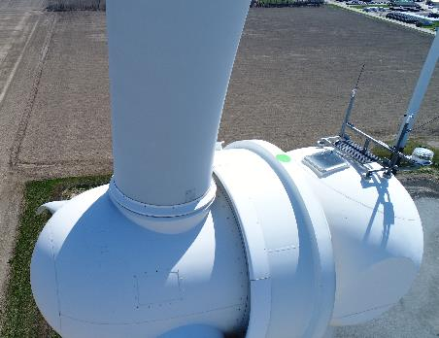
Inspection Procedure
Performing a full inspection:
  Starting from an end of the blade, the drone steadily flies up/down one side of the blade
  Pictures are taken at ~50% overlap, with special focus on areas where damage is seen or suspected
  Video may be taken simultaneously
  This process is performed on the leading edge and both sides of the blade
  Weather conditions dependent
Inspection Path

Slide 27
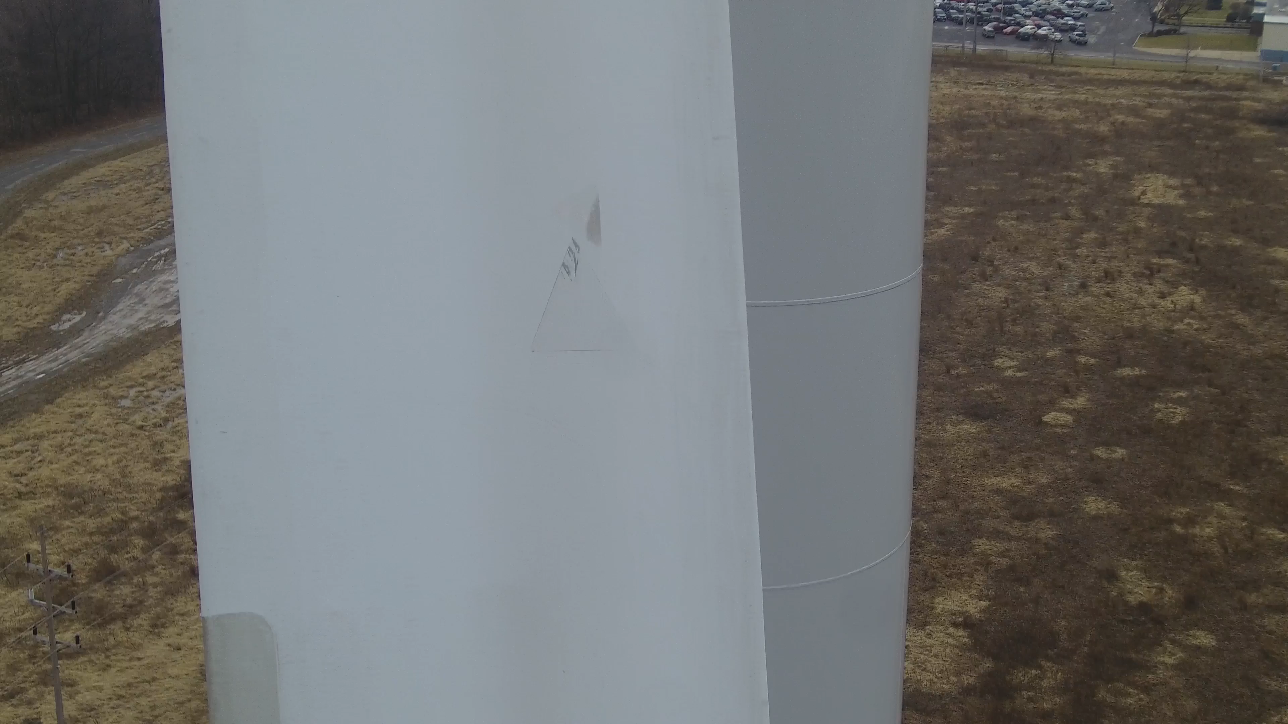
Incidental Inspection video clip
30-second clip from a blade inspection at NFWC turbine Z1.

Slide 28
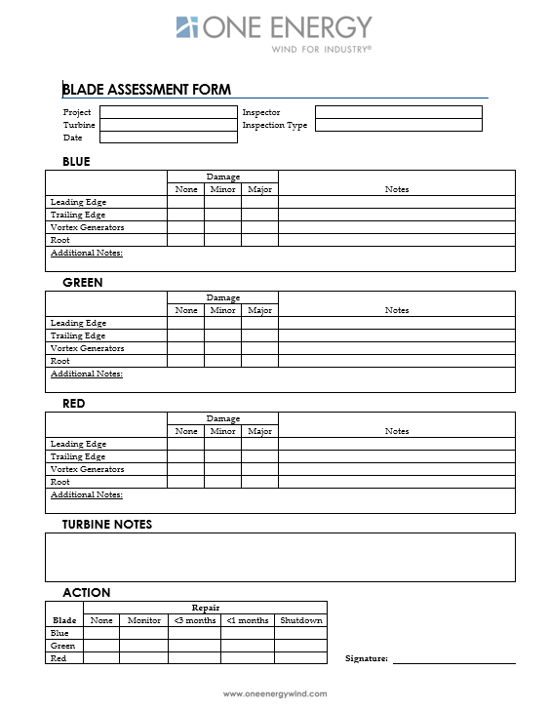
Inspection reporting
Condensed 1-Page Turbine Assessment
  Focus on actionable items
  Can be filled out in field
  1 Assessment/Turbine
  Attach imagery of interest

Slide 29
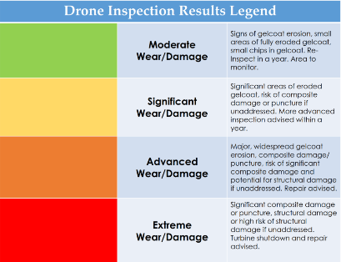
Inspection Reporting
Detailed project assessments can used for record keeping and/or reporting
Historically been created upon request
  This will be done for all inspections in the future
The data following an inspection is reviewed and the blades are graded according to a color scale indicating its level of damage and urgency
If applicable, a report of significant damage is reviewed with Goldwind to determine next steps

Slide 30
Inspection Reporting
The reports following inspections:
  Evaluate the condition of each blade
  Show observed damage
  Assess urgency for further inspection or repair
In some instances a more in-depth inspection is needed. Usually this is a manned inspection of the blade on rope.
  This need should be mitigated when using the M210

Slide 31
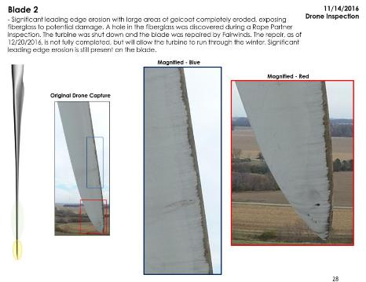
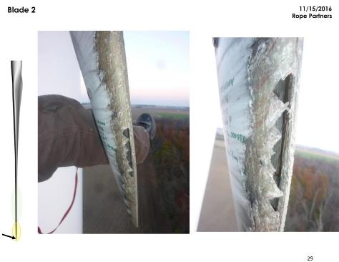
Cooper T3 - Example report
Rope Partners Inspection (on rope)
Initial Inspection

Slide 32
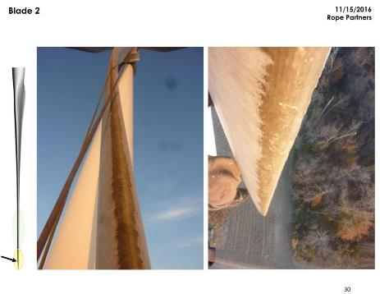
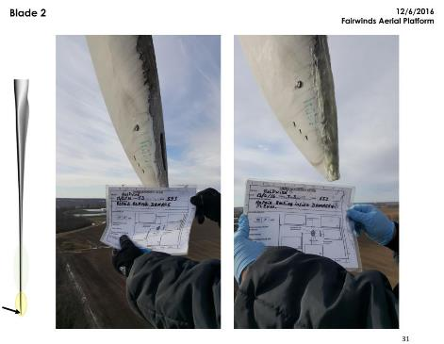
Example report
Turbine was taken out of service following the Rope Partners inspection and placed back into service following the Fairwinds repair.
Fairwinds Aerial Platform Repair
Rope Partners Inspection (on rope)

Slide 33
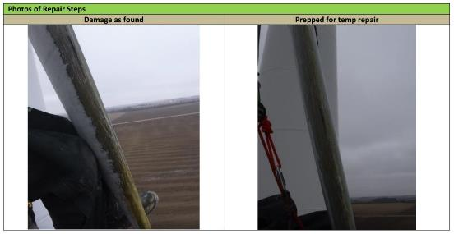
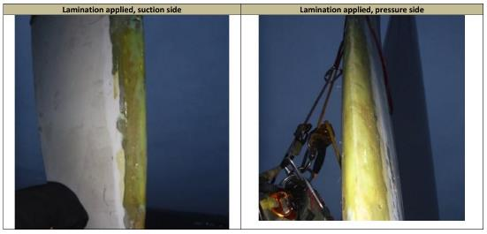
Rope Partners Repair
1/2/2017: One Energy performed an inspection on the Fairwinds Repair
  Suspected damage observed directly above the initial repair
  Goldwind took turbine out of service
1/19/2017: A repair was performed by Rope Partners
  Follow-up for permanent repair needed in warmer weather
  Goldwind put turbine back into service
Pictures from Rope Partners report

Slide 34
Timeline
Cooper T3:
11/14/2016: Initial blade inspection performed
11/15/2016: Rope Partners inspection performed
11/15/2016: T3 taken out of service by Goldwind
12/06/2016: Fairwinds Aerial Platform performs repair
12/06/2016: T3 placed back into service by Goldwind
1/02/2017: Repair inspection performed
1/02/2017: T3 taken out of service by Goldwind
1/19/2017: Rope Partners performs repair
1/19/2017: T3 placed back into service by Goldwind
3/16/2017: Repair inspection performed

Slide 35
surveying
It is possible to perform a site survey with aerial imagery taken from a drone
Have tested using pix4d and dronedeploy
https://www.dronedeploy.com/

