Slide 1
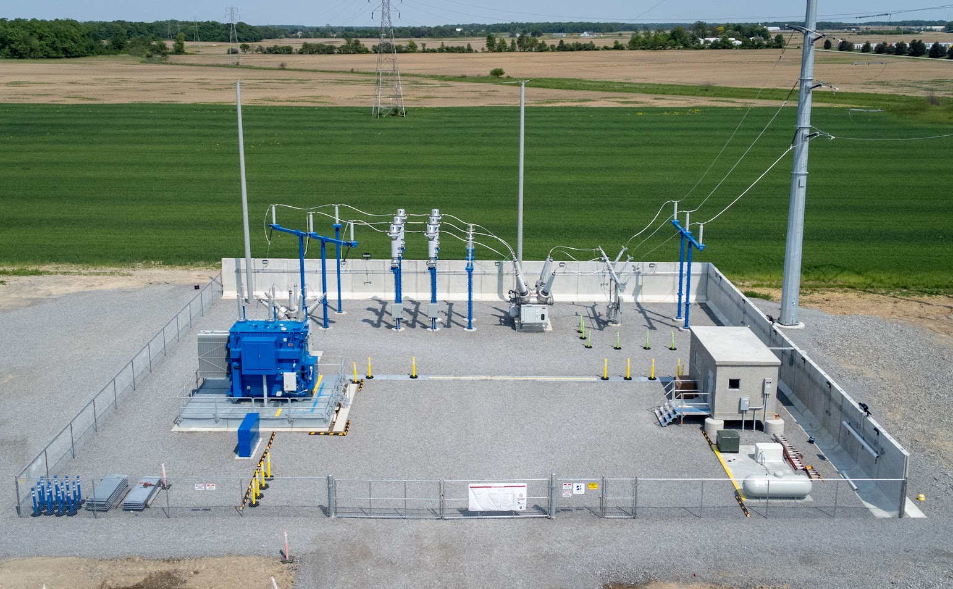
Parts of the Substation
Dead End Pole (Interconnect)
Static
Pole (Shield Mast)
Station Post Insulators
CTPTs
Surge Arresters
89L
Disconnect Switch
52T
Breaker
(Transformer protection)
Over Head Structures
Main Power Transformer
Oil Containment
52L
Breaker
(Line/Bus Protection)
Control
House
Junction
Box
Ballistic Wall

Slide 2
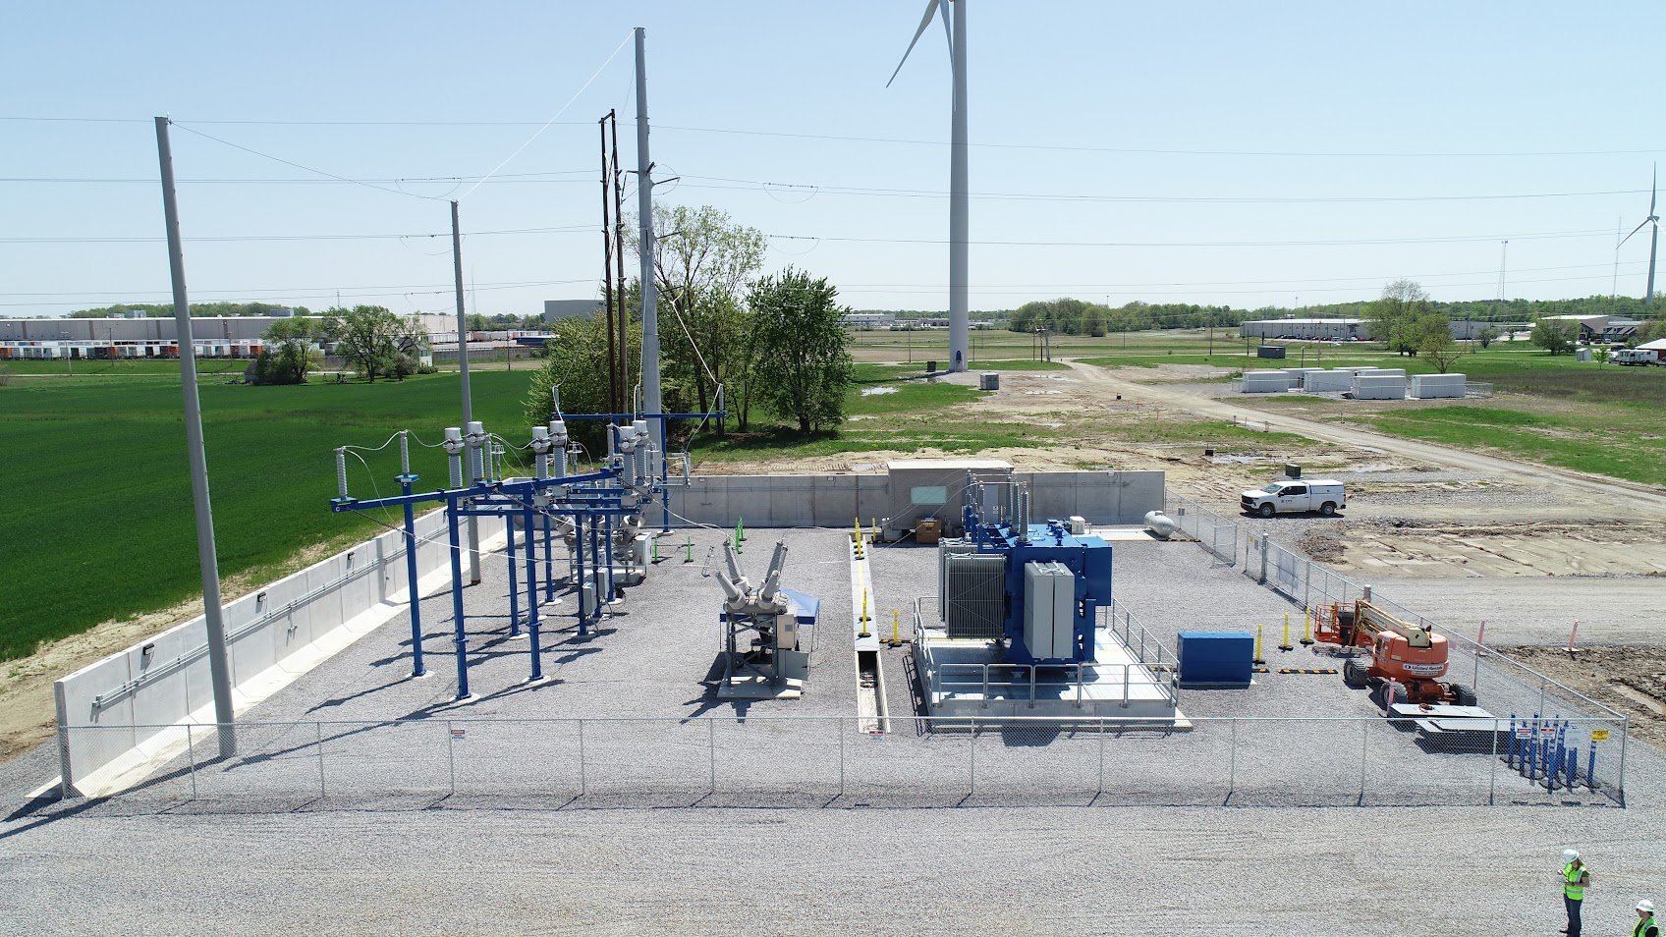
North View

Slide 3
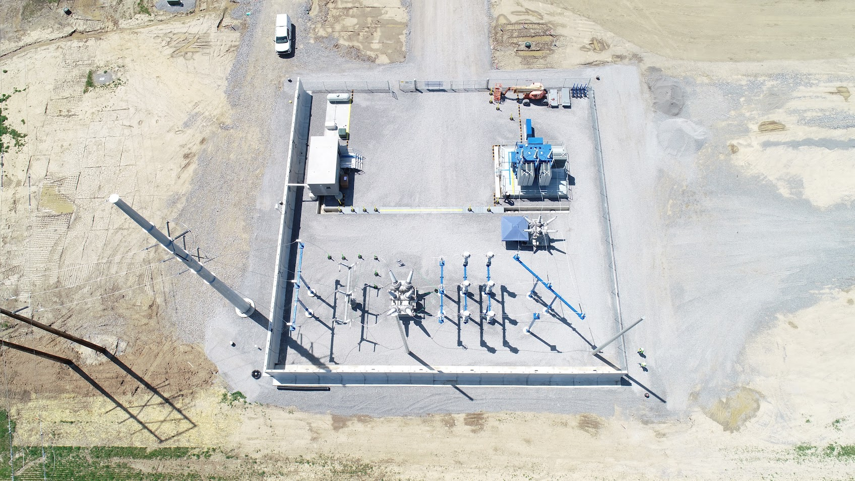
Bird’s eye View

Slide 4
Zones
KNOX LOCK
SAFETY ZONE
HAZARD ZONE

Slide 5
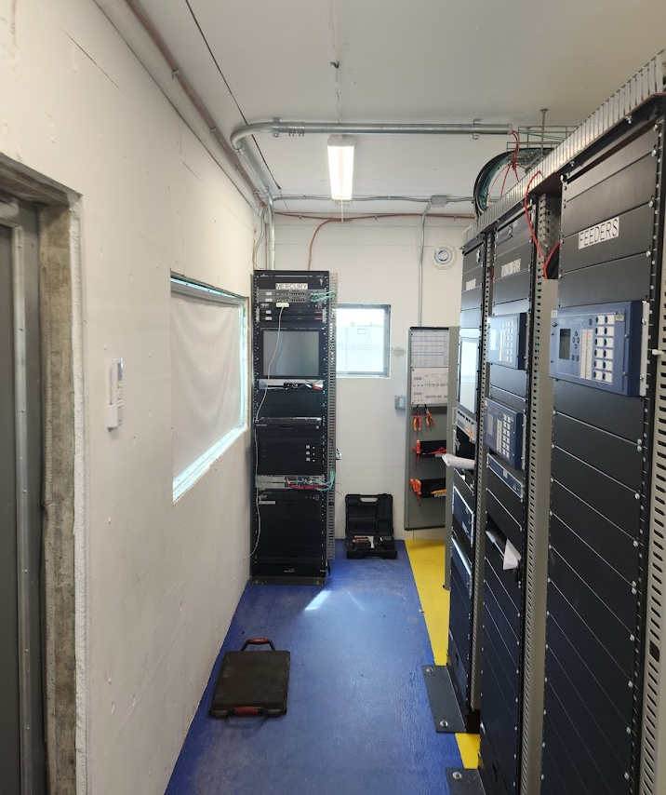
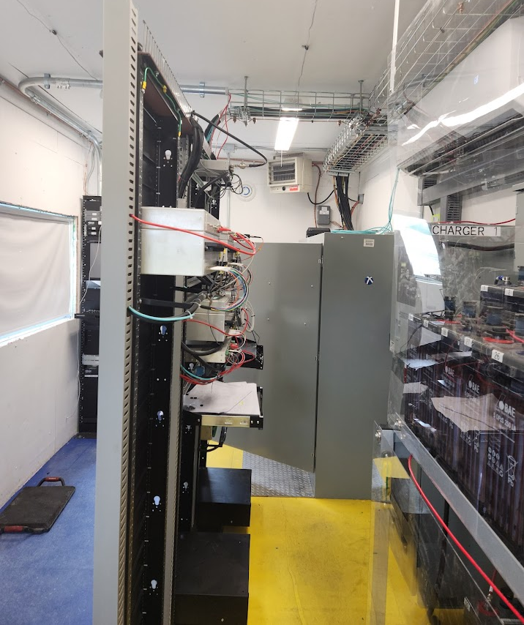
Zones
SAFETY ZONE
HAZARD ZONE

Slide 6
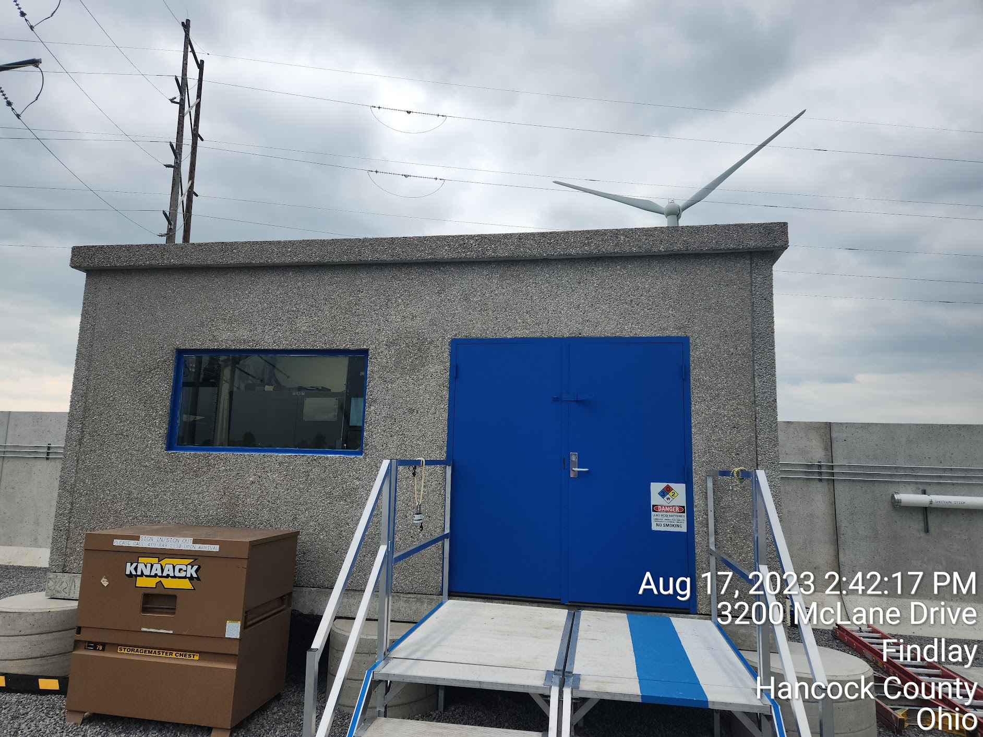
The control house

Slide 7
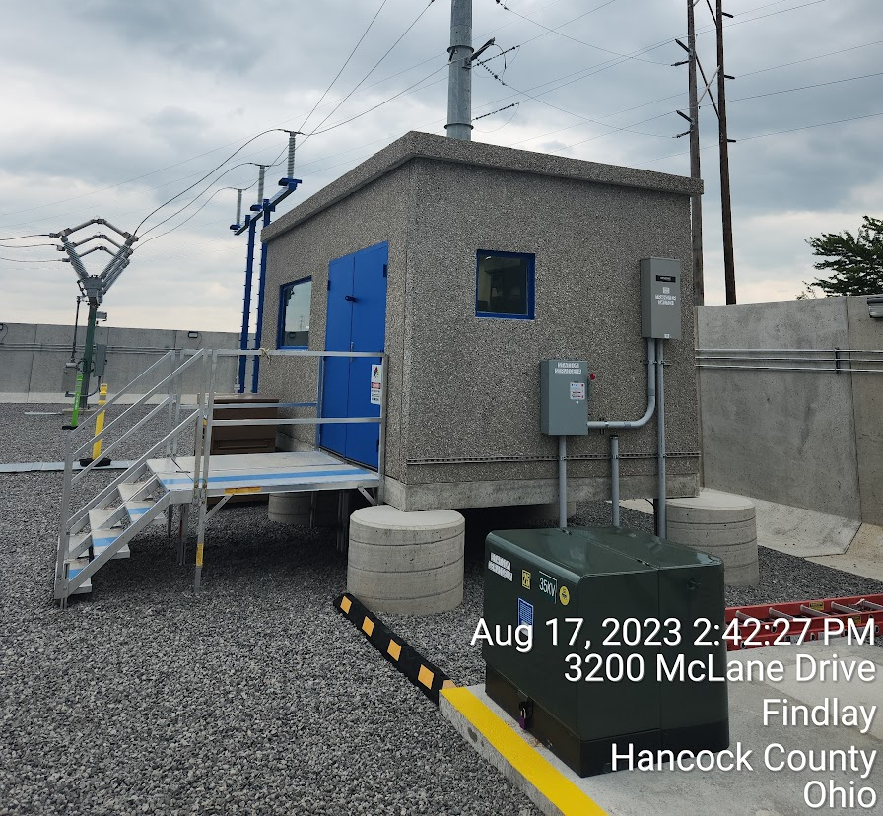
Control Enclosure
Bullet Proof Glass
  Windows aren’t typical for substations
High Strength Precast Concrete Structure
Contains Electrical systems
  Breaker and Fiber Enclosure “Big Ass Box”
  Relay Racks
  Battery Backup and Chargers
Controls all 240/120 VAC and 125VDC systems
  Lights
  Future Cameras
  Equipment Control Power
  Internal Accessories

Slide 8
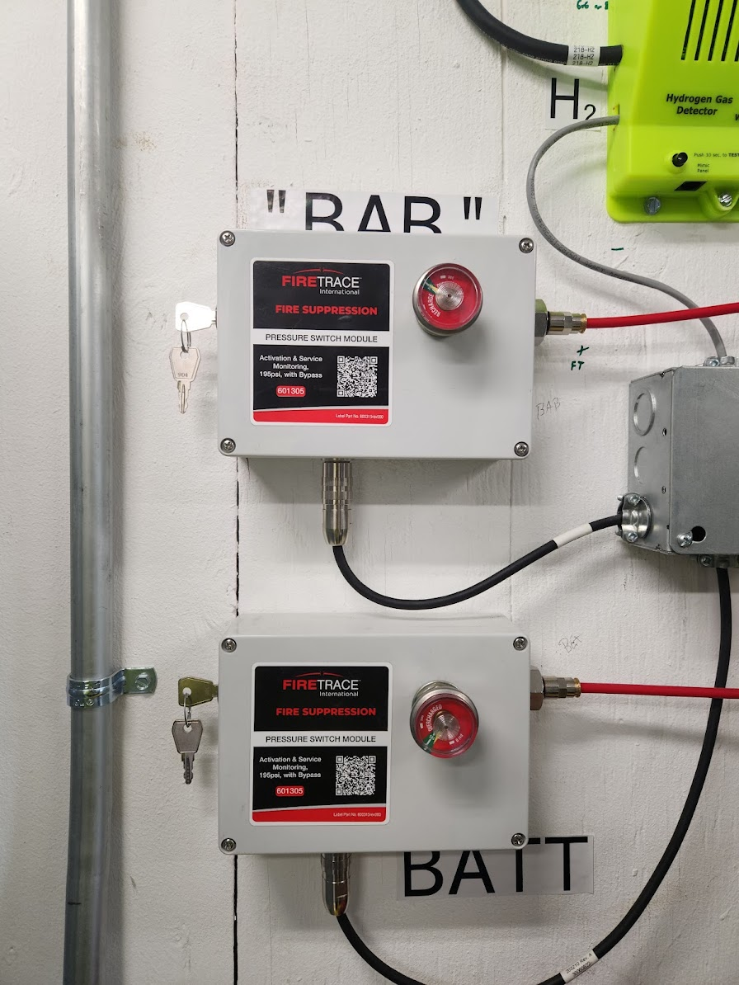
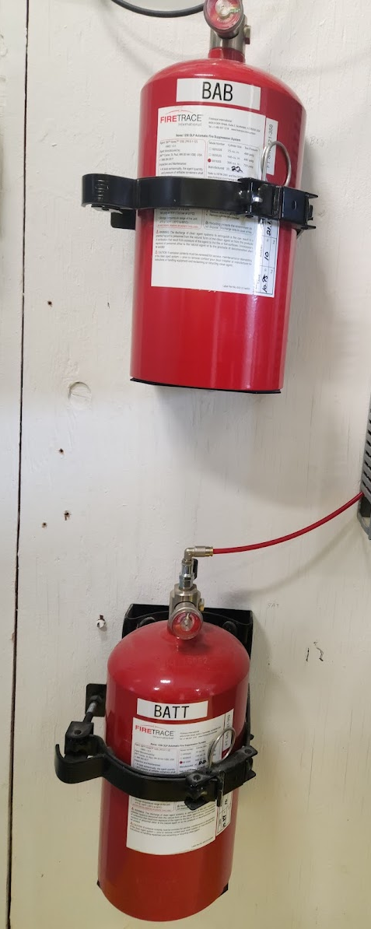
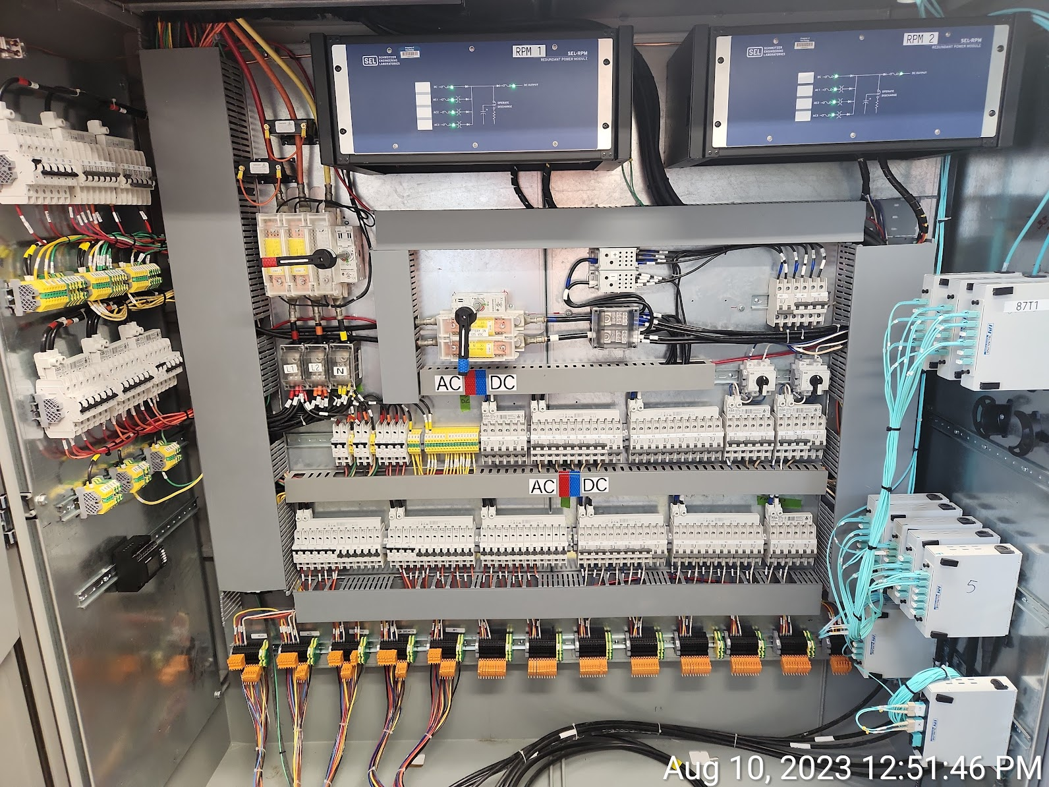

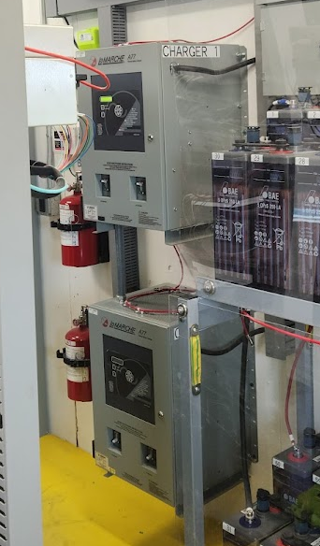
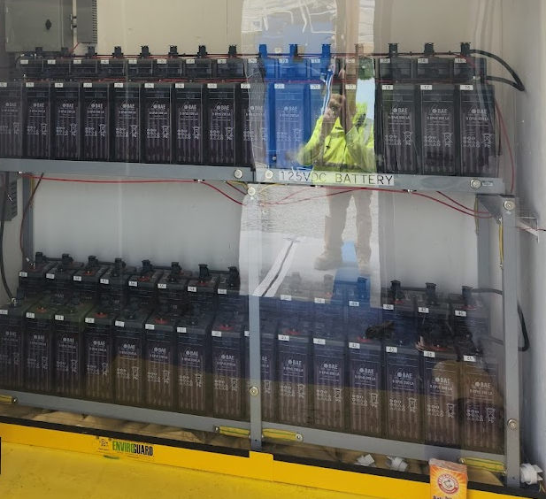
Control House interior

Slide 9
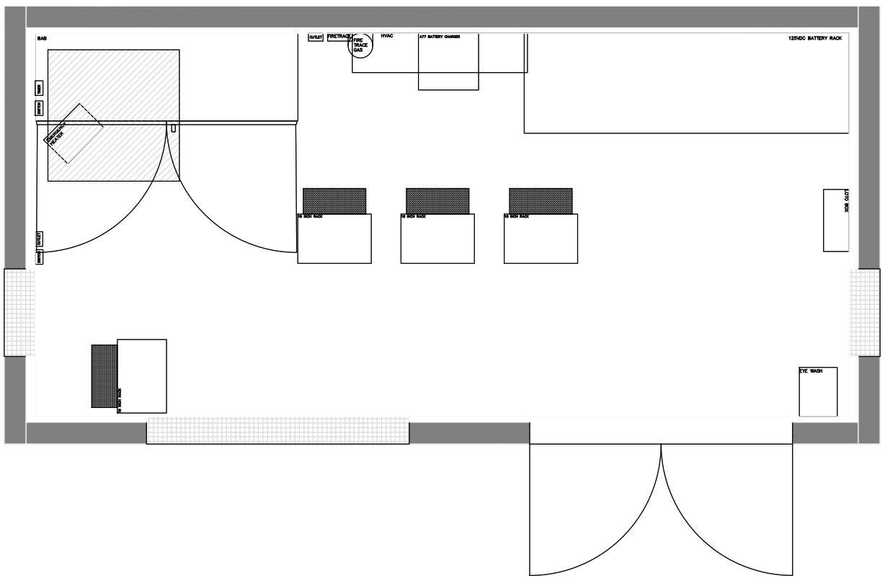
The Control House

Slide 10
‘Big Ass Box’
Controls house and yard’s ancillary equipment
Connection point for equipment low voltage supply
Fiber Junction connecting Equipment to Relays

Slide 11
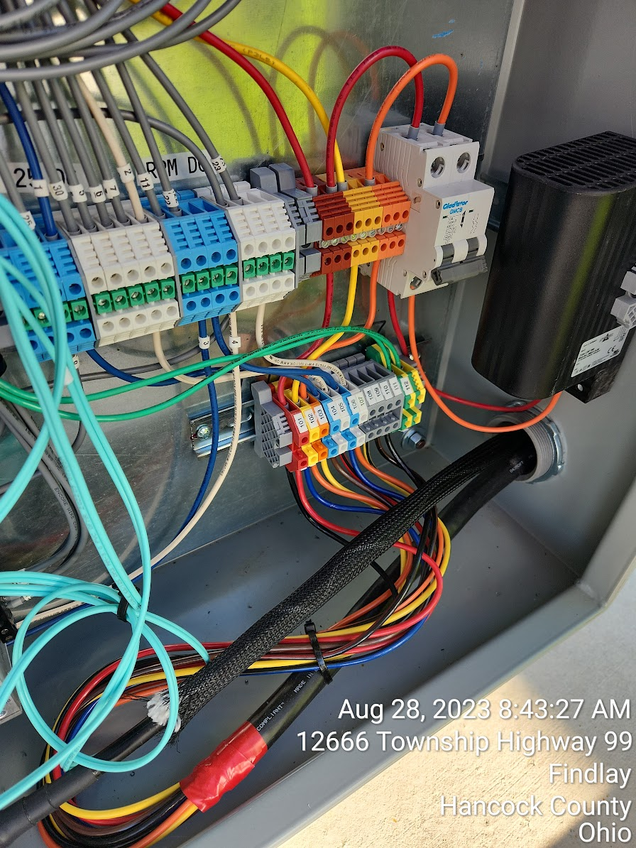
Equipment Feed Lines
2 Cables brought into each piece of equipment
Industry practice involves many more cables and prevents quick swapping/wiring of equipment.
OE practice allows quicker installs, easier wiring
Plug n’ Play

Slide 12
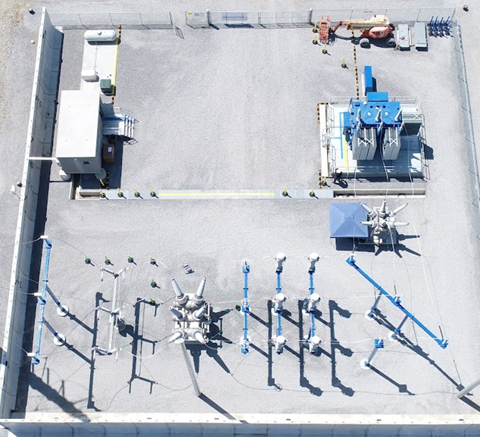
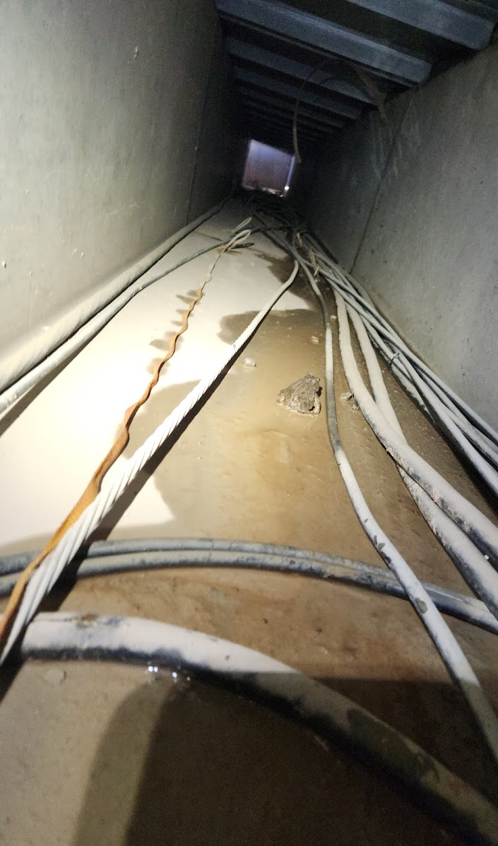




How our cables travel
Control
138kV
34.5kV
19.9kV

Slide 13
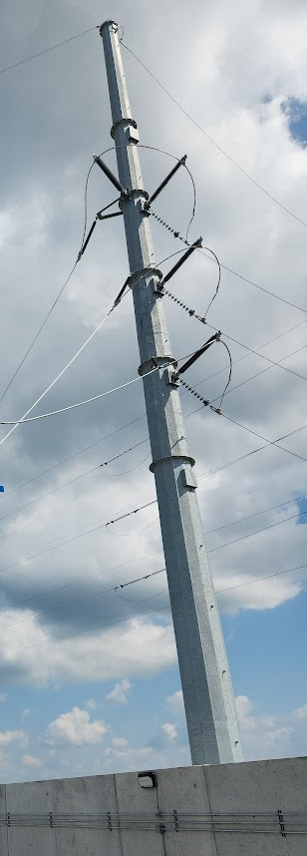
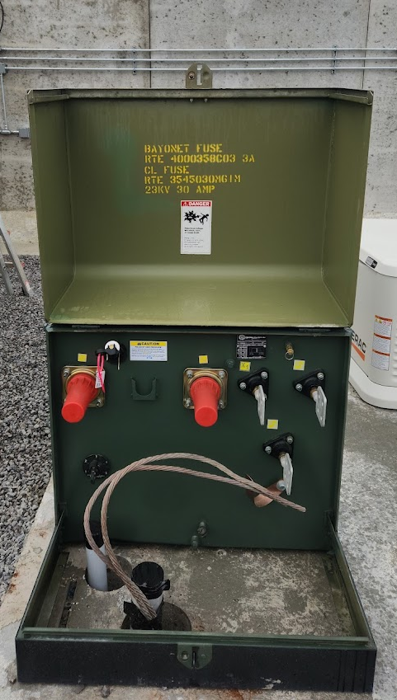
Redundancy of CONTROL power 1
138kV enters Hub
Converted to 34.5kV at Main Power Transformer
Converted to 120/240V at pad mount.

Slide 14
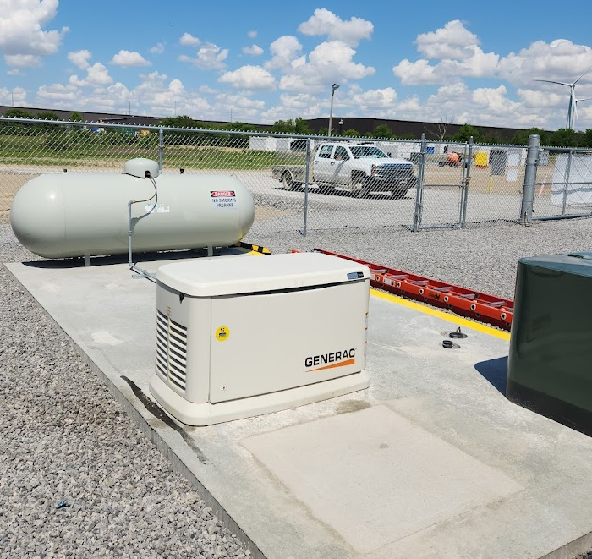
Redundancy of CONTROL power 2
Following Loss of Sub Main Power (grid)
Propane Generator automatically kicks on.
Feeds 120/240V to power Control Enclosure

Slide 15

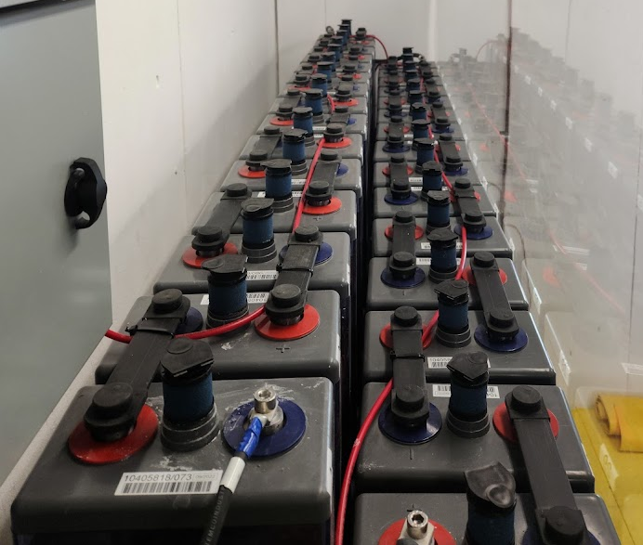
Redundancy of CONTROL power 3
Following Loss of Sub Main Power (grid) and Propane Generator
Also, holdover power between transitions
125VDC (60 Cells) Lead Acid Battery

Slide 16
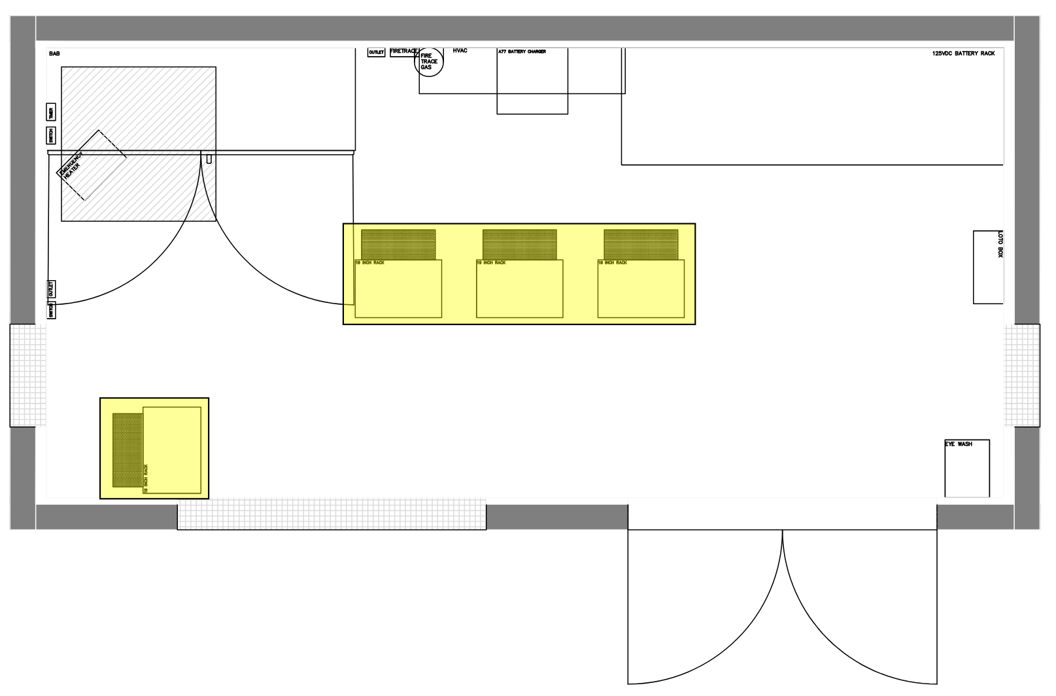
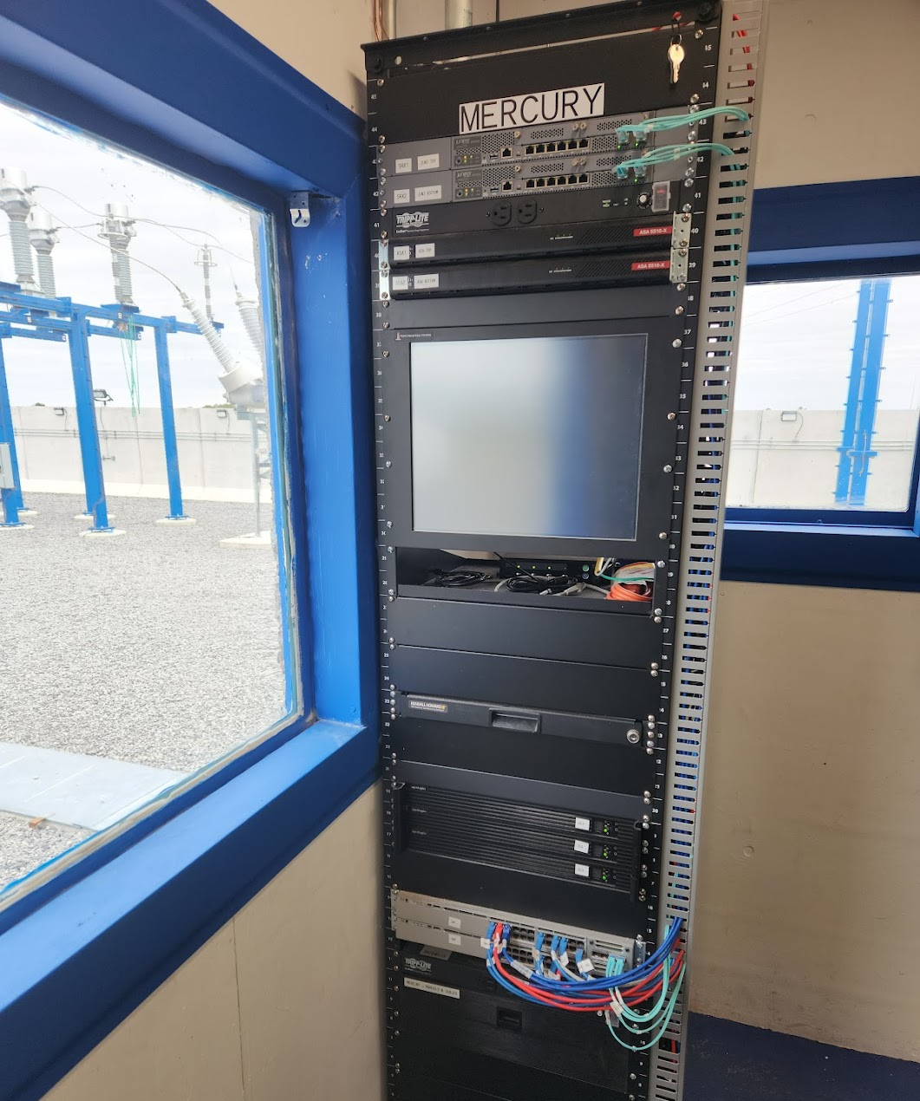
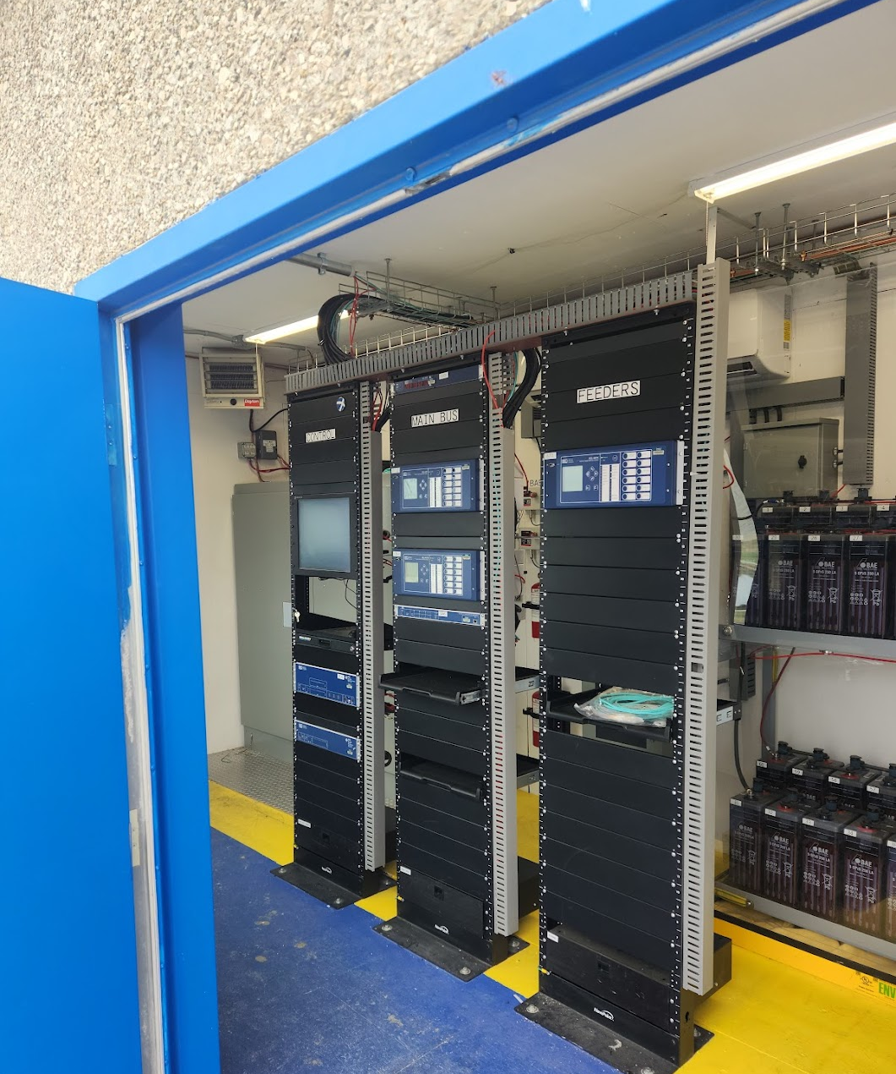
The Relay racks
MERCURY
FEEDERS
MAIN BUS
CONTROL

Slide 17
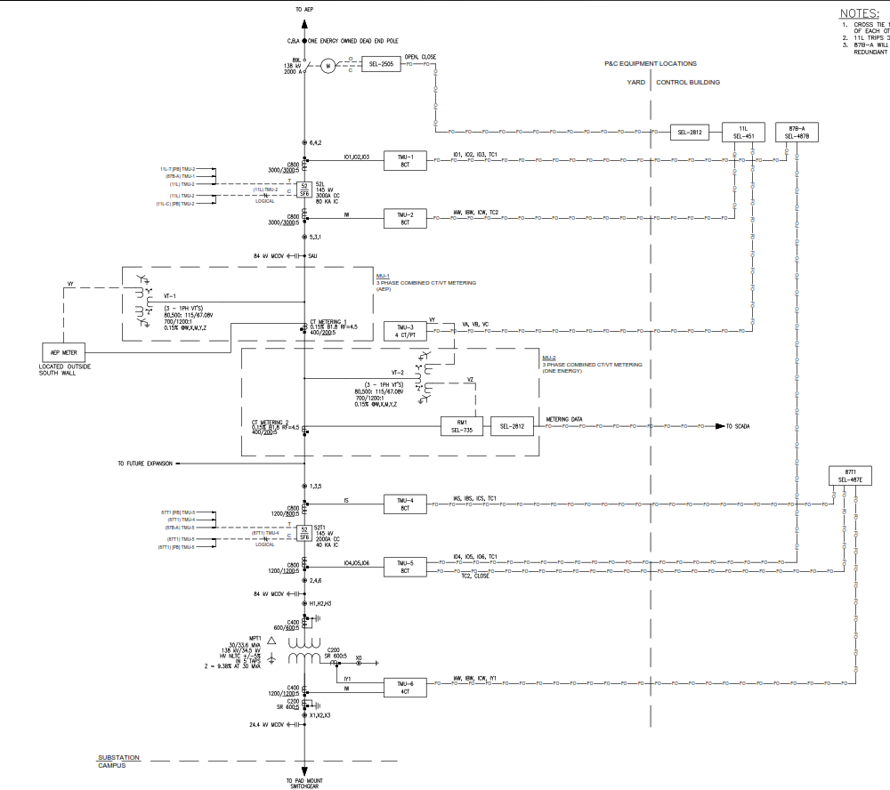
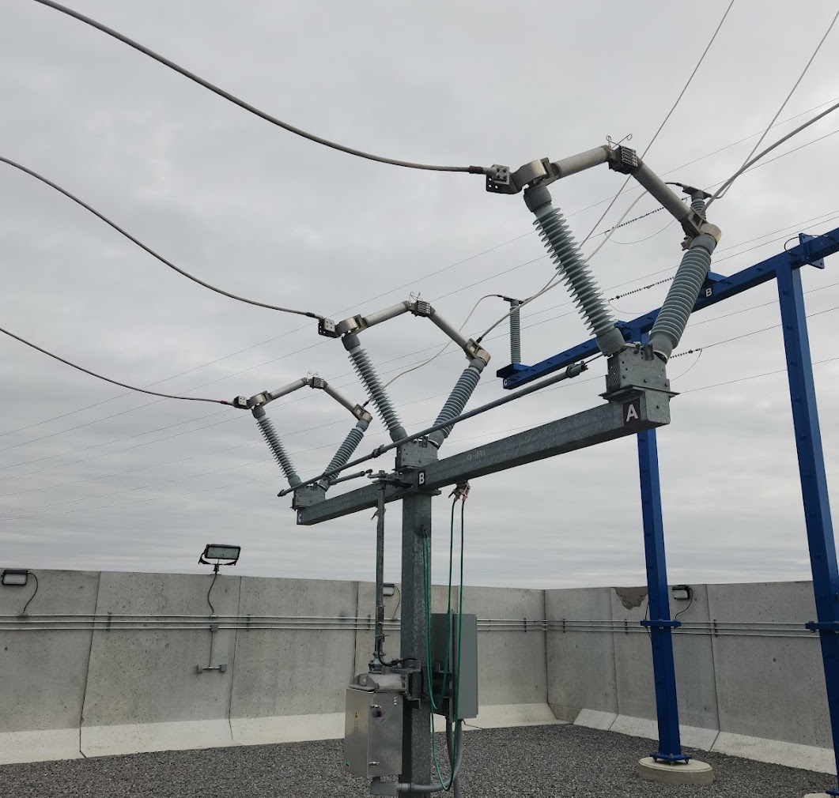
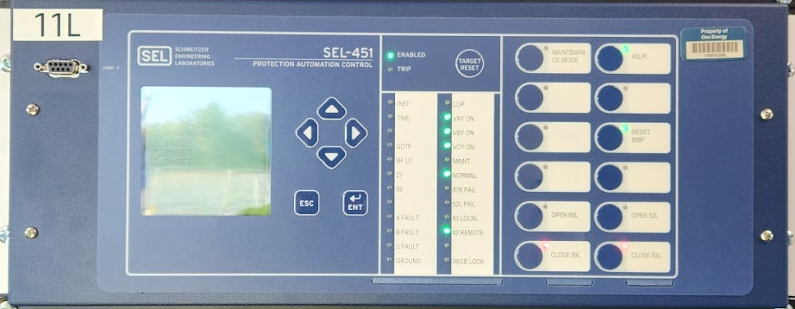
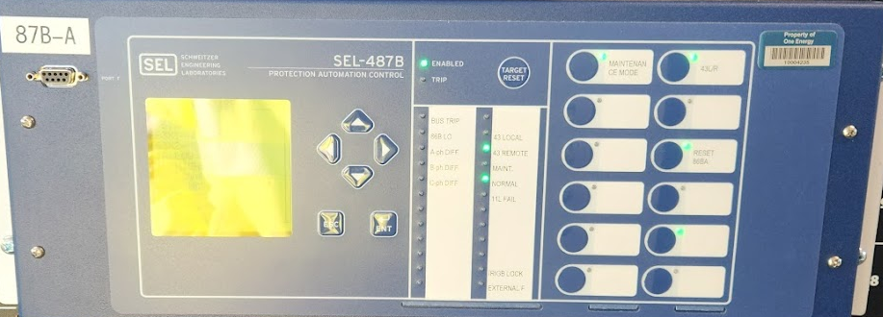
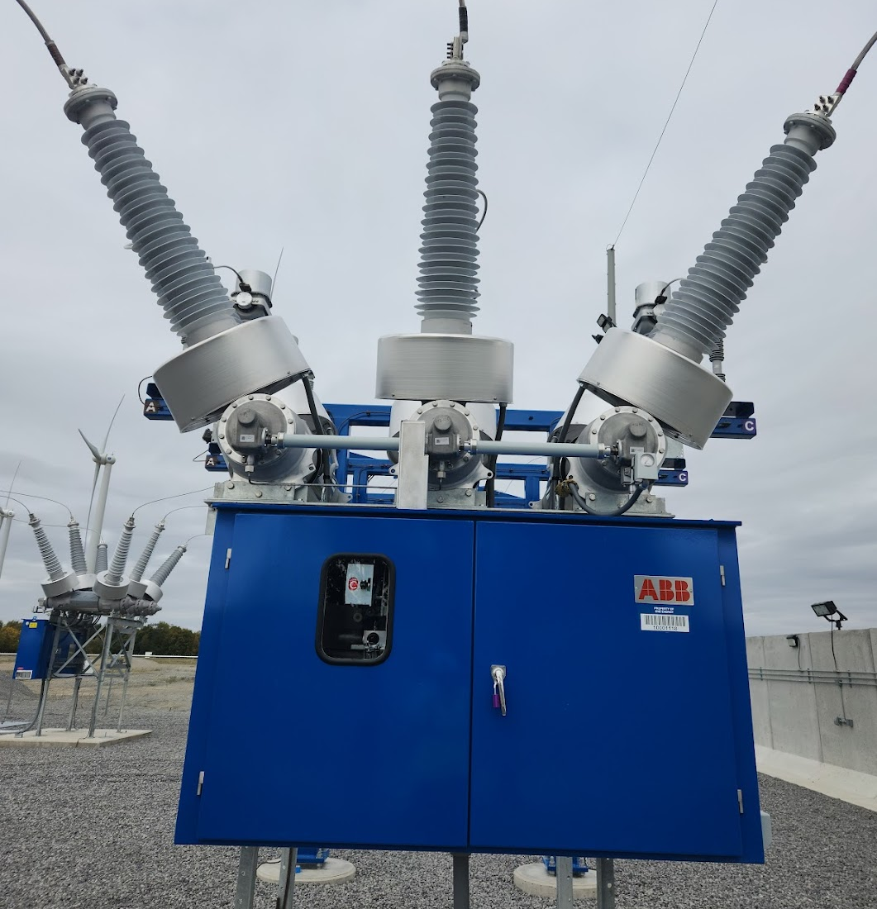
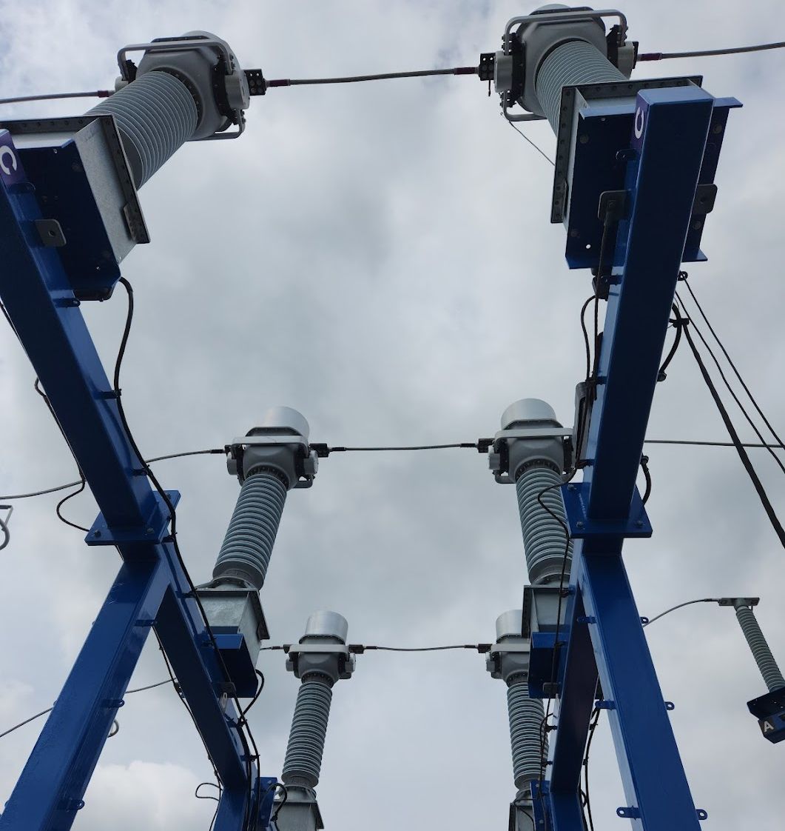
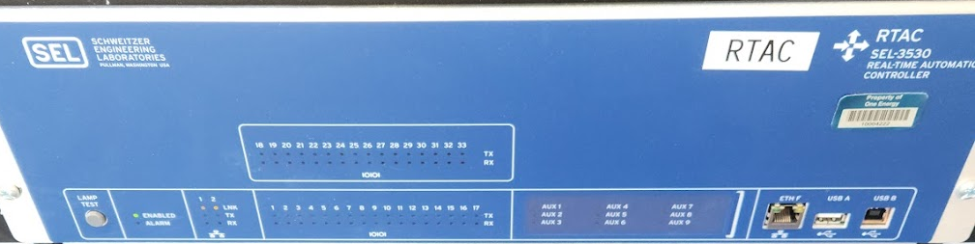
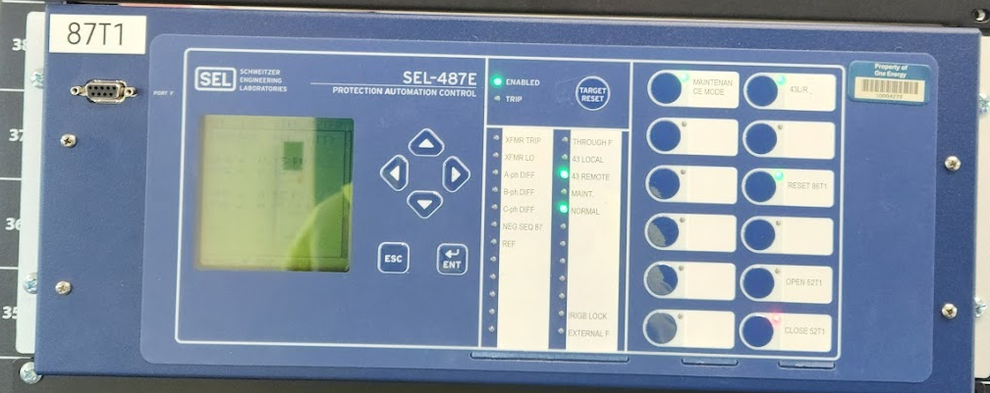
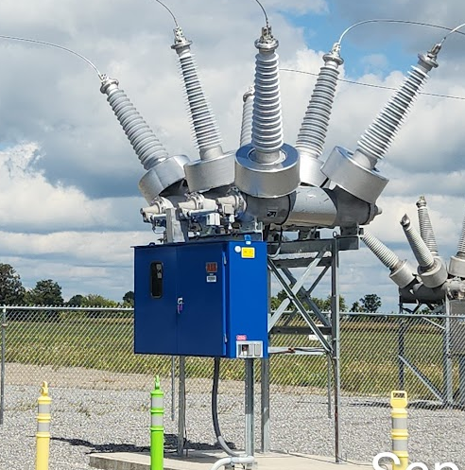
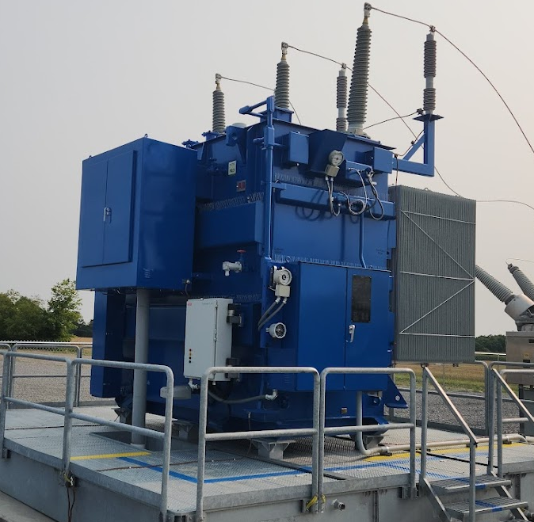
Relays overview
11L
SEL 451
87B-A
SEL 487B
89L
52L
RTAC
SEL 3530
CTVT
87T1
SEL 487E
52T1
MPT1

Slide 18
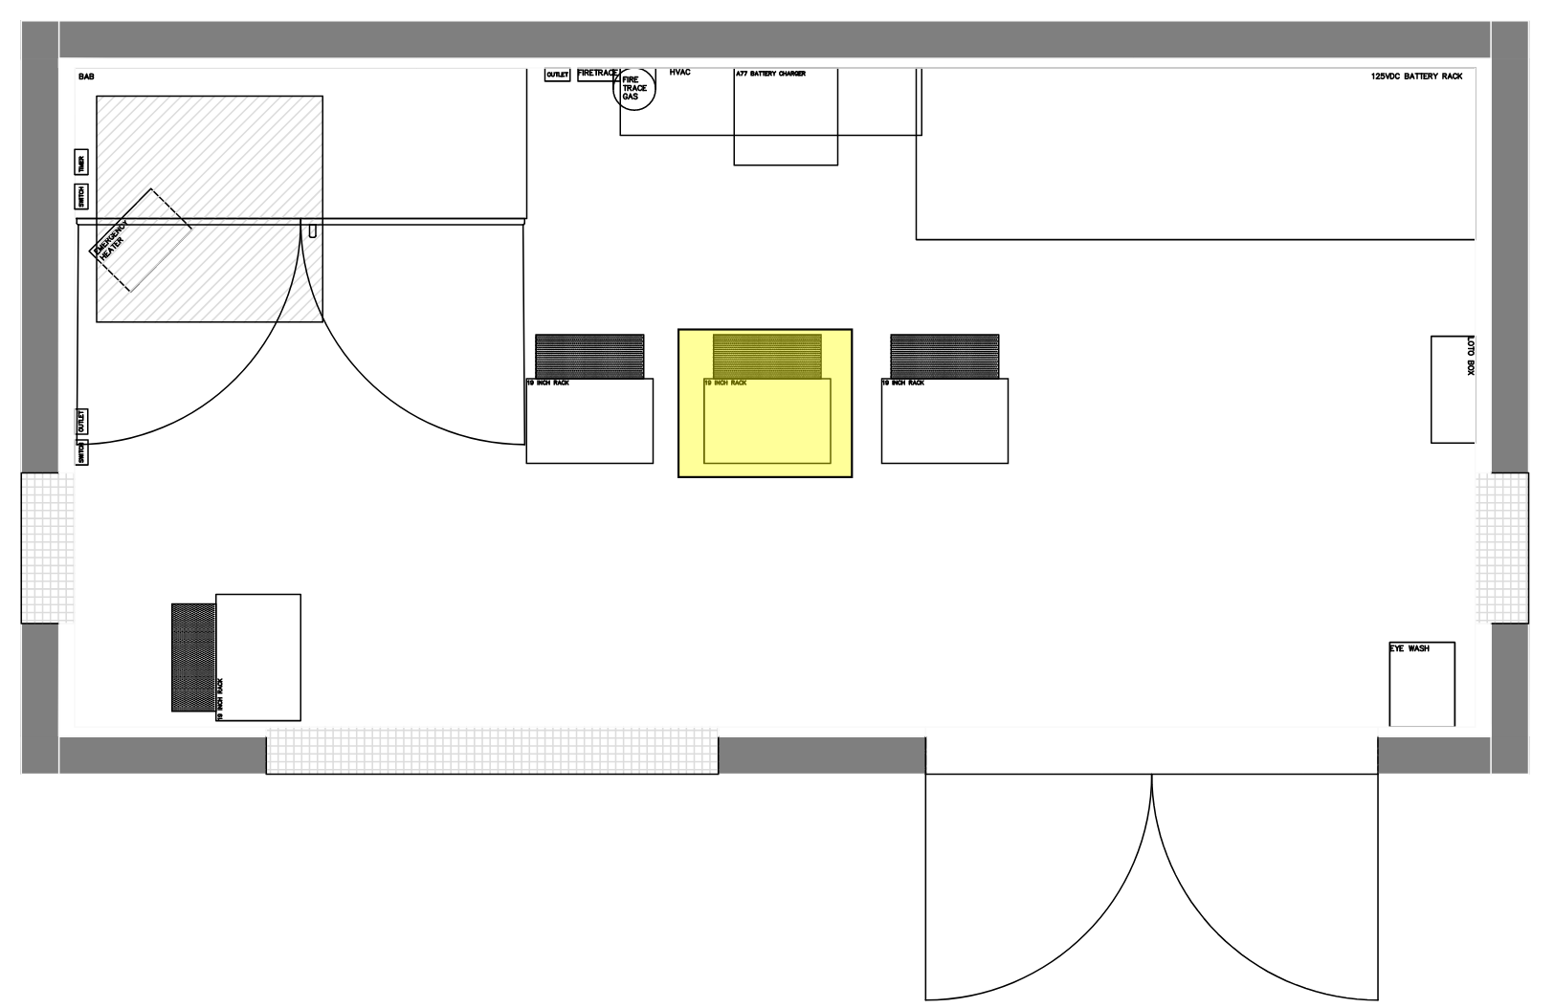
11L
SEL 451
11L
SEL 451
89L
52L
CTVT
OPEN CLOSE
CURRENT
VOLTAGE
METERING DATA
TRIP COIL

Slide 19
87B-A
SEL-487B
87B-A
SEL 487B
52L
CTVT
52T1
OPEN CLOSE
CURRENT
VOLTAGE
METERING DATA
TRIP COIL

Slide 20
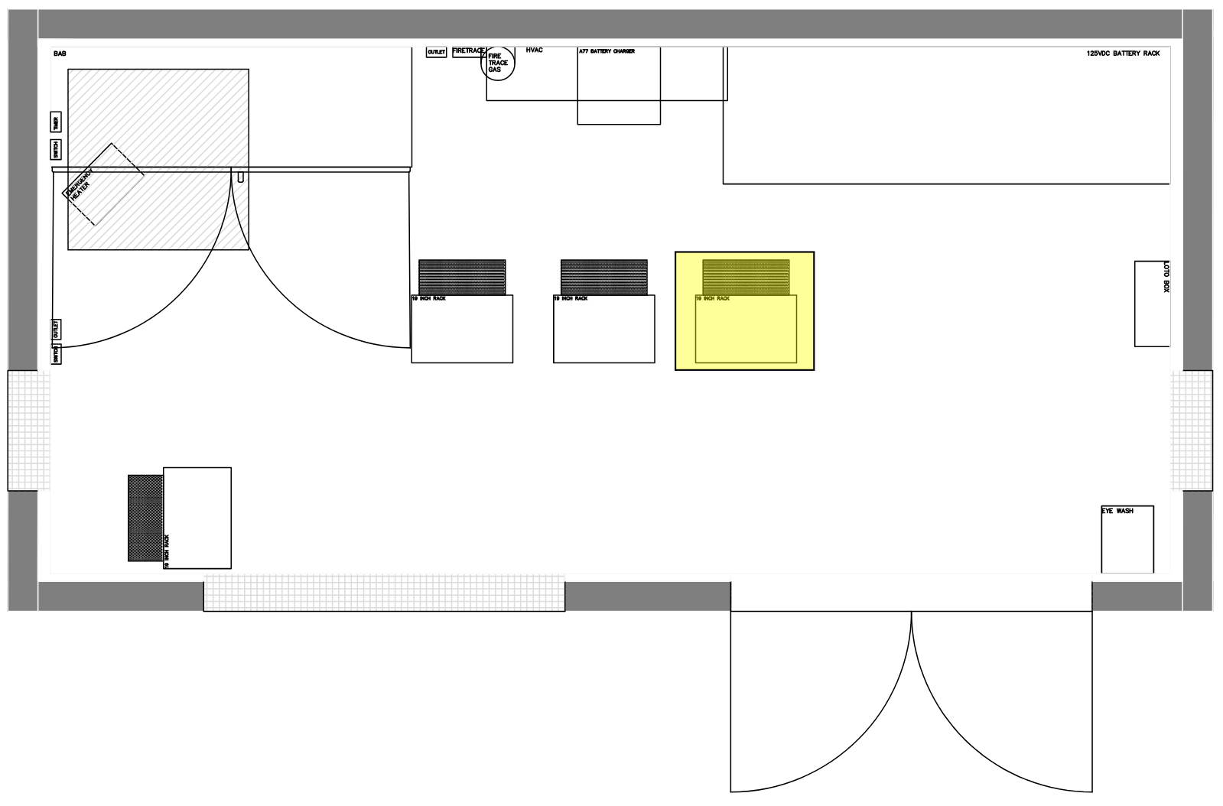
87T1
SEL 487E
87T1
SEL 487E
52T1
OPEN CLOSE
CURRENT
VOLTAGE
MPT1
METERING DATA
TRIP COIL

Slide 21
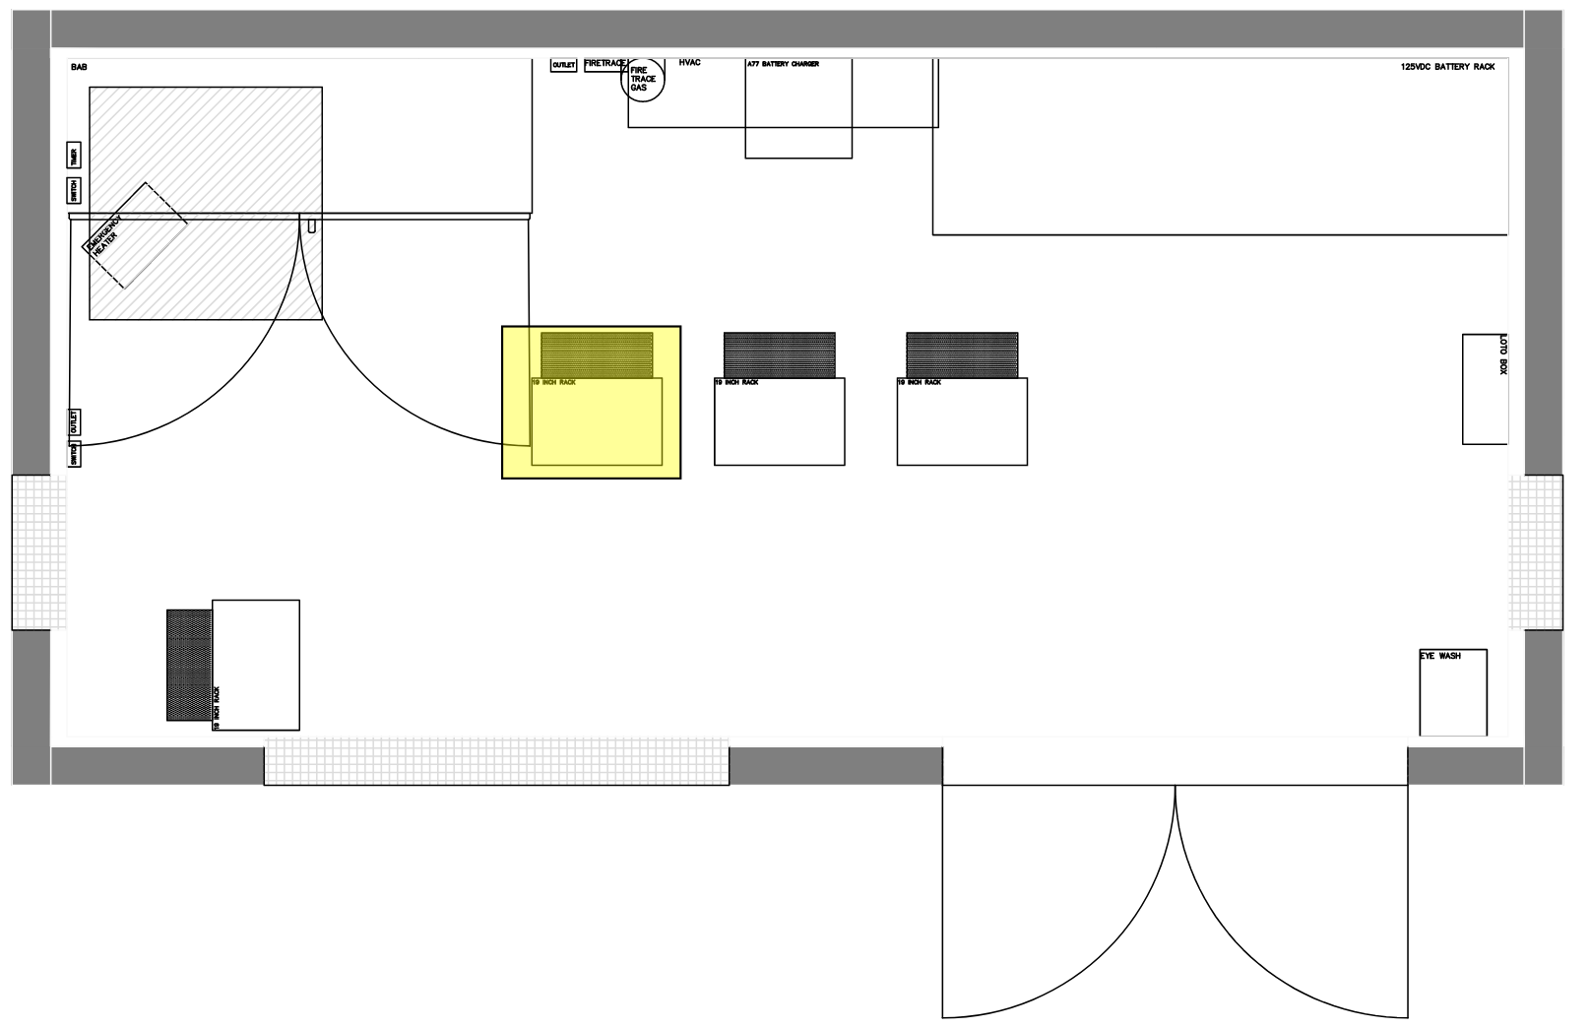
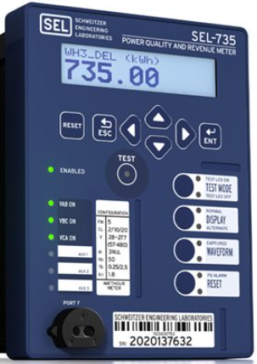
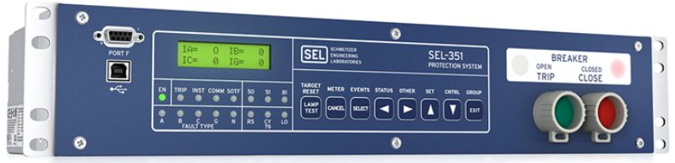
RTAC
SEL 3530
RTAC
SEL 3530
CTVT
OPEN CLOSE
SWITCHGEAR:
SEL735
SEL351
CURRENT
VOLTAGE
METERING DATA
TRIP COIL

Slide 22
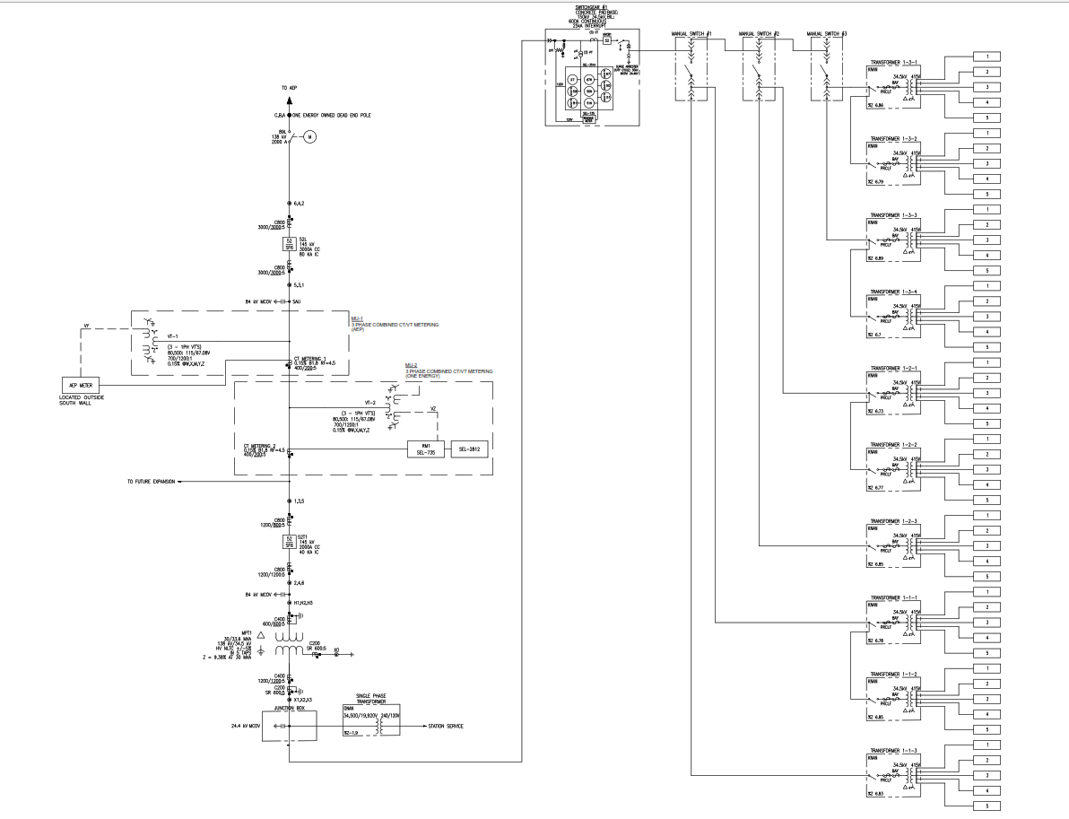

Slide 23
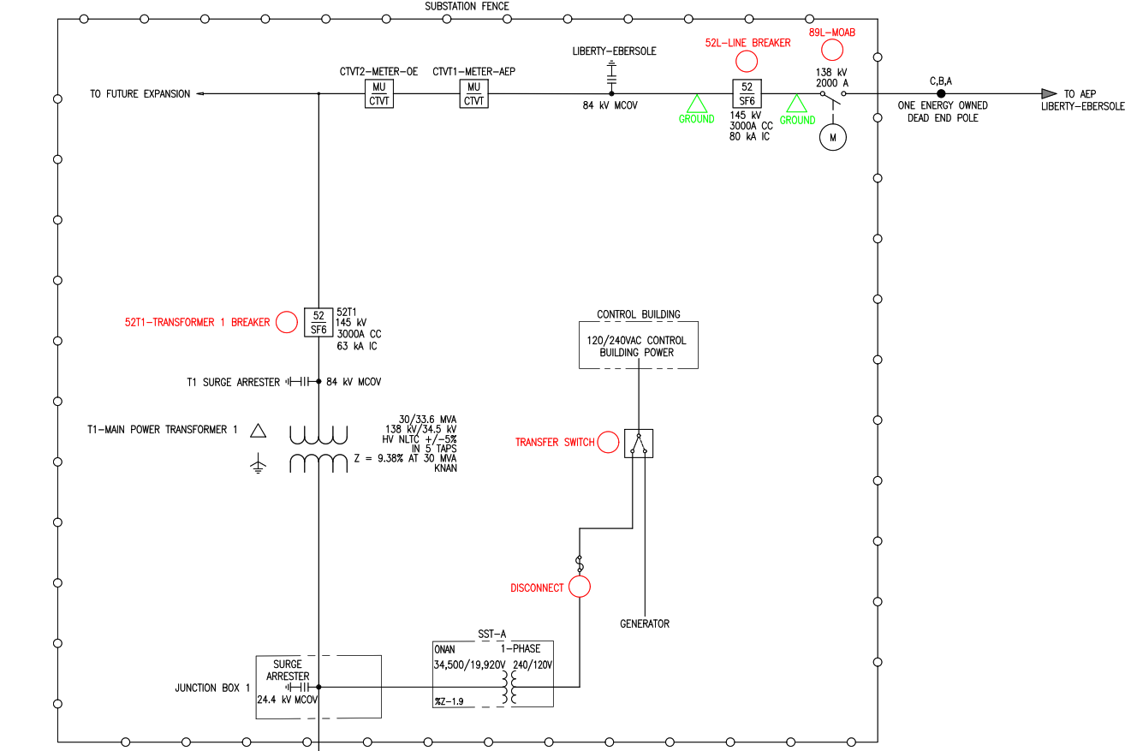

Slide 24
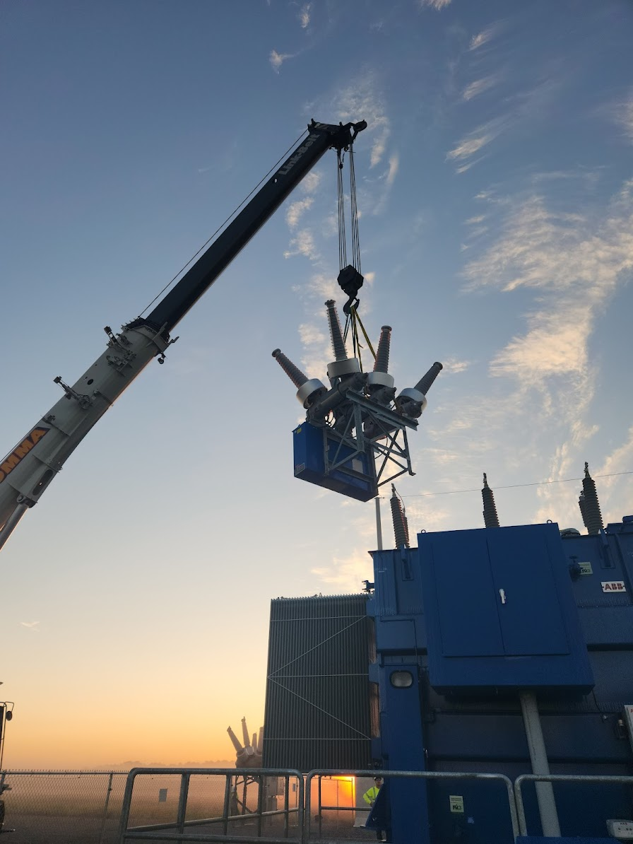
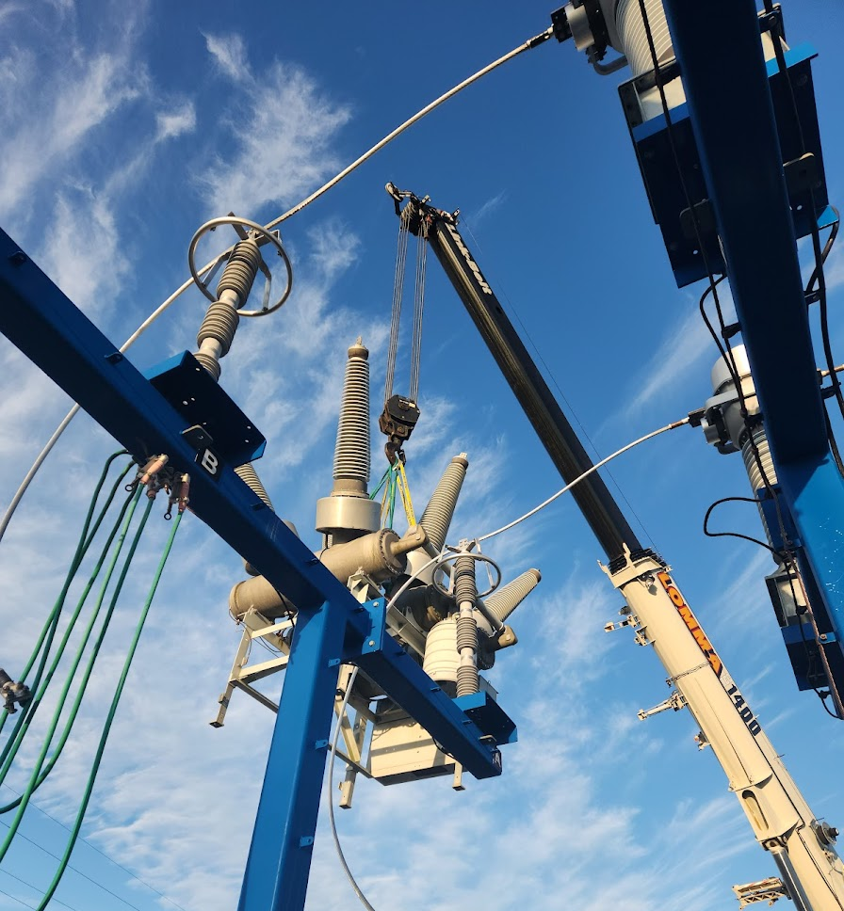
Questions so far?

Slide 25
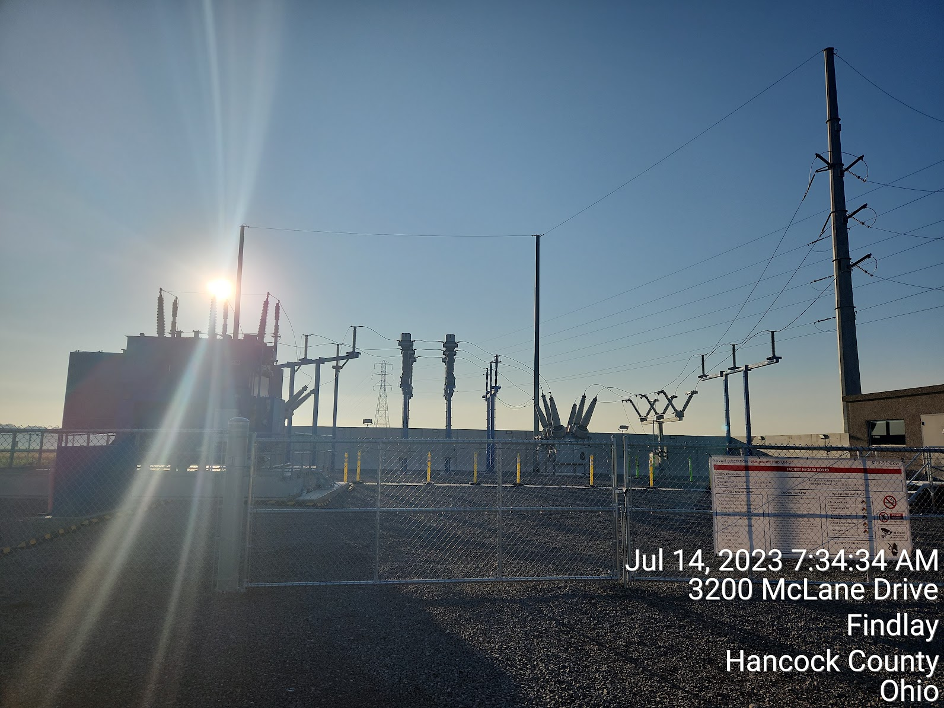
Thank you for your time

Slide 26
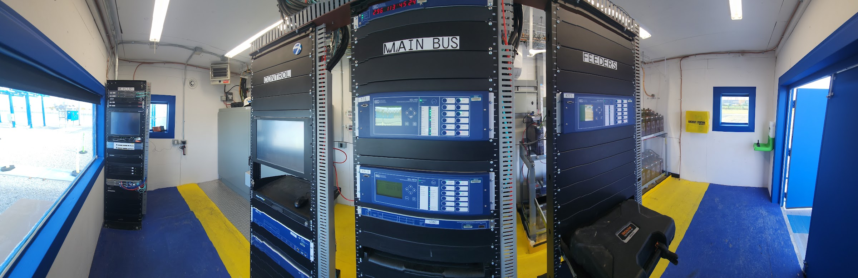

Slide 27
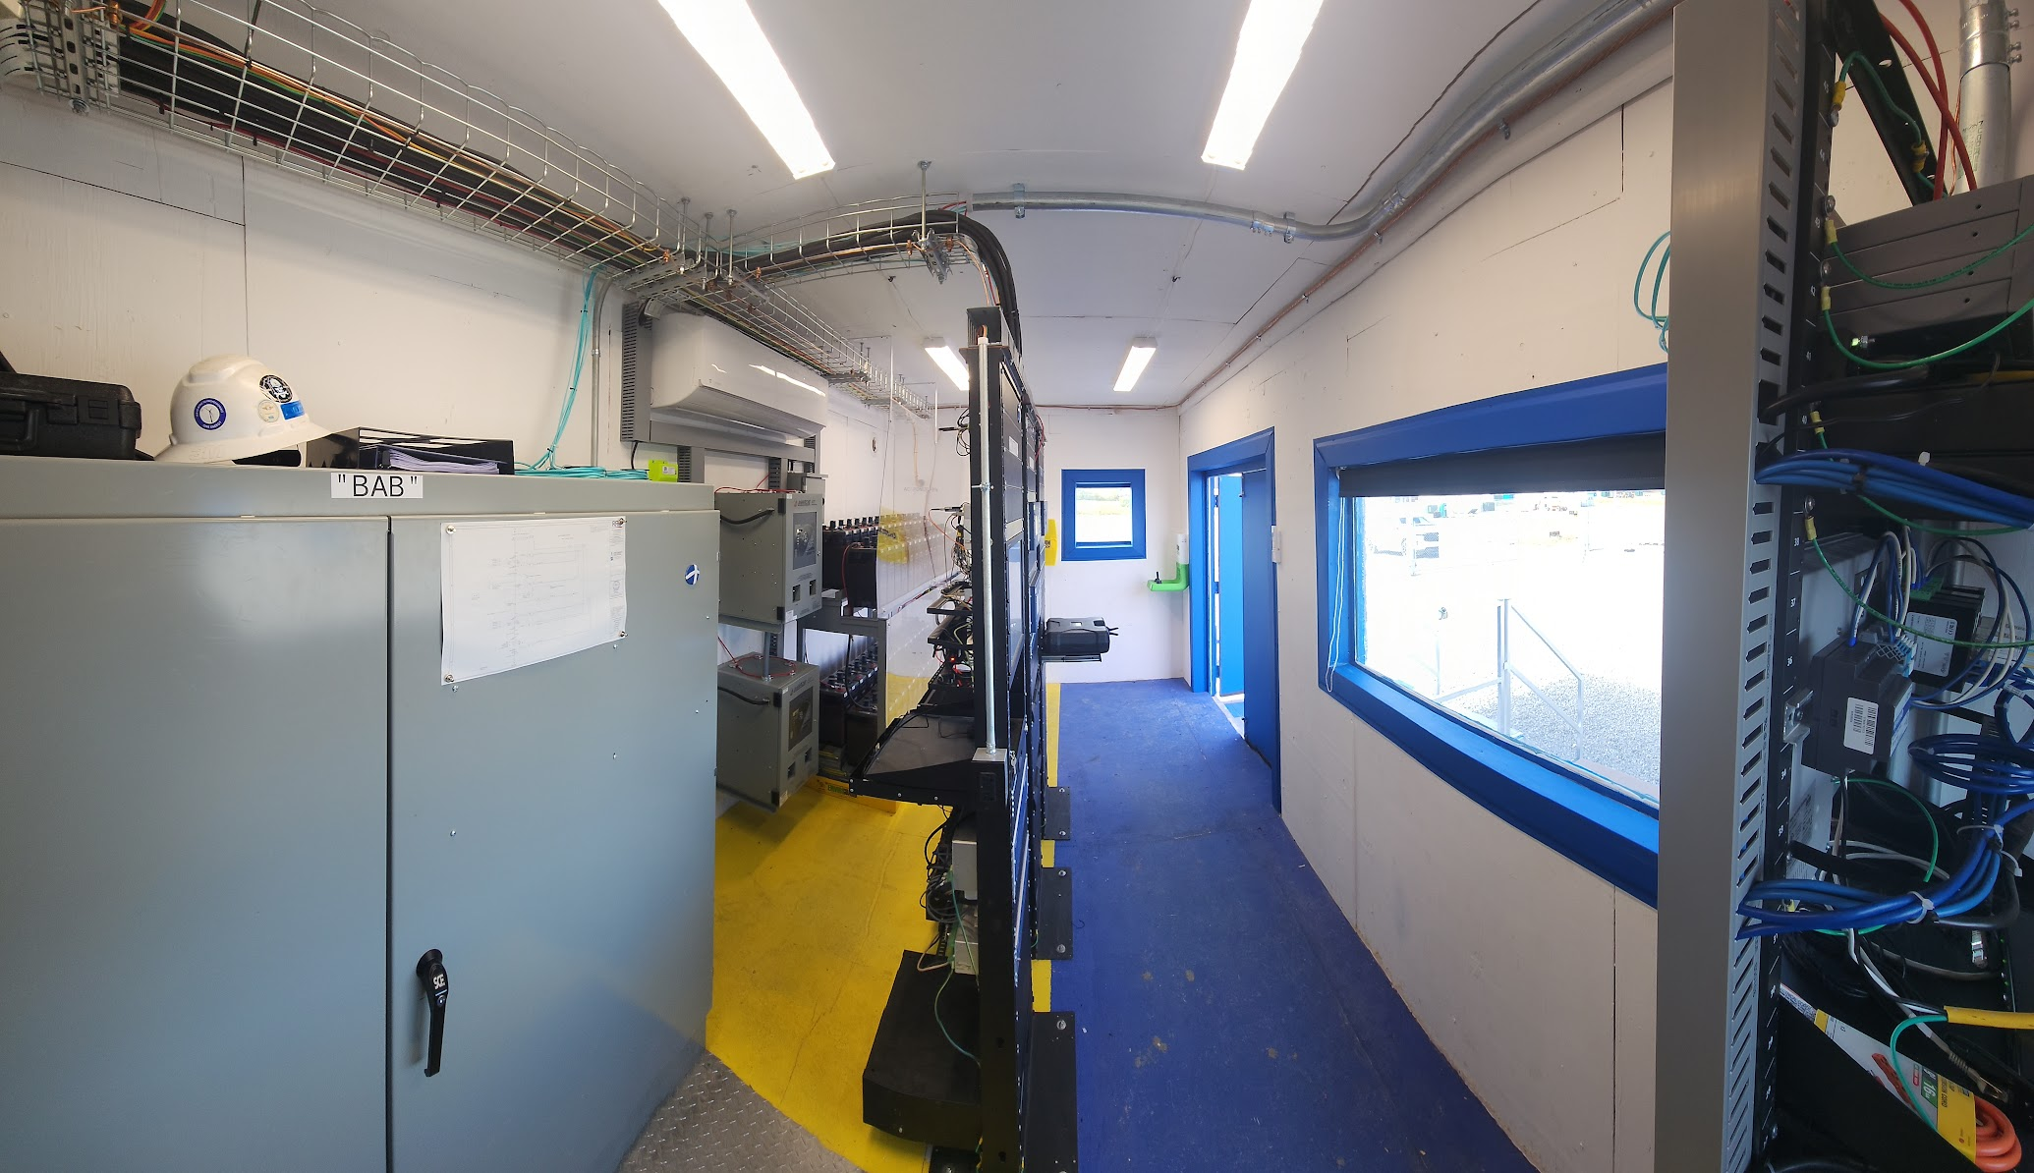

Slide 28
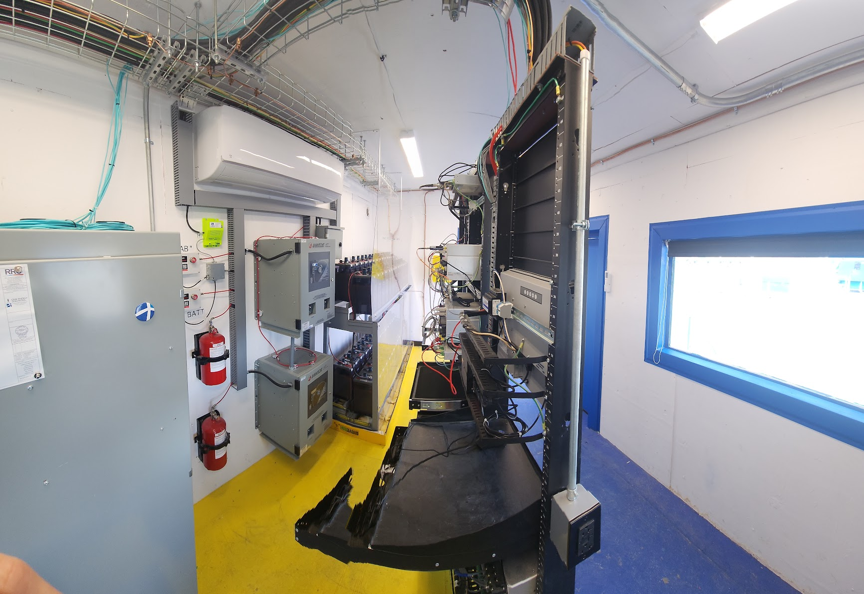

Slide 29
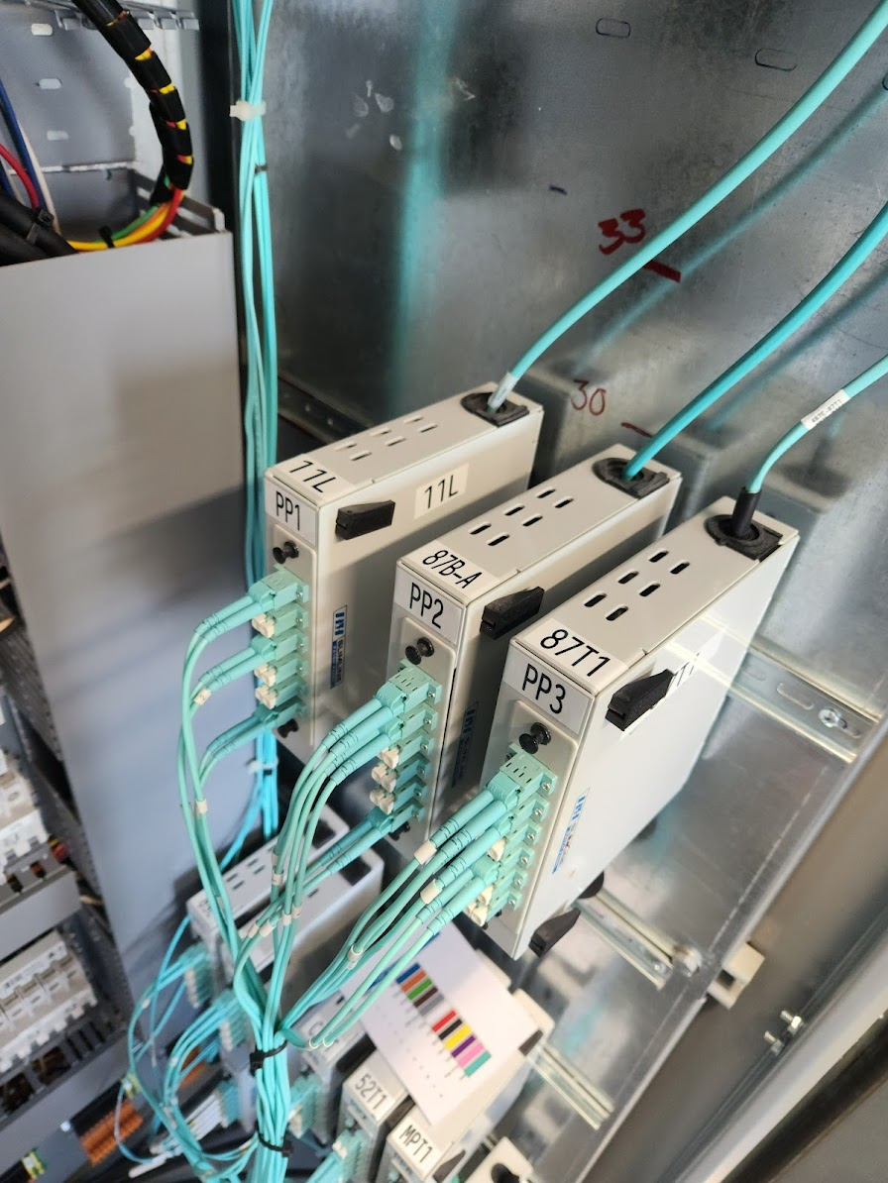
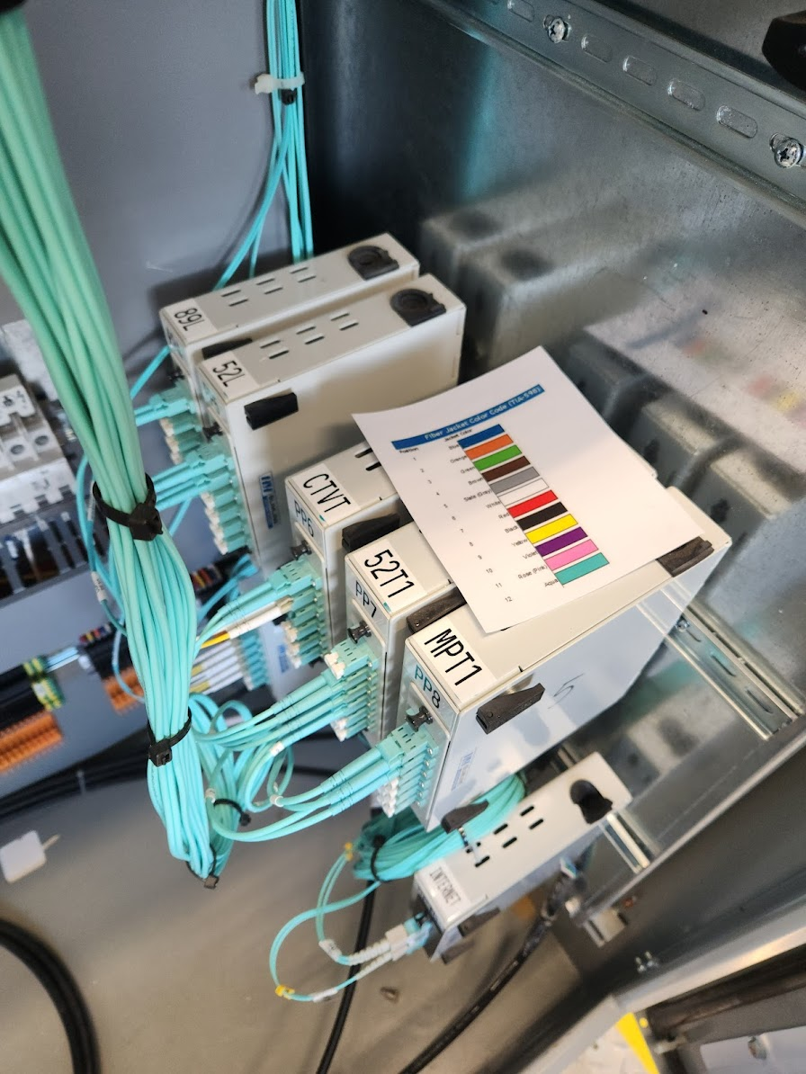

Slide 30
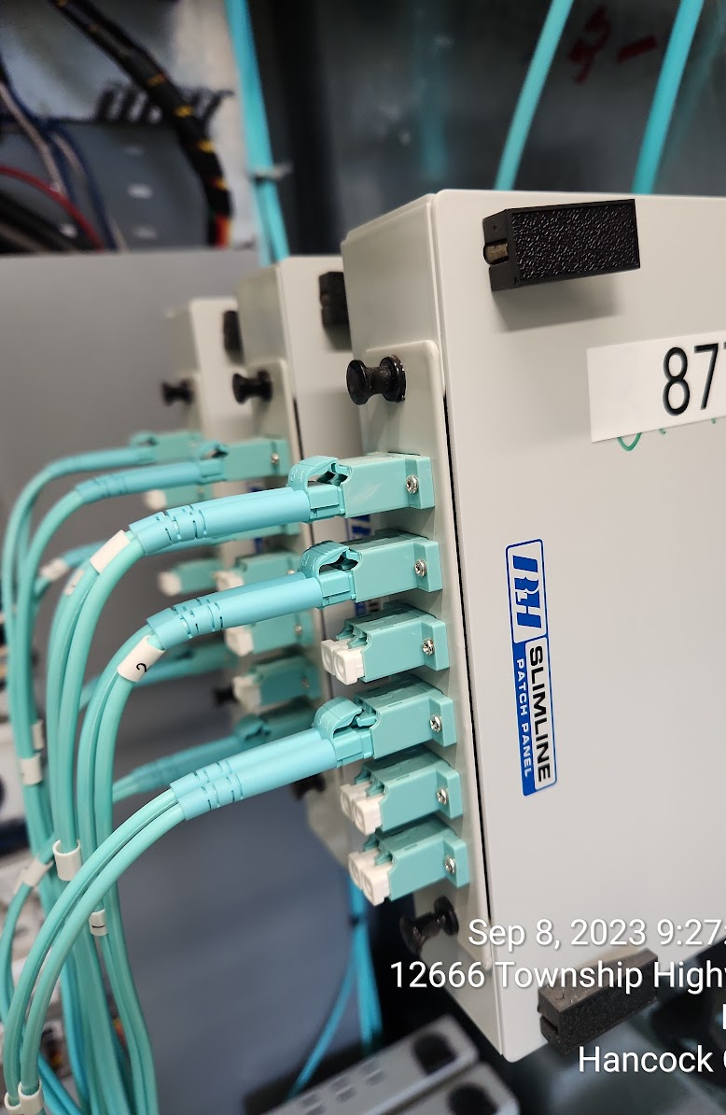
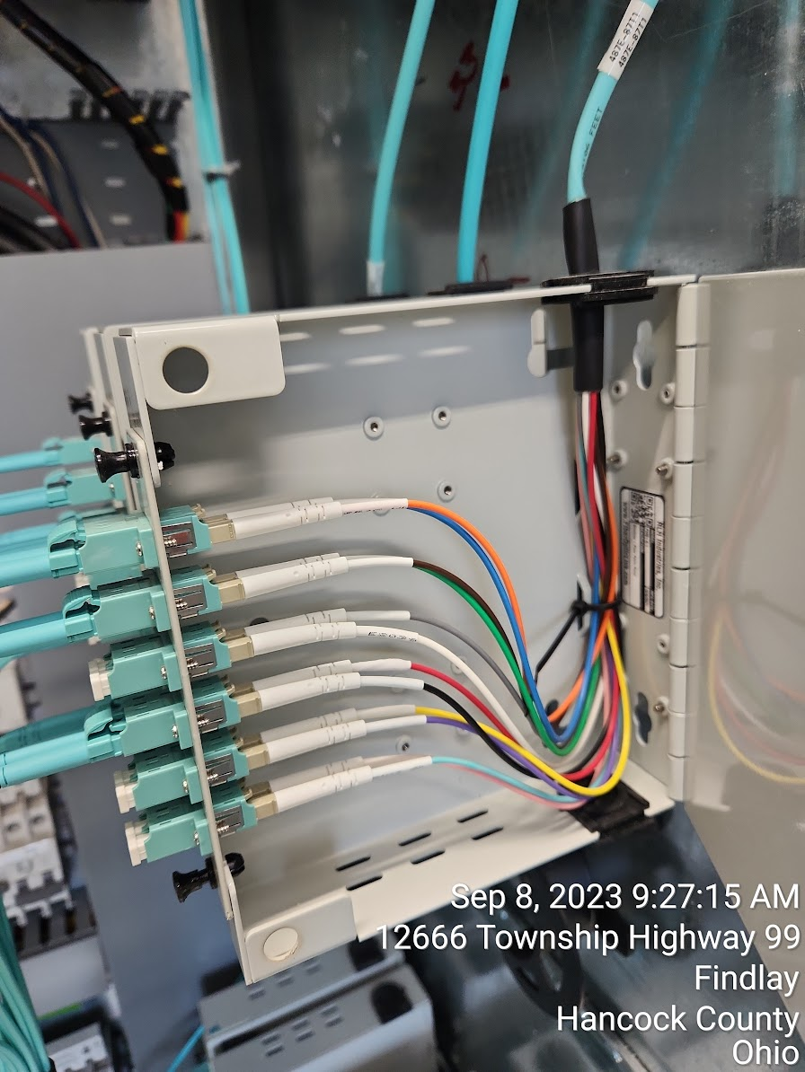

Slide 31



Slide 32


Slide 33


