Slide 1
Basics of Solar Resource Modeling how the algorithms work and limitations
Zhuoran Zhang
08/29/2023

Slide 2
OUtline
Solar panel working mechanism
Parameters for Solar Resource simulation
PVWatts
PVsyst
Limitations
OE Application

Slide 3
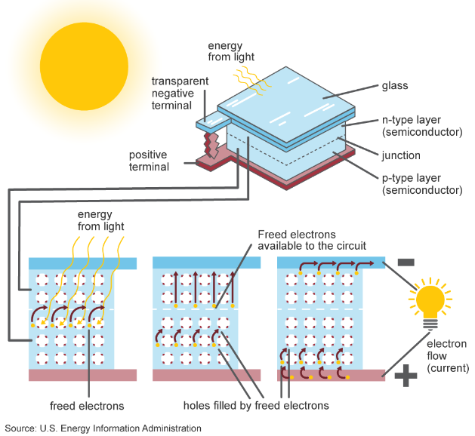
Solar to electricity
Absorption of photons
Generation of electron-Hole Pairs
Flow of electrons
Electric field and current
Metal contacts
Direct current output (DC)
Powering electrical devices (AC)

Slide 4
Important parameters
Location and Geographic
Solar Irradiance
Obstacles (Shading)
Panel Orientation
Panel Efficiency
Technology Type
Inverter Efficiency
Losses and Degradation
Size (Area/Power need)
Energy Storage
Financial and Economic

Slide 5
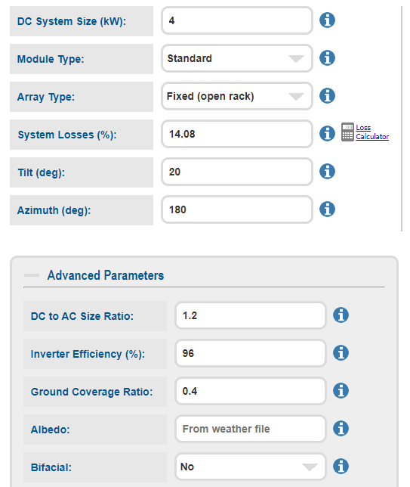
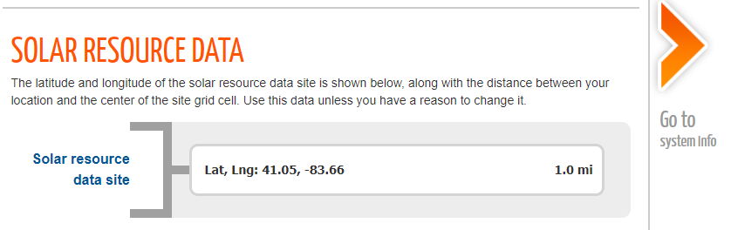
Inputs (Pvwatts)
Inputs:
Size
Technology Type and Panel Efficiency
Orientation
Shading, Losses and Degradation
Orientation
Size
Inverter Efficiency
Shading
Solar Irradiance
Technology Type

Slide 6
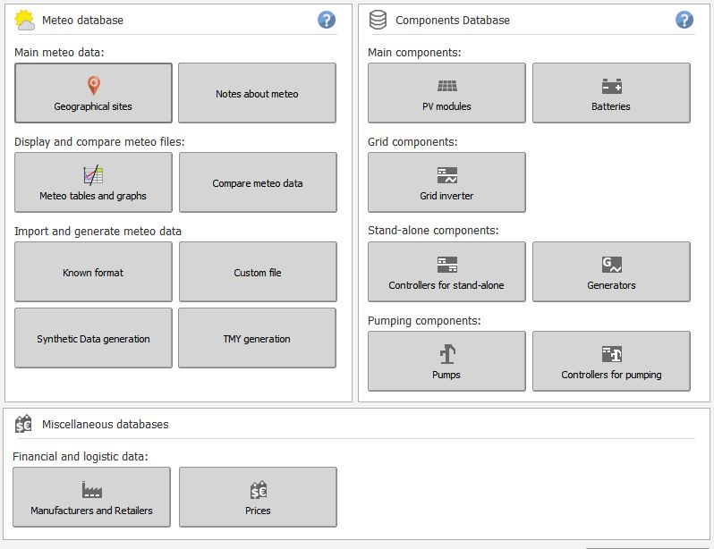
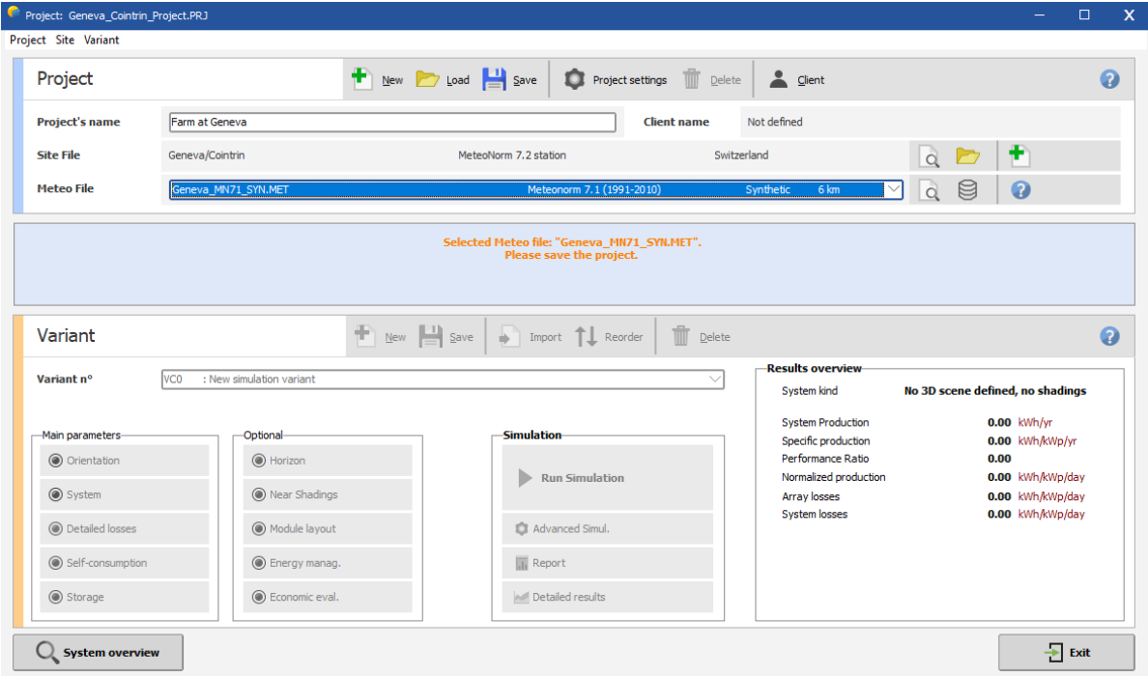
Inputs (PVSyst)

Slide 7
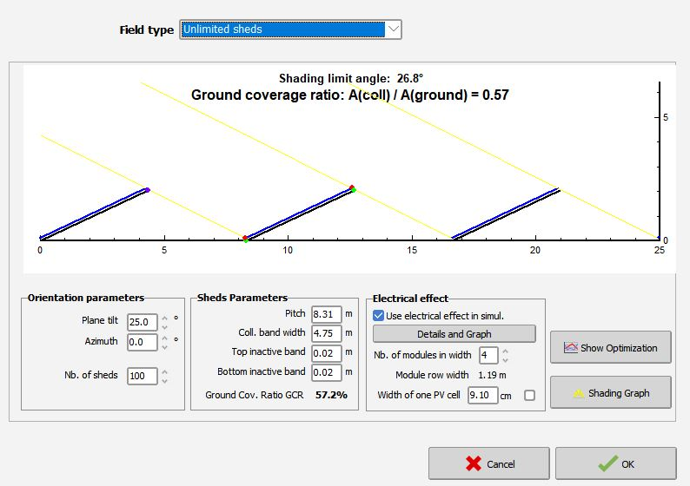
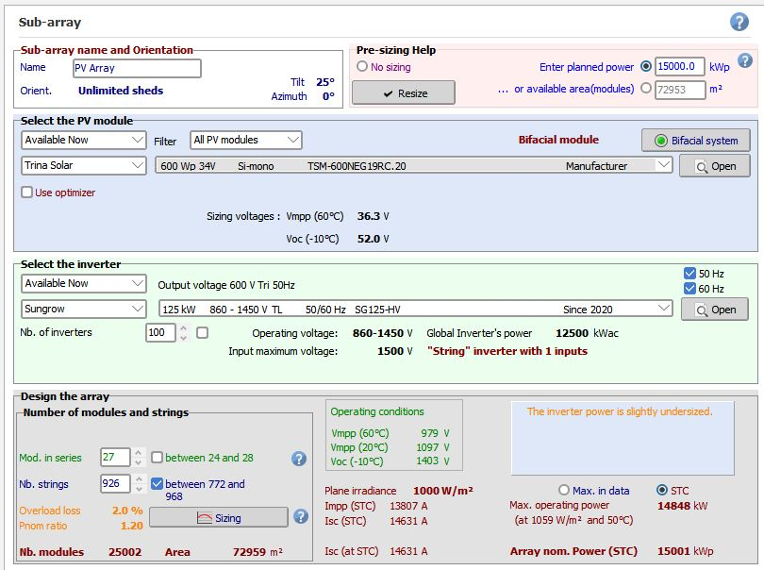
Inputs (PVSyst)

Slide 8
Algorithms
Effective Energy Input
Meteo Data Input
Data analyze and modeling
Performance
Shading
Detailed Loss
PV Array and Inverter Behavior
Array MPP energy after all array losses
DC to AC

Slide 9
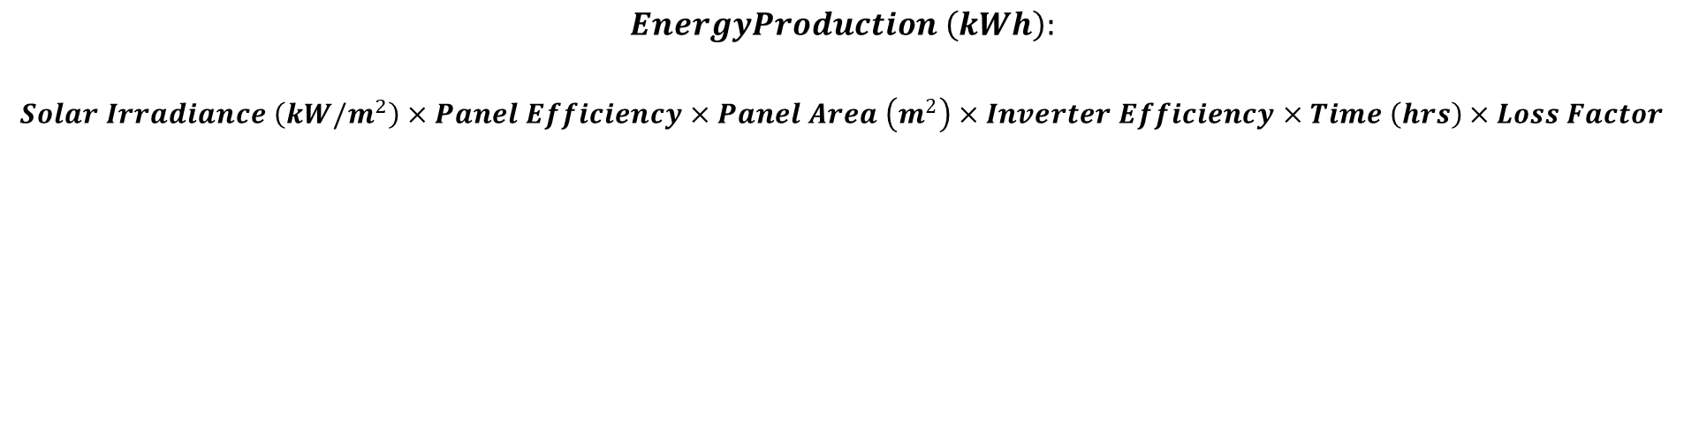
Main Output
Algorithm not publicly disclosed
$$EnergyProduction \left(kWh\right):$$
$$Solar Irradiance \left(kW/m^{2}\right)×Panel Efficiency×Panel Area \left(m^{2}\right)×Inverter Efficiency×Time \left(hrs\right)×Loss Factor$$
Effective Energy Input
PV Array and Inverter Behavior
Performance

Slide 10
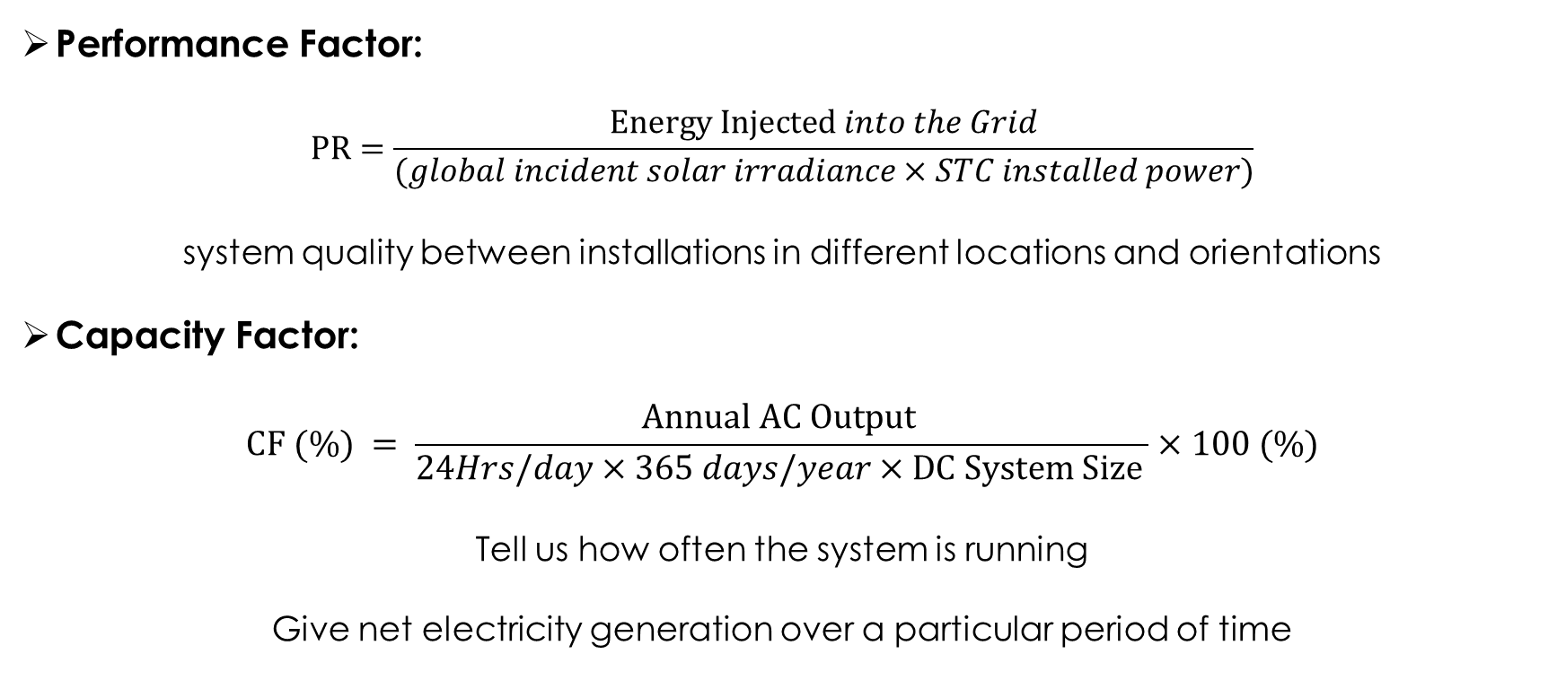
Main Output
Performance Factor:
$$PR=\frac{Energy Injected into the Grid}{(global incident solar irradiance×STC installed power)}$$
system quality between installations in different locations and orientations
Capacity Factor:
$$CF (\%) = \frac{Annual AC Output }{24Hrs/day×365 days/year×DC System Size }×100 (\%)$$
Tell us how often the system is running
Give net electricity generation over a particular period of time

Slide 11
Limitations
Relies on historical or synthetic weather data
Simulation accuracy heavily depends on input data
Moving shadows cannot be accounted
Long learning curve

Slide 12
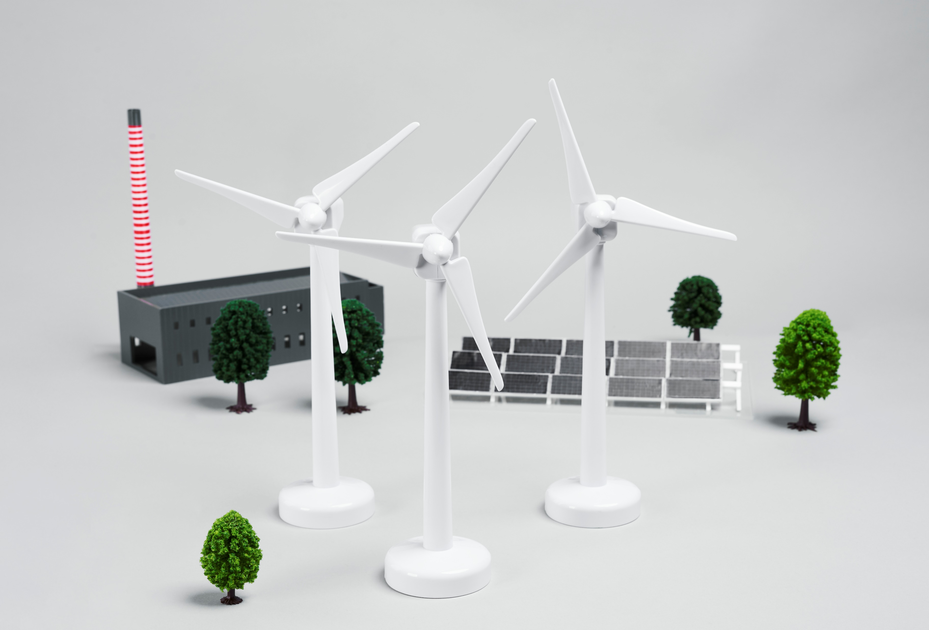
OE APPLICATION
Simulate monthly and yearly consumption for IE
Help design and sizing the project
Help financial analysis
Performance monitoring

Slide 13

Thank you!
Questions?

