Slide 1
ManagedHV: A Crash Course
20240604

Slide 2
WELCOME!
Brian Curkendall, Director of Engineering
Erica Johnson, Engineering Manager

Slide 3
WHAT IS HIGH VOLTAGE? WHAT IS MANAGEDHV?
Nominal Voltage Level | Industry Description | One Energy
<1,000V | Low voltage | Low voltage
>1,000V - 69kV | Medium voltage | High voltage
>69kV - 230kV | High voltage
>230kV - 765kV | Extra high voltage
“One Energy’s ManagedHV systems provide a state-of-the-art plant high-voltage distribution system that enables One Energy customers to efficiently move power, monitor usage, and protect plants from grid issues. More importantly, it provides an expandable and adaptable platform, enabling customers to add more distributed energy resources (DERs) to their system when desired.”

Slide 4
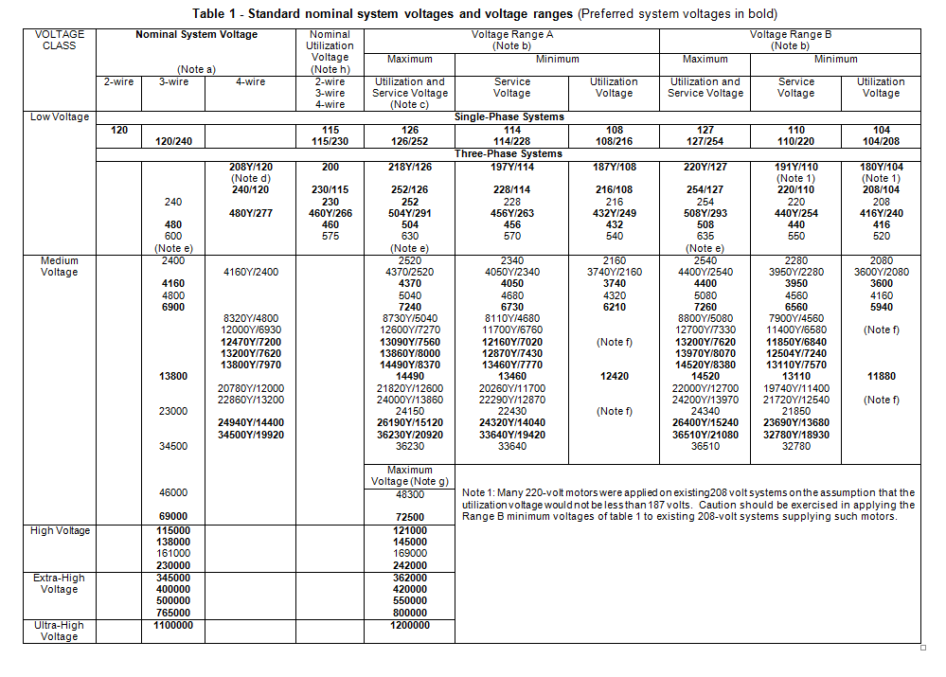
ANSI C84.1 - THE NITTY GRITTY DETAILS ON ALL THE VOLTAGES

Slide 5
BUT WHAT DOES THAT MEAN?
We can help customers who are:
Expanding their plant
Upgrading voltage to a product line/the plant
Need to upgrade equipment
Have voltage/power factor problems
OE typically installs, owns, and operates equipment, up to and including the step down transformer.
CapEx is also an option.

Slide 6
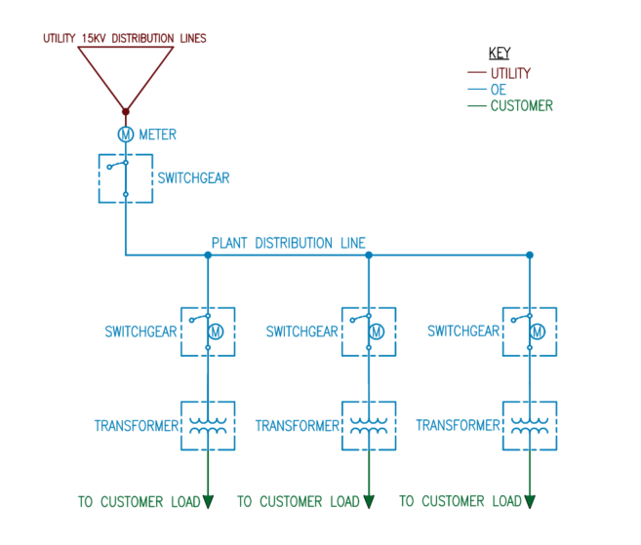
WHAT PART DOES OE NEED TO BUILD?
Typically, OE installs from where the Utility distribution ends to the step down transformer.

Slide 7
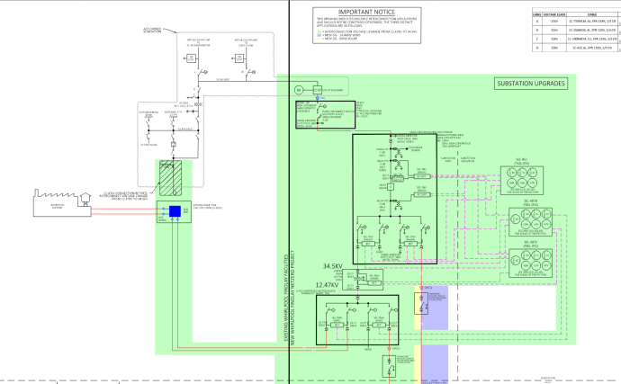
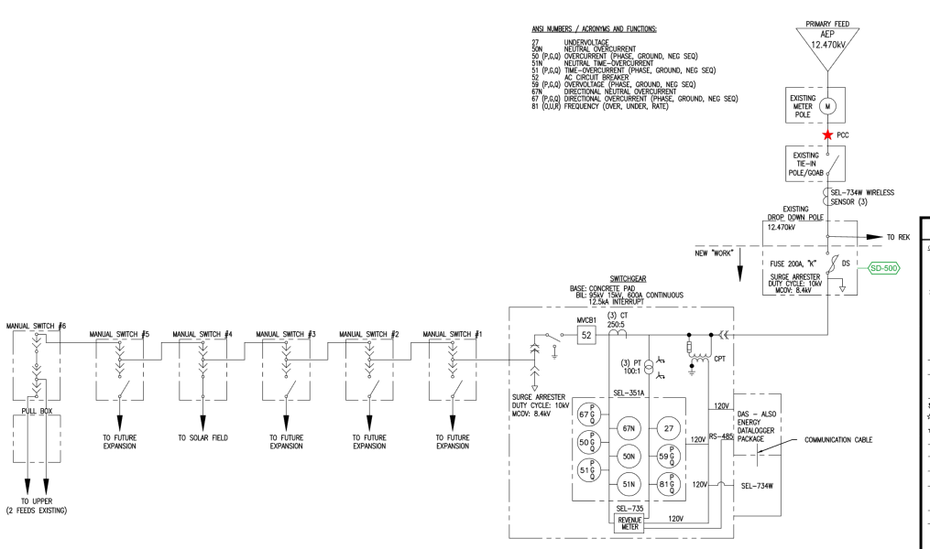
WHAT’S THE RELATIONSHIP BETWEEN MANAGEDHV AND SUBSTATION?
A ManagedHV project can include a substation, but does not have to.
Ex: Whirlpool Findlay vs Kalmbach

Slide 8
WHY MANAGEDHV IF WE ALREADY HAVE WIND & SOLAR?
They serve different purposes!
Wind & Solar offset kWh consumption and we can typically provide a lower cost of energy
ManagedHV provides customer with up-to-date infrastructure to deliver their power
ManagedHV upgrades can help customers use power more effectively
Some plants need ManagedHV upgrades to interconnect the size of project they want (ex. WP Findlay)

Slide 9
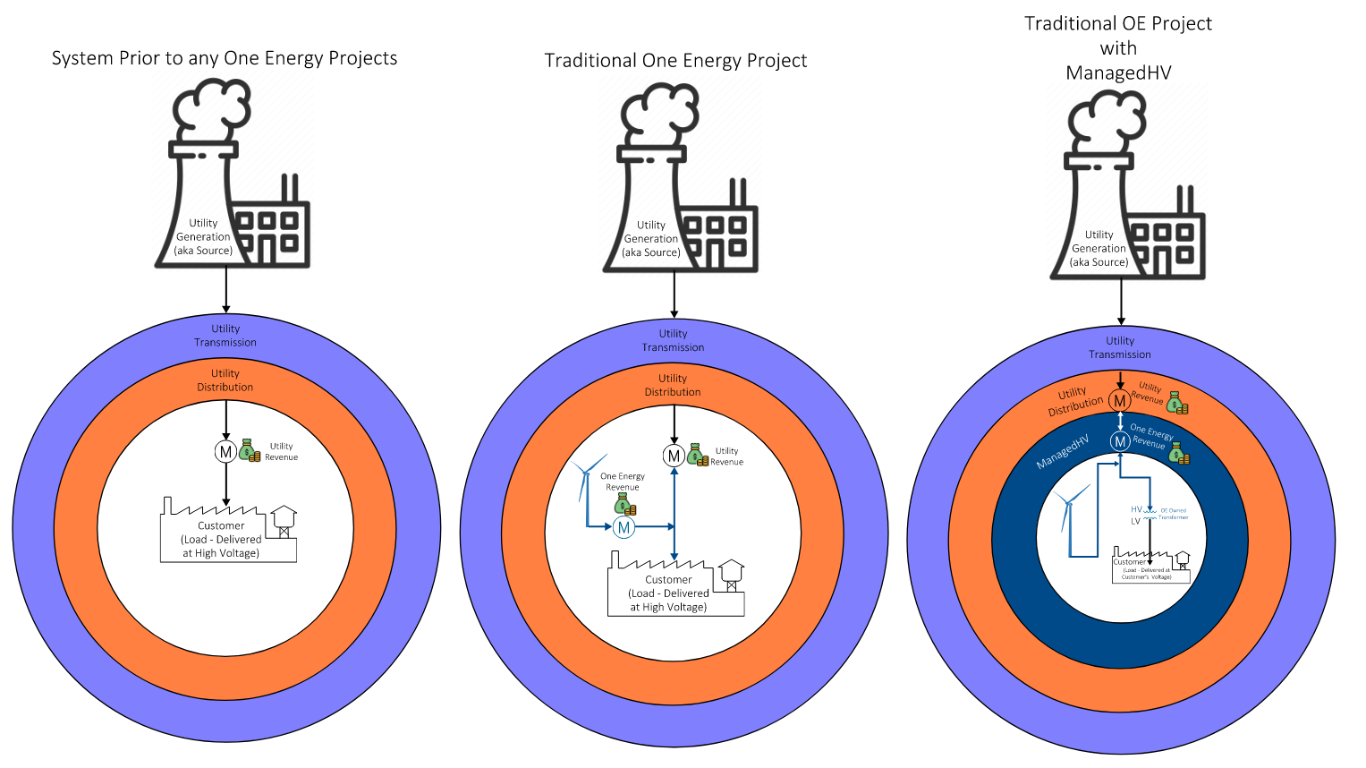
PROJECT TYPES

Slide 10
HOW DOES ONE ENERGY MAKE A PROFIT?
Depends on the delivery method!
CapEx:
  Estimate the cost of the job, including equipment, material, labor, etc.
  Add risk and profit margin
PPA:
  Estimate the cost of the job, including equipment, material, labor, maintenance, etc.
  Use financial model - options to price renewables + MHV together, or each component separately
  For more financial model details, talk to Carly

Slide 11
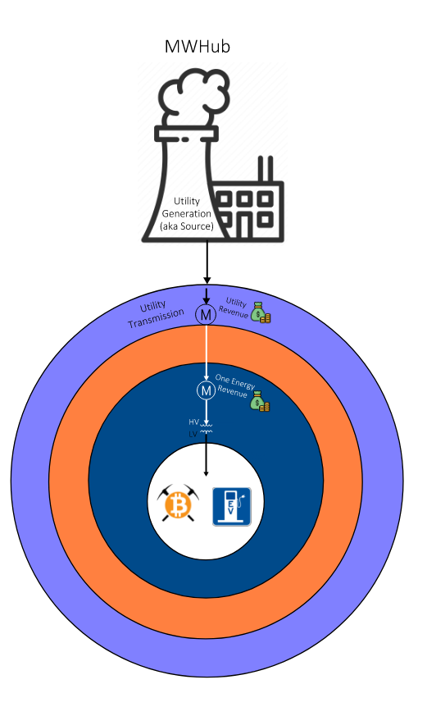
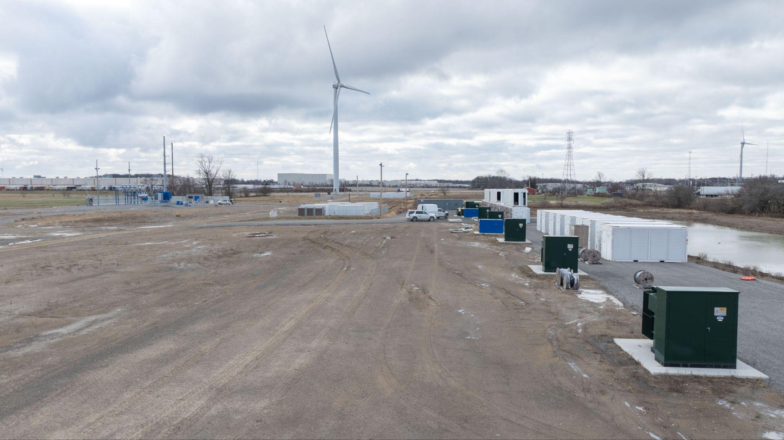
SO WHAT’S A MEGAWATT HUB?
A substation and distribution infrastructure for industries that consume large amounts of energy. MWHub #1 Capacity = 30MW, expandable to 150MW.
  Crypto mining
  EV truck charging
We build out site, customer shows up and plugs things in

Slide 12
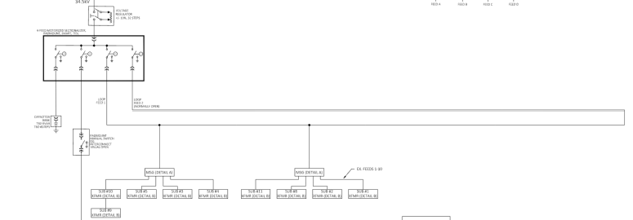
WHAT’S A LOOP?
Electrical system runs in a loop around plant and is fed separately on each end.
Each feed into plant has relay protection, allowing for different lines to have different levels of protection.
Provides a system that allows for no single feed issue to take down the entire plant.
Easiest on a green field site, but can be a retrofit
Useful for customers who are very sensitive to downtime or with large differences in what lines can tolerate

Slide 13
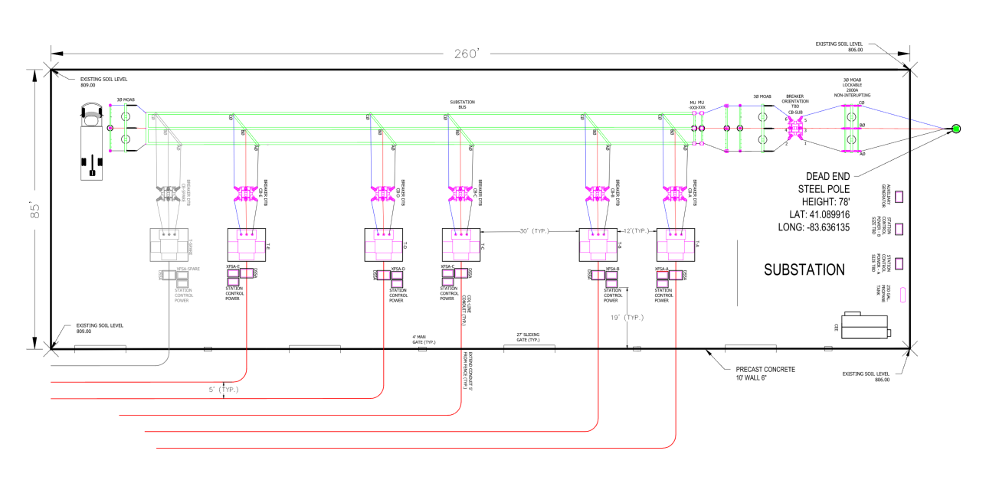
SUBSTATION LAYOUTS - GOOD, BAD, AND UGLY
OE designs physical layouts to be as concise and easy to access as possible
Want to be able to get wrecker/crane in to swap out components easily
Don’t want to be running cable etc. all over creation

Slide 14
SUBSTATION LAYOUTS - GOOD, BAD, AND UGLY
Things we don’t like:
  Inaccessible equipment
  Easy to see/harm equipment
  Inefficient cable/conductor routing
  Old, outdated equipment
  Crusty, poorly maintained equipment

Slide 15
REDUNDANCY/REPLACEMENT
OE plans in redundancies to keep systems running in as many cases as possible
  i.e., having generator and battery back up in sub
OE will stock 1-1 spares of key pieces of equipment (MPT, breaker, etc) to allow for quick replacement
OE contracts to include guaranteed replacement times

Slide 16
MAINTENANCE & MONITORING
Monitored via real-time alerts
CROs can sign in to view web HMI
Annual maintenance plans being drafted

Slide 17
THE PROCESS
Development:
  Someone (usually PPT) asks for a ManagedHV review
  Engineering looks at provided information (one line and loads) to determine what is beneficial & feasible
  Sketch a one line (usually pretty standard), have Brandon draw
  Provide a write up (usually pretty standard) for PPT report
Due Diligence
  Work on spec’ing and procuring equipment
  Detailed drawings, including layouts, P&C
  Interconnection, pre-construction analyses
Construction
  IFC drawings, including schematics, wiring diagrams, etc
  Testing & commissioning of equipment

Slide 18
WHERE DO WE GET INFORMATION FROM?
From the customer:
Facility one line
Load/usage data
Site layout
Publicly available:
Line voltage (transmission)
From the utility:
Line capacity
Line voltage (distribution)

Slide 19
Additional Questions
What are the criteria for a good candidate for a MHV project?
What (if any) considerations need to be made for where a substation is placed?
What are the current MHV projects we have, what problem we were solving, and how did we accomplish that?
What does an overview of the design process of a MHV project look like from engineering's point of view?
What does the decision making process look like for if we propose a MHV project to a customer or not.

Slide 20
HOW CAN WE LEARN MORE?
Substation IFC Drawings: Projects - Construction\Z003 Bitcoin NFWC Phase II\G. Communication\d. Engineering\RRC\20230310 Latest Drawings
OE Library has substation books
Brian’s Knowledge Afternoon (Electricity Big & Small): https://www.myoneenergy.com/oe-enrichment-courses.html
Ask questions!

