Slide 1
Machine learning in mcp
Pablo nieves
5/20/2025

Slide 2
WHAT is MACHINE LEARNING?
LET’S START DEFINING AN ALGORITHM
An algorithm is a set of instructions that is designed to transform an input into a desired output.
Algorithm
Inputs
Outputs

Slide 3


WHAT is MACHINE LEARNING?
LET’S START DEFINING AN ALGORITHM
An algorithm is a set of instructions that is designed to transform an input into a desired output.
Algorithm

Slide 4

WHAT is MACHINE LEARNING?
LET’S START DEFINING AN ALGORITHM
An algorithm is a set of instructions that is designed to transform an input into a desired output.
Algorithm
If the apple is green, place it in the right basket; if it’s red, place it in the left one.

Slide 5
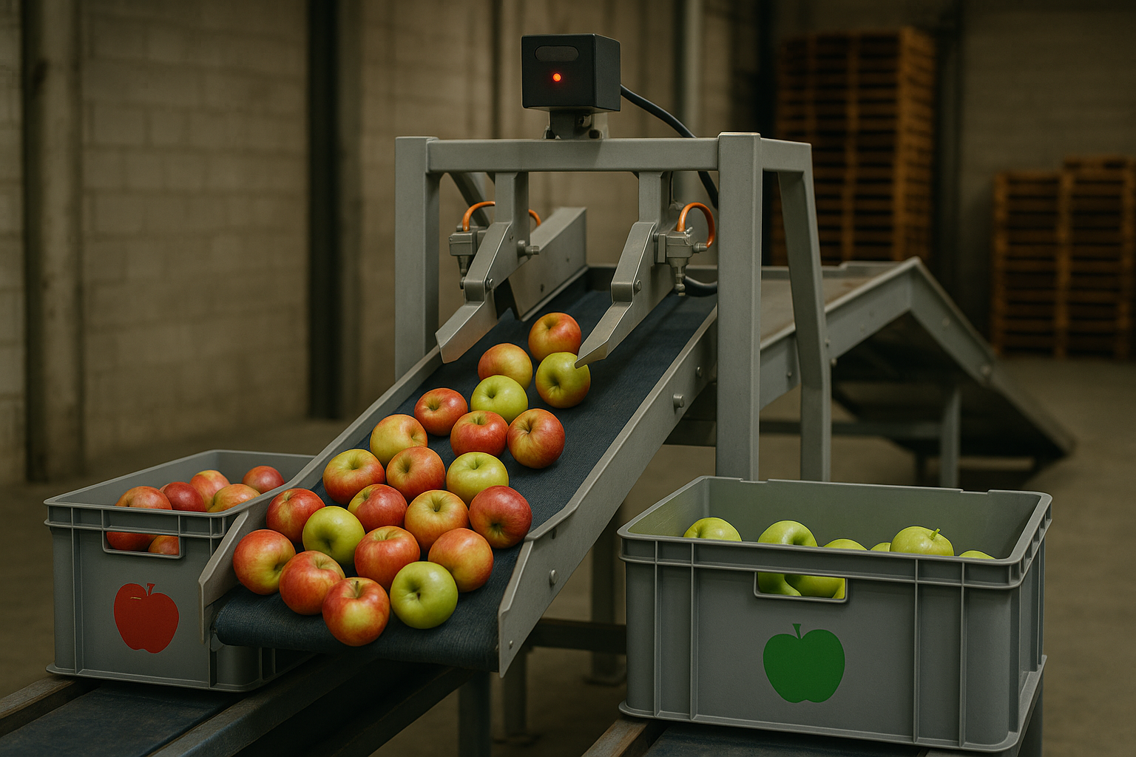

WHAT is MACHINE LEARNING?
LET’S START DEFINING AN ALGORITHM
Everything changed with automation. Now algorithms must be written in machine language.
If position sensor is active, trigger color detection.
If color detection is green, activate left hydraulic pump; else, activate right hydraulic pump.
If impact sensor is not triggered, assume an error and restart.
If impact sensor is triggered, activate control loop…
…
…
If the apple is green, place it in the left basket, if it’s red, place it in the right one

Slide 6
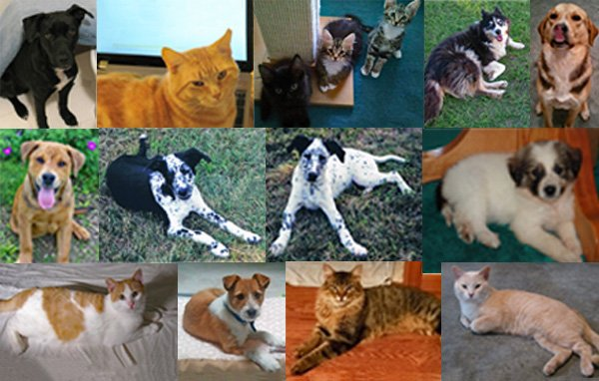
WHAT is MACHINE LEARNING?
STATIC VS. dynamic algorithm
Now let’s imagine how we can program an algorithm for more complex tasks.

Slide 7

WHAT is MACHINE LEARNING?
STATIC VS. dynamic algorithm
Algorithm
Dog!

Slide 8

WHAT is MACHINE LEARNING?
STATIC VS. dynamic algorithm

Slide 9


WHAT is MACHINE LEARNING?
STATIC VS. dynamic algorithm
We could try to predict adding some rules that the computer can understand.
0.1 $<\frac{eye1+eye2}{space1+space2+space3}$
Dog!
0.1 $>\frac{eye1+eye2}{space1+space2+space3}$
Cat!

Slide 10
WHAT is MACHINE LEARNING?
STATIC VS. dynamic algorithm
Translating these instructions to a computer adds another level of complexity…
First, detect where the eyes are:
Iterate over all the pixels.
If pixel is black, check if surrounding pixels are black
If not, continue
If yes, check if there is a significant number of black pixels together with circular shape.
Repeat the process for second eye.
Start measuring face:
Count the maximum number of black horizontal pixels on each eye position.
Count the number of pixels between the interior edge of both eyes…
…
…

Slide 11

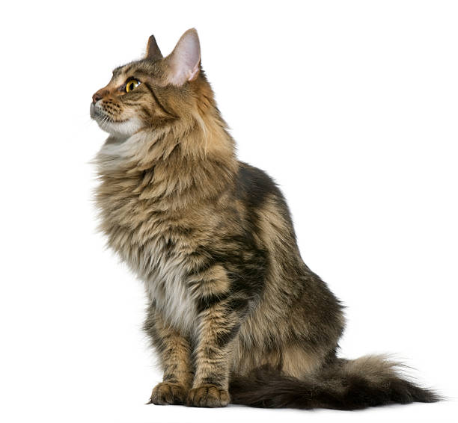
WHAT is MACHINE LEARNING?
STATIC VS. dynamic algorithm
But then… What happens if the images don’t have the format that we need for the algorithm to work?

Slide 12

WHAT is MACHINE LEARNING?
STATIC VS. dynamic algorithm
But then… What happens if the images don’t have the format that we need for the algorithm to work?
But what if the dog looks like this?

Slide 13

WHAT is MACHINE LEARNING?
STATIC VS. dynamic algorithm
But then… What happens if the images don’t have the format that we need for the algorithm to work?
And how can we approach this?
But what if the dog looks like this?

Slide 14

WHAT is MACHINE LEARNING?
STATIC VS. dynamic algorithm
But then… What happens if the images don’t have the format that we need for the algorithm to work?
And how can we approach this?
But what if the dog looks like this?
And what do we do with this one?

Slide 15

WHAT is MACHINE LEARNING?
STATIC VS. dynamic algorithm

Slide 16
WHAT is MACHINE LEARNING?
STATIC VS. dynamic algorithm
How can this be approached? How can we find the way to program a machine with these simple instructions that we cannot rationally structure?
Algorithm
Dog!

Slide 17
WHAT is MACHINE LEARNING?
STATIC VS. dynamic algorithm
How can this be approached? How can we find the way to program a machine with this simple instructions that we cannot rationally structure?
Algorithm
56% confident that’s a dog
Training Algorithm
Is 100% a dog
Error measurement

Slide 18
WHAT is MACHINE LEARNING?
STATIC VS. dynamic algorithm
The learning process of an algorithm:
Algorithm
Inputs
Outputs
Training Algorithm
Correct output
Error measurement
Feedback Loop

Slide 19
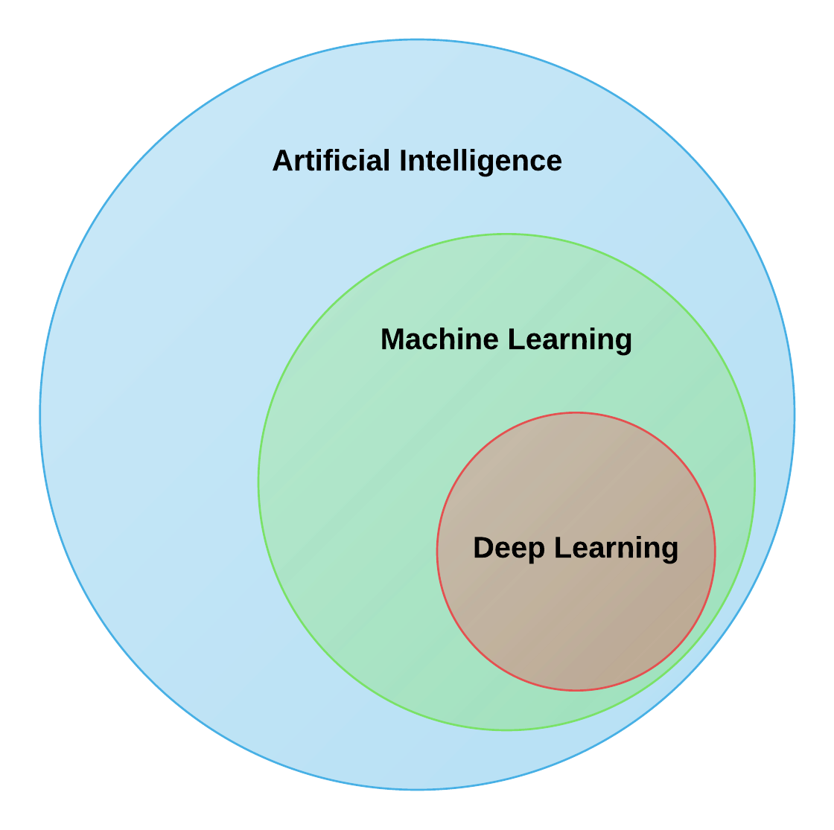
WHAT is MACHINE LEARNING?
Where does ml fit into the ai field?

Slide 20
MACHINE Learning in the mcp project
How do we forecast wind speeds?
We use wind speeds close to the site and we correlate them with our lidar/met towers. With that correlation, we forecast the full time series.
1 year
Lidar/Met tower data
Reanalysis data
30 years

Slide 21
MACHINE Learning in the mcp project
How do we forecast wind speeds?
We use wind speeds close to the site and we correlate them with our lidar/met towers. With that correlation, we forecast the full time series.
1 year
Prediction
Lidar/Met tower data
Correlation
Reanalysis data
30 years

Slide 22
MACHINE Learning in the mcp project
How do we forecast wind speeds?
We use wind speeds close to the site and we correlate them with our lidar/met towers. With that correlation, we forecast the full time series.
New ERA/MERRA
Wind Speeds
ERA/MERRA
Wind Speeds
Error measurement
Correlation Algorithm
Predicting Algorithm
Site Wind Speeds
-Orthogonal regression
-Method of Bins
-Matrix
-Variance ratio
Forecasted Wind Speed Time Series

Slide 23
MACHINE Learning in the mcp project
WHY USE other algorithms?
I saw it might be interesting to use a ML model for that because:
We can use more features to predict (more information)
Other algorithms might work better with these time series.

Slide 24
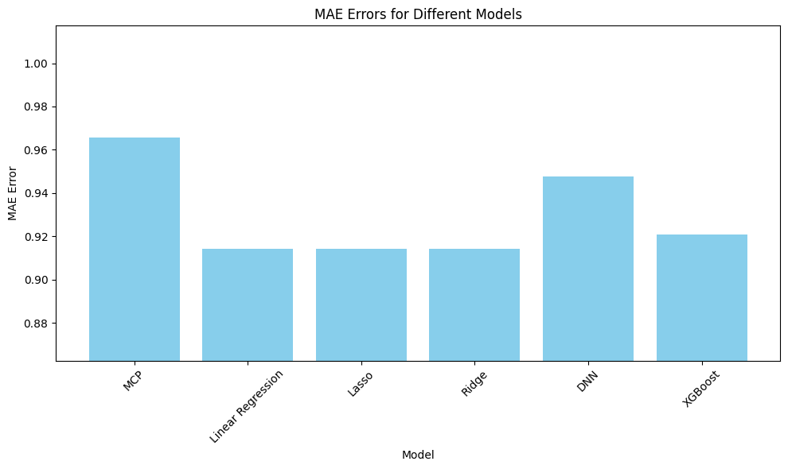
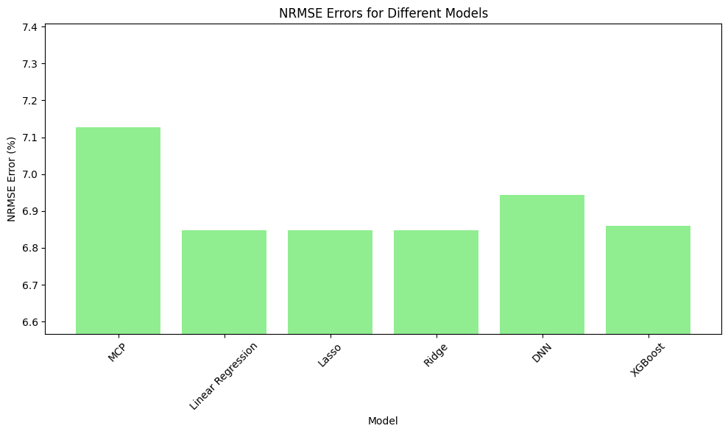
MACHINE Learning in the mcp project phase 1
The errors of some models were significatively lower!

Slide 25
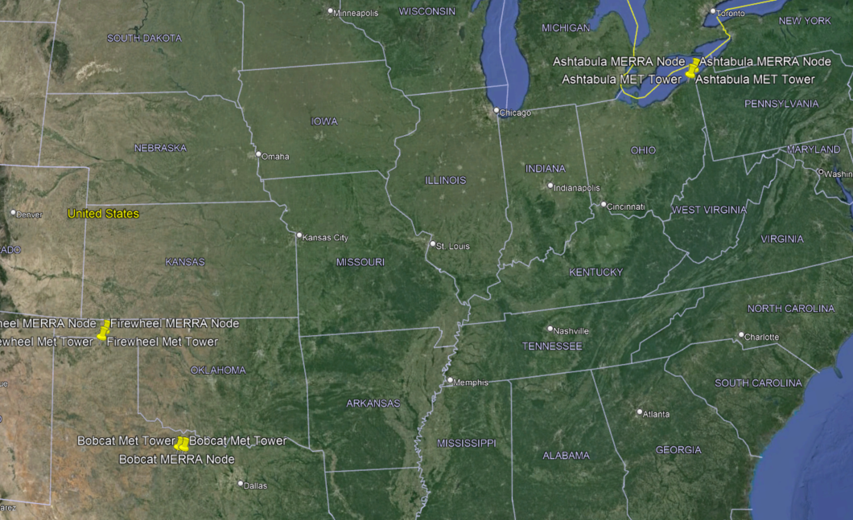
MACHINE Learning in the mcp project phase 2
The second phase was done with three different dataset, comparing them in terms of MAE
NAME | Location | Anem and Vane Height | MERRA2 Node (50m) | Time Frames
Bobcat (Texas) | 33.48446 N | 60m | 33.5 N | 1/1/2008
 | 98.5817 W |  | 98.75 W | 12/31/2011
Firewheel (Texas) | 36.32829 N | 60m | 36.5 N | 1/1/2011
 | 101.369 W |  | 101.369 W | 12/31/2015
Ashtabula (Ohio) | 41.86533 N | 49m | 41. 86533 N | 1/1/2007
 | 80.8035 W |  | 80.8035 W | 12/31/2008

Slide 26
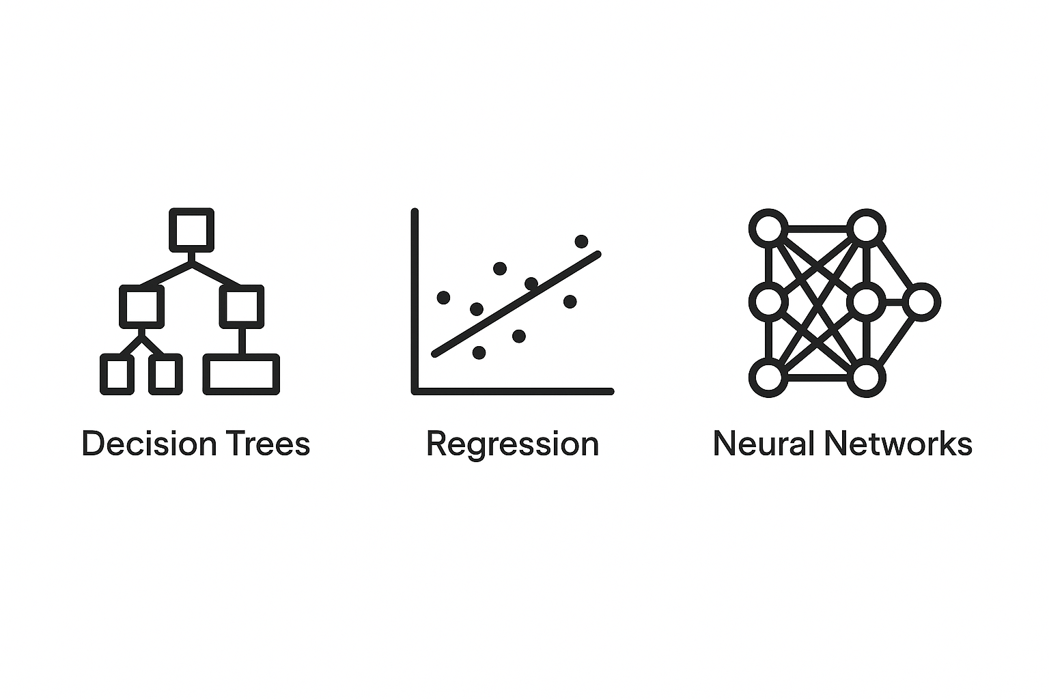
MACHINE Learning in the mcp project phase 3
Existing models:
Method of bins, variance ratio, Orthogonal Regression, Matrix,
Models tried: (in order)
Multi-variable Linear regression
Lasso
Ridge
Multi-Layer Perceptron
LightGBM
XGBoost

Slide 27
MACHINE Learning in the mcp project phase 2
Best models were Gradient Boosting or Neural Networks.
Next step: Implement it directly to C3 code in C#

Slide 28
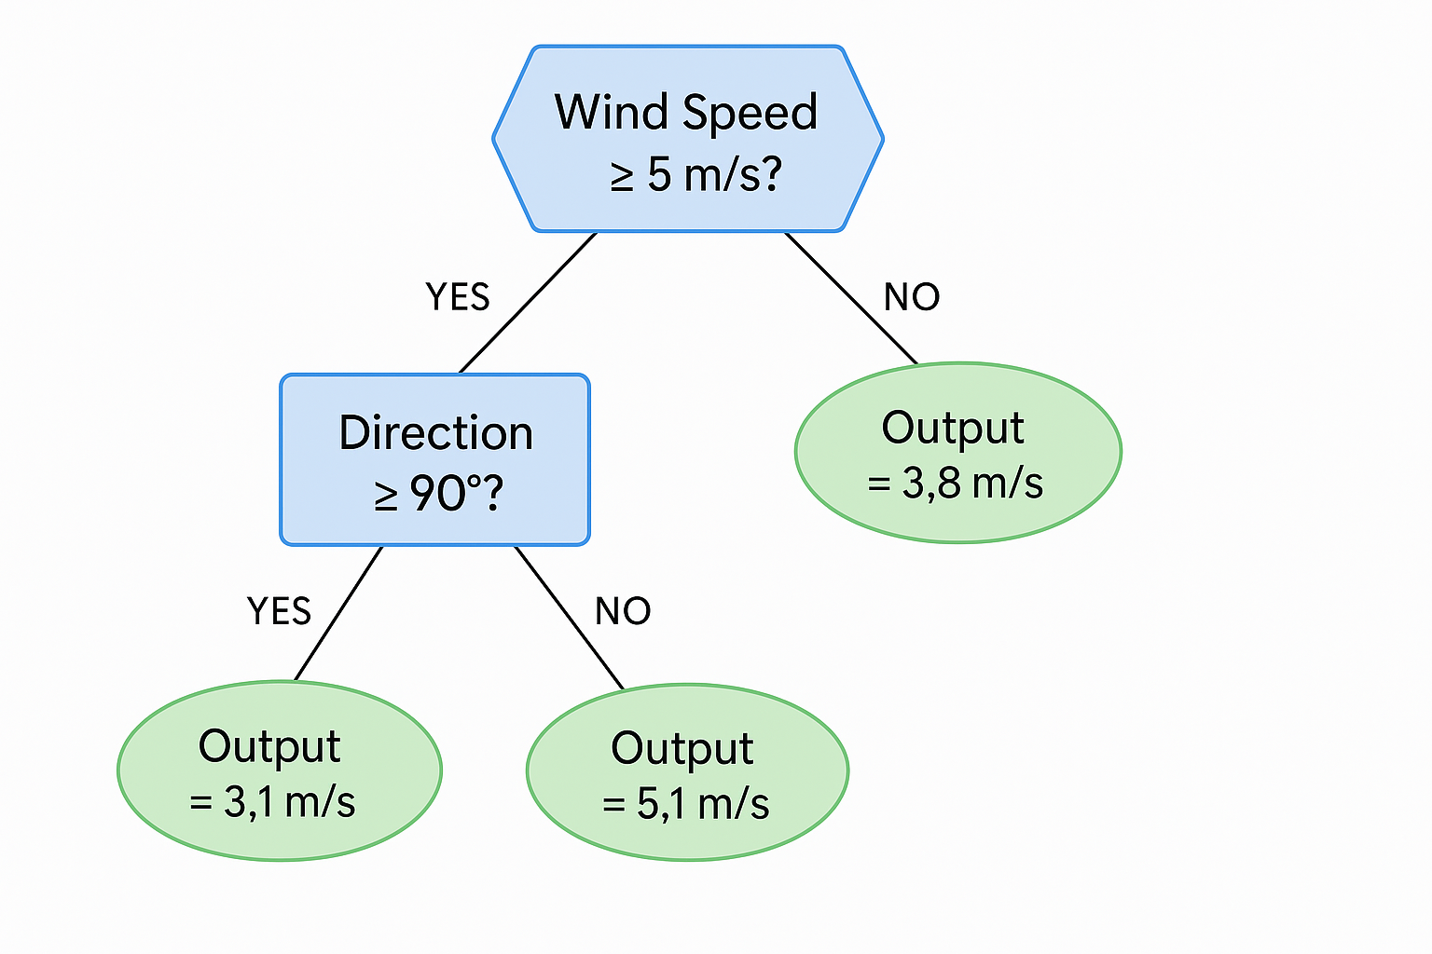
MACHINE Learning in the mcp project
The lightgbm model
Algorithm based on decision trees.
Fast and efficient with large datasets.
Higher accuracy with shorter training time.

Slide 29
MACHINE Learning in the mcp project phase 3
Implemented LightGBM into the C# C3 code.

Slide 30
Other potential applications of ml in opc
ML is a very transversal field that can be applied almost everywhere. Some ideas:
Predictive maintenance model for GW 87/1500
Electricity price forecasting

Slide 31
Machine learning in mcp
QUESTIONS?

