Slide 1
Hydrogen Fuel Technologies
Kevin Padgett
05/03/2022

Slide 2
Hydrogen

Slide 3
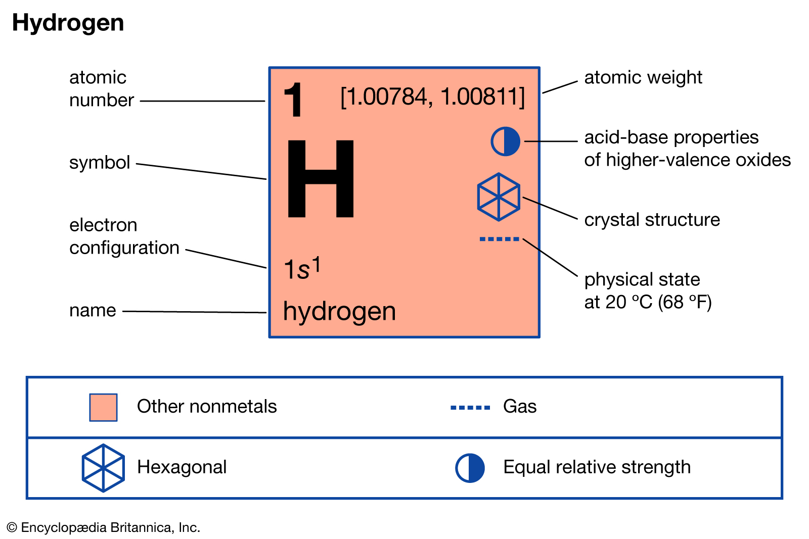
What is hydrogen

Slide 4
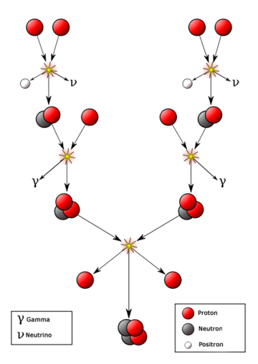
What is hydrogen
Other hydrogen facts:
  Colorless, odorless, tasteless, and flammable
  Diatomic element
  Most abundant element in the universe
  “Powers” the sun
Notes:
Around 73% of the mass of the universe
Four hydrogen molecules undergo nuclear fusion to form helium in the sun’s core, releasing energy that is radiated out from the core to the outer layers of the sun and into the space beyond

Slide 5
Production

Slide 6

How is hydrogen produced
While it may be the most common element on earth, hydrogen gas makes up a very minimal portion of its atmosphere
The majority of hydrogen is found in compounds such as:
  Water (H₂O)
  Methane (CH₄)
  Ethanol (C₂H₅OH)
One of the six most common elements in organic matter (CHONPS)
Notes:
On the order of 1/1000 of a percent atmospheric makeup, nitrogen and oxygen make up most of the gases in the atmosphere
Hydrogen capture not really an option, so production it is!

Slide 7
How is hydrogen Gas produced
Most common ways to produce H₂ gas:
  Natural gas reforming
  Gasification
  Water Electrolysis
  Liquid reforming
  Fermentation
Methods in development
  High-temperature water splitting
  Photobiological water splitting
  Photoelectrochemical water splitting
Notes:
NOTE: Give quick notes on these here
→High-Temp water splitting: Using heat to split water (500-2000 Celsius)
→Photo-Bio water splitting: light and microorganisms used to split water molecules
→Photo-Electro water splitting: light energy directly used to split water molecules

Slide 8

Natural gas reforming
Most common method of hydrogen gas production
Two-step reactions process:
  Methane is reacted with high-temperature steam to produce carbon monoxide and hydrogen
  Carbon monoxide is reacted with the steam to further produce hydrogen and excess heat
  Can also be carried out through partial oxidation, where methane is reacted with oxygen or air, followed by the same water-gas shift reaction above
$${CH}_{4}+H_{2}O \underset{→}{Δ} CO+3H_{2}$$ | (1)
$$CO+H_{2}O→CO_{2}+H_{2}+heat$$ | (2)
Notes:
→BIG downside is production of heat and abundant GHG in CO2

Slide 9
Natural Gas reforming
H₂O
CH₄
Heat Exchange
Desulfurization
Reformer
Heat Recovery
Sulfur
Fuel
H₂
Methanation
CO₂ Recovery
Shift Conversion
CO₂

Slide 10
Gasification
Another common method of producing hydrogen
Reactions between the fuel and a gasifying agent take place to produce syngas
  Syngas is mainly composed of hydrogen, nitrogen, carbon monoxide, and carbon dioxide
The fuel can be any carbon-based matter, such as coal or biomass
The gasifying agent is usually air, steam, or carbon dioxide
Similar process to steam reforming if steam used as gasifying agent

Slide 11
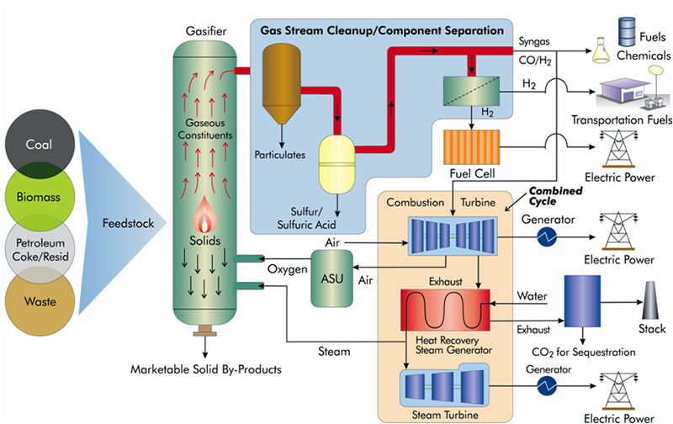
Gasification
Notes:
→From Nation Energy Technology Laboratory

Slide 12
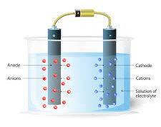
Water Electrolysis
An electrochemical reaction resulting in the splitting of water compounds into its constituents, hydrogen and oxygen
Different types of Electrolyzers:
  Polymer Electrolyte Membrane
  Alkaline
  Solid Oxide
Generally consist of an anode and cathode separated by an electrolytic medium
Notes:
Electrolysis is thought to be the most capable hydrogen production method
Only byproduct is oxygen
Water is a renewable source

Slide 13
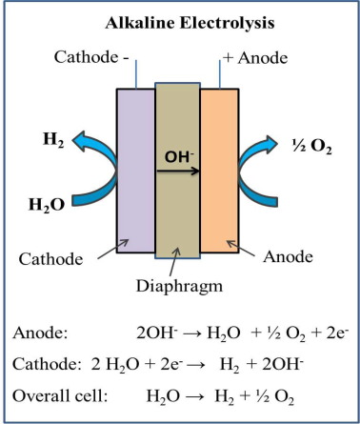
Alkaline water electrolysis
Electrolytic medium: aqueous solution of KOH/NaOH
Reaction at cathode forms hydroxide ions and H₂ gas
Hydroxide ion travels to anode to recombine into oxygen and water
Established water electrolysis technology
Notes:
New approach uses solid alkaline membranes instead of porous diaphragm and solution

Slide 14
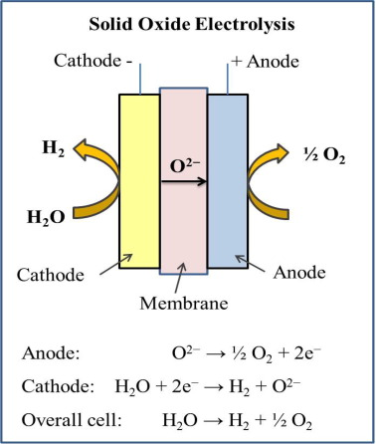
Solid oxide water electrolysis
Membrane material: ceramic proton conductor
Utilizes high temperature steam, operates at high T and P
Steam reacts with electrons from external circuit to form H₂ gas and oxygen ions
High efficiency (90%-100%)
Notes:
This electrolyzer can effectively use waste heat from upstream processes
High efficiency is due to the favorable thermodynamic and electrochemical kinetic conditions of cell since it is run at higher T and P (reduction of Gibbs Free Energy)

Slide 15
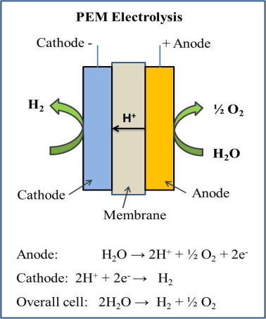
PEM Water electrolysis
Membrane material: Perfluorosulfonic acid polymer
Reaction at anode forms hydrogen and oxygen ions
Electrons travel through external circuit and combine with hydrogen ions to form H₂ gas
High purity (99.99%)

Slide 16
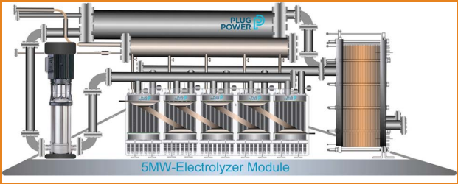
Industrial Electrolyzers
Electrolyzers can be scaled to meet a variety of functions
  From small applications to large, continuous operations requiring high hydrogen production
  The three types described above make up the majority of industrial electrolyzers
Notes:
→PEM Electrolyzer from Plug Power
→A couple of our projects had possible planned use for electrolyzers in tandem with wind and solar… Peloton (fell through) and WP Greenville (possibly upcoming, 5 MW electrolyzer)

Slide 17
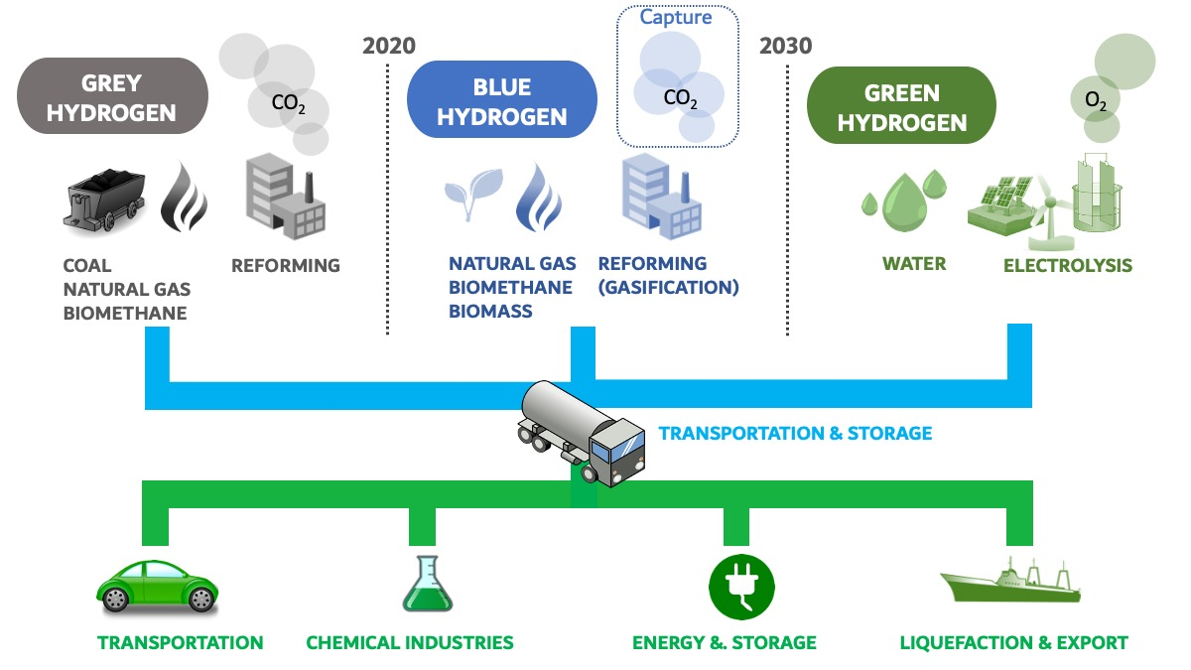
Hydrogen color scale
Notes:
→It is important to note where hydrogen comes from when assessing it’s color designation
→Only difference between grey and blue is the attempt at capturing GHG byproducts

Slide 18
Use as fuel

Slide 19
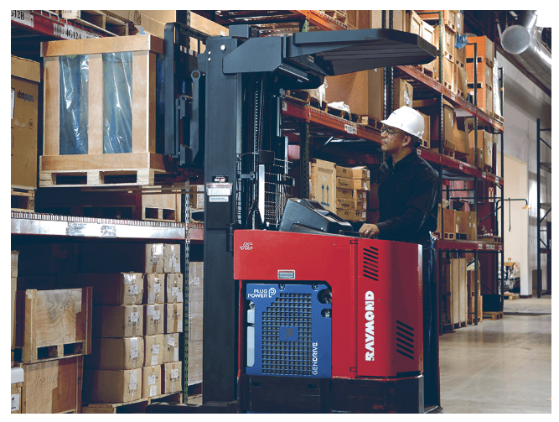
How is hydrogen used for fuel
Hydrogen fuel has a variety of applications
It can be:
  Burned for electricity generation as part of a natural gas-hydrogen fuel mixture
  Used as fuel for vehicles through the use of fuel cells or combustion engines
  Used for a varying of sizes of fuels cells, from those small enough to power a laptop to those large enough to generate 16 MW
Notes:
→20,000 hydrogen fuel cell forklifts are now in use in warehouses and manufacturing facilities throughout the U.S.
→ Plug Power is a great example; they have contracts with FedEx and Walmart to supply hydrogen fuel cells for forklifts
→Hydrogen powered forklifts/other vehicles can reduce a facility’s carbon footprint and remove the element of time required with electric charging

Slide 20
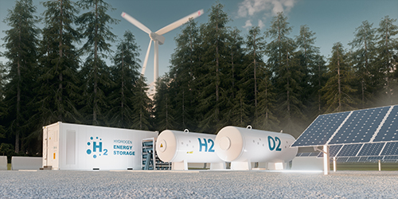
Hydrogen fuel cells
Pathway to generating energy from hydrogen gas without the byproducts associated with combustion of hydrogen gas mixtures
Inputs are hydrogen and air
Outputs are electricity, water, and heat
Notes:
→ At the end of October 2021, there were 166 operating fuel cells at 113 facilities in the US. The largest is 16 MW, the next two largest are 6 MW each

Slide 21
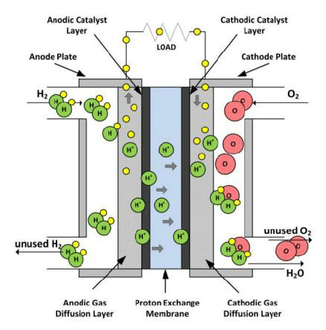
Hydrogen Fuel cells
Hydrogen gas enters the fuel cell and is oxidized at the anode
Hydrogen ion travels through a proton specific membrane
Electrons travel through an external circuit (electricity generation)
Hydrogen recombines with oxygen to form water (releasing heat in the process
Notes:
→Electrolyzers and fuel cells have very similar structures and reaction pathways
→Must input pure hydrogen, other gases can poison catalyst/membrane

Slide 22
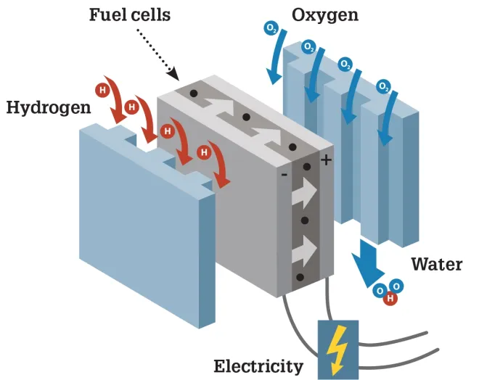
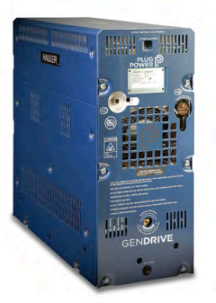
Hydrogen fuel cells
Notes:
→Fuel cells can be stacked to increase capacity, example is a 4 kW cell made by plug power
→Plug Power 4.0 kW fuel cell, size: 2.57’ x 1.07’ x 2.92’

Slide 23
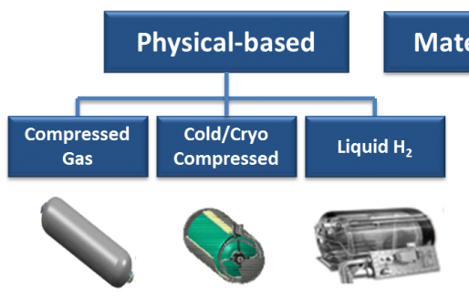
Hydrogen Gas Storage
Hydrogen gas is not dense
  0.00523 lb/ft³ compared to 0.0765 lb/ ft³ for air
  Storage in gas form requires high-pressure vessels
  Storage in liquid form requires low-temperature vessels

Slide 24

Market

Slide 25
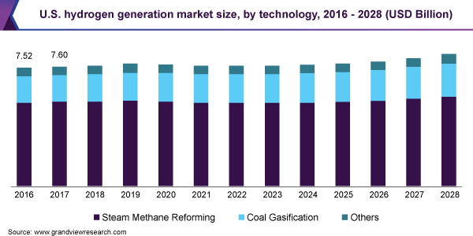
Hydrogen market
An increase in the demand for renewable fuels/energy is expected to drive an increase in the hydrogen generation market
Non-renewable generation sources still account for most hydrogen generation

Slide 26
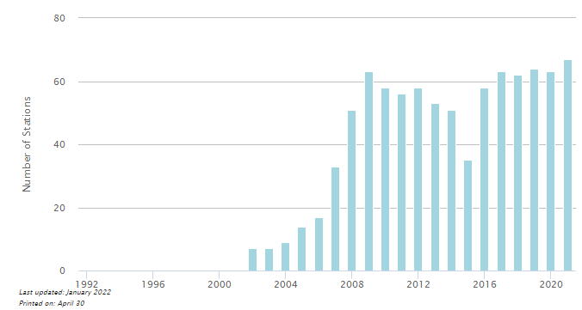
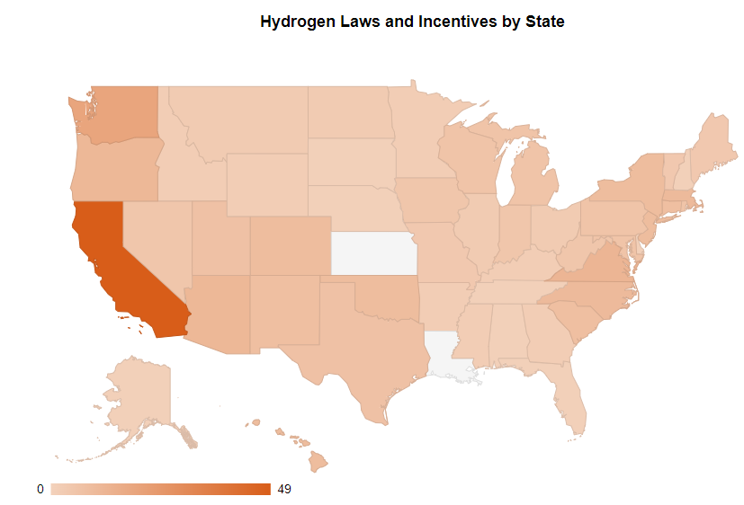
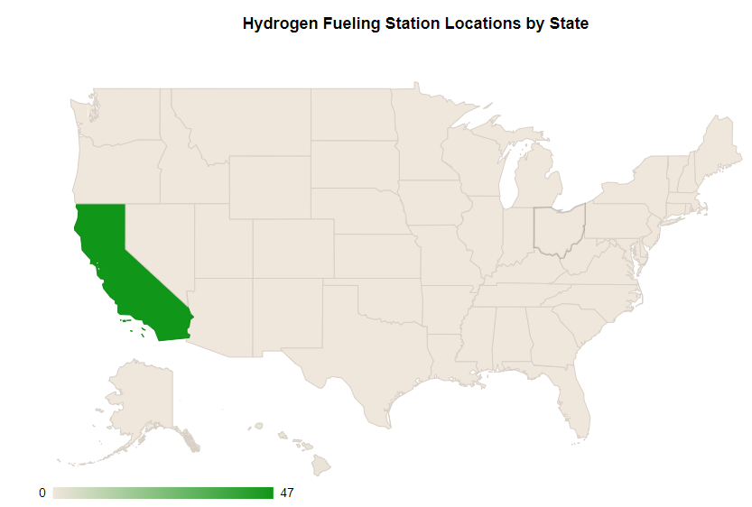
State of hydrogen in U.S.
Notes:
→Hydrogen fueling station increasing, but currently the market is trending to hydrogen for vehicles such as forklifts… vehicles used in facilities versus road vehicles (except CA)
→States are beginning to take notice of hydrogen fuel
→From EIA

Slide 27

Low carbon fuel standard And Carbon Intensity value
LCFS
California regulation to reduce GHG emissions
Credits are generated from low-carbon fuels in the California fuel pool
Incentivizes businesses to bring cleaner fuel options to California
CI Value
Measurement of GHGs emitted versus energy consumed for a fuel
Energy Economy Ratio
The efficiency of a fuel in comparison to a reference fuel

Slide 28
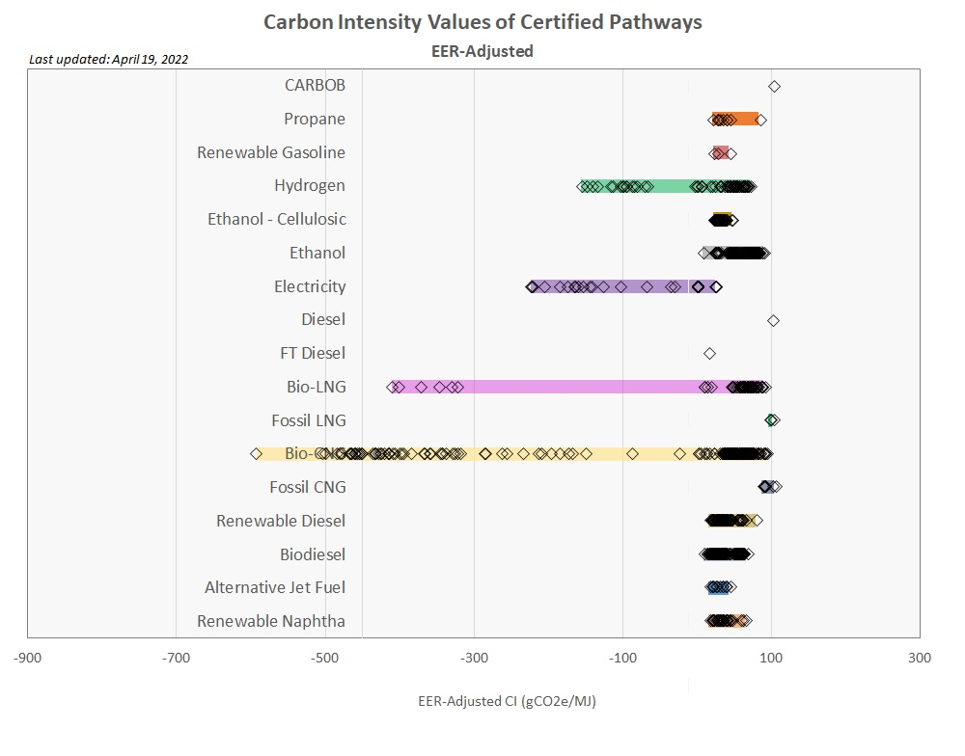
Carbon intensity value
Notes:
→From California Air Resources Board
→Graph shows the CI value for fuels divided by its EER to obtain an EER-adjusted CI value
→Bar lengths indicate the variations in CI that may be achieved through different synthesis methods
→Variations in CI come down to how “green” that synthesis pathway is

Slide 29

Government programs
Hydrogen Energy Earthshot
  A program deployed by the U.S. Department of Energy to reduce the cost of clean hydrogen by 80%
Decreasing the cost of renewable energy production could facilitate the integration of electrolyzers into renewable systems and help move away from fossil-fuel based production methods (i.e., steam reforming)
Notes:
→80% to $1 per 1 kilogram per 1 decade
→Launched June 7th, 2021

Slide 30





[Name]
[Date]

