Slide 1
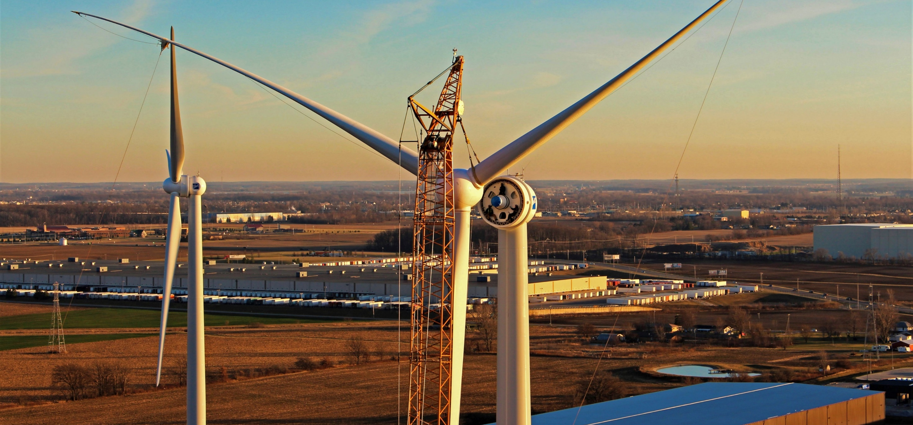

KNOWLEDGE NIGHT: RECRUITING
12385 Township Rd 215 | PO Box 894
Findlay, Ohio 45840
877-298-5853 | www.oneenergy.com
NAME
DATE

Slide 2
RECRUITING SCHEDULE
School | Type | Date | Attendees
U of M | In Person | 9/12/2022 | JG, BC, KP
U Penn | In Person | 9/16/2022 | DB, KP, RW
U of IL | Virtual | 9/19/2022 | CH, BS
OSU | Virtual | 9/20/2022 | CG, JC
Colorado School of Mines | Virtual | 9/21/2022 | MW
U of Minn. | In Person | 9/21/2022 | CG, BS
Toledo | In Person | 9/21/2022 | CB, EB, EJ
MIT | Virtual | 9/28/2022 | DP, DB
Northwestern | Virtual | 9/28 -29/2022 | (CH, JG -28th)(EB, KP – 29th)

Slide 3
GRADING SCALE
Brilliance
Embody Our Values
A : 8+
B : 5-7
C : <5
1 : Great
2 : Good, Acceptable
3 : <Acceptable
 | A | B | C
1
2
3
Green = Skip questions, bring in for interview
Yellow = Normal Process
Blue = Send questions, review before interview
A1 is rare. Think of this as someone you would want to bring in for an interview tomorrow.

Slide 4
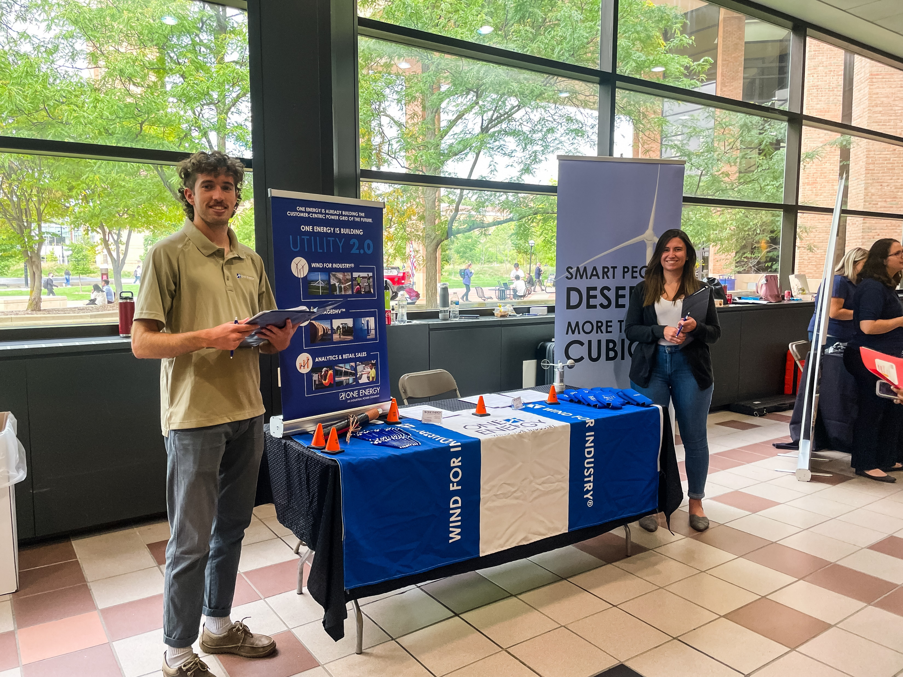
BASIC LOGISTICS
In Person
  Check-in/register
  Booth Set Up
  Conversation Length: ~ 5 min
    This should vary depending on how long the line is
  Ask for Resume
  Give out recruiting@ card
  Grade on resume
Virtual
  Set up location in the office
    Not at your desk
    Show off the office
  Conversation Length: depends on time slot
    Use our standard screening questions
  Ask for resume (if possible)
  Take notes!
    Student name
    Grade

Slide 5
WHAT TO WEAR
One Energy apparel
  Polo
  Button Down
  Sweater
  Nice sweatshirt (no hoodie)
  Clean construction shirt (Utility 2.0)
Comfortable shoes
Name tags
  Professional yet approachable is what we’re going for.

Slide 6
PACKING LIST
Individual
Booth
Clip board/Folder
Pen
Water
Hand Sanitizer
Name tag
OEE Credit Card
Snacks
Laminated Rating Sheet + Questions
Suggested
  Chapstick, eye drops, mints, gum, layers (sweatshirt), ibuprofen, hairbrush
Swag
  Foam turbines
  Koozies
  Pens
Job Descriptions (100 intern, 50 full time)
Tablecloth (x2)
One Energy table runner
Recruiting business cards
Business card holders
Banners/Signs
  1 floor banner
  1 tabletop banner
Show & Tell table displays

Slide 7
HOW TO APPLY
Handshake
12Twenty
(other one?)
Email Recruiting@oneenergyllc.com
Try not to give out your direct contact information. Unless you want to get a TON of emails.

Slide 8
WHAT TO TALK ABOUT
Steps
  Get resume
  Have conversation
  Ask if full time or internship, and timeline
  Make sure they know how to apply and that we will send questions
  Give recruiting@ card
  Rate them
  Note if Analyst, FE or both
We are hiring for full-time and internships for summer 2023
  Analyst
  Field Engineer
Difference between Analyst and Field Engineer role
What is One Energy
  Business lines
What are they looking for out of a full-time or internship?

Slide 9
FAQ
Do you provide sponsorship for international students?
  Yes
Do you offer remote work?
  No
Do you hire freshman (first years)?
  Yes, but they must be exceptional
Do you have any job opportunities in R&D?
  Possibly. If the candidate was right.
What kind of jobs do you have available?
How much do you pay?
  Interns: between $18 - $30 hour depending on experience. Overtime available.
  Full-time: Adjusted year to year. Evaluate pay regularly and aggressively match your growth to your pay.
What kind of growth opportunities are there?
What are your benefits?
  Interns: housing
  Full-time: Lots
Do you offer housing for interns?
  Yes
What is your culture like?
How is your diversity at OE?
  We are aggressively recruiting at multiple universities from all over the country.
  We have a female dominated leadership team.
What kind of work does a ______ engineer do?
What does One Energy Analytics do?

Slide 10
OTHER IMPORTANT THINGS
Take breaks!
Drink water!
Be friendly!
Exit the conversation when you need to
Know when to call in reinforcements

Slide 11
EXAMPLE CONVERSATION
Practice!

