Slide 1
What is A Wetland?
Zhuoran Zhang
10/9/2024

Slide 2
Outline
Wetland introduction
Jurisdiction over wetlands
General steps involved in a third-party delineation
Resources
Summary

Slide 3
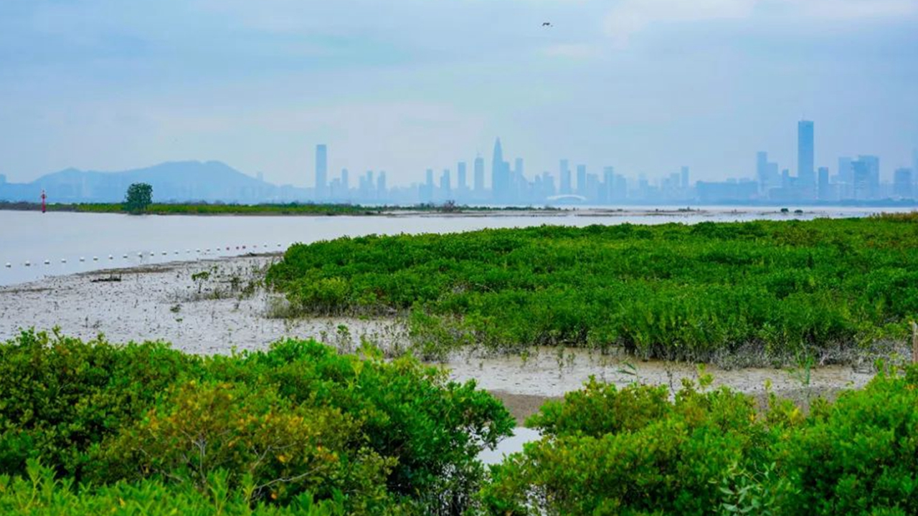
What is A wetland
Definition
Wetlands are areas where water covers the soil or is present either at or near the surface of the soil all year or for varying period during the year including during the growing season.
Coastal Wetlands: Mangroves, salt marshes, and tidal marshes
Inland Wetlands: Freshwater marshes, swamps, peatlands, and wet meadows

Slide 4
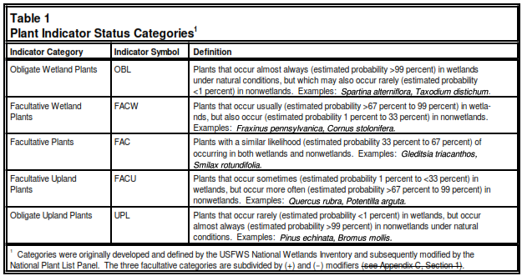
Wetland characteristics
Hydrophytic Vegetation
  Plants that grow in areas where the soil is frequently or constantly wet, influencing the types of plants that can thrive there
  Indicators:
  Dominant Species: Over 50% of the plant species should be classified as obligate wetland species (OBL), facultative wetland species (FACW), or facultative species (FAC).
  Morphological Adaptations: Plants may have special adaptations such as aerenchyma tissue for oxygen transport.
Figure 2. Environmental Laboratory. (1987). Corps of Engineers Wetlands Delineation Manual. Technical Report Y-87-1, U.S. Army Engineer Waterways Experiment Station, Vicksburg, MS.

Slide 5
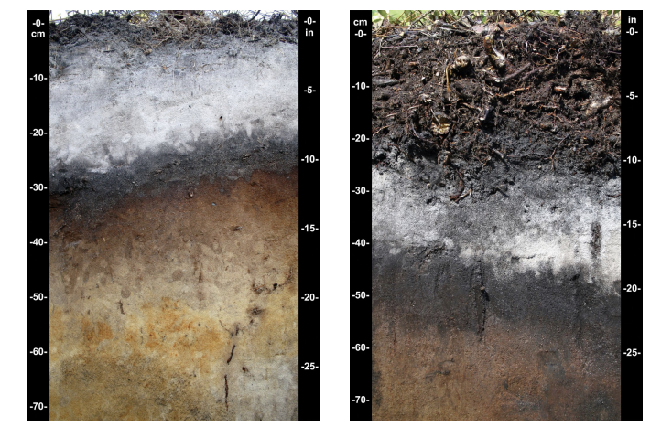
Wetland characteristics
Hydric Soil
  A hydric soil is a soil that formed under conditions of saturation, flooding, or ponding long enough during the growing season to develop anaerobic conditions in the upper part.
  Indicators:
  Soil Color: Presence of gleied soils (gray or bluish color) or redoximorphic features (mottling).
  Organic Content: High organic matter, especially in the organic horizon, indicating prolonged saturation.
  Odor: Rotten Egg Smell
Figure 3. United States Department of Agriculture, Natural Resources Conservation Service. (2010). Field Indicators of Hydric Soils in the United States (Version 7.0). Edited by L.M. Vasilas, G.W. Hurt, and C.V. Noble. In cooperation with the National Technical Committee for Hydric Soils

Slide 6
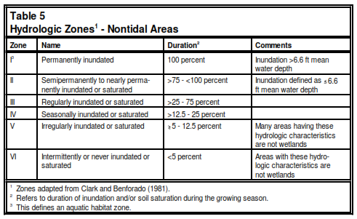
Wetland characteristics
Wetland Hydrology
  The presence of water at or near the surface long enough during the growing season to influence the types of plants and soils that develop due to low oxygen conditions.
  Indicators:
  Surface Water: Visible presence of water or waterlogged conditions during field visits.
  Water Marks: Stains on trees or structures indicating regular water levels.
  Soil Saturation: Water table near or above the surface during growing season.
Figure 4. Environmental Laboratory. (1987). Corps of Engineers Wetlands Delineation Manual. Technical Report Y-87-1, U.S. Army Engineer Waterways Experiment Station, Vicksburg, MS.

Slide 7
Wetland characteristics
At least one indicator from each category from slide 3 to 4 must be present to identify an area as a wetland.

Slide 8
Is farmland a wetland?
Not all farmland is classified as a wetland
Determining whether farmland is a wetland is difficult in our region.

Slide 9
A Suspected wetland IS present
Disturbance of wetlands should be avoided when siting projects or constructing them
If a suspected wetland is indicated nearby to a project, further research is needed
If through further internal research (checking historical data, cross-referring different maps) the suspected wetland cannot be ruled out or avoided, then consultation with the regulatory team is needed
The regulatory team may determine that a wetland delineation or alternative siting is needed. Further action would be informed by the results of this delineation

Slide 10
jurisdiction over wetlands
Federal Jurisdiction:
  U.S. Army Corps of Engineers (USACE): Authority under the Clean Water Act (Section 404) for wetlands connected to "waters of the United States.“
  EPA: Works with USACE to enforce regulations and water quality standards.
  Requires permits for activities like filling, dredging, or construction.
State Jurisdiction:
  States regulate isolated wetlands and may have more stringent rules than federal standards.
  Section 401 Water Quality Certification: State permits for wetland impacts.
  - Example: Ohio EPA oversees isolated wetlands and water quality.
Local Jurisdiction:
  Local governments may have zoning codes or ordinances impacting wetland use.

Slide 11
General steps involved in a Delineation
Preliminary Data Gathering:
  USGS Maps
  Soil Surveys
  Aerial Photography
  Previous Studies
Onsite Evaluation:
  Soil Sampling
  Vegetation Assessment
  Hydrology Assessment
Delineation Report:
  Maps showing the boundaries of identified wetlands
  Soil and vegetation data.
  A description of hydrology.
The delineation report is submitted to the U.S. Army Corps of Engineers (USACE) for review and approval.
Third-party professionals will go onsite and do the delineation.

Slide 12
General steps involved in a Delineation
If third-party professionals determine that a wetland will be disturbed, permits must be obtained prior to construction.
Section 404 Permit (Federal): If your property has wetlands that are considered "waters of the United States," you will need a Section 404 permit from the USACE to place fill material into the wetlands.
Section 401 Water Quality Certification (State): Obtain this certification from Ohio EPA to ensure that your project complies with state water quality standards.
Isolated Wetland Permit: If the wetland is not classified as "waters of the United States" but is a state-recognized isolated wetland, you will need an isolated wetland permit from Ohio EPA.
Coordinate with Local Authorities.

Slide 13
General steps involved in a Delineation
Wetland Mitigation
Mitigation Requirements: Under the Clean Water Act (in the U.S.), if a developer impacts a wetland, the U.S. Army Corps of Engineers may require them to:
  Create a new wetland (wetland creation)
  Restore a degraded wetland (wetland restoration)
  Enhance an existing wetland (wetland enhancement)
  Preserve an at-risk wetland (wetland preservation)
No Net Loss Policy: wetland losses must be offset by wetland gains in terms of actual acreage and, to the extent possible, ecosystem function

Slide 14
Organizations
Local Soil and Water Conservation District (SWCD): They provide initial property reviews and assistance in identifying wetlands.
Ohio Environmental Protection Agency (EPA): Offers support for wetland permitting and information on isolated wetlands in Ohio.
U.S. Army Corps of Engineers (USACE): The main federal agency responsible for reviewing wetland delineations and issuing Section 404 permits.

Slide 15

Setbacks
Three Tiers and Setbacks: Ohio EPA classifies wetlands into three categories to determine setback requirements:
The setbacks are based on wetland quality and functional capacity, as defined in the Ohio Administrative Code and guidelines from environmental protection agencies.
Default One Energy Wetland Buffers (subject to change):
  For Solar: 50 ft
  For Nordex N149: Rotor Radius (260 ft)
Figure 5. Ohio Environmental Protection Agency. (2022). Wetland Setback Guidelines. Draft version, Chapter 1.6, Rainwater and Land Development

Slide 16
reSources
U.S. Fish and Wildlife Service (USFWS) - National Wetlands Inventory (NWI)
Provides detailed and comprehensive wetland maps for the entire U.S.
Highly accurate, frequently updated, widely used by government agencies and developers.
Updated twice a year (Last update 2023 June)
Inherent inaccuracies due to reliance on high-altitude imagery for mapping
Accuracy influenced by image quality, analyst experience, and ground verification
Data reflect a biological, not regulatory, definition of wetlands
Wetland boundaries may not be up-to-date or legally recognized.

Slide 17
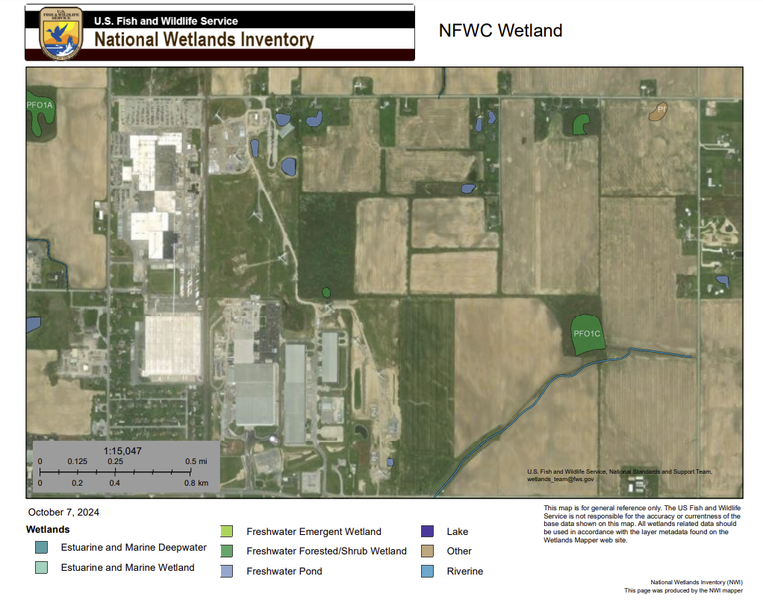
National Wetlands Inventory (NWI)
Examples

Slide 18
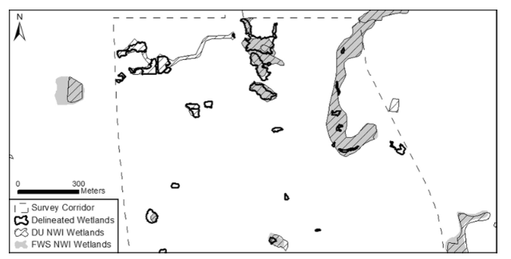
National Wetlands Inventory (NWI)
Examples
Figure 6. Matthews, J. W., Skultety, D., Zercher, B., Ward, M. P., & Benson, T. J. (2016). Field verification of original and updated National Wetlands Inventory maps in three metropolitan areas in Illinois, USA. Wetlands, 36(6), 1155–1165. https://doi.org/10.1007/s13157-016-0836-6

Slide 19
National Wetlands Inventory (NWI)
When can we use it?
Preliminary Screening:
Early Planning: Use NWI maps at the initial Evaluation stage. This helps in understanding the general presence, location, and approximate boundaries of wetlands.
Initial Site Assessment: The maps can provide a preliminary indication of areas that may need further investigation.
NWI maps are useful starting point, but field verification is essential for accurate wetland delineation.

Slide 20
Summary
Disturbing a wetland without following the proper delineation process poses significant legal risks.
The financial and time-related costs associated with suspected wetland delineation can be substantial.
It is strongly advised to avoid suspected wetland during the initial siting process.
Until an approved wetland delineation report from a third-party is obtained, everyone should use the word “suspected wetland” during any communication (chat, email and documentations).

Slide 21
Questions?

