Slide 1



PRIVILEGED AND CONFIDENTIAL
OE Wind & Solar
Permitting
Katie Treadway
March 19, 2024

Slide 2
OUTLINE
Discuss OE’s permitting methodology
Discuss federal, state, and local permits and approvals for OE’s wind and solar projects

Slide 3
OE PERMITTING MEMOS
One Energy has two outlines that set out One Energy’s permitting methodology 1) a FERC approvals outline and 2) an outline that covers everything else
One Energy develops these outlines with FERC counsel and counsel in every state a project is in
One Energy will have these two outlines for every state it operates in
The goals of these outlines are to ensure OE is following the law when it develops, constructs, and operates its projects and prove that to investors

Slide 4
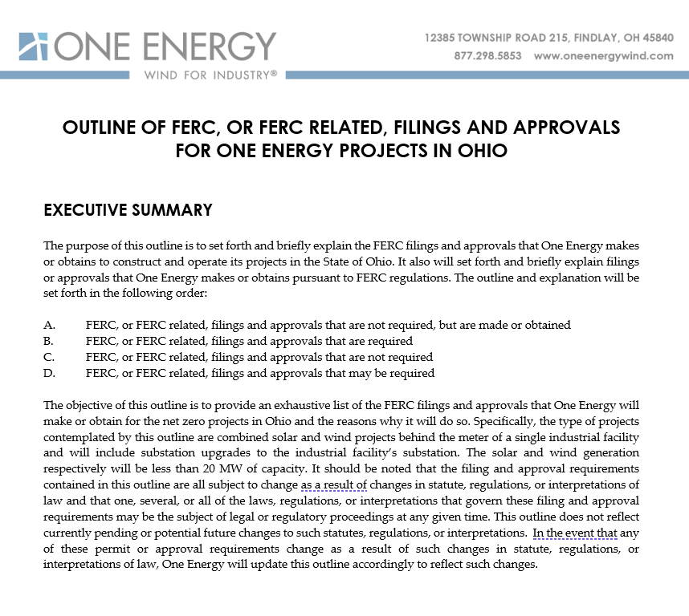
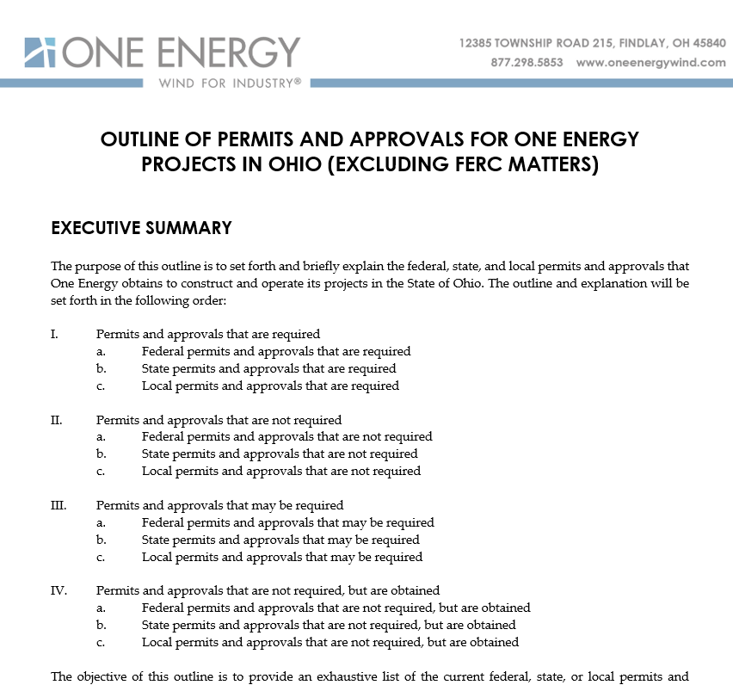
OE PERMITTING MEMOS
The permitting outlines aren’t that lengthy and worth a read if you want to understand OE’s permitting better!

Slide 5
OE PERMITTING TAKEAWAYS
PPT, Construction, and Legal/Regulatory are all responsible for project permitting and compliance at OE
Things each department does (especially siting) impacts whether OE is regulated and in compliance
Some permits trigger other permits
Projects are regulated very differently depending on size, type, and transaction involved (i.e. wind, solar, combined wind/solar, electric infrastructure with no wind and solar included, voltage, size in MW, sale versus rental veruses capex etc)
Projects are regulated very differently depending on location

Slide 6
POTENTIAL FEDERAL PERMITS/APPROVALS (EXCLUDING FERC)
Relevant Law | When Required? | Consequence? | How Often?
14 CFR Part 77 (FAA) | If constructing or altering a structure over 200 ft. AGL | File notices with FAA | Always for wind. PPT performs analysis & files notice (7460-1 and 7460-2) with FAA.
EIA Generating Plant Reporting | Electric generators 1 MW or greater | Reporting requirements | Always for wind and solar. Regulatory files EIA 860 w EIA and reports during operation
Fish and Wildlife Coordination Act | If a stream or body of water is modified | Consult w/ USFWS; Can take years | Rarely/Never. OE avoids impacts to streams or waterways. Phase I; wetland inventory.
U.S. Army Corps of Engineers (Army Corps) Clean Water Act Section 404 Permit | If discharge dredge or fill into waters of US. | Need 404 permit from US Army Corps. Can take months & trigger other lengthy permits | Rarely/Never. OE avoids impacts to waters including wetlands. Phase I; wetland inventory.
National Environmental Policy Act (NEPA) Review | If “federal nexus.” i.e. siting on federal lands, federal funding, or certain permits. | Can take years; Must perform EIS/EA | Rarely/never. OE avoids building on federal lands and federal funding. Siting
Endangered Species Act (ESA) Incidental Take Permit | Activities that may kill or injure threatened or endangered species | Can take years | Rarely/Never. Due to size and location of projects. Desktop review; IPaC

Slide 7
POTENTIAL FEDERAL PERMITS/APPROVALS (EXCLUDING FERC)
Relevant Law | When Required? | Consequence? | How Often?
Endangered Species Act (ESA) Section 7 Consultation | Federal agencies consult with USFWS for federal action that may impact threatened or endangered species | Can take years | Rare/Never. Due to size and location of projects. Desktop review; IPaC
U.S. EPA Spill Prevention, Control, and Countermeasure (SPCC) Plan | Sites with above ground oil storage of at least 1,320 gallons (buried > 42,000 gallons). | Prepare SPCC plans for sites. | Construction reports if needed. Depends on oil quantities at sites.

Slide 8
FERC PERMITS/APPROVALS
Relevant Law | When Required? | Consequence? | How often?
Federal Power Act | If own or operate facilities subject to the jurisdiction of FERC. FERC jurisdiction if there is the transmission of electric energy in interstate commerce or sale of electric energy at wholesale. Wholesale = sale for resale | Lots of regulation. FERC approval for mergers & acquisitions (§ 203), FERC market-based rate approval (§ 205; § 206), interlocking directorate obligations (§305), etc. | Always. Have to look at every project to see if exemption exists.
Public Utility Holding Company Act | If own or operate facilities used for generation, transmission, or distribution of electricity for sale. | Entities that do this and/or any entity that owns 10% or more of such entity has to maintain books and records in accordance with FERC accounting standards. Intrusive and investors hate it. | Always. Have to look at every project to see if exemption exists.
Public Utility Regulatory Policies Act of 1978 (PURPA)
The Public Utility Regulatory Policies Act of 1978 (PURPA) grants very important exemptions to these laws.

Slide 9
PURPA
Public Utility Regulatory Policies Act (PURPA) (18 C.F.R. 292.101 - 18 C.F.R. 292.404)
A 1978 federal statute.
Obligates utilities to: 1) purchase energy from qualifying facilities* (QFs) at avoided costs*, 2) sell energy and capacity to QFs at nondiscriminatory rates, and 3) allow QFs to interconnect
Avoided costs = the cost to the utility of generating its next incremental unit of electricity; See 18 C.F.R 292.101(b)(6)
  The cost to the utility of procuring generation in absence of QF
  This calculation varies by utility and by state. Most often determined by market rates
Exempts QFs from certain state and federal laws
* A 2020 change to PURPA removed this obligation in many circustances
Takeaway: PURPA is very important for our business model. It protects our projects from discrimination by established utilities and exempts us from costly, complicated regulations.

Slide 10
PURPA EXEMPTIONS
QF = A project is a QF and more specifically a small power production facility (SPP) if it is ≤ 80 MW, a FERC Form 556 is filed, and the primary energy source is renewable
80 MW: To qualify under PURPA, SPP must be under 80 MW.
30 MW: Certain people interpret PURPA so that if project is 30 MW or greater, the SPP loses its PUHCA exemption.
  Entity and all its investors subject to FERC accounting & reporting
  Deal killer
20 MW: SPPs greater than 20 MW lose their exemption under FPA section 205 and 206 re market base rates.
  Must make baseline filings in FERC’s relational database, file an application that includes a market power analysis, and detail wholesale transactions in electric quarterly reports.
  Pain in the butt, not a deal killer.
5 MW: SPPs greater than 5 MW typically can’t sell to utilities at avoided costs, must sell excess in wholesale markets (unless net metering applies)

Slide 11
PURPA EXEMPTIONS
How big is a project?
FERC doesn’t define projects like OE does.
QFs that 1) use the same energy resource, 2) are owned by the same person or its affiliates, and are located at the “same site,” are considered the same facility.
“Use the same energy resource” → wind is counted separate from solar
“Owned by the same person or its affiliates” → 5% or more ownership or 5% owned by common owner
“Same site”
  If one mile or less from another project →irrebuttable presumption that same site
  If more than 1 mile and less than 10 miles → rebuttable presumption that separate site
  If ten miles or more → then irrebuttable that separate site
  For wind measure from center of tower to center of tower
  For solar measure from closest edge to closest edge

Slide 12
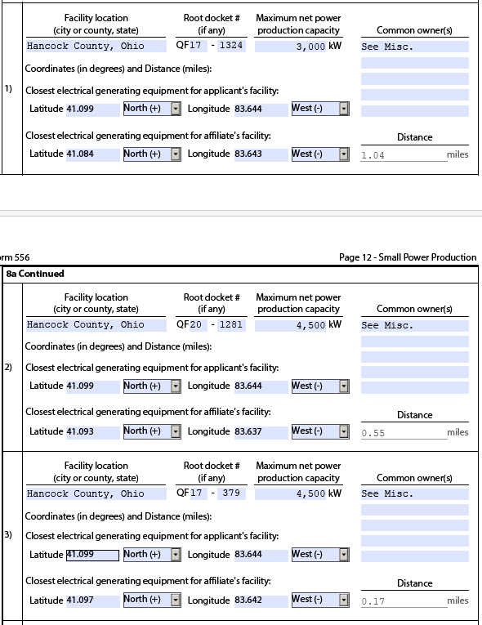
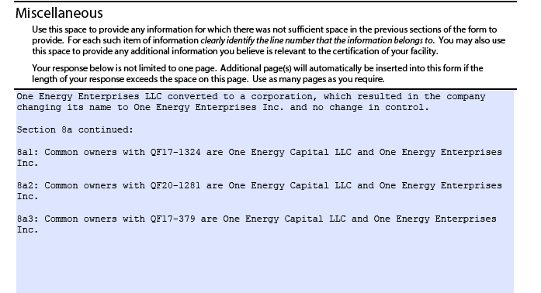
PURPA EXAMPLE
Whirlpool Findlay FF 556
  Measure W2 to V2
  Measure W2 to Z1
  Measure W2 to Z4

Slide 13
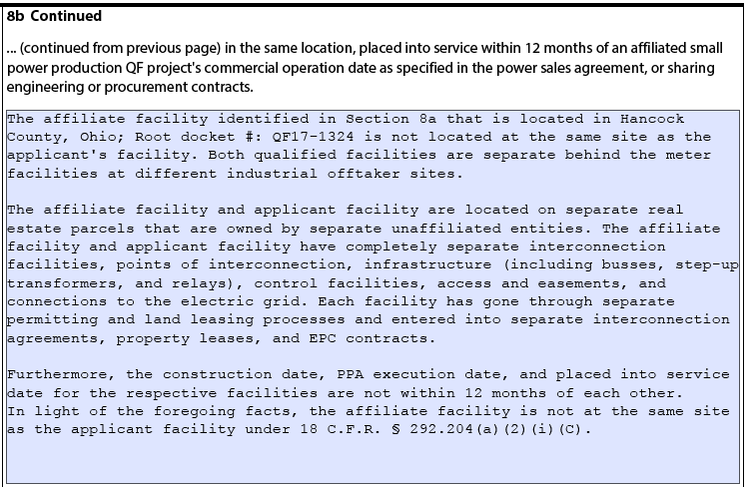
PURPA EXAMPLE (CONT.)

Slide 14
PURPA EXAMPLE (CONT.)
Findlay Net Zero
Will need to file the net zero wind FF 556 and refile all of the existing FF 556s for Whirlpool Findlay, Ball 1, Ball 2, and Valfilm
Will need to separately file the net zero solar FF 556.
Worst case: 15 MW of existing wind + 14.4 MW of net zero wind = 29.9 MW.
  Will have to file for market based rates because larger than 20 MW.
  Maintain PUHCA exemption
  Intend to file for a waiver from market based rates

Slide 15
PURPA EXEMPTIONS
MW hubs. Have to file individual PUHCA exemptions because they don’t qualify as a QF under PURPA. ☹
$37,760 per filing

Slide 16
POTENTIAL STATE PERMITS/APPROVALS
Relevant Law | When Required? | Consequence? | How often?
Ohio interconnection regulations | Application required to interconnect generation with utility | File interconnection application with utility, load study, interconnection agreement | Always for wind and solar. Construction files application.
Ohio net metering law | Required for project to be net metered. | File net metering application and enter into agreement. | Always for wind and solar. Filed with interconnection application.
OH EPA General Permit under NPDES (Storm Water Pollution Prevention Plan (SWPPP)) | Construction that disturbs more than an acre of land. | Create SWPPP, file it, and then terminate it after construction. | Almost always. Construction creates plan and makes filings.
Ohio Power Siting Board (OPSB) laws | Not required if wind less than 20 MW for a single customer. Not required for solar less than 50 MW. | Many studies, large application filed with OPSB, multiple year approval process. | Never if projects stay under a certain size. Considered at interconnect.
SHPO Section 106 Review | If federal permit or OPSB review triggered. | Coordination w SHPO under State Historic Preservation Act. OE studies & review | Rarely/never if projects stay under certain size and sited to avoid impacts.
ODOT Office of Aviation Construction/Alteration Permit | If project located in 6 surfaces. | Obtain permit from ODOT Aviation. | Rarely/never. PPT ensures siting outside of 6 surfaces.

Slide 17
POTENTIAL STATE PERMITS/APPROVALS
Relevant Law | When Required? | Consequence? | How often?
Ohio EPA 401 Water Quality Certification | If US Army Corps permit required | Obtain water qualify certification from Ohio EPA. | Rarely/Never. PPT. OE avoids impacts to waters including wetlands. Phase I; wetland inventory.
Ohio EPA Isolated Wetlands Permit | Impacts to wetlands not covered by US Army Corp. (isolated state wetlands) | Permit from Ohio EPA. | Rare/Never. OE avoids impacts to waters including wetlands. Phase I; wetland inventory.
Ohio EPA Risk Management Plan | If toxic of flammable chemicals above certain quantities | Submit plan to Ohio EPA. | Rarely/Never. Construction monitors quantities w respect to thresholds
Permit for Combustible/Flammable Tanks | If flammable/combustible tanks over certain sizes for certain durations. | Consult with State Fire Marshal and Fire Depts. | Sometimes. Construction monitors
ODNR Incidental Take permit | Activities that may kill or injure threatened or endangered species | Cooperative agreement with ODNR | Rarely/Never. Due to size and location of projects. Desktop review; IPaC
REC Certifications (OH, PA, MD, VA) | To generate RECs for projects. | File certifications to generate RECs in each state. | Regulatory files for all projects.
Ohio Payment in Lieu of Tax (PILOT) Program | To pay a per MW payment for wind and solar instead of PUPP. | Significant tax savings for projects. | Regulatory files for all wind and solar projects.

Slide 18
POTENTIAL LOCAL PERMITS/APPROVALS
Relevant Law | When Required? | Consequence? | How often?
Local zoning approval/permits | When local zoning ordinance applies | Must obtain relevant approval from local zoning authority. | Many of OE’s projects. Coordinated effort among depts.
Access drive permits | Construction that disturbs more than an acre of land. | Create SWPPP, file it, and then terminate it after construction. | Almost always. Construction creates plan and makes filings.
Flood Plain Permits | When project located in flood plain. | Typically must obtain a local flood plain from local authority | Rarely/Never. OE typically avoids flood plains through siting.

Slide 19

Questions?

