Slide 1
Financial model
By: Carl

Slide 2
Outline
Quick financial model overview
Build out your own financial model
Sensitivity testing

Slide 3
Reminders
Financial modeling predicts the project’s financial outcomes over the 20-year lifetime of the project. The P&L tracker logs actuals.
Blue cells – inputs
Black cells – calculations (DO NOT CHANGE)
Orange - Check cells to make sure you didn’t mess something up

Slide 4
GENERAL MODEL
INPUTS

Slide 5
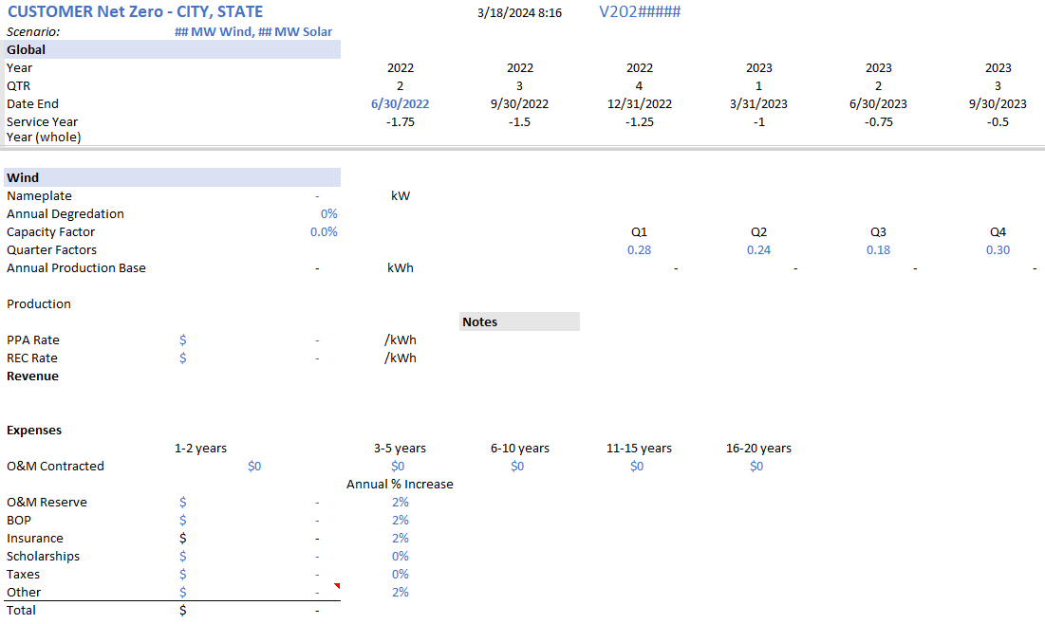
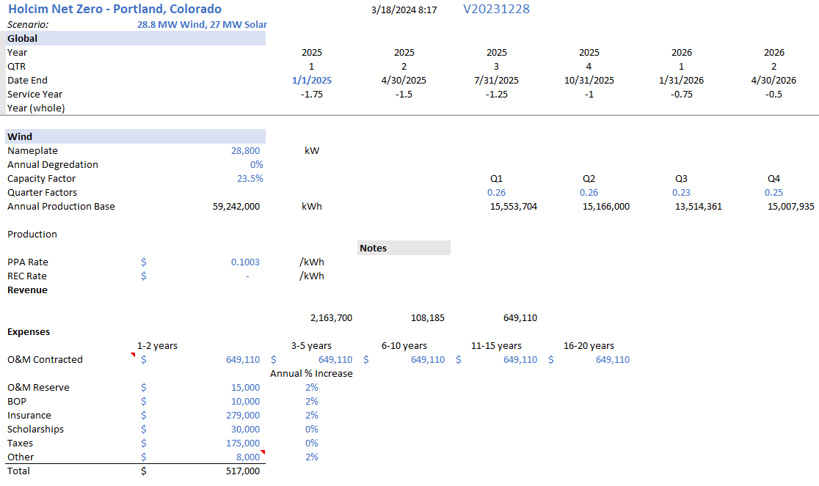
Model inputs – customer information

Slide 6
Model inputs – Version

Slide 7
Model inputs – project scenario

Slide 8
Model inputs – Project Begin Date

Slide 9
WIND INPUTS

Slide 10
Model inputs – wind project size (kW)

Slide 11
Model inputs – wind annual degradation
Notes:
Typically, 0% for wind

Slide 12
Model inputs – wind Capacity Factor
Notes:
This should be the IE wind analysis or p50 from PPR. This number HAS to be logged in the wind log

Slide 13
Model inputs – wind quarter factors
Notes:
Either use the default in the template or use the monthly production numbers to come up with the quarterly factors and insert here

Slide 14
Model inputs – PPA Rate
Notes:
Put in a number to start with (0.0500/kWh) and will solve for the actual number in the end

Slide 15
Model inputs – REC Rate
Notes:
This is location dependent and what the REC market is in the RTO. We get this number from regulatory (updated quarterly).

Slide 16
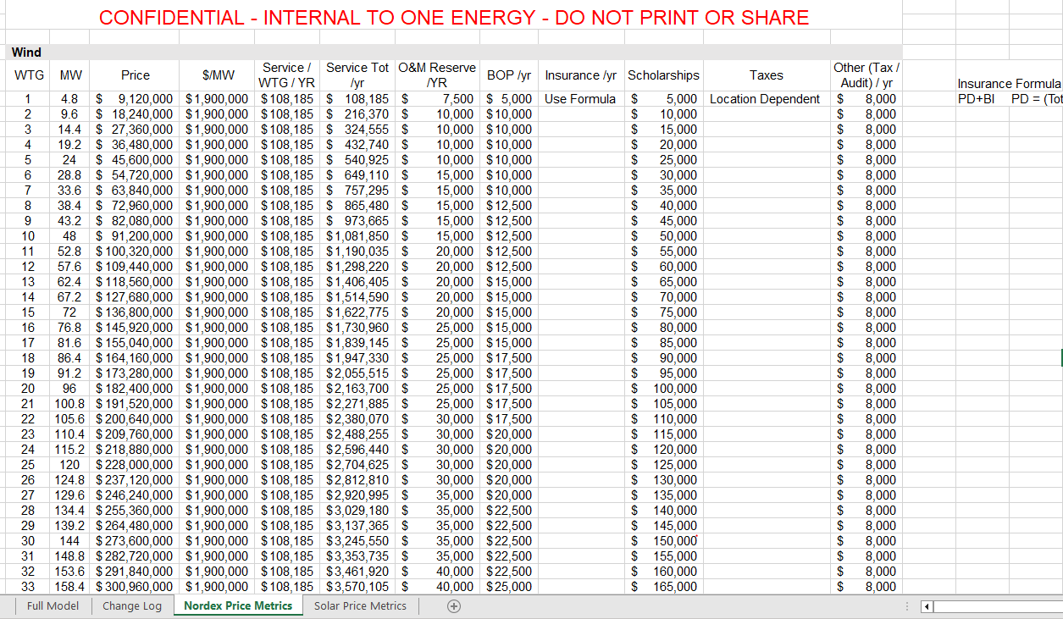
NORDEX PRICE METRICS

Slide 17
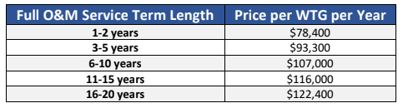
Model inputs – WINd o&m contracted
Notes:
This number should be flat across the 20 years (the reasoning is that we will pay down our principal and have a lower debt payment and the financials don’t playout as expected when its increasing).

Slide 18
Model inputs – WIND O&M Reserve
Notes:
This is the money we keep in reserve in an event we may need it for not accounted for O&M

Slide 19
Model inputs – WIND Balance of Plant
Notes:
BOP is the money we pay ourself annually to maintain the balance of plant

Slide 20
Model inputs – WIND Insurance
Notes:
Insurance for the project from loss of property and loss of revenue.
This formula is PD+BI
PD = (Total CAPEX/100)*0.45
BI = [(Annual Production*PPA Rate)/100]*0.55

Slide 21
Model inputs – WIND Scholarships
Notes:
Megawatt Scholarship - $5,000/WTG/year to a local hs senior going into STEM

Slide 22
Model inputs – WIND TAXES
Notes:
This is location-dependent. Each entity has their own rules on what would apply to the project (property tax, revenue, real, etc.). In the State of Ohio it is PILOT (Payment in Lieu of Taxes) which for wind is $6,000/MW/Year

Slide 23
Model inputs – WIND OTHER
Notes:
Other is the payment for annual legal fees and taxes to maintain the project/entity

Slide 24
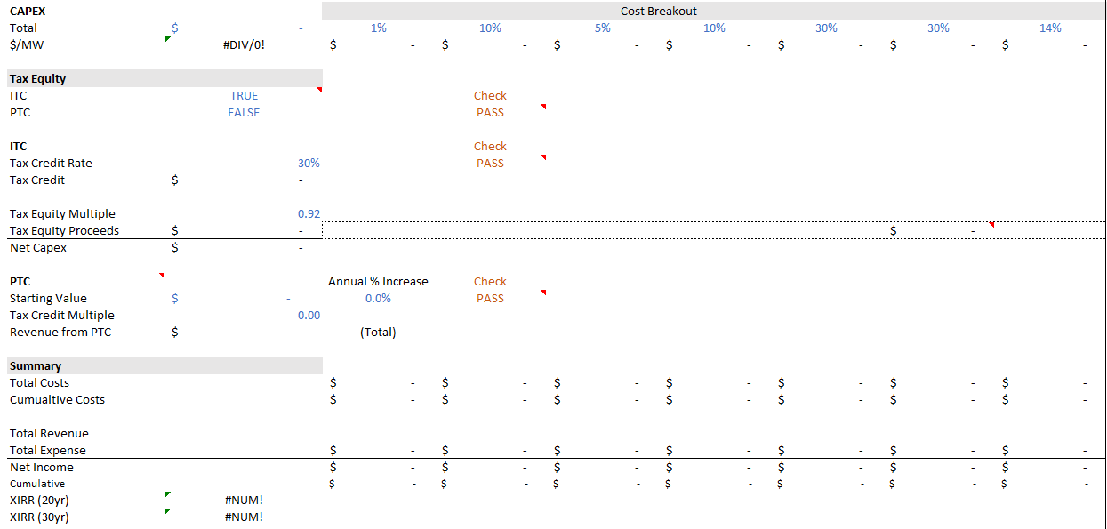
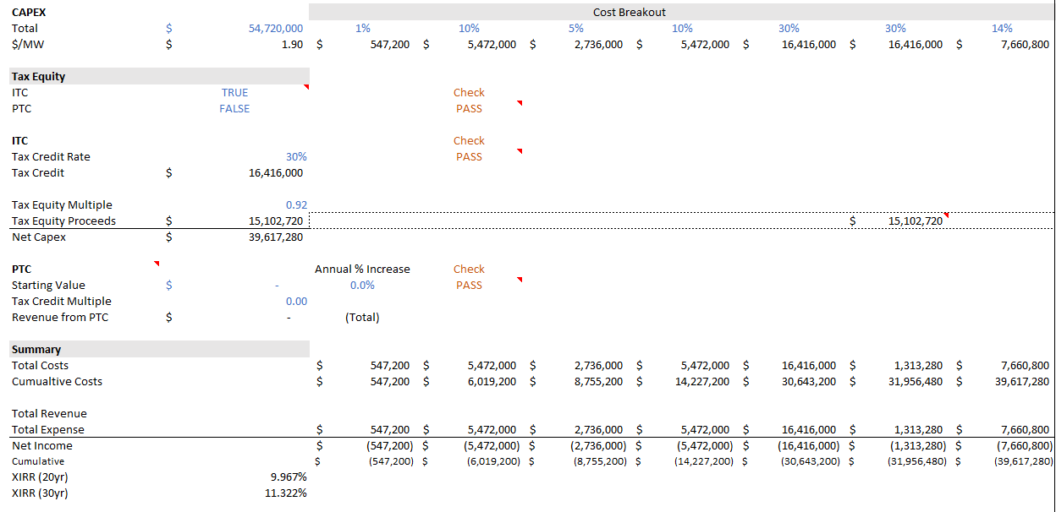
Model inputs – WIND CAPEX
Notes:
This number factors in all NORDEX costs and OE costs to install

Slide 25
Model inputs – WIND CAPEX Cost Breakout
Notes:
Don’t change unless told to

Slide 26
Model inputs – WIND ITC/PTC
Notes:
OE Wind Projects are usually most financially attractive with ITC. True/false – calculates itself dependent on what is true

Slide 27
Model inputs – WIND ITC Rate
Notes:
Under the Inflation Reduction Act the current ITC rate is 30%. 40% if you can prove American Made. IRS still defining what that means

Slide 28
Model inputs – WIND Tax Equity Multiple
Notes:
How many cents we expect our buyer to pay per dollar of credit

Slide 29
Model OUTPUTS – WIND 20-YEAR XIRR
Notes:
Important to note returns on wind project to compare to other portions of the projects

Slide 30
SOLAR INPUTS

Slide 31
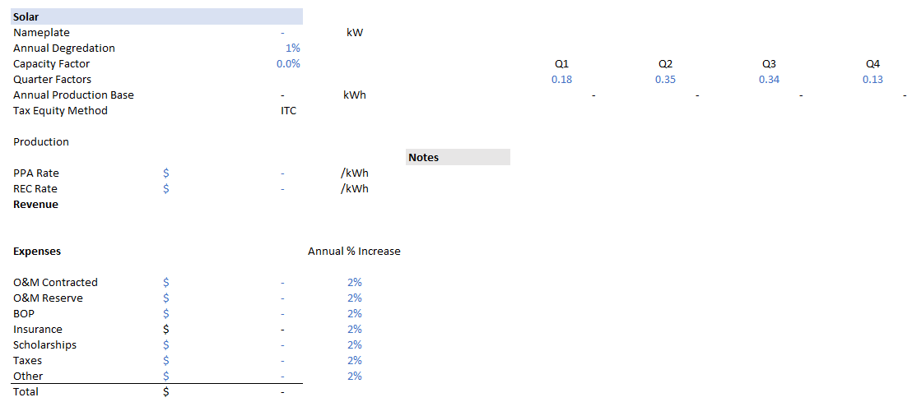
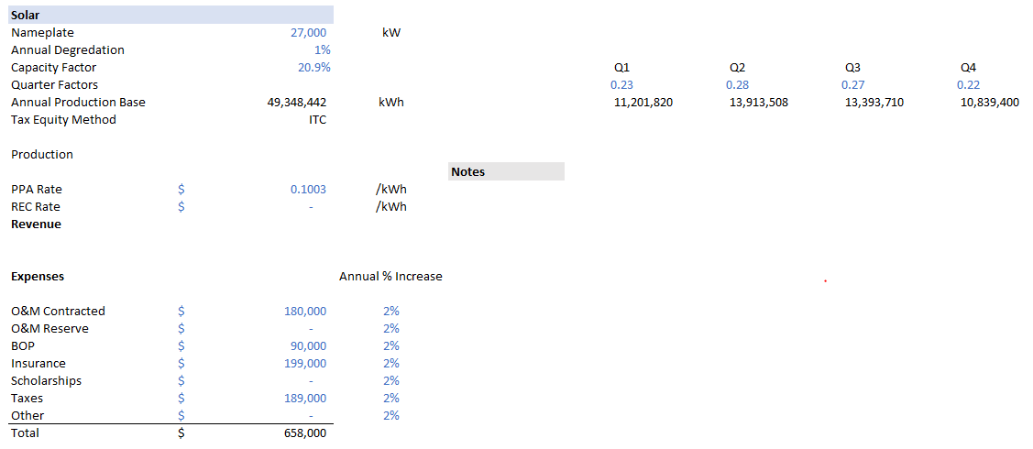
Model inputs – SOLAR Project Size (KW)

Slide 32
Model inputs – SOLAR Annual Degradation
Notes:
This number is typically 1%

Slide 33
Model inputs – SOLAR Capacity Factor
Notes:
This number should come from PVsyst calcs

Slide 34
Model inputs – SOLAR ITC/PTC
Notes:
ITC is selected from the wind section. Would execute the same

Slide 35
Model inputs – SOLAR Quarterly Production factors
Notes:
Either use the default in the template or use the monthly production numbers from PVsyst to come up with the quarterly factors and insert here

Slide 36
Model inputs – SOLAR PPA RATE
Notes:
This number should equal the wind PPA rate unless we are offering multiple different rates which we usually don’t

Slide 37
Model inputs – SOLAR REC Rate
Notes:
This is location-dependent and what the REC market is in the RTO. We get this number from regulatory (updated quarterly).

Slide 38
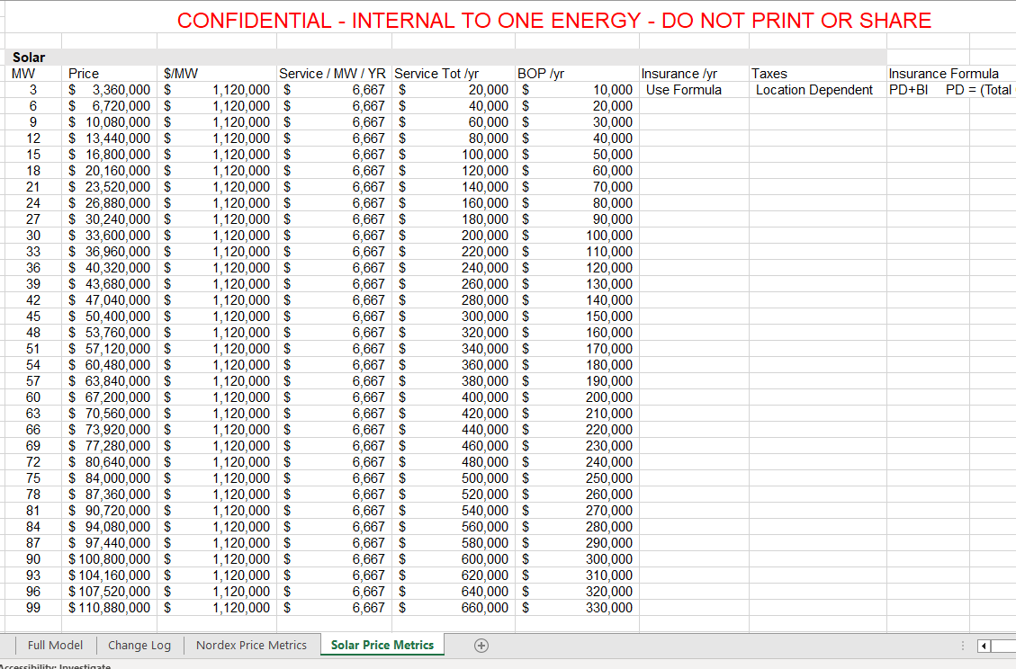
SOLAR PRICE METRICS

Slide 39
sOLAR OPEX NOTES
NOT INCLUDED:
  O&M Reserve
  Scholarships
  Other

Slide 40
Model inputs – Solar O&M Contracted
Notes:
This is provided by Nooter (solar contractor)

Slide 41
Model inputs – Solar BALANCE OF PLANT
Notes:
This is determined through conversations with Nooter (solar contractor)

Slide 42
Model inputs – Solar Insurance
Notes:
Insurance for the project from loss of property and loss of revenue.
This formula is PD+BI
PD = (Total CAPEX/100)*0.45
BI = [(Annual Production*PPA Rate)/100]*0.55

Slide 43
Model inputs – Solar Taxes
Notes:
This is location-dependent. Each entity has its own rules on what would apply to the project (property tax, revenue, real, etc.). In the State of Ohio, it is PILOT (Payment in Lieu of Taxes) which for solar is $7,000/MW/Year

Slide 44
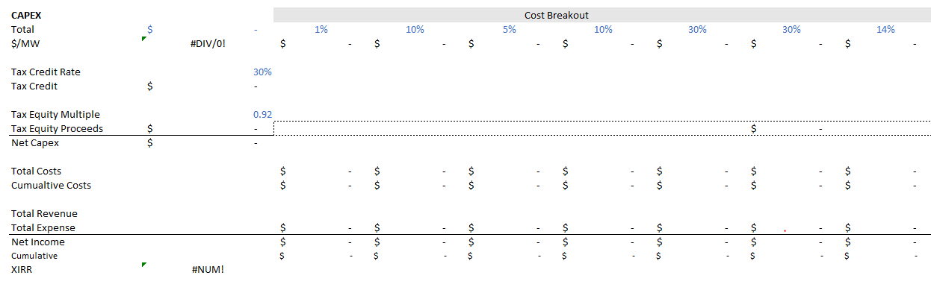
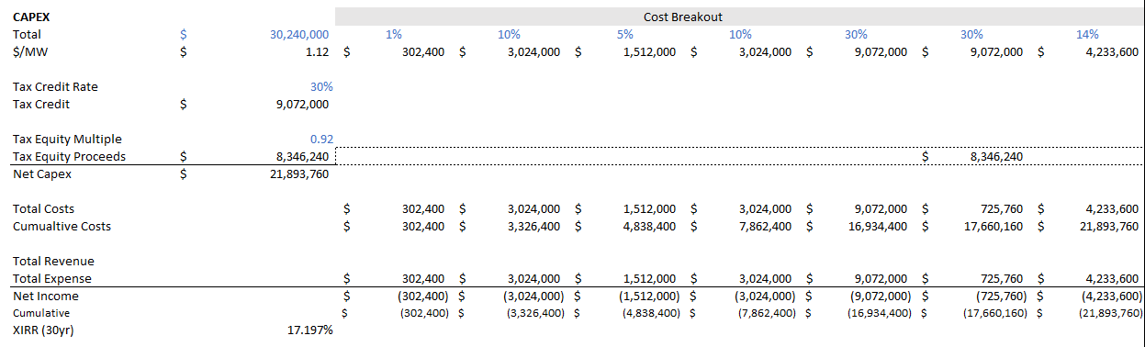
Model inputs – Solar CAPEX
Notes:
This number factors in all module/racking/invertor/installation costs

Slide 45
Model inputs – Solar CAPEX COST BREAKOUT
Notes:
Don’t change unless told to

Slide 46
Model inputs – Solar Tax equity Multiple
Notes:
How many cents we expect our buyer to pay per dollar of credit

Slide 47
Model Outputs – Solar Xirr
Notes:
Important to note returns on wind project to compare to other portions of the projects

Slide 48
MANAGEDHV INPUTS

Slide 49
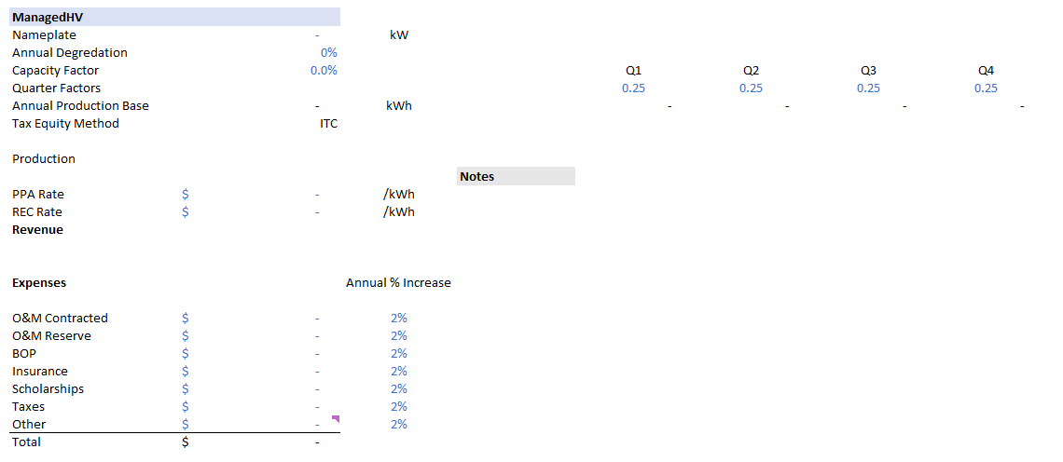
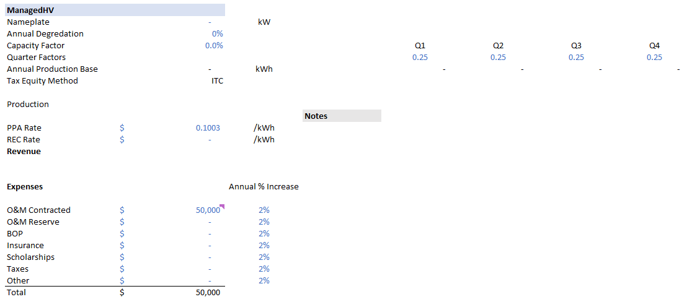
Model inputs – Managedhv ppa rate
Notes:
This number should equal the wind PPA rate unless we are offering multiple different rates which we usually don’t

Slide 50
Model inputs – Managedhv O&M Contracted
Notes:
This number is provided by engineering, typically $50,000/year

Slide 51
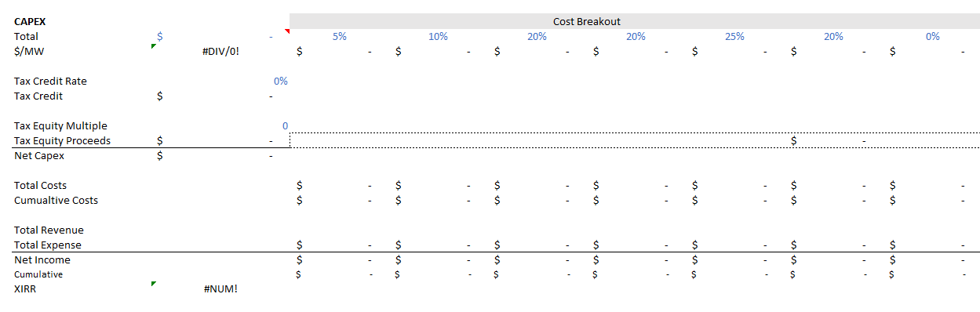
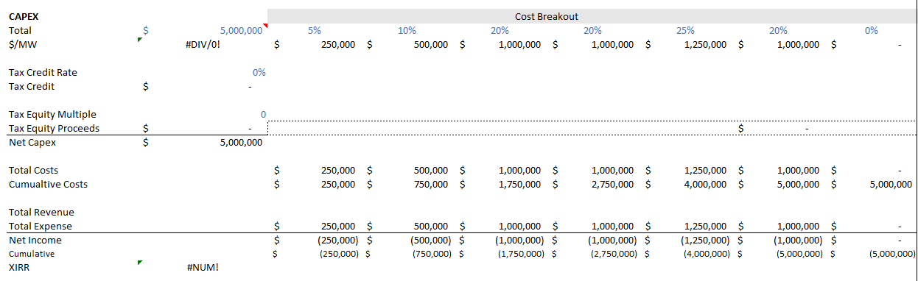
Model inputs – Managedhv O&M Contracted
Notes:
This number is provided by engineering based on substation size/other upgrades necessary

Slide 52
Model Outputs – Managedhv Xirr
Notes:
This number does not populate because there is no production for managedhv

Slide 53
PROJECT OUTPUTS

Slide 54
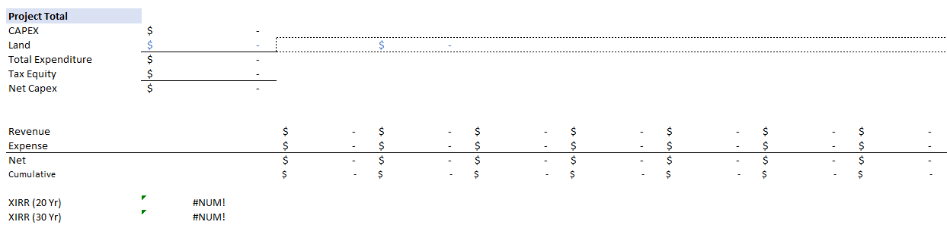
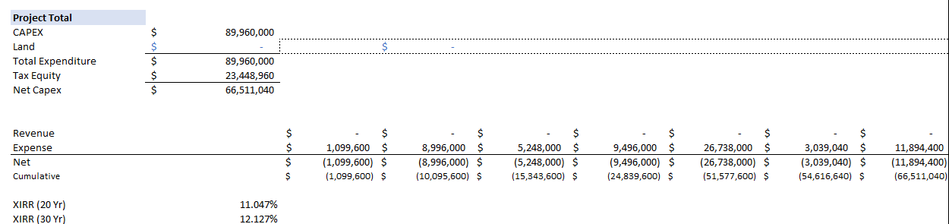
Model Outputs – PROJECT CAPEX
Notes:
This is the total CAPEX cost for wind, solar, managedhv

Slide 55
Model inputs – LAND
Notes:
Put the total land costs for the project here – this can be calculated by finding comparables and getting the price/acre and estimate how much it will be per acre for this project

Slide 56
Model Outputs – Total Expenditure
Notes:
Total project costs + land costs

Slide 57
Model Outputs – total tax equity
Notes:
Add up the tax equity proceeds from wind, solar, and managedhv

Slide 58
Model Outputs – NET CAPEX
Notes:
Total project costs + land costs – tax equity

Slide 59
Model Outputs – XIRR
Notes:
Total project 20 year IRR

Slide 60
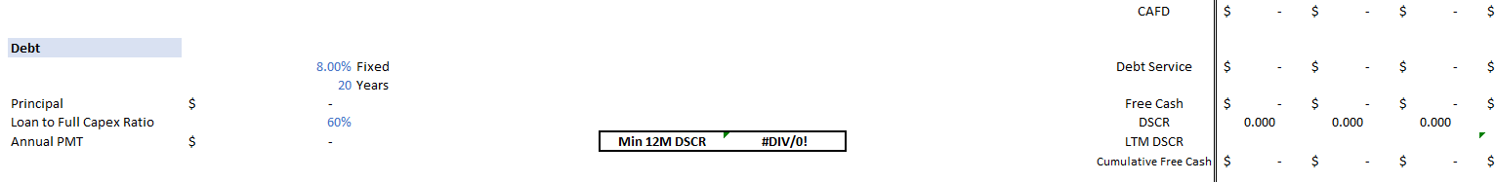
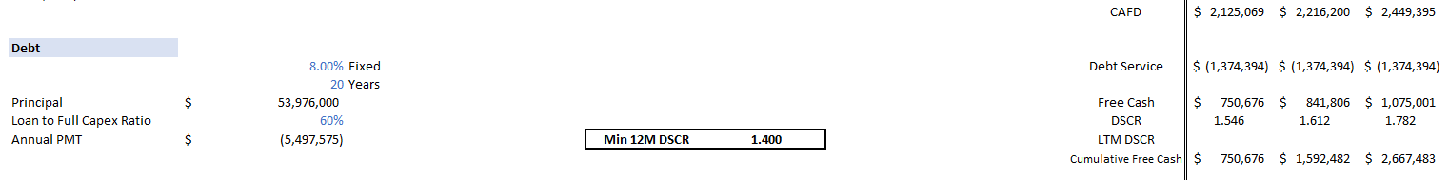
Model inputs – project debt interest rate
Notes:
Set by SOFR (secured overnight finance rate) and current project financing rates (around 2 pts over SOFR)

Slide 61
Model inputs – project debt Length
Notes:
Length of the loan is typically the expected lifetime of the project

Slide 62
Model inputs – project Debt Ratio
Notes:
This calculates the principal. This is the total project cost (including land). This accounts for 30% tax equity and 10%

Slide 63
Model inputs – project DSCR (debt service cash ratio)
Notes:
This calculates the principal. This is the total project cost (including land). This accounts for 30% tax equity and 10%

Slide 64
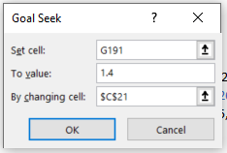
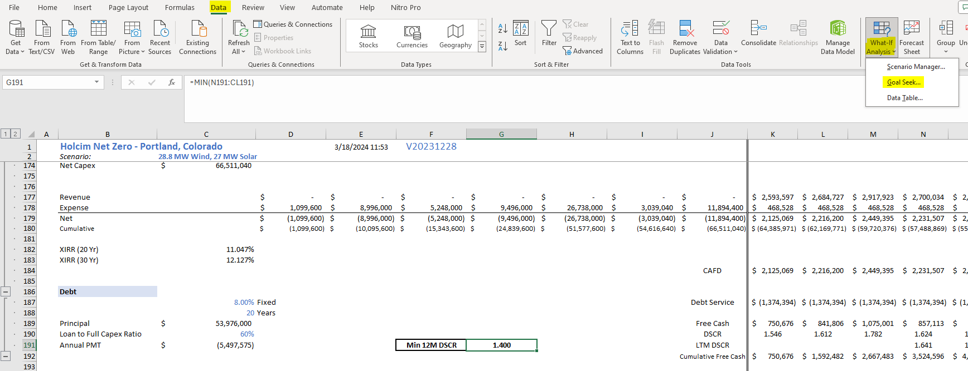
Solve for the PPA rate - DSCR (debt service cash ratio)
Click in cell G191
Click “Data” tab
Click “What-if Analysis” Dropdown
Click “Goal Seek…”
Set cell : G191
To value: 1.4
By changing cell: C21
Click “Ok”
Check that G191 is 1.400 and the REA rate will be in cell
Notes:
This DSCR is always 1.4 unless told otherwise

Slide 65
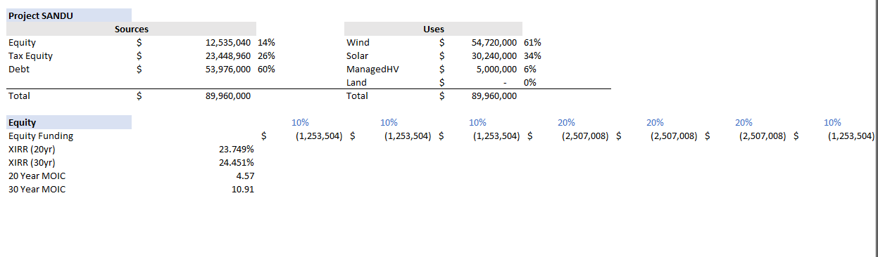
Model Outputs – project SANDU (
Notes:
This is what each investing entity is responsible for, how much each type of project plays into the total costs, and what the equity returns are for the project.

Slide 66
INTERACTIVE
SENSITIVITY ANALYSIS
Google Drive > Shared Drives > PPT > Trainings

