Slide 1
Intro to
public relations (pr)
Hank doster
10/24/2023

Slide 2

What is PR?

Slide 3
PR textbook definition
Investopedia defines it as…
Public relations (PR): the set of techniques and strategies related to managing how information about an individual or company is disseminated to the public, and especially the media.
Its primary goals are to disseminate important company news or events, maintain a brand image, and put a positive spin on negative events to minimize their fallout.
PR may occur in the form of a company press release, news conference, interviews with journalists, social media posting, or other venues.

Slide 4
what does pr mean to us?
Our main PR goal, thus far, has been brand awareness and education - getting the company’s name out there and getting various stakeholders to know who we are and understand what we do.

Slide 5
Who are our PR stakeholders?
Investors
Communities
Media
Lenders
Stockholders
Local government
Local citizens
Local schools
Journalists
Financial analysts
Researchers
Broadcast hosts
Podcasters
Customers
Employees
Potential
Existing
Current
Coming onboard soon
Recruiting

Slide 6

What exactly does a pr firm do?
Identify relevant reporters and build relationships between them and us
- a good PR firm will have an extensive rolodex
Pitch journalists/media outlets about our stories and company news
- make introductions, schedule interviews, brief us on the reporters
Draft press releases
- and all the administrative work that comes with putting them out
On-site event planning
- managing an invite list, developing materials, logistics assistance
Find valuable conferences to attend and identify speaking opportunities
Find awards for our company and team members to apply to

Slide 7
Types of pr firm partnerships
General
This is the type of PR partnership One Energy has usually engaged in.
They dedicate a team of four or so people to our company, and we rely on them for all our PR needs - and then some.
Firms are remote 99% of the year because any good PR firm has offices in New York and California. We ask them to visit once or twice a year to strengthen the relationship between our teams and their understanding of what OE is doing.
These are long-term partnerships. Usually, the minimum contract length is 12 months then, you can renew it for that length, go on a month-by-month basis, or terminate it. Payment is per month.

Slide 8
Types of pr firm partnerships
Specialty
These partnerships are more of a case-by-case situation for a specific campaign or need.
You might see this type of partnership in a Fortune 500 company like Whirlpool. Maybe they are getting ready to roll out a digital campaign and need an expert in viral social media campaigns to help them with the logistics and securing a celebrity or an influencer relevant to the campaign to make a bigger splash.
These partnerships are usually for a shorter fixed amount of time and can be quite costly. If you’re a Fortune 500 company and you want to get a household name to endorse and participate in your product campaign – you’re likely hiring one of the most expensive firms in the world. We’re talking upwards of several hundreds of thousands of dollars a month.

Slide 9
Types of pr firm partnerships
Crisis Communications
This tends to be a more common need in public companies or government organizations.
Crisis communication means working to prevent or fix a public relations disaster – something blows up, an executive does something terrible, etc.
Global and national companies likely have entire in-house teams dedicated to this, depending on the industry. The organization’s internal communications team will be the first line of defense in managing the message around a crisis incident. However, there may be occasions when they need to bring in some bigger guns.
This is not something One Energy has had to use. Crisis communications is something a general PR partnership could assist with as well.

Slide 10
One Energy pr/ir timeline
2019 - 2022
We partnered with third-party national PR firms to help us reach our PR goals.
2023 - present
Now that we’ve announced our intention to go public via SPAC, our needs have changed to be more investor relation-focused.
Before making our SPAC announcement, we partnered with an IR firm called ICR, which offers PR on the side – they are contracted to work with us through the end of the SPAC process.

Slide 11

Sidenote - PR vs IR
But what the heck is an Investor Relations (IR) firm?

Slide 12
Investor Relations (IR)
Investopedia defines IR as…
The investor relations (IR) department is a division of a business, usually a public company, whose job it is to provide investors with an accurate account of company affairs. This helps private and institutional investors make informed decisions on whether to invest in the company.
Our current main IR goals are to connect with financial analysts/potential investors, get them to visit the NFWC, and give a positive report on the company.

Slide 13

Back to pr
PR is like the crossword; each day presents a new puzzle to solve.
Successful PR is a fluid strategic guessing game.
A sure-fire blueprint for earned coverage does not exist.
It is a combination of preparation, a well-connected and informed PR team, relationship-building, timing of whatever is in the news cycle, and luck.

Slide 14


Types of media
Earned/Organic Media
Paid Media
This is natural coverage stemming from:
Our PR firm pitching us or one of our stories
Networking/word of mouth
An outlet seeks us out as a reliable source on a topic like on-site wind energy
This is pay-to-play where we pay a fee to be:
Featured in an article or a video series
A conference sponsor - which also happens to come with a speaking slot
An award winner and as a result, get a featured write up about our company
*Some paid media companies are getting crafty by presenting themselves as major outlets like CBS News. Realistically, they’re trying to sell you a commercial spot.

Slide 15
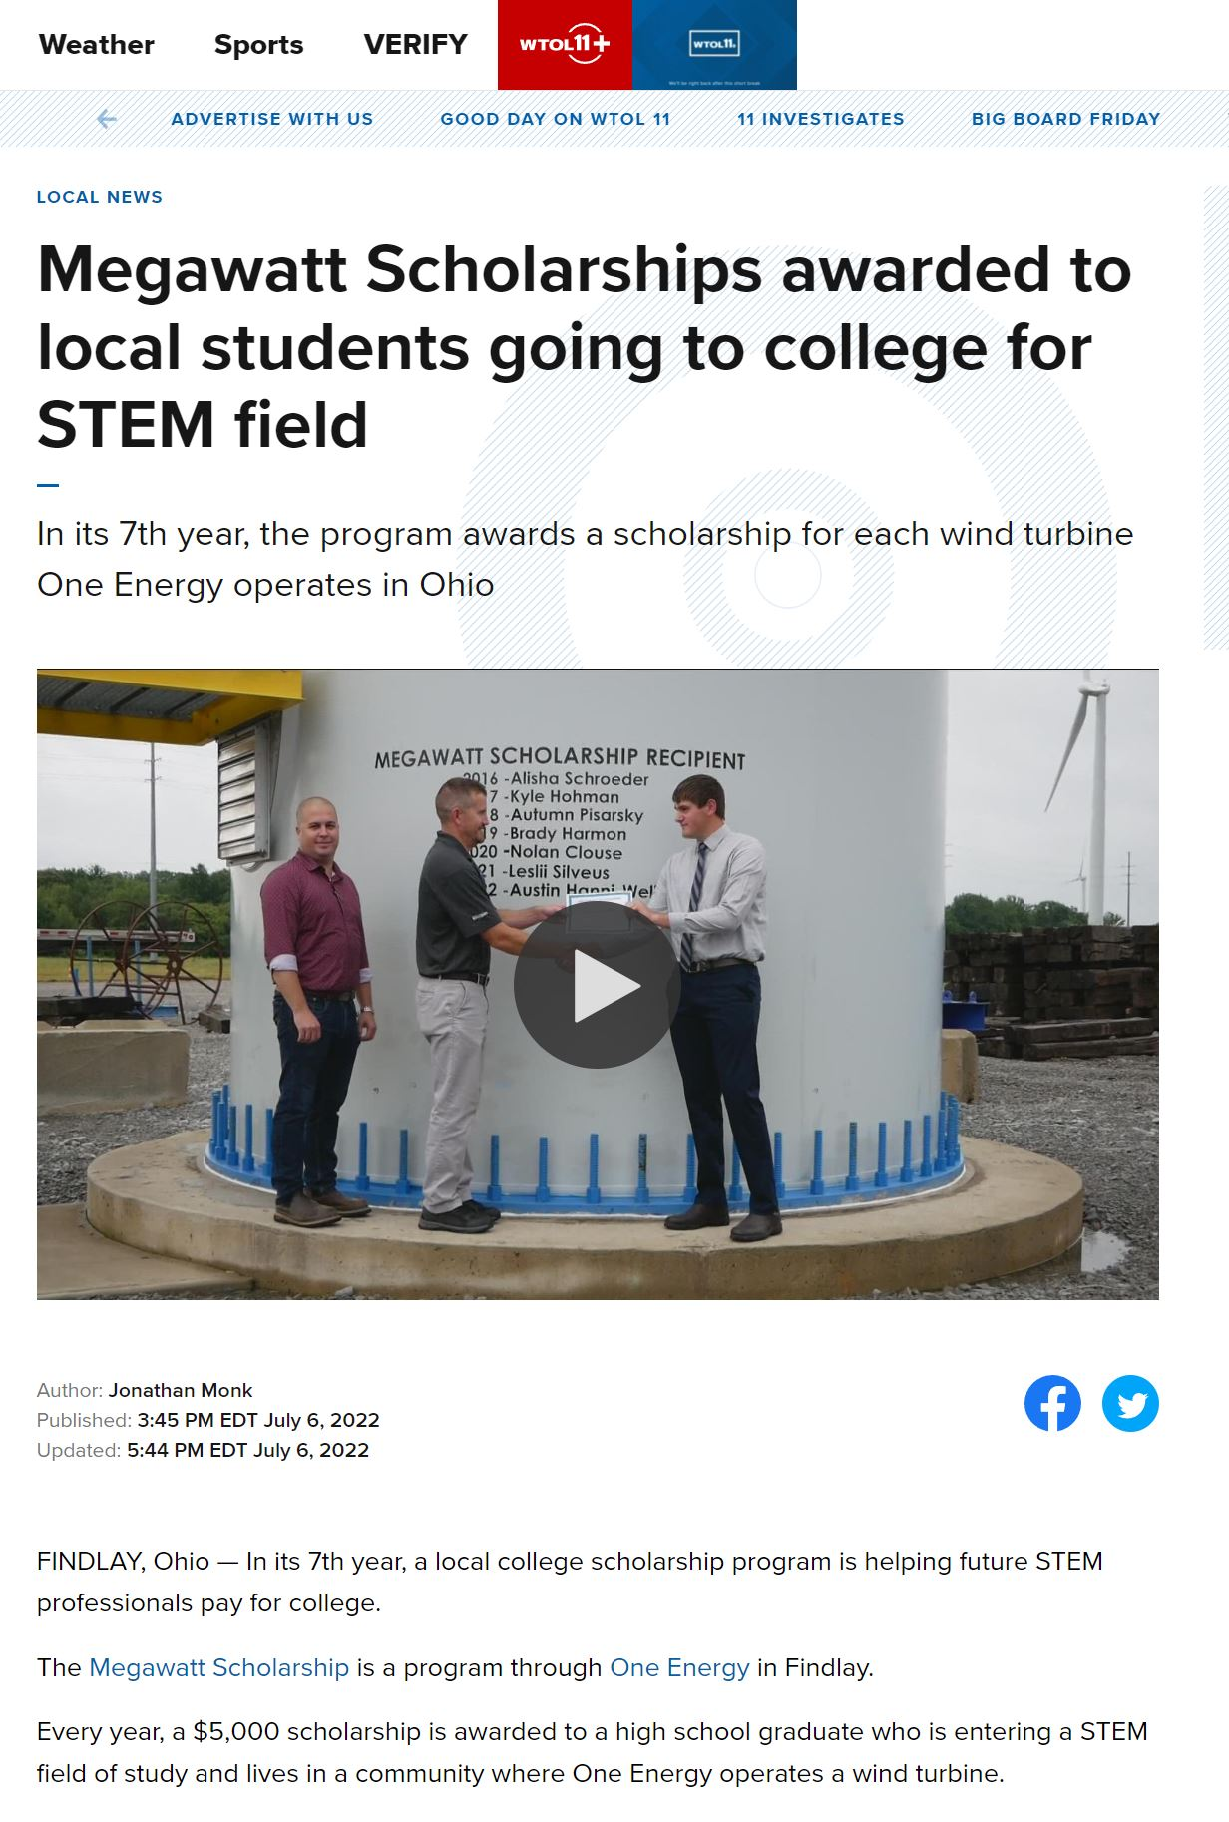
One Energy media examples
Local Coverage
Who: The Courier, WFIN, WTOL, Lima Hometown Stations, University of Findlay
What: Digital/print newspaper articles, broadcast news segment, and social media posts
Where: OE’s HQ in Findlay, our project locations, locations of future projects
When: Educational tours, MWS ceremonies, project news, company updates
Why: Community members like to know what’s going on in their community
How: By appealing to what garners readership for local outlets -
for example, they like to see names they recognize as scholarship winners

Slide 16
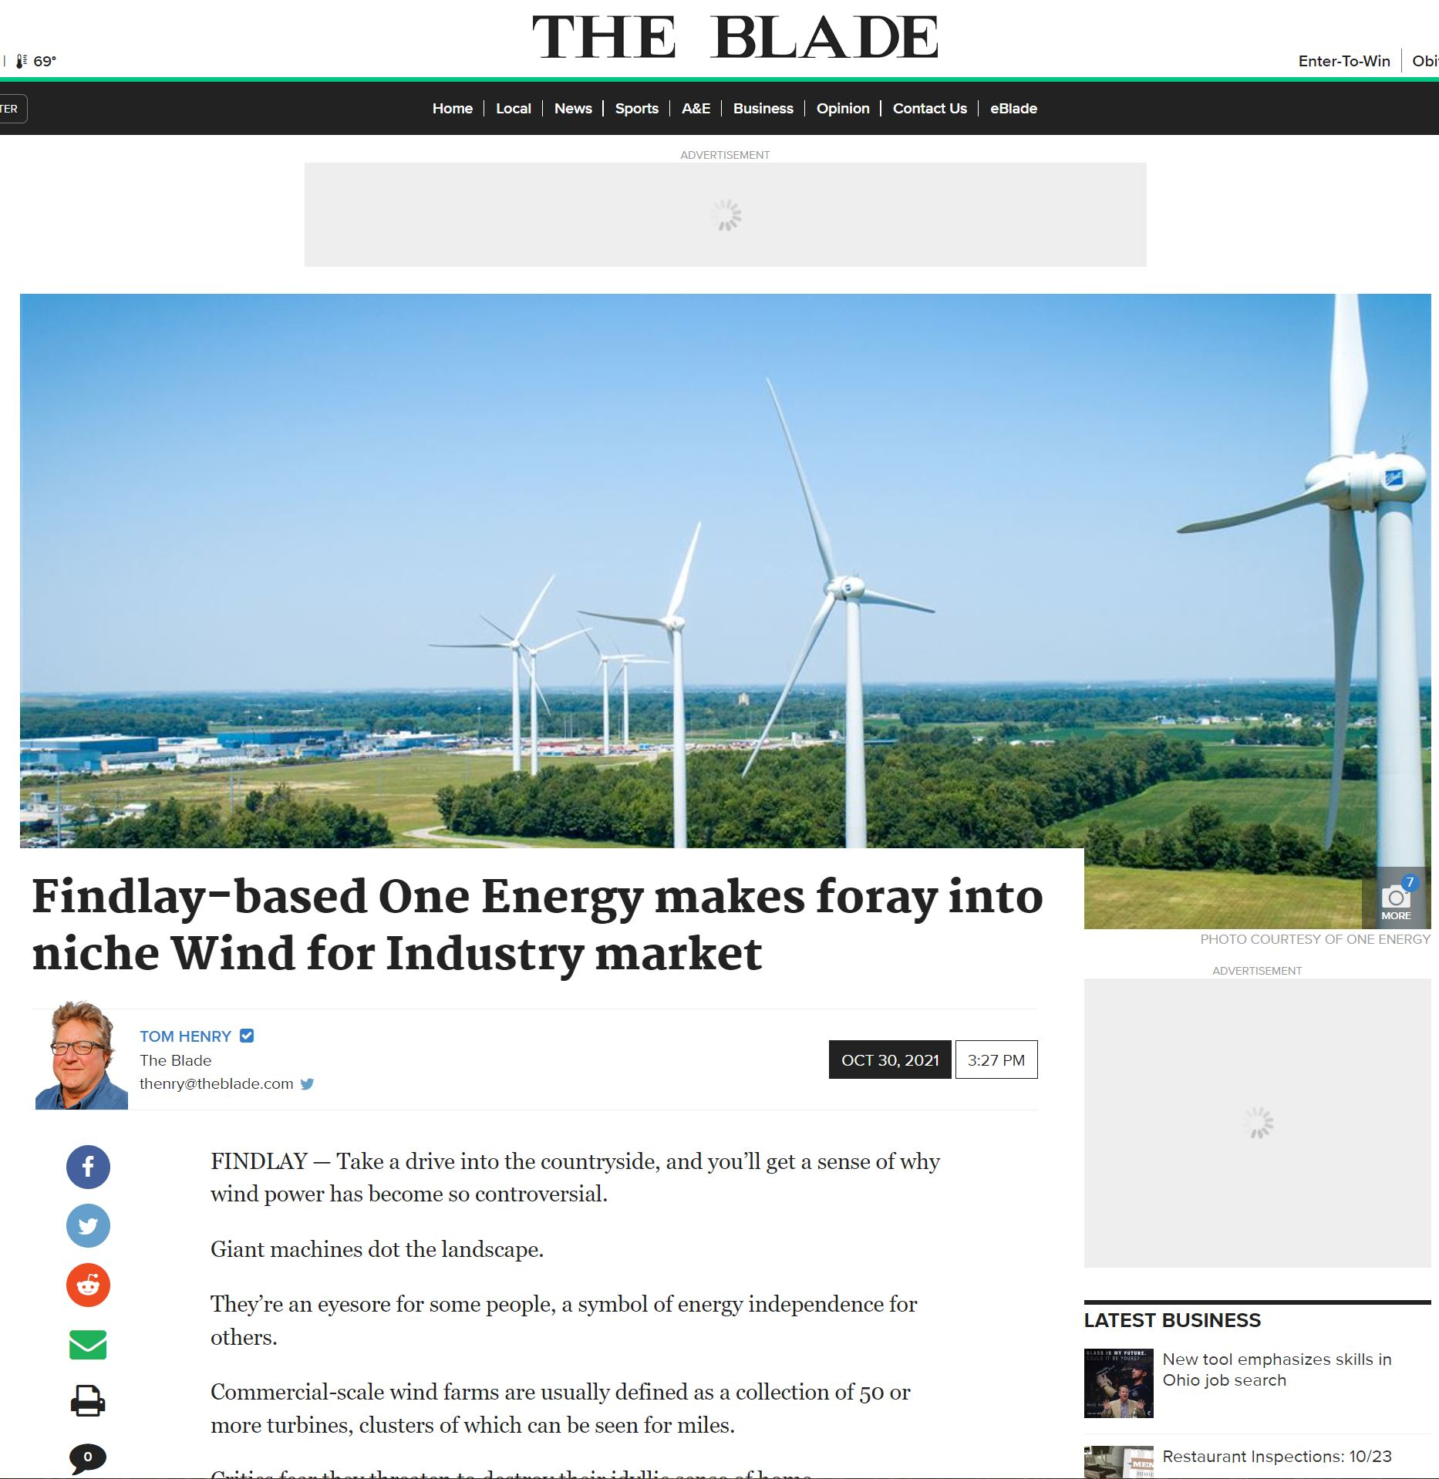
One Energy media examples
Regional Coverage
(Some overlap with Local Coverage)
Who: The Blade, The Business Journal, Cleveland Plain Dealer, Associated Press
What: Digital/print newspaper articles, and social media posts
Where: Larger cities and hubs in Ohio
When: Company features/awards, thought pieces, someone cited as a source
Why: Highlights companies in the state, shows Ohio has credible professionals
How: By winning Top Workplace Awards, doing newsworthy things, and being a credible source for reporters

Slide 17
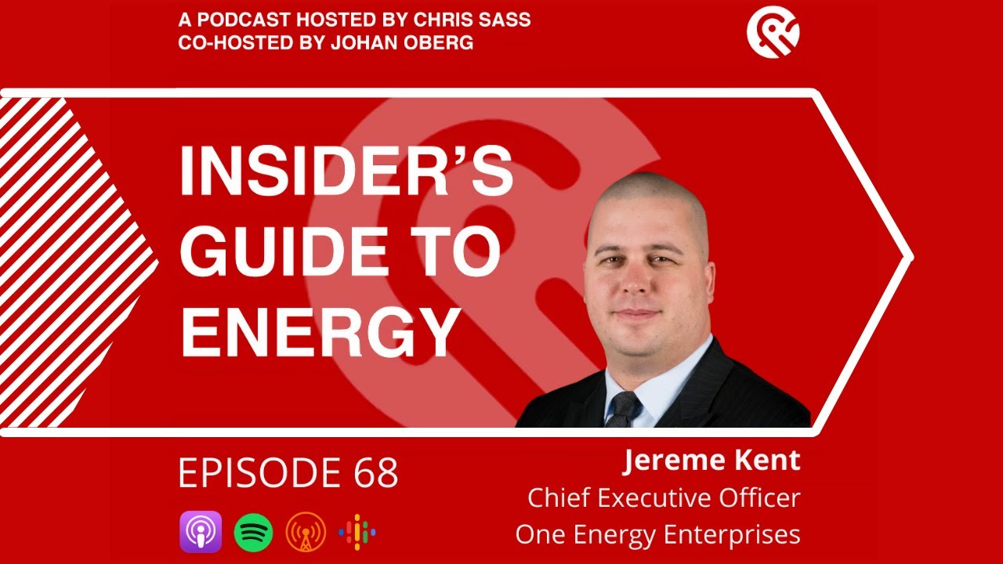
One Energy media examples
Industry/Trade Coverage
Who: Insider’s Guide to Energy Podcast, Power Magazine, Electric Charging Infrastructure
What: Digital/print articles, sharing company press releases, social media posts, and op-eds
Where: All over the world
When: Relevant press releases, projects, and current events
Why: These outlets want to be seen as credible in their industries and are always looking for the next cutting-edge advancement or insight
How: Through PR pitching efforts, or by getting our press releases picked up

Slide 18

One Energy media examples
Finance Coverage
Who: Benzinga, Barron’s, Financial Times
What: Digital articles or mentions (typically behind a paywall), web segments, email newsletters, and social media posts
Where: Hubs like New York, London, etc.
When: Big company news or mentioned as a credible source on a timely topic
Why: These outlets want to provide credible information to investors and the markets
How: Through PR pitching efforts and building relationships with journalists

Slide 19
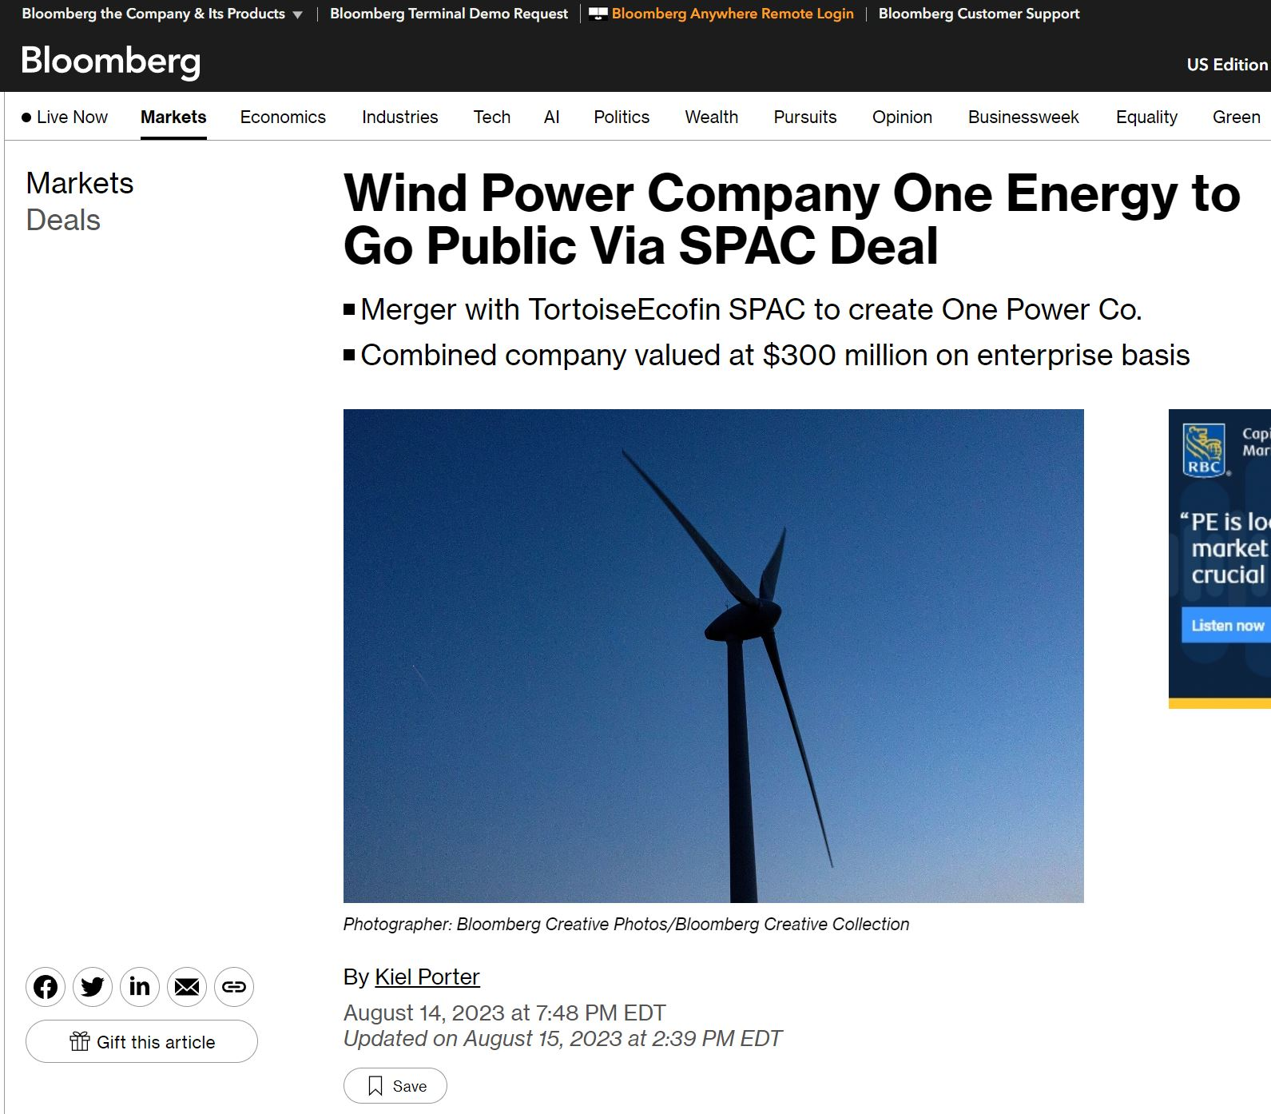
One Energy media examples
Top-Tier Coverage - aka a homerun
(Some overlap with Financial Coverage)
Who: The Wall Street Journal, PBS, CNBC, The Economist, Bloomberg
What: Digital/print articles or mentions (sometimes behind a paywall), live broadcast/web segments, email newsletters, and social media posts
Where: Hubs like New York, London, etc.
When: Big company news or mentioned as a credible source on a timely topic
Why: These outlets want exclusives to news other people haven’t yet covered – it needs to be a full story that considers all angles and gets fact checked
How: Through PR pitching efforts, having a newsworthy hook, building relationships with journalists, and playing the long game

Slide 20
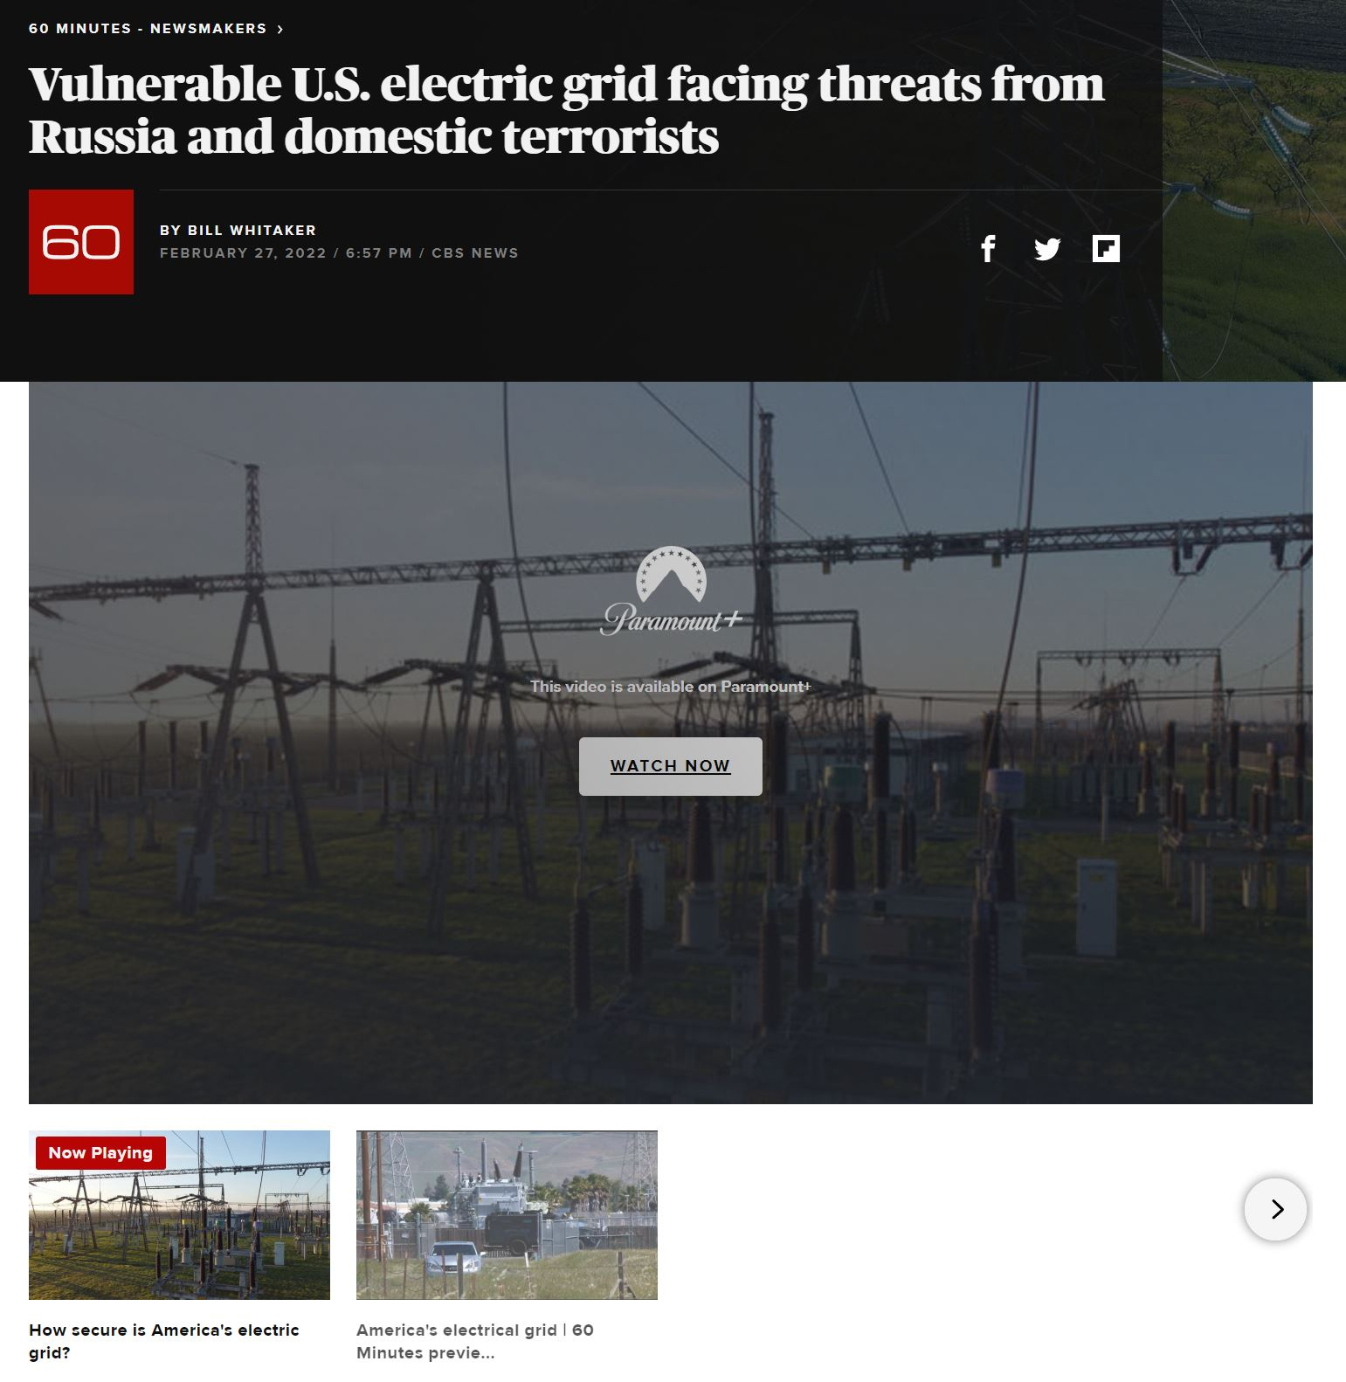
One Energy media examples
Misc. Coverage
Who: 60-Minutes, NowThis Can it Save the Planet, Hitachi Panel
What: Digital articles, live broadcast/web segments, livestream company/industry events, and social media posts
Where: All over the world.
When: Relevant current events, networking works out, an industry partner needs a favor – for example, OE board member Jon Wellinghoff was featured on 60-minutes as a source on grid safety
Why: Outlets need credible sources, panels need speakers, etc.
How: Sometimes the universe smiles upon us

Slide 21
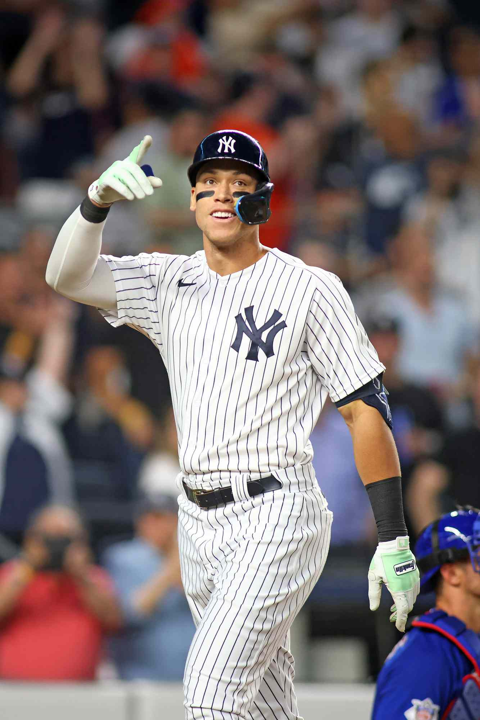
In summary
PR is an ever-evolving challenge that requires a lot perseverance, strategy, and luck.
Successful communication techniques are key.
We are constantly:
keeping a pulse on the news
evaluating angles other companies and reporters are taking
deciding how to frame what we are doing to be the most appealing to reporters and our audiences
figuring out how to tell our story effectively
Sometimes, we are simply trying to place a MWS feature in a local news outlet.
Other times, we are swinging for the fences.

