Slide 1

(Title)
(name)
(date)
Analytics Overview
08/17/2021

Slide 2

Who is Analytics?
Jeff Wedgeworth – Technical Manager
The man behind the curtain
Does 80% of the technical analysis work
Data expert
Software instructor
Great at solving technical problems

Slide 3

Who is Analytics?
Scott Erickson – Director of Analytics
The “people person”
Does 80% business expansion
Customer relationship expert
Likely to know someone in a room

Slide 4

Who is Analytics?
Rich Bohon – Head of Analytics
The “problem solver”
Solves 80% of the customer issues
Manufacturing process master
Carries the vision for the group
Deals with JK

Slide 5

Who is Analytics?
Rich Bohon – Head of Analytics
The “problem solver”
Solves 80% of the customer issues
Manufacturing process master
Carries the vision for the group
Deals with JK

Slide 6
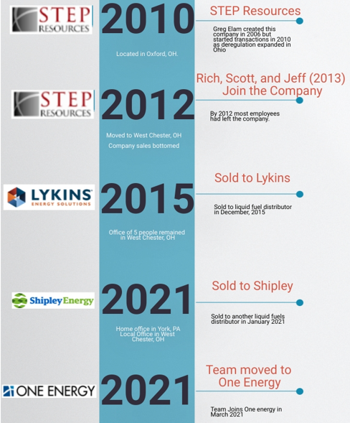
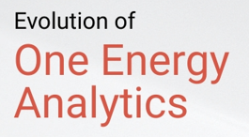
Where did the Analytics team come from?
Born from a toxic ownership environment
Individual strength were accepted and valued which allowed the company to evolve into a great place to work
Jeff, Scott, Rich are the cornerstones of the foundation

Slide 7

What does Analytics do?
We are consultants which means we:

Slide 8
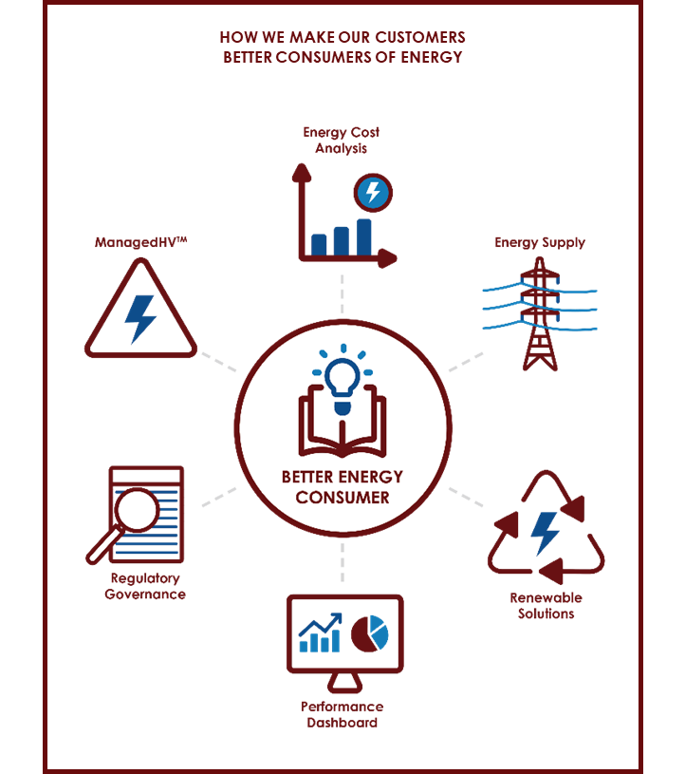
What does Analytics do?
We don’t make anything
We don’t buy anything
We sell knowledge

Slide 9
What does Analytics do?
6 areas of focus for Analytics
  Energy Analysis – How companies use their energy
  Procurement – How companies buy their electric and gas
  Renewables – How can we help with company ESG
  Performance – Chart how the company is performing
  Regulations – How is the company regulated in energy use
  Infrastructure – What energy projects does the customer require
Where One Energy is more concerned about what happens outside the building, we care more about what happens inside the building.

Slide 10
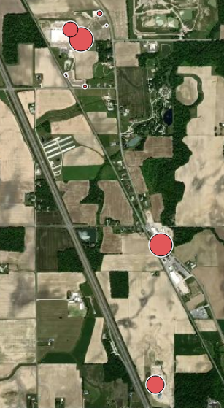
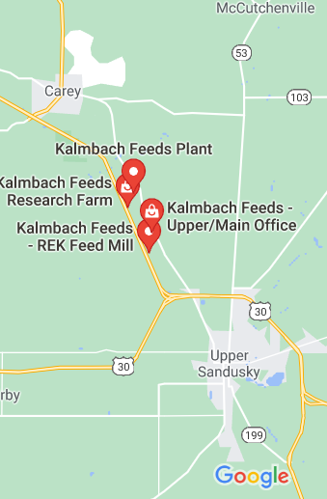
What does Analytics do?
Energy analysis
Becomes the foundation for everything we do
Involves a site visit
Look at hourly interval data
Look for trends or issues

Slide 11
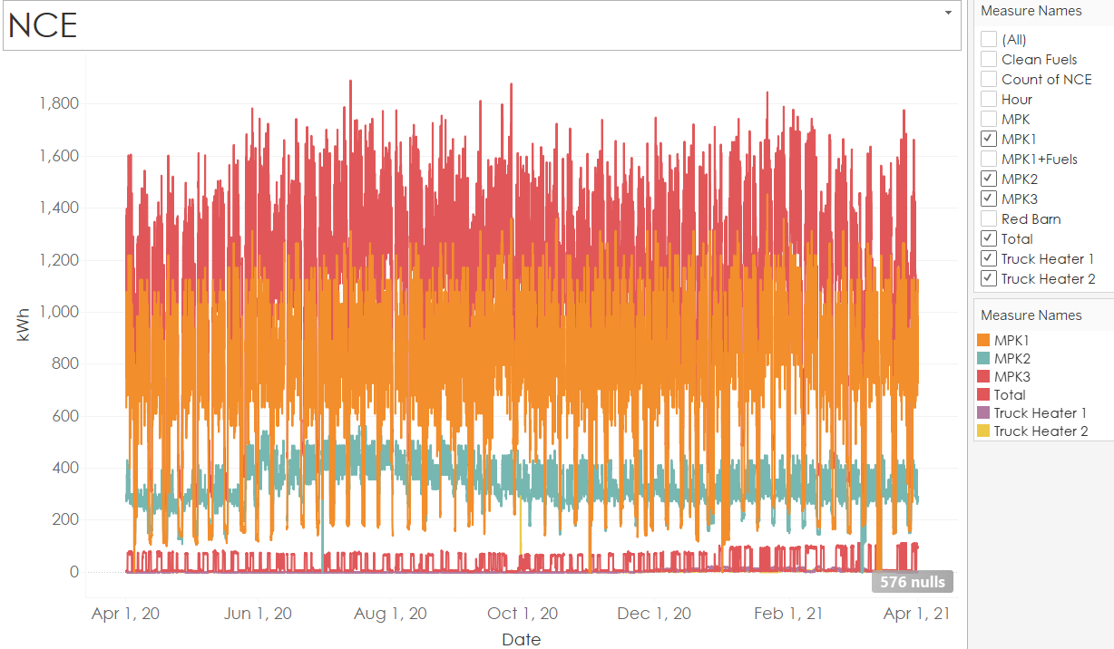
What does Analytics do?
Energy analysis

Slide 12
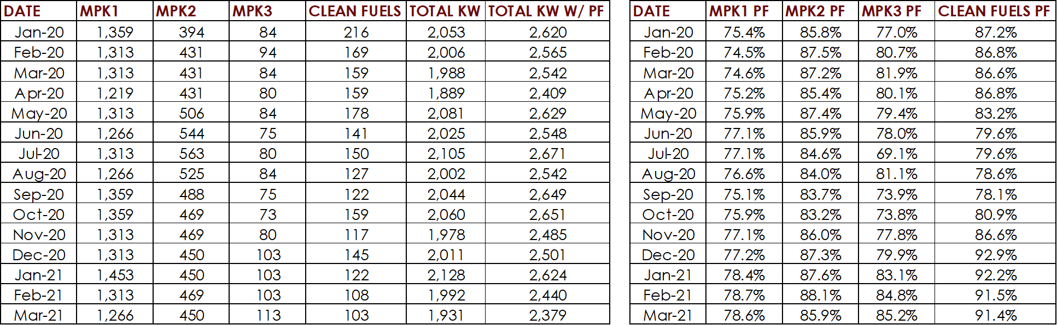
What does Analytics do?

Slide 13
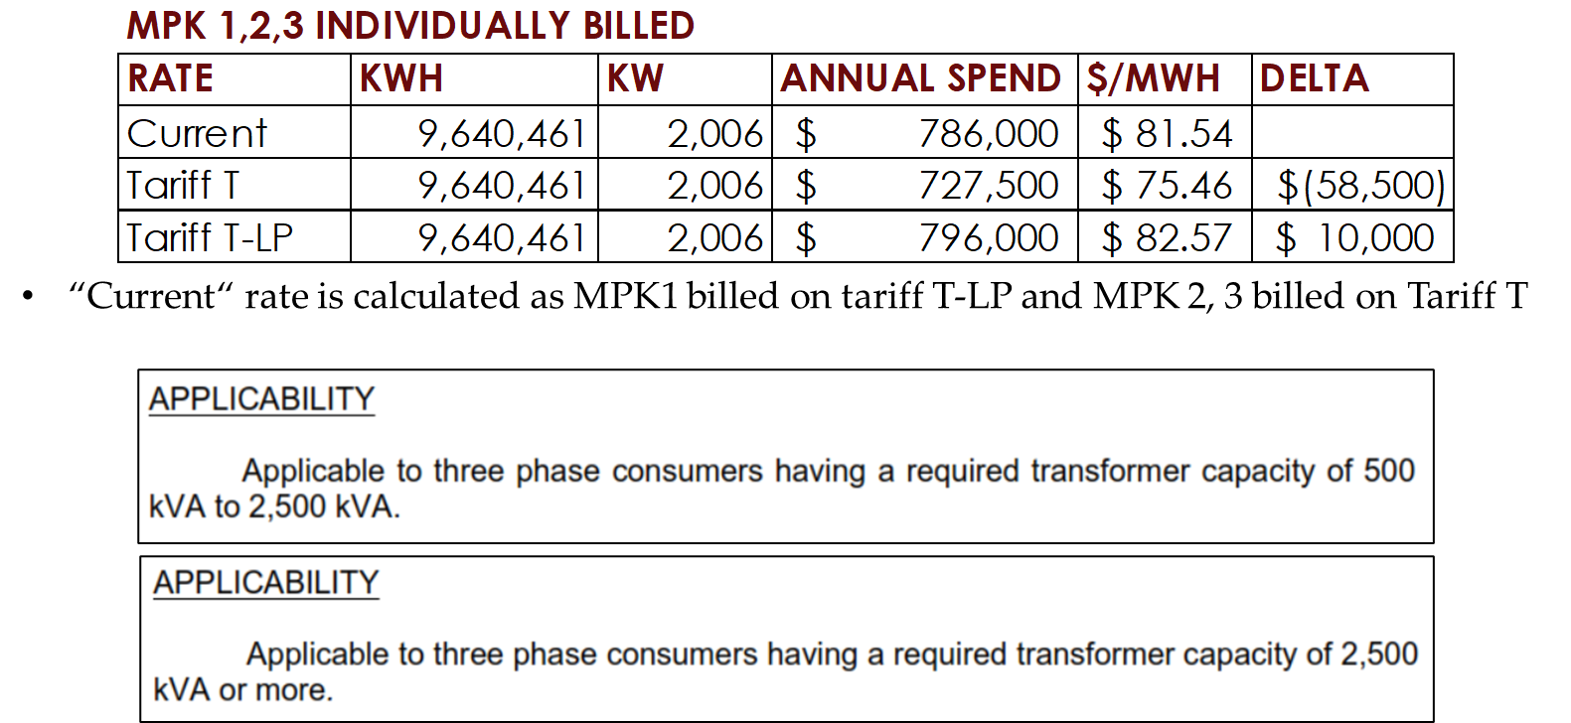
What does Analytics do?

Slide 14
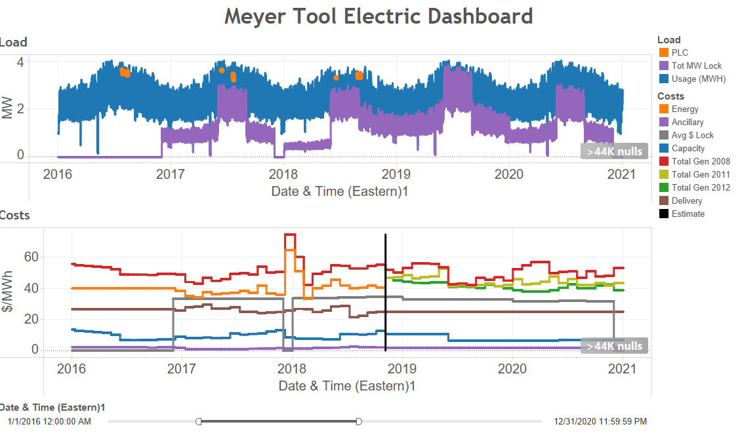
What does Analytics do?

Slide 15
How does the analytics group fit into OEE?
Operational Structure
Corporate Structure
Cash Flow
Tax Structure

Slide 16
Overall Corporate Structure
OEE
Single Member LLC
Disregarded Entity
Single Member LLC
Disregarded Entity
OE RETAIL SERVICES LLC
OE CONSULTING SERVICES LLC
OEA Trade Name use agreement
DBA under Trade Name
DBA under use agreement
One Energy Analytics

Slide 17
Overall Corporate Structure
OE RETAIL SERVICES LLC
OE CONSULTING SERVICES LLC
DBA One Energy Analytics
OERS own OEA trade name
Only Brokering Business
All income from suppliers
Contracts between suppliers and OERS
All LOA under this name
All LOE under this name
Unique EIN
W9 uses OEE EIN
Separate checking account
Separate Foundation account
DBA One energy Analytics
OECS licenses OEA trade name
All other business
All income from customers
Service contracts between OECS and customer
All NDA under this name
All ATR under this name
Unique EIN
W9 uses OEE EIN
Separate checking account
Separate Foundation account

Slide 18
Show me the money
OEE
OE RETAIL SERVICES LLC
OE CONSULTING SERVICES LLC
Service Contract
Suppler Agreements
CUSTOMERS
Supply Agreements
KALMBACH, MMM, NFF, ETC
SUPPLIERS
IGS, AEPE, MP2, ENGIE, ENERGY HARBOR, CONSTELLATION

Slide 19
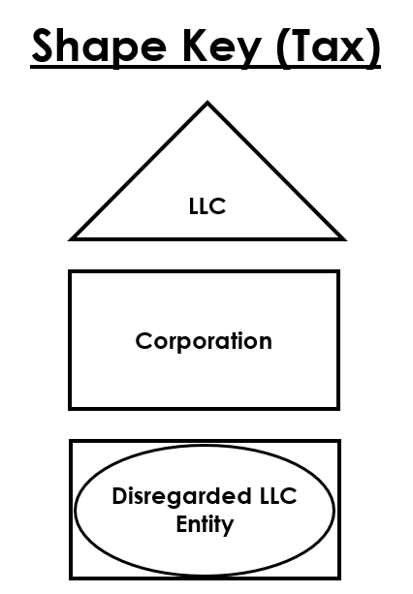
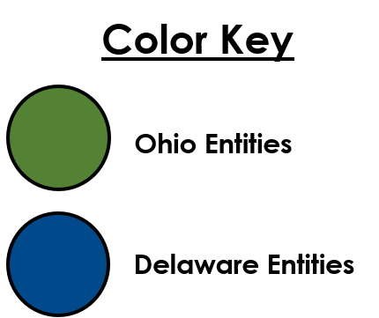

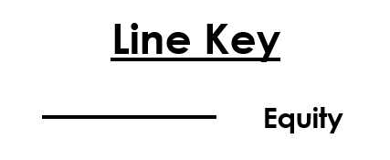

Tax structure
OE Consulting Services LLC

Slide 20
Why does the Analytics team exist?
We are the group that will help customers:
  Understand their energy uses
  Help them meet their ESG
  Manage their energy spend
  Optimize their storage/renewables
  Bring new ideas to the customer
    K-Air Batteries
    Kinetic energy storage
    Distributed thermal storage
    Fuel cell generation
This is why we love what we do.

Slide 21

Why we love this job

