Slide 1
Camera history &
photography Basics
Hank doster
July 6, 2021

Slide 2
OVERVIEW
Camera History
  What is a Camera?
  The First Camera
  Evolution Over Time
  The Modern Camera
Photography Basics
  Exposure
  ISO
  Shutter Speed
  Aperture
Film Photography
  Necessary Equipment
  Developing Process

Slide 3
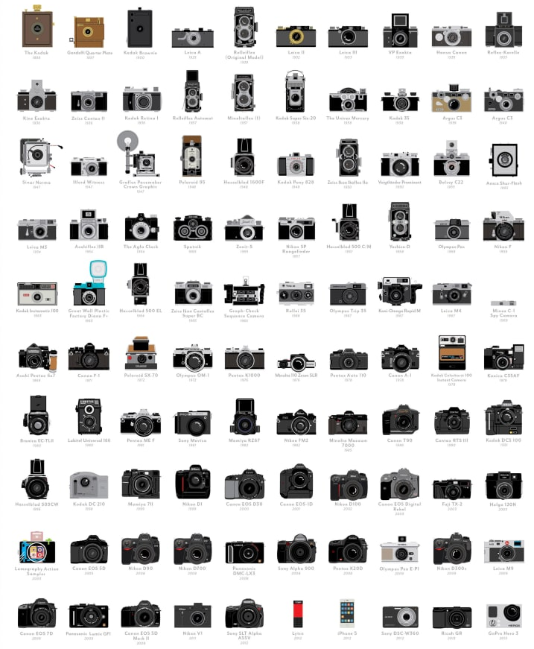
Camera History

Slide 4
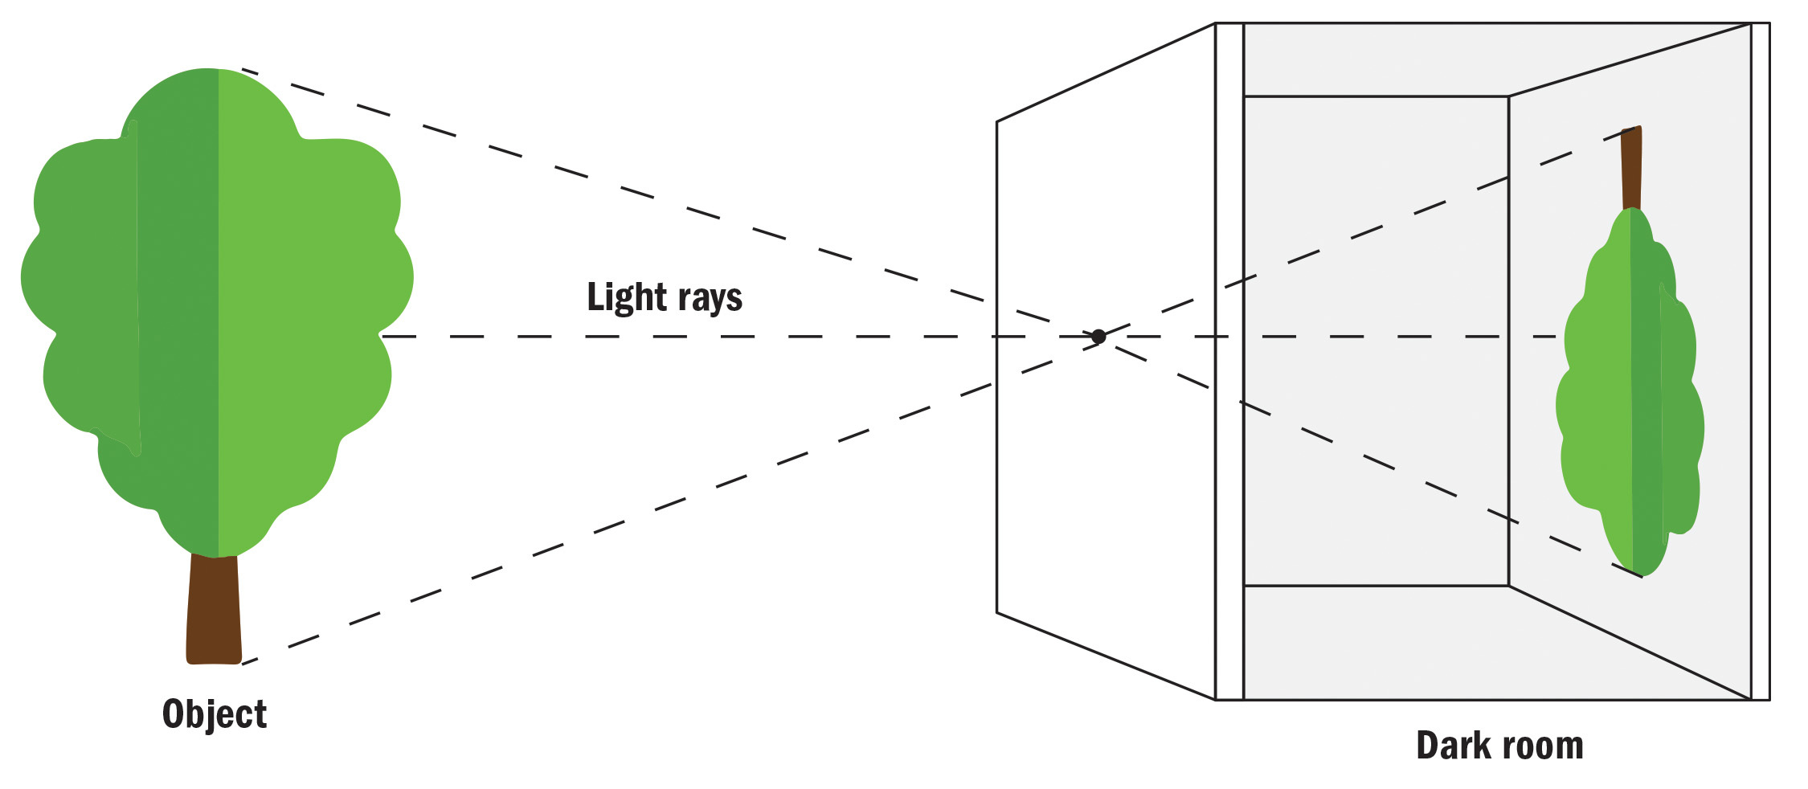
Camera History | What is a camera?
Camera: an optical instrument that captures a visual image

Slide 5
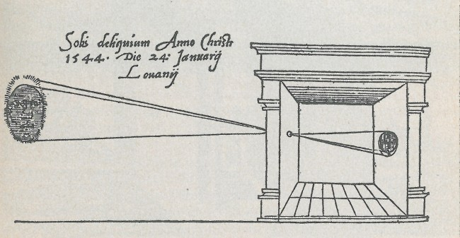
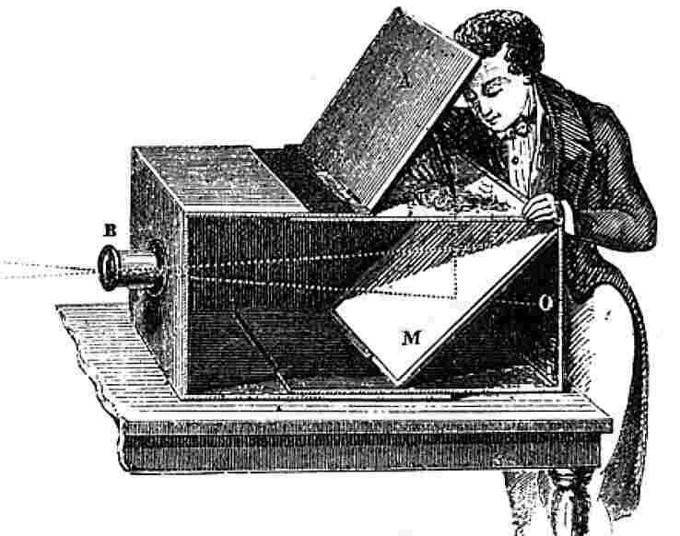
Camera History | the first camera
Camera Obscura: a darkened room, box, or tent with a small hole or lens at one side through which an image is projected onto a wall or table opposite the hole.

Slide 6
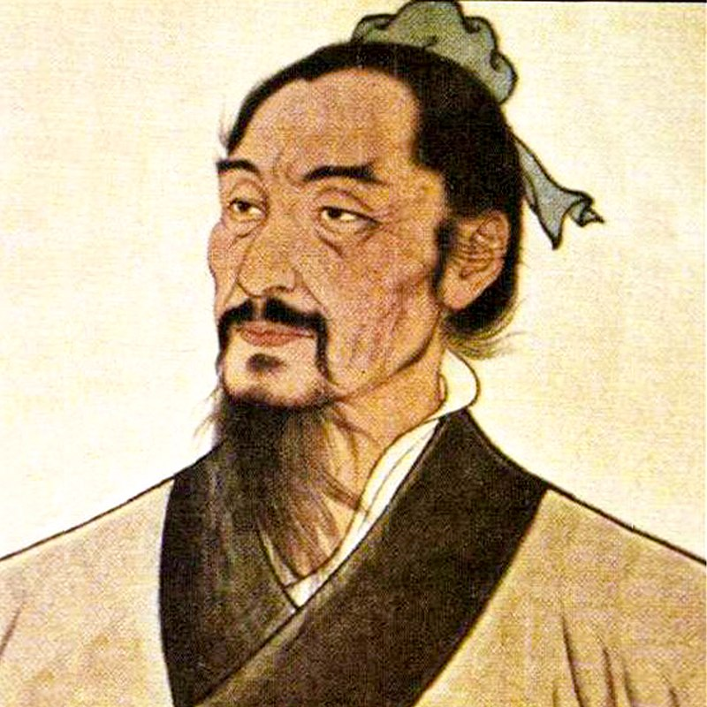
Camera History | the first camera
4th Century BCE – the first written record of the camera obscura is found in the Chinese book Mozi.
This is the only known description of the camera obscura concept before the 11th century.

Slide 7
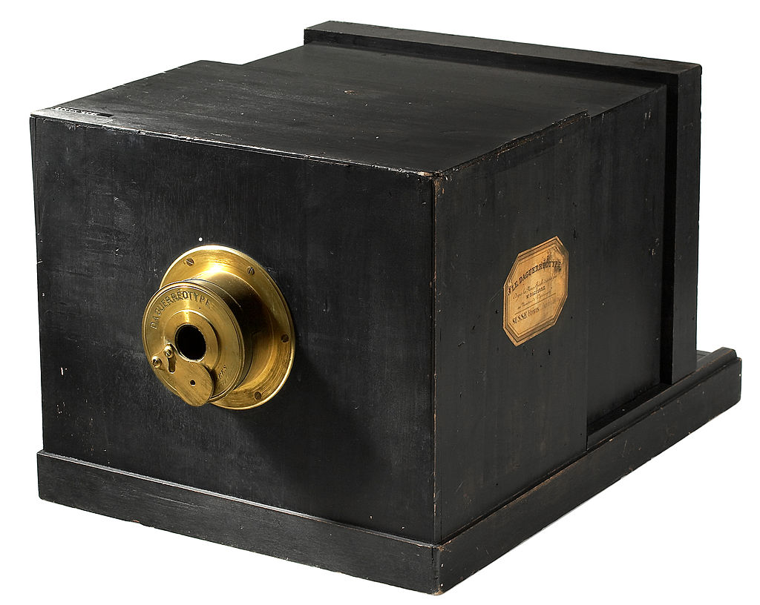
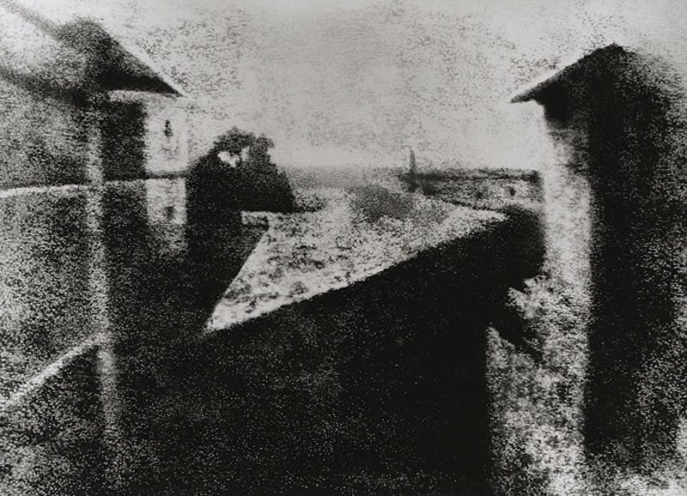
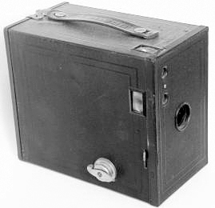
Camera History | evolution over time
1826
first portable camera & world’s first photograph
1888
Kodak sells first commercial camera

Slide 8
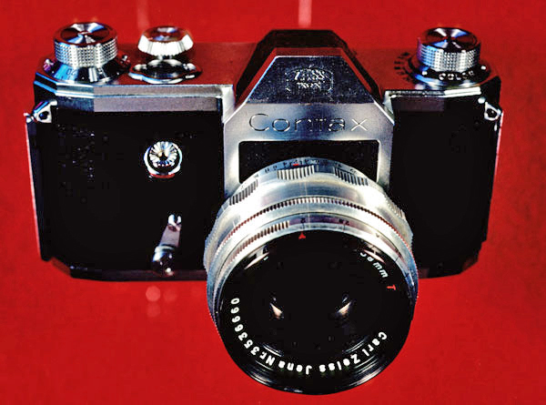
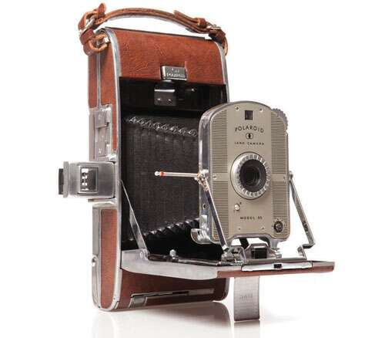
Camera History | evolution over time
1930s
The first 35mm SLR cameras were being developed
1948
Polaroid introduces first instant camera

Slide 9
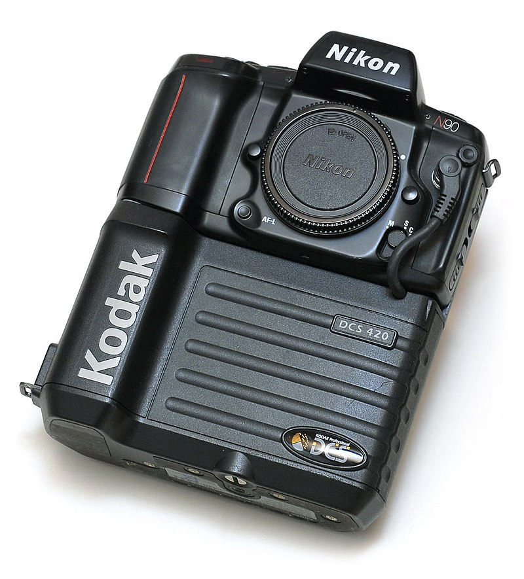
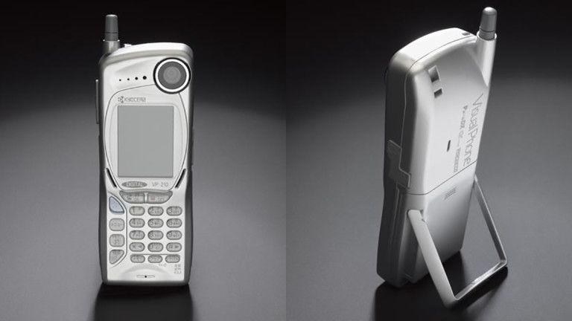
Camera History | evolution over time
1991
Kodak launched the first digital camera available to the public
1999
Kyocera released the first commercial camera phone

Slide 10
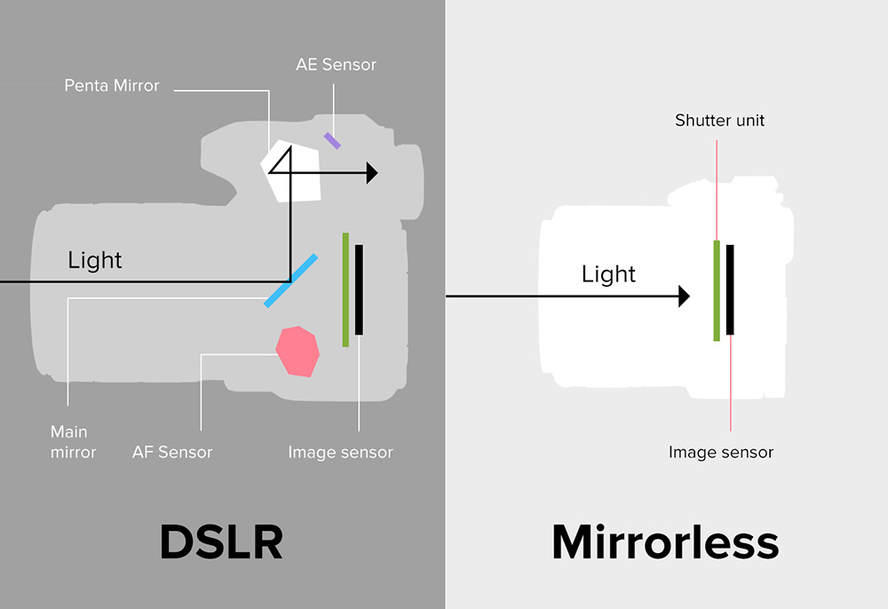
Camera History | The modern camera

Slide 11
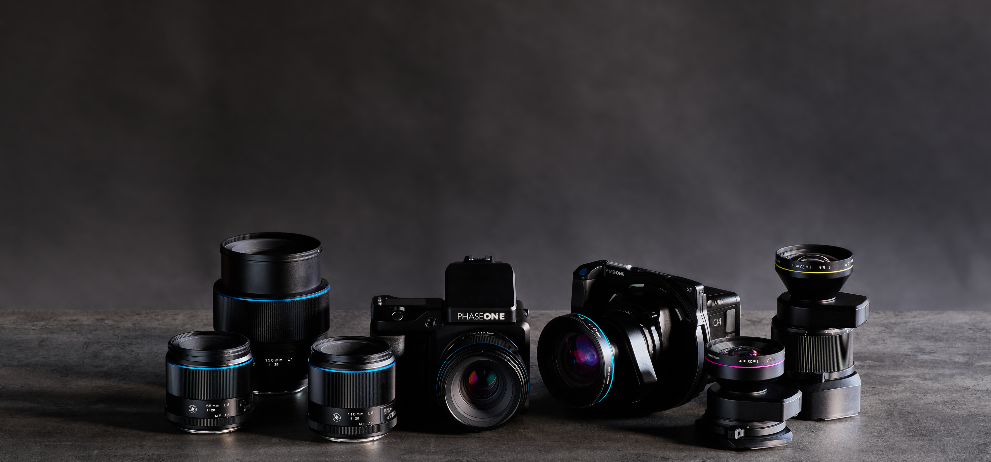
Photography Basics

Slide 12
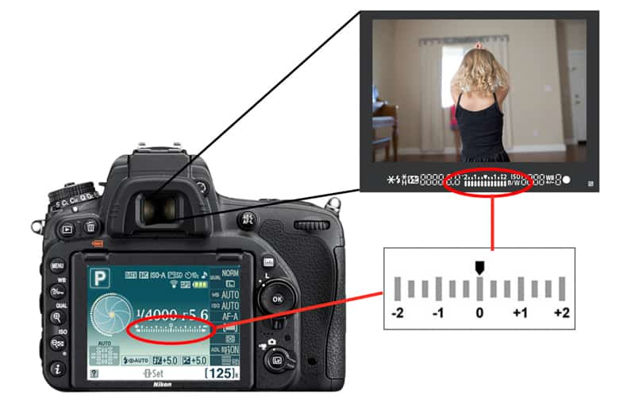
Photography Basics | exposure
A great photo requires proper exposure
Exposure: the amount of light that reaches your camera sensor or film

Slide 13
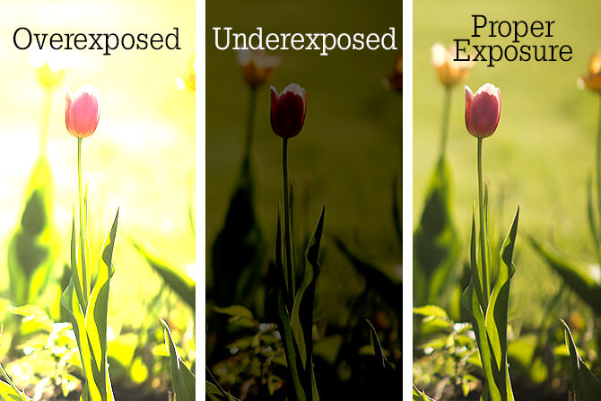
Photography Basics | exposure

Slide 14
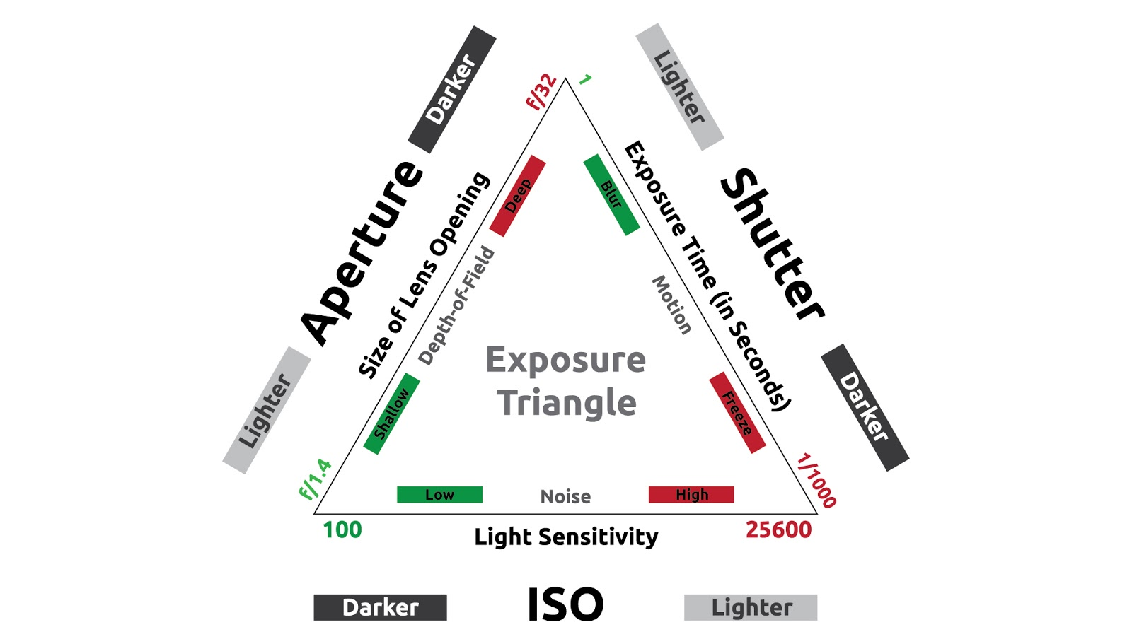
Photography Basics | exposure
There are 3 elements working together to control exposure:
ISO
Shutter speed
Aperture

Slide 15
Photography Basics | exposure
All three elements control the amount of light reaching the sensor.
Individually they can also control things like:
Motion blur
Depth of field
Image quality

Slide 16
Photography Basics | ISO
ISO: stands for International Standards Organization which is the organization that standardizes sensitivity ratings for camera sensors
ISO Rating: ranges in value from 25 – 3200+ and indicates specific light sensitivity

Slide 17
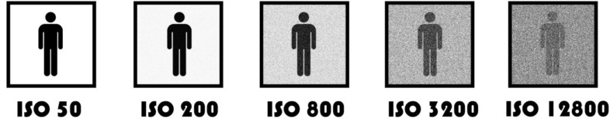
Photography Basics | ISO
Lower ISO number: the less light reaching the sensor and the clearer the image quality
Higher ISO number: the more light reaching the sensor and a grainer image quality

Slide 18
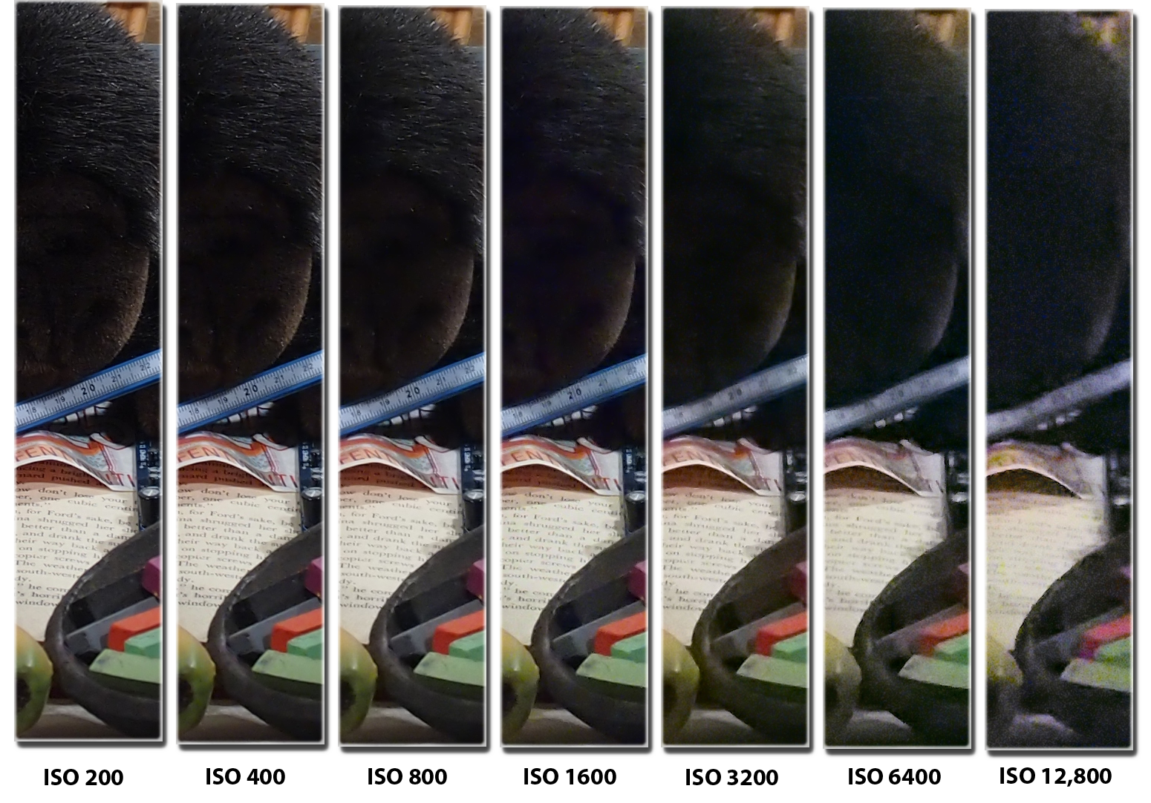
Photography Basics | ISO

Slide 19
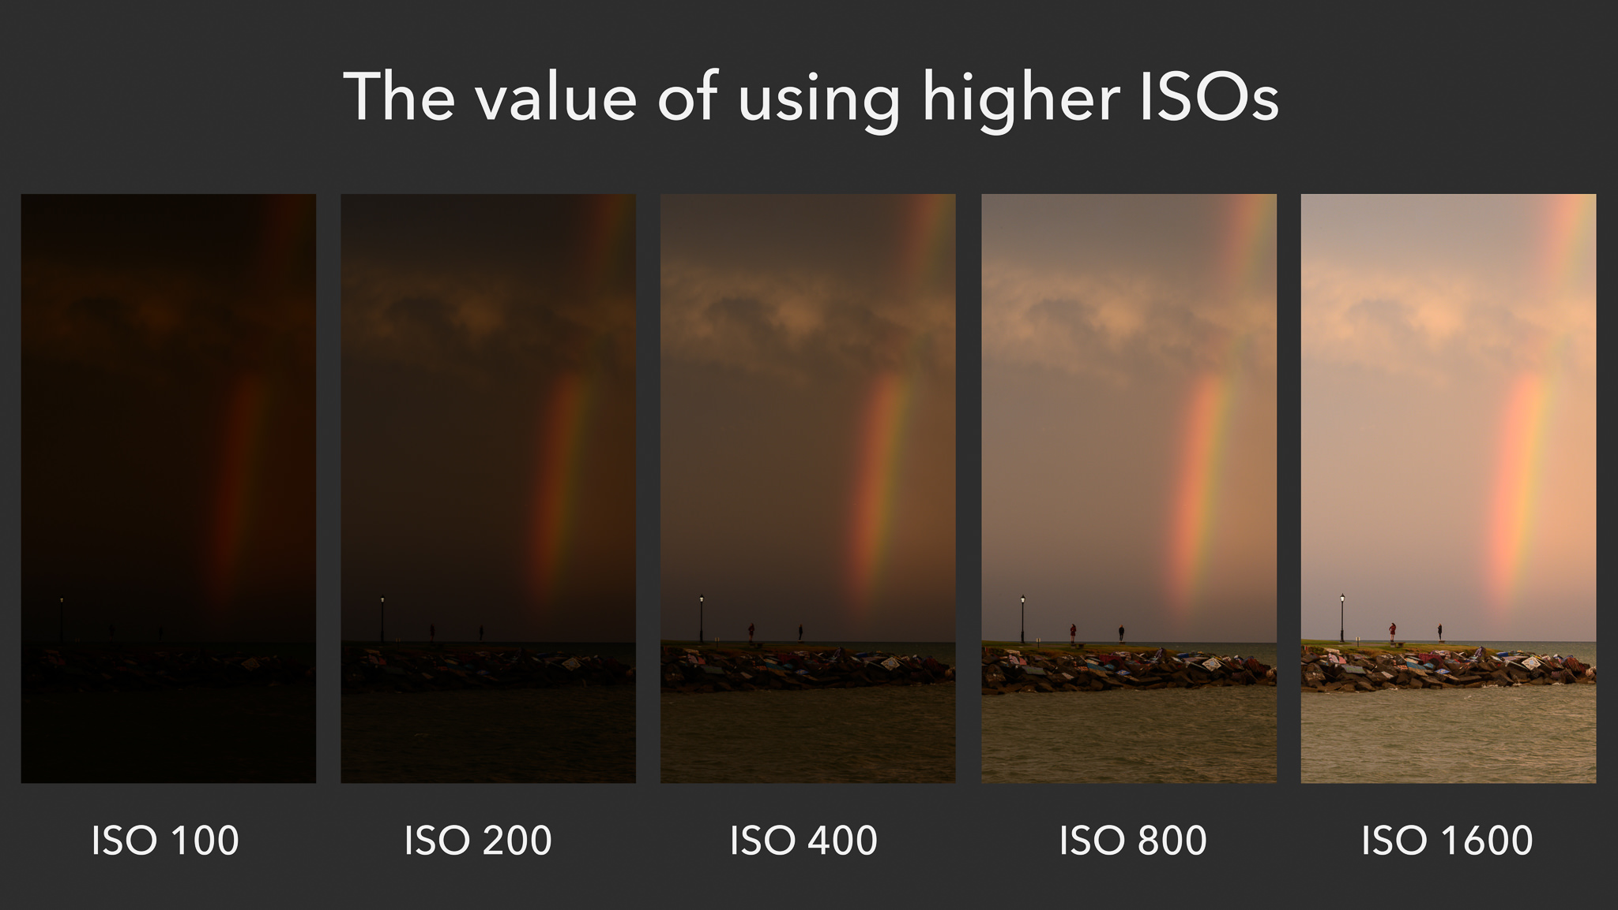
Photography Basics | ISO

Slide 20
Photography Basics | shutter speed
Shutter speed: is measured in fractions of a second and indicates how fast the curtains at the film plane open and close

Slide 21
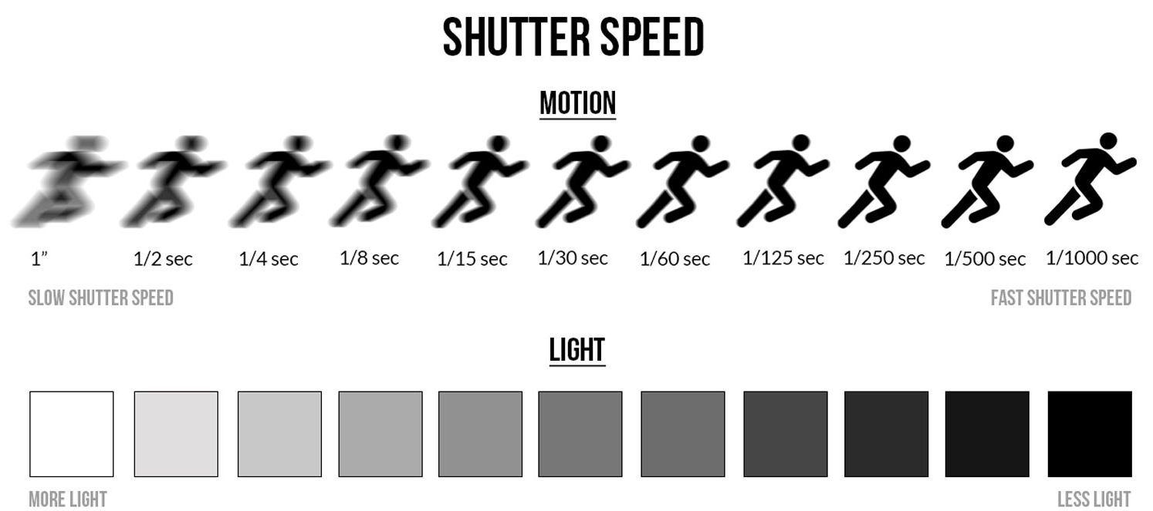
Photography Basics | Shutter speed
Slower shutter speed more light reaching the camera sensor and more motion is being captured
Faster shutter speed less light reaching the sensor and little to no motion is being captured

Slide 22
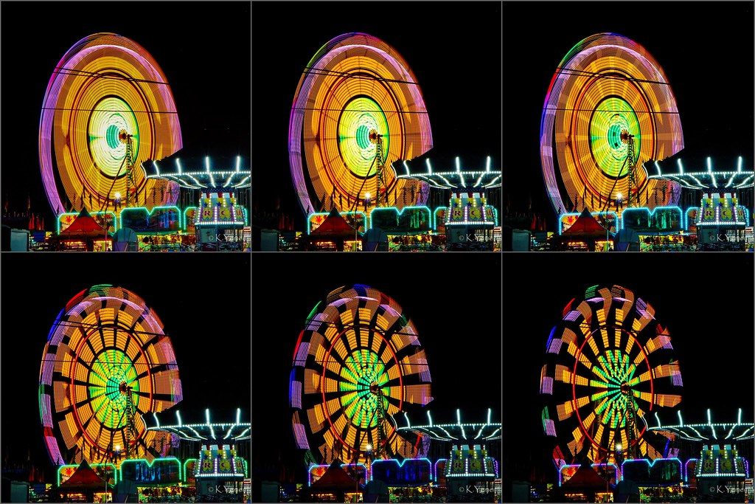
Photography Basics | Shutter speed
Slow shutter speed
Fast shutter speed

Slide 23
Photography Basics | aperture
Aperture: is the opening in the diaphragm that determines the amount of focused light passing through the lens

Slide 24
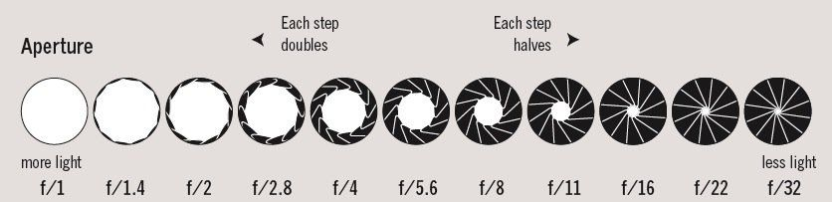
Photography Basics | aperture
Larger aperture more light reaching the camera sensor and a shallow depth of field
Smaller aperture less light reaching the sensor and a deep depth of field

Slide 25
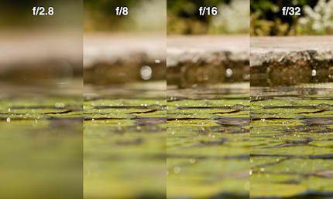
Photography Basics | aperture
Large aperture
Small aperture

Slide 26
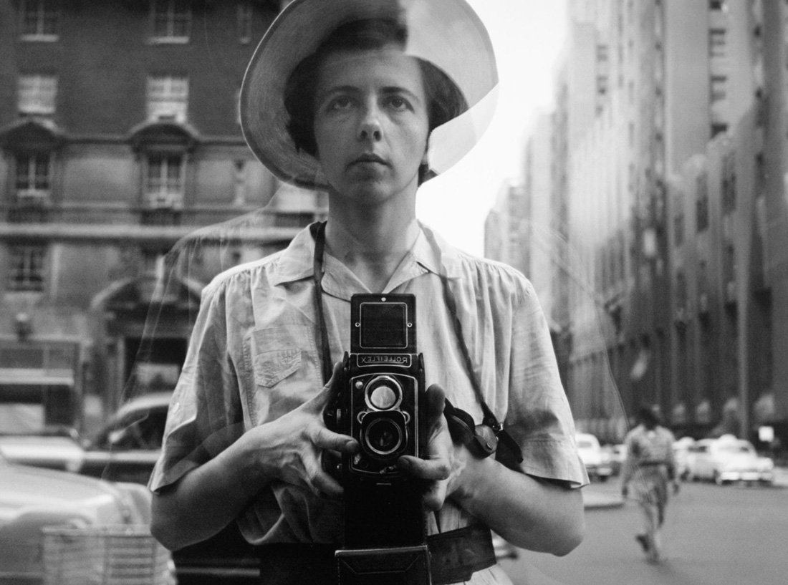
Film photography
Self-portrait, Vivian Maier

Slide 27
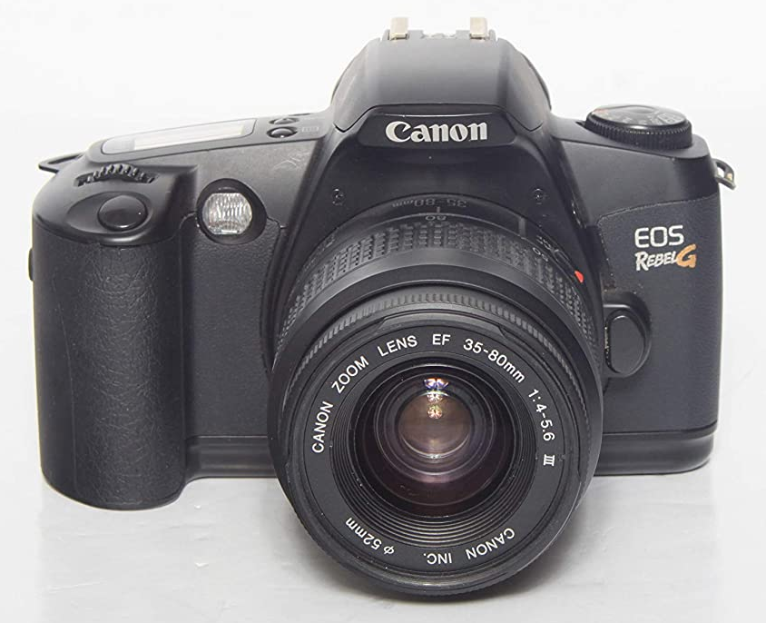
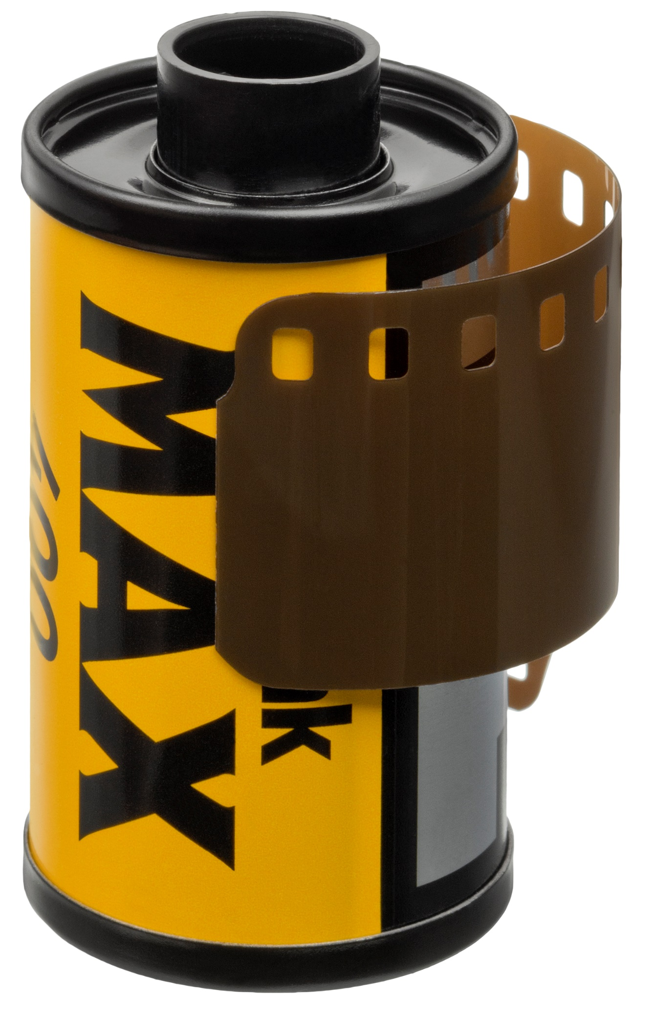
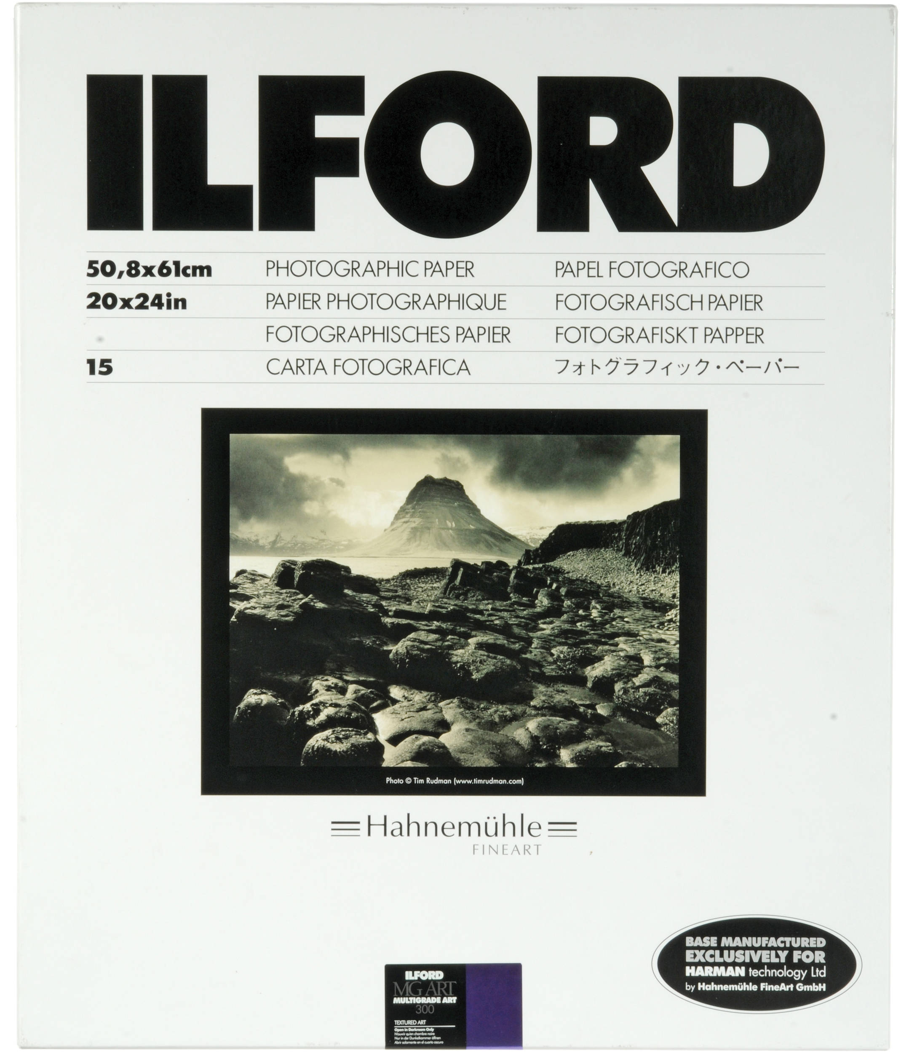
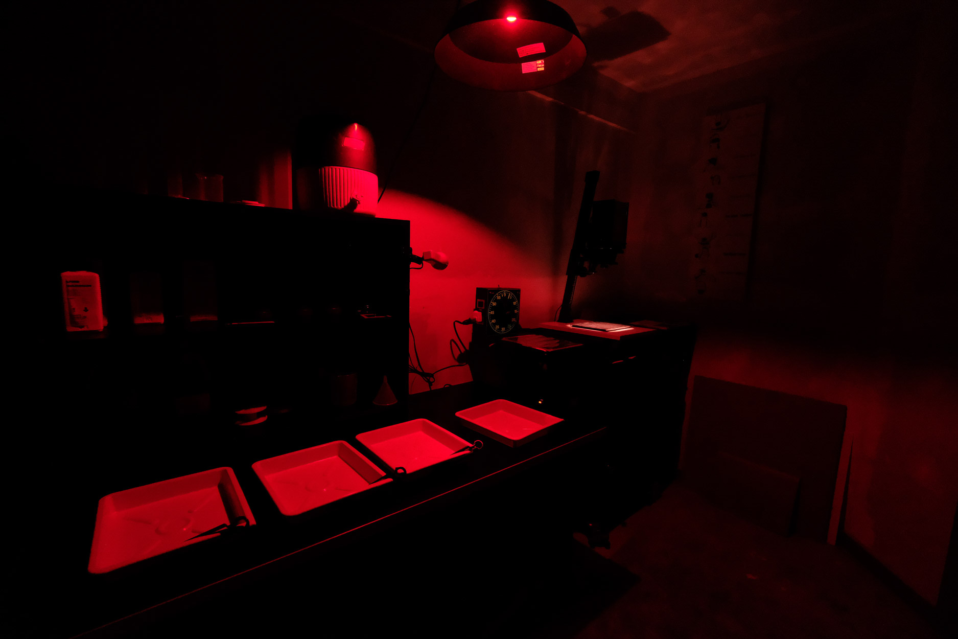
Film photography – necessary equipment
Film camera
SLR
Compact
Disposable
Film
Black & white
Color
Novelty
Photo paper
Color/BW
  Glossy
  Luster
  Matte
Darkroom
Professional
Homemade
Mail-in

Slide 28
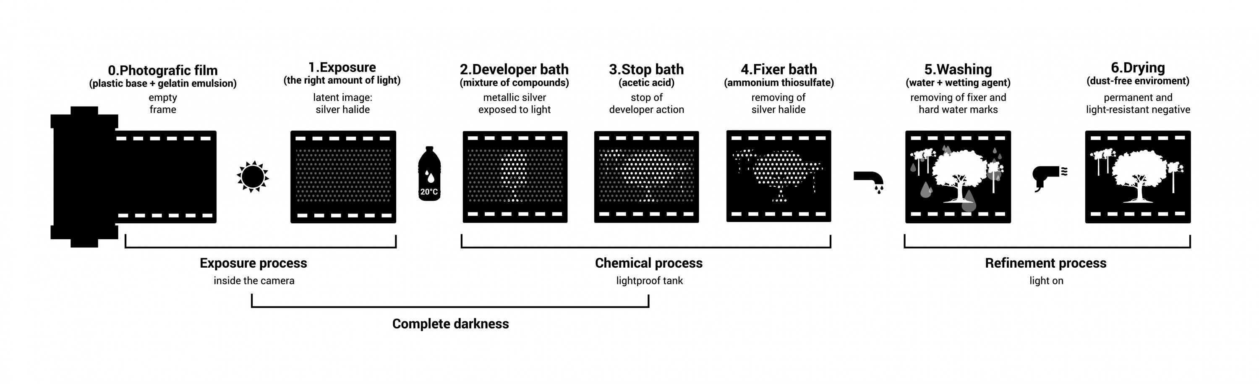
Film photography – developing process
You’ll be in the dark for most of this process
Your only source of light comes from the safelight, which only provides light from the visible spectrum which the photographic paper is insensitive (usually red or light brown light)
So, you’ll want to set up all your chemicals, trays, etc. ahead of time

Slide 29
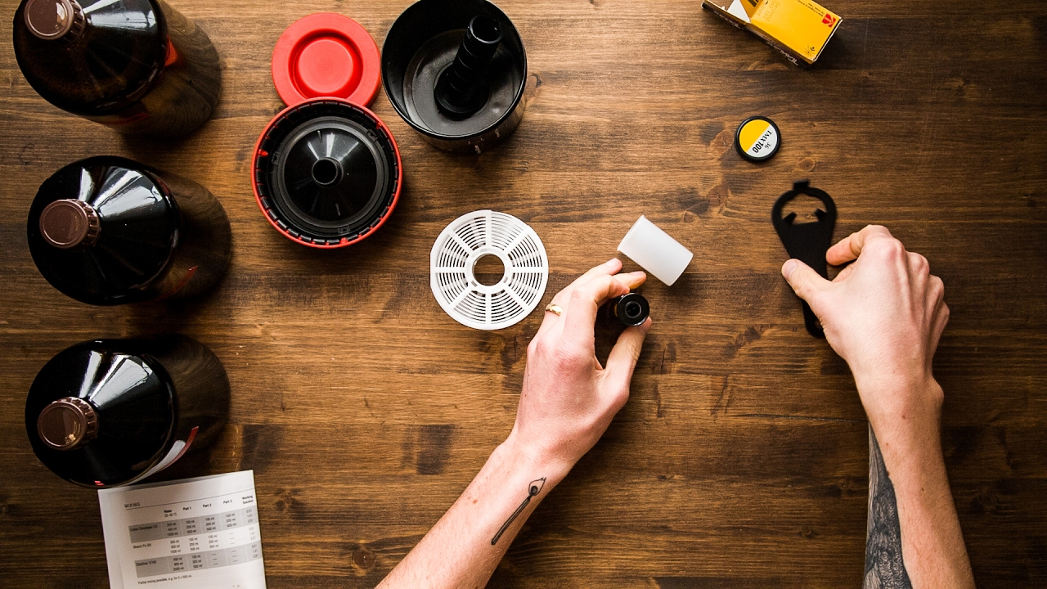
Film photography – Developing process
Step 1: Develop film
This is where you get your film negatives, and it is approx. a 14-step process

Slide 30
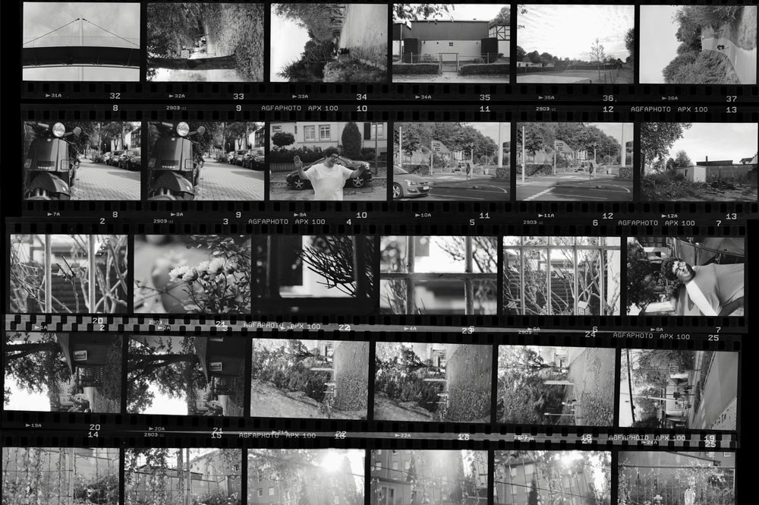
Film photography – developing process
Step 2: Create contact sheet
Contact sheets are created by laying negatives on a piece of printing paper and are a great way to help locate individual photos quickly

Slide 31
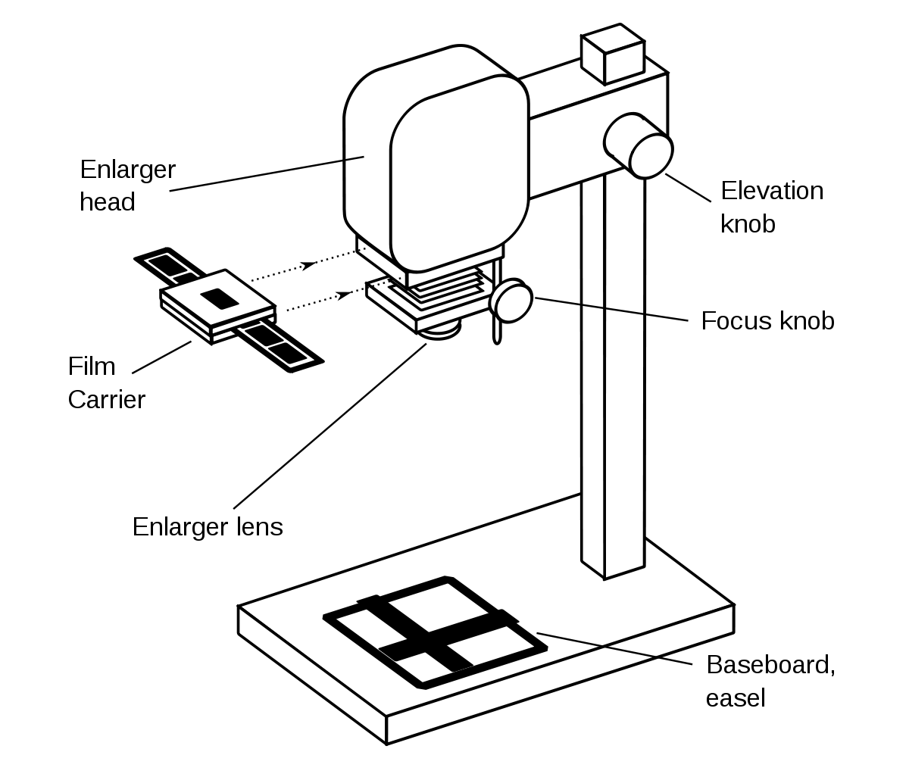
Film photography – developing process
Step 3: Use the enlarger
The enlarger is what you use to produce photographic prints from your negatives

Slide 32
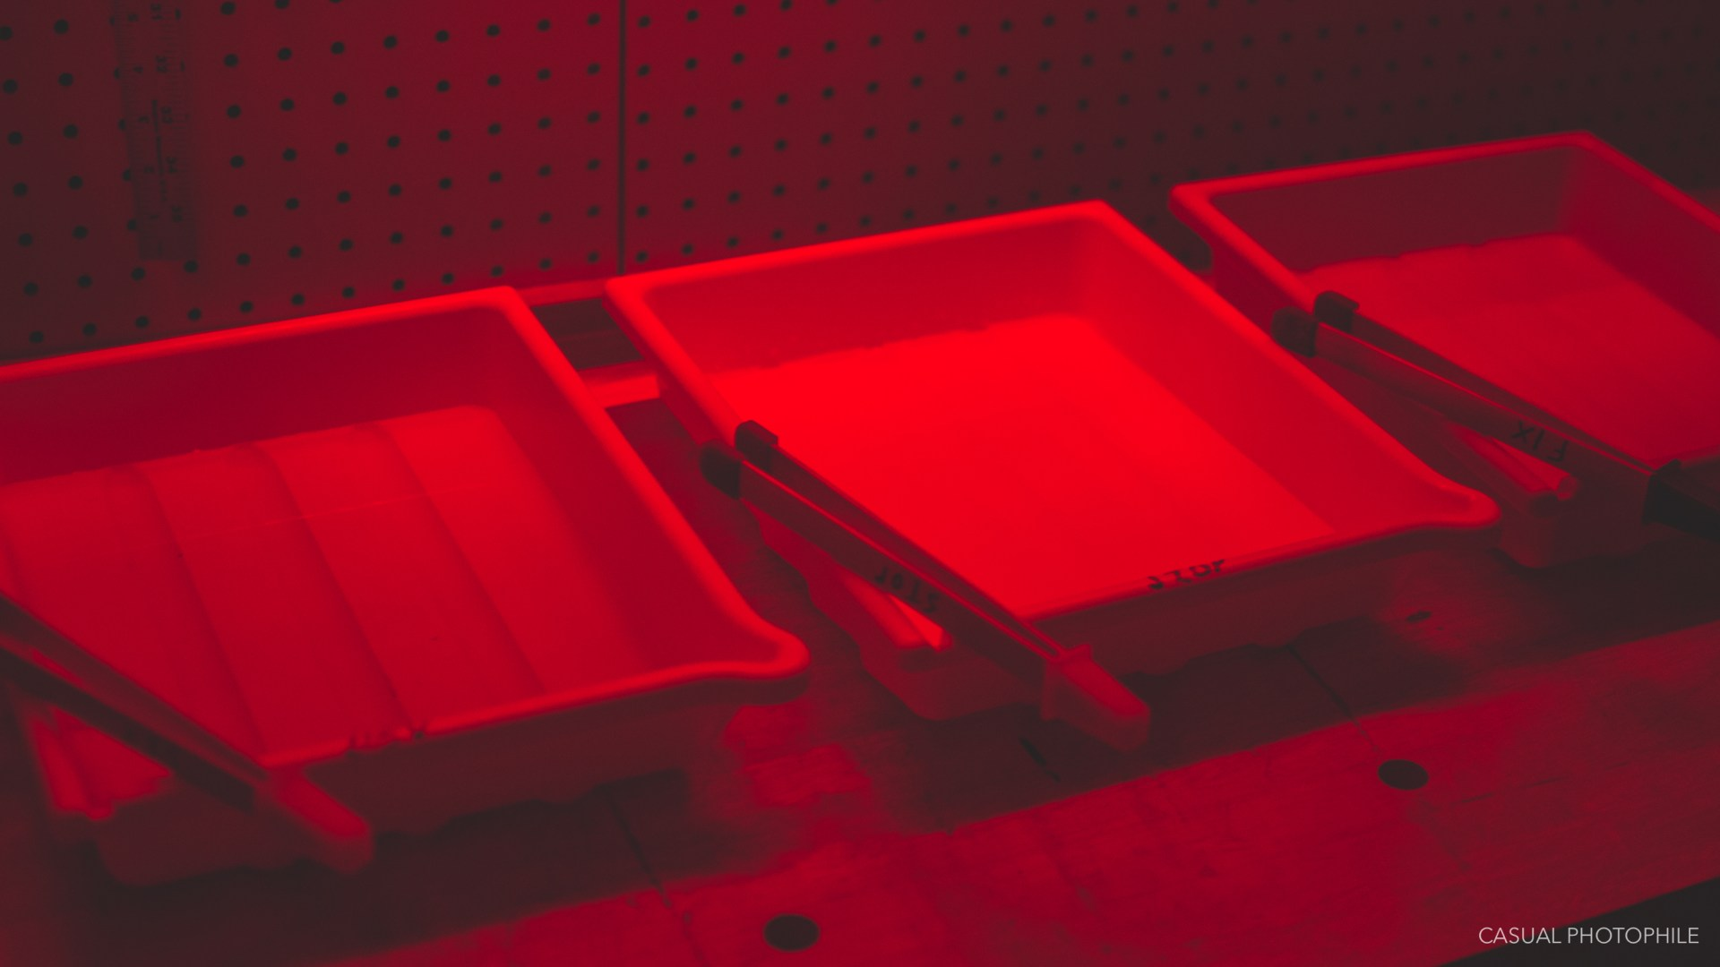
Film photography – developing process
Step 4: Develop prints
You’ll take your print from the enlarger and put it through a 3-step chemical process (developer, stop, fix) and a wash

Slide 33
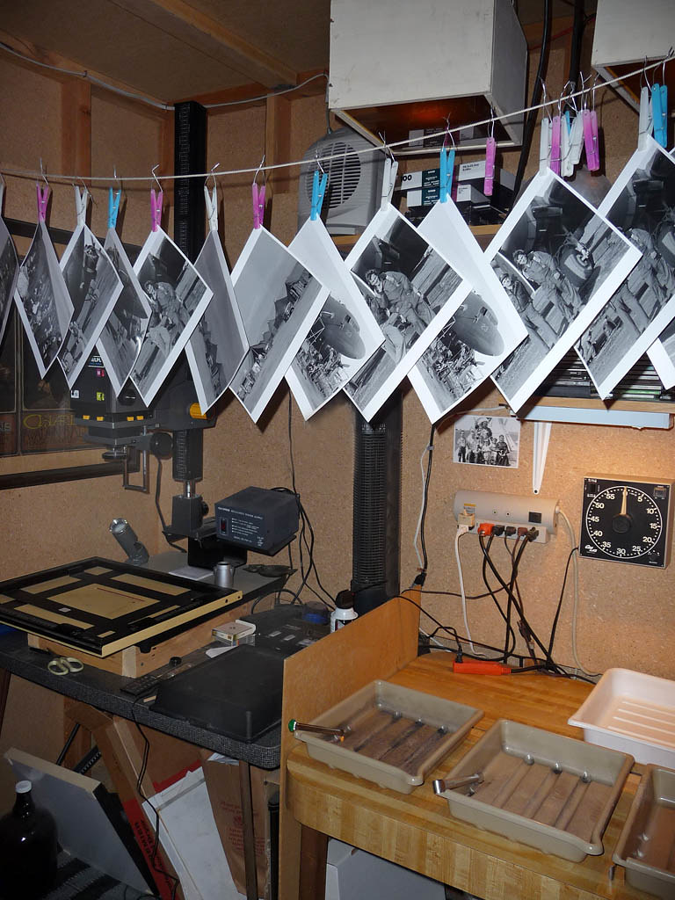
Film photography – developing process
Step 5: Hang your prints up to dry

Slide 34

The end

