Slide 1
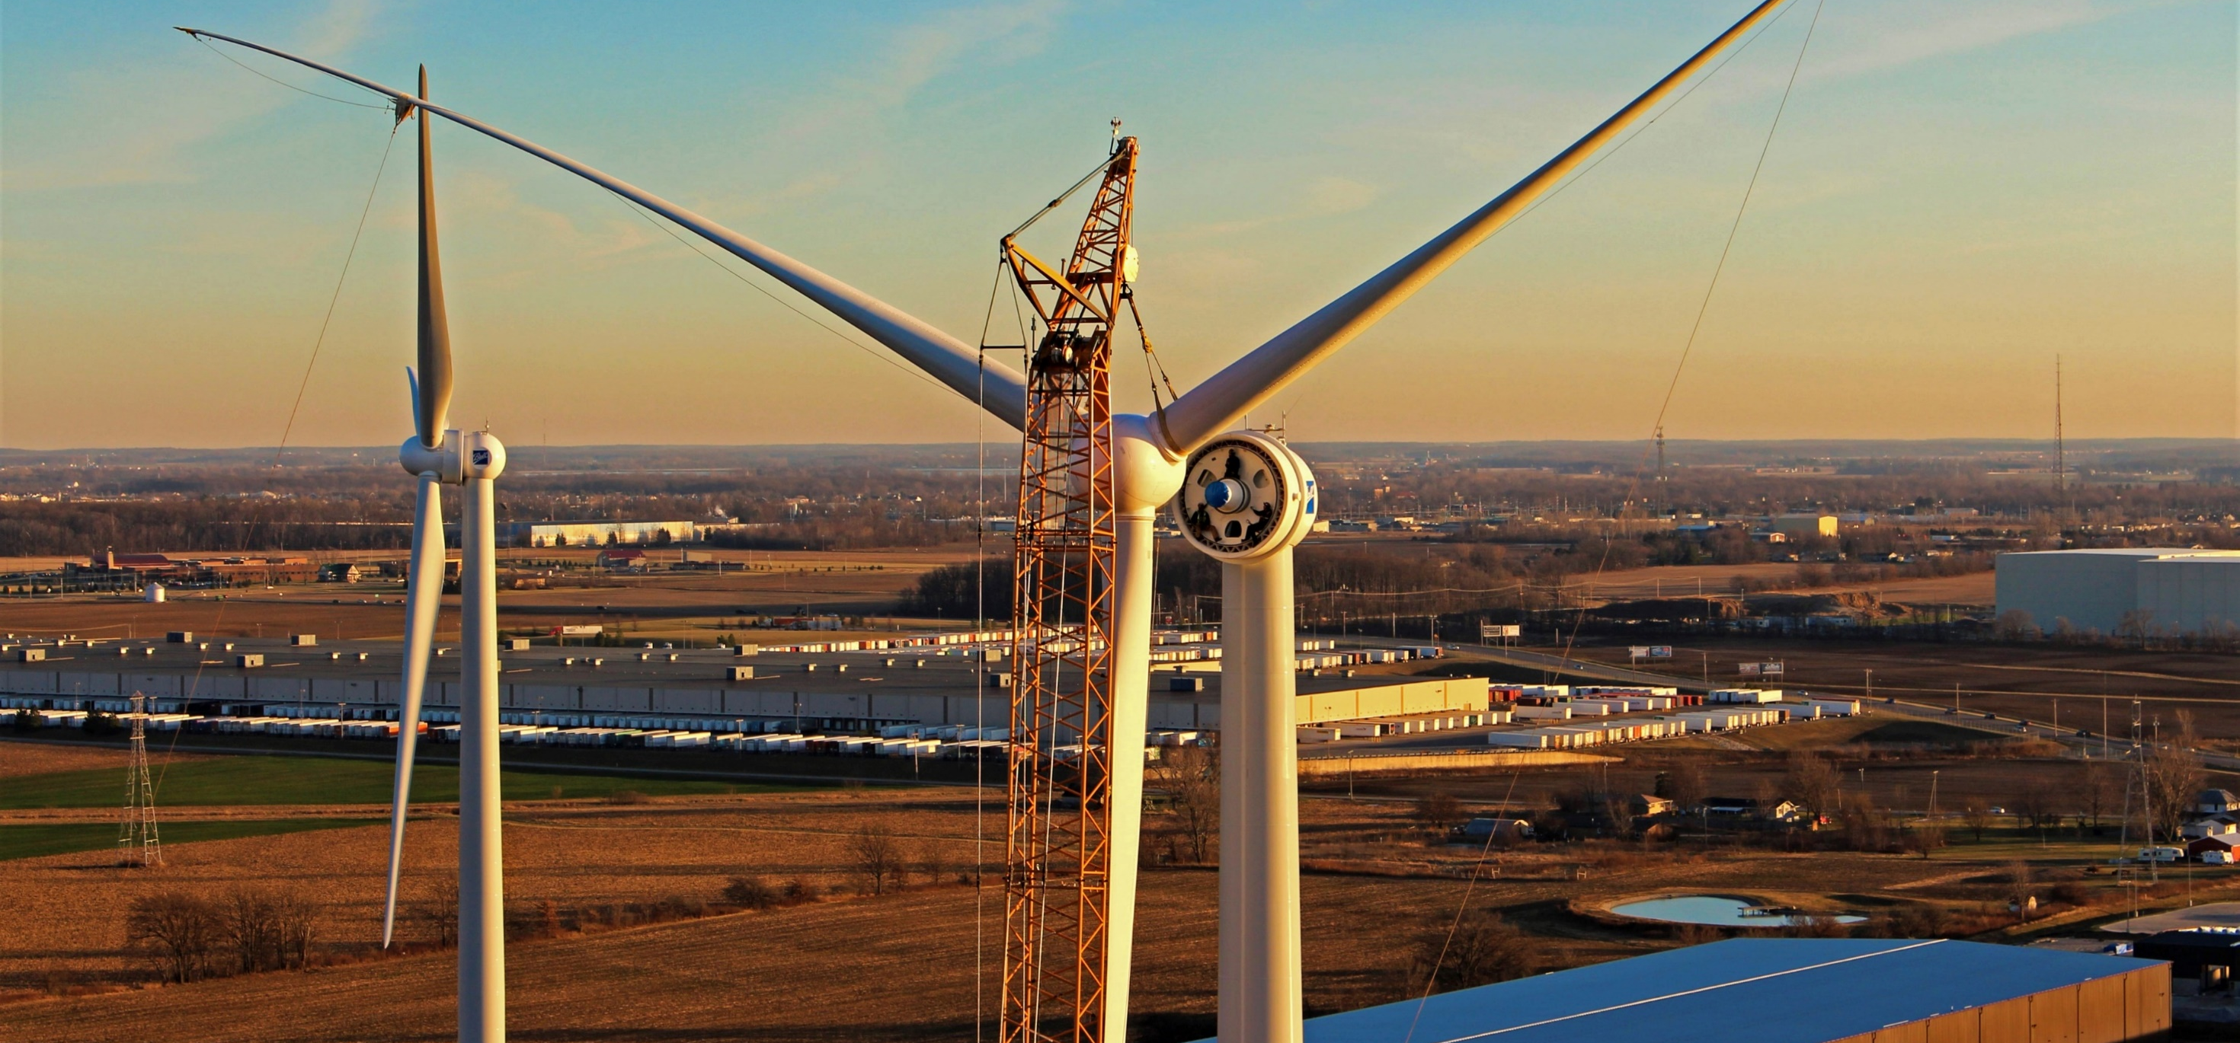

Hancock County Volunteering Overview
12385 Township Rd 215 | PO Box 894
Findlay, Ohio 45840
877-298-5853 | www.oneenergy.com
Tyler Yannuzzi
10/24/2023

Slide 2

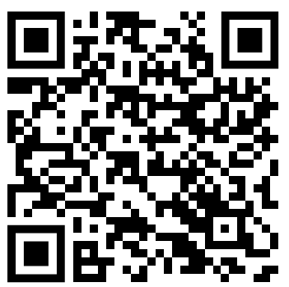
Hancock Park District
Improvement, beautification, and maintenance
Role: Volunteer
Responsibilities are skill dependent
Including carpentry, teaching, and art projects
Online application center

Slide 3
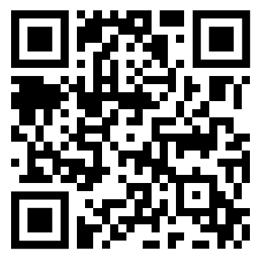

Children's Mentoring Connection
Local big brother, big sister program (various mentoring styles)
Role: Mentor
Mentorship and maintaining consist contact
Engagement as a positive role model
Individual training/ education
Online interest form

Slide 4

Findlay - Hancock County Public Library
Read for Life program → Improving adult literacy
Role: Tutor
Educational support: reading, math, writing
Assistance with GED and citizenship
readforlife@findlaylibrary.org

Slide 5

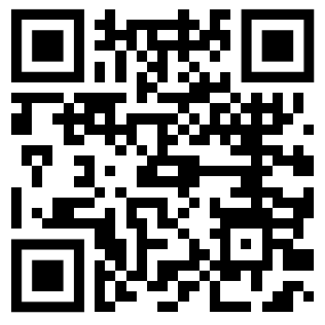
National Alliance on Mental Illness (NAMI) Hancock Co.
Promoting mental health → education, support, and advocacy!
Role: Volunteer
Event help or committee service
Facilitate support groups/classes
Online application center

Slide 6


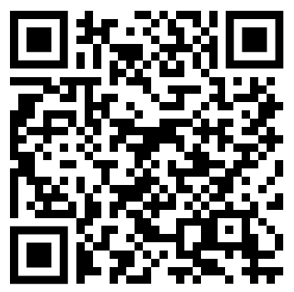
West Ohio Food Bank
Largest regional food bank serving Hancock and more
Role: Volunteer
Sort, process, and package food for distribution
Office skills/ specialty skills applicable
Groups welcomed with advanced notice
&

Slide 7
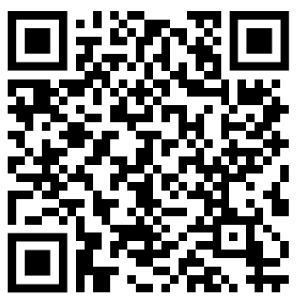

Habitat for Humanity - Findlay ReStore
Restoring and Reusing household necessities and comforts
Role: Volunteer
Tuesday’s 6-8pm
Clean, sort, and stage donations
Select times you are available a month in advance

Slide 8

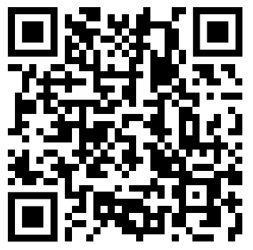
United Way of Hancock County - Volunteers United
Facilitate the process of finding diverse volunteer opportunities
Role: Volunteer Seeker
Match program to align volunteer’s skills and interests
Registration form online

Slide 9
Thank you!! …Questions?
12385 Township Rd 215 | PO Box 894
Findlay, Ohio 45840
877-298-5853 | www.oneenergy.com
Tyler Yannuzzi
10/24/2023

Slide 10
“Opportunity/ Organization title”
Mission of opportunity or organization
Role:
Responsibilities
…
Contact information

