Slide 1
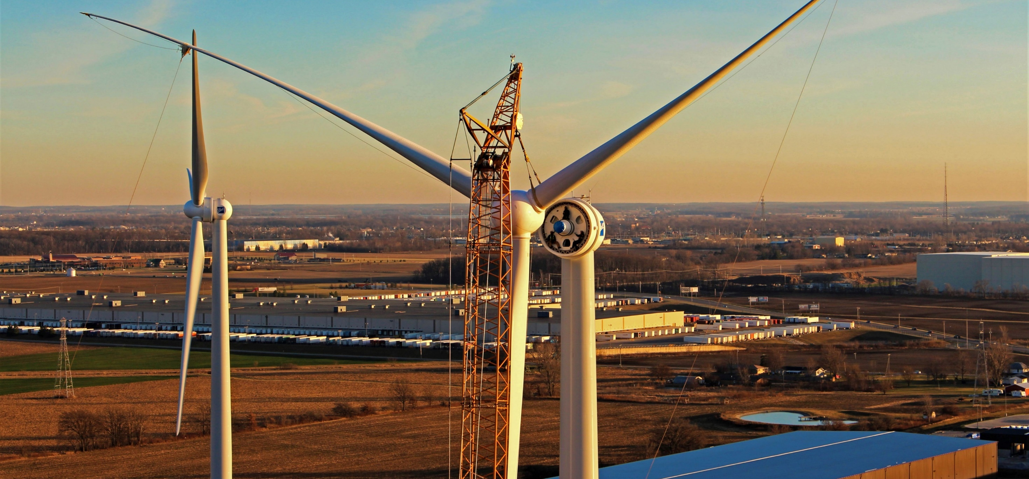

CONCRETE REPAIRS: WHAT AND WHY
12385 Township Rd 215 | PO Box 894
Findlay, Ohio 45840
877-298-5853 | www.oneenergy.com
NAME
DATE

Slide 2
OUTLINE
RRC Foundation Design
Concrete Quality Concerns
Why Does It Matter?
Industry Repair Practice
One Energy Foundation Repairs

Slide 3
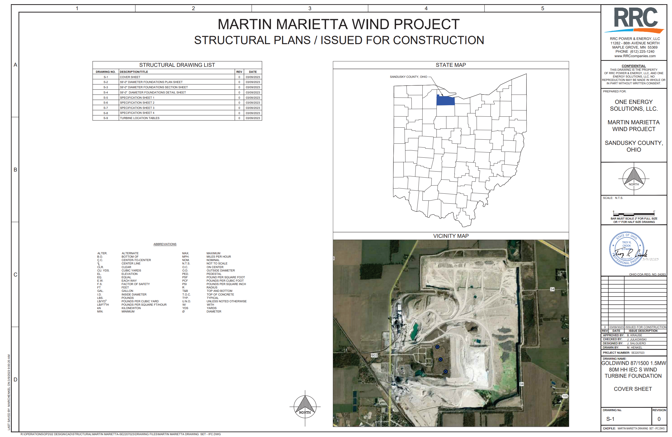
RRC FOUNDATION DESIGN
PERTINENT SECTIONS FOR CONCRETE
Concrete (Mix Design Requirements)
Execution of Concrete Mixing and Placement
Mass Concreting
Hot Weather Concreting
Cold Weather Concreting
Required Submittals (Mix Design Requirements cont.)
Notes:
The foundation design we use for the GW turbines meets all current ACI standards and is extremely overdesigned – like extremely.
There are specific sections within the foundation design that detail specifics for concrete, including (but not limited to), concrete mix design, proper consolidation techniques and extreme weather concrete procedures.

Slide 4
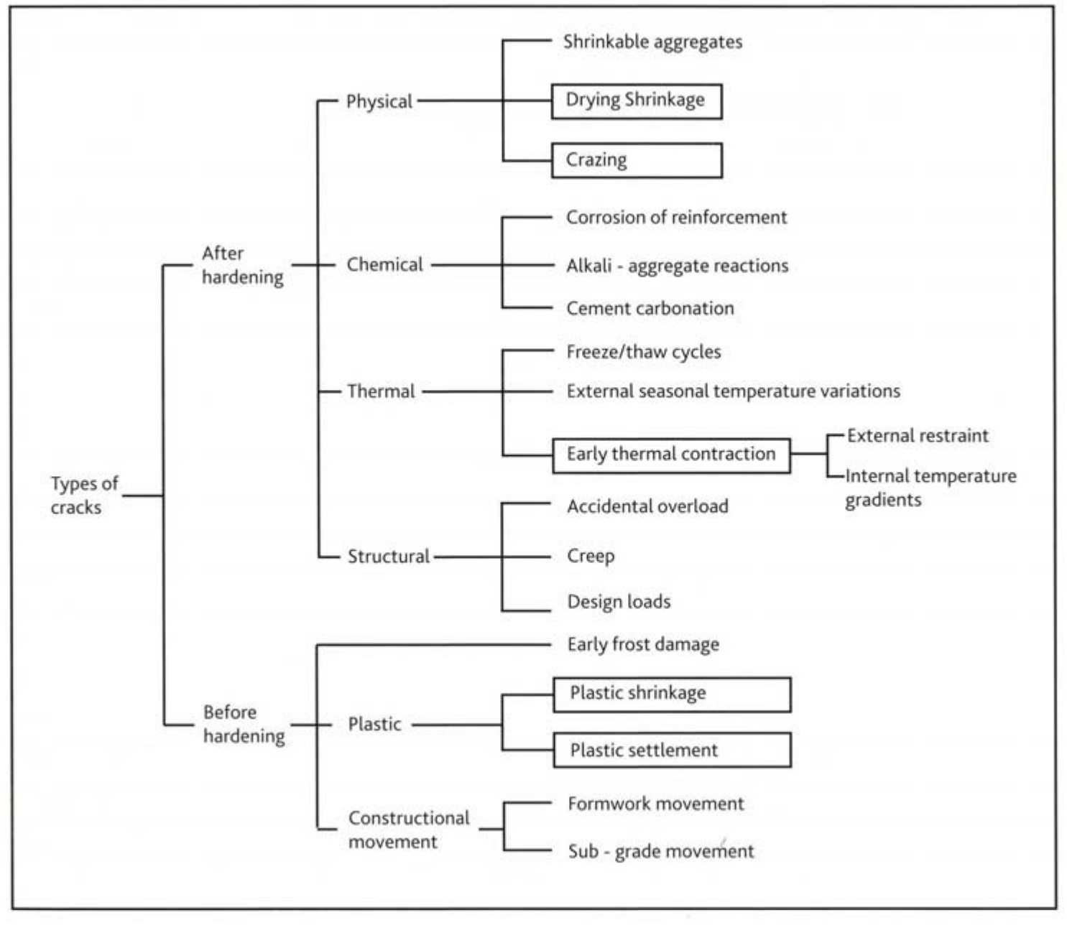
CONCRETE QUALITY CONCERNS
Some Causes of Concrete Cracks
Poor consolidation
Extreme weather (curing process)
Concrete placement procedures
Concrete delivery
Poor mix design
Notes:
Even with an extremely overdesigned foundation design, there can obviously still be issues with turbine foundations. The execution of foundation pours does not always go smoothly due to a variety of factors (lack of experience, weather, concrete delivery issues, concrete consolidation etc.) and as a result, there may be cracks that will cause quality concerns.
This is a comprehensive tree of types of cracks (and likely causes) that could be expected with any type of concrete job.

Slide 5
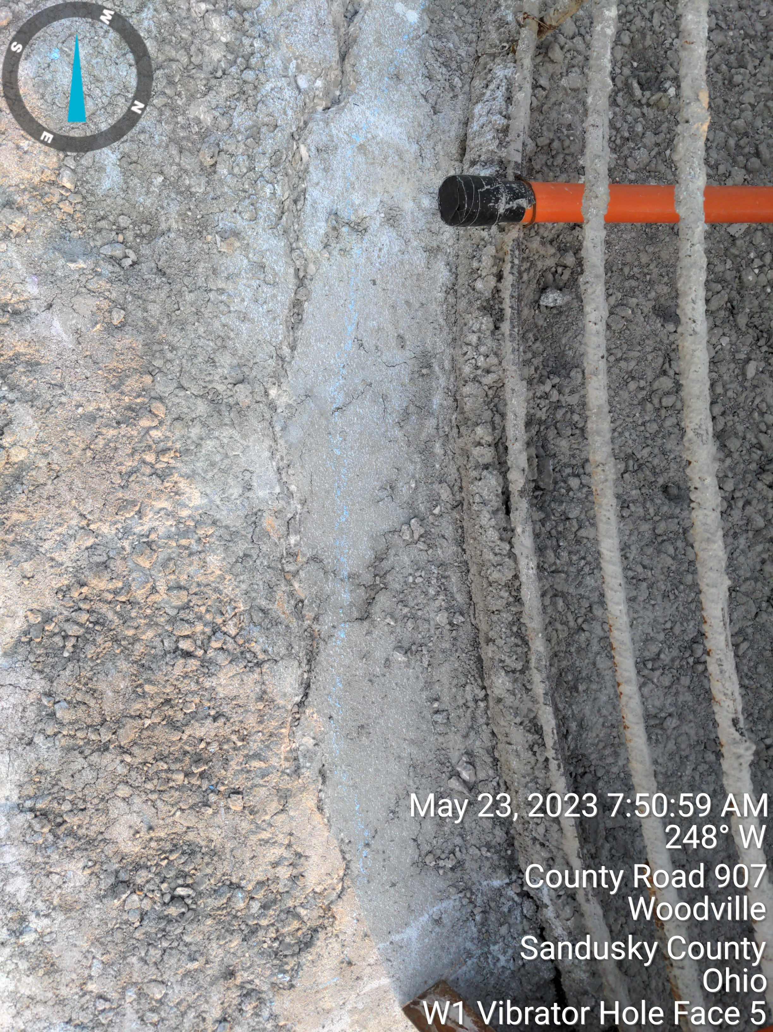
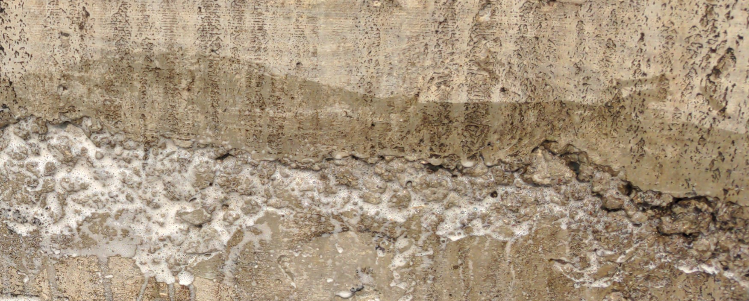
CONCRETE QUALITY CONCERNS
HONEYCOMBING
COLD JOINTS
Exposed coarse aggregate creating hollow spaces
Potential Causes
Improper consolidation, poor mix design
Layer of concrete sets up before next layer can be placed
Potential Causes
Concrete delivery, improper consolidation, extreme weather
Notes:
There are certain types of cracks that are more common than others.

Slide 6
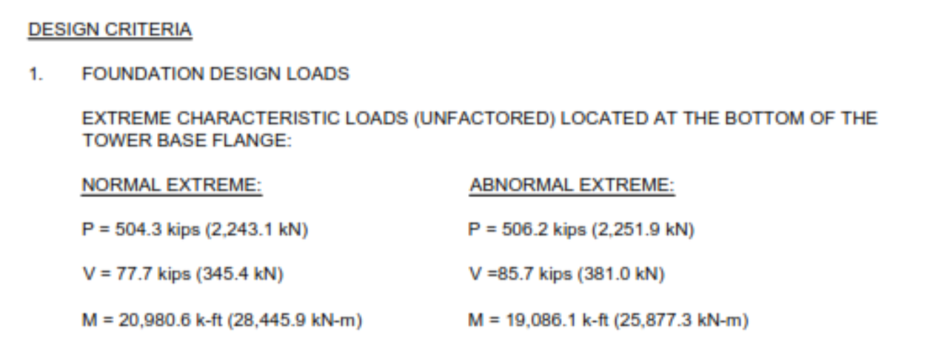
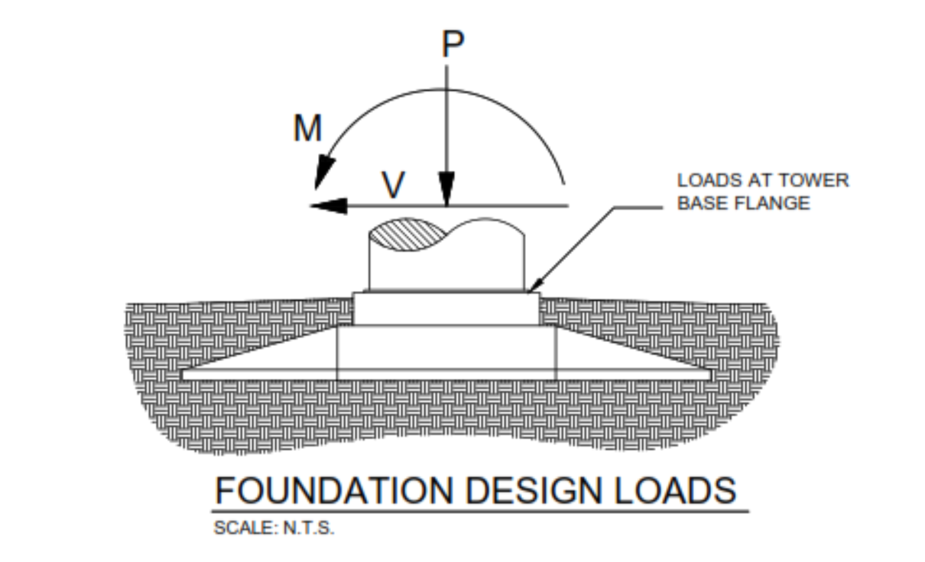
WHY DOES IT MATTER?
Short-Term Consequences
Construction Costs
Project Schedule
Long-Term Consequences
Turbine Design Life (20 year vs. 30 year)
Operations and Maintenance Costs
Notes:
Why do we really care about concrete cracks?
Well – concrete cracks create voids in the structure where water (or other substances) can seep in and cause the crack to propagate further. You’ve then diminished the foundation’s ability to support the static and dynamic loads applied to it. The concrete foundation in general will have lower strength, higher permeability, and a poor resistance to deterioration.
There are both short-term and long-term consequences associated with concrete cracks.

Slide 7
INDUSTRY REPAIR PRACTICE
Minor to Moderate Repairs
Application or injection of grout or epoxy resins
Major Repairs
Drill coring is necessary for the injection of grout or epoxy resins
Extreme Repairs
- Excavation of turbine foundation and repouring
General Idea: Fill the voids!

Slide 8
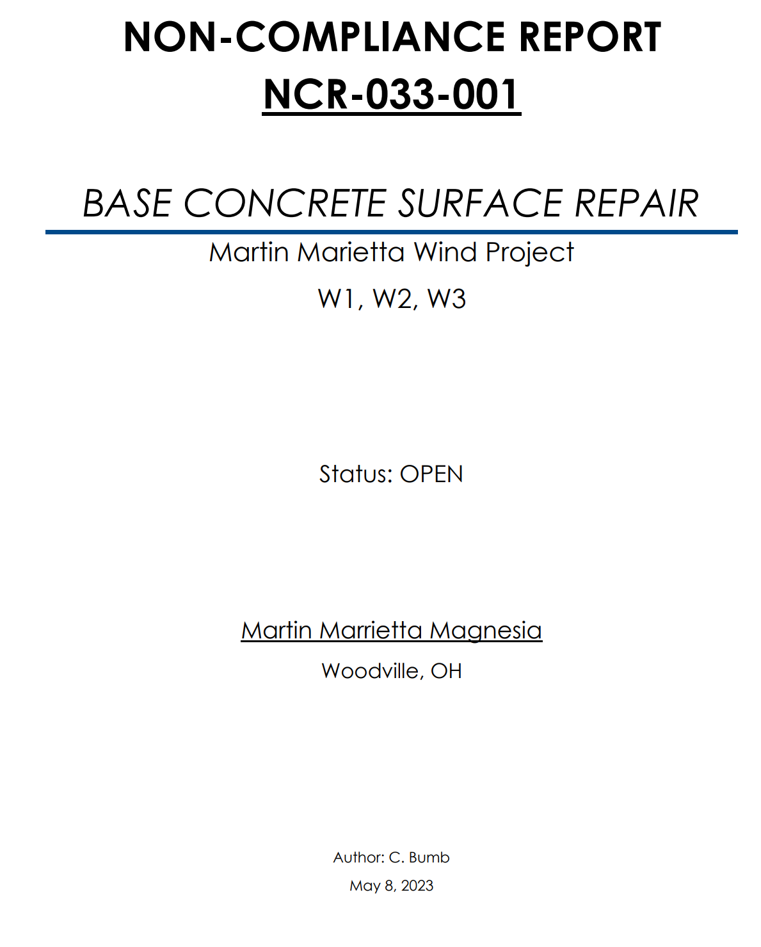
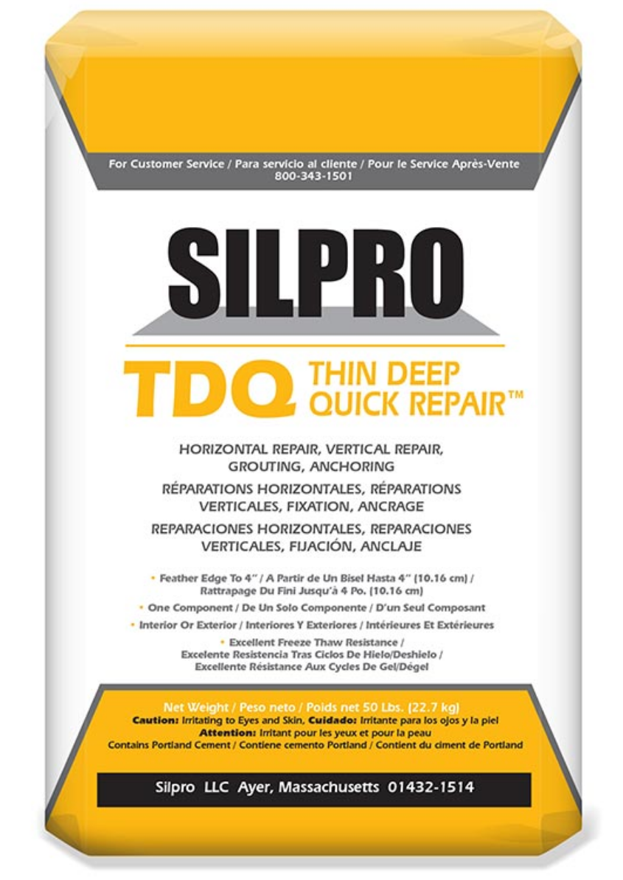
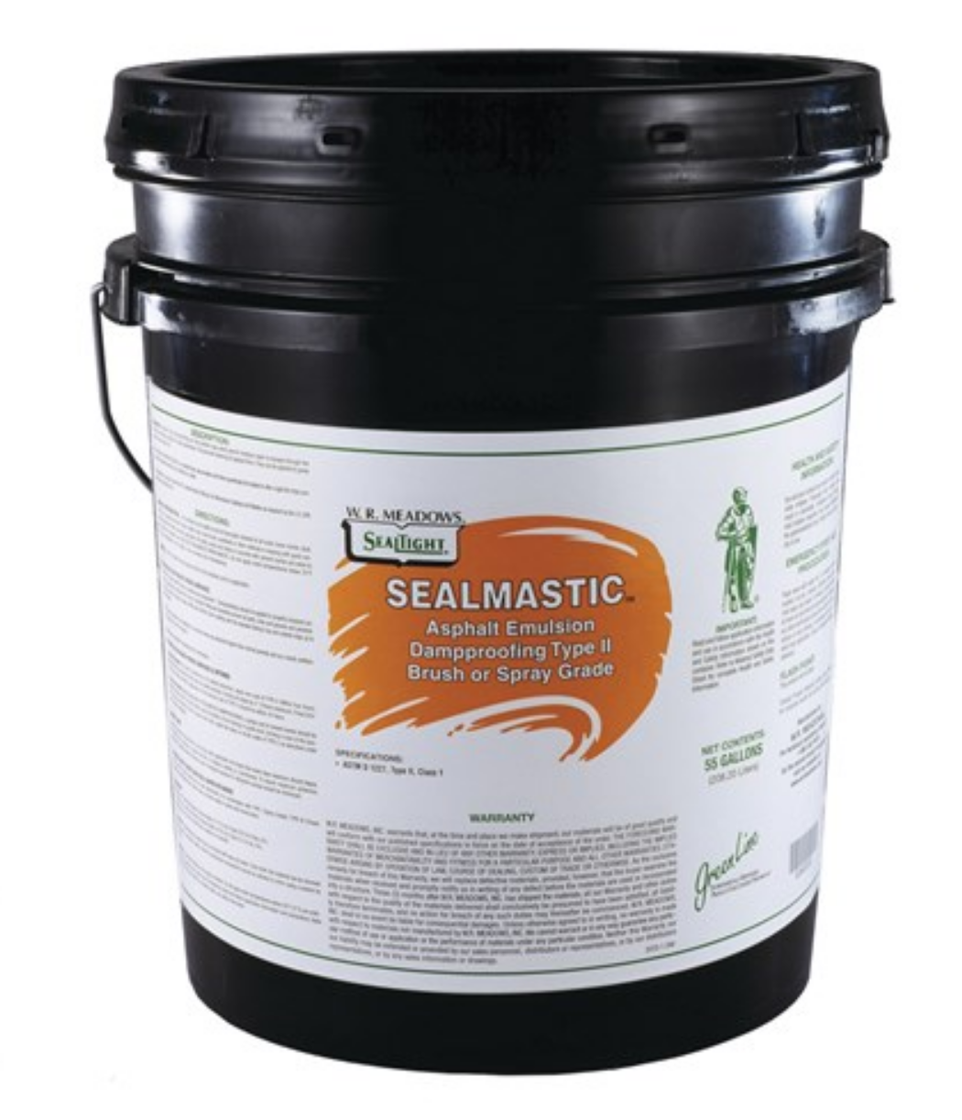
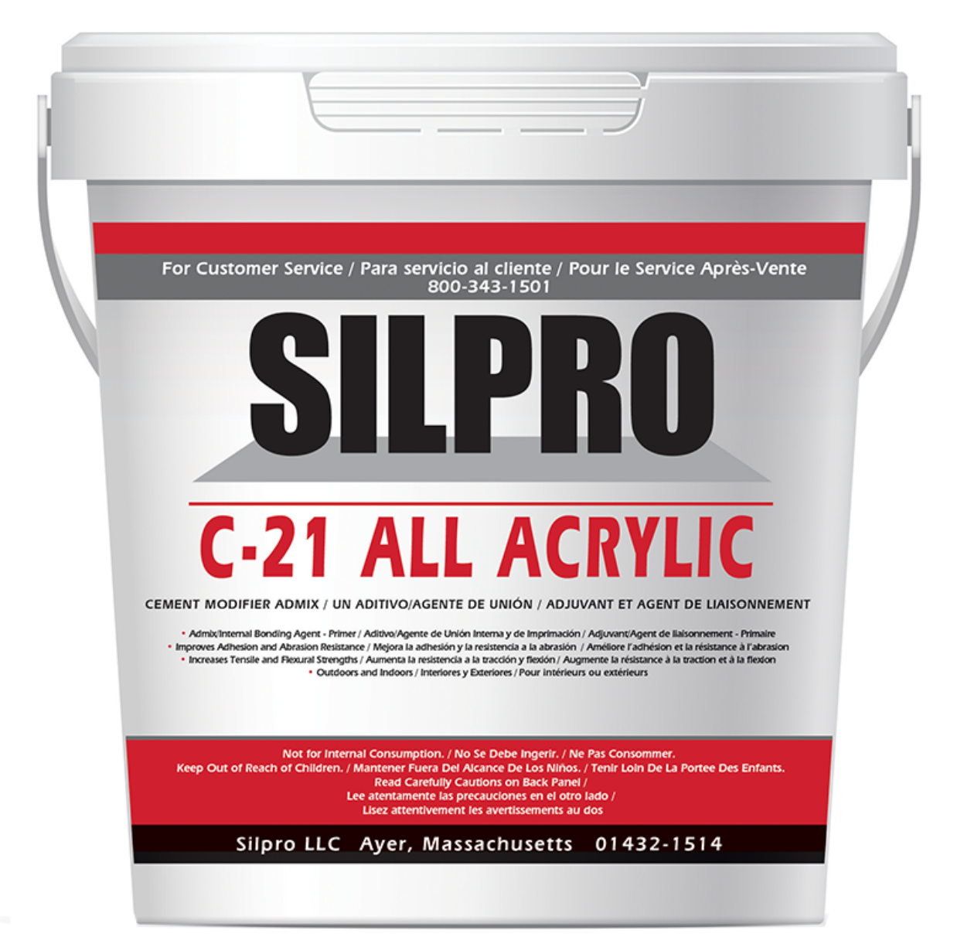
ONE ENERGY FOUNDATION REPAIRS
Non-Structural Repairs
Sealant applied to surface
No other action needed
Structural Repairs
Any surface cracks greater than 1/8 of an inch
Any voids greater than 1- 2 inches of depth
Bonding agent and patch product applied

Slide 9
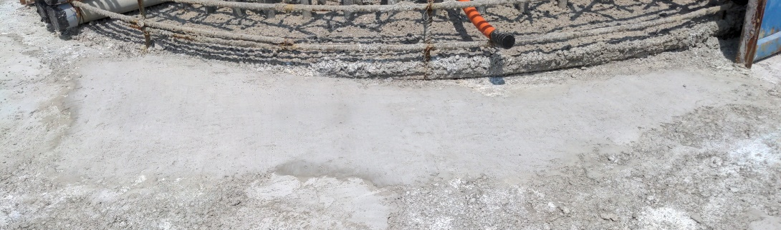
ONE ENERGY FOUNDATION REPAIRS
BEFORE
AFTER

Slide 10
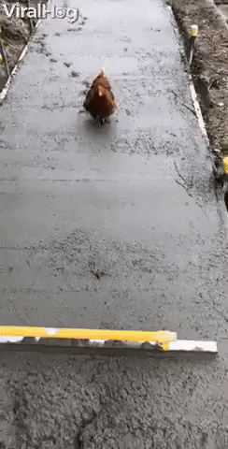

BONUS SLIDE
FURTHER PREVENTATIVE MEASURES
1.) Don’t walk on wet concrete ☺
EJ
CB
EG
JB

