Slide 1
Computers 101
Mitchel Bumb
9/14/2021

Slide 2
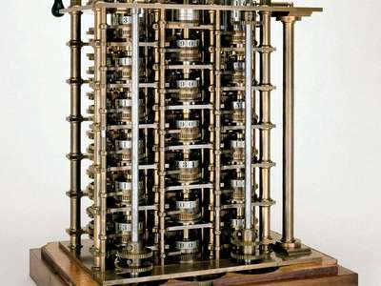
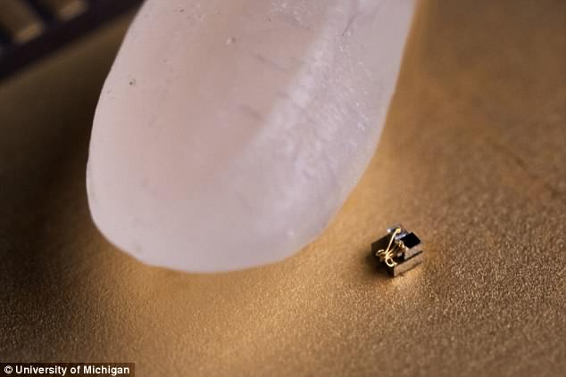
Computers are interesting
What was the first computer ever?
  The Babbage Difference Engine (1822)
  Pretty much a calculator
What is the smallest computer?
  The University of Michigan created
  a computer that is only 0.3 mm long
  This computer senses temperature
  changes
How fast do computers improve?
  Moore’s law states that computers
  processing speeds double every
  18 months. This no longer holds true
  but computers are still improving quickly

Slide 3
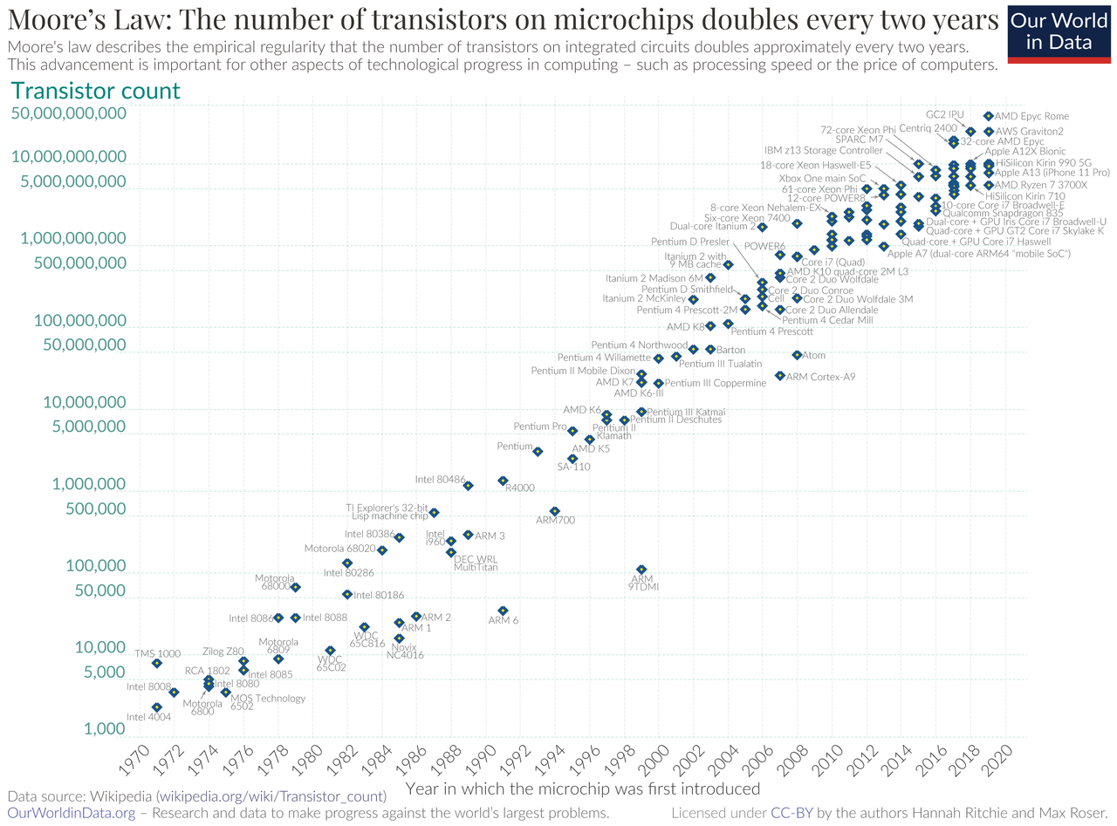
Moore’s Law

Slide 4
Brief hardware overview
Power Supply- Converts power from the wall into usable power for your computer
Motherboard- Connects all the parts of a computer together
CPU- Responsible for interpreting and executing most of the commands from the computer hardware and software
HDD/SSD- Responsible for data/file storage
RAM- Stores the computers working memory and allows the computer to fetch information much faster
Graphics Card- Allows the computer to display information on a monitor

Slide 5
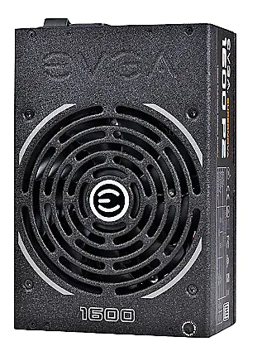
Power Supply
Why is it important?
  Wall outlets in a common household use Alternating Current (AC) power. AC power is historically cheaper to generate and transport over long distances ( there are exceptions to this)
  Computers work by storing ones and zeros in logic gates and for these logic gates to work a very stable input voltage is required
  Wall outlets are 110 volts or 220 volt
  Your computer needs Direct Current (DC) power as this can provide a constant voltage
Notes:
Your computer wants DC power
110 and 220 are way higher than you want
AC power which alternates from positive to negative many times a second could be used but this is not the most practical application for a computer

Slide 6
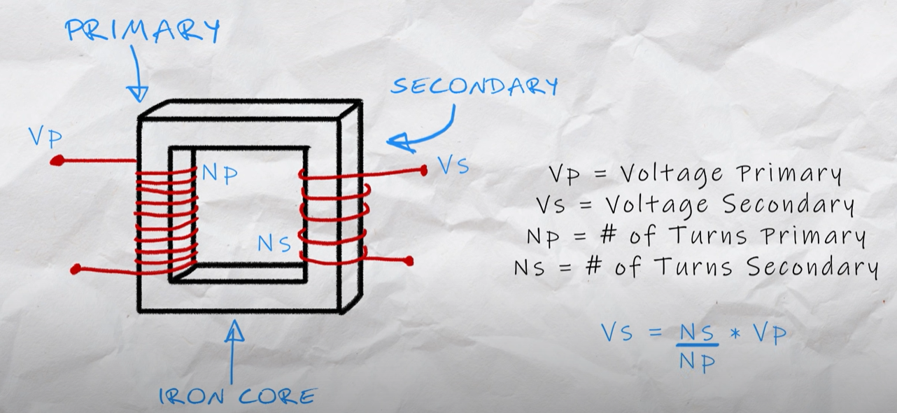
Linear Power Supply
The 110-volt AC power needs to be transformed with a transformer from 110-volt to 12-volt
Transformers are relatively simple, when AC current travels through a wire it creates a magnetic field. This magnetic field can be made much stronger by wrapping the wire into a tight coil and then if you place another coil next to it the changing magnetic field will start moving electrons in the second wire
Notes:
You can relate this to our projects because we need to change our voltages with transformers to step up for transmission lines and step down for the plant

Slide 7
Linear Power Supply
The voltage you get in the second wire is determined by the number of turns in each coil
To take 110 volt down to 11 volt you could have 100 turns on the first coil and just 10 on the second

Slide 8
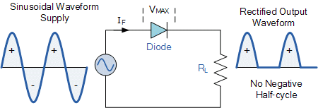
Linear Power Supply
A rectifier can turn the voltage AC into voltage DC
Rectifiers work on the basis that diodes only allow electricity to flow in one direction so if you track AC through it will only show one side of the sine wave
Add a capacitor to make up for fluctuations and boom DC power is achieved
Single Diode Rectifier
Notes:
Once at a more manageable voltage you are ready to use a rectifier
you have something called a single diode rectifier (picture) but that is not the ideal rectifier

Slide 9
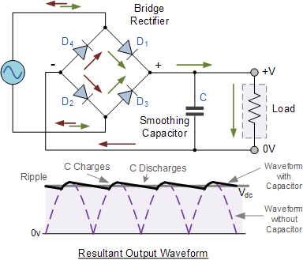
Linear Power Supply
A single diode rectifier is not ideal and is known to be bad
A full bridge rectifier uses 4 diodes and in the shown configuration electricity in the positive wave flows through diodes 1&3 and in the negative wave it flows through 2&4
Full Bridge Rectifier
Notes:
This creates much less waste as a single diode would waste at least half of the AC sine wave. This is where you would add a capacitor on the output, and you have created a linear power supply

Slide 10
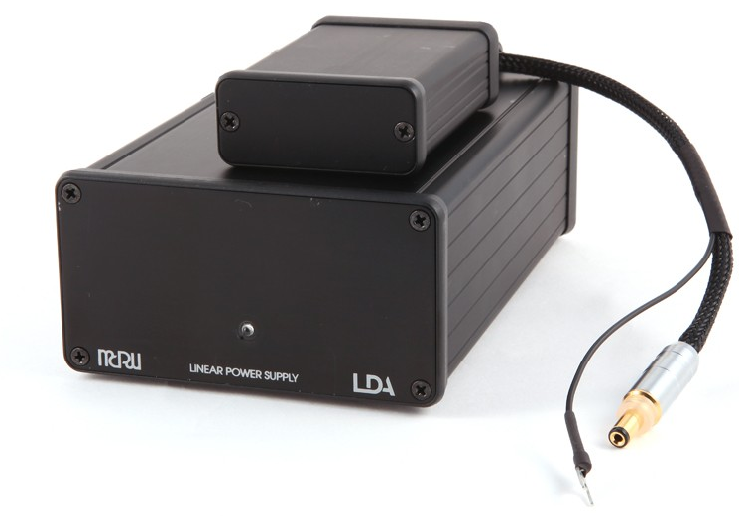
Linear Power Supply
Linear power supplies are used in many applications such as music due to their ability to deliver very clean power
You would not want to use a linear power supply for your computer due to their low efficiency rating and the fact that they only work for a single input frequency and voltage
Notes:
This would mean power supply manufacturers would need to create completely different models of the same power supply configuration to fit every application it could be used for

Slide 11
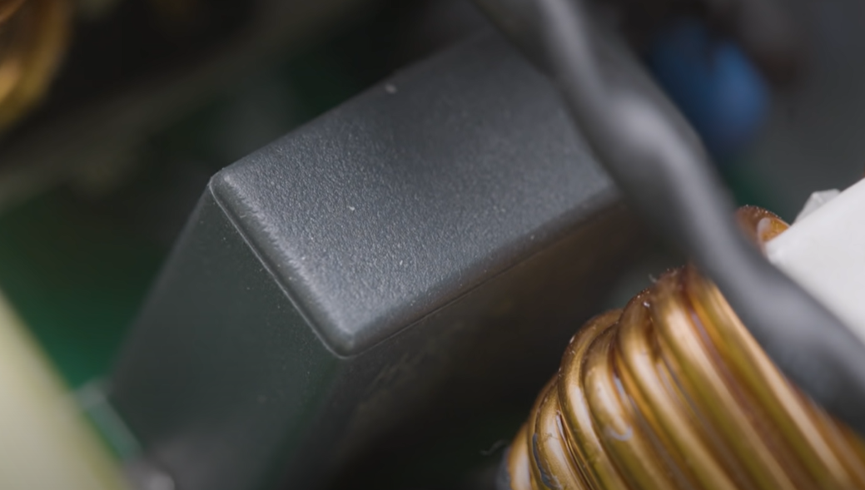
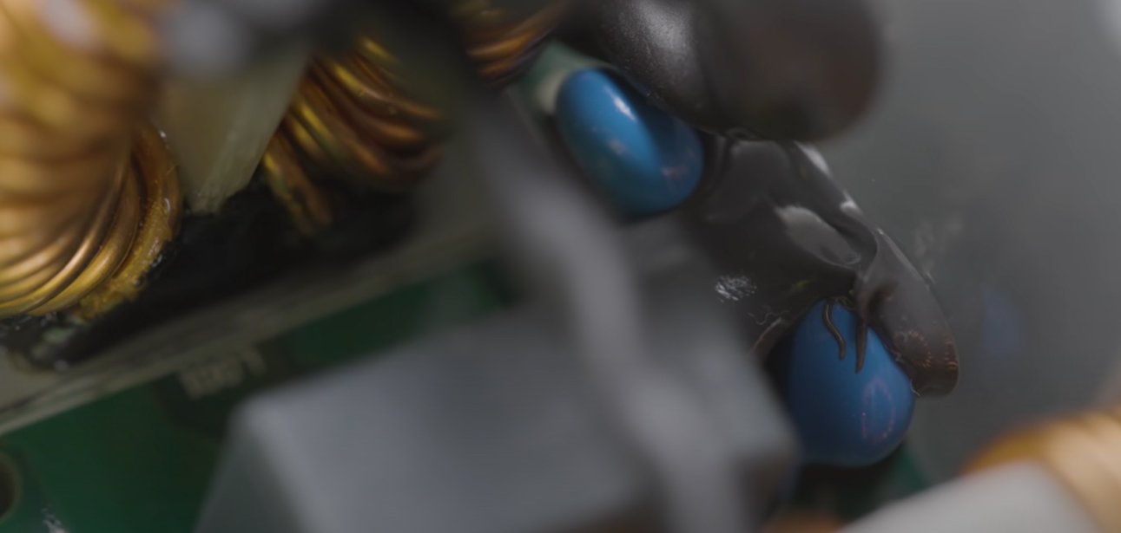
Switching mode power supply
Switching Mode Power Supplies are used in the modern computer however these Power Supplies need filtering before they can even start to convert AC to DC.
Y capacitors and X capacitors prevent your computer from sending electrical noise back into your house wiring which could cause problems with other devices
Y-Capacitor
X-Capacitor

Slide 12
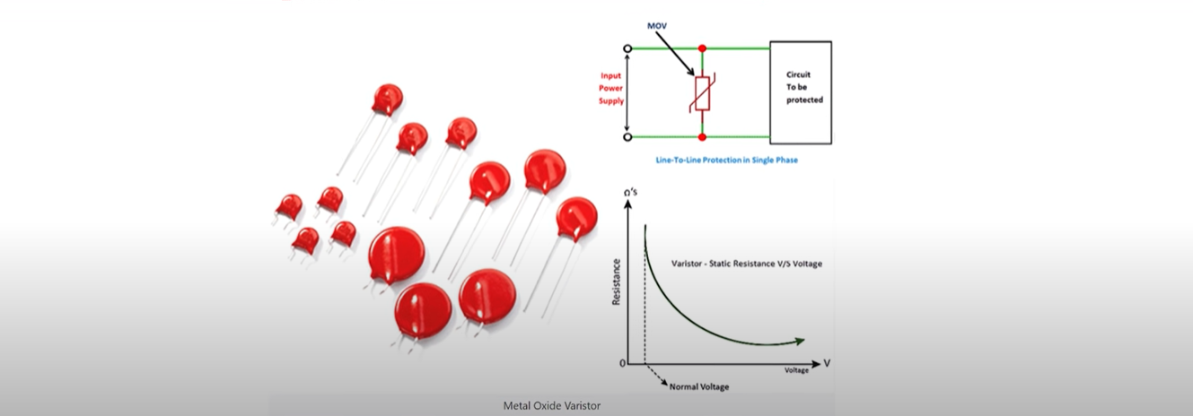
Switching mode power supply
Incoming power need to be filtered as well and can be done so using a metal-oxide varistor (MOV)
The MOV can change its resistance based on the input voltage
In cheap power supplies the MOV might be omitted and if it was you should avoid using that power supply
Notes:
The MOV can change its resistance based on the input voltage so normally it is just acting as an open circuit but when a voltage spike comes in its resistance drops and that extra energy gets grounded instead of frying your hardware

Slide 13
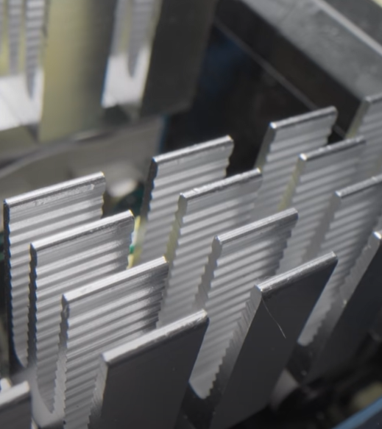
Switching mode power supply
When the signal is clean you need a power factor correction
As AC power flows through inductors or capacitors the voltage and current will get out of phase with each other resulting in wasted energy
The power supply uses a bank of MOSFETs (fancy switches) and a big inductor to maximize the AC input
The AC input is rectified resulting in three to four hundred volts DC
Notes:
The MOV can change its resistance based on the input voltage so normally it is just acting as an open circuit but when a voltage spike comes in its resistance drops and that extra energy gets grounded instead of frying your hardware

Slide 14
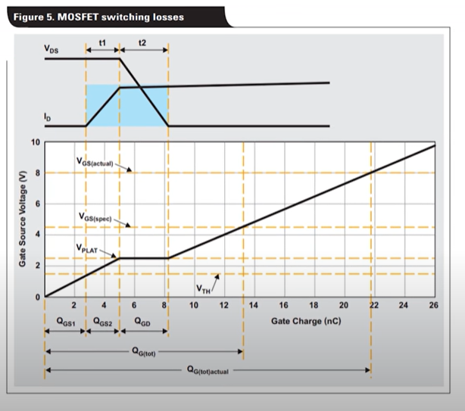
Switching mode power supply
large capacitors smooth out the voltage of the DC current flowing from the main bridge rectifier
Interestingly we need to go back to AC again and this is done by running the DC power through MOSFETs in the Power Supply
Results in AC power with a square sine wave
Every time a MOSFET gets turned on or off you lose some efficiency, so a technique called “Soft Switching” is used and this almost entirely eliminates these switching losses
Notes:
Now this might seem a bit confusing because we have gone from AC which comes from the wall to DC which your computer needs and now are going to go back to AC.
so, in parallel to these MOSFETs is a capacitor and an inductor that will begin to resonate as the MOSFETs are switched. The resonator creates a sin wave and by syncing up the MOSFETs switching to when the sine wave is close to at zero you can almost entirely eliminate the switching losses
If you want more info on how that works I can happily shoot some papers your way in which you can read.

Slide 15
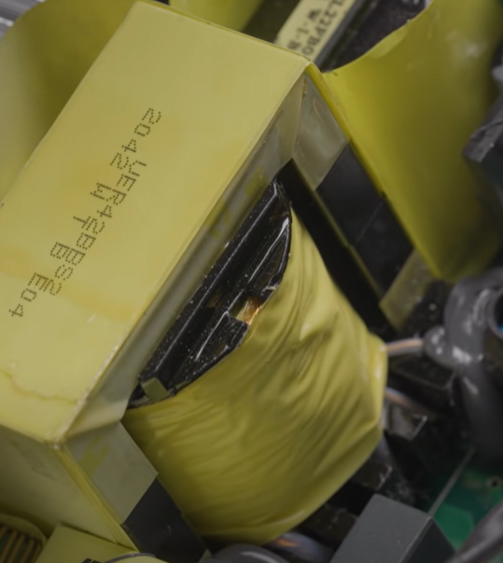
Switching mode power supply
The AC power is now perfectly power corrected and at a much higher voltage and frequency compared to what's coming out of your wall
This allows the main transformer rate to be both much smaller and a lot more power efficient as it converts it into 12 volts AC
The 12 volts AC flows through a rectifier and you have 12 volts DC

Slide 16
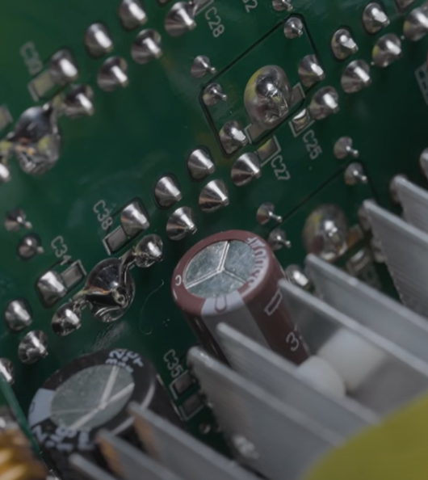
Switching mode power supply
Large capacitors are added for more filtering and to improve transient response( basically just the systems ability to react to changes from a steady state or equilibrium)
Not everything in your PC uses 12 Volt so you will also need DC to DC buck converters to achieve 3.3 and five volts
You have everything you need to power your computer except the ability to turn it on
Notes:
Simply put the capacitor is going to help significantly if your graphics card decides it suddenly needs 500 or 600 Watts for a few milliseconds

Slide 17
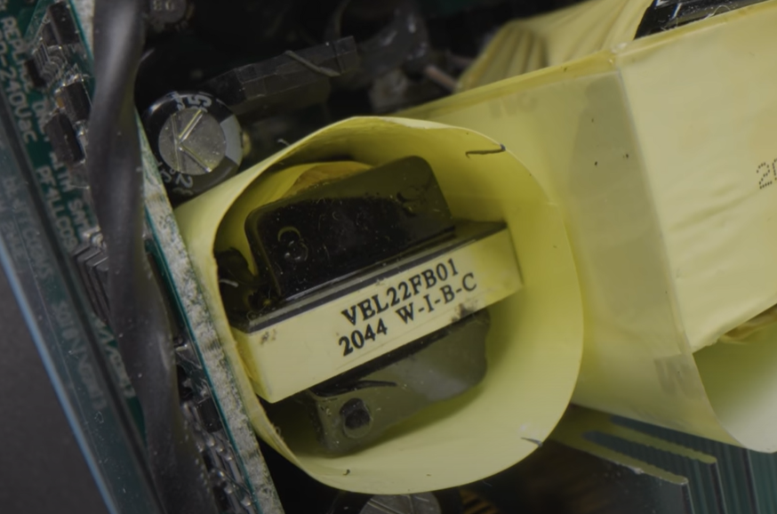
Switching mode power supply
Another transformer within your computer that takes the high voltage DC from before and turns it into 5 volts standby
This 5 volts on standby is always on even when the computer is turned off allowing it to power RGB, always on USB charging ports, and most importantly the power button
Notes:
This doesn't explain why good power supplies can range from one to five hundred dollars. This is due to component quality which may not even make a difference in a modern power supply

Slide 18
How Motherboards get power
Power supplies output 12 volts but if 12 volts were outputted directly to your mother board it would smoke it
The 12 volts needs to be stepped down with a voltage regulation module (VRM). The step down will go from 12 V to around 1.25V
Basic circuit consists of 2 MOSFETSs which is once again basically a fancy switch, an inductor, and a diode

Slide 19
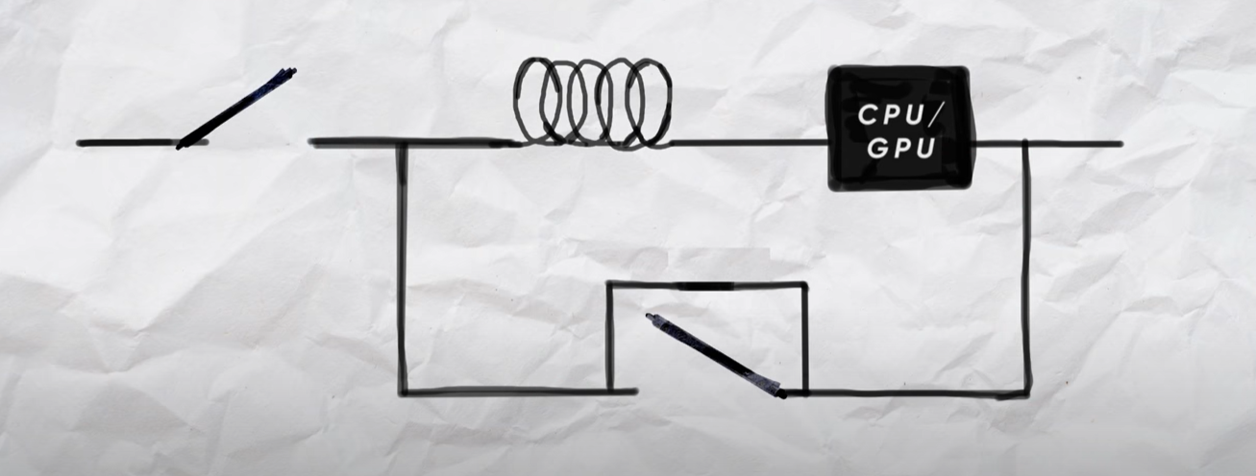
How Motherboards get power

Slide 20
How Motherboards get power
The first switch closes and charges the inductor creating a magnetic field
The voltage the CPU gets depend on how long the switch is closed but when it is opened the voltage to the CPU begins to drop, if both switches are open the magnetic field will collapse destroying your CPU
The diode is highly inefficient, so it is important to close that switch as soon as possible to not create any unnecessary heat

Slide 21
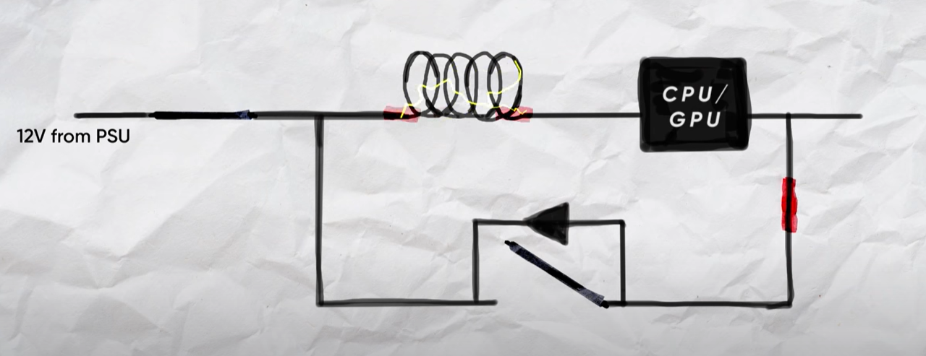
How Motherboards get power

Slide 22
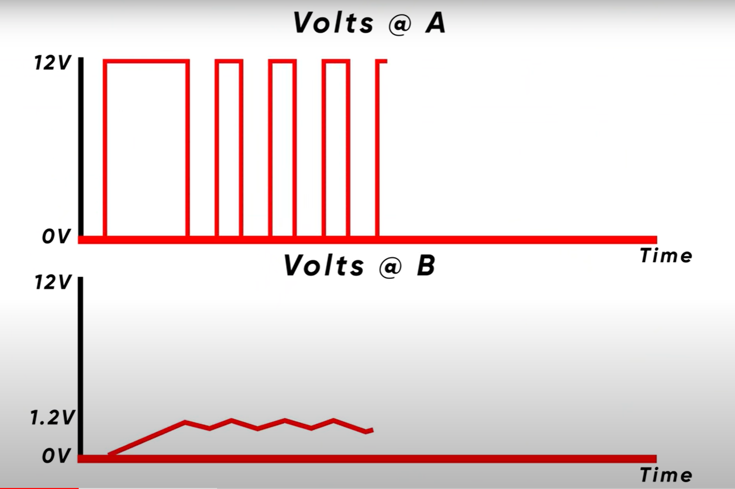
How Motherboards get power
This circuit results in a lot of voltage spikes as it bounces around what the CPU is asking for
To solve this, you can increase the speed of the MOSFET switch up to about 300,000 times per second, but this may still fluctuate more than the CPU wants
It is not practical to increase the speed anymore that that
Notes:
this is because the MOSFET generates some heat every time it switches and if the MOSFET hits around 150 degrees Celsius it will die

Slide 23
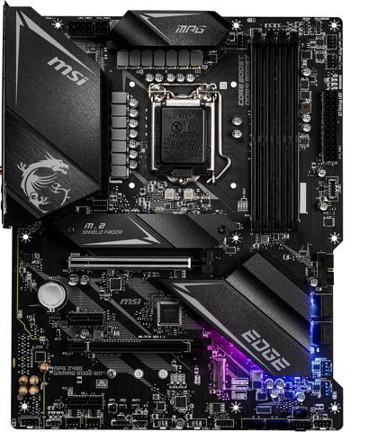
How Motherboards get power
To achieve cleaner power instead of having faster MOSFETs you have a higher quantity of them
Basically, one circuit is a single phase and if we add another circuit, we roughly double how clean our power is and as you add more phases you will scale roughly linearly from there
Motherboards will tell you the phases that they have e.g. 8+2 which means 8 phases for the CPU and 2 dedicated for the ram
Notes:
If you remember what Michelle talked about during her knowledge night, then you will remember single phase vs double phase and so on

Slide 24
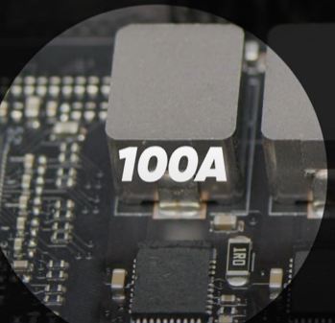
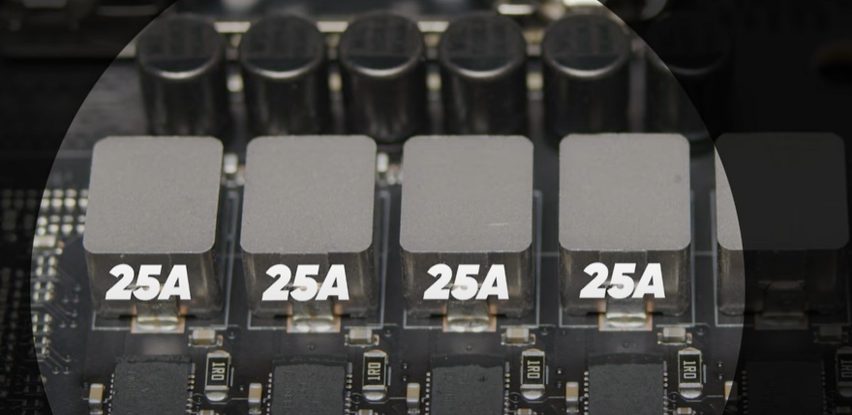
How Motherboards get power
If you have 100 amps in total running through a single phase would mean 100 amps are going through each component in that circuit but if you have two phases that means only 50 amps will run through each circuit
More phases means cheaper components can be used due to less stress on the parts
Adding more phases is good until a point because more phases are harder to control which results in the VRM being less able to respond to changes in voltage
Notes:
The amps would be divided by how many phases you have

Slide 25
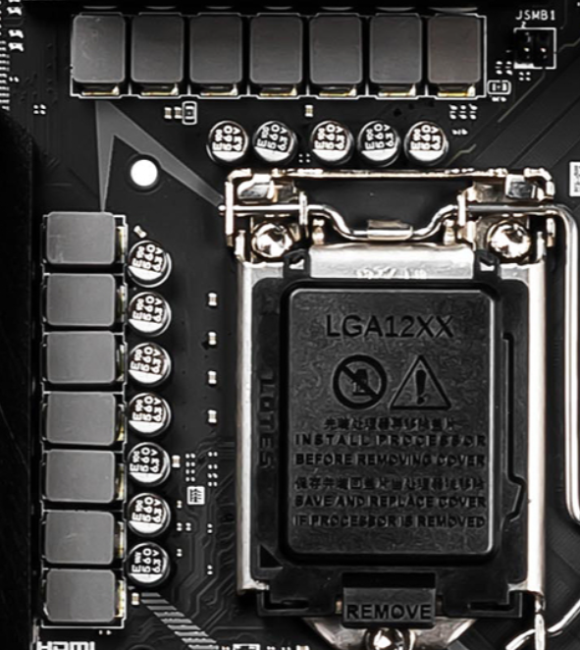
VRM Heatsinks
High end motherboards normally have the most phases, the most expensive components, and the best VRM heatsinks
Mid-range boards might need good VRM coolers as they typically don't have as many phases and the components are cheaper than the high-end boards
Notes:
The VRM heatsink is there to ensure that the components like the MOSFETs stay cool as they generate heat when switching
The only reason the high-end motherboards have the best VRM heatsinks is to look cool as they would not need to cool those components off as the due not generating enough heat

Slide 26
Communicating with The Ram
Travel distance of an electric signal in 1 nanosecond
Random-Access Memory(RAM) communicates with the CPU and acts as a quick access memory
An electric signal can travel about a foot in one nanosecond
At 5,000 MHz your RAM could send data every 0.2 nanoseconds which is impossible because the electric signal could not make it to the RAM stick and back to the CPU in that time.
This means that RAM has a hard limitation due to the distance it is located from the CPU
electric signal in 0.2 nanosecond
Notes:
RAM manufacturers have been lying to us

Slide 27
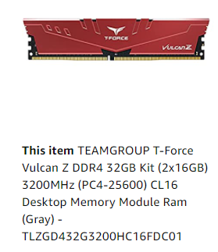
RAM SPEEDS
The MHz rating actually means is that the RAM is completing 5000 mega transfers per second
Since most RAM is Double Data Rate RAM (DDR) data transfers are done at the beginning and the end of each individual Hz
The RAM is actually running at half the MHz rating specified

Slide 28
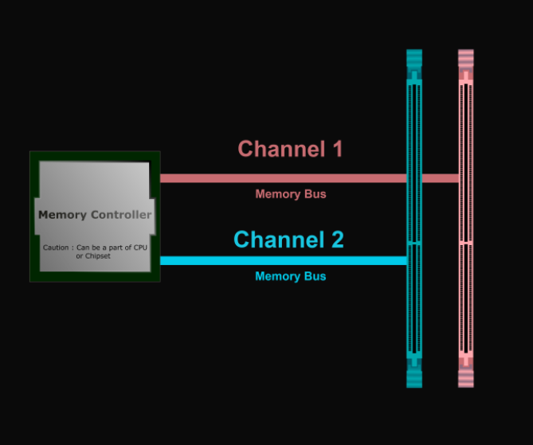
RAM configurations
knowing how the ram and CPU connect can be very important depending on the application
The most common configuration is the dual RAM configuration.
The best-case scenario for dual RAM CPUs is to have two ram slots where the printed circuit board (PCB) traces go directly from the controller in the CPU to the ram stick with nothing else in the way

Slide 29
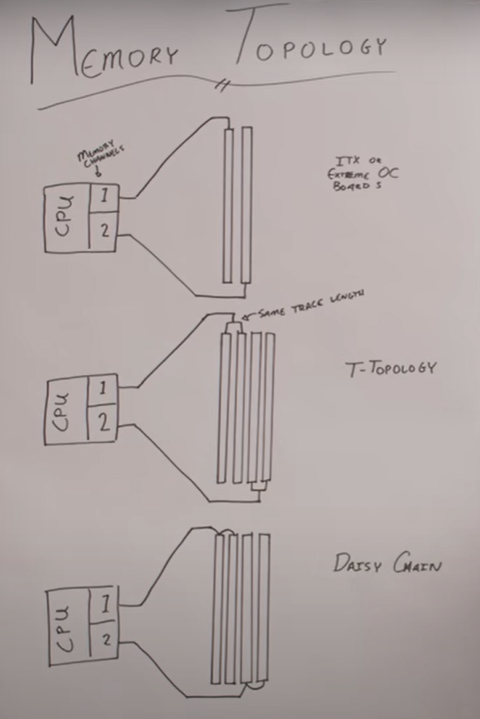
RAM Configurations
The Dual RAM configuration is the fastest possible setup using 2 RAM sticks
The two configurations for a motherboard with four RAM slots is the T-topology and Daisy chaining
T-topology is when the traces to each ram stick are the same length which is great for running all four slots at high speeds.
Notes:
This is why some top tier motherboards only have two RAM slots and why some smaller motherboards with only two RAM slots preform extraordinarily well in regard to ram overclocking

Slide 30
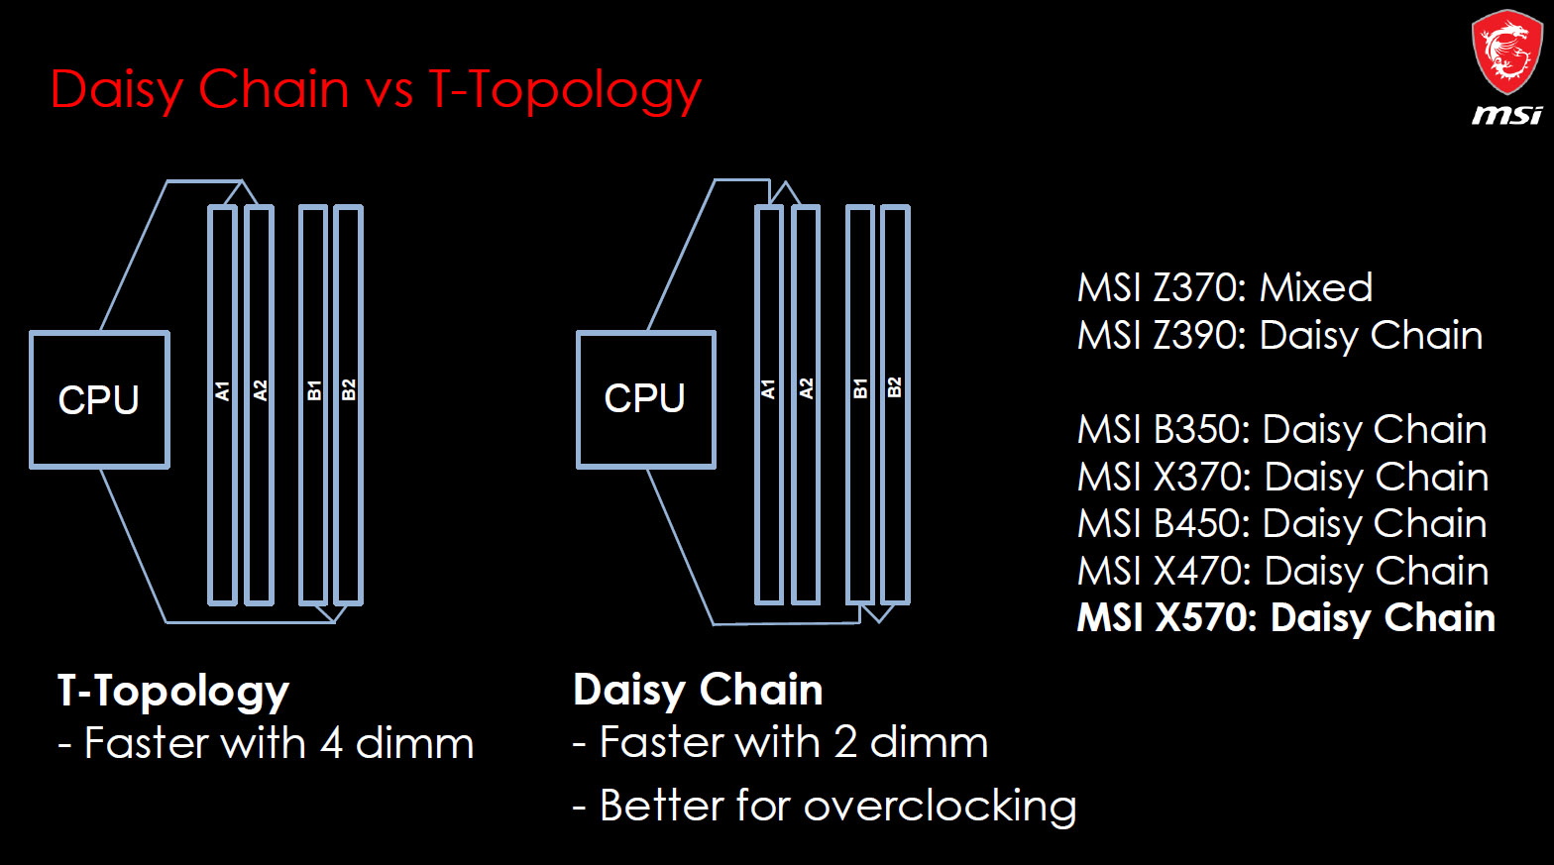
RAM Configurations
If pure speed is what you are after, then daisy chaining is the way to go because the traces just go to on slot and continue onto the next one
Daisy chaining can cause the speeds to be lower when all four RAM slots are being utilized because the timing difference between the two sticks needs to be figured out by the controller in the CPU
If you only have two sticks you can run them at nearly the same speed as there only being two slots even though there are four slots

Slide 31
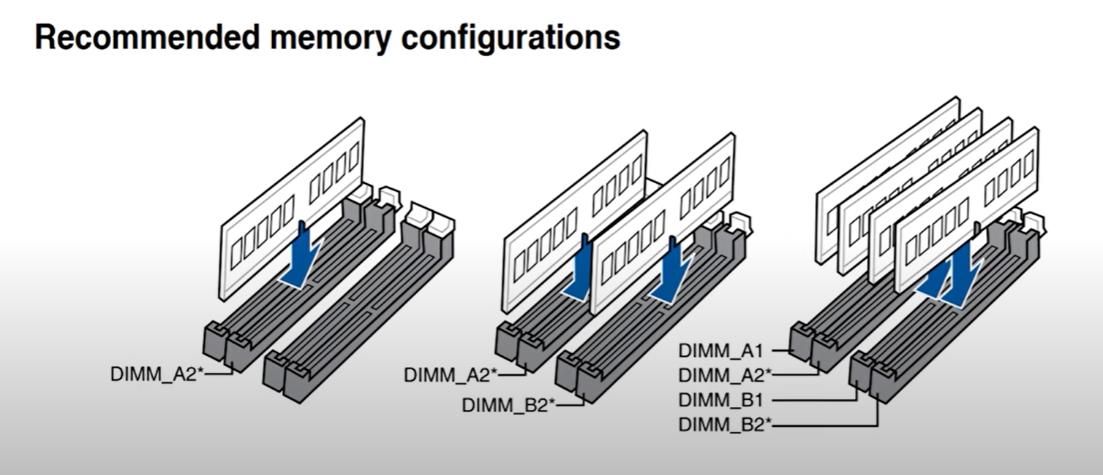
RAM Configurations
For these configurations to be effective it is important to use the correct RAM slots
If an electric signal goes through a wire and the connecting ends abruptly with nothing connected to it the signal can reflect back creating noise in the circuit
By putting the RAM sticks in the second slot of each channel the traces end at the RAM stick reducing noise in the circuit and allowing for higher speeds

Slide 32
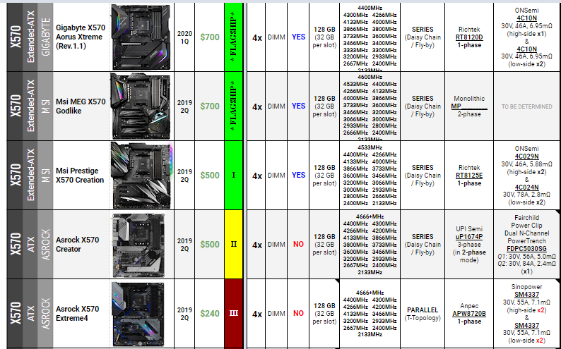
RAM Configurations
When purchasing RAM you should check your motherboard to see if it uses T-topology or daisy chain because it will dictate if you should get two higher capacity sticks or 4 lower capacity sticks
Higher capacity sticks have been getting cheaper recently so it would make sense for setups to be optimized with only two ram slots to go as fast as possible
Notes:
This however does not seem to be what people want because it hurts the upgradability of the ram sticks even though most people don't upgrade their computer anyway.

Slide 33
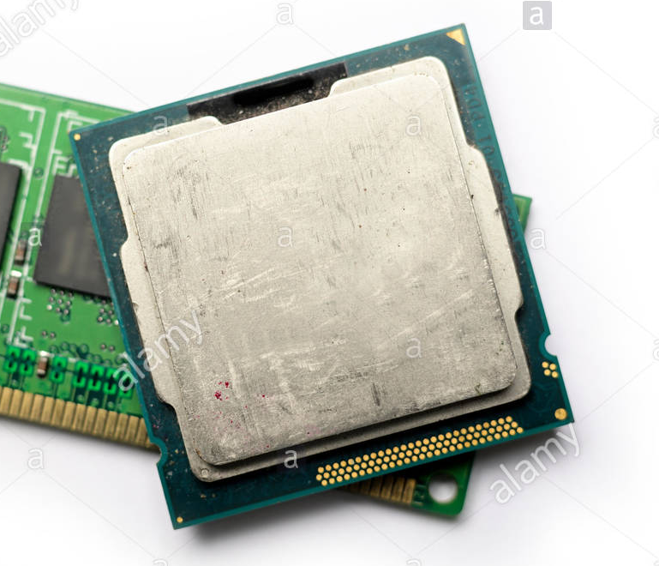
RAM Configurations
In the perfect scenario with gold traces and almost no distance from the CPU to the ram stick, the memory controller on the CPU would hold the speeds back
The Silicon Lottery has become widely accepted and can play a major part in memory controller speeds
Notes:
There is something called the silicon lottery and some CPUs that are the exact same make and model can clock higher with lower voltages this same ideology applies to the memory controller on the CPU. Just being lucky on a good CPU can have a huge effect on how fast your ram runs.

Slide 34
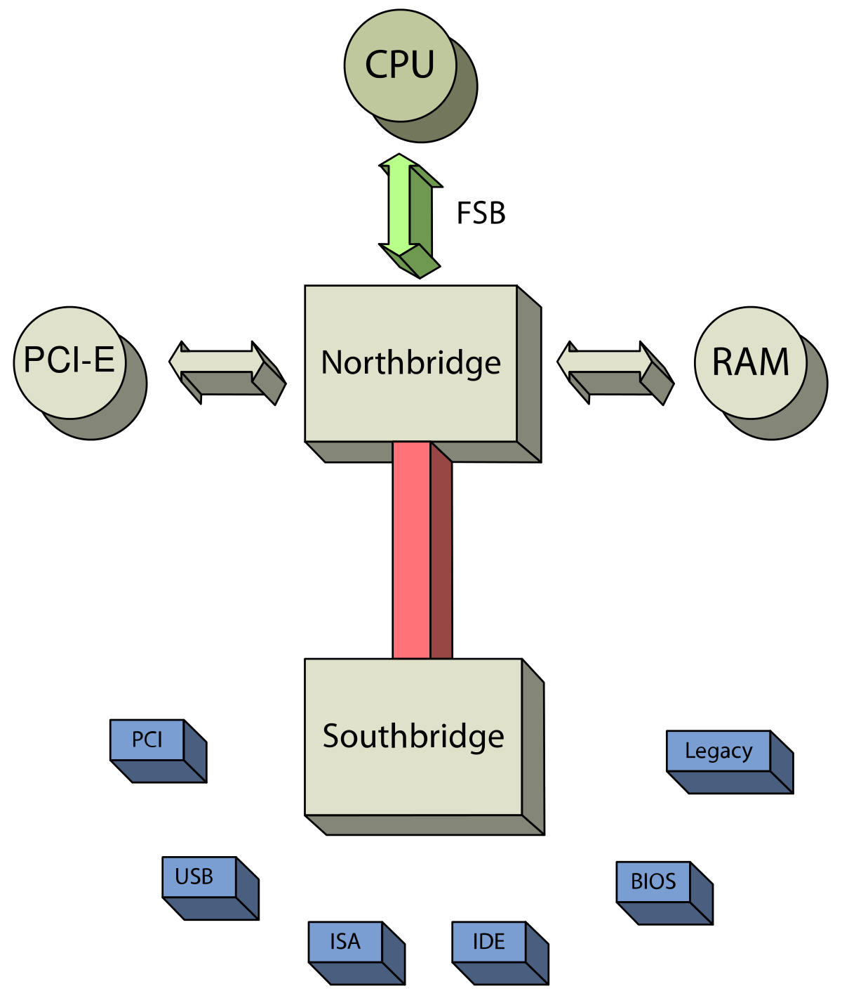
Chipset Layout
North bridge takes care of PCIE and memory while the south bridge handles IO storage, audio, usb, and etc.
On modern motherboards the memory and some PCIE lanes are connected directly to the CPU while the chipset handles everything else
This simplifies the layout and allows for lower latencies. Losing a full chip has a large effect but PCIE lanes have become incredibly fast
Notes:
peripheral component interconnect express
A chipset is basically the electronics on the motherboard that communicate with all the connected components.

Slide 35
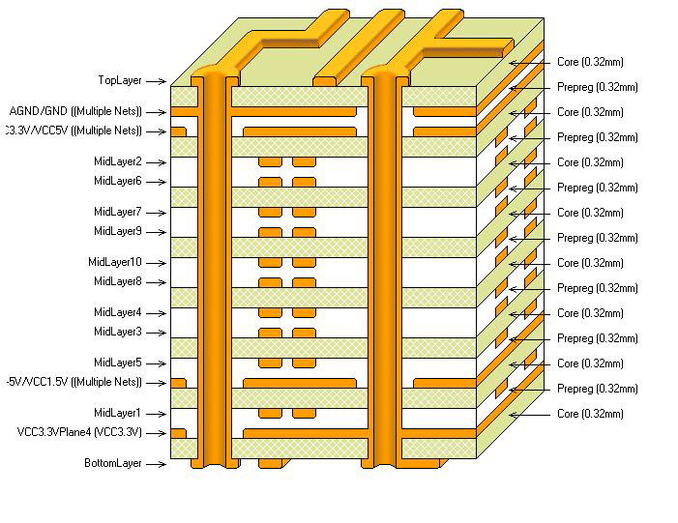
Motherboard layers
With PCIE 4.0 a one lane slot can transfer 2 GB/s while a 16-lane slot can transfer 32 gigabytes per second. If it is bidirectional it can transfer at 64 GB/s.
That is close to the speeds of DDR4 RAM and they pull this off by using very expensive PCBs
in order to get PCI 4.0 levels of signal quality 8 to 12 layers of PCBs are basically required
Notes:
Previously it was possible for lower end motherboards to have four or so layers
Every 2 layers can come with a 20-30% cost increase the insanely high prices of mother boards start to make sense
A large overarching theme for motherboards is balancing the actual value vs the perceived value

Slide 36
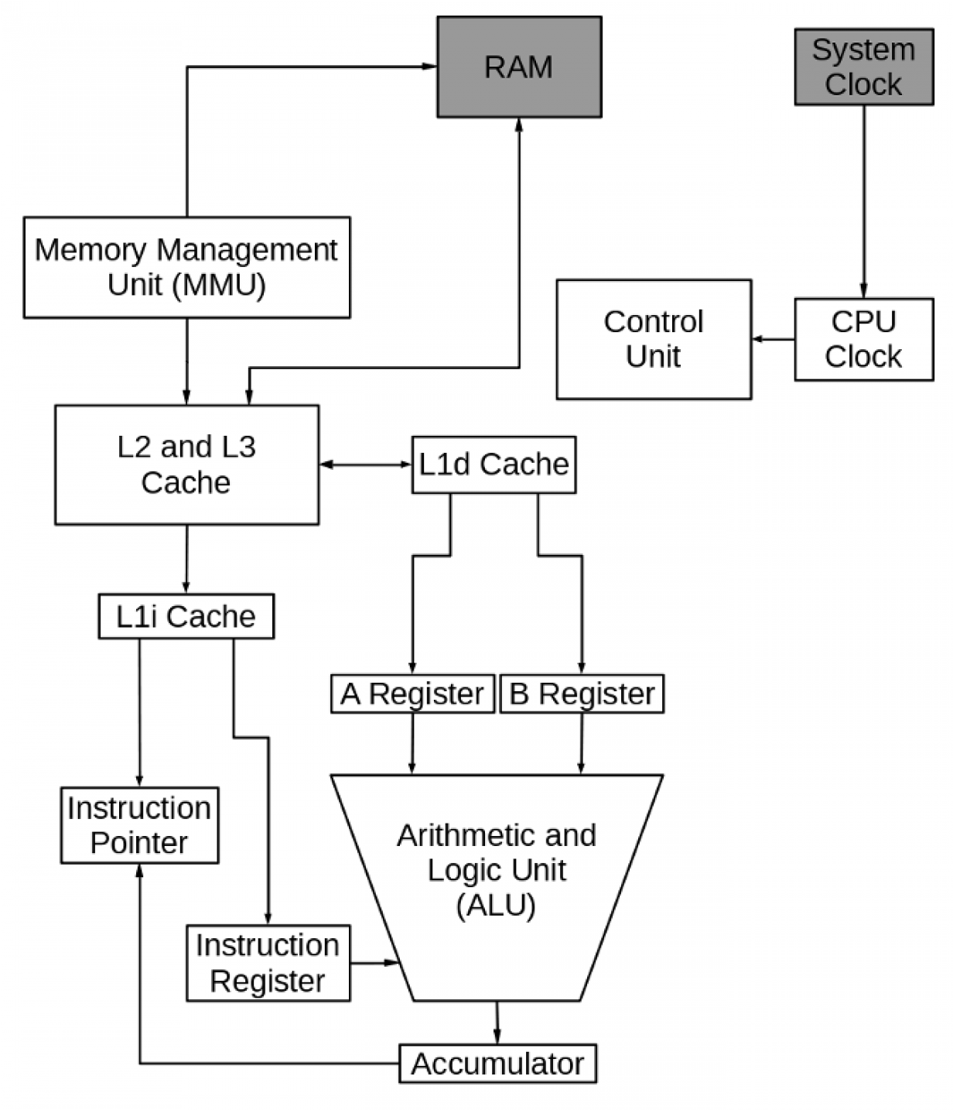
HOW THE CPU works
The arithmetic logic unit (ALU) performs the arithmetic and logical functions that are the work of the computer
The A and B registers hold the input data, and the accumulator receives the result of the operation
The instruction register contains the instruction that the ALU is to perform
Another type of operation done by the preformed by the ALU results in an address in memory and is used to calculate a new location in memory to begin loading instructions.
Notes:
The figure is a simplified diagram of a typical CPU
For example, when adding two numbers, one number is placed in the A register and the other in the B register. The ALU performs the addition and puts the result in the accumulator. If the operation is a logical one, the data to be compared is placed into the input registers. The result of the comparison, a 1 or 0, is put in the accumulator. Whether this is a logical or arithmetic operation, the accumulator content is then placed into the cache location reserved by the program for the result.

Slide 37
HOW THE CPU works
The instruction pointer specifies the location in memory containing the next instruction to be executed by the CPU
After the instruction is loaded into the instruction register, the instruction register pointer is incremented by one instruction address
Incrementing allows it to be ready to move the next instruction into the instruction register.

Slide 38
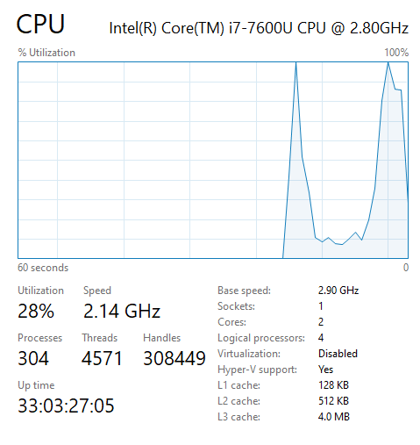
HOW THE CPU works
The CPU never directly accesses RAM
Modern CPUs have one or more layers of cache
The CPU's ability to perform calculations is much faster than the RAM's ability to feed data to the CPU
Cache memory is faster than the system RAM, and it is closer to the CPU because it is on the processor chip

Slide 39
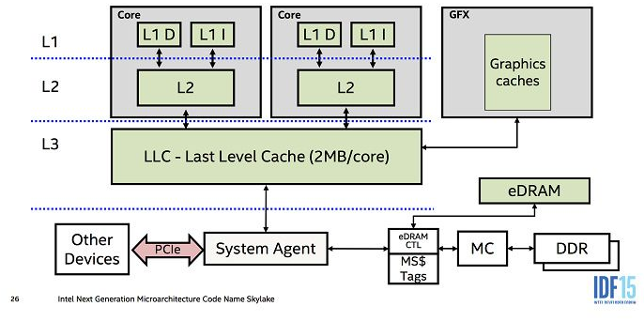
CPU cache
The cache provides data storage and instructions to prevent the CPU from waiting for data to be retrieved from RAM
If the requested data is not in the cache, it's retrieved from RAM and uses predictive algorithms to move more data from RAM into the cache
CPU can remain busy and not waste cycles waiting for data

Slide 40
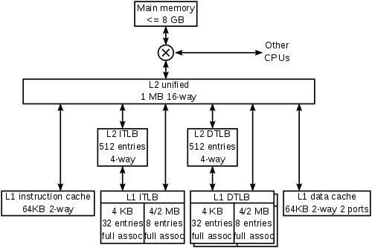
CPU cache
The cache sizes typically range from 1 MB to 32 MB depending upon the speed and intended use of the processor
The Level 1 cache is closest to the CPU
There can be different types of cache such as an instruction cache or a data cache

Slide 41
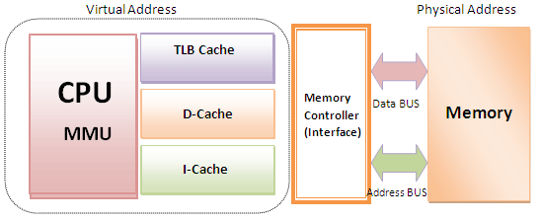
CPU Communication
The memory management unit (MMU) manages the data flow between the main memory (RAM) and the CPU
It also provides memory protection required in multitasking environments and conversion between virtual memory addresses and physical addresses.

Slide 42
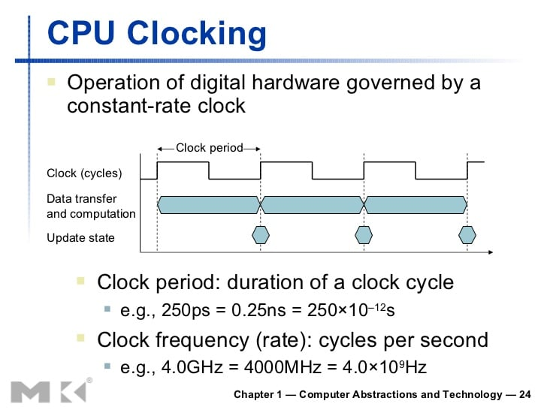
CPU Clock and control
The CPU components must be synchronized to work together smoothly
The control unit performs synchronization at a rate determined by the clock speed and is responsible for directing the operations of the other units by using timing signals that extend throughout the CPU

Slide 43
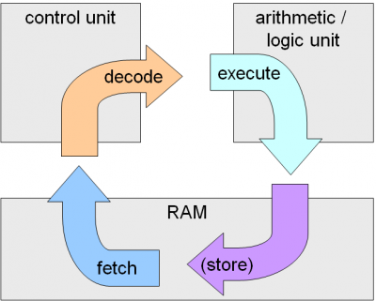
CPU Cycle
CPUs work on a cycle that is managed by the control unit and synchronized by the CPU clock
This cycle is called the CPU instruction cycle, and it consists of a series of fetch/decode/execute components.
The instruction, which may contain static data or pointers to variable data, is fetched and placed into the instruction register

Slide 44
CPU Cycle
The instruction is decoded, and any data is placed into the A and B data registers
The instruction is executed using the A and B registers, with the result put into the accumulator
The CPU then increases the instruction pointer's value by the length of the previous one and begins again

Slide 45
Supercharging the instruction cycle
One of the first strategies for improving CPU performance was overlapping the portions of the CPU instruction cycle to utilize the various parts of the CPU more fully
This design looks nice and smooth, but factors such as waiting for I/O can disrupt the flow
Certain instructions also take more CPU cycles to complete than others
Notes:
The input/output processor or I/O processor is a processor separate from the CPU designed to handle only input/output processes for a device or the computer
The I/O processor is capable of performing actions without interruption or intervention from the CPU. The CPU only needs to initiate the I/O processor by telling it what activity to perform. Once the necessary actions are performed, the I/O processor then provides the results to the CPU

Slide 46
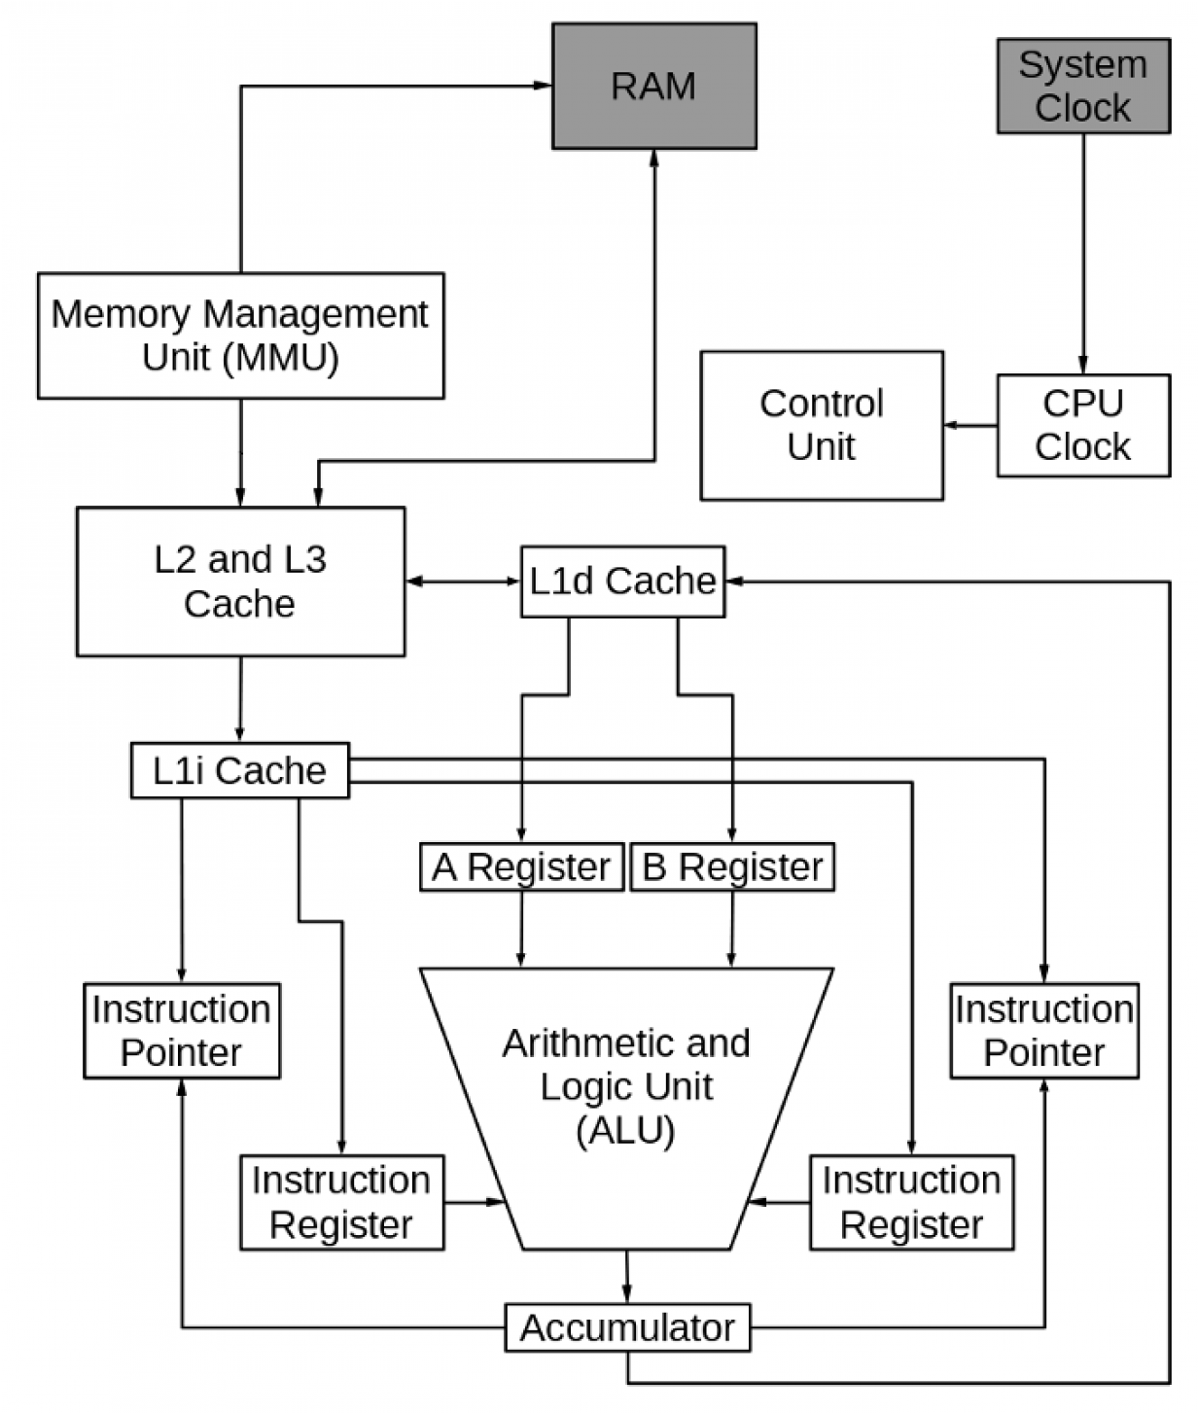
CPU hyperthreading
Another strategy to improve CPU performance is hyperthreading. Hyperthreading makes a single processor core work like two CPUs by providing two data and instruction streams.
Adding a second instruction pointer and instruction register to our hypothetical CPU

Slide 47
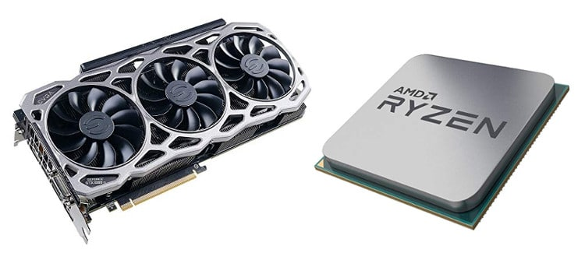
Graphics card
There are two types of graphic processors including integrated graphics and dedicated graphics
The graphics card is installed in an expansion slot on the motherboard typically the PCIe slot
The four main components to a graphics card include a motherboard, graphics processor(GPU), video memory (VRAM), and a connection to a monitor
Notes:
Integrated graphics does not have the same processing power that a dedicated graphics/video card would. This is due to the cooling and space that a dedicated card can have

Slide 48
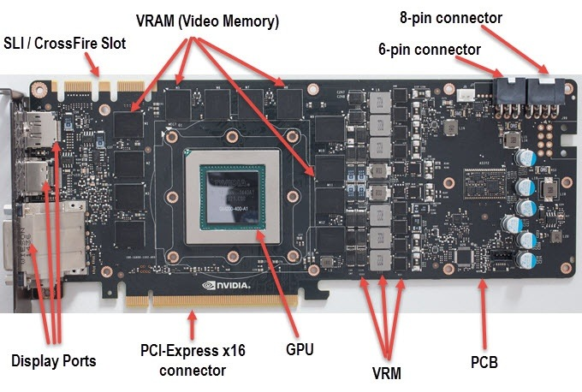
Graphics card
Like a motherboard, a graphics card is a printed circuit board that houses a processor and VRAM
The graphics card has its own dedicated BIOS
The graphics card’s GPU is designed specifically for performing the complex mathematical and geometric calculations that are necessary for graphics rendering
The graphics cards responsibilities could be replaced with software, but this is inefficient and not as fast

Slide 49
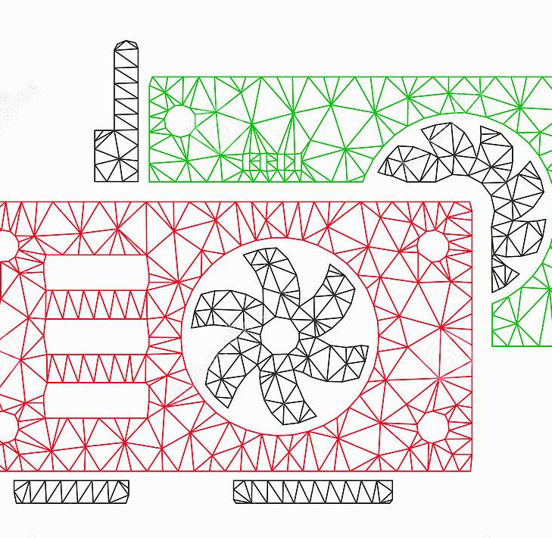
Graphics card Processing
To make a 3-D image, the graphics card first creates a wire frame out of straight lines from the binary data
The image is rasterized, and lighting, texture, and color are added
For some processes, the graphics card may need to do this process 60 to 120 times a second

Slide 50
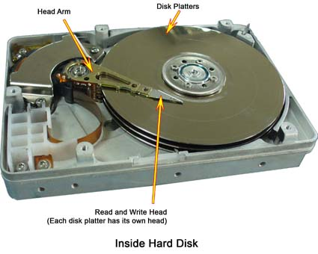
How Does the HDD store data
When you save a document, it gets written somewhere "non-volatile" that keeps its state even when the power is off.
The hard drive contains a spinning platter with a thin magnetic coating
A "head" moves over the platter, writing 0's and 1's as tiny areas of magnetic North or South on the platter

Slide 51
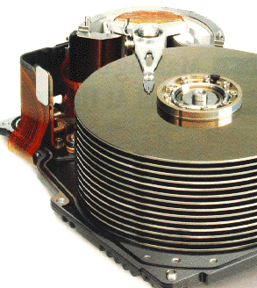
How Does the HDD store data
To read the data back, the head goes to the same spot, notices the North and South spots flying by, and so deduces the stored 0's and 1’s
A Modern hard drive can store well over a trillion 0/1 bits per platter, so the individual North/South spots are quite small

Slide 52
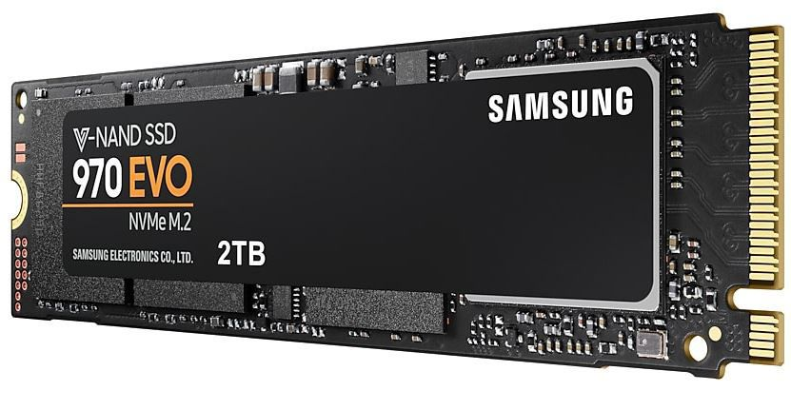
How DOES the SSD Store data
Solid State Drives (SSD) use flash which is similar to ram however flash memory does not lose data when there is no power
SSDs have no moving parts so they can run at much faster speed when compared to HDDs
SSDs use semiconductor chips to send and receive data. These chips are divided into pages which store the data

Slide 53
That’s It folks
[Name]
[Date]

