Slide 1
Electric vehicles and Charging
January 9, 2024

Slide 2
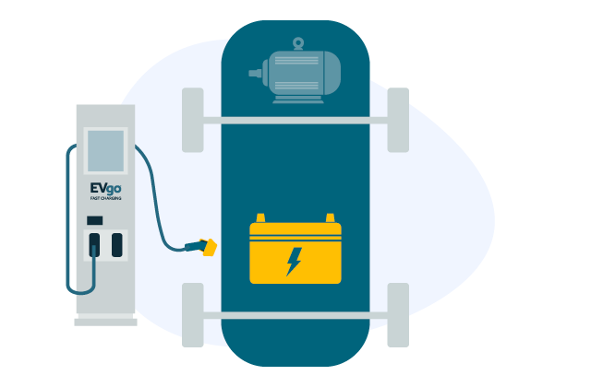
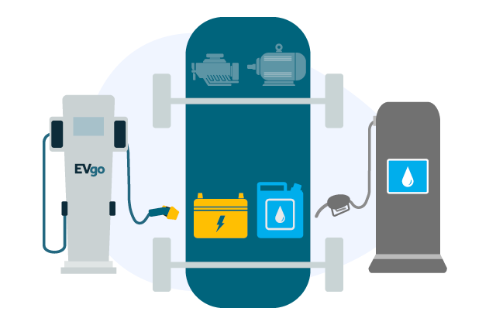
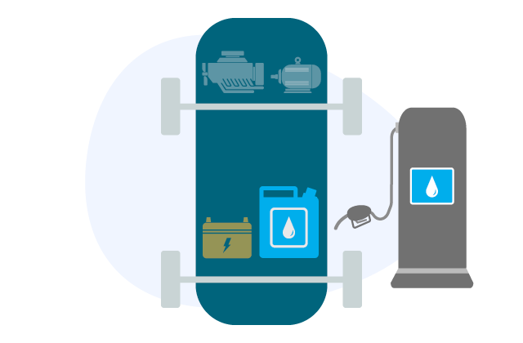
Electric Types
Hybrid Electric Vehicles (HEVs)
Low-emission vehicles that use an electric motor to assist gas-powered engines. All energy comes from gasoline.
Battery Electric Vehicles (BEVs)
Powered solely by an electric battery, with no gas engine parts. Most BEVs are capable of fast charging and L2 charging. Zero emissions.
Plug-in Hybrid Electric Vehicles (PHEVs)
Similar to a Hybrid, but with a larger battery and electric motor. Has a gas tank and a charging port. Can charge by using L2 chargers.

Slide 3
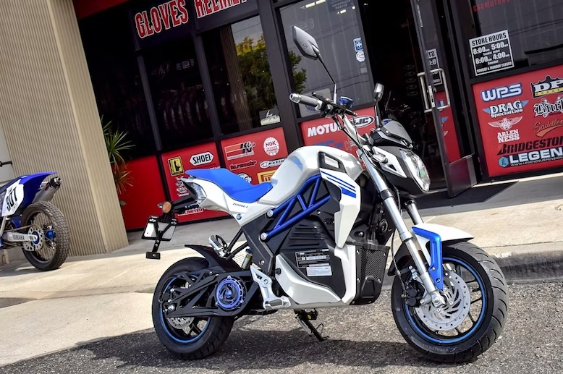
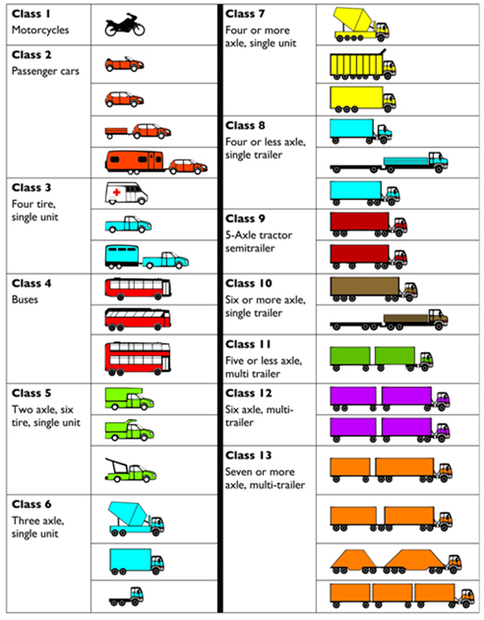
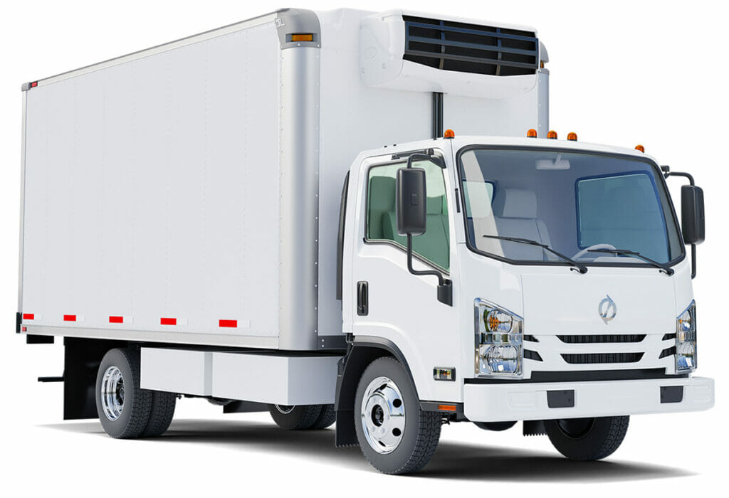
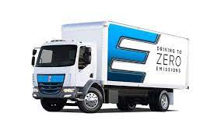
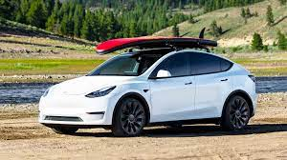
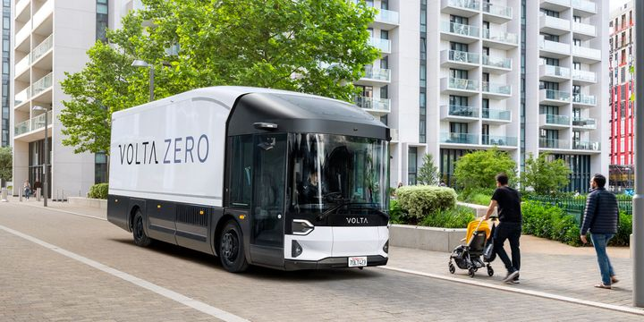
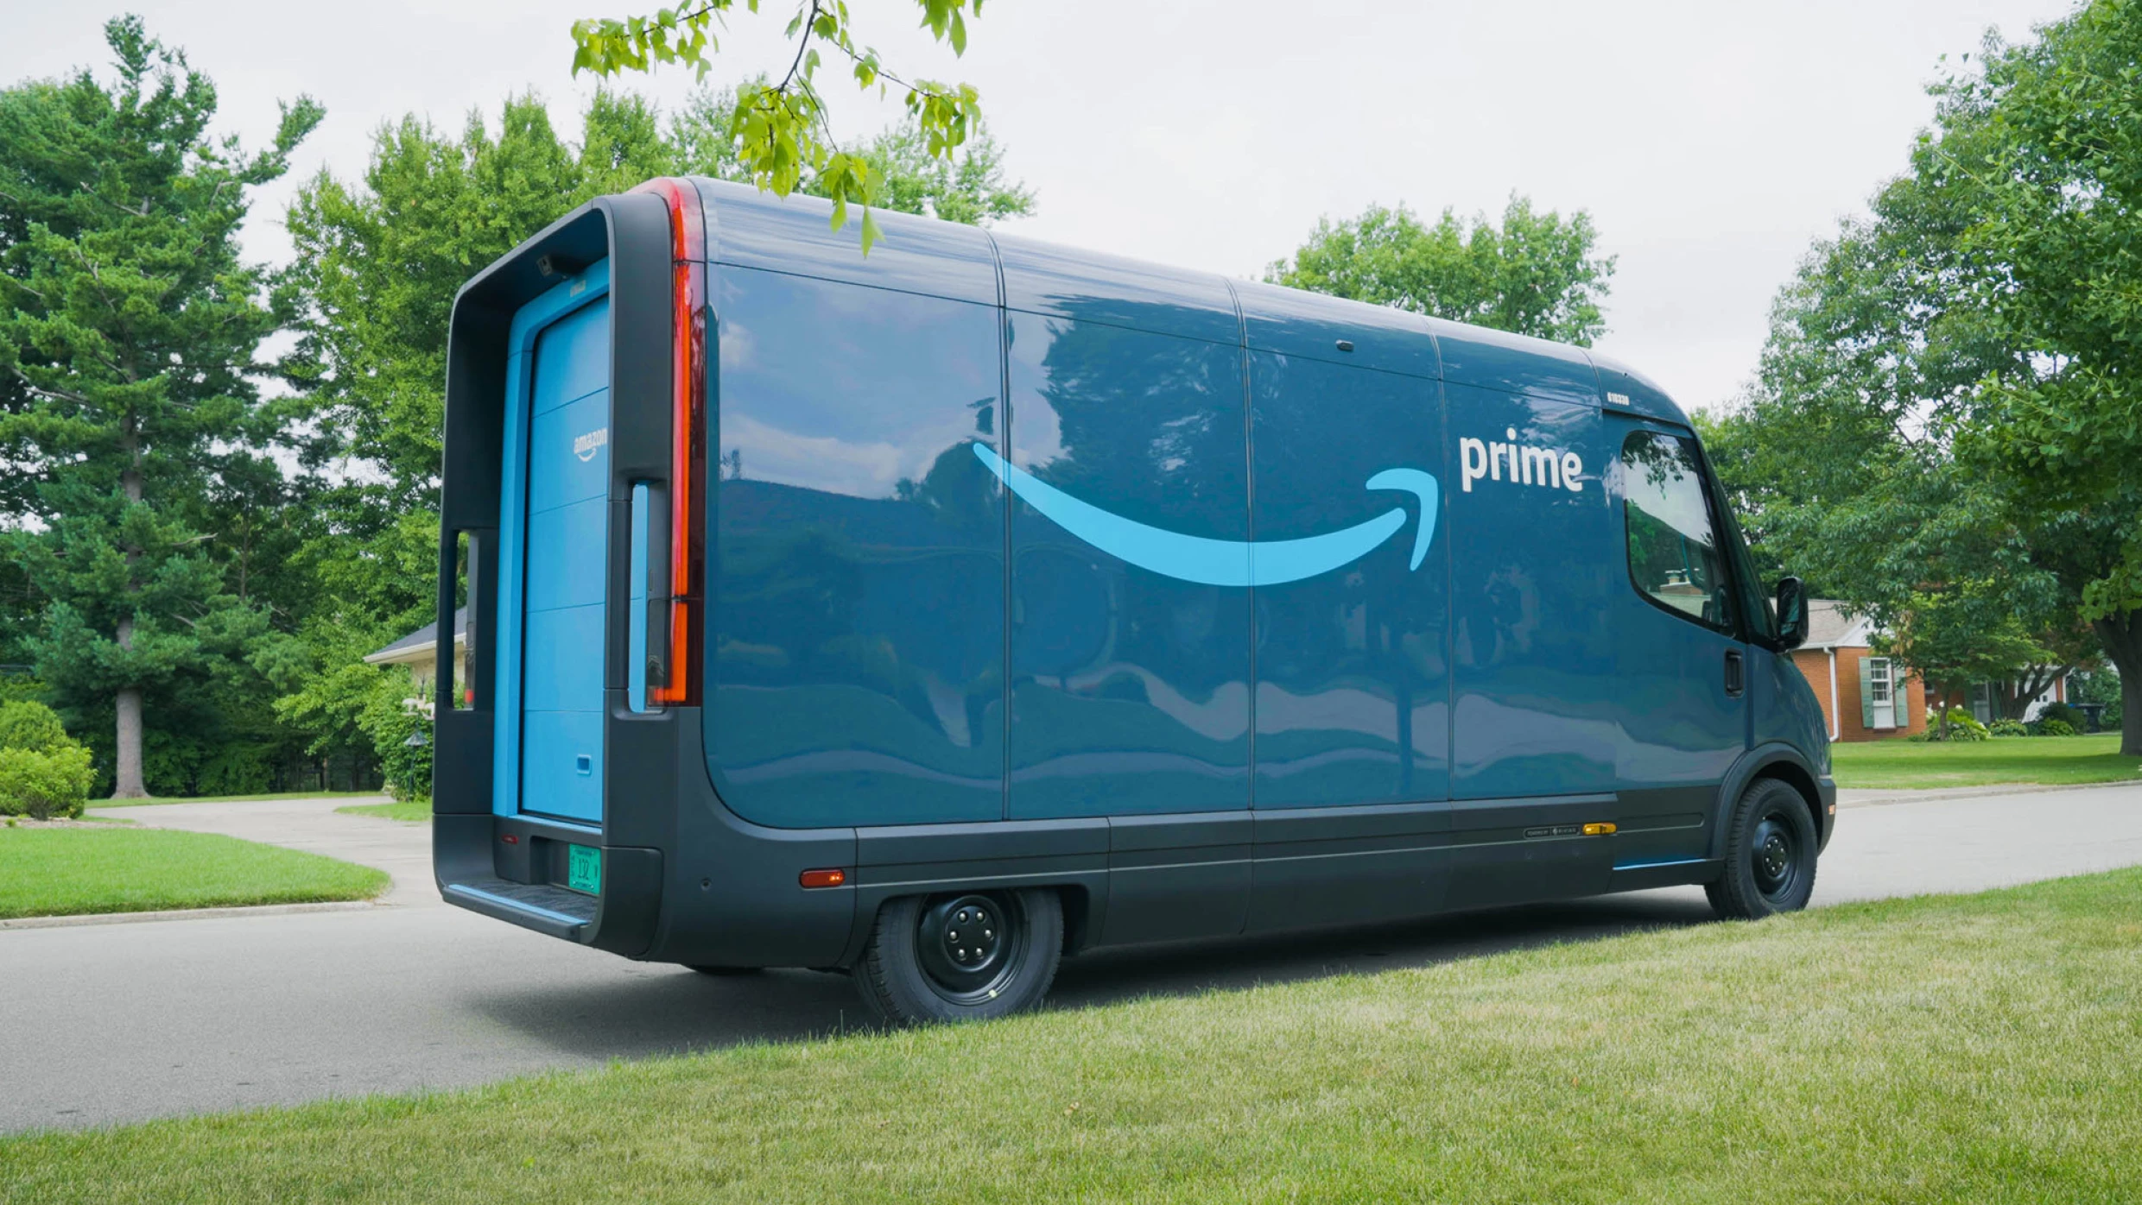

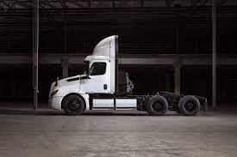
Vehicle Classes

Slide 4
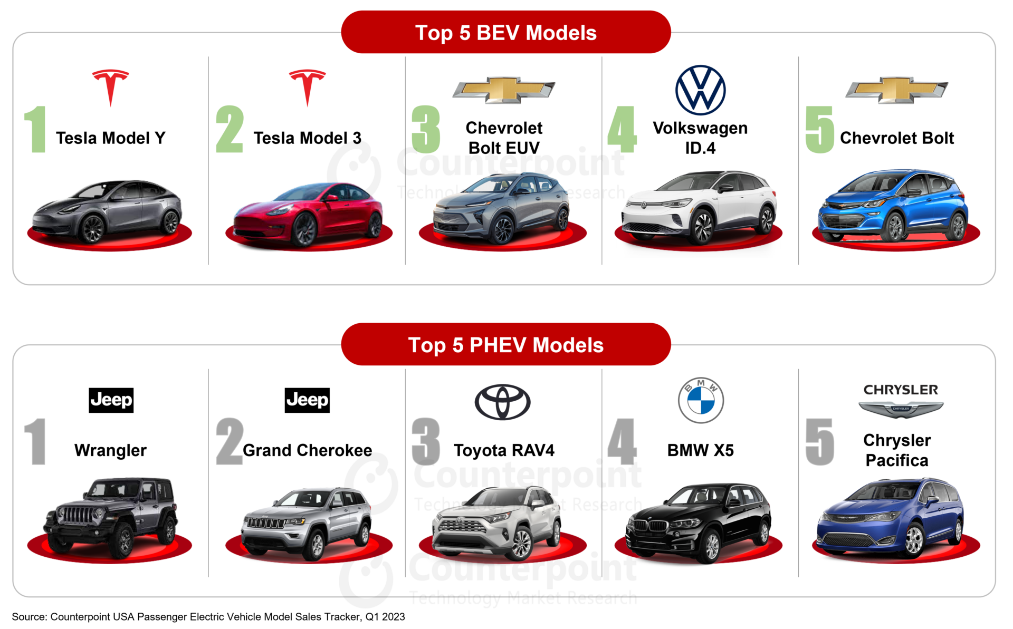
Class 2

Slide 5
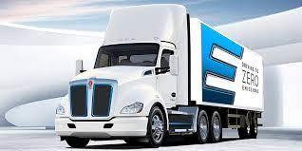
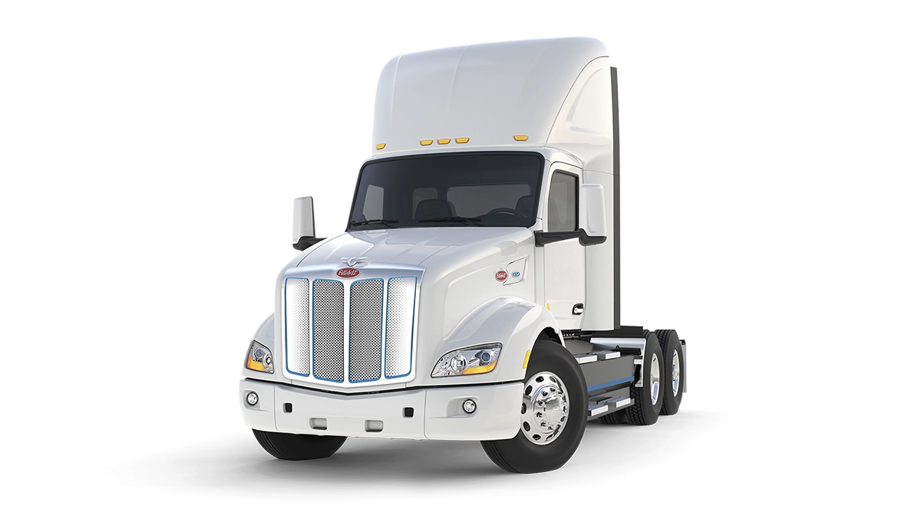
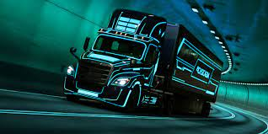
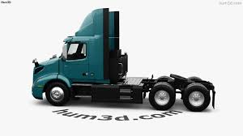
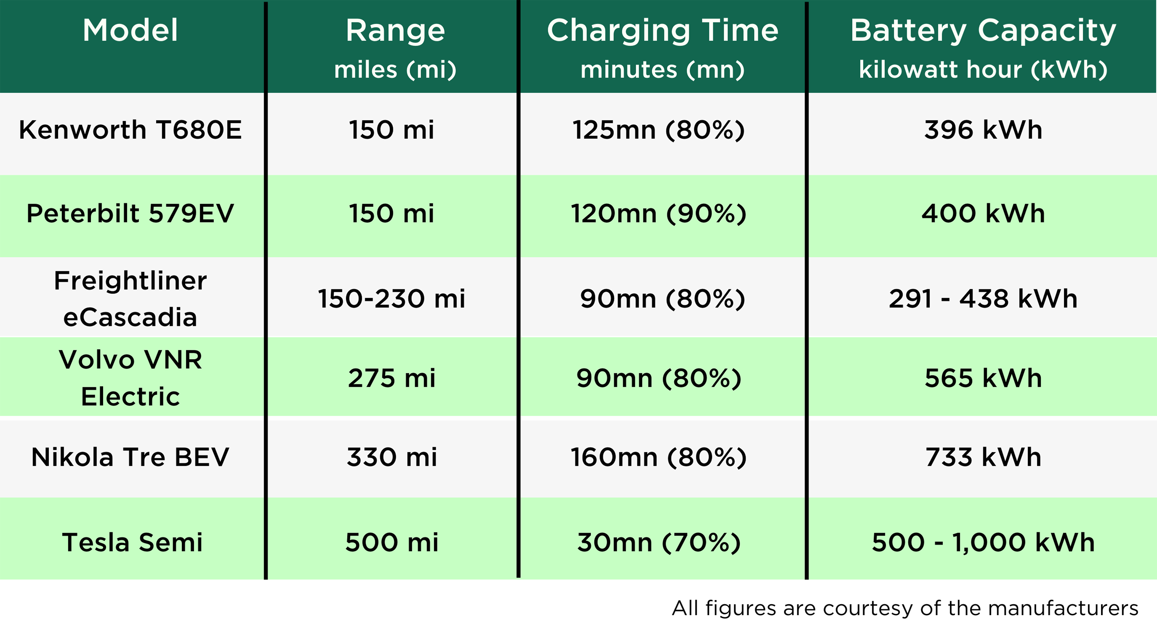
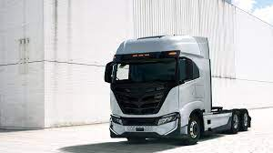
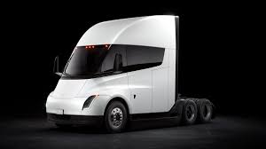
Class 8
Tesla
Peterbilt
Kenworth
eCascadia
Volvo
Nikola
Tesla

Slide 6
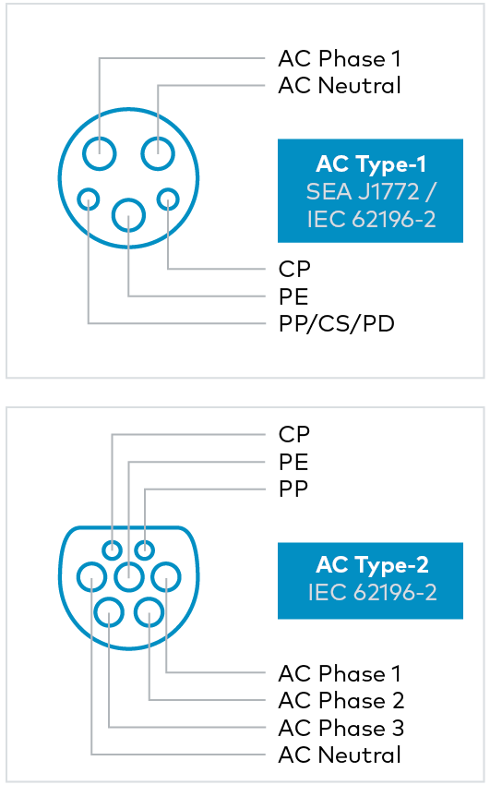
Charging
Level 1 Charging (120-Volt)
Connectors: J1772, Tesla.
Speed: 3 to 5 miles per hour.
Locations: Home, Workplace, Public.
Usage: Common household outlet charging. Suitable for plug-in hybrid electric vehicles (PHEVs) with smaller batteries. Slowest charging method, ideal for minimal daily driving.
Level 2 Charging (208-Volt to 240-Volt)
Connectors: J1772, Tesla.
Speed: 12 to 80 miles per hour.
Locations: Home, Workplace, Public.
Usage: Most common for daily EV charging. Can be installed at home or public places. Charges up to 10 times faster than Level 1. Suitable for overnight charging. Chargers vary, with 40-amp chargers offering practical speed and cost balance.
Level 3 Charging (400-Volt to 900-Volt) - DC Fast Charge & Supercharging
Connectors: Combined Charging System (Combo), CHAdeMO, Tesla.
Speed: 3 to 20 miles per minute.
Locations: Public.
Usage: Fastest charging type, using direct current (DC). Not suitable for home installation due to high voltage requirements and cost. Used in public stations for rapid charging.
In all cases, the vehicle determines the maximum power it can accept, ensuring safety regardless of the charger's capacity. Level 3 chargers are significantly more expensive and are typically found only in public locations due to their high-voltage requirements.

Slide 7
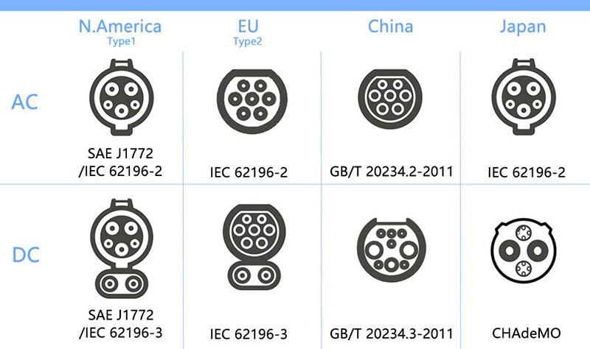
Charging
In North America, all EVs except Tesla use the same connector for Level 1 and Level 2 charging, called J1772 or the “J-Plug.” For Level 3 charging there are three standards currently in use. Tesla uses its proprietary plug, Nissan and Mitsubishi use the Asian standard called CHAdeMO, and all other manufacturers use the Combined Charging System, CCS or “Combo” plug.
EV Charging Speed on Level 1, 2, 3 Chargers
Charging Level | Power Delivery | Range Added Per Hour | Time to Charge 60 kWh EV
Level 1 | 1-1.4 kW | 3-5 miles | 30-40 hours
Level 2 | 3.9-19.2 kW | 12-80 miles | 2.5-4.5 hours
Level 3 | 24-300 kW | 75-1,200 miles | 30-40 minutes

Slide 8

Megawatt Charging (where we are going)
What is Megawatt Charging Standard (MCS)?
MCS is like the latest, most powerful phone charger but for electric commercial vehicles. Just like how some phone chargers fill up your battery faster, MCS does this for big electric vehicles, giving them a lot of power in a short time.
Who will benefit from the Megawatt Charging System (MCS)?
It's going to be a game-changer for businesses that use these large vehicles, like shipping and transport companies. They can charge their vehicles quickly, which means less waiting and more driving.
When do we expect universal adaptation of MCS?
It's a bit like waiting for the newest smartphone to become popular. Everyone knows it's great, but it takes time for everyone to start using it. For MCS, it might take a few years to become common because we need the right places to plug in these super chargers (capacity) and for everyone to agree on using them.
Why does MCS matter?
MCS is important because it solves a big problem: how to charge big electric trucks quickly. This means these trucks can get back on the road faster, making electric vehicles a more attractive choice.

Slide 9
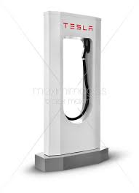
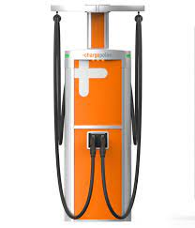
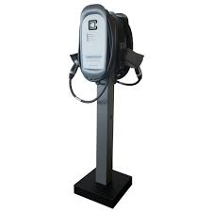
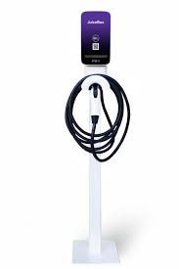
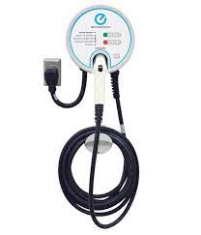
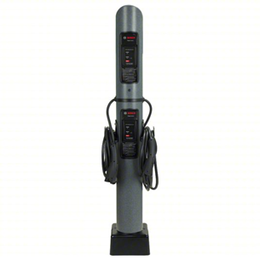
Charging Stations
Tesla, Inc. is known for its electric vehicles, but it also manufactures the Tesla Wall Connector for at-home charging. The Tesla Wall Connector is one of the highest-rated EV charging stations with a maximum charging speed of 44 miles per hour. It's easy to use and comes with a sleek, modern design.
ChargePoint offers over 100,000 charging stations across the US and Canada. It's not only popular amongst EV drivers, but also commercial property owners. They offer a range of charging stations, including ones with DC fast-charging capabilities. They have a mobile app that makes it easy to locate a charging station.
ClipperCreek is a US-based manufacturer that offers a variety of charging stations designed to be easy to use. They have charging stations that work for both home and commercial use and offer a range of features such as lockable stations, low-profile stations, and varying charging speeds.
Enel X is an Italian-based company that has made its mark in the US market with its high-quality, robust charging stations. They have charging stations with a range of charging speeds that work for both home and commercial use. They offer a mobile app that makes finding a charging station easy.
AeroVironment is a US-based company that has been designing energy solutions for a wide range of industries for over 50 years. They manufacture EV charging stations for homes, workplaces, apartments, and more. Their charging stations are easy to use and come with smart features such as a mobile app that lets users track and schedule their charging sessions.
Bosch is a German-based company that has been manufacturing EV charging stations for over a decade. They offer a wide range of charging stations designed for various locations such as homes, businesses, and parking garages. They have a reputation for being user-friendly and reliable.

Slide 10



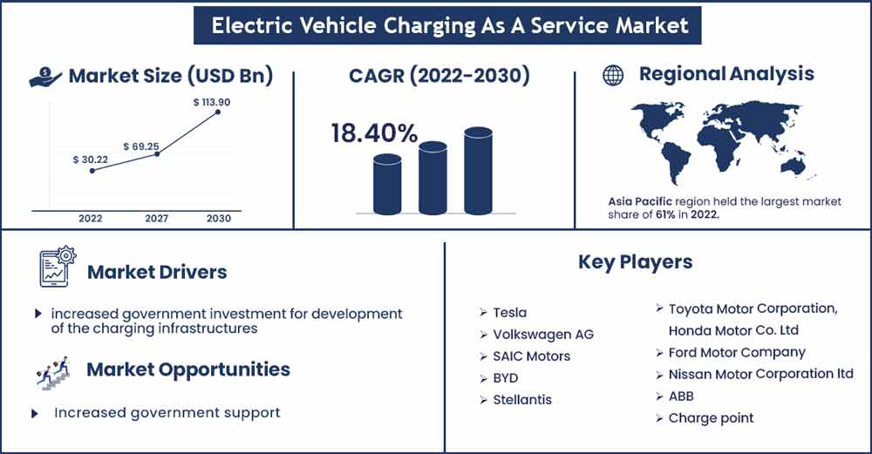
Caas (charging as a service)
Current Market:
The CaaS market provides electric vehicle charging solutions through third-party providers who manage the deployment, maintenance, and operation of charging infrastructure. This model is particularly advantageous for EV fleet operators, businesses, and government entities, as it allows for scalable and tailored infrastructure without the complexities of owning and maintaining the infrastructure​​. The market size for CaaS was valued at around USD 242.5 million in 2022. It's predominantly driven by the need for efficient, accessible, and easy charging experiences for EVs, and the difficulties in maintaining different charging infrastructures​​.
Future of CaaS:
The CaaS market is expected to grow significantly, with a projected value of USD 1,239.5 million by 2030. This growth is fueled by the increasing adoption of electric vehicles and the consequent demand for more accessible and efficient charging solutions​​. The future of CaaS also includes integration with renewable energy sources and expanding charging infrastructure.

Slide 11





Taas(Trucks as a service)
Fleet Advantage
Specializes in truck fleet business analytics, equipment financing, and lifecycle cost management.
Offers customized Trucks-as-a-Service solutions for electric vehicles.
Known for providing comprehensive lease structures including trucks, chargers, infrastructure, and sometimes electricity.
Actively involved in adopting and promoting new technology in truck leasing​​.
Ryder
An American-based provider of transportation and supply chain management products.
Focuses on offering package deals that cover electric trucks, charging infrastructure, maintenance, and other services.
Has cross-functional departments, resources, and partners for a comprehensive service offering.
Places a strong emphasis on environmental services, telematics, and regulatory compliance​​.
Hino Trucks
A well-known truck manufacturer, offering medium-duty electric trucks.
Launched InclusEV, providing end-to-end electric vehicle enablement, including EV consulting services and intelligent charging solutions.
Partners with ChargePoint, EnTech Solutions, and Mitsubishi HC Capital America for comprehensive service offerings.
Aims to simplify and accelerate the transition to EVs with bundled financing products and customer service​​.
WattEV
A Southern California-based startup focusing on electric trucks.
Developed an Electric Truck-as-a-Service (TaaS) model, providing access to battery-electric trucks at competitive rates.
The service includes vehicles, charging infrastructure, installation, and maintenance.
Ordered 50 Class 8 Volvo VNR Electric trucks to launch its TaaS model, with plans to expand significantly by 2030​​​​.
Volta Trucks
Offers Truck as a Service solution for commercial fleet electrification.
Provides comprehensive service including infrastructure, maintenance, servicing, financing, and training.
Focuses on simplifying the transition to electric vehicles for businesses with an all-inclusive operating lease.
Has networks across major European markets, optimizing uptime and service efficiency

Slide 12
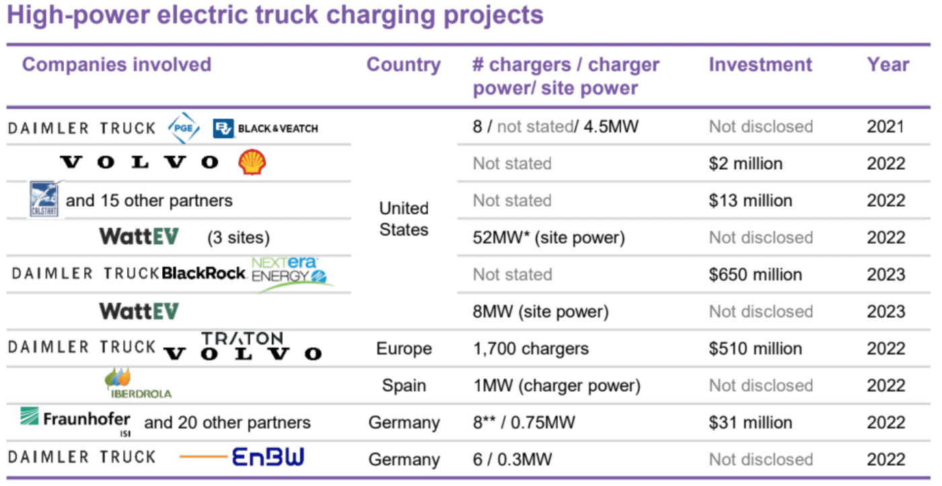
Established Partnerships

Slide 13





Legislation
Legislation in place to phase out ICE 2030-2035
Inflation Reduction Act of 2022: This act includes several provisions to promote electric vehicles. Notable among them are:
Extended light-duty EV tax credit up to $7,500 per vehicle through 2032.
New federal tax credits for used EVs up to $4,000.
Commercial EVs are eligible for federal tax credits, up to 30% of the sales price.
$3 billion allocated for electrifying the United States Postal Service fleet.
$1 billion for states, municipalities, Indian tribes, or non-profit school transportation associations to replace class 6 and 7 heavy-duty vehicles with clean EVs.
Infrastructure Investment and Jobs Act: This act made significant investments in EV infrastructure, including:
$5 billion to build out a network of EV charging along highways.
Additional $2.5 billion in competitive grant funding for further building out charging infrastructure.
Emphasis on funding access in low-income and rural communities.
Federal Fleet Electrification: There's a focus on electrifying the federal fleet, including the U.S. Postal Service vehicles, to demonstrate leadership in the shift to electric transportation.
EV Charging Equipment Tax Credit: Extended through 2032, offering tax credits for both individual/residential and commercial uses of charging equipment. For residential uses, the tax credit remains at 30%, up to $1,000, and for commercial uses, it is 6% with a maximum credit of $100,000 per unit.

Slide 14
Roadblocks
High Upfront Costs: EVs generally have higher initial purchase prices compared to traditional internal combustion engine vehicles, which can be a significant barrier for many consumers. BEV COST=$300k-$500k vs $130k-$160k
Limited Charging Infrastructure: The lack of widespread and accessible EV charging stations can deter potential buyers who are concerned about the convenience and feasibility of charging their vehicles.
Range Anxiety: Concerns about the driving range of EVs on a single charge and the availability of charging stations contribute to hesitancy among consumers.
Battery Cost and Performance: The cost of EV batteries remains high, and there are concerns about their long-term performance and the cost of replacement.
Consumer Awareness and Perception: Lack of awareness or misconceptions about EV capabilities, maintenance, and benefits can affect consumer acceptance.
Supply Chain Constraints: Issues in the supply chain, including the availability of critical raw materials for batteries, can limit the production of EVs.
Technological Development: The need for further advancements in EV technology, particularly in battery efficiency and charging speed, is crucial for wider adoption.
Government Policies and Incentives: Inconsistent government policies and the availability of incentives can impact the pace of EV adoption.
Energy Grid Capacity: Concerns about the capacity of the current energy grid to support widespread EV charging, especially during peak demand.
Transition for Auto Manufacturers: The automotive industry needs significant restructuring and investment to shift from traditional vehicle production to EVs, which is a complex and time-consuming process.

Slide 15
Questions

Slide 16
[Name]
[Date]

