Slide 1
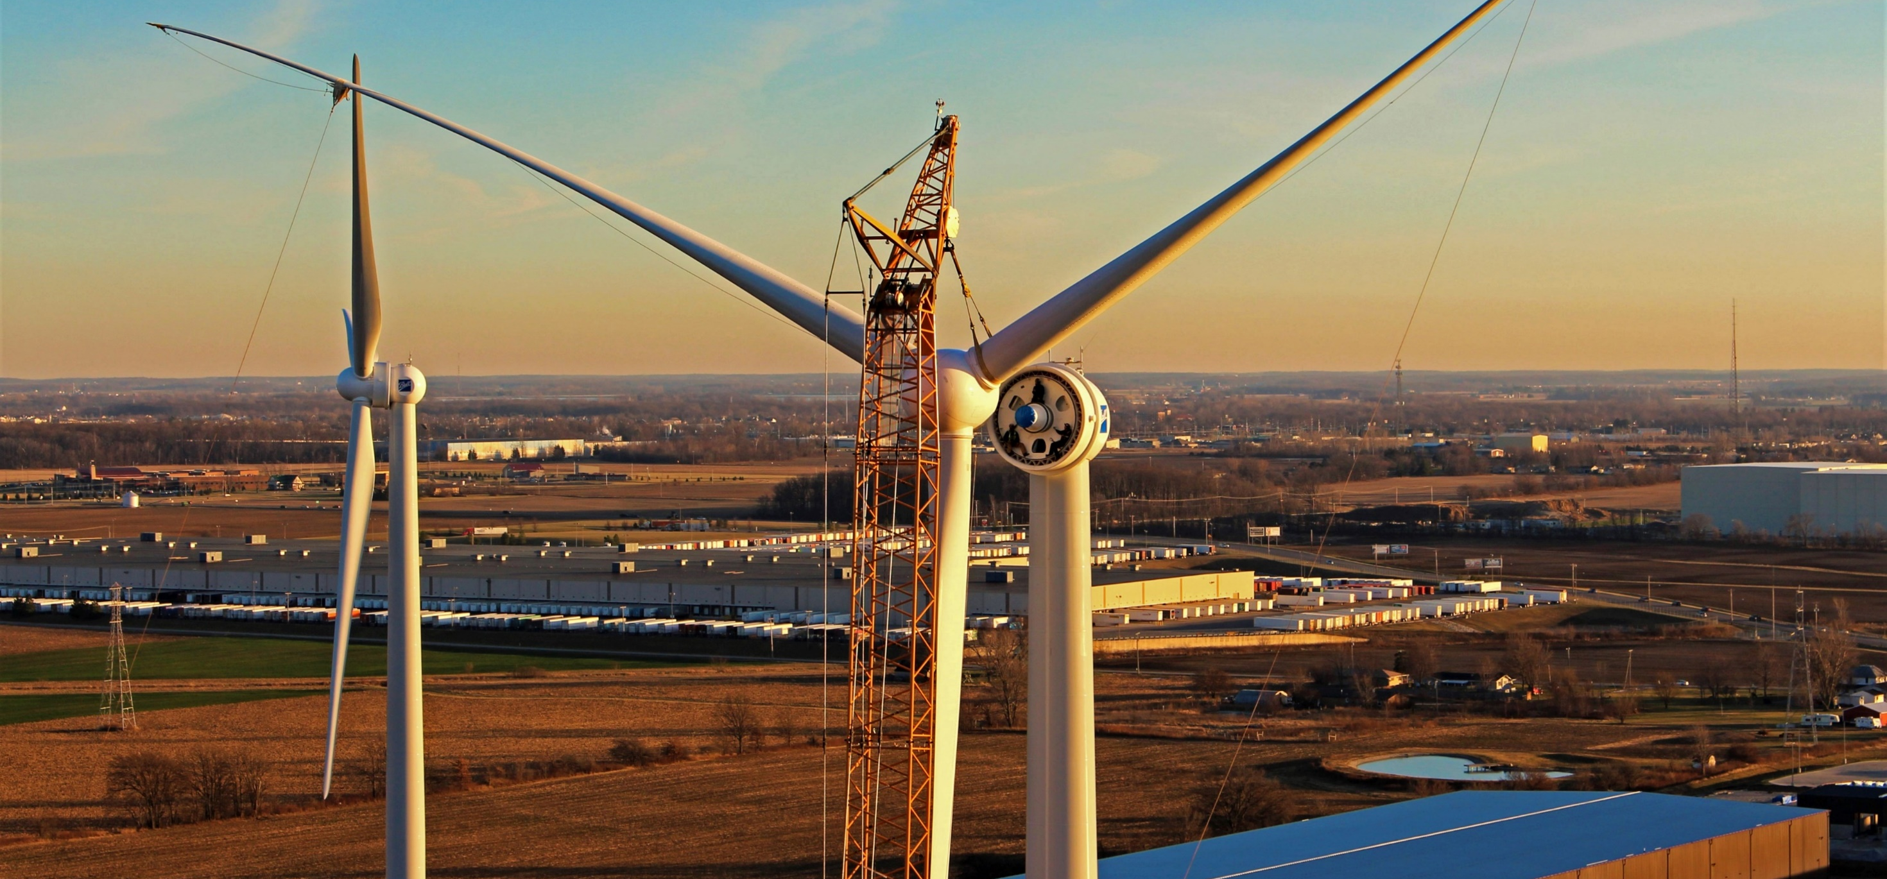

Atmospheric Stability
12385 Township Rd 215 | PO Box 894
Findlay, Ohio 45840
877-298-5853 | www.oneenergy.com
Bobbi Covington
1/31/2023

Slide 2
What is Atmospheric Stability?
Definition: a measure of the atmosphere’s tendency to discourage or deter vertical motion.
  Determines whether air will rise, sink, or essentially do nothing
Three Types of Stability:
  Unstable
    If an air parcel is warmer than the surrounding environment it will be less dense than the surrounding air and rise
  Stable
    If an air parcel is colder than the surrounding environment it will be denser than the surrounding air and sink
  Neutral
    If an air parcel is the same temperature as the surrounding environment, it will essentially do nothing
The parcel is always compared to the surrounding environment and not the other way around.

Slide 3
Lapse Rate
The rate of change of an atmospheric variable with height
  Stability: Change in temperature with height (°C/km)
Two Type of Lapse Rates:
  Dry Adiabatic Lapse Rate (DALP)
    Γ_{d} = 10 °C km⁻¹
  Saturated (Moist) Adiabatic Lapse Rate (SALP or MALR)
    Γ_{s} = 6 °C km⁻¹
For this presentation we will assume dry air

Slide 4
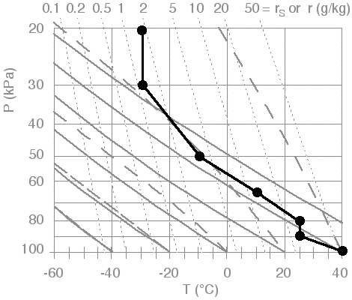
Instability/Unstable Air
Γ_{e} > Γ_{d}
Example:
  100 kPa – 90 kPa
  40°C - 25°C
    Γ_{e} = 15 °C km⁻¹
    Γ_{d} = 10 °C km⁻¹

Slide 5
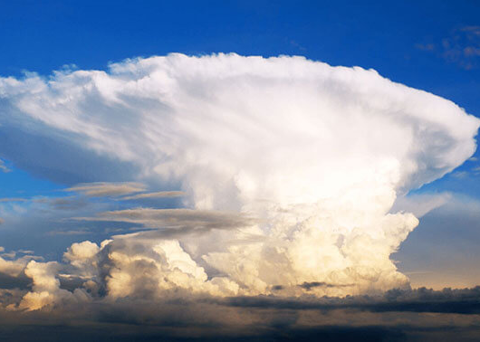
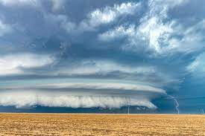
Unstable Environmental Conditions
Thunderstorms
Supercells

Slide 6
Stability/Stable Air
Γ_{d} > Γ_{e}
Example:
  90 kPa – 80 kPa
  25°C - 25°C
    Γ_{e} = 0 °C km⁻¹
    Γ_{d} = 10 °C km⁻¹

Slide 7
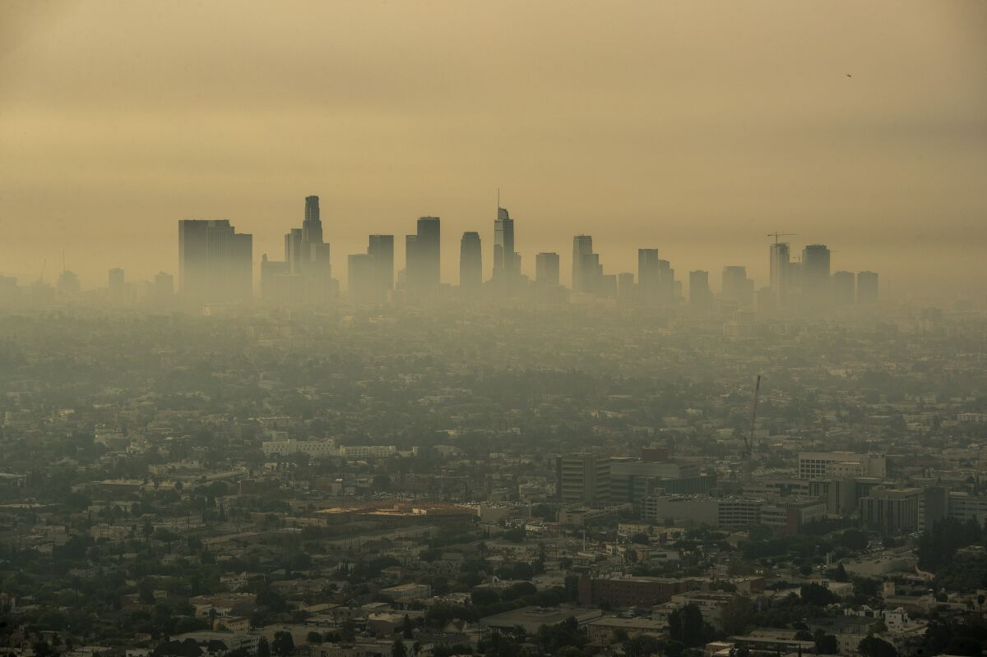
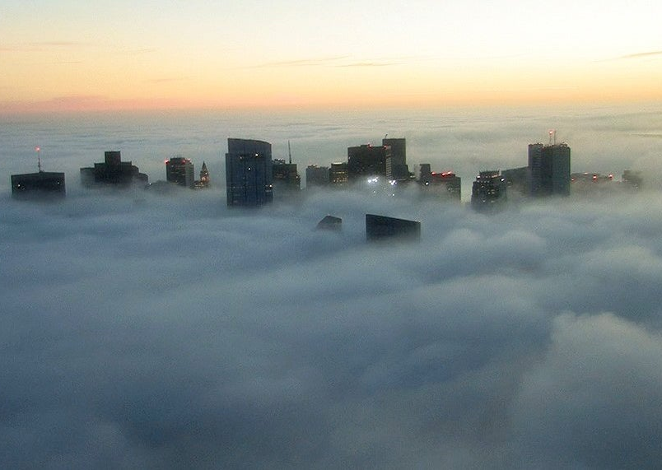
Stable Environmental Conditions
Smog
Fog

Slide 8
Neutral/Neutral Air
Γ_{d} = Γ_{e}
Example:
  65 kPa - 50 kPa
  10°C - -10°C
    Γ_{e} = 10 °C km⁻¹
    Γ_{d} = 10 °C km⁻¹

Slide 9

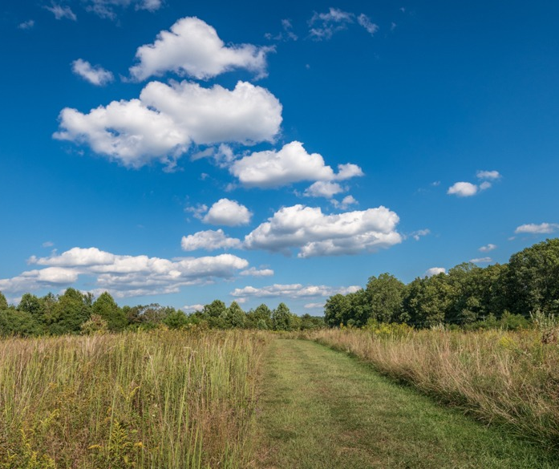
Neutral Environmental Conditions

Slide 10
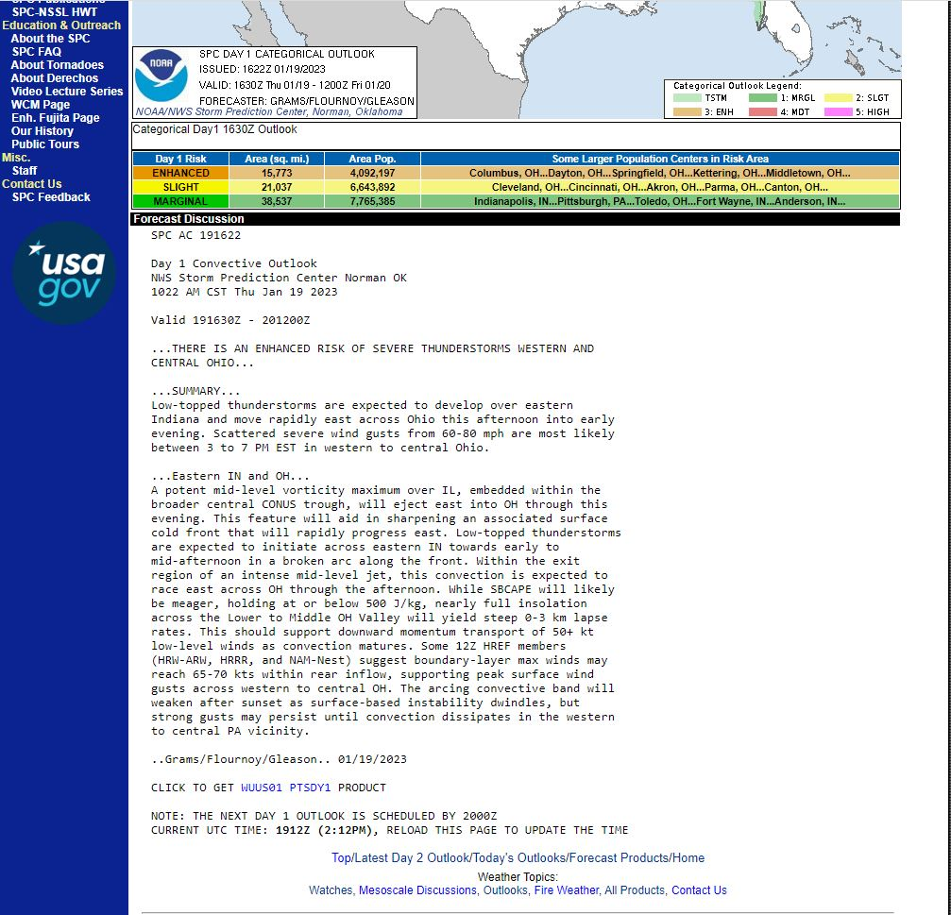
Storm Prediction Center
Storm Prediction Center
  January 19, 2023
Severe Thunderstorms in Eastern IN and OH
Instability
  Γ_{e} > Γ_{d}
  0-3 km
    ~10,000 ft
  Unstable layer 1000mb-700mb

Slide 11
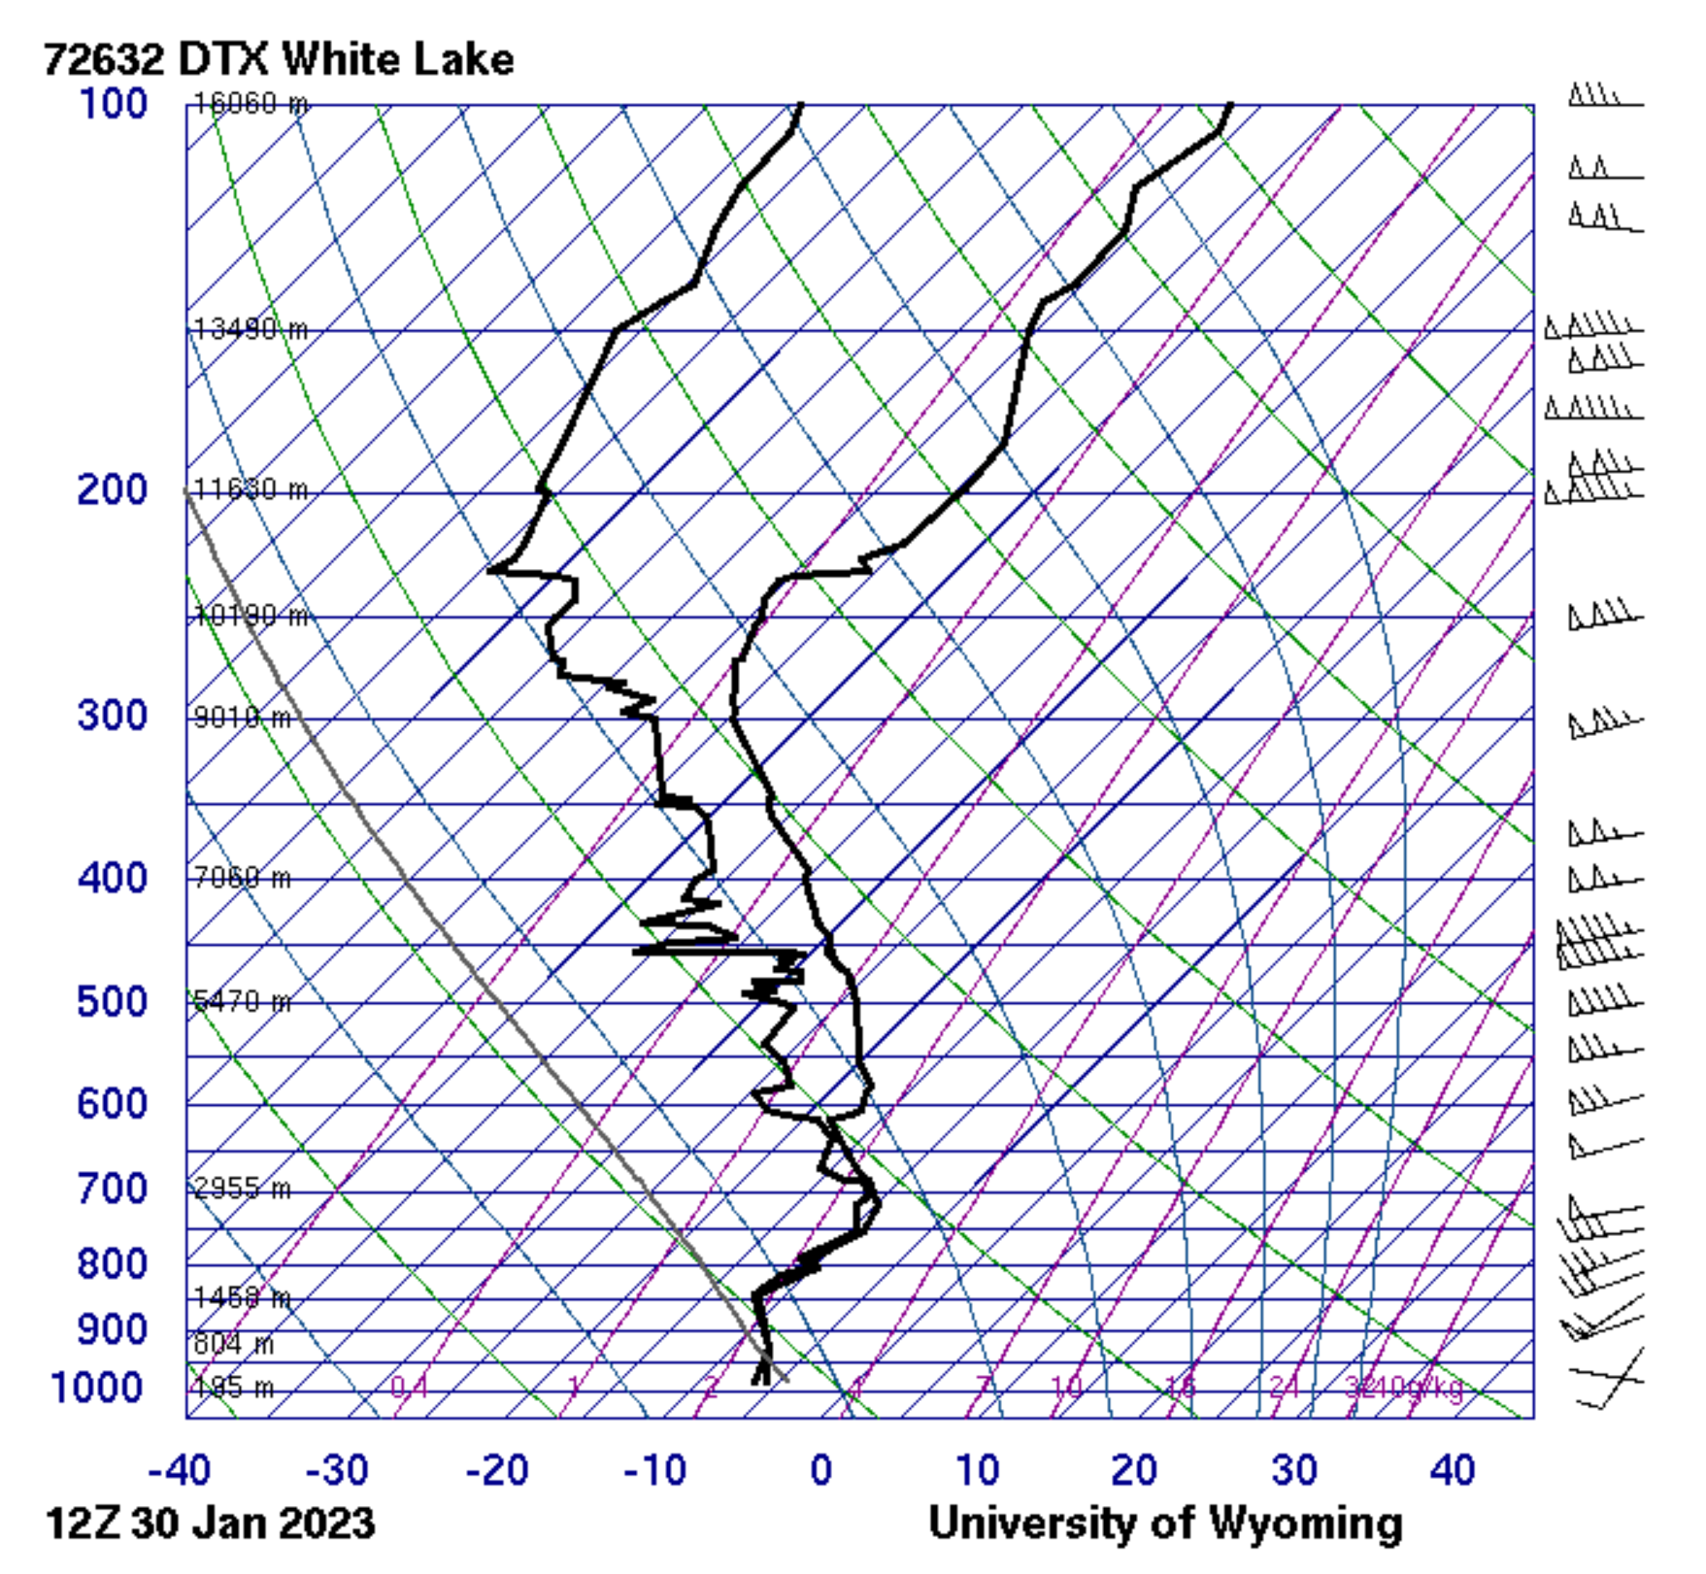
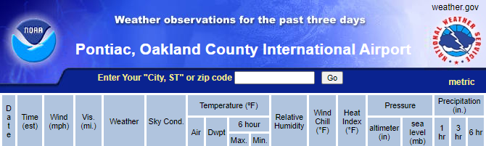
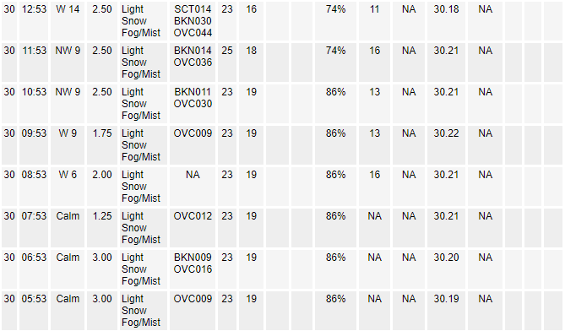
University of Wyoming Soundings

Slide 12
Questions?
Bobbi Covington

