Slide 1
KNOWLEDGE NIGHT:
All things api’s
Bower Sarra
November 8, 2022

Slide 2
WHAT IS AN API?
Application Programming Interface
  APIs originated in the 1940’s, term not used until 1960’s and 70’s
  Software intermediary that allows two (or more) programs to talk to each other
  API specification vs. implementation
  Different from a user interface
  API calls
Database
Web Server
API
Internet
Web App
Request/ Response
Notes:
Application programming interfaces, or APIs, are an intermediary type of software that allow two or more programs to interact with each other. The term API is often used to refer to two things: the API specification or the API implementation. API specifications refer to the document or standard that describes how the API is used or built. API implementation occurs when a computer system meets those standards. That system then “implements” or “exposes” the API.
APIs are different from user interfaces in that they are not intended to be used directly by a person (other than the programmer), while user interfaces are intended to connect the computer to the end user. APIs allow the programmer to access information hosted by another software programmatically, instead of having to hard-code according to the specific system the request is sent to. Think about this like plugs and sockets in our home. Devices that use electricity have a standard interface, two or three prongs, that are easily interchangeable to the outlets in our house. The API acts as the interface, or the outlet/prong standard to allow plugging and playing of different software.
APIs are typically used to send calls and receive requests. An API call is a subroutine, method, request, or endpoint that is defined by the API specifications mentioned earlier. The instructions and how to implement the call are also laid out in the specifications.

Slide 3

HOW APIS MAKE TASKS EASIER
Restaurant analogy
  Menu – Request
  Waiter – API
  Kitchen – System
Applying to real world:
  Uber eats
Hiding Information
REQUEST/RESPONSE
API
https://www.freepik.com/premium-vector/cartoon-drawing-waiter_20243831.htm
Notes:
Let’s consider an example in a restaurant. You sit down and view a menu in front of you. After deciding what you want to eat the waiter asks for your order. The waiter delivers the order to the kitchen. The kitchen then interprets your request and produces a response, your food! The waiter then delivers the response to you. This is what occurs with the API. The user sends a request, usually in the form of an HTTP request, to the API. The API then delivers that response to the system, which then produces a response. This response is then sent back to the user.
Now let’s consider a similar example that uses a real API to accomplish a similar task. Restaurants on the Uber eats app have their own database that consists of the menu and the stock of each item. When ordering from that restaurant’s website, it could be directly accessing the restaurant’s database. When you order from the Uber Eats app, all the databases from each restaurant are connected via the website’s API. This allows the user to have access to every local restaurant’s information (like menus, hours, etc.) from one place. The API also enables the Uber Eats application to update the stock of the restaurants, view the menus, and many other functions.
One thing to note is that APIs allow the system to keep sensitive information private, only allowing specific information to be available to the users.

Slide 4
USE CASES
Libraries and Frameworks
  Use APIs to communicate with software
Operating Systems
Remote APIs
Web APIs
  The subject when APIs are being referred to
Notes:
There are so many different use cases for APIs and the more you think about how your daily programs work, the more you may be able to identify an API use case. There are a few different types of APIs that are used:
Libraries and frameworks utilize APIs to communicate with software. This allows programmers to use information that is not typically compatible with the language they are writing in.
Operating systems use APIs to communicate to the software downloaded onto the computer.
Remote APIs are APIs designed to interact through a communications network, I.E. the resources are outside of the computer making the request.
Web APIs are becoming most common and are typically what is being referred to when APIs are mentioned. Let’s dive further into web APIs.

Slide 5
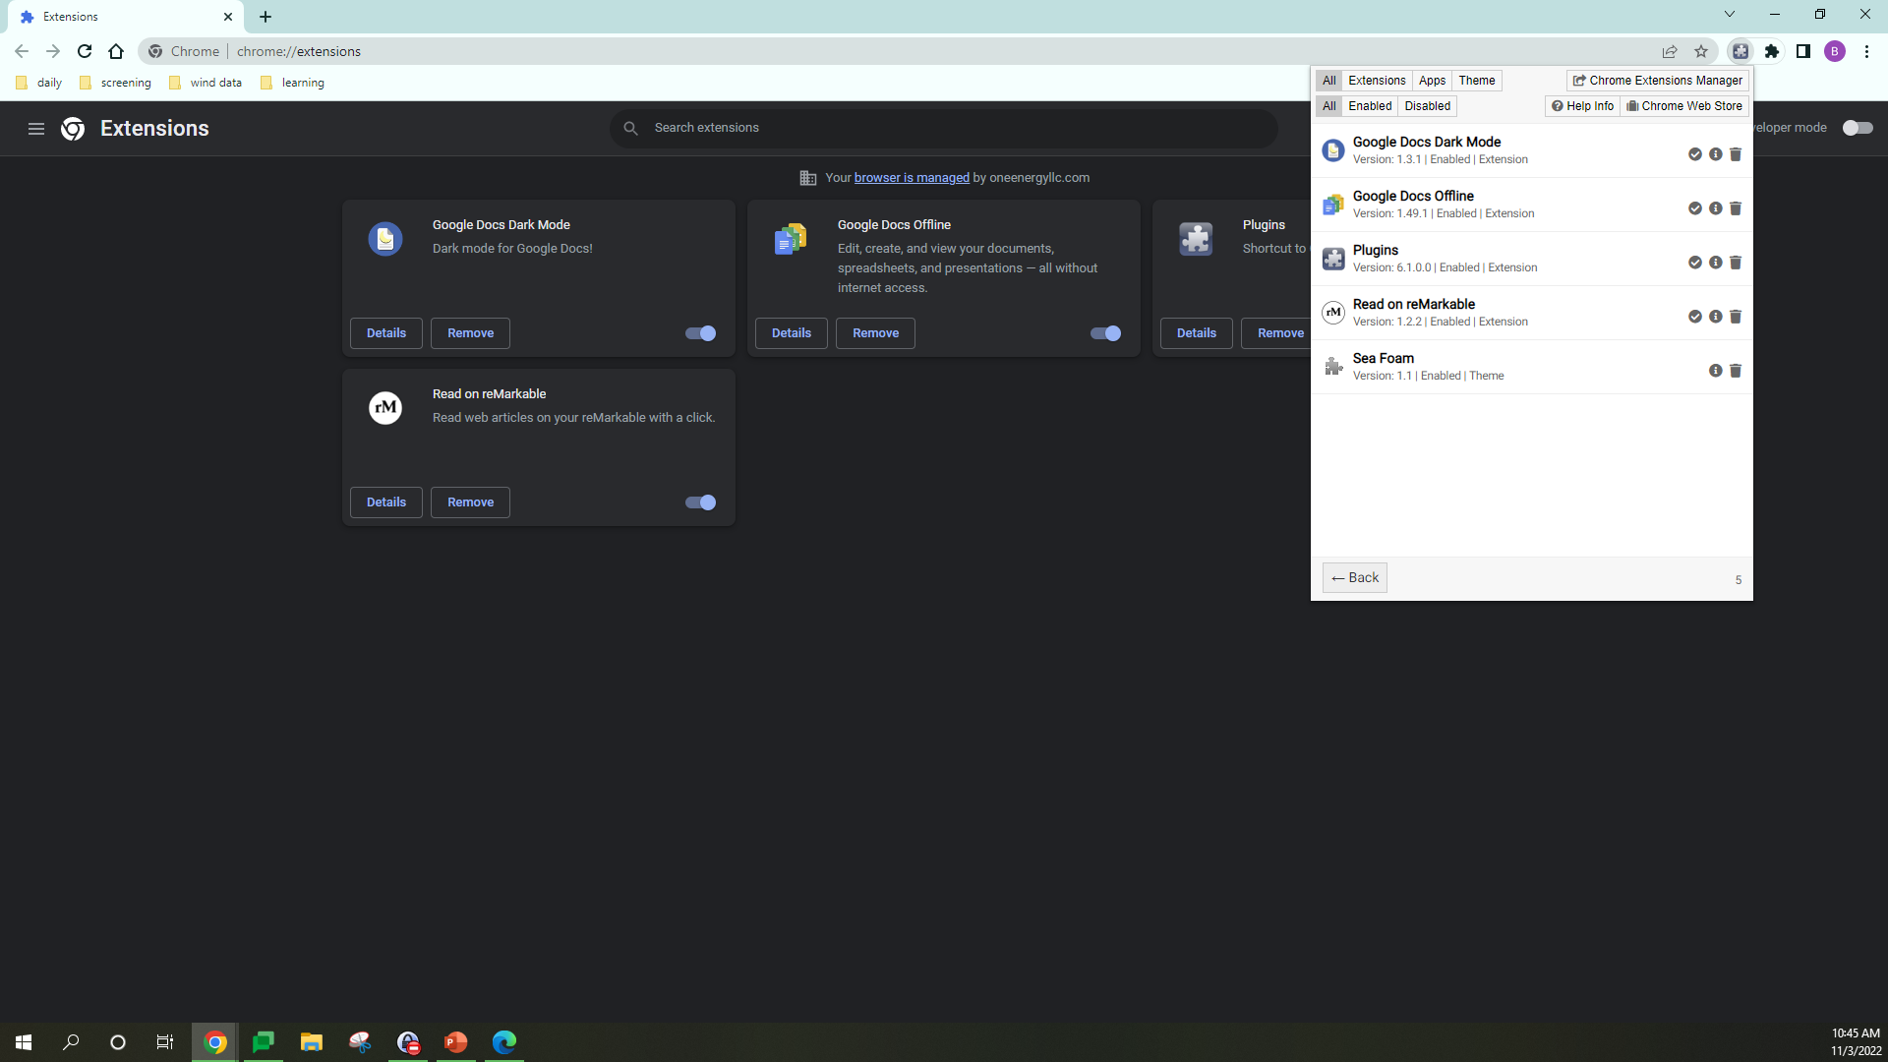
WEB APIs
Web APIs can be either client or server side
Client-Side
    Commonly in the form of native plug-in browser extensions
Server-Side
    Consists of one or more publicly exposed endpoints and a defined request-response message system
Notes:
Web APIs are used as a software interface for a web server or web browser.
Client-side APIs are programmatic interfaces that extend the functionality of that web browser or HTTP client. When thinking of client-side API’s, think of plug-in browser extensions. For example, Google Chrome extensions allow customization of many different things such as themes, translators, and various other tools.
Server-side APIs are programmatic interfaces that are made up of two things: endpoints and a request-response message system. Endpoints specify where the resources are located that can be queried by third party software. Server-side APIs are typically accessed by URI’s (uniform resource identifiers) where requests are posted, and responses are expected.
Now let’s think about some of the websites we visit on a regular basis. For example, the weather app on iPhones. The app gets its data from The Weather Channel. These forecasts from the meteorologists rely on data from the National Weather Service, NASA, satellites, and weather balloons. This data is accessible through the respective APIs that is then compiled and interpreted. (sorry android, Im sure there’s something similar LOL). This is an example of a mashup, which is a web application that uses multiple server-side APIs. Now that we have explored the different types of APIs, lets brainstorm some other examples we might use on a regular basis.

Slide 6
Examples of apis
Flight searches
Twitter API
Google API
YouTube API
And MORE!!!

Slide 7
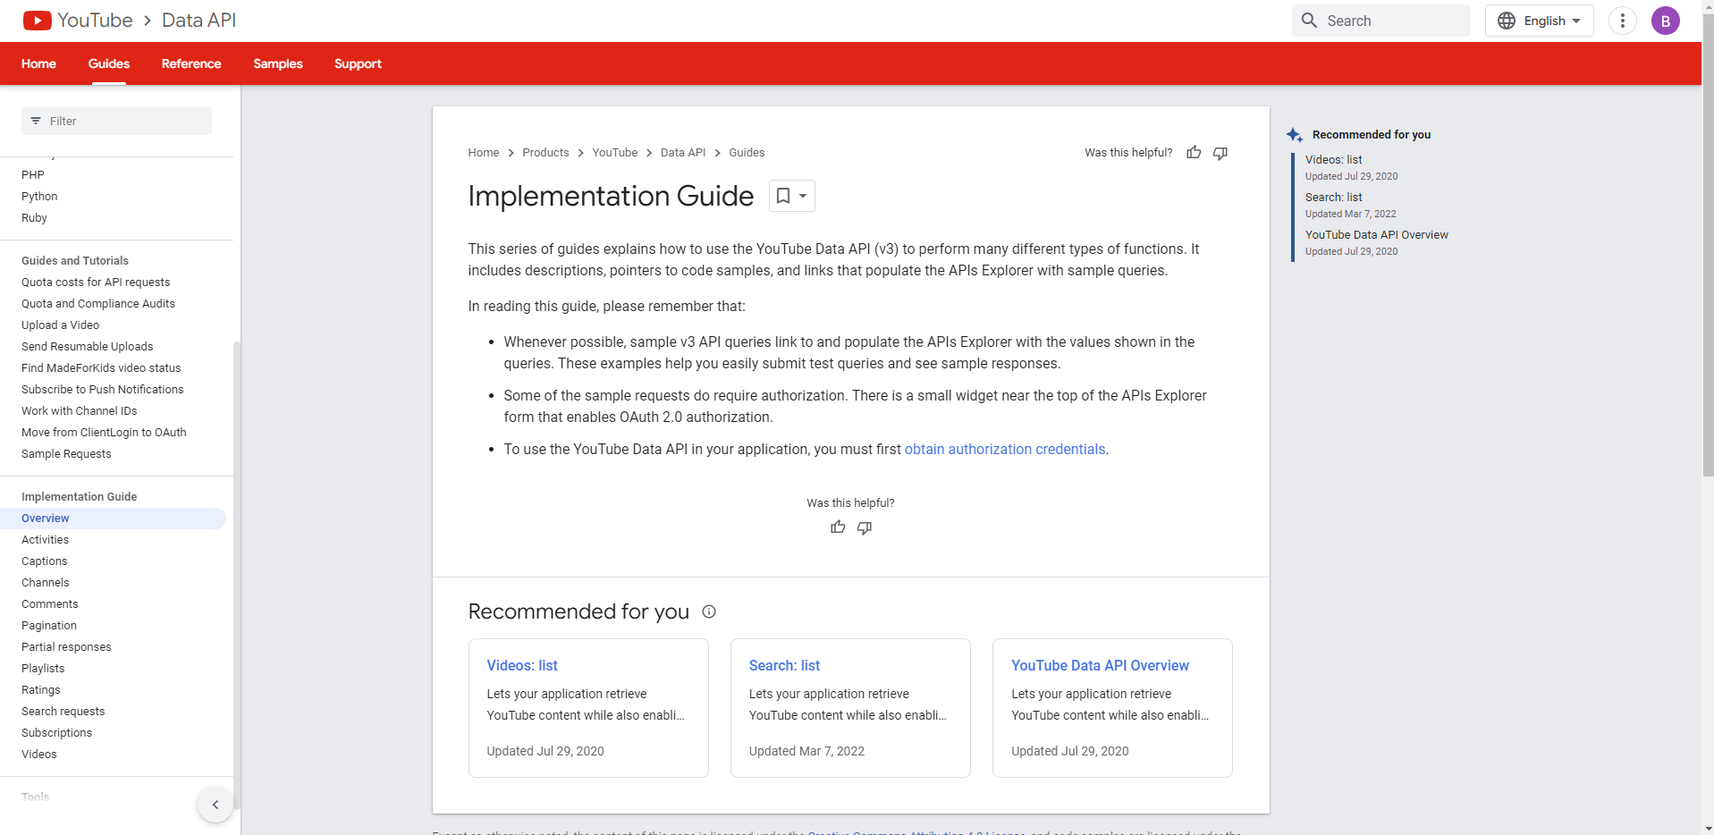
Web APIs Cont.
Additional Information
  Resources
  Documentation
  Growth and Impact
  Business
Notes:
Web 2.0 uses REST and SOAP interactions most often. We will be exploring REST, or Representational State Transfer, mostly for this knowledge night. REST APIs use HTTP methods to access methods using URL parameters and JSON or XML to transmit the data.
Documentation for server-side APIs detail references, tutorials, and/or examples that help developers use the API. The documentation does not expose the sensitive information to the developer, only how to use the API that will give access to the information they will have available. YouTube’s API has organized, helpful information and is a good example of documentation. They even have a built-in tool to test methods.
The number of Web APIs has grown over the past few years, from 105 in 2005 to 24,000 in 2022.
This is a fun fact I found, In 2014, Netflix received about 5 BILLION API requests, within their private API.

Slide 8
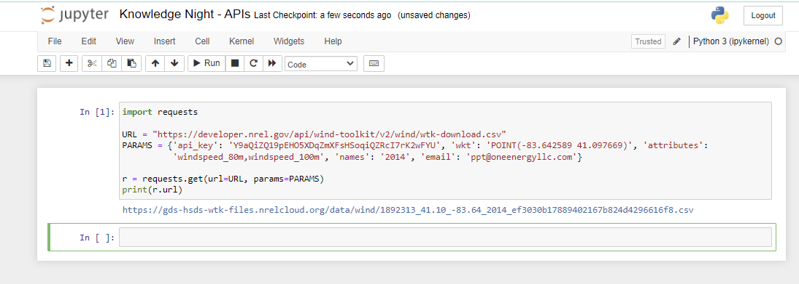
API Walk Through
Let’s step through the nitty gritty:
Notes:
Here is an example of what an application might be doing behind the scenes. This is a python script that is sending an HTTPS request to NREL’s WIND TOOLKIT API. Okay, what does that actually mean? We are sending a URL (uniform resource locator) to the NREL API that will then use that URL to locate the information we are trying to query. The URL we are sending to the API is made up of four parts:
The scheme, which identifies the protocol to be used to access the resource.
The host, which identifies the host name that holds the resource, in this case that is developer.nrel.gov
The path, which identifies the specific resource in the host we are trying to access. In this case that is /api/wind-toolkit/wtk-download.csv
And finally, the query string, which provides a string of information that the resource, in this case the WIND TOOLKIT database, can use to interpret the request.
With all of that, NREL’s WIND TOOLKIT will receive an HTTPS request from the API, extract the meteorological data we are requesting, and sending it back to us in the form of a .csv file via the API.
To actually send the HTTPS request, we are using a web-based computing platform that supports Python called Jupyter Notebook. The code is written in python and utilizes the requests library. (side-note, the library we are accessing also uses an API so that we can extract the data we need from it!) Jupyter Notebook then compiles and runs the program, which sends the get request and receives the .csv file.

Slide 9
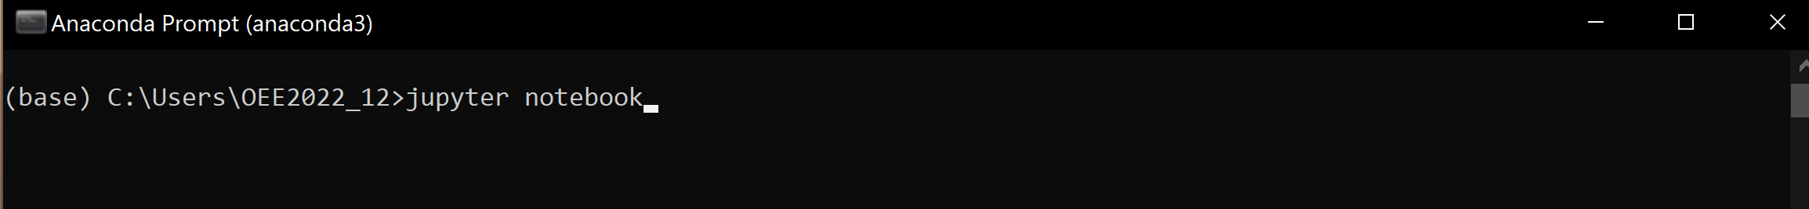
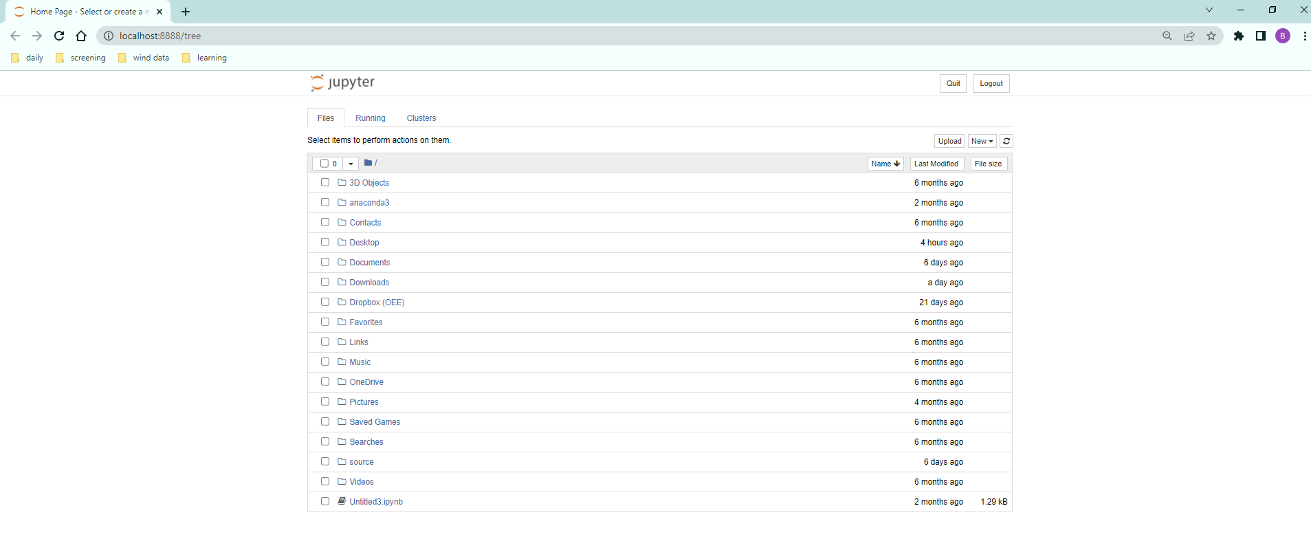
API WALK THROUGH

Slide 10
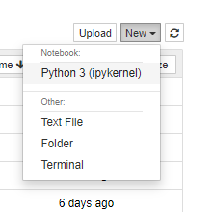
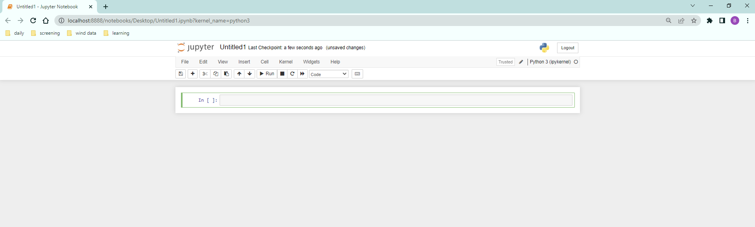
API WALK THROUGH

Slide 11
What is sent to nrel?
HTTPS GET REQUEST:
https://developer.nrel.gov/api/wind-toolkit/v2/wind/wtk-download.csv?api_key=Y0aQiZ19pEHO5XDqZmXFsHSoqiQZRcI7rK2wFU&wkt=POINT%28-83+41%29&attributes=windspeed_80m+windspeed_100m&names=2014&email=ppt%40oneenergyllc.com
RESPONSE
https://gds-hsds-wtk-files.nrelcloud.org/data/wind/1892313_41.10_-83.64_2014_83fe4a661571d7405bf12b50f52fa855.csv

Slide 12

OE APPLICABILITY
Database access
Web browser enhancements
Improved extraction tools

Slide 13
THE END
QUESTIONS?

