Slide 1
Algae Biofuels: An Overview
CLAIRE HANRAHAN
1/4/2022

Slide 2
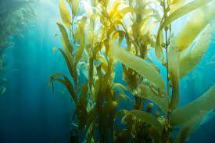
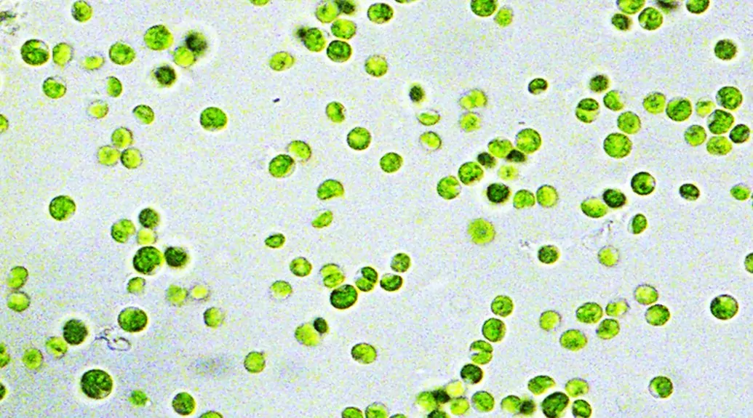
What is algae?
Macro
Seaweed
Not typically part of the conversation for biofuels
Micro
Sometimes called phytoplankton
Unicellular

Slide 3
Microalgae in detail
Found all over
  Freshwater, salt water, brackish, etc
  Arctic
Grows rapidly
  Some double w/n 6 hours
Potentially millions of species
Energy-rich oils
  Depends on species

Slide 4
Eukaryotic vs prokaryotic
Eukaryotic
  Distinct organelles
  Higher lipid content
    Triacylglycerols (TAGs)
Prokaryotic
  Cyanobacteria or blue-green algae
    Not technically algae
  Easier to genetically engineer

Slide 5
Biofuels
Fuel made from organic matter
  Wood, sugar, oil, etc
1st generation
  Conventional biofuels
  Come from food sources
    Sugar, starch, vegetable oil
2nd generation
  Come from non-food sources
    Wood, organic waste, food waste, and certain crops
  Requires pre-treatment
3rd generation
  Algae

Slide 6
1st generation
Advantages:
  Infrastructure already in place
  Relatively simple to convert to ethanol
Disadvantages:
  Relatively low fuel production
    Sugar cane is highest at 650 gallons/acre
  Directly competes for food sources and land availability
  Requires pesticides

Slide 7
2nd generation
Advantages:
  Does not compete with food sources
  Plants can typically grow on marginal land
  Allows for recycling of waste products
  Certain sources are readily available
  Higher energy yield than 1st generation
Disadvantages:
  Many sources require pre-treatment

Slide 8
3rd generation
Advantages:
  Highest yield per acre
  Does not compete with food
  Does not compete with arable land
  Does not need to complete for available freshwater
    Wastewater, saline, brackish
  Potential for high-value co-products
  Can recycle carbon from power plants
    Closed system
Disadvantages:
  Not currently economically viable
    Estimates ($10-$93 per gallon)
    Heavily reliant on co-products to bring down cost

Slide 9
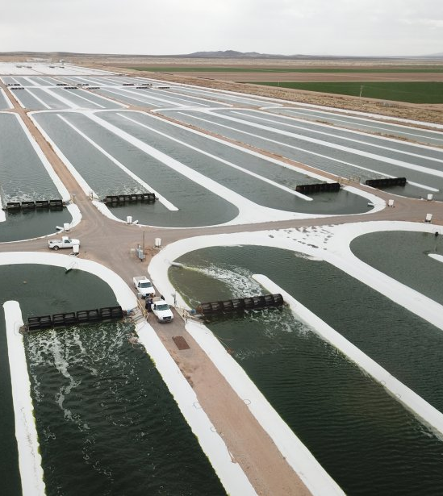
Growing Algae
Open ponds
  Either open ponds or “raceway” ponds
  May or may not have mixing
  Cheapest capital cost
  Prone to contamination
Closed Loop System
  Sterile CO2

Slide 10
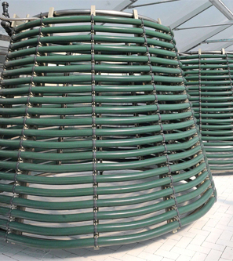
Growing Algae Continued
Photobioreactors
  High Capital Cost
  More controlled
    CO2
    Temperature
    Nutrients
    Mixing
    Light intensity
  Easier to harvest
    Biomass density ~30x raceway pond

Slide 11
Harvesting
Typically two steps:
  Bulk Harvesting
  Thickening
Bulk Harvesting
  Flocculation to clump algae
  Filtration, flotation, or gravity to collect clumps
Thickening:
  Concentrate biomass after it is separated
    Centrifuging most common

Slide 12
Dewatering
Major source of energy use
Often used in tandem with harvesting
Some methods
  Sun Drying
    Raceway ponds
  Spray drying
    Rapid drying with hot gas
Trade off between efficiency of fuel conversion and energy use

Slide 13
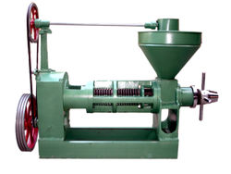
Extracting oil
Mechanical Press
  Squish the algae
  Up to 70% oil extraction
  Requires dry algae
Hexane solvent
  Oil dissolves in solvent
  Solvent then separated and filtered
  Up to 95% oil extracted

Slide 14
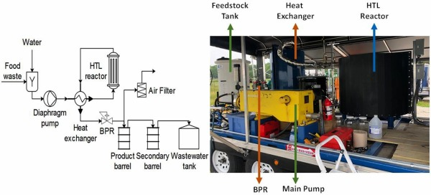
Extracting Oil continued
Hydrothermal Liquefaction (HTL)
  Uses heat along with pressure (supercritical)
    ~15-30 min
  Separates liquid, gaseous, and solid products
  Does not require dewatering
  Does not require solvents

Slide 15
Lowering the cost
Optimal species selection
  Bioprospecting
Co-products
Recycling:
  Carbon
  Heat
  Nutrients
Crop protection
Harvesting wild algae

Slide 16
Bioprospecting
Systematic search for useful compounds and organisms
Yellowstone as classic example
Looking for:
  High lipid content
    TAGs as opposed to polar lipids
  High growth rate
  High growth density
  Valuable co-products
Potentially millions of species
  More chances for useful traits

Slide 17
Creating an optimal species
Not likely to find perfect species
Either breed, or genetically modify
  High, energy-rich lipid count
Create mixture of symbiotic algae

Slide 18
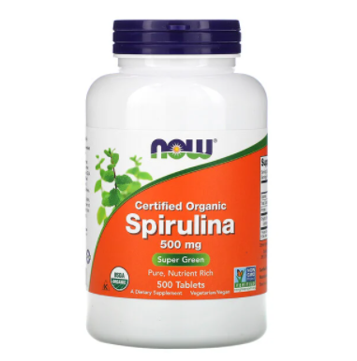
Co-Products
Industries:
  Cosmetics
  Pharmaceuticals
    Vitamins, antibiotics, Omega-3, etc
  Research
    Dyes
    Stable isotope biomolecules
  Food
    dyes
  Animal Husbandry
    Left over biomass

Slide 19
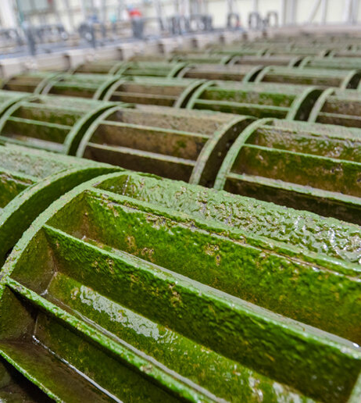
REcycling
Wastewater
  Remove Nitrogen and Phosphorous
  Smaller capital cost
Heat and CO2 can be recycled from power plants
  Drying is most energy intensive process

Slide 20
Crop protection
Contamination damages yields
  Competing for resources
  Predation
Cultivate extremophile algae
  E.g. able to withstand 35% salinity
  Possible for other species to adapt
Add cyanobacteria to algae mix
  Secrete toxins
Genetically engineer algae with defense mechanisms

Slide 21
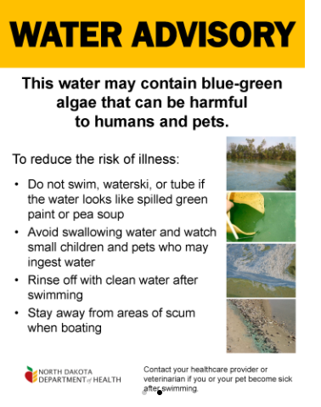
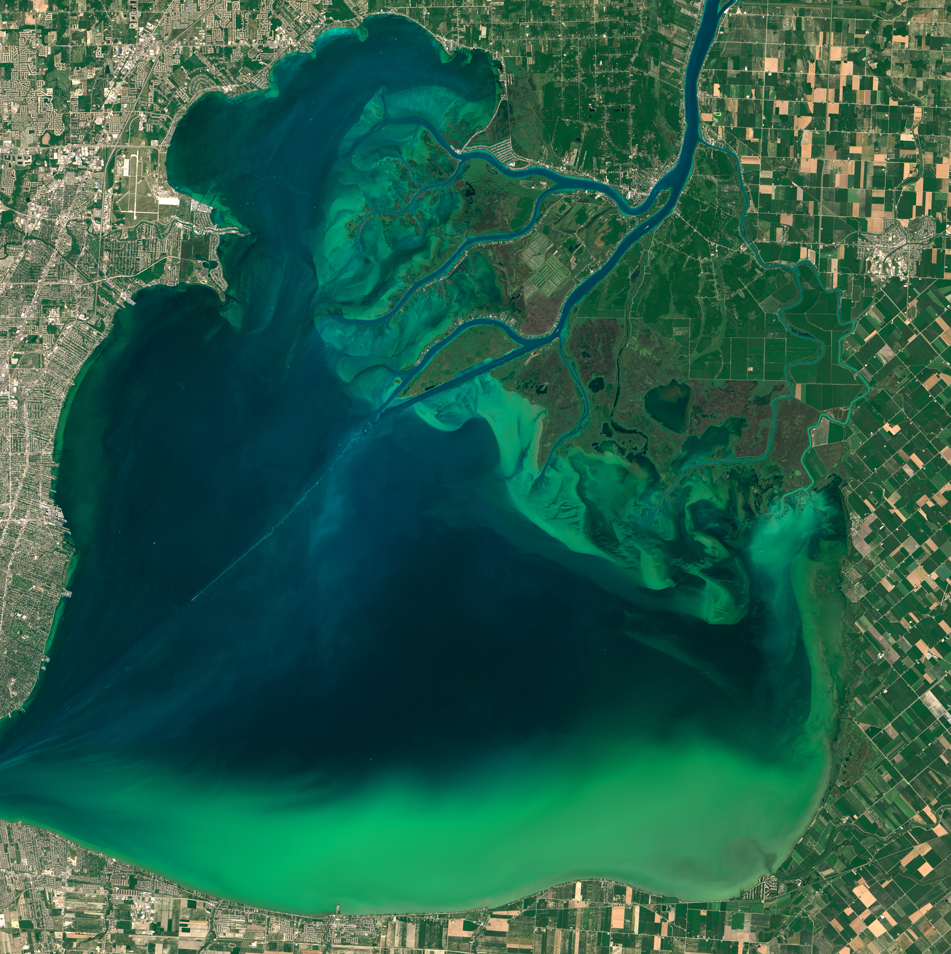
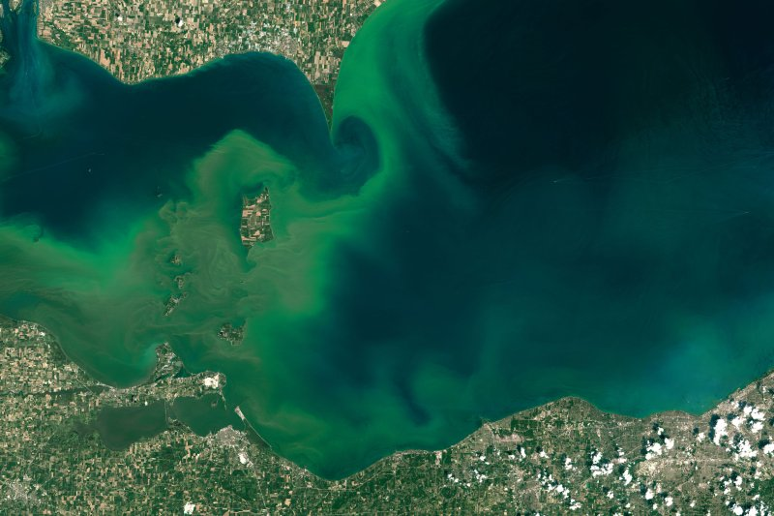

Slide 22
Harvesting Wild algae
Theoretically reduces capital cost upfront
Incentivizes cleaning up ponds and lakes
Impossible to control for optimal traits
Might be difficult to harvest co-products
Harvesting would be a challenge
  More surface area to cover
  Lower density

Slide 23
Limiting factors for expansion
Land use
  Where to put algae farms?
    Coast vs. desert
Nutrients
  Traditional fertilizers are finite
  Wastewater can mitigate to an extent
    Back to placement of farms
Water use
  Requires a lot of water
    Back to placement of farms

Slide 24
Questions?
[Name]
[Date]

