Slide 1

(in 1969)
accounting
Anne B. Bain, CPA
(also a 1972 movie by Woody Allen)

Slide 2


A little bit about Anne

Slide 3
Safety features
Overflowing ash tray (glass of bourbon got cropped out)
Rickety baby seat that couldn’t survive a crash into a marshmallow
Complete absence of seat belts
Front seat

Slide 4


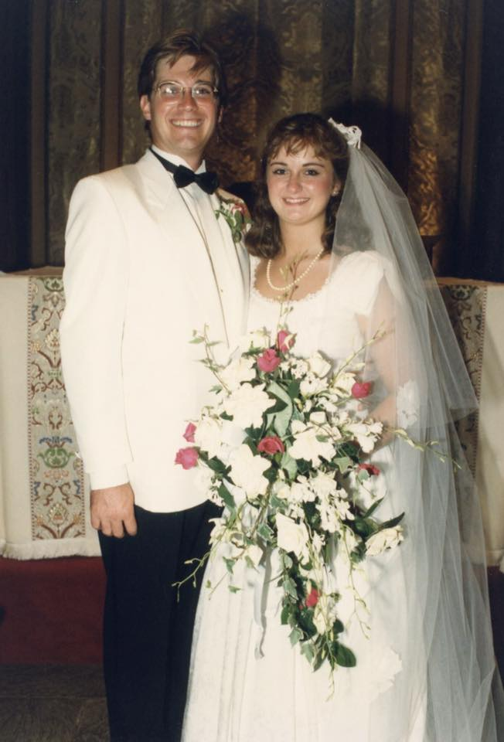




A little bit more about Anne

Slide 5




A little bit more about Anne
17 years as CEO, up to $30M in revenue, up to 250 employees

Slide 6
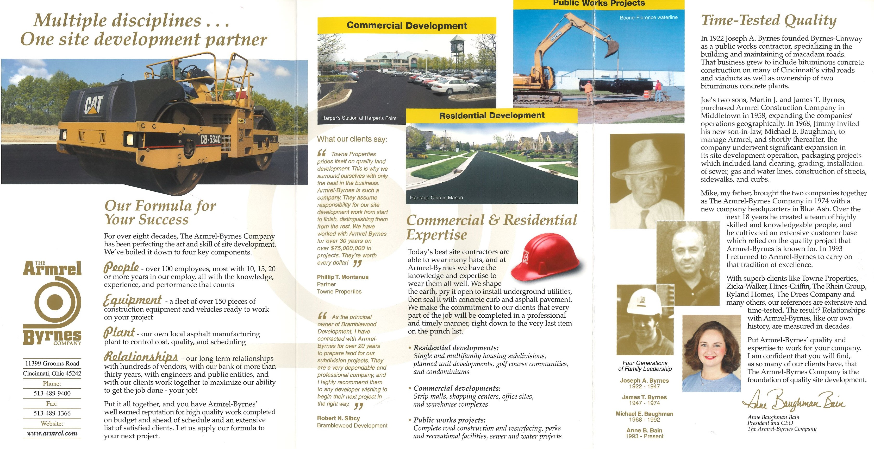
A little bit more about Anne

Slide 7



A little bit more about Anne
The Visiting Nurse Assn. of Greater Cincinnati & Northern Kentucky
Home Health & Hospice
And thank heavens for Kaiser …

Slide 8
because that’s how I ended up here!
[Name]
[Date]

Slide 9
Accounting vs. finance
Accounting – reporting on actual things that really happened (and making occasional educated guesses)
Finance – fabricating fantasies about the future (by making sometimes educated and sometimes wild-ass guesses)
Also, accounting is about the day-to-day flow of money in and out of an organization, and finance is a broad term for the management of assets and liabilities and the planning of future growth

Slide 10
Accounting
Financial Statements
  Balance Sheet -- a snapshot in time of where your company is as of a specific date, typically the end of a period (a month, a quarter, a year)
  Income Statement – more of a movie which tells the story (in numbers of course) of what happened during a certain period
  Cash Flow – where did your cash come from (sources of cash) and where did it go (uses of cash)
  Accrual Basis (vs. Cash Basis) – based on the “matching principle” where you put your costs and your revenues together in the same period of time
  Prepared according to GAAP – Generally Accepted Accounting Principles – a set of common rules that everyone follows so that you can compare one business to another

Slide 11
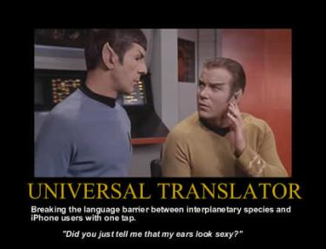
GAAP Accounting

Slide 12
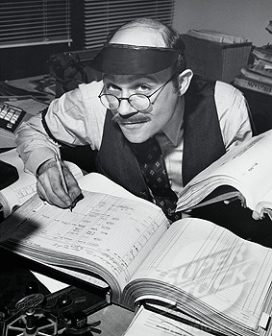
Accounting
Accountants like Ledgers
General Ledger
Accounts Payable Ledger
Accounts Receivable Ledger
Fixed Asset Ledger
Inventory Ledger
In software, we might call this a “Module”

Slide 13
Balance Sheet
ASSETS – what you have
LIABILITIES – what you owe
EQUITY (also CAPITAL) – what you are worth
Assets minus Liabilities leaves you with Equity
Assets = Liabilities + Equity

Slide 14
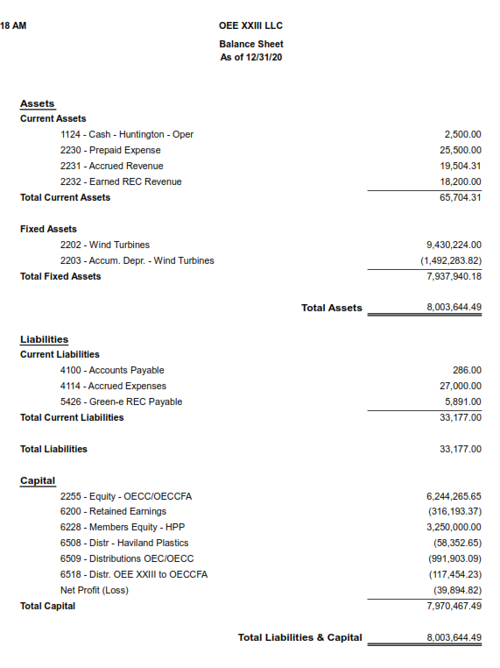
Balance Sheet
Within each section, line items are in order of liquidity – how fast we expect them to turn to cash
“Current” generally means within a year
“Long-term” generally means in more than a year
It is a BALANCE sheet, which means that it must balance – see how Total Assets = Total Liabilities & Capital

Slide 15
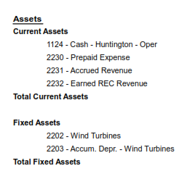
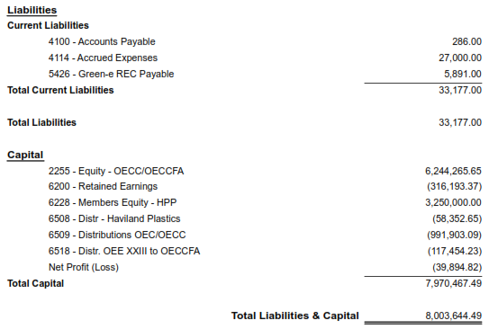
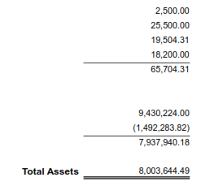
Balance Sheet
Another way to present a Balance Sheet if you don’t mind a landscape view

Slide 16
Income statement
Also called a “P&L” (Profit & Loss Statement) or a Statement of Operations – a summary of what happened over a period of time, usually a month, a quarter, or a year
REVENUE (or INCOME) – what you make
EXPENSES (or COSTS) – what you spend
PROFIT (also NET INCOME) – the difference between the two
Revenue minus Expenses leaves you with Profit (Loss)
Revenue - Expenses = Profit (Loss)

Slide 17
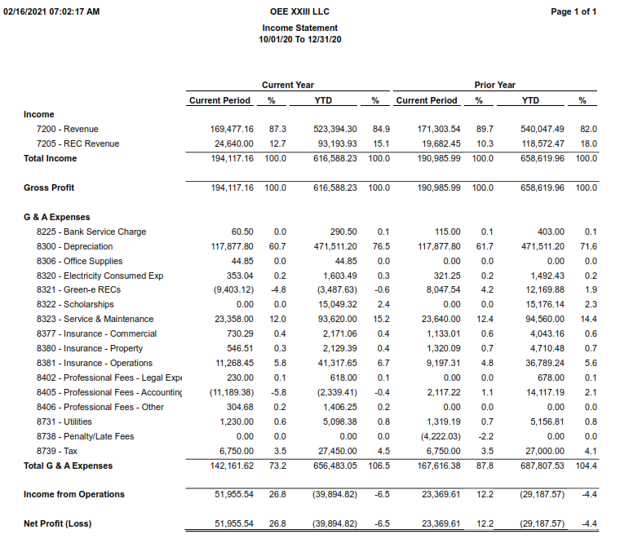
Income Statement – OEE XXIII

Slide 18
Income statement
Some other important terms:
Direct Costs (construction) or Cost of Goods Sold (more in manufacturing, retail) – a price that can be directly tied to the production of specific goods or services
Indirect Costs – costs that cannot be directly tied to production, often called “Overhead” or “G&A Expenses” (General and Administrative)
Gross Income, Gross Profit – this is Revenue less Direct Costs

Slide 19
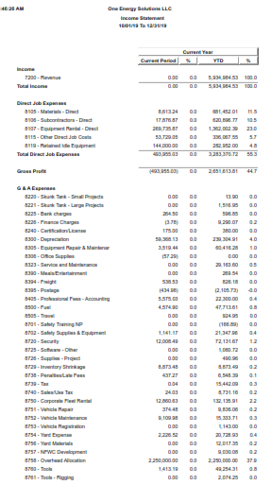
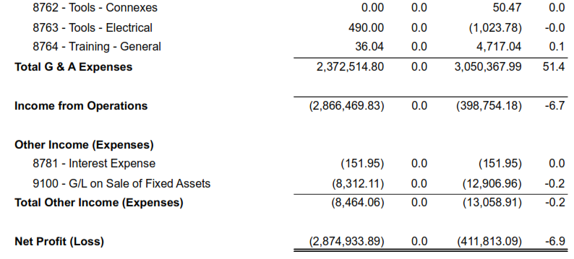
Income Statement - OES
Direct Job Expenses – when you code expenses to a job, they go here
Gross Profit – before we take any overhead (indirect) expenses into account
G&A Expenses – if you put a G/L code without a job number, chances are good it goes here
Income from Operations
Other Income (Expenses) – things that are not really part of our operations, like interest and the Gain (Loss) on the sale of assets (because we are not in the business of selling equipment … we just do it when we’re done with it)
Net Profit (Loss) – after everything is taken into account, even the “below the line” items

Slide 20
How do they tie together?

Slide 21
What’s an audit?
An outside CPA (Certified Public Accounting) firm verifies the integrity and accuracy of the financial statements
  Errors
  Fraud / Theft
  Internal Controls
Testing
Materiality Threshhold
PCAOB – Public Company Accounting Oversight Board
End result is an opinion – unqualified is as good as it gets (it’s all very anti-climactic)

Slide 22
finance
OK, so what is Finance?
Forecasting – predicting future performance based on assumptions that reflect conditions the business expects to exist and the course of action reasonably expected to be followed
Projection – also the prediction of future performance but based on hypothetical but realistic assumptions
Models – complex spreadsheets which allow the input and alteration of multiple variables to support the projection
There’s a fine line between optimism and fraud …

Slide 23
finance
Let’s look at the Closing Model for Rosemawr – Forecasts of the Fleet Alpha Projects’ performance

Slide 24

Accounting & finance
Sometimes, Accounting & Finance meet up … in a dark alley, both hoping no one sees them together …

Slide 25
Accounting & finance
Accounting involves estimates – depreciation is a common one:
Turbines, assume a useful life of 20 years, depreciate accordingly – so we build a $3M turbine and we “expense” it over 20 years, $150K/year, $12,500/month
Some are less common, and less straightforward
Asset Retirement Obligation – our obligation to remove (deconstruct) a turbine at the end of 20 years, often assuming that the turbine is on the customer’s land, not ours. A function of:
  The deconstruction cost (labor, equipment, etc.) in twenty years
  The “Net Present Value” based on interest rate assumptions (inflation)
  The value of the scrap metal salvages from the deconstruction

Slide 26
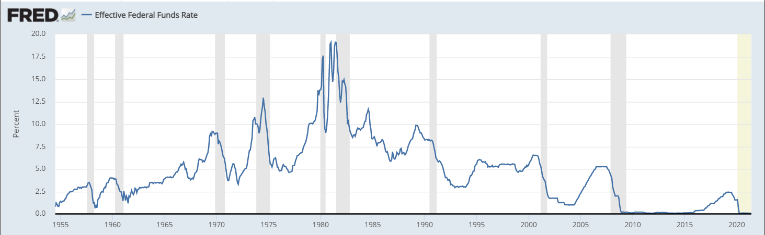
Net present value
Nearly every finance calculation involves “Net Present Value” – the current (present) value of a cash flow, dependent upon the interval of time between now and the cash flow and on the “discount rate” (interest rate). Often called “the time value of money.”
Jan 1981 = 19.08%
June 2021 = .08%
July 1965 = 4.09%
May 2012 = .16%
Oct 1989 = 8.84%

Slide 27
Asset retirement obligation – OEE XVII
Asset Retirement Obligation – our obligation to remove (deconstruct) a turbine often assuming that the turbine is on the customer’s land, not ours. A function of:
  The deconstruction cost (labor, equipment, etc.) in twenty years
  The “Net Present Value” based on interest rate assumptions (inflation)
  The value of the scrap metal salvages from the deconstruction
Let’s look at my model for that calculation

Slide 28
Entities & Ownership structure
OEE is the parent company which owns OES, OEC, and OECC (and more)
OEE
OEE OECC owns OECC FA, and OECCFA has ownership in each of the Fleet Alpha Projects
OES
OEC
OECC
OEC is the Manager of all the Projects
OECC Fleet Alpha
Projects 17 & 20
Fleet Alpha Projects 19, 23, 24, 25, 26, 28, 30
Each project has an outside investor (TIBE investor) who receives the investment tax credit (ITC) from the IRS, puts cash into the project up front, and receives ownership and cash distributions over the life of the Project
Outside (Third-Party Investors)

Slide 29
How does the cash flow?
OEE
OECCFA has to make a quarterly loan payment to Rosemawr (just like your mortgage) – then excess funds can be distributed up to OECC
OES
OEC
OECC
OECC Fleet Alpha
New Projects (Fleet Bravo?)
Projects 17 & 20
Fleet Alpha Projects 19, 23, 24, 25, 26, 28, 30
Rosemawr
Rosemawr lent money to OECC Fleet Alpha
Outside (Third-Party Investors)
NOTE: In this slide, size (of the arrows and the shapes) does NOT matter!

Slide 30
Debt vs. equity (in financing)
Debt – a loan, someone (a person, a bank, another type of financing organization) is lending you money that they expect to have paid back, with interest, over time – this goes in the liability section of your Balance Sheet and the interest is an expense
Equity – someone (a person, a venture capital or private equity firm, a SPAC and/or the public market) is giving you money in exchange for owning a part of your company – this goes in the Equity / Capital section of your balance sheet and proceeds disbursed back to the equity-holders are called “Distributions” in a Partnership or “Dividends” in a Corporation

Slide 31
Did we make any money?
“It depends” …
Cash?
Net Income?
Taxes?
Return on Investment?

