Slide 1
EMPLOYEE BRAND
and Style GUIDE

Slide 2
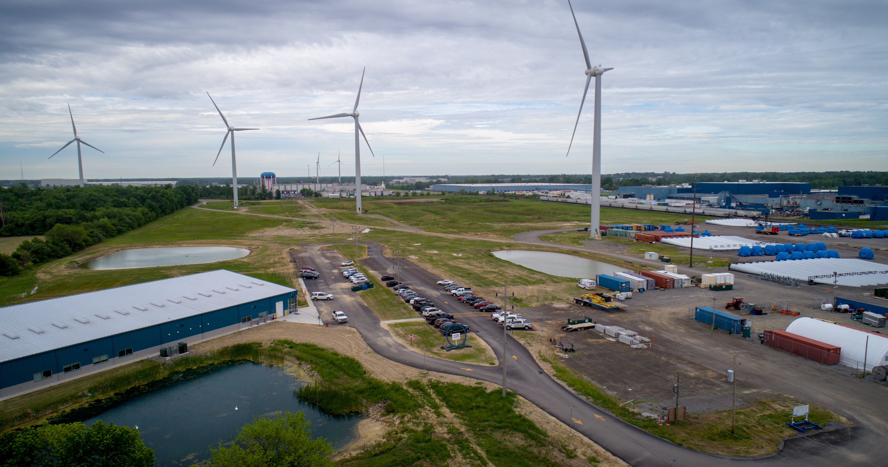
Overview
BRAND BASICS
COLOR USAGE
TYPOGRAPHY, FONT STYLES, AND TEMPLATES
COPY AND TONE
THE ONE POWER LOGOTYPES
EMAIL SIGNATURES
PHOTOGRAPHY
VIDEOGRAPHY
SOCIAL MEDIA

Slide 3
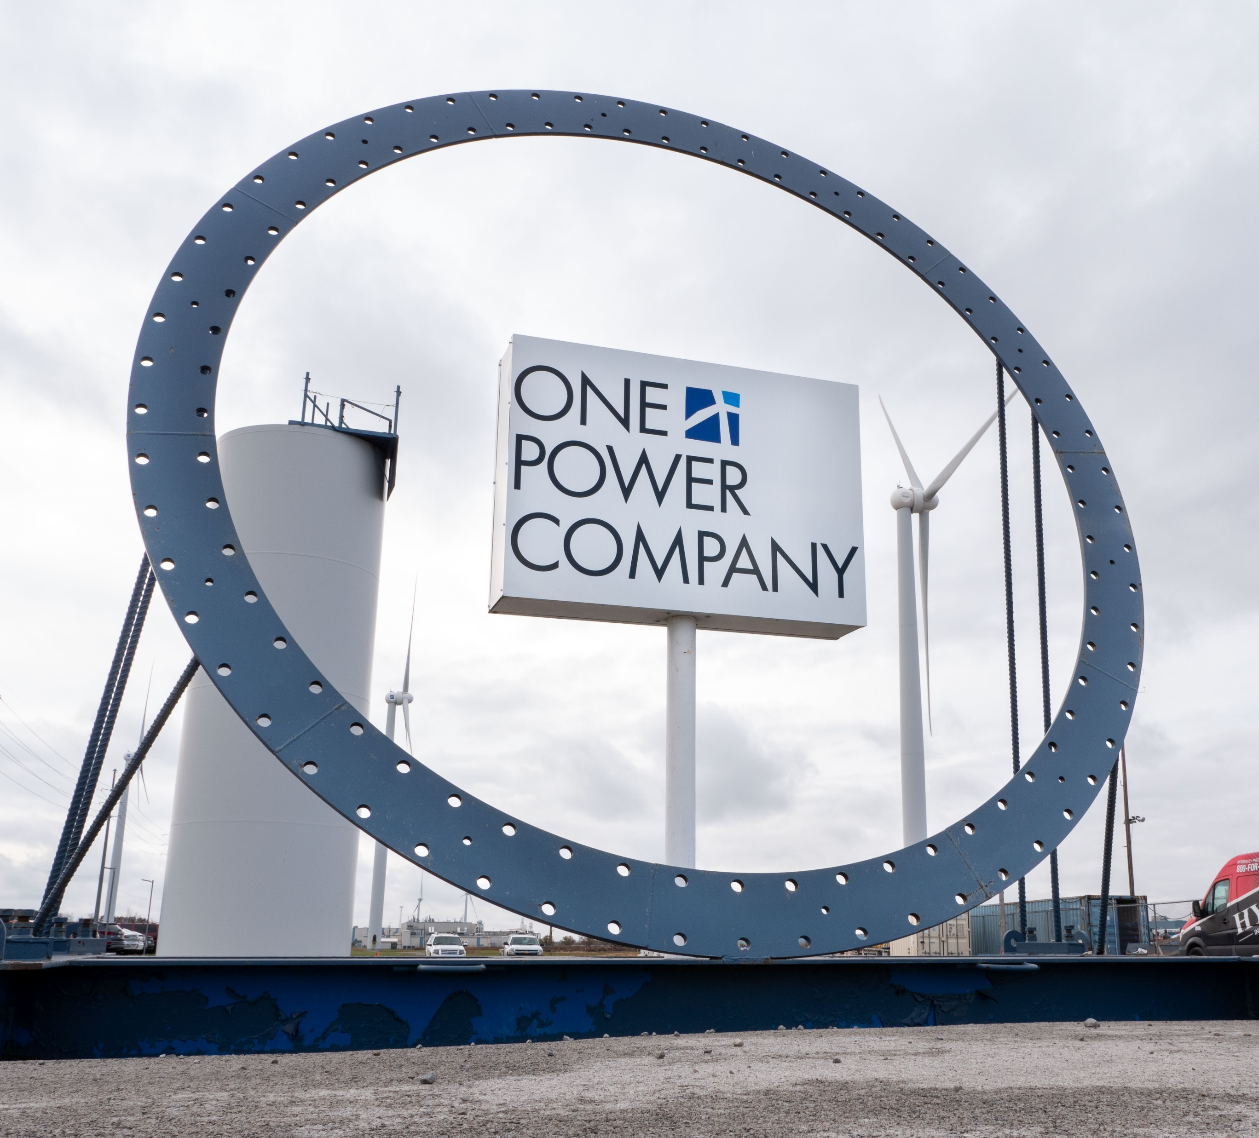
Brand Basics
What is a Brand?
Brand Description
Brand Positioning Statement
Tone

Slide 4
Color Usage
PRIMARY
OPC dark blue is front and center in this brand. It communicates a straightforward, professional tone. A different shade of blue is used when some variation is desired and/or when the material allows for a lighter, more playful tone. If a third, neutral color is desired, use white, black, or OPC gray.
RGB: 0/125/183
Hex: #007db7
CMYK: 100/32/0/28
Pantone: 3015
RAL: 5015
RGB: 102/103/105
Hex: #666769
CMYK: 3/2/0/59
Pantone: 431
RAL: 7005
RGB: 0/74/138
Hex: #00498a
CMYK: 100/46/0/46
Pantone: 2945
RAL: 5017

Slide 5
Color Usage
SECONDARY
A secondary palette helps add variety and is used to complement the primary palette. The green shades are used in the One Power Capital Corporation logos and are reserved primarily for finance-related materials.
RGB: 105/11/12
Hex: #690b0c
CMYK: 0/90/89/59
Pantone: 1815
RAL: 3011
RGB: 1/93/43
Hex: #04672e
CMYK: 99/0/54/64
Pantone: 349
RAL: 6001
RGB: 0/139/61
Hex: #008B41
CMYK: 100/0/53/45
Pantone: 355
RAL: 6037
TERTIARY
There is a tertiary color palette, that is reserved for instances when the six previous colors are not enough (for example, when many items need to be represented in a graph.) Please refer to the Employee Brand Guide.

Slide 6
Typography, Font Styles, and Templates
Primary Typography
CENTURY GOTHIC
AaBbCcDdEeFfGgHhIiJjKkLlMmNnOoPpQqRrSsTtUuVvWwXxYyZz
1234567890
Light
Light Italic
Book
Book Italic
Bold
Bold Italic

Slide 7
Typography, Font Styles, and Templates
Secondary Typography
PALATINO LINOTYPE
AaBbCcDdEeFfGgHhIiJjKkLlMmNnOoPpQqRrSsTtUuVvWwXxYyZz
1234567890
Light
Light Italic
Book
Book Italic
Bold
Bold Italic

Slide 8
Typography, Font Styles, and Templates
Font Styles
TITLE Century Gothic, 16 pt, bold, caps, OPC blue bottom border
MAJOR SECTION Century Gothic, 14 pt, bold, caps
Section Century Gothic, 12 pt, bold, OPC blue
Sub Section Century Gothic, 11pt, bold
ITEMIZED Palatino Linotype, 10 pt, bold
body text Palatino linotype, 10 pt, regular

Slide 9
Typography, Font Styles, and Templates
Templates
Microsoft Word Templates
In order to create a document with an OPC letterhead, use the following steps to add and access One Power approved templates in Microsoft Word.
Open a blank presentation in Word
Click “File” in the top left corner
Click “Options” at the bottom of the list on the left
Click “Save”
DON’T CLOSE ANYTHING
Go to your file explorer
Go to Dropbox (OEE)\Marketing - Approved Templates\Microsoft Word
Copy your file path (you can do this by clicking the long bar at the top to the left of the search bar)
Go back to Word
Paste your file path in the bar that says “Default personal templates location:” (it is in the middle right above the gray bar that says “Offline editing options for document management server files")
Click “OK”
Now when you open Word you can click on the “Personal” tab and the OPC templates should be there.
Note that there are a variety of templates categories available, even within the “Letterheads” folder – including OPC Analytics, OPC Capital, OPC Capital Corporation, OPC, and OPC Solutions. In most instances, employees will utilize the standard letterheads found in the “OPC” folder.

Slide 10
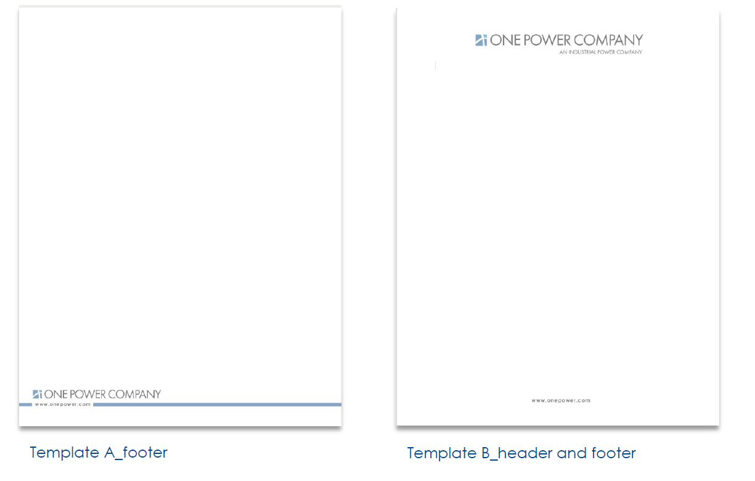
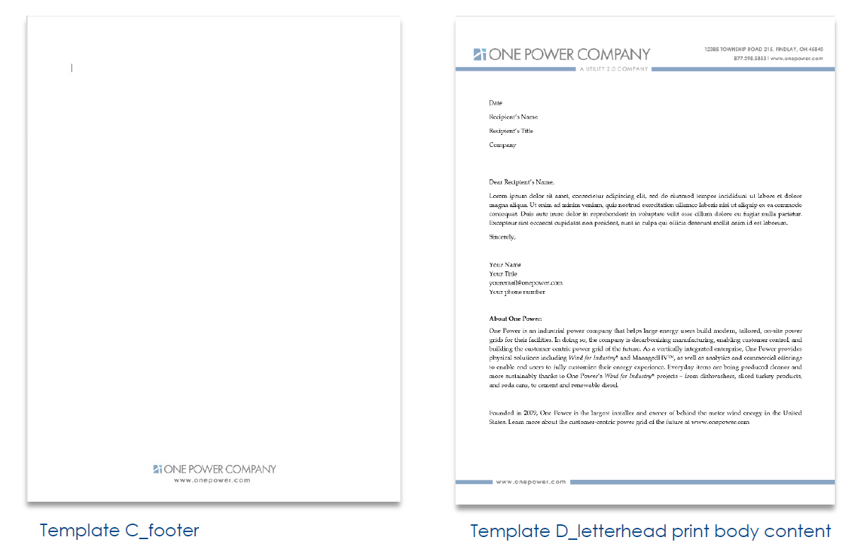
Typography, Font Styles, and Templates
Templates
Microsoft Word Templates

Slide 11
Typography, Font Styles, and Templates
Templates
Microsoft PowerPoint Templates
In order to create a presentation in an OPC format, use the following steps to add and access One Power approved templates in Microsoft PowerPoint.
Open a blank presentation in PowerPoint
Click “File” in the top left corner
Click “Options” at the bottom of the list on the left
Click “Save”
DON’T CLOSE ANYTHING
Go to your file explorer
Go to Dropbox (OEE)\Marketing - Approved Templates\Microsoft PowerPoint
Copy your file path (you can do this by clicking the long bar at the top to the left of the search bar)
Go back to PowerPoint
Paste your file path in the bar that says “Default personal templates location:” (it is in the middle right above the gray bar that says “Offline editing options for document management server files)
Click “OK”
Now when you open PowerPoint you can click on the “Personal” tab and the OPC templates should be there.

Slide 12
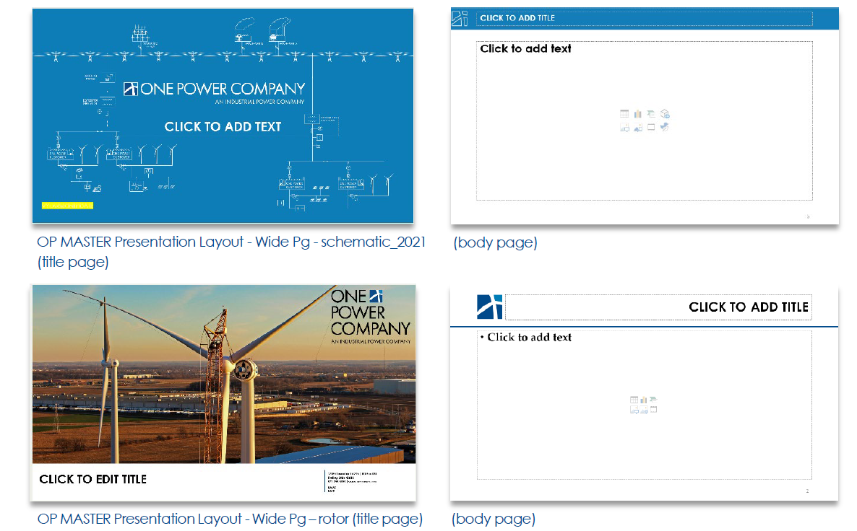
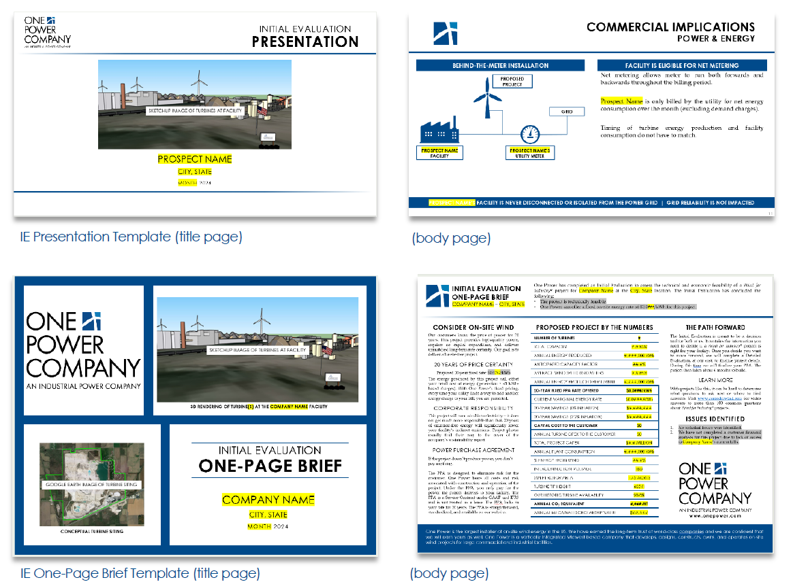
Typography, Font Styles, and Templates
Templates
Microsoft PowerPoint Templates

Slide 13
Copy and Tone
Commas
One Power uses serial commas, or the “Oxford comma” in our publications. When listing multiple items in a sentence, separate each item with a comma – including the final item before the “and” or “or.” For example,
Correct:
  The turbines were sited with consideration to existing infrastructure, such as residences, businesses, pipelines, powerlines, and microwave paths.
Hyphens
Hyphenate when multiple words are used as an adjectival phrase. For example,
Correct:
  utility-scale turbine
Punctuation and Quotation Marks
One Power places punctuation within quotation marks as a general rule.
Correct:
  “Renewable” is a good alternative, since we endorse wind as a “free and infinite fuel source.”

Slide 14
Copy and Tone
Frequently Used Terms and Acronyms
kilowatt (kW)
kilowatt hour (kWh)
megawatt (MW)
megawatt hour (MWh)
Meteorological (MET) tower
Power Purchase Agreement (PPA)
Renewable Energy Agreement (REA)
Wind Resource Assessment (WRA)
Project Performance Report (PPR)
Annual Energy Production (AEP)
Initial Evaluation (IE)
Detailed Evaluation (DE)
Project Due Diligence Package (PDDP)
Turbulence intensity (TI)
Wind speed (WS)
Wind direction (WS)
Measure-Correlate-Predict (MCP)
Original Equipment Manufacturer (OEM)
Goldwind (GW)
American Electric Power (AEP)
National Climatic Data Center (NCDC)
NASA’s Modern-Era Retrospective analysis for Research and Applications, Version 2 (MERRA-2)
Continuum®, Continuum® 2.0, etc.
Wind for Industry® - always italicize, always include superscript registered symbol
  NOTE: ALWAYS include the trademark symbol (®) UNLESS this statement is somewhere on the page/in the document: “Wind for Industry” is a registered trademark of One Power Company.
ManagedHV ®
$100,000
$3 million

Slide 15
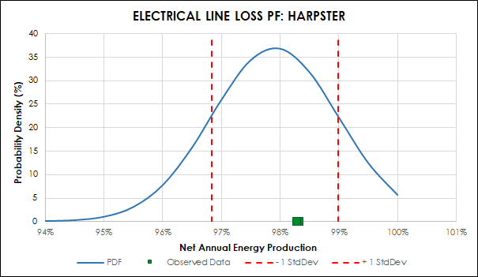
Copy and Tone
Graphs and Tables
Graphs and tables should adhere to OPC colors and typography when possible and when it makes sense. Century Gothic typeface with 9 pt. font is what has generally worked best in most OPC documents, but use your best judgement. Titles and headers should be center aligned, in all caps, and bold for both tables and graphs.
WIND TURBINE SETBACK KEY
Setback | Setback Distance | Applicable Setbacks
Blade-Length Setback | 150/160 feet | Property lines Railroads Low-traffic roads Local transmission (power) lines
Turbine-Clearance Setback (1.1 x maximum tip-height) | 445/455 feet | Customer-owned facility Underground pipelines High-traffic roads High-voltage transmission lines
Private-Residence Setback | 1,000 feet | Private residences Businesses
For graphs, axis labels should be in title case and bold, and all other copy in an appropriate case for the content and non-bold. In the example graph below, the header uses size 12 font to distinguish from the axis labels, and slightly brighter shades of red and green are used instead of OPC’s red and green, which would not contrast enough for the purpose of this graph.
Tables should follow the same guidelines as above, with major headers center aligned, in all caps, and bold; sub headers center-aligned, in title case, and non-bold; and table body content formatted appropriately based on the goal.

Slide 16
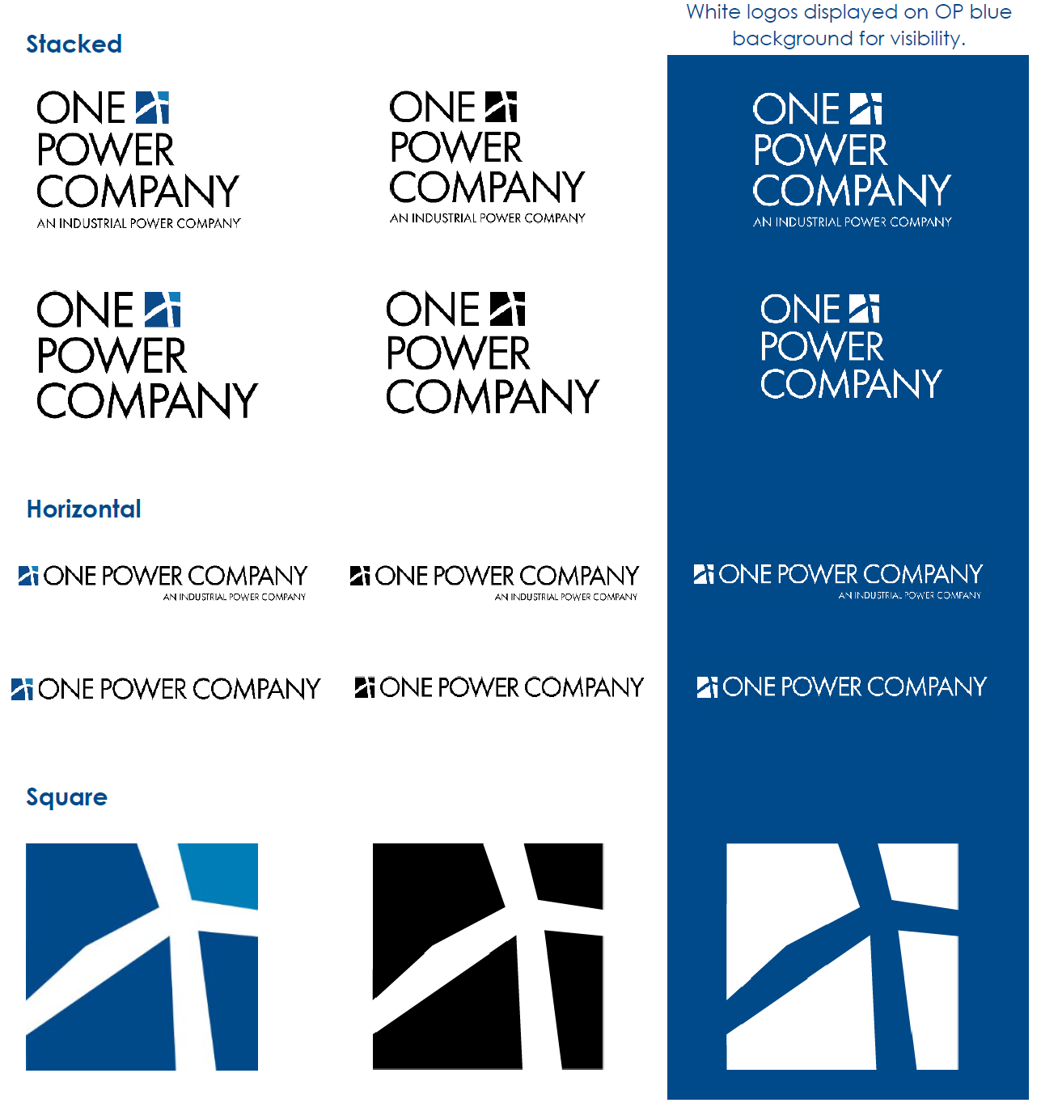
The One POWER Logotypes
The OPC logo has three formats (stacked, horizontal, and square) and three color variations (full color, black, or white).
The “An Industrial Power Company” tagline can be included or left out, and in some instances, the simple square logo is used.
These logos can be found in Dropbox at:
Dropbox (OEE)\Marketing - Approved Documents\Logos\Main Logos OE Enterprises Trademarked
Please note that One Power employs additional logos, including a “Wind for Industry®” logo (used when talking about our Wind for Industry® business line), and logos for One Power Analytics, One Power Solutions, One Power Capital Corporation, etc.
For now, the logo shown at right (referred to as the “Industrial Power Company” logo) is all you need to worry about. You can learn more in the OPC Employee Brand Guide.

Slide 17
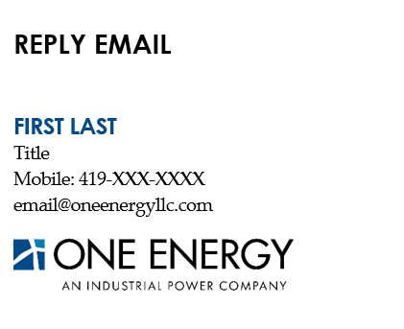

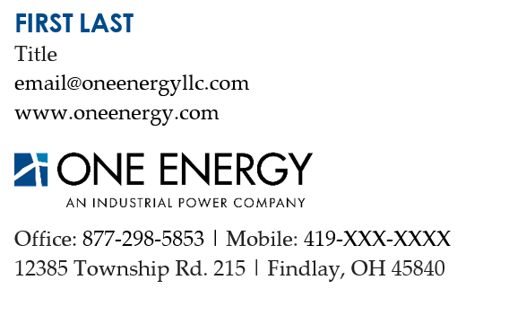

Email Signatures
A template to copy/paste these email signatures from can be found in Dropbox at: Dropbox (OEE)\Marketing - Approved Templates\Style Guide
INITIAL EMAIL

Slide 18
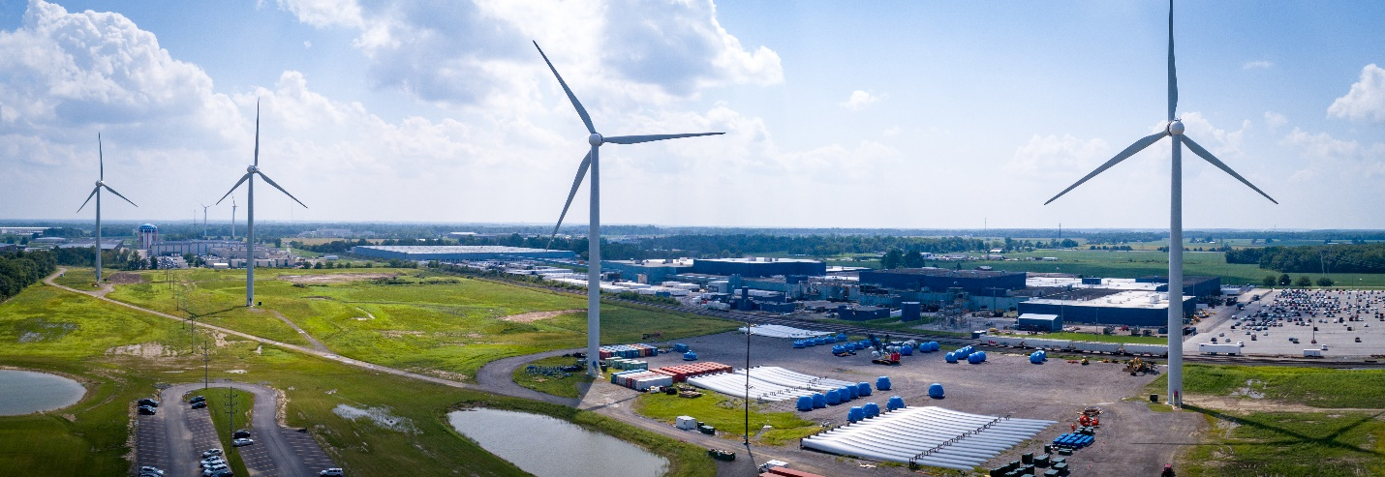
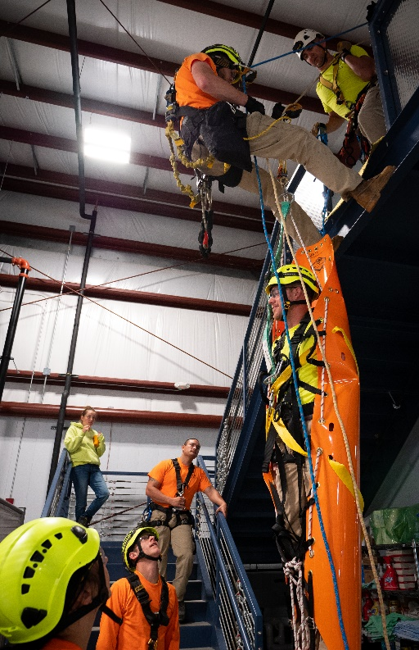

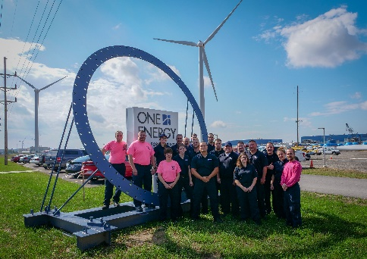

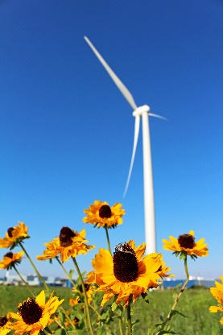
Photography
The photography style conveys One Power’s lighthearted and edgy, yet technical and sophisticated brand.
Photos taken at One Power cover the breadth of our vertically integrated company. Types of photos range from glamour shots of customer projects, to staged staff photos or NFWC visitors posing in front of our sign, to candid shots of construction sites or EMT training.

Slide 19
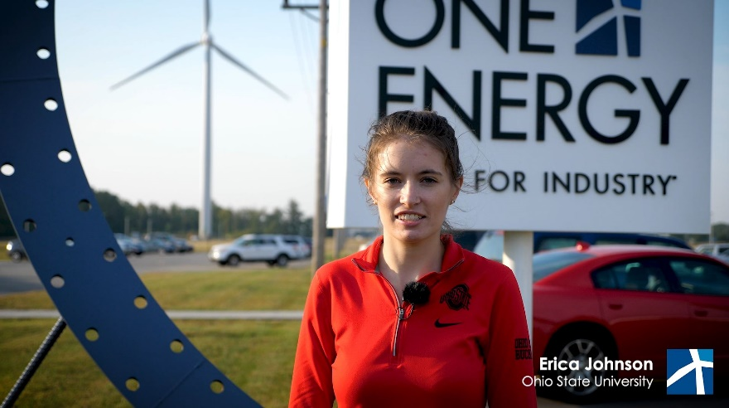
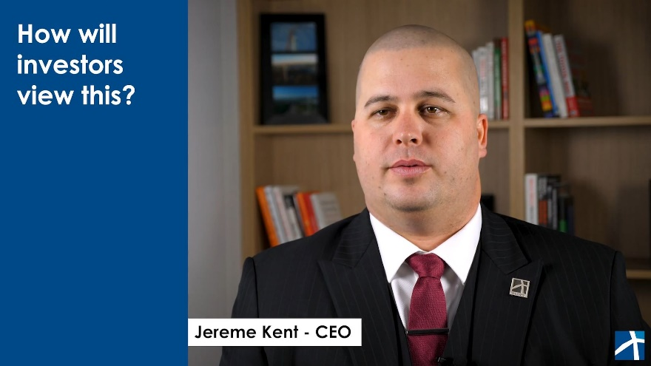
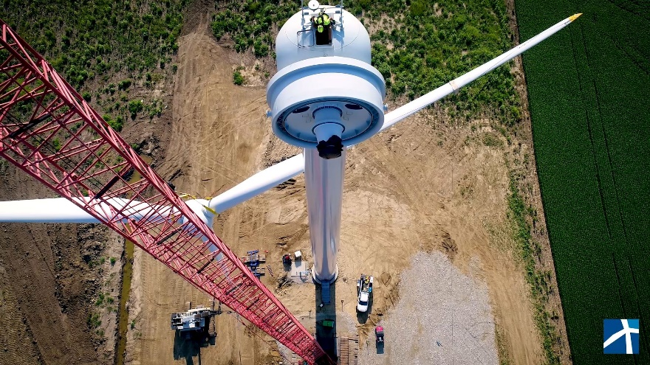
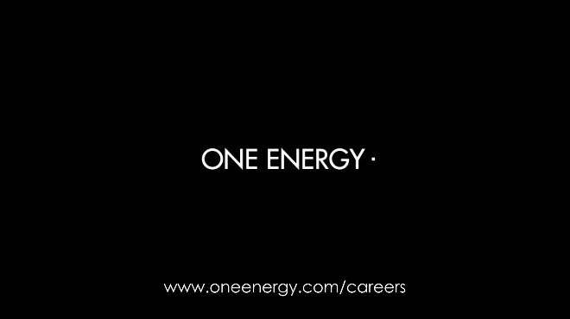
Videography
One Power makes videos for internal and external purposes. Categories of One Power videos include marketing, training, corporate, business development, social media, recruiting, and educational/informational. All One Power videos follow our corporate standard of quality.
ONE POWER COMPANY
www.onepower.com

Slide 20





Social Media
This section describes guidelines for posting as One Power, from one of our corporate social media accounts. Guidelines for employees posting about One Power from their personal accounts can be found on the intranet under Employee Resources > Guidelines and Policies.
Goals
Accounts
Voice and Tone
Words, Phrases, and Topics to Avoid
Good Post Examples
Guidelines for Visuals

Slide 21
QUESTIONS?

