Slide 1
Doubly Fed
VS.
Permanent magnet
Wind Turbine Generators
Lukas nelson
May 17, 2022

Slide 2


Wind power project Safety
Wind turbine generators are giant machines standing hundreds of feet tall that convert wind energy into electricity! Cool stuff right!?
These giant machines are no jungle gym folks.
Actually…F*** that! Yes, they are. Just be safe.
Access only when permitted.
Only perform work you are qualified to do.
Always stay vigilant when on a wind power project.

Slide 3
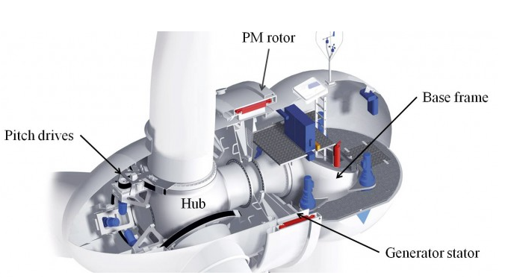
Utility Scale Wind turbine Generators PMDD
Permanent Magnet Direct Drive (PMDD)

Slide 4
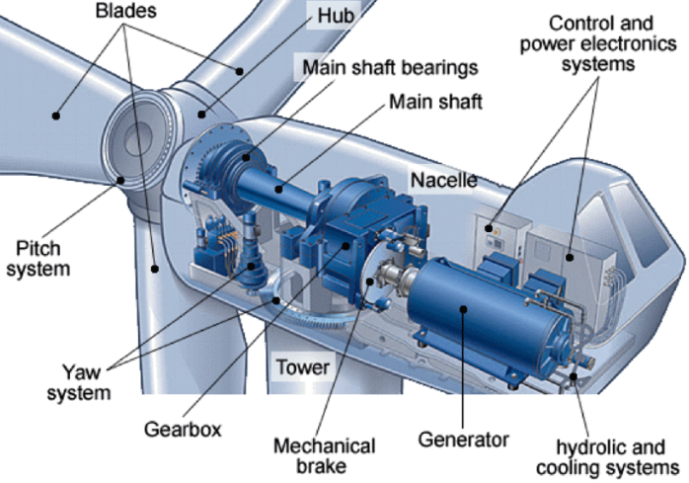
Utility SCALE Wind turbine Generators DFIG
Doubly Fed Induction Generator (DFIG)

Slide 5
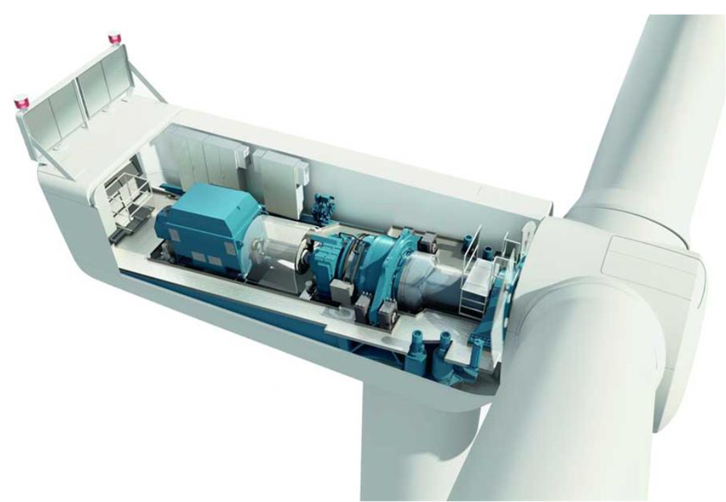
Doubly Fed Induction Generator (DFIG)
Electrical Layout
Drivetrain
Generator
IGBTs
High speed shaft

Slide 6
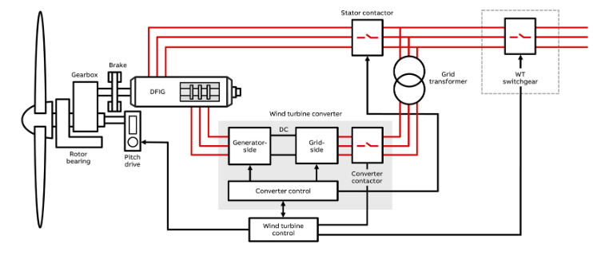
DFIG Electrical layout

Slide 7
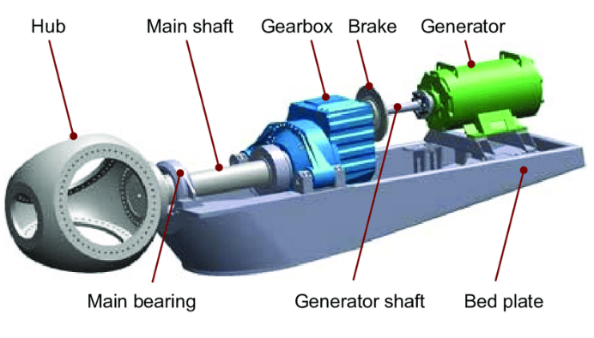
DFIG drivetrain

Slide 8
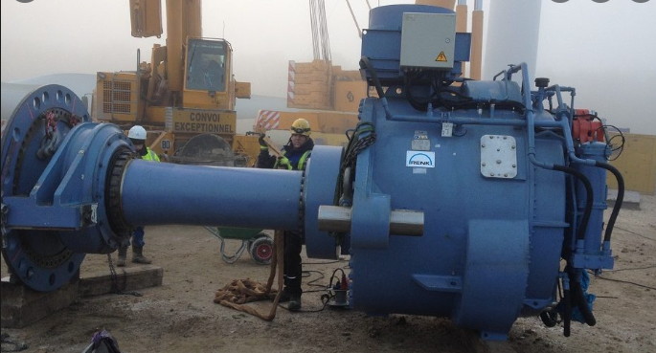
Main bearing - Low speed shaft- Gear BOX

Slide 9
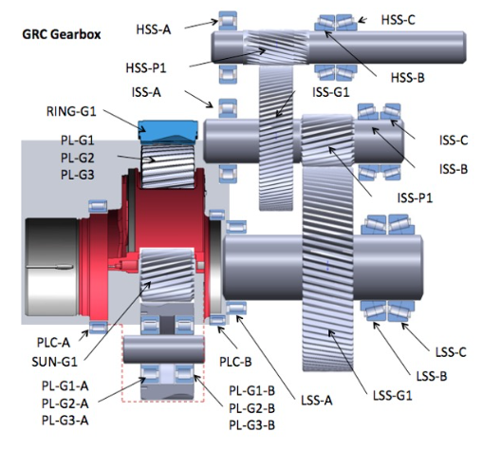
DFIG Gearbox

Slide 10
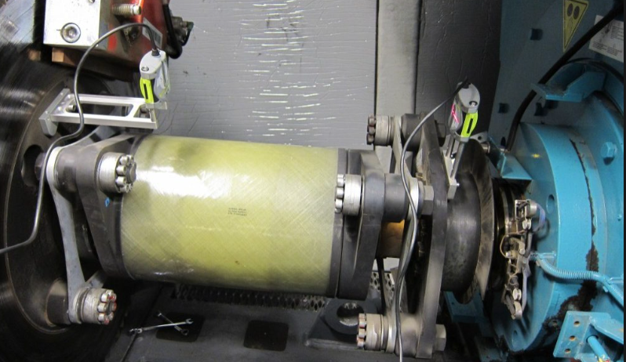
DFIG High speed shaft coupling

Slide 11
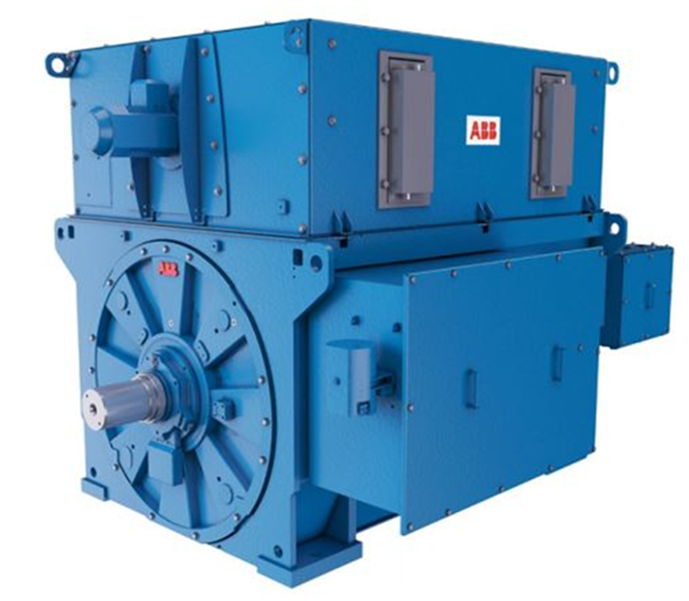
Dfig Generator
Rotor excitement required. Must induce voltage on to the rotor through a slip ring.
Equipment stress during low wind speeds as the gen-stator connection opens and closes frequently.
Auxiliary cooling system required.
Precise alignment with gearbox shaft required.

Slide 12
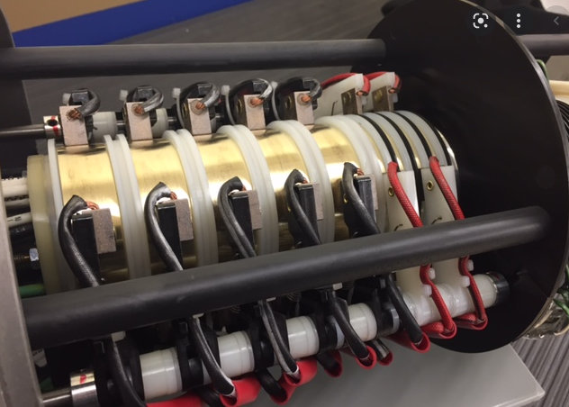
DFIG Converter/Generator ROTOR SLIP RING

Slide 13

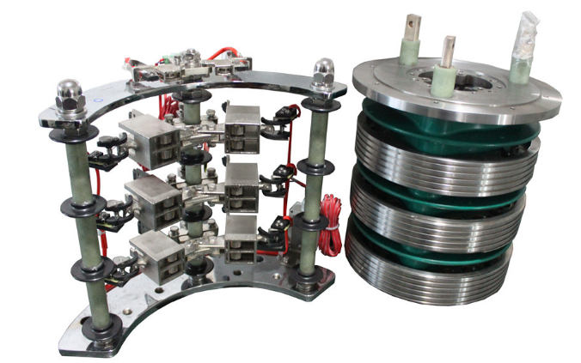
DFIG Converter/Generator Slip RING
Carbon Brushes (Converter Side)
Slip Collector Ring (Generator Side)

Slide 14
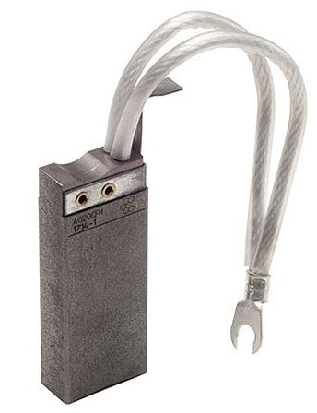
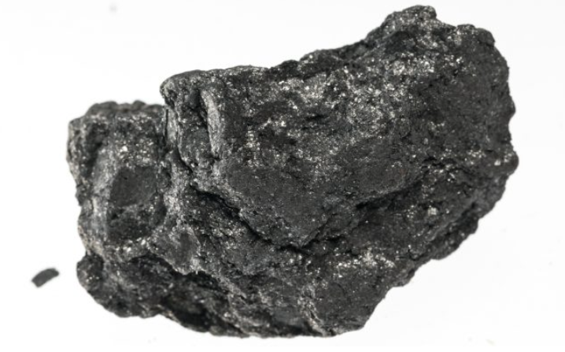
Carbon brush
Conducts electricity.
Made from graphite/carbon powder.

Slide 15
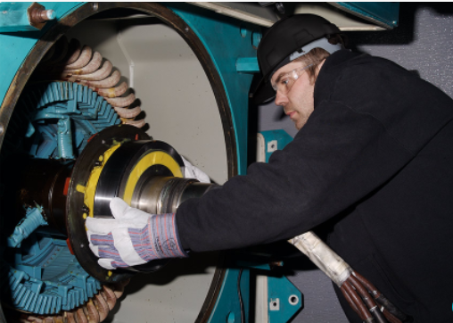
Generator Bearings
High speed bearings (2000rpm+) that require maintenance and replacement.
1 bearing on each side of the generator.
Require automatic lubrication.
Hot work required to replace.
8hr+ labor intensive job to replace.

Slide 16
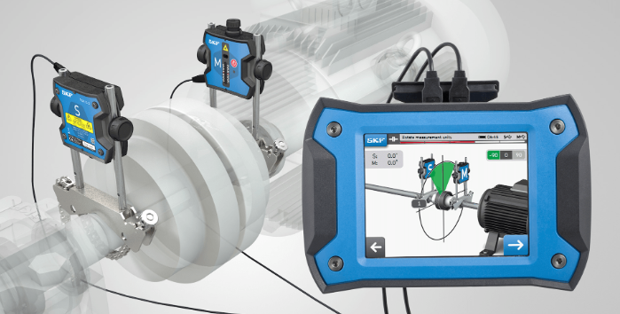
Generator alignments

Slide 17
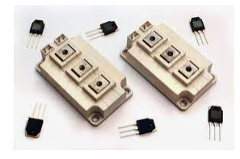
DFIG Converter iGBT
DFIG Converters induce current on to the rotor.
The DFIG converter corrects the sign wave of induction, as opposed to production.
Variable Frequency Drives are used.
Very complex to troubleshoot.
An insulated-gate bipolar transistor (IGBT) is a three-terminal power semiconductor device primarily used as an electronic switch. Has a gate, collector, and an emitter to correct the sign wave to meet grid frequency.

Slide 18
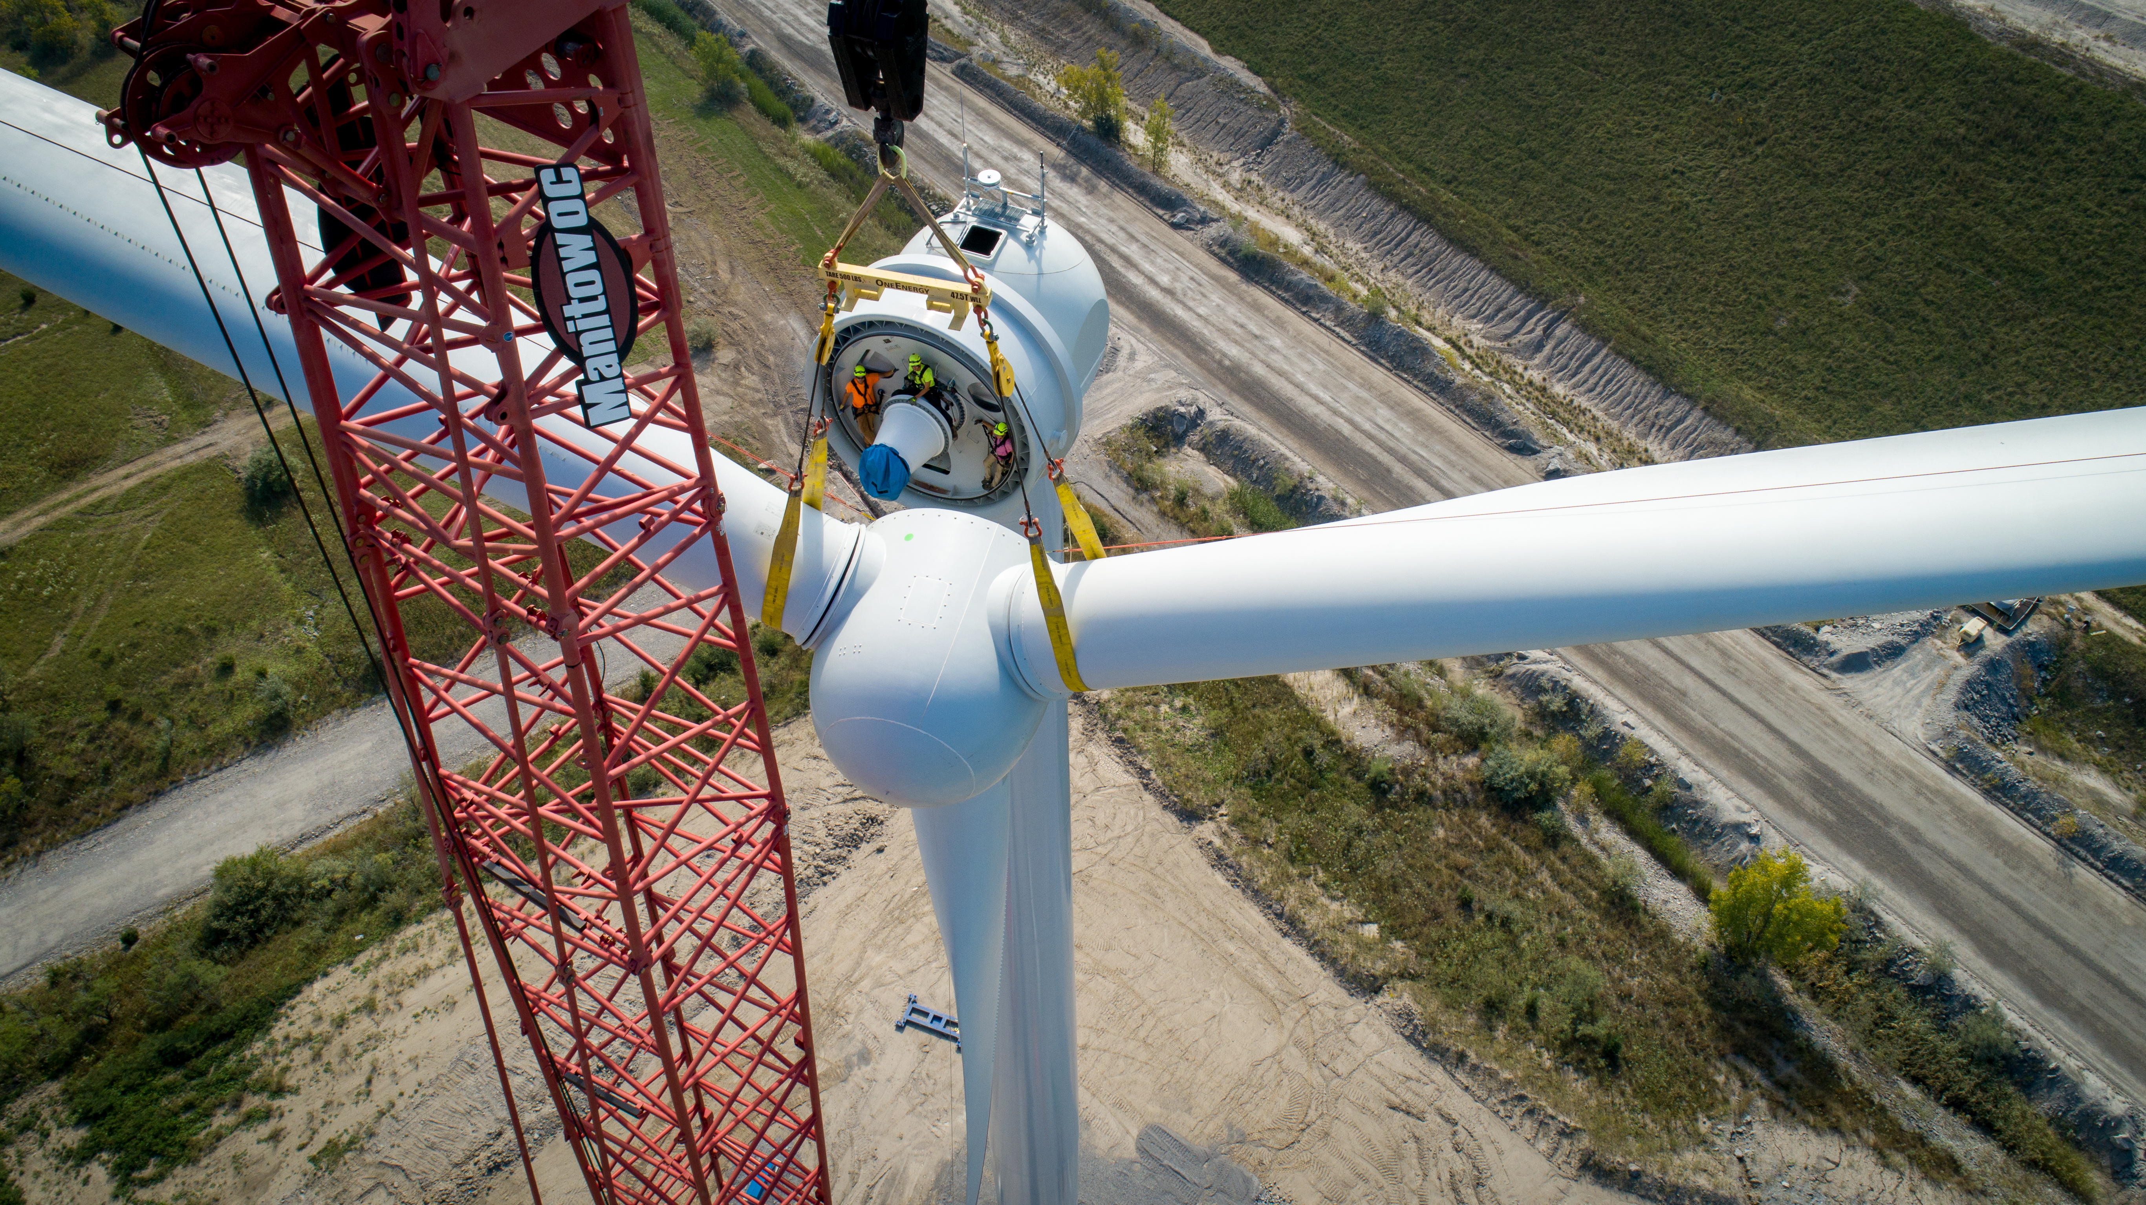
Permanent Magnet Direct Drive (PMDD)
Layout
Benefits
Generator
Converter
Things that suck

Slide 19
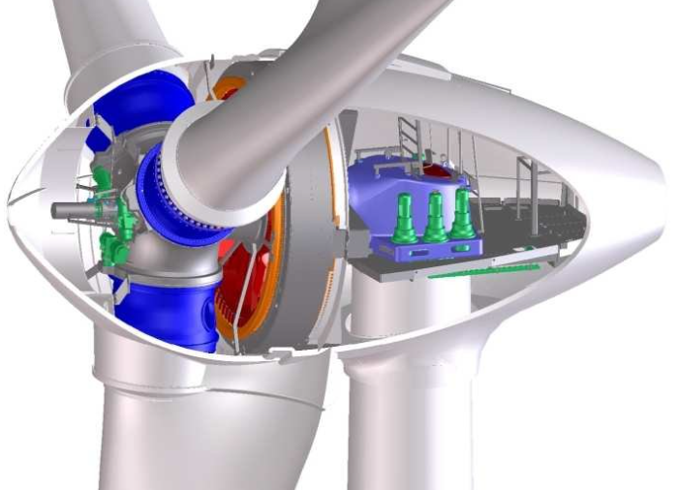
PMDD Layout

Slide 20
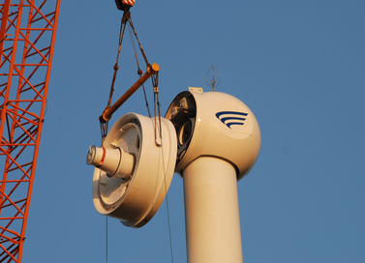
PMDD Generator Benefits
No gearbox needed.
Many eliminated rotating components in the nacelle.
Full power converter.
Better grid fault ride through.
Benefits: Initial component Costs, Installation, Preventive Maintenance, Replacement.

Slide 21
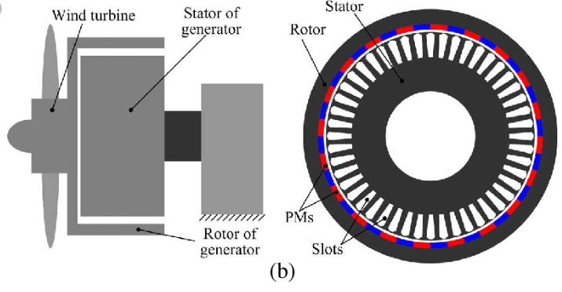
PMDD Generator layout

Slide 22
PMDD Converter
The converter is always working when the turbine is in operation.
IGBT for each phase of the generator.
IGBT for each phase of the grid voltage.
Large number of capacitors attached to each individual IGBT.
Older Goldwind models rectify(AC-DC) voltage after it comes through filters. New model IGBTs do all the work.

Slide 23
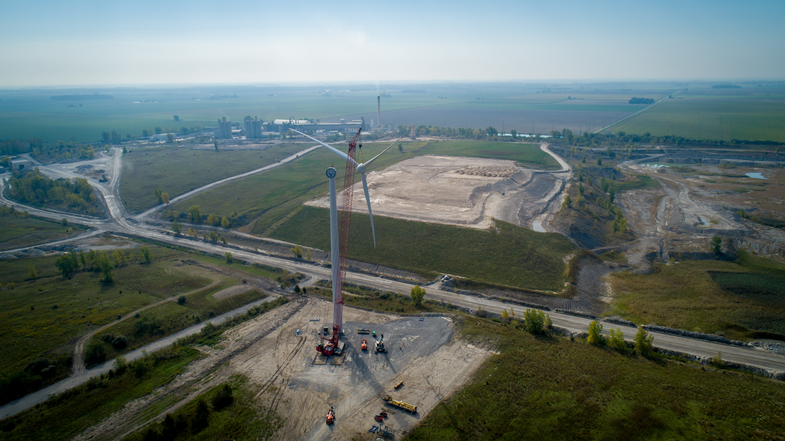
Things that suck about pmdd turbines
PMDD Wind Turbine Generators require rare earth metals that are primarily mined in other countries(China), and strictly controlled by them.
If the generator fails, you must remove the rotor first before replacing the generator.

Slide 24
QUESTIONS?
Lukas Nelson
05/17/2022

