Slide 1


TRENCHER GRADE CONTROL
Sourcing a Mountable Machine Control System for Buried Collection Line Trenching
12385 Township Rd 215 | PO Box 894
Findlay, Ohio 45840
877-298-5853 | www.onepower.com
SAM BLUM
24 JULY 2025
Notes:
Hi everyone, my name is Sam Blum.
My intern project for this summer was sourcing a mountable machine control system for our trencher, which we use for buried collection line trenching.

Slide 2
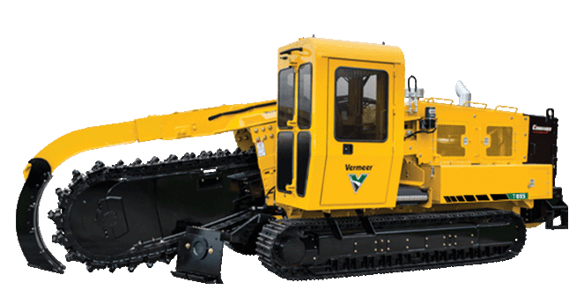
Agenda
Background
The Problem
Our Trencher
Our Current Solution
Our Desired Solution
The Three Vendors
SITECH Ohio
Measutronics
The Winner
Future Steps
Notes:
Here is a brief overview of what I will be talking about to you all today:
The first few slides will introduce our trencher and its current setup, as well as the problems associated with that setup.
I will then go over what we want to see in a machine control system for our trencher.
I will talk about the three different vendors we considered and detail the setups that they put together for us
Two companies offered us quotes, so I will go more in depth on their offerings
With everything laid out, I will go over who we decided will be “winner” aka our upgraded system of choice
Lastly, having chosen a machine control system, I will outline the next steps for the trencher

Slide 3
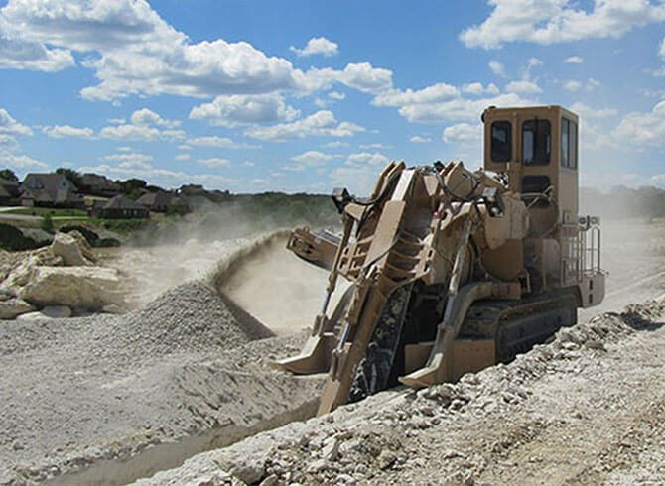
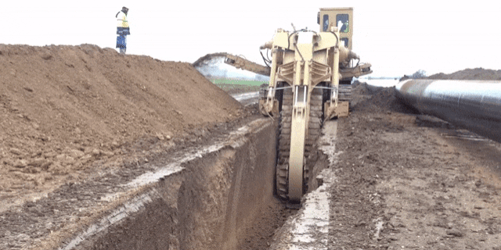
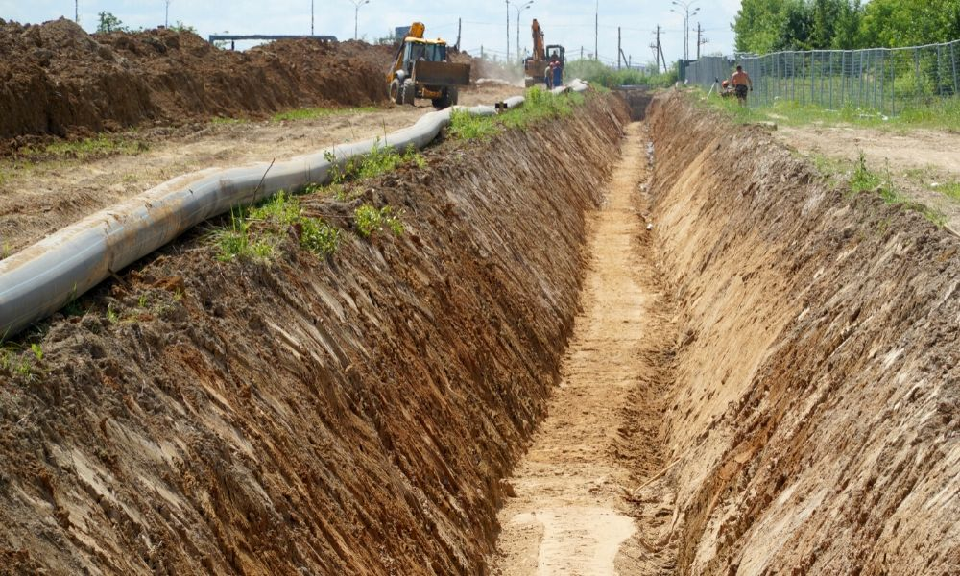
What’s a Trencher?
Heavy machine used to dig trenches
  Laying cable, cutting tree roots
Notes:
So, what exactly is a trencher? When I first got my intern project, I knew what a trench was, but wasn’t familiar with what a trencher was.
A trencher is a heavy machine that is used to DIG trenches in the ground.
It does so by scraping and tossing dirt using a chainsaw-like contraption that is angled towards the ground. This can be seen in the gif on the slides.
The result is a long narrow hole in the ground that is called a “trench”.

Slide 4
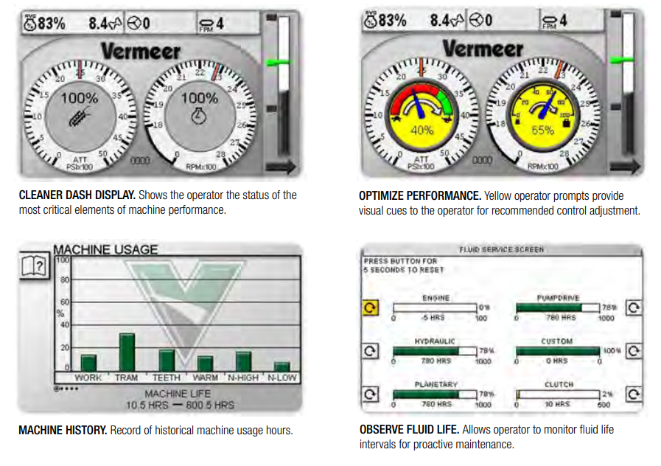
Background
One Power currently has a VERMEER T655 Ride-On Pipeline Trencher, equipped with the SmartTEC software.
SmartTEC software provides basic info:
Fluid life
Oil pressure and temperature
No information regarding vehicle location, trenching depth or history is provided.
Notes:
One Power currently uses a Vermeer T655 Pipeline Trencher to dig trenches for laying cable.
This trencher comes with a built-in software which provides the most basic information about the machine– stats about steering, hydraulic oil temperature, engine oil pressure, et cetera.
You can see in the image that the information and the way it is displayed onscreen is also pretty rudimentary, fairly basic. It’s not giving you any information about where the machine is in relation to its environment
There’s a lot of information that we want to know about the trencher that is missing here.
Using SmartTEC alone, all depth control and guidance is conducted manually, and subject to human error.
Laying electrical cable is an expensive process that requires the utmost precision, so an upgrade to the trencher that automates the surveying process will streamline the construction process as a whole.
Also, with an automatic control system, the driver can focus more on where he is going, rather than trying figure out where he even is.

Slide 5
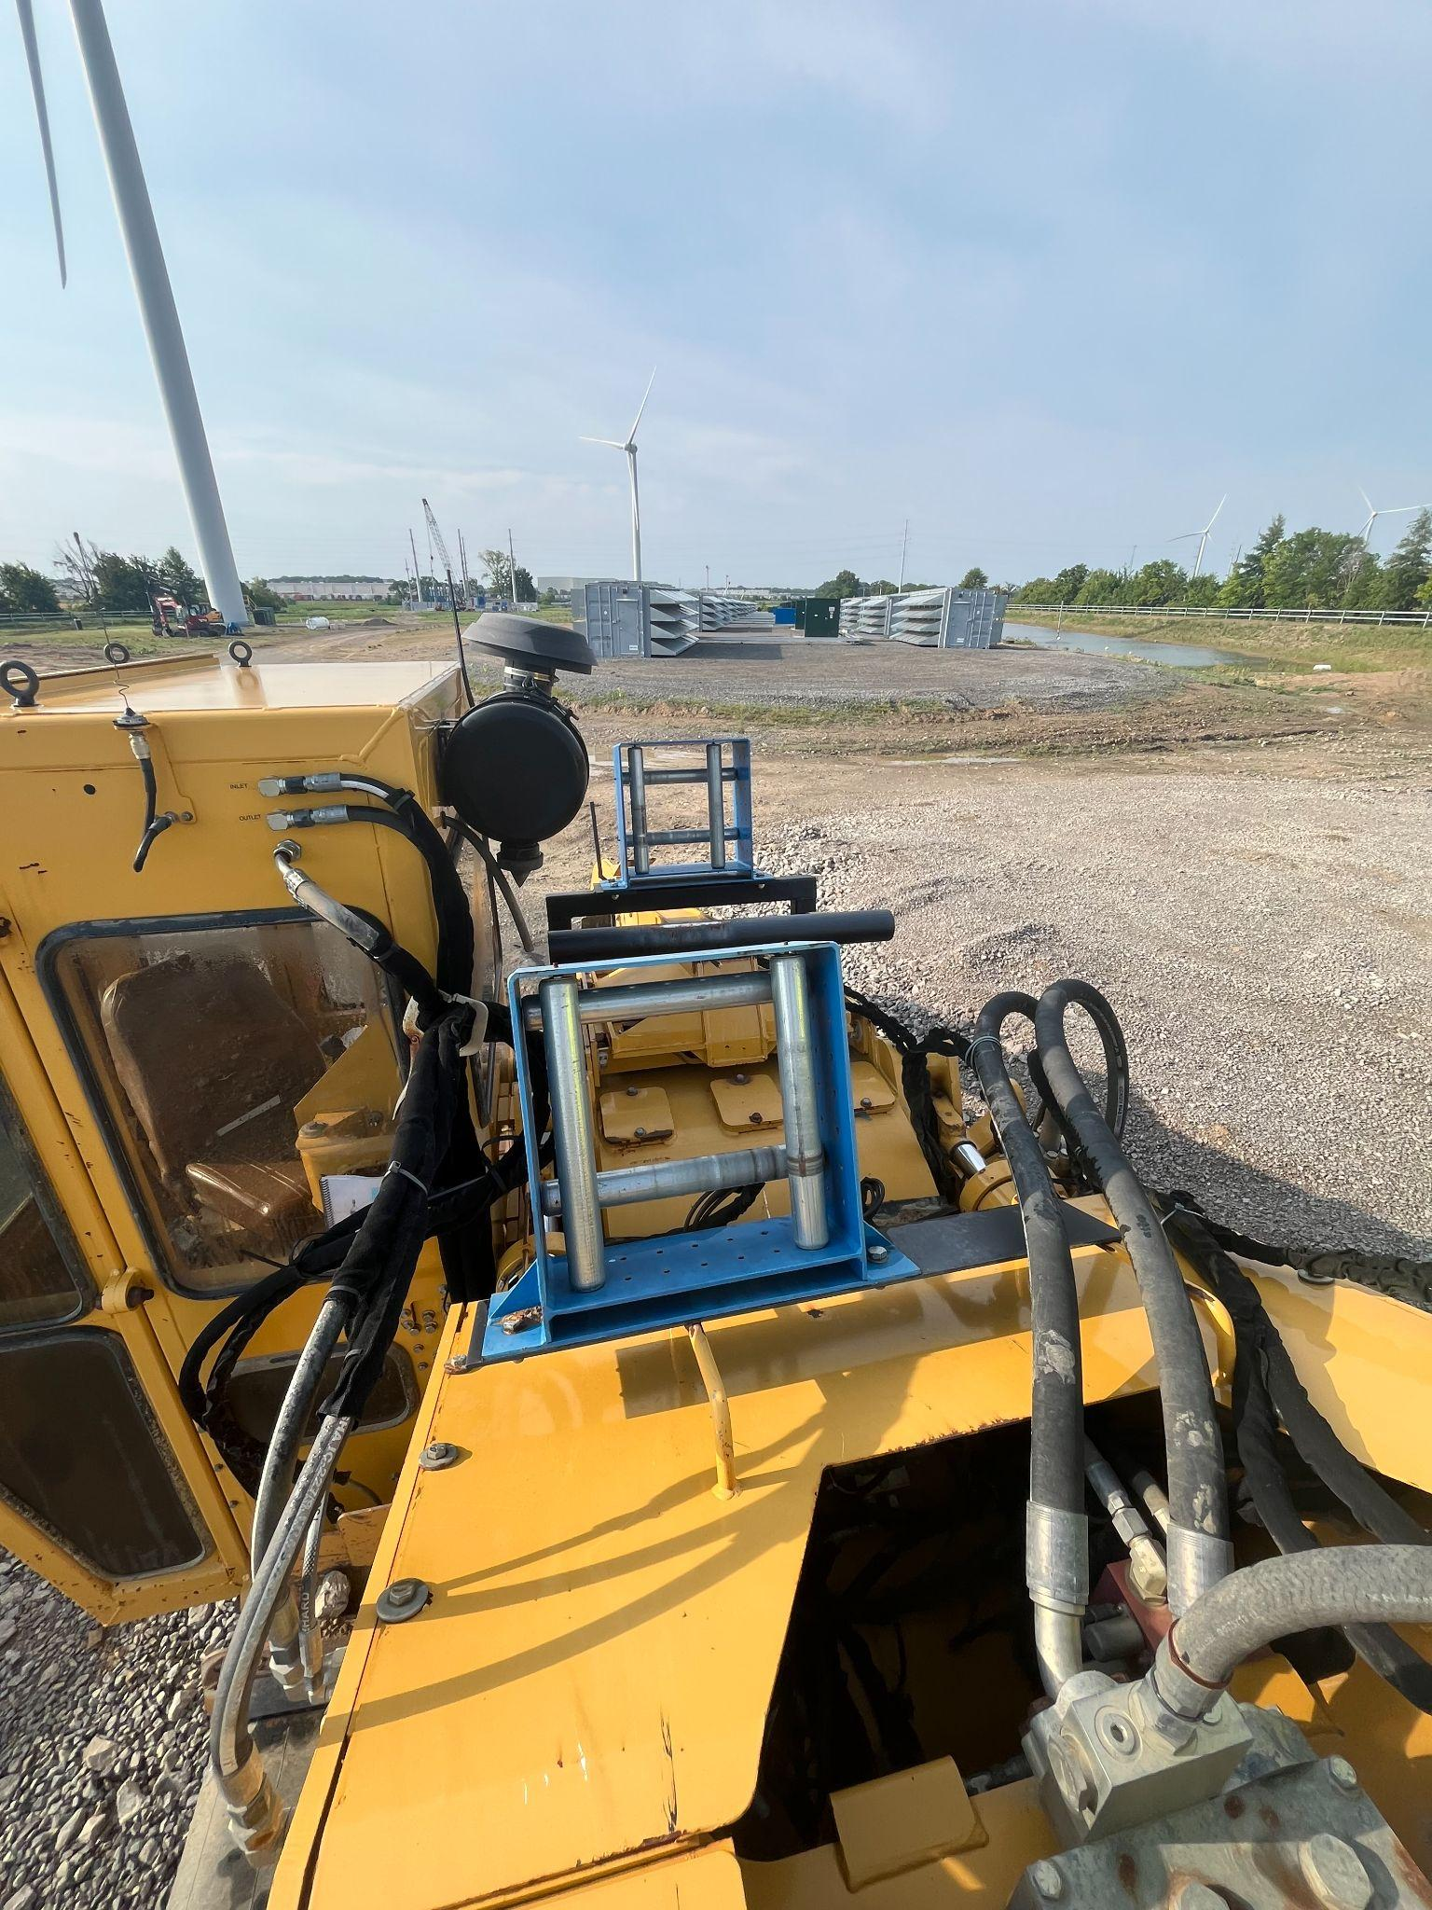
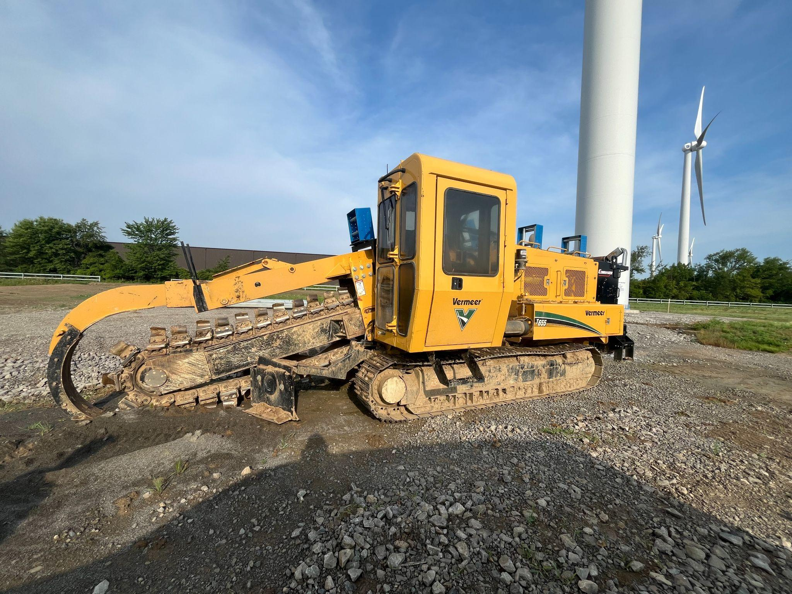
Our Trencher
VERMEER T655III Pipeline Trencher
One Power’s add-ons
Cab
Trencher attachment
Notes:
Here are some pictures of our Vermeer T655 Pipeline trencher.
In the right image, you can see the trencher with a trenching attachment on it. The cab is where the operator sits.
On the left, you can see the large brackets we have on our trencher that aid in trenching collection lines
You can see that the brackets span the body of the trencher and almost reach the trenching attachment.
Any sort of machine control setup would need to account for the extra equipment on One Power’s trenchers.
If we wanted to place sensors or receivers there, we would have to make sure we offset the readings of the sensor or receiver.
This means it is very important that whoever installs our sensors is experienced enough to take this into account!!

Slide 6
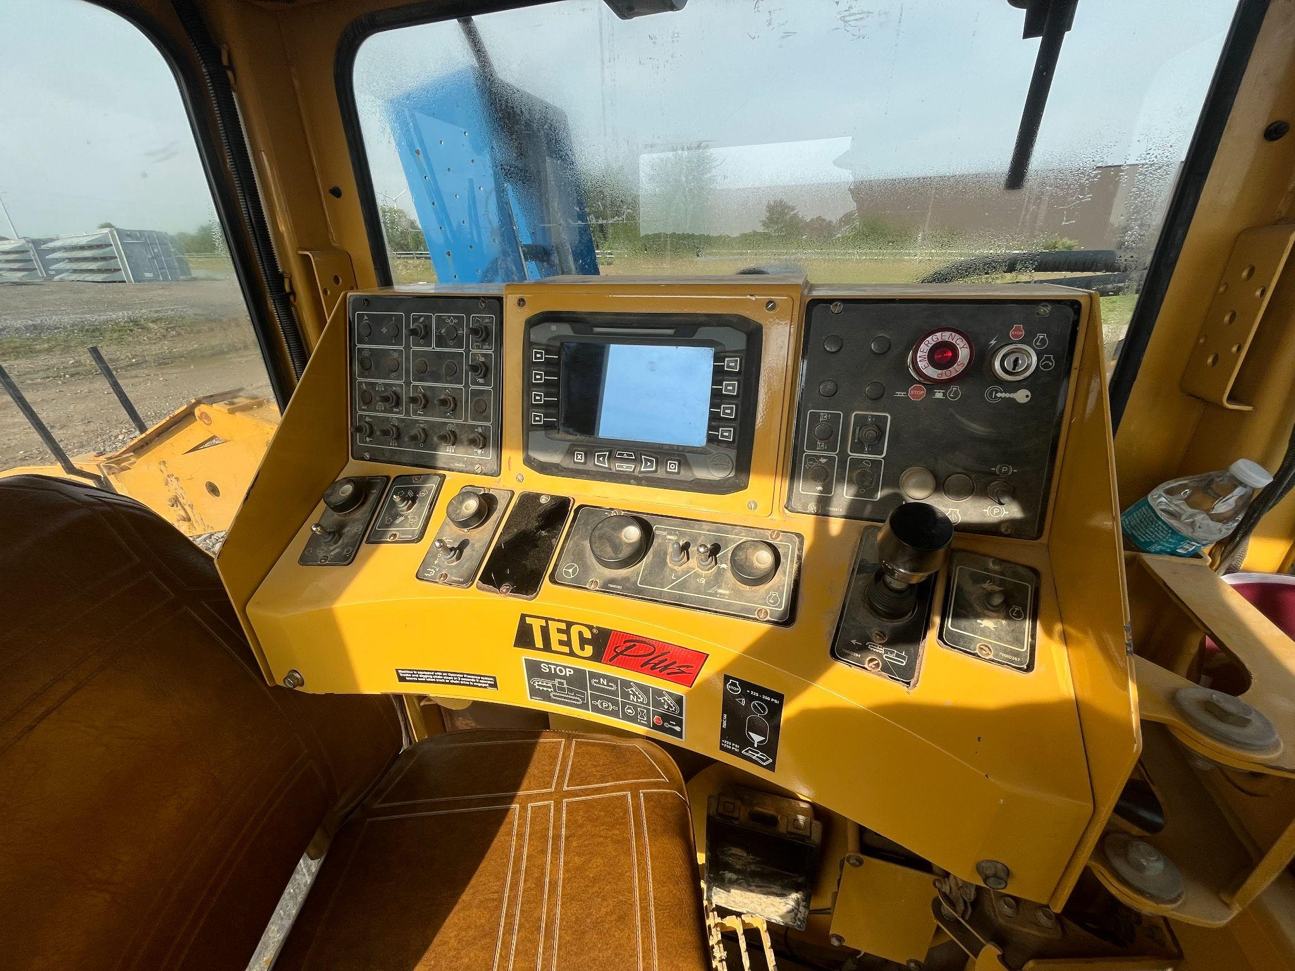
Our Trencher
Notes:
On this slide you can see what the inside of the trencher cab, where the operator sits, currently looks like.
As you can tell, the display is quite small.
Combined with the limited features shown by the SmartTEC software, shown on the LEFT, the information you’re getting about the trencher’s movements and position is really limited.
There’s a lot of room for improvement here

Slide 7
The Problem
One Power needs to keep GPS records of installed electrical line.
One Power needs a system that is:
Mountable
Tracks GPS points and depth in real-time
Data can be downloaded off machine
Why is this important?
Important for maintenance
2) Important if another entity is digging in the area
Notes:
One Power is in need of a trencher that can keep GPS records of installed electrical lines.
We want it to track location and depth as it is trenching.
Preferably, we also want to be able to upload and download files wirelessly from the Trencher.
Why do we need to be able to track the trencher’s depth and location? What does that accomplish?
BEYOND making the actual trenching process easier:
Having this system in place is important for maintenance purposes, as having GPS records lets us know exactly where we need to perform maintenance
It is also important if another entity is digging in the area; we can be aware of how close or far they are to our electrical lines and warn them accordingly.

Slide 8
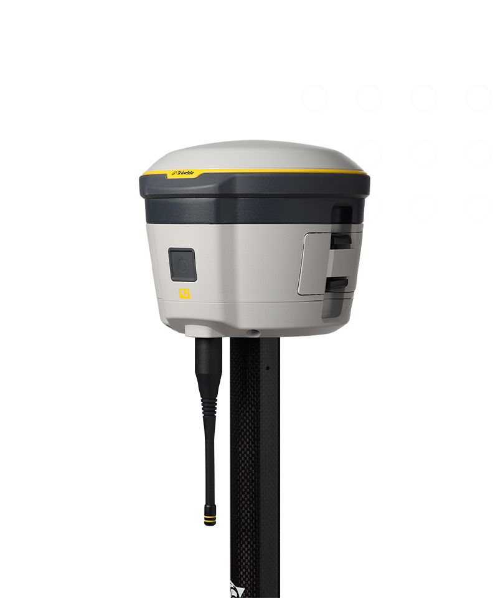

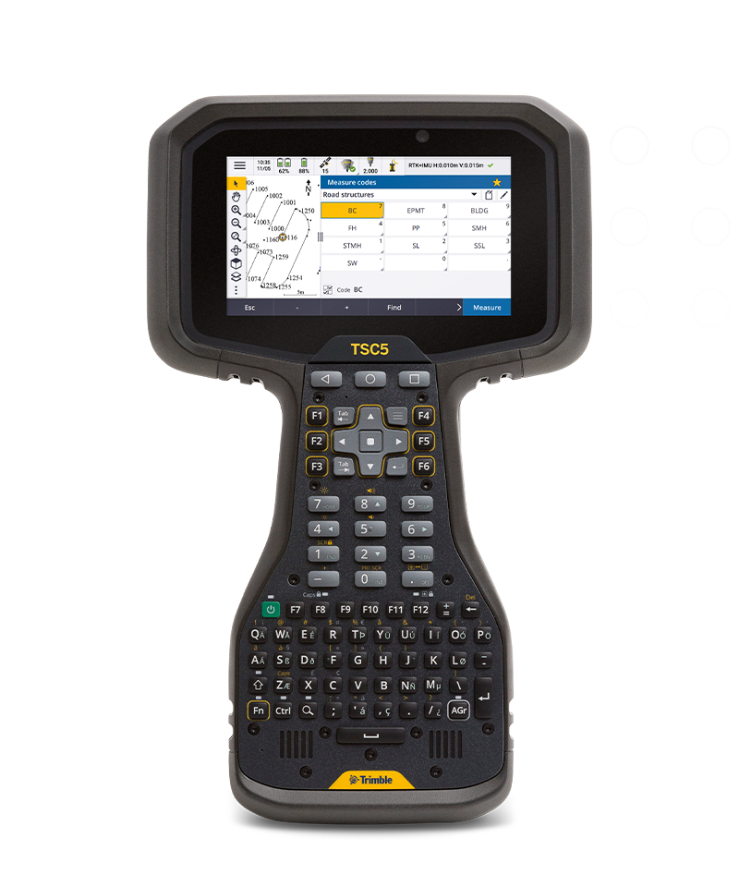
Our Current Solution
Current setup requires manual surveying of area prior to trenching.
Trimble R2
Communicates with to cell tower which talks to satellite
One person surveying
Need to use Trimble R2 receiver, TSC5 data collector AND cellphone to survey
USB connection to upload data
TSC5
Data Collector
Collects data from Trimble R2 using phone Bluetooth hotspot
Notes:
OUR CURRENT SOLUTION
You may be wondering how we currently manage to locate our trencher without an adequate machine control system.
As it stands, we have to manually survey the area prior to trenching using a Trimble R2 Receiver and a TSC5 data collector.
The Trimble R2 is a device that geolocates at a given point by communicating with a cell tower, which then talks to a satellite.
The TSC5 data collector collects data from the Trimble R2 Receiver via bluetooth provided by the user’s mobile phone
A surveyor has to use their mobile phone as a bluetooth hotspot while using the Trimble R2 and TSC5 to survey and collect data on the area that they will be trenching in.
They need to use 3 different devices, and go from point to point to measure depth and coordinates. Once they are done, they need to THEN upload that data manually via USB connection
AS YOU CAN IMAGINE, this is extremely tedious!!

Slide 9
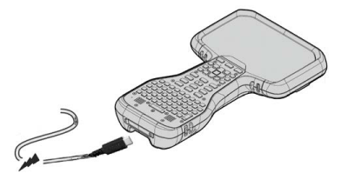
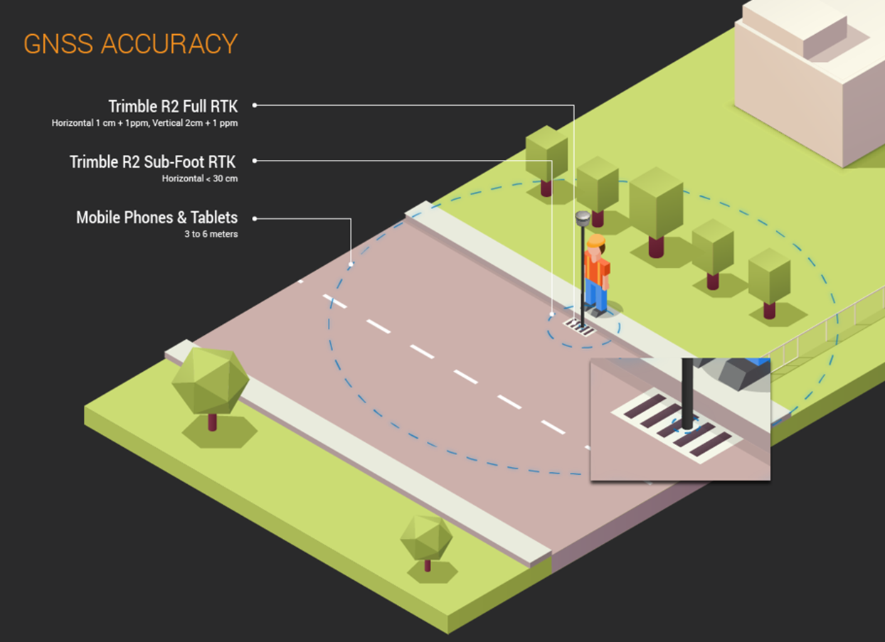
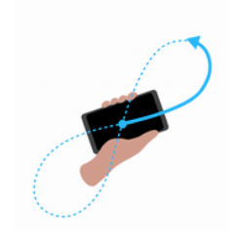
Our Current Solution
Trimble R2 Receiver and TSC5 Data Collector pinpoint location through directly signaling cell towers
Notes:
Any data collected has to be manually uploaded from the TSC5 data collector onto a computer. This process is not only tedious BUT time consuming too.
Additionally, as a human is the one doing the surveying manually, there’s a lot of human error that’s introduced into the equation as a result.
Another source of inaccuracy comes from the fact that the Trimble R2 Receiver and TSC5 Data collector are moving targets that get information from signalling cell towers directly.
That means if trees or buildings are in between the Trimble R2 receiver and cell tower, or the cell tower and data collector, then the signal can get interrupted.

Slide 10

Our Desired Solution
Our desired machine control system for the Vermeer trencher is:
Safe
Customizable
Robust
Accurate
Notes:
Having gotten all of that background out of the way, we can now delve into what we would like our desired solution to look like.
We want a safer and more accurate setup than what we currently have.
This means we want to eliminate the need for an on-the-ground surveyor by having the machine control system do the geolocating itself.
We want the system to be customizable, in that we can upload any sort of custom 3D line path for the machine to trench.
We need the system and its components to be robust. The trencher is not going to be driven on level ground, so the sensors and receivers need to be able to withstand more shock and vibration than a normal Trimble R2 receiver or TSC5 data collector would.
And of course, we would like the setup to be able to GPS track the trencher location and trenching depth in real time.

Slide 11
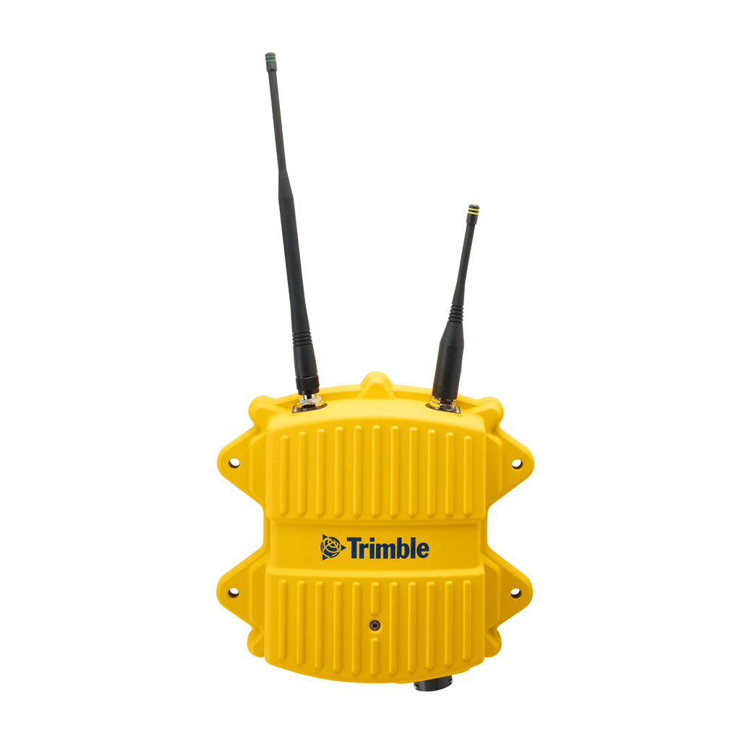
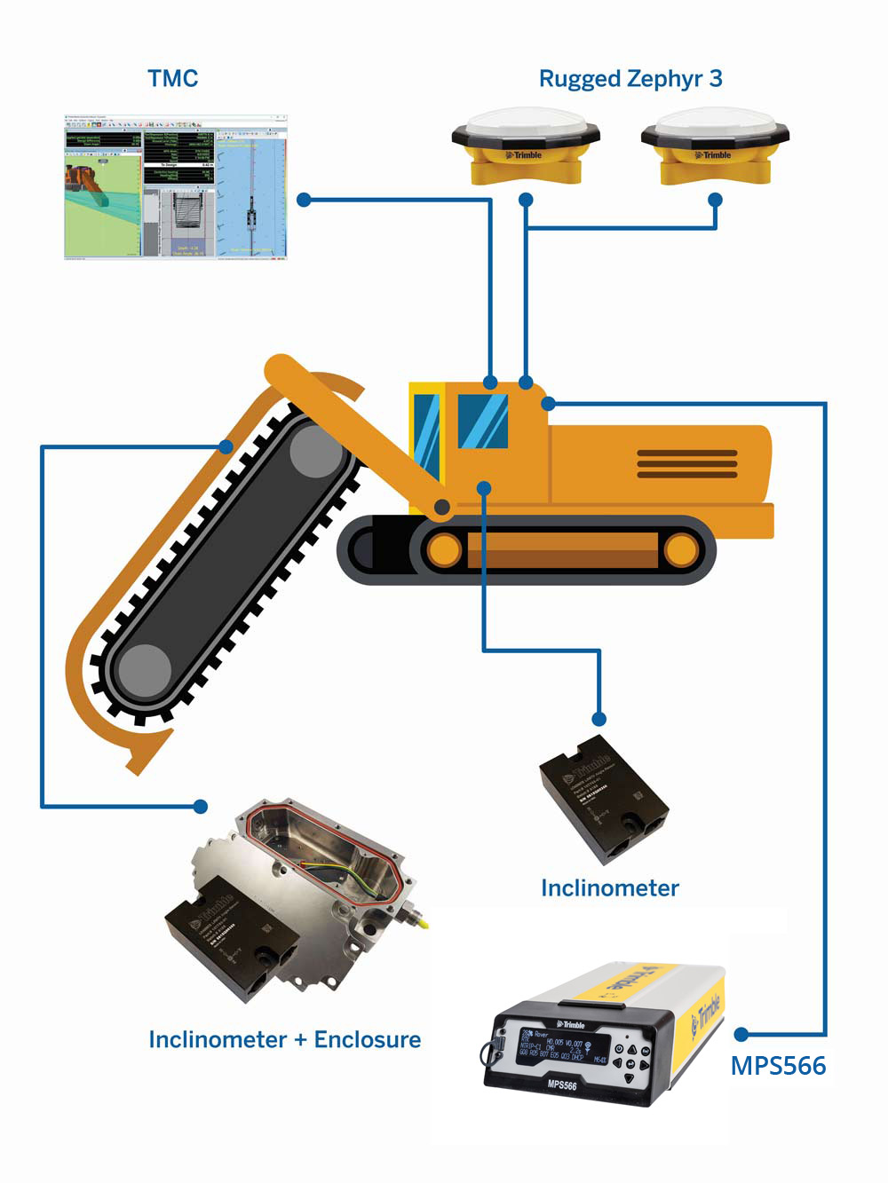
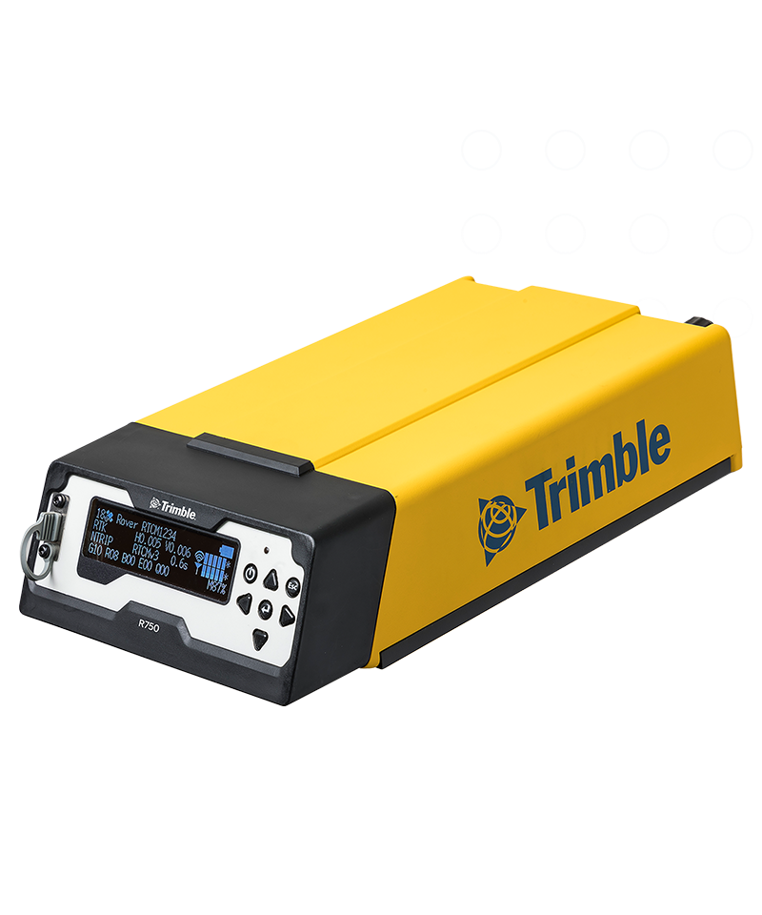
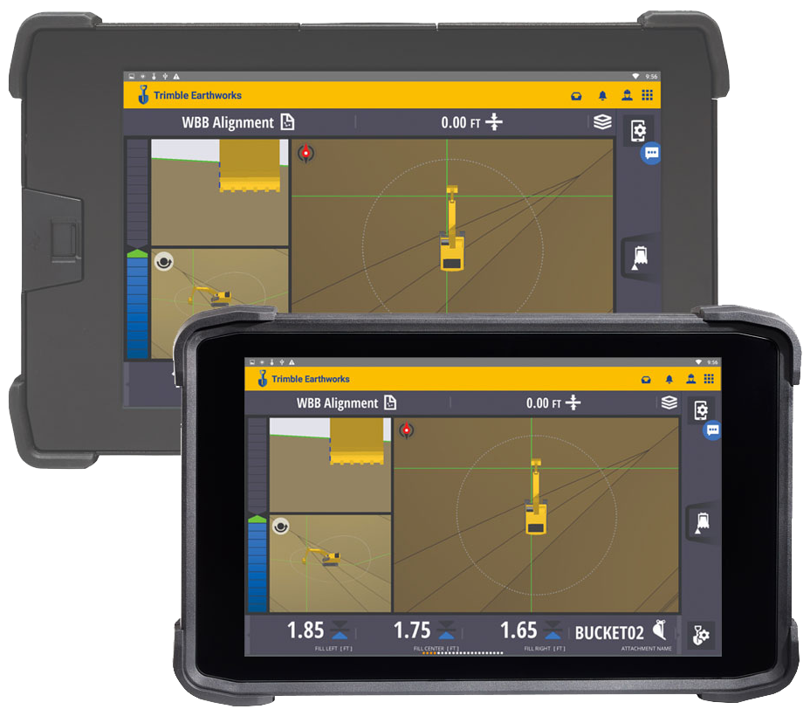
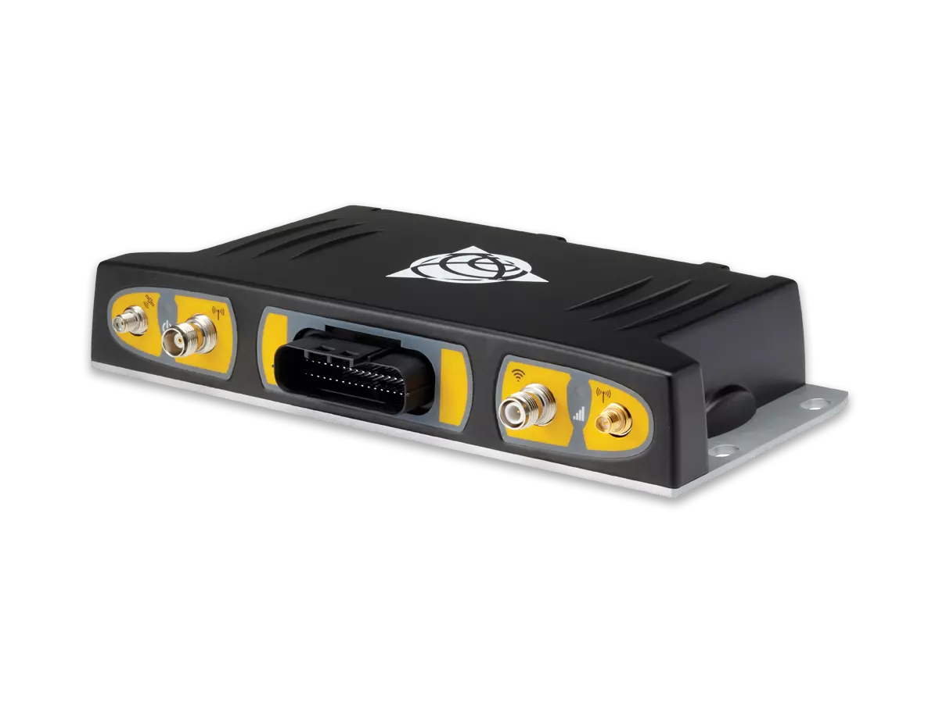
Our Desired Solution
RADIO
ANTENNAS
Base Station
DISPLAY AND VISUALIZATION SOFTWARE
Acts as a stationary intermediary receiver between mobile GPS receiver and tower. Greater accuracy (mm-level).
Cellular Modem
PITCH AND ROLL, POSITION SENSORS AND ENCLOSURES
Can be used instead of a base station to provide real time wireless connection
No need for additional piece of equipment, BUT is less accurate (cm-level).
INCLINOMETER
CONTROL BOX AND GNSS RECEIVER
Notes:
This slide goes more in depth regarding the specific components that would make up our ideal solution.
We would need a radio, two antennas and a satellite signal receiver to send and receive GPS signals, as well as an assortment of sensors to detect incline, pitch and roll, position, et cetera. 4
EXPLAIN EACH COMPONENT
Antenna sends signals geolocating
Receiver and control box receives and interprets signals
Position sensors, pitch and roll sensors tell what orientation the trencher is in, what angle the trenching attachment is etc.
Radio is a radio, it allows for operator communication
The software and display integrates this all and puts it into a nice 3D view that provides info about WHERE The trencher is
Given the limited display capabilities of our trencher currently, it is important that we have a new display and visualization software to show where we are trenching in real time.
AS FAR AS PACKAGING ALL OF THIS INFORMATION AND SENDING IT TO THE SATELLITE :
If we were to install a cellular modem in our trencher setup, then the system would geolocate the trencher through signaling the cell tower directly.
Just like the manual setup, obstructions can affect the accuracy of the readings.
Instead, a base station, which essentially is a stationary receiver, can be installed on site in an unobstructed space, and acts as a stationary intermediary between the receiver and the cell tower.
This is an extra component that will need to be installed on site, but it allows for a lot more accuracy and avoids obstruction issues.

Slide 12
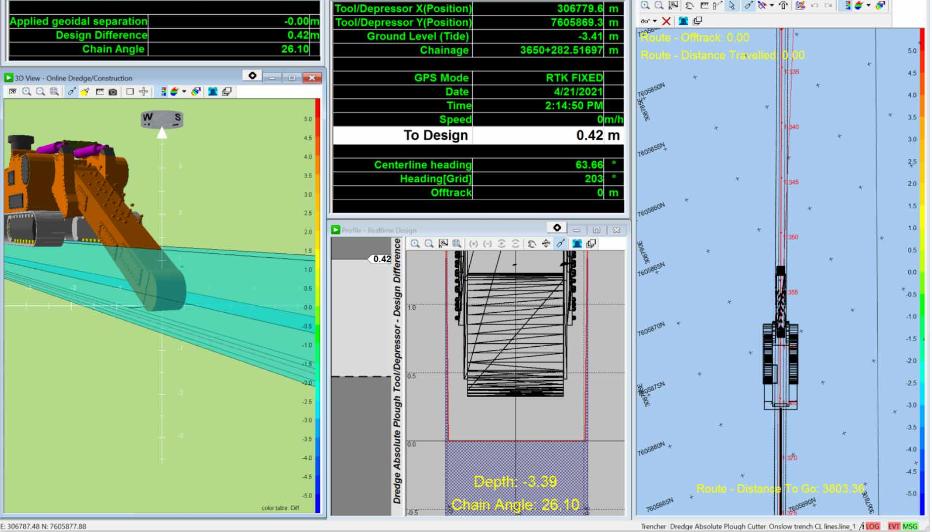
Our Desired Software
We want our display to look like this:
LINE VIEW
3D VIEW
Notes:
This slide expands on what an ideal visualization for our system would look like. We have a 3D view of our trencher, a top-down line view of our trencher, as well as necessary information about depth, angle, etc.
Note that there is even an indicator telling the user how far they are to the goal depth.

Slide 13
The Three Vendors
Positioning Solutions
SITECH Ohio
Measutronics
($)
($$)
($$$)
Midrange option: $60,802
Comes with position sensors + mounts
Base station included
Trimble Earthworks
Training included + local
Wireless upload is limited
Communication is difficult with this vendor
Priciest: $66,744.39
Comes with position sensors + mounts
Cellular modem instead of base station
TMC software
Fast communication
Training, setup is provided for $2530/day
Modem has recurring fee for data service ($110/day)
May lose satellite signal when close to obstructions
Cheapest option: $32,208
Comes with 2 antennas, display and control box, radio
Base station included
Sensors and mounts not included
Installation, training and support not offered
Notes:
Note that the SITECH and Measutronics also come with 2 antennas, display, control box and radio
We took these goals and requirements to numerous Trimble resellers.
We received THREE responses at three different price points, of which two provided a detailed quote.
I show a pros and cons list for each of the vendors here. I will go more in depth on SITECH and Measutronics on their own slides, as they provided detailed quotes.
TALK ABOUT POSITIONING SOLUTIONS
The cheapest option is Positioning Solutions.
They did not provide a quote, so I won’t be going into too much detail with them.
They sell two different kits that when purchased together, could give us most of the components we need.
Together, the two kits come out to roughly 32.2 thousand dollars.
It includes antennas, a display, control box, radio, and a base station kit.
The kits do not include any sort of position or pitch and roll sensors.
It was not clear whether software was included with the kits
They also do not include any sort of cables, harnesses or other mounting devices, and do not offer any installation or support.
The company is based in Mesa, Arizona, which could make any sort of customer service fairly difficult.
WE CAN THEREFORE ELIMINATE POSITIONING SOLUTIONS FROM OUR CONSIDERATION

Slide 14
SITECH Ohio
SITECH Ohio
Additional details:
Trencher setup is a modified dozer machine control system which uses Trimble Earthworks
SITECH has three technicians in Columbus who can aid in installation
Small amounts of welding and fabrication will need to be done by One Power
($$)
Midrange option: $60,802
Comes with position sensors + mounts
Base station included
Trimble Earthworks
Training included + local
Wireless upload is limited
Communication is difficult with this vendor
Notes:
.
The midrange option is SITECH Ohio, whose pre-tax total comes out to around 61 thousand dollars.
A radio, display, 2 antennas, all position/incline/pitch-and-roll sensors are included.
The setup comes with Trimble Earthworks, which is a visualization software that can be used with the display.
The setup also comes with a base station kit.
UNLIKE Positioning solutions, SITECH Ohio is based in Columbus, and offers training, troubleshooting and setup.
SOME CONS associated with this vendor are that with the base station setup and no cellular modem, site connectivity is limited.
Additionally, this vendor was very difficult to get ahold of with regards to acquiring a quote. TOOK WEEKS
It remains to be seen as to whether this applies to the company as a whole.

Slide 15
Measutronics
Measutronics
Additional details:
Virtual troubleshooting is available, and in-person support is pricey
Virtual Reference Stations are more convenient but less accurate, especially if there are above-ground obstructions
Trimble Base Station can be added… for an extra $19,207
($$$)
Priciest: $66,744.39
Comes with position sensors + mounts
Cellular modem instead of base station
TMC software
Fast communication
Training, setup is provided for $2530/day
Modem has recurring fee for data service ($110/day)
May lose satellite signal when close to obstructions
Notes:
LASTLY, the most expensive option is from Measutronics, with a pre-tax total of around 67 thousand dollars.
Their setup includes similar if not identical antennas, position sensors, mounts and radio.
The key difference between Measutronics and SITECH is that the Measutronics setup utilizes a modem and cellular service to provide VRS connection.
Additionally, instead of Trimble earthworks, the Measutronics setup uses Trimble Marine Construction, which would give us the same visualization system that we saw on the previous slide.
Measutronics also was extremely fast and helpful in their communications, often responding within a few hours, compared to the days and/or weeks required for SITECH.
SOME CONS associated with this option are that they are really expensive– they charge two and a half thousand dollars per day for training, setup and troubleshooting.
The company is also located in Florida, so response time may be delayed.
Additionally, the use of VRS and a cell modem does not increase the accuracy of our system.
At the same time, only one month of cellular data is included, so we would have to pay a recurring fee to continue using the system.

Slide 16

The Winner
Notes:
Out of our three options, we ultimately decided that SITECH was the best option for us given their proximity to us, the fact they offer support,
It is likely that we will be trenching in areas where cellular connectivity is limited, and where there will be buildings or trees obstructing our view.
In this case, being able to obtain a clear and unobstructed view of the site and the trencher supersedes the ability to wirelessly connect to the trencher.
Note that we did inquire about including a base station in our Measutronics setup, but this raised the pre-tax total by around 19 thousand dollars.

Slide 17
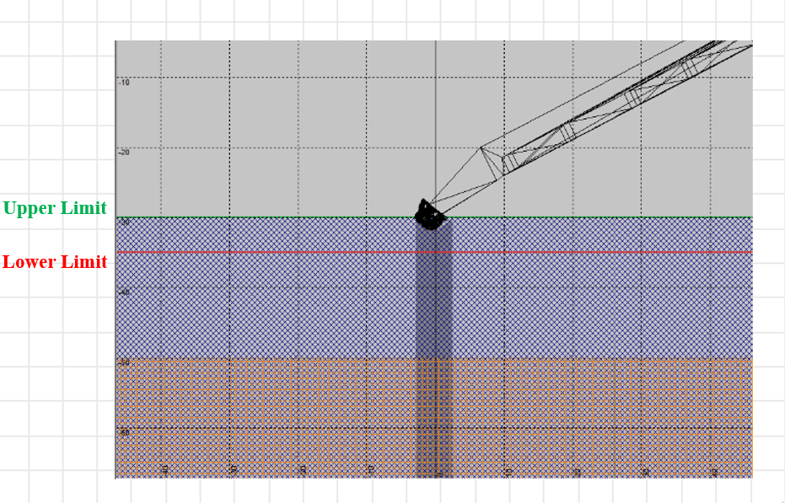
Future Steps
SITECH would install + calibrate the trencher control system
Testing consists of making a small design (3D line) in the yard where installed
  Verify the tooth follows the line to the correct elevation
One Power will need the trencher in the fall near Columbus
Notes:
Now that we have chosen a vendor to proceed with, our next step with SITECH is to install and calibrate the control system
After that, we would test the trencher by making a small 3D line design in the yard we installed the system and verify that the tooth on the trencher’s chain follows the line to the correct elevation
Once we get it calibrated and dialed to where we need it, One Power will use the trencher in the fall in a project near Columbus

Slide 18
Acknowledgements
Many thanks to Brandon Ewing for all his help on this project!
Thank you to everyone at One Power for a great internship!
Notes:
I would like to give my thanks to Brandon Ewing for all his guidance and expertise on this project! I could not have done it without him.
I also wanted to thank everyone at One Power for such a great internship.
Any questions?

Slide 19
Thank you! Any Questions?

Slide 20
Works Cited
[1] “T655III Pipeline Trencher,” Vermeer Corporation - Industrial & Agricultural Equipment [Online]. Available: https://www.vermeer.com/na/pipeline-trenchers/t655iii. [Accessed: 18-Jul-2025].
[2] “How to Use Different Type of Trenchers,” https://www.catrentalstore.com/en_US/blog/trencher-uses.html [Online]. Available: https://www.catrentalstore.com/en_US/blog/trencher-uses.html. [Accessed: 18-Jul-2025].
[3] “SMART PERFORMANCE SmartTEC,” VERMEER.COM [Online]. Available: https://www.vermeer.com/getmedia/f0001a5b-0f6c-49a8-9820-77eabe24e216/smarttec?ext=.pdf. [Accessed: 18-Jul-2025].
[4] “Trimble R2 GNSS RECEIVER Datasheet,” Trimble [Online]. Available: https://trl.trimble.com/docushare/dsweb/Get/Document-1065702/022516-708C-en-US_TrimbleTDC6_DataCollector_SpecSheet_USL_0124_LRsec.pdf. [Accessed: 18-Jul-2025].
[5] “Trimble TSC5 CONTROLLER Datasheet,” Trimble [Online]. Available: https://trl.trimble.com/docushare/dsweb/Get/Document-962962/022516-528A-de-DE_Trimble_TSC5_DS_A4_0522_LR.pdf. [Accessed: 18-Jul-2025].
[6] “Machine Guidance for Trenching Machines,” Trimble Civil Engineering and Construction [Online]. Available: https://heavyindustry.trimble.com/en/products/machine-guidance-trenching-machines. [Accessed: 18-Jul-2025].
[7] “TESMEC 950R T620,” www.tesmec.com [Online]. Available: https://www.tesmec.com/sites/default/files/2020-07/Tesmec-Trenchers%20Catalogue%202019-EN-950R%20CS.pdf. [Accessed: 18-Jul-2025].
[8] Positioning Solutions, “Trimble 3D GPS dozer machine control cab kit GCS900,” positioningsolutions.com [Online]. Available: https://positioningsolutions.com/collections/machine-control/products/trimble-3d-gps-dozer-machine-control-cab-kit-gcs900-mc-1355. [Accessed: 18-Jul-2025].
[9] Positioning Solutions, “Trimble R750 GPS / GNSS base station Kit - 450 mhz UHF,” positioningsolutions.com [Online]. Available: https://positioningsolutions.com/products/trimble-r750-gps-gnss-base-station-450-mhz-uhf. [Accessed: 18-Jul-2025].
[10] 2023, “Machine control,” Sitech Ohio [Online]. Available: https://www.sitech-ohio.com/solutions/machine-control-systems/. [Accessed: 18-Jul-2025].
[11] 2024, “Machine Control Components,” Sitech Ohio [Online]. Available: https://www.sitech-ohio.com/products/machine-control-components/. [Accessed: 18-Jul-2025].
[12] 2025, “Trimble Marine Construction Systems for Cutter Suction Dredges,” Marine Positioning and Guidance [Online]. Available: https://measutronics.com/machine-control. [Accessed: 18-Jul-2025].
[13] 2023, “Understanding RTK VRS Networks,” Global GPS Systems [Online]. Available: https://globalgpssystems.com/gnss/understanding-rtk-vrs-networks/. [Accessed: 18-Jul-2025].
[14] 2024, “SNM941 connected site Gateway,” Sitech Ohio [Online]. Available: https://www.sitech-ohio.com/products/snm941-connected-site-gateway/. [Accessed: 18-Jul-2025].

