Slide 1
Personal protective Equipment
(PPE)

Slide 2
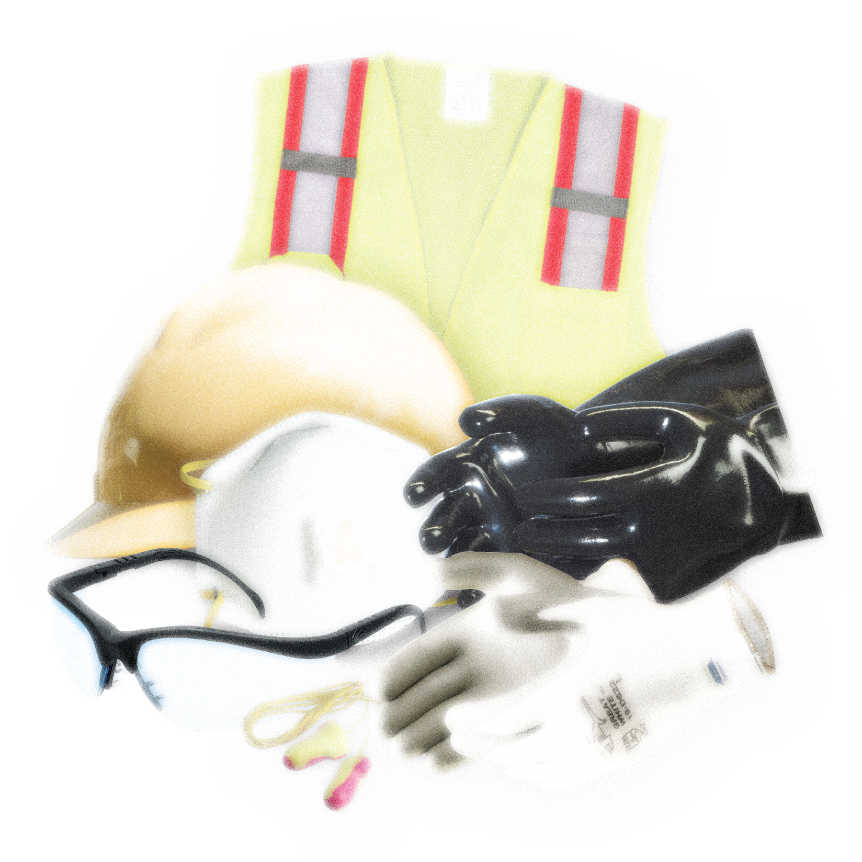
What is ppe?
Personal Protective Equipment:
Refers to protective clothing, helmets, goggles, or other garments or equipment designed to protect the wearer's body from injury or infection
One Energy issued
SITUATIONAL AWARENESS MUST BE APPLIED WHEN USING PPE

Slide 3
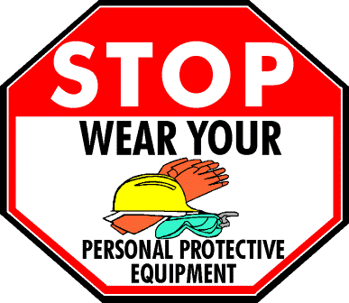
General ppe list
Gloves
Hardhat
Safety glasses
Steel toe boots
High visibility clothing

Slide 4
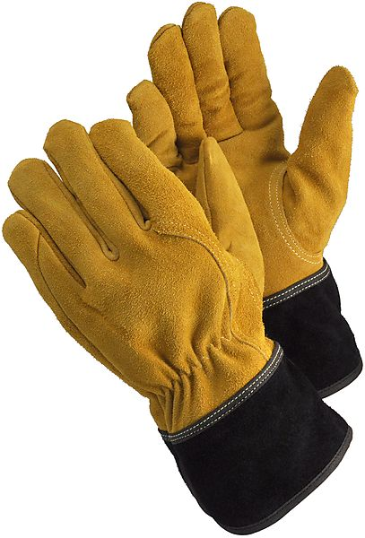
Gloves
Gloves are designed to protect workers from a variety of threats: lacerations from the rough and sharp edges, chemical burns, and the threat of injury from the many materials and tools handled in the course of a day’s work.
  Should be worn when:
    Handling tools
    Rigging
    Handling materials and sharp objects
    When working with chemical products, including concrete.

Slide 5

Hard hat
Hardhats are built to protect workers heads by resisting penetration by objects, absorbing the shock of a blow, and being water resistant and slow burning.
Hardhats should be worn when:
  Objects might fall from above and strike employees on the head
  There is potential for employees to bump their heads against fixed objects
  There is a possibility of accidental head contact with electrical hazards

Slide 6
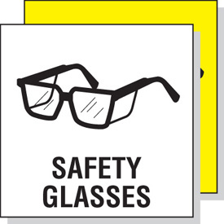
Safety glasses
Safety glasses are meant to protect a worker’s eyes from projectile particles or splashes that may cause damage to a worker’s vision.
Safety Glasses should be worn when:
  Projectiles, such as dust, concrete, metal, and other particles are present
  Chemicals that create fumes or splashes are present
  Moving parts at eye level, equipment, rigging, etc.

Slide 7
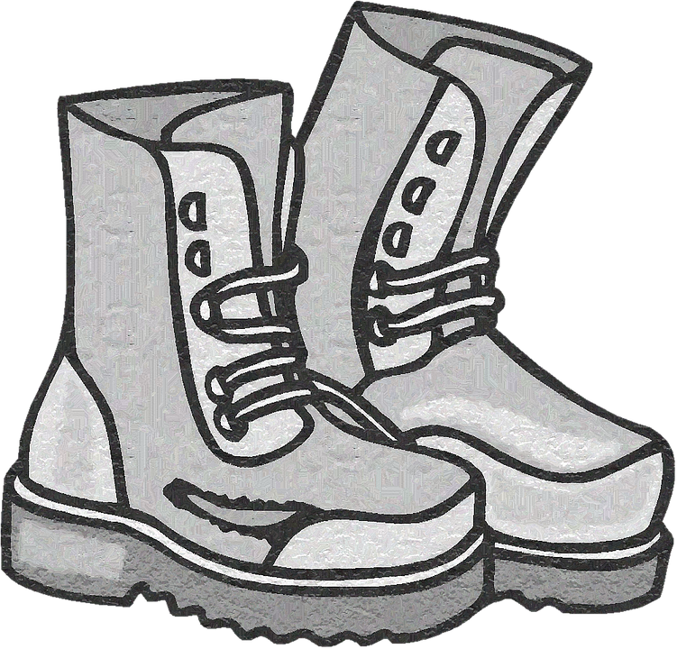
Steel toe boots
Steel toe boots are meant to protect a worker’s feet from falling objects, rolling objects, or objects piercing the sole.
Steel toe boots should be worn:
  Near heavy equipment operation (including service trucks)
  When there is a risk of falling/rolling objects
  Near sharp objects such as nails or screws
  When carrying heavy objects

Slide 8
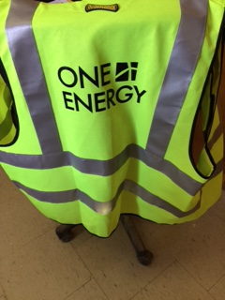
High visibility clothing
High visibility clothing is to help make workers visible to others while working. There are several classes of visible clothing, with varying levels of reflective and prismatic properties.
High visibility clothing should be worn:
  When working on roads
  When working in poor weather conditions
  When working around heavy equipment
  When working in poor light

Slide 9
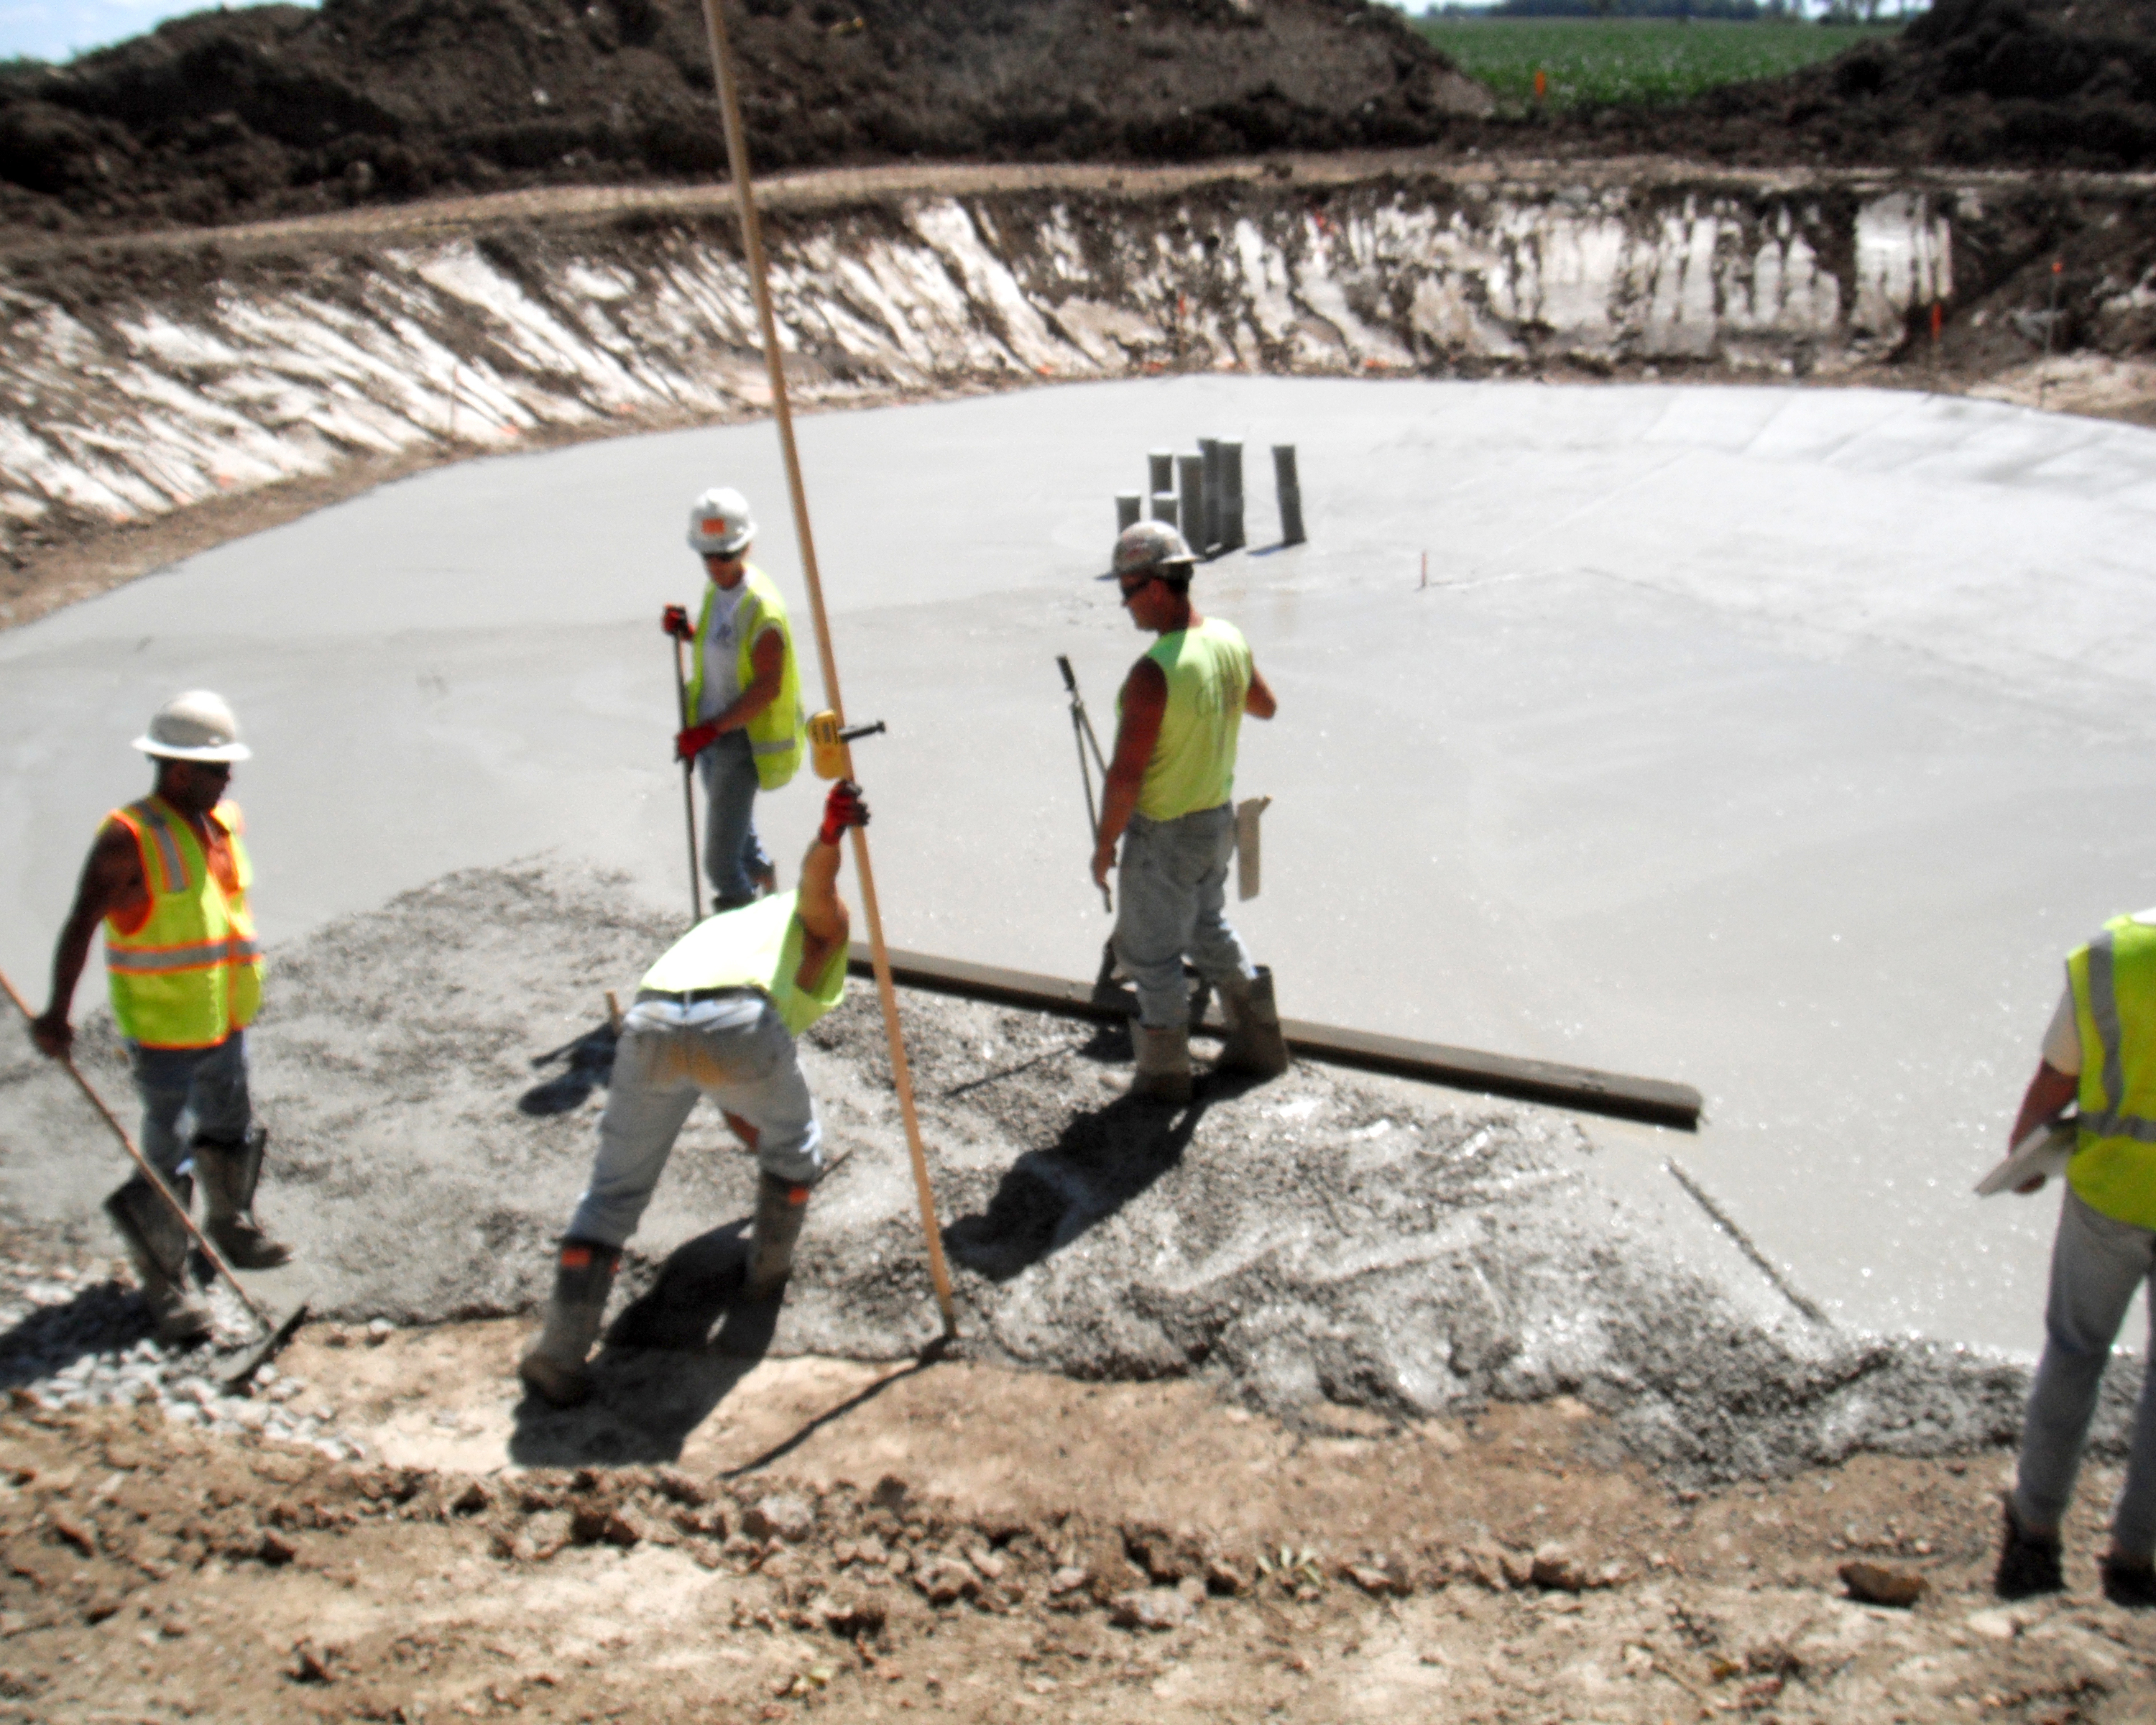
Where do we use ppe?
Active construction projects
Operating projects
Office
Yard
Climbing Activities
Construction non-project related
Field work

Slide 10
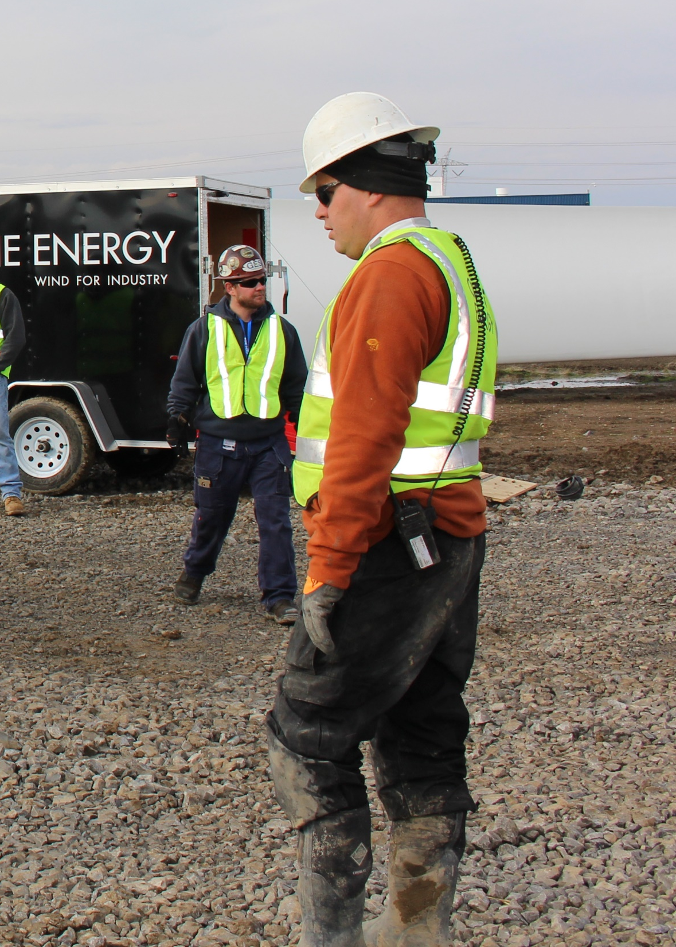
Active construction projects
Minimum Requirements:
  Safety Glasses
  Steel Toe Boots
  High Vis Shirt (min req.)
  Gloves
  Hard Hat
Consult Project Manager for questions and interpretation for specialty/additional PPE requirements.

Slide 11
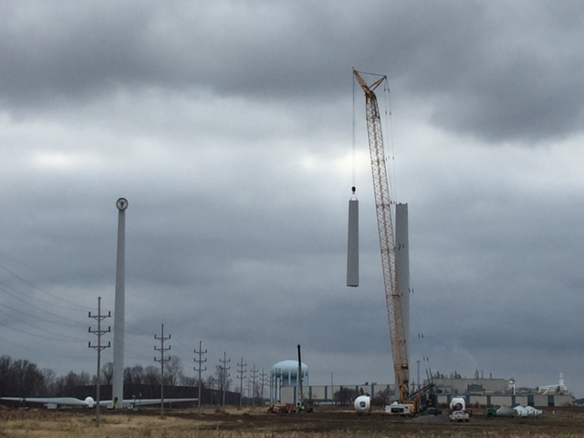
Operating projects
Minimum Requirements
  Closed toe shoes
Depends greatly on the situation
  System operation
  Remote operation
  Site visits
Consult System Operator (A delegation) for additional PPE requirements per assigned tasks.

Slide 12
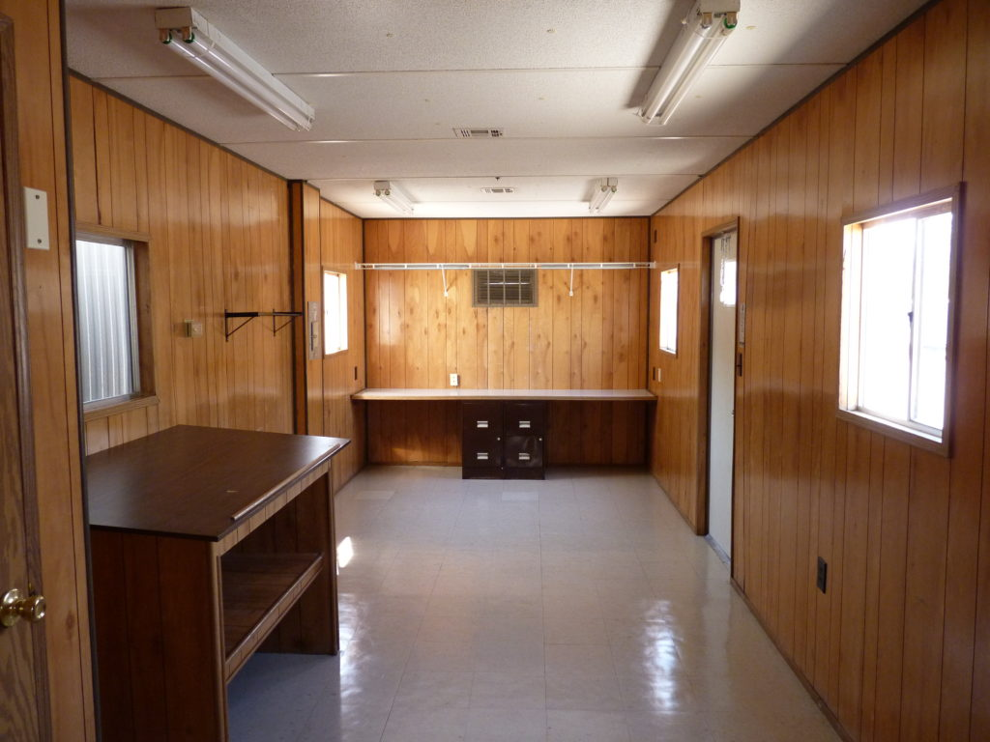
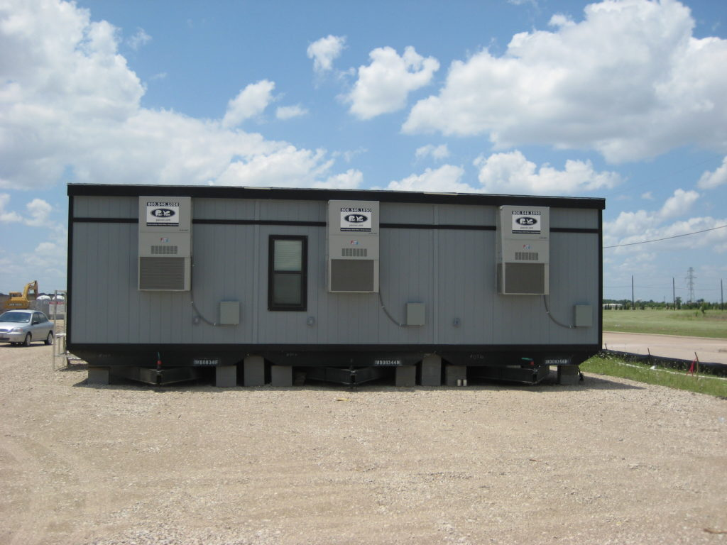
office
Minimum Requirement
  None
Depends on the situation
  Using tools?
  Using heavy equipment?
Consult Manager for PPE requirements per assigned tasks.

Slide 13
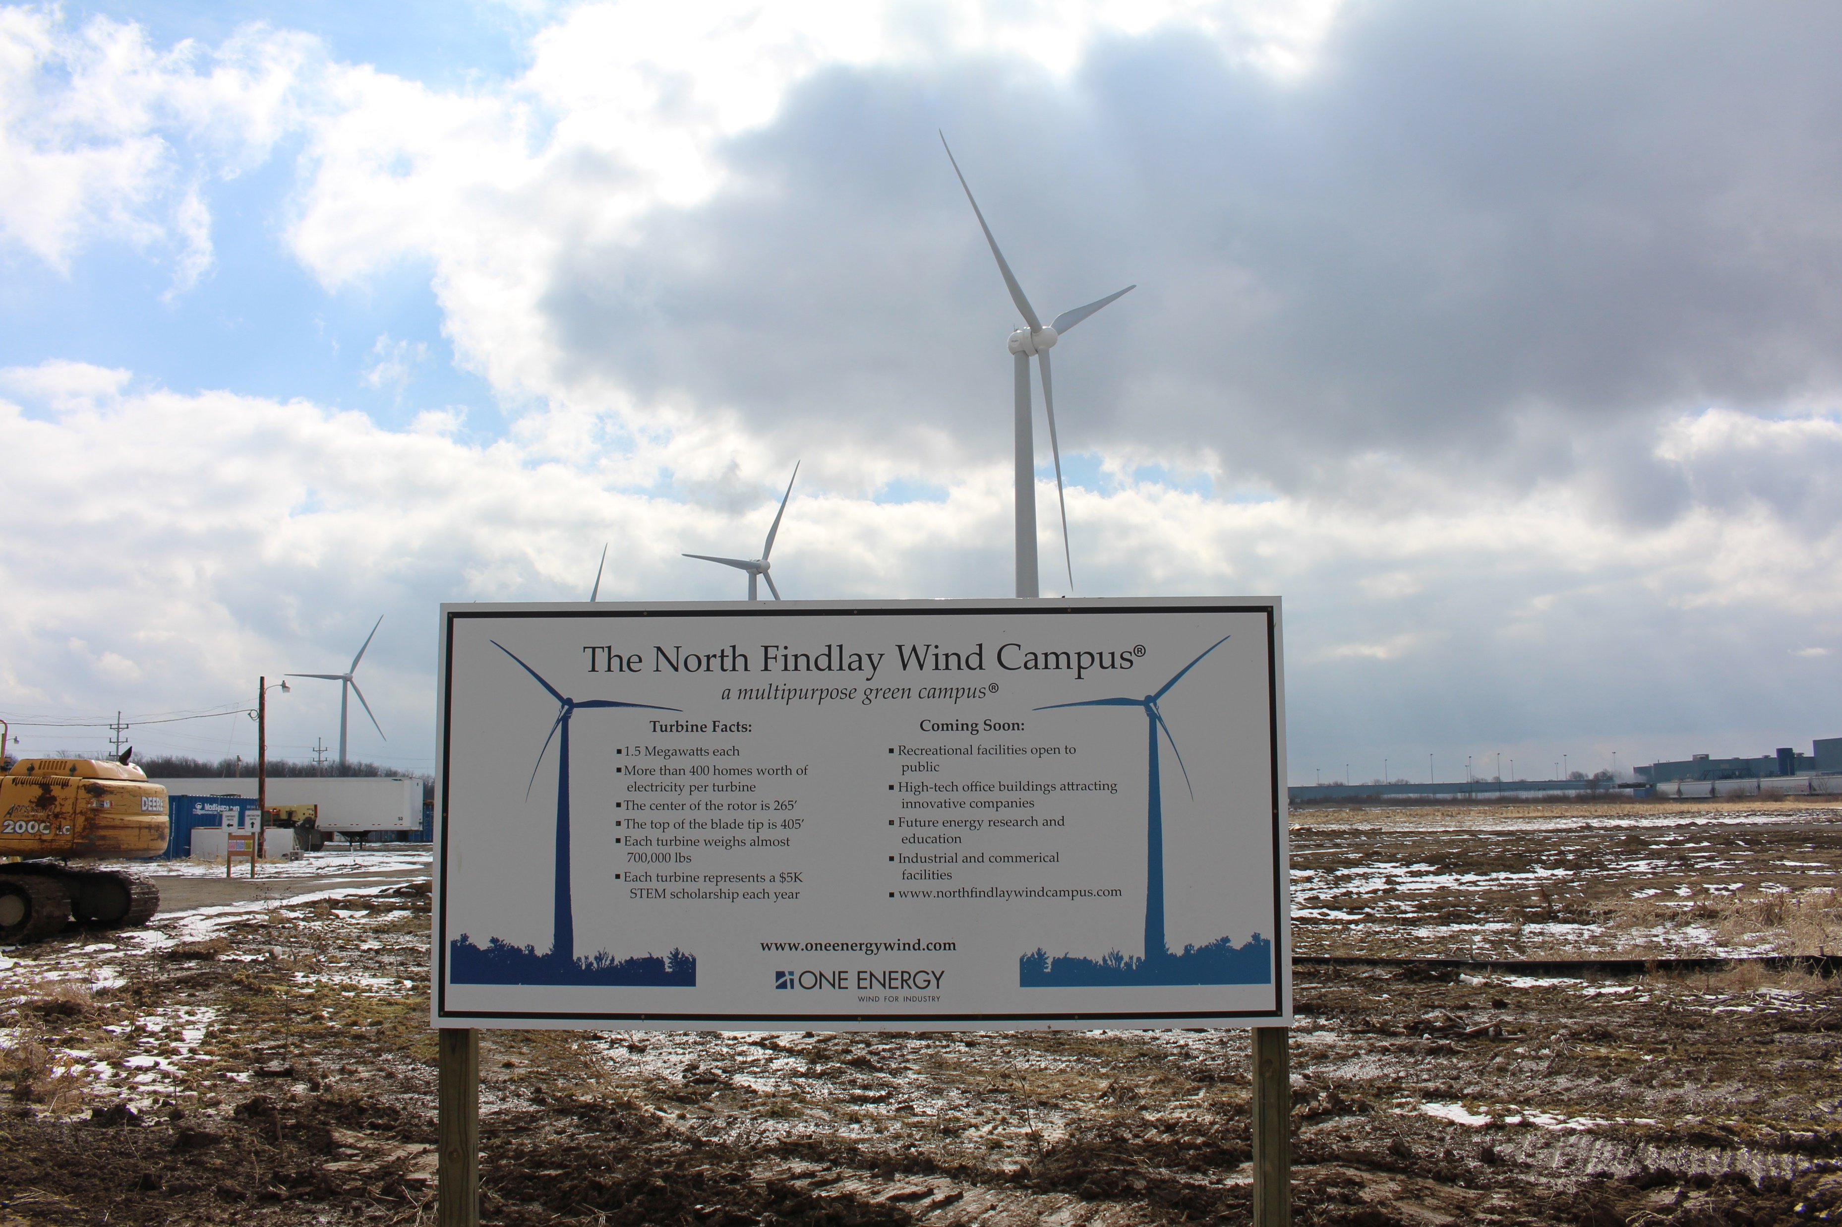
yard
Minimum Requirement
  Closed toe shoes
Depends greatly on the situation
  Hand Tools?
  Operating equipment?
  Overhead loads?
Consult Manager for additional PPE requirements per assigned tasks.

Slide 14
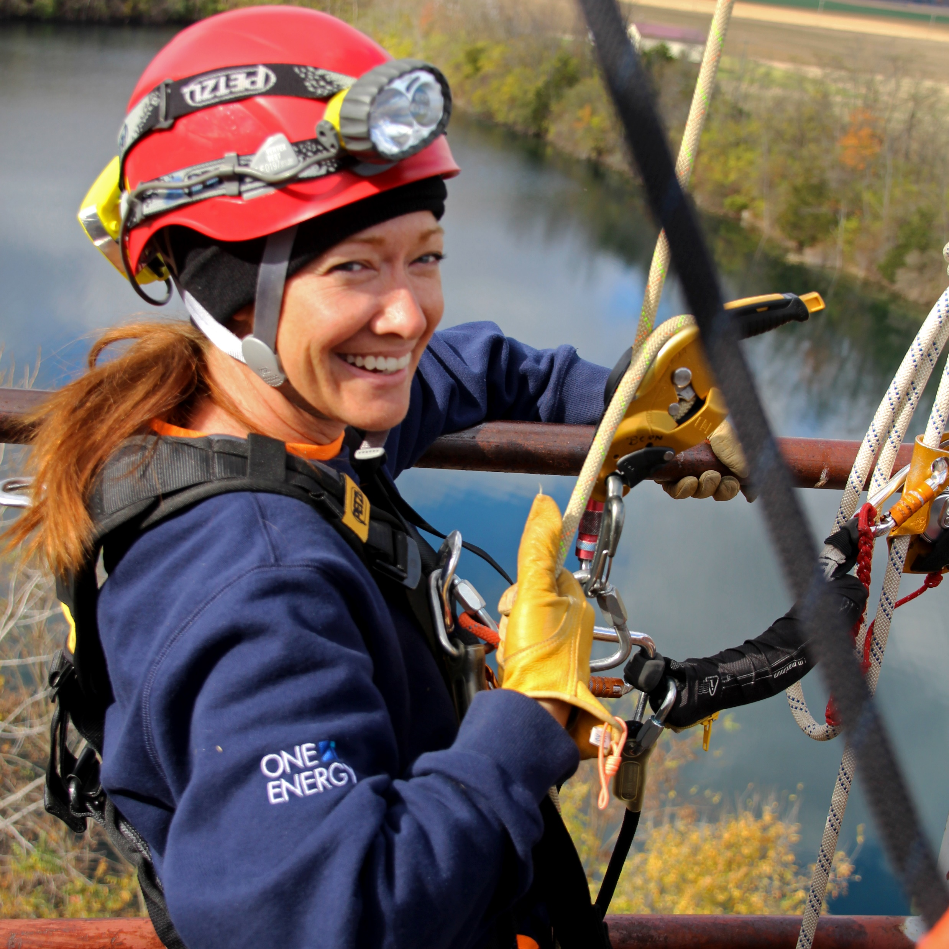
Climbing activities
Minimum PPE Requirements
  Climbing helmet
  Gloves
  Y-Lanyard
  Harness
  Cable Grab
  Safety Glasses
Consult Manager for additional PPE requirements per assigned tasks.

Slide 15

Construction - not project related
One Energy minimum requirement:
  Steel Toe Boots
  High Vis Shirt
  Hard Hat
  Safety Glasses
MUST ALSO COMPLY WITH PPE REQUIREMENTS SET FORTH BY CONTRACTOR(S).
Consult Manager for additional PPE requirements per assigned tasks.

Slide 16
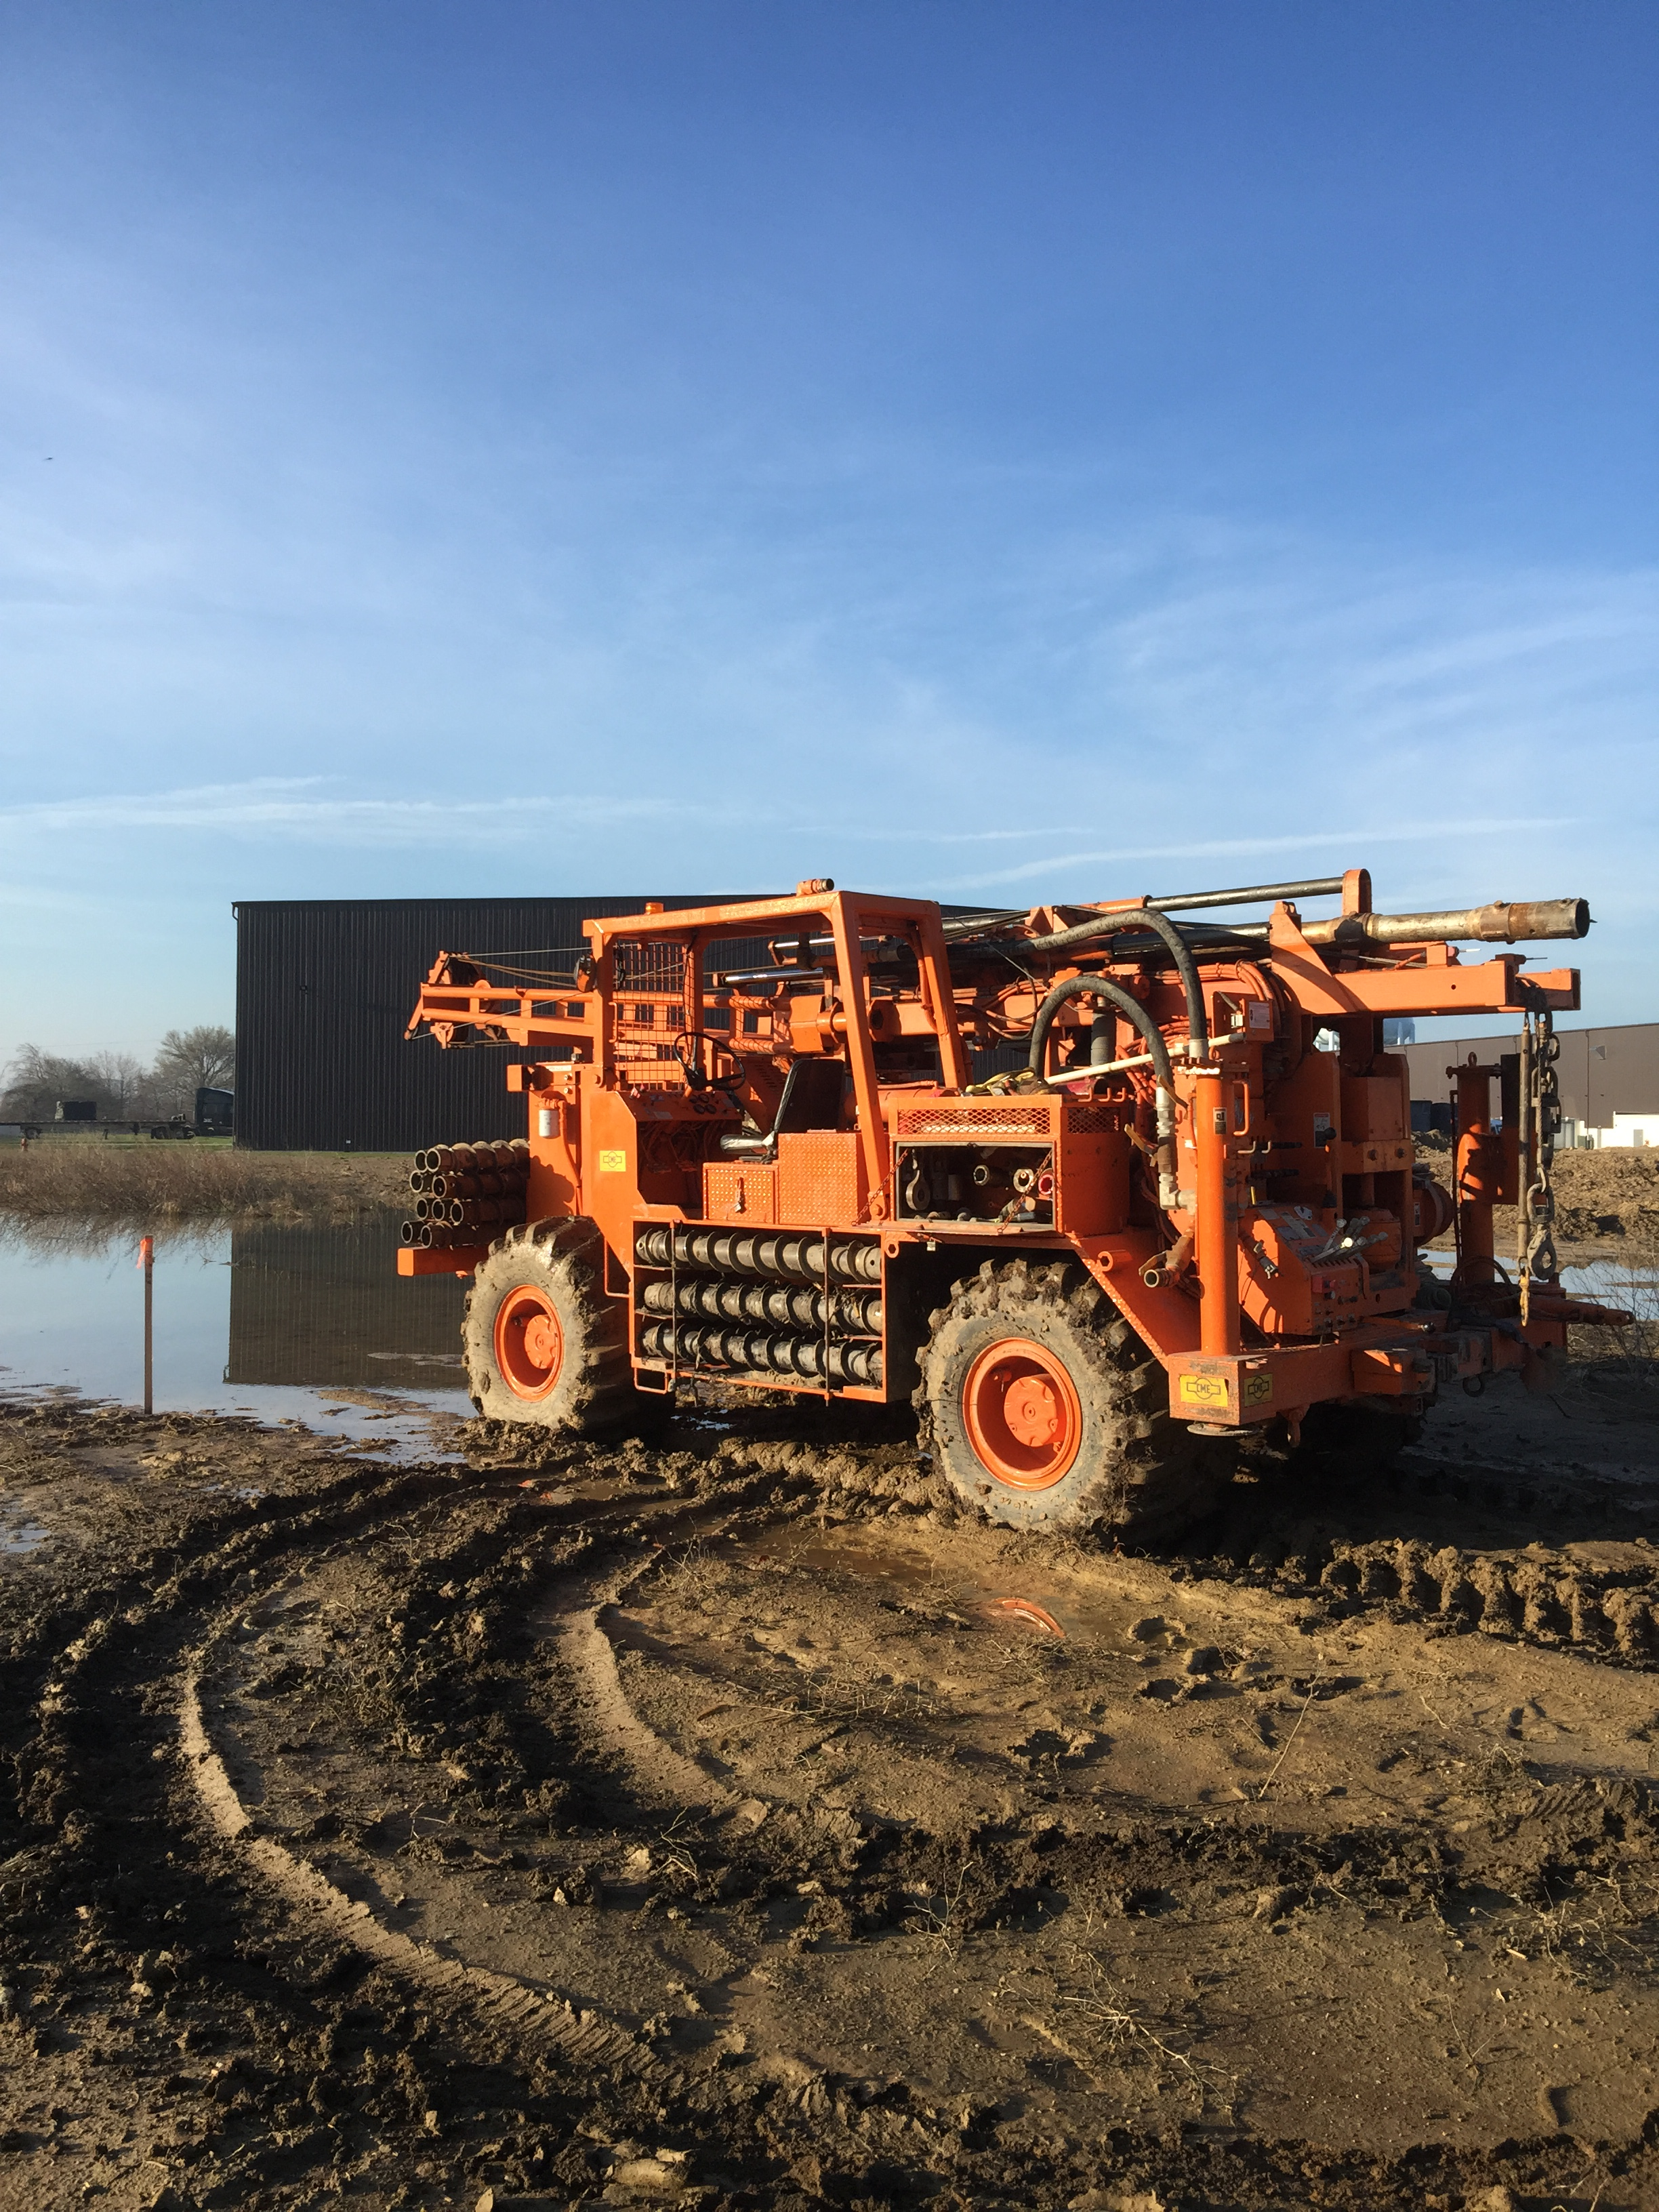
Field work
Minimum Requirements:
  Closed toe shoes
Depends greatly on the situation
  LIDAR deployment?
  Work at height?
  Moving equipment?
Consult Manager for additional PPE requirements per assigned tasks.

Slide 17

Safety factors to consider
Environmental
  Rain, Snow, Ice, Fog, etc.
Hazardous Materials
Time of Day
Skill Level/Training

Slide 18

conclusion
We must:
  keep ourselves and others safe
  keep the work environment safe
  make PPE decisions based on situations and safety factors
  set clear expectations going into activities
  continue training and learning
  hold ourselves accountable
  understand individual limitations

Slide 19
Thank you!

