Slide 1
Social media guidelines

Slide 2

Intro
One Power wants to encourage all employees to post on social media and to do so in a way that is safe and enjoyable for everyone.

Slide 3

Intro
Most importantly, make good decisions for the company.

Slide 4


Do not post
Don’t post media that includes:

Slide 5
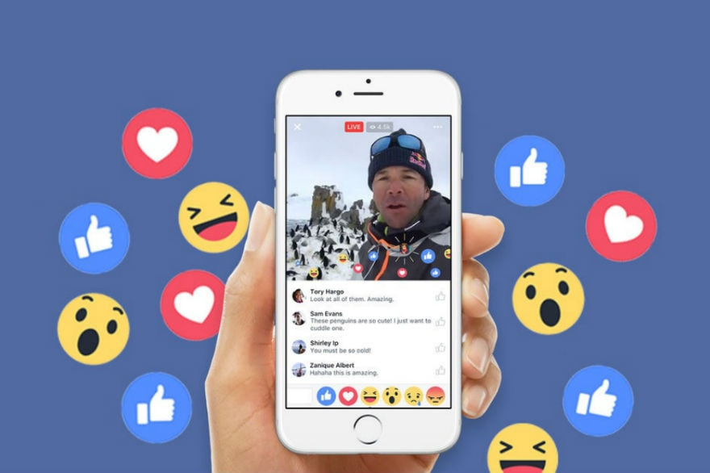
Do not post
live streams.
NO LIVE STREAMS EVER.

Slide 6

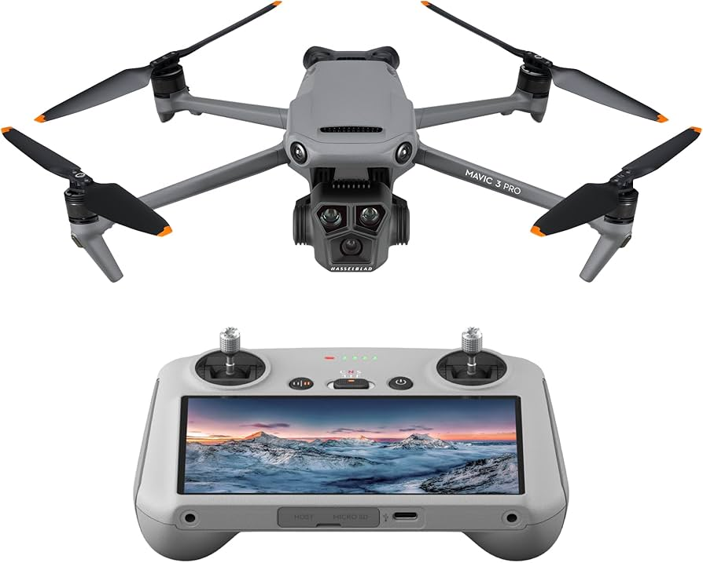
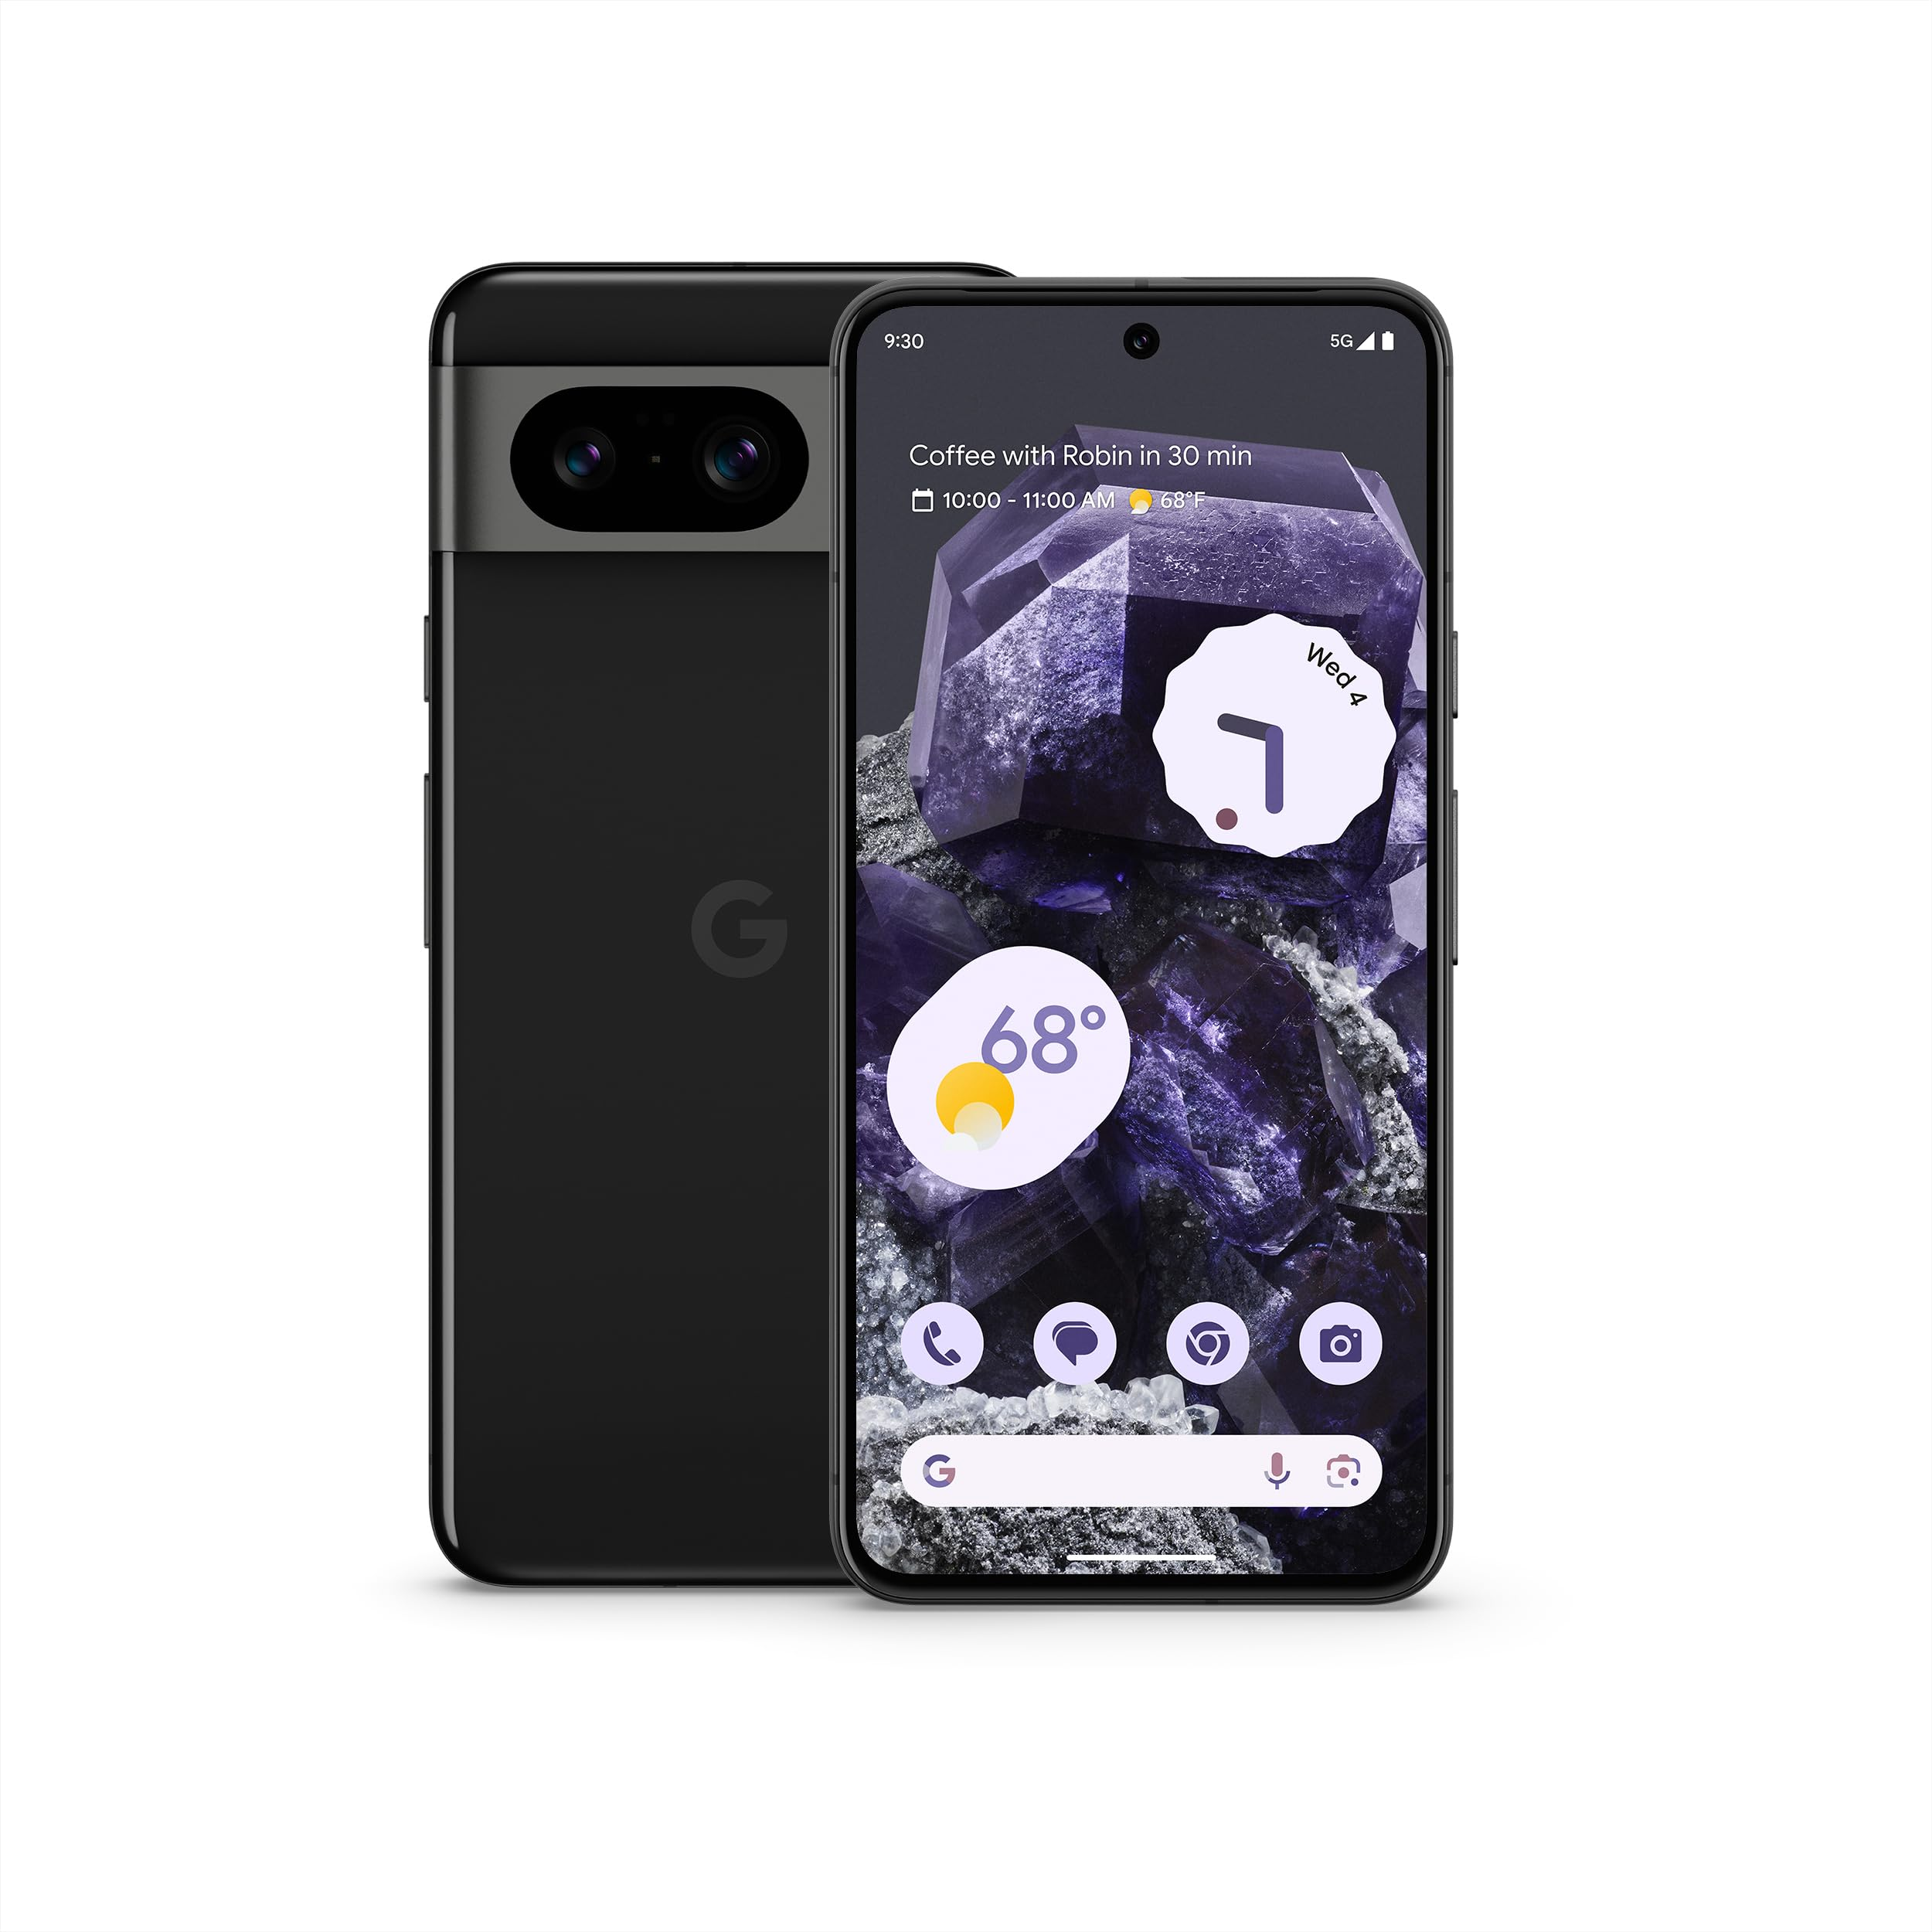
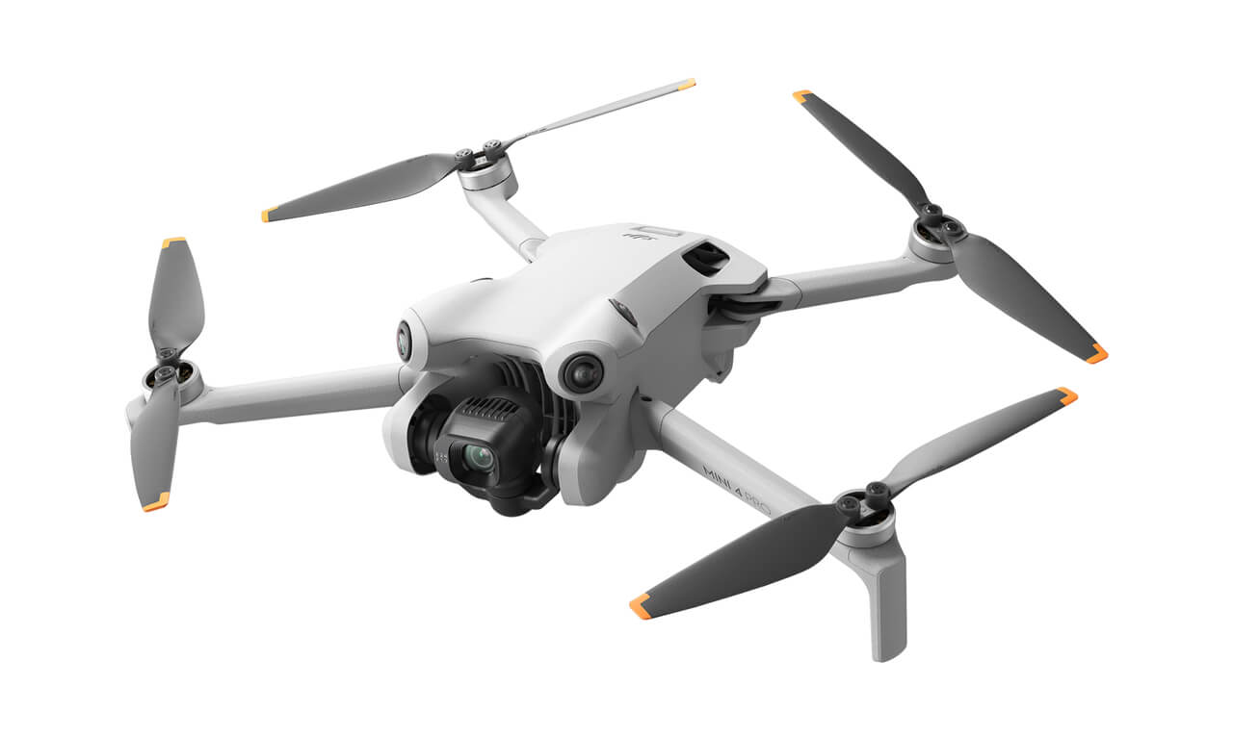
Do not post
2. pictures/videos that were taken with company-owned specialized equipment
(OP cell phones*, cameras, drones, etc.).
*ask your department head if you would like permission to post a photo captured on your work phone.

Slide 7
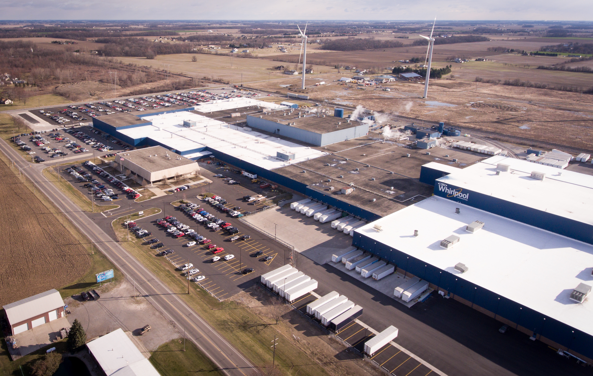
Do not post
3. customer property.

Slide 8
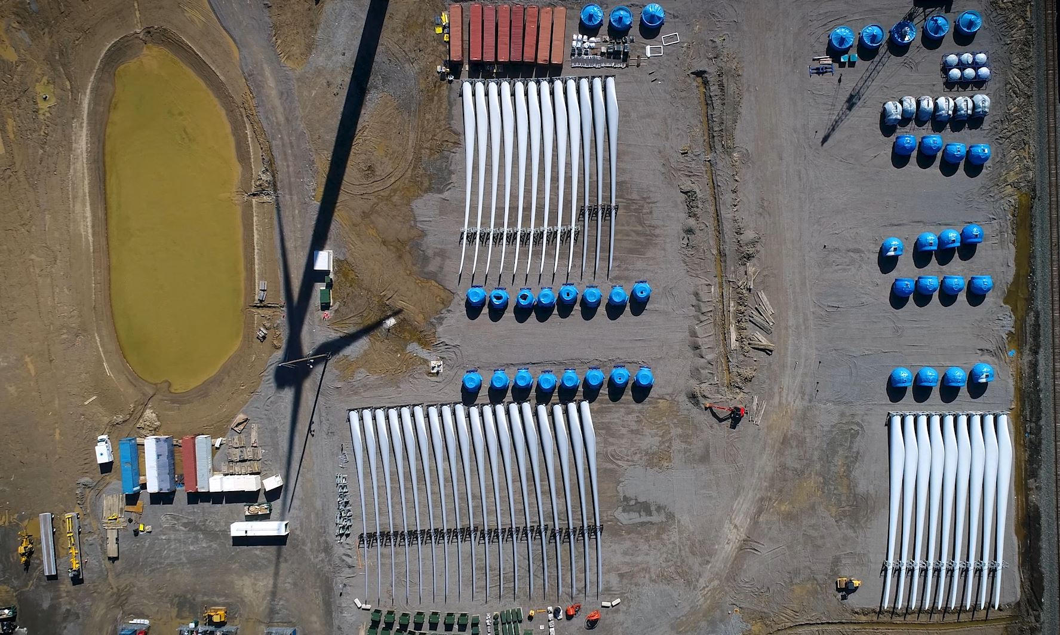


Do not post
4. security equipment, processes, or layouts.

Slide 9

Do not post
5. near-misses or accidents.

Slide 10

Do not post
6. improper Personal Protective Equipment (PPE).

Slide 11
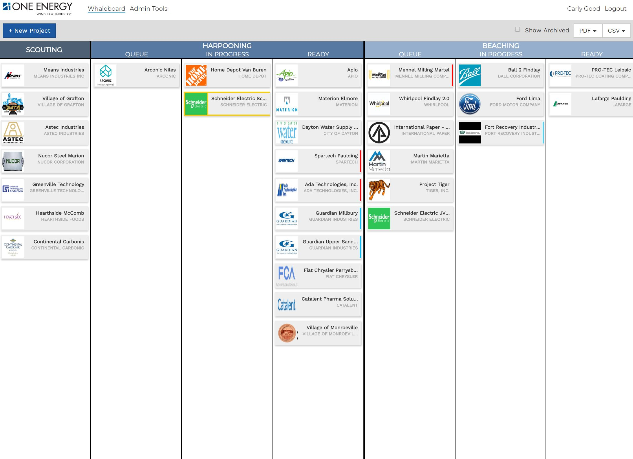

Do not post
7. any information that is confidential or proprietary to the company or to any third party that has disclosed information to One Power.

Slide 12
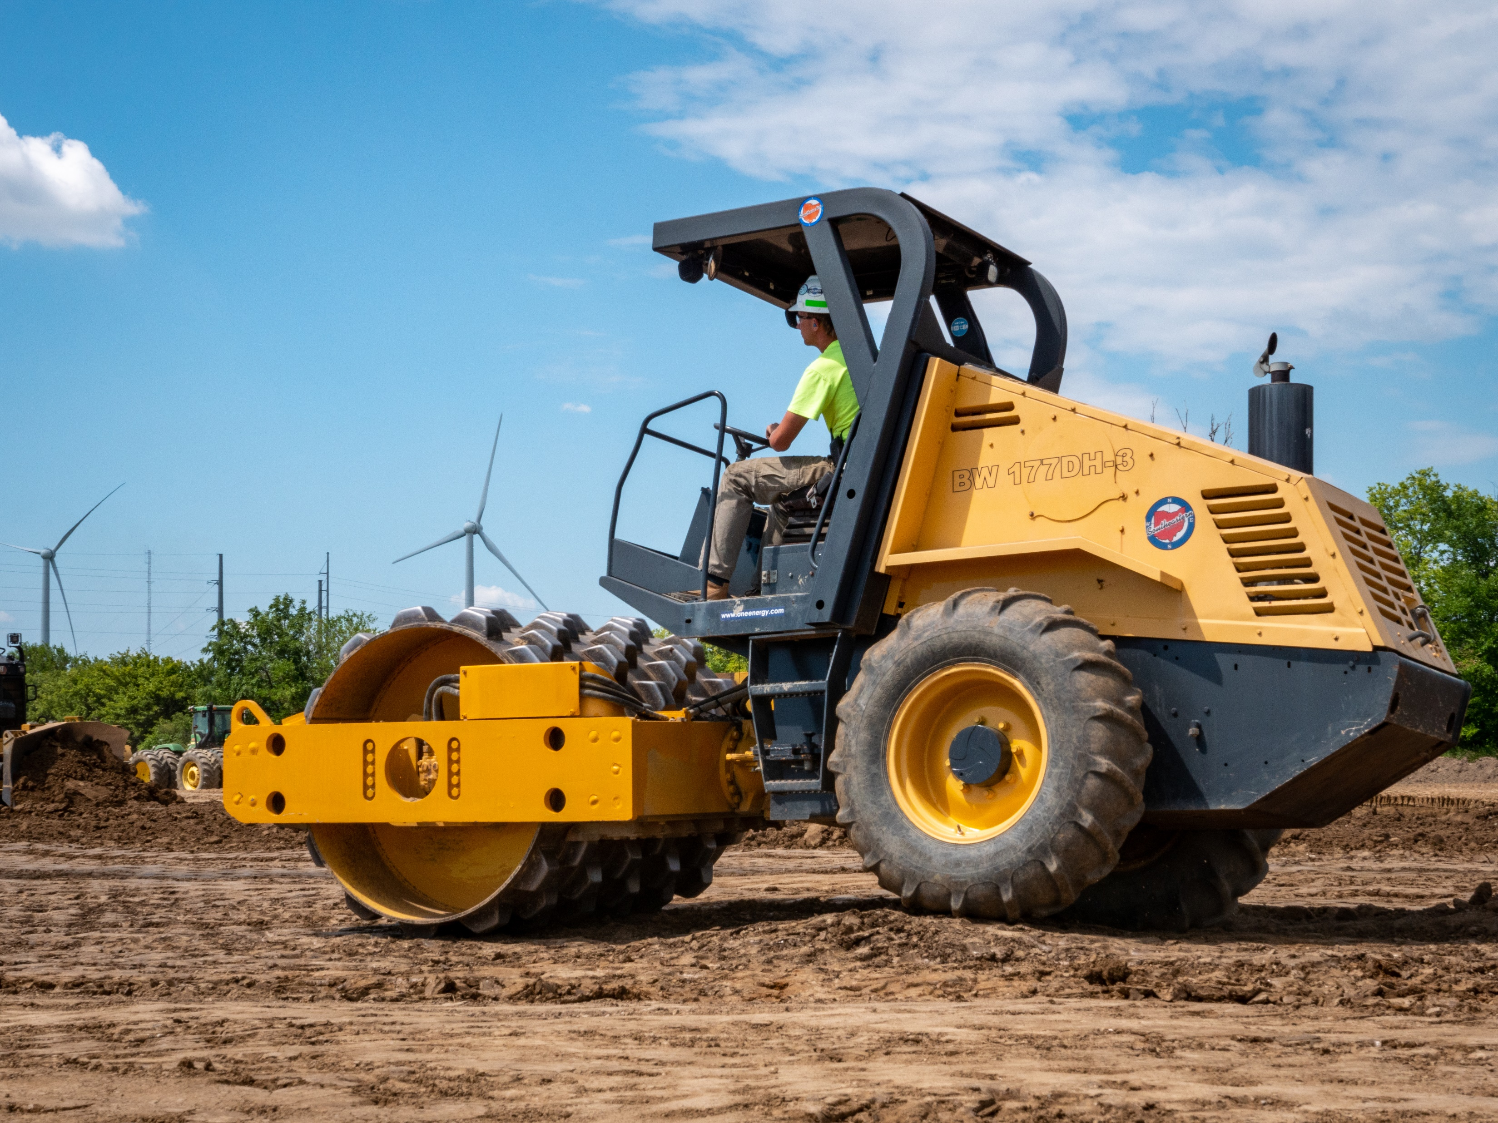
Do not post
8. pictures/videos taken while you were operating or inside running equipment.

Slide 13
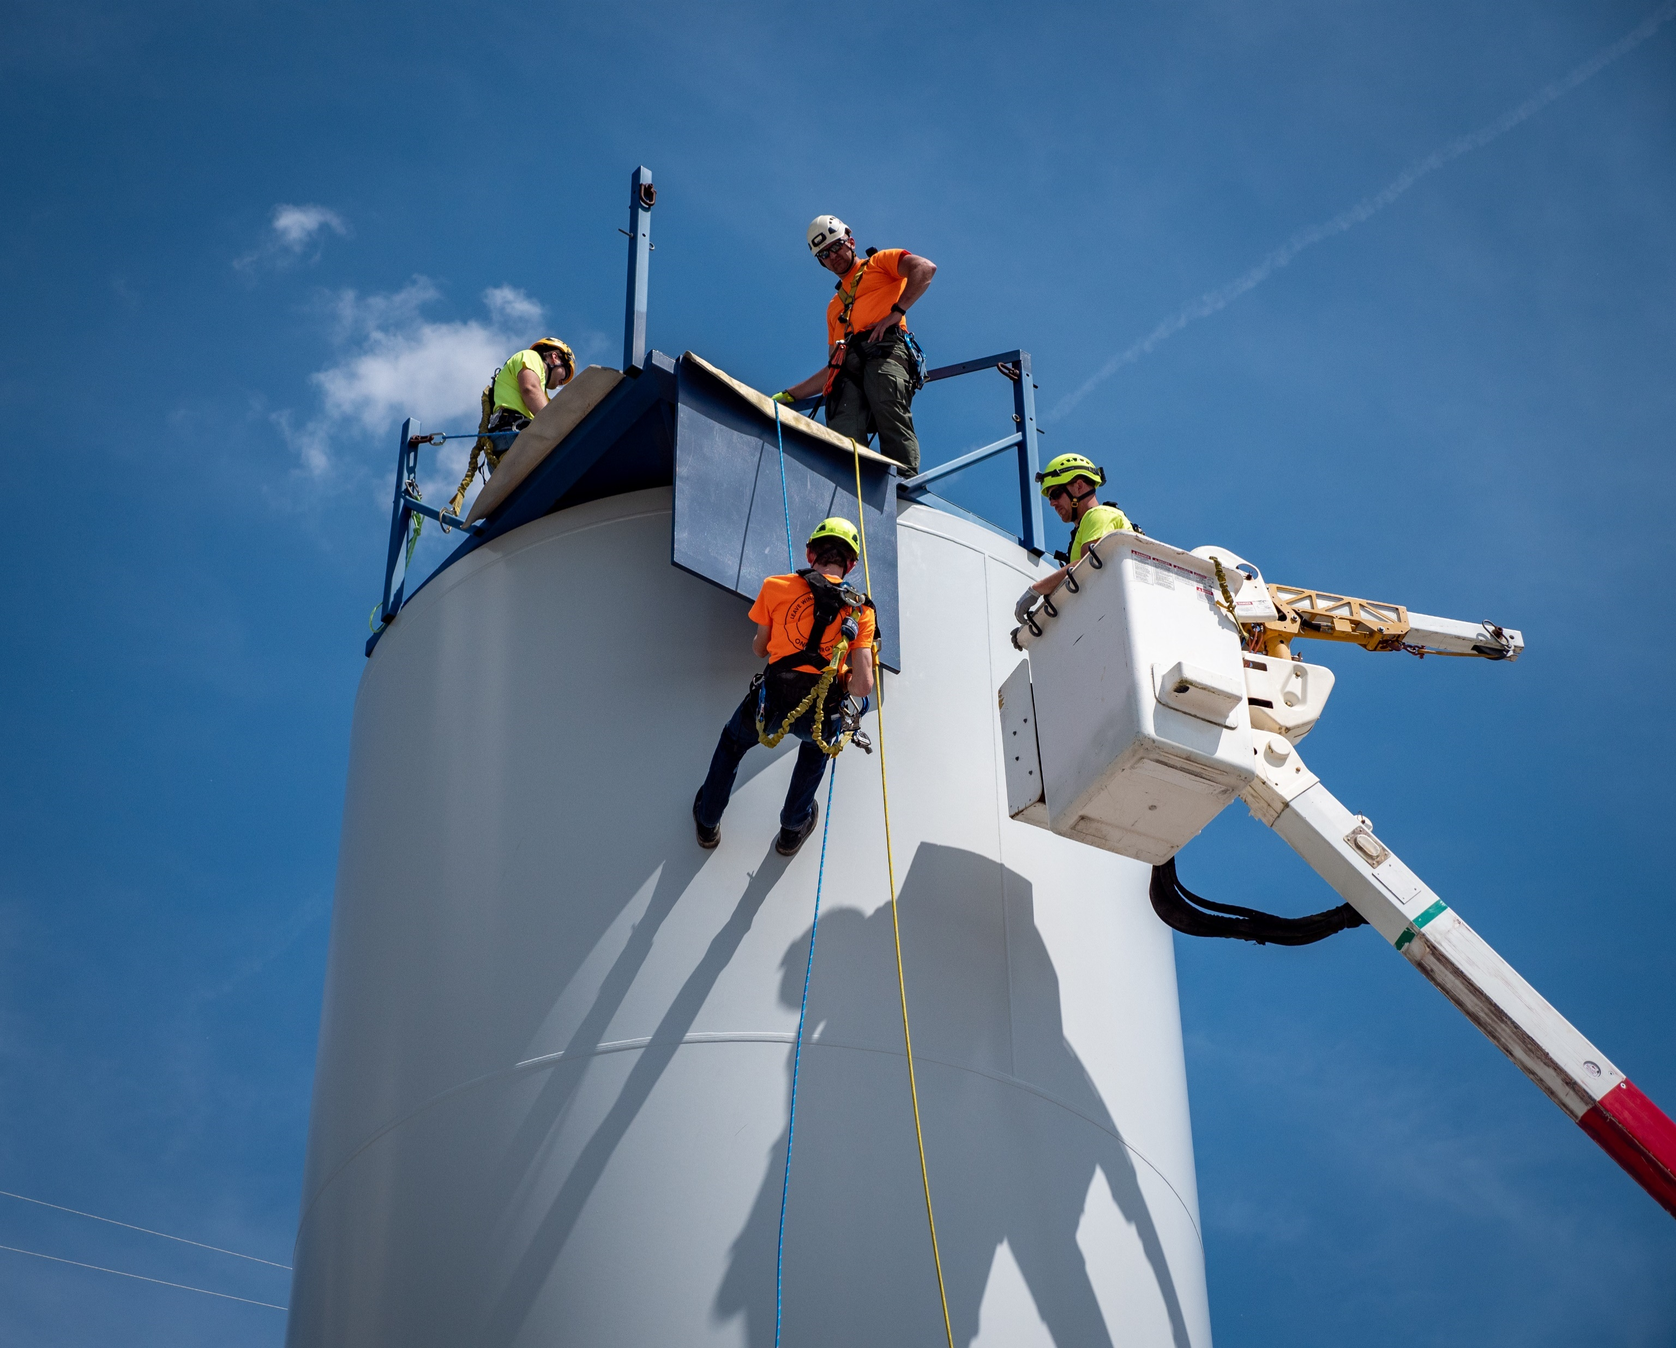

Do not post
9. pictures/videos that compromise the safety of yourself or other employees.

Slide 14


Do not post
10. pictures/videos that do not comply with OSHA.

Slide 15


Unsure
*When unsure: Ask your department head if you’re uncertain about the content you’re posting.

Slide 16

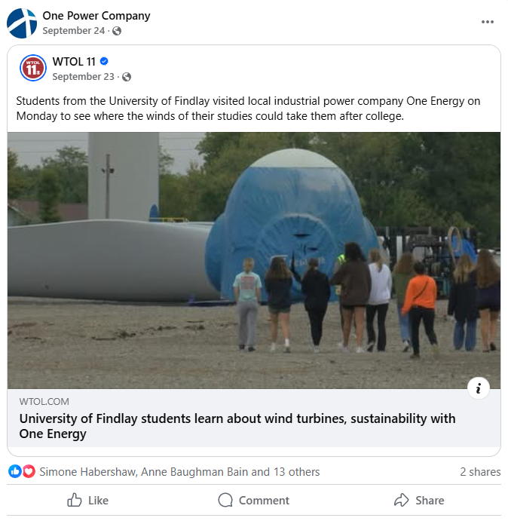
Okay to post
1. anything already posted on a One Power social media account.

Slide 17
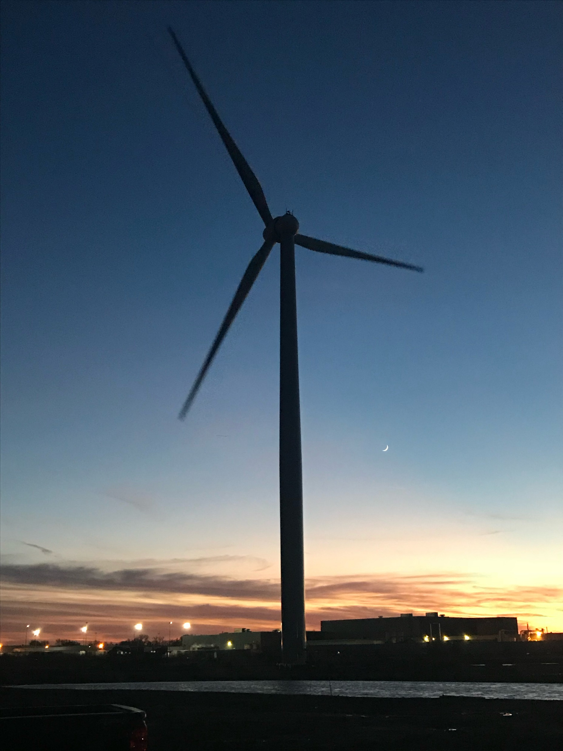
Okay to post
2. photos of operating turbine projects safely taken on your personal phone.

Slide 18
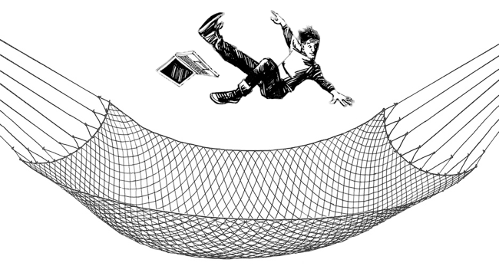
Safety net
Email social@onepower.com the image/video you are uploading.

Slide 19

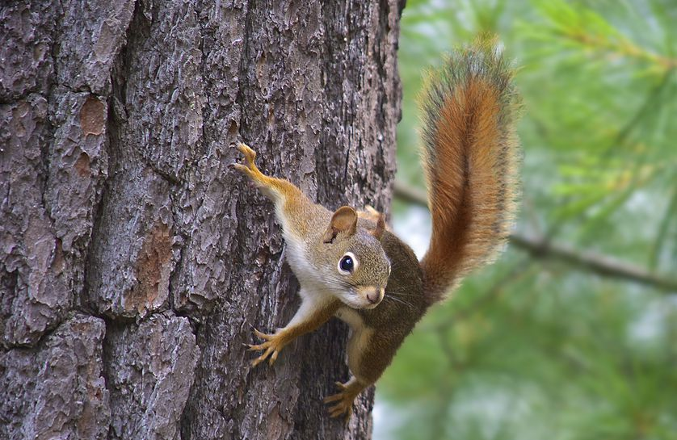
examples
If you are running a skid-steer and want to take a picture of a cute squirrel and post it on Snapchat…
DON’T.
It isn’t safe.

Slide 20
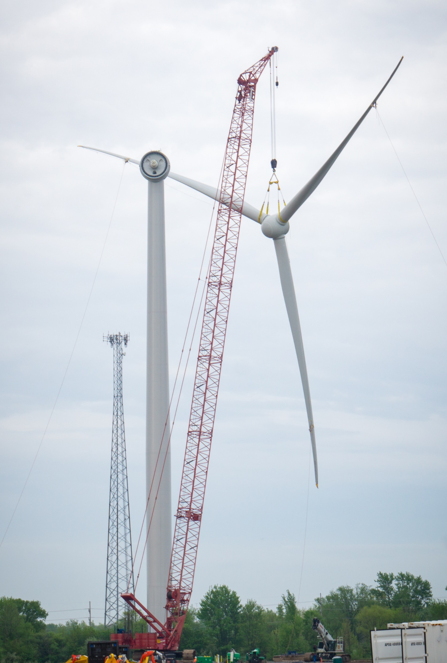
examples
If you are visiting a construction site to watch a rotor fly and want to post some pictures to show off how cool it is…
DON’T.
Before posting, ask your department head if everything looks okay. If it IS approved, post and email a copy of the picture to social@onepower.com.

Slide 21
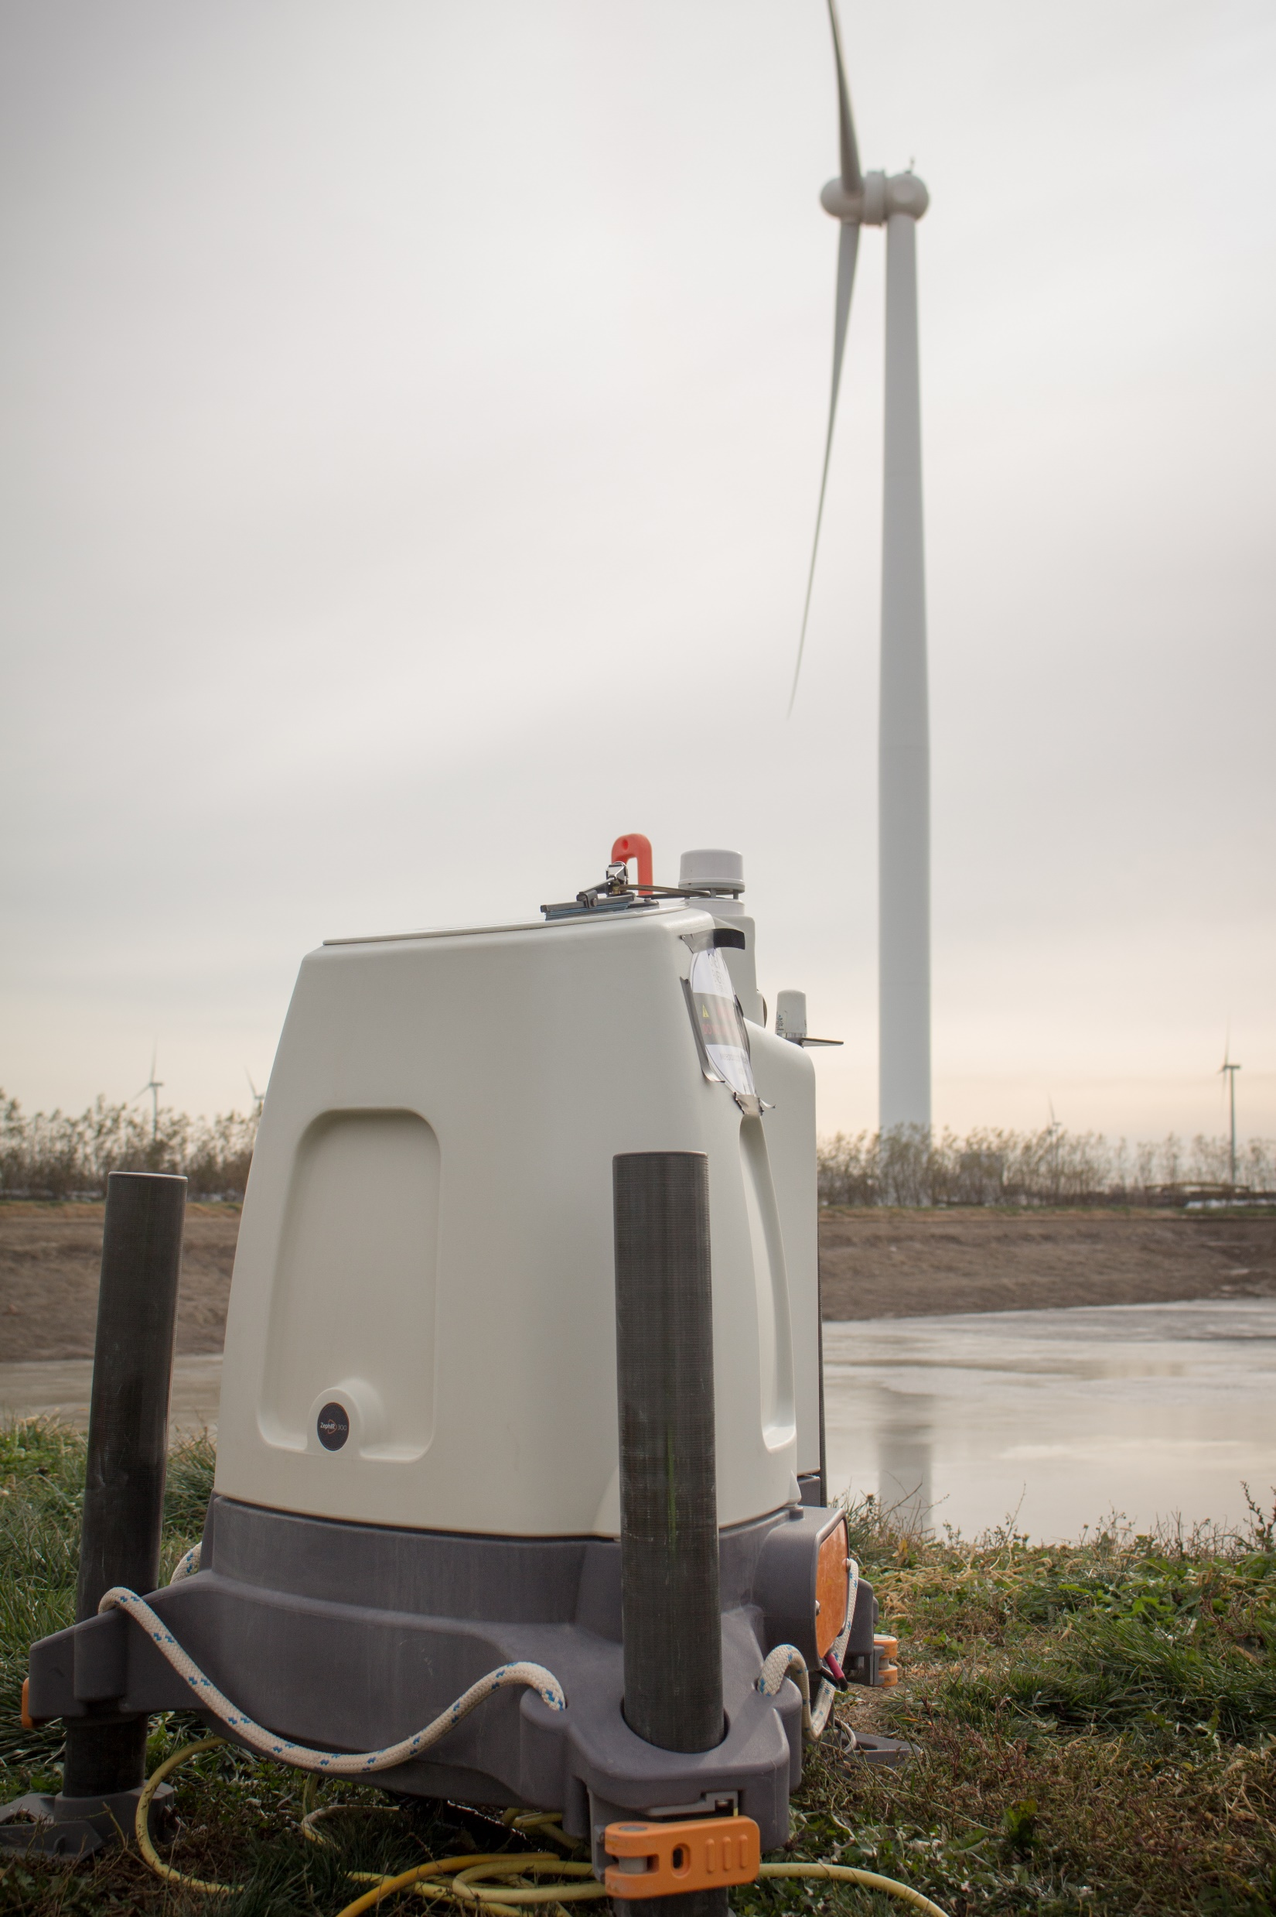
examples
If you’re dropping off a LiDAR at a customer’s site and you want to post a video of your coworker setting it up…
DON’T.
It’s confidential/proprietary and on customer property.

Slide 22
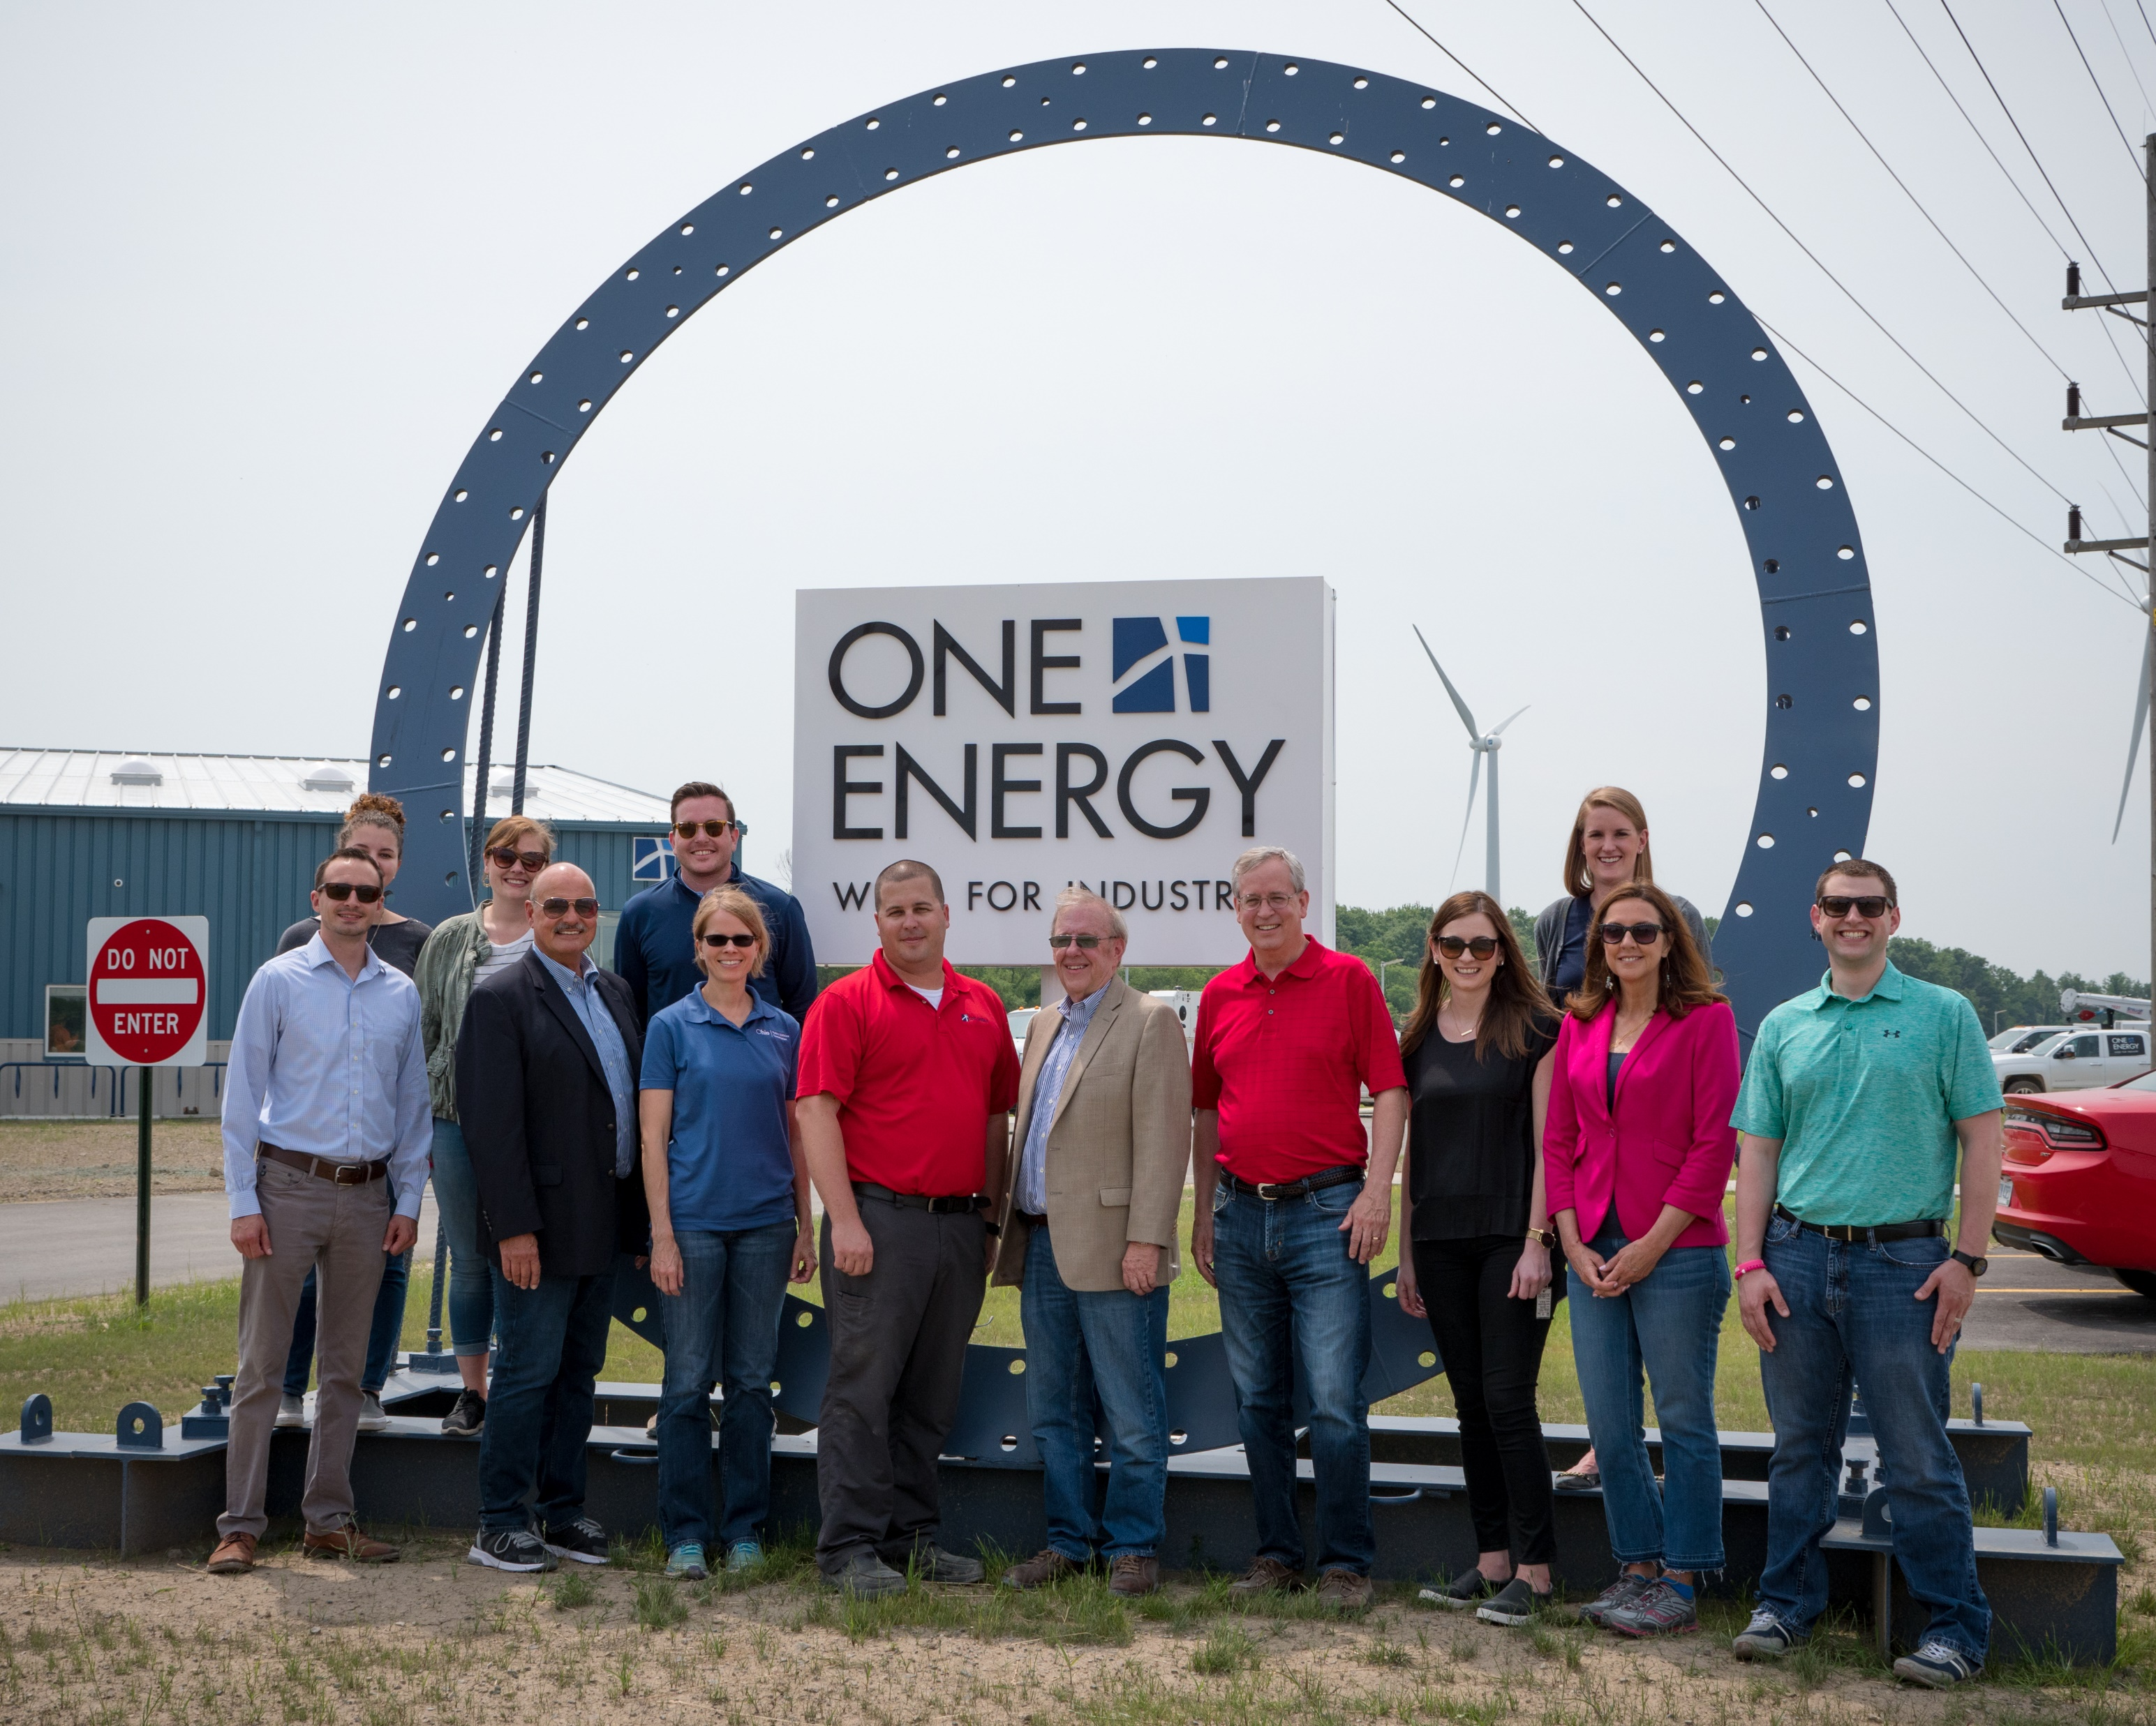
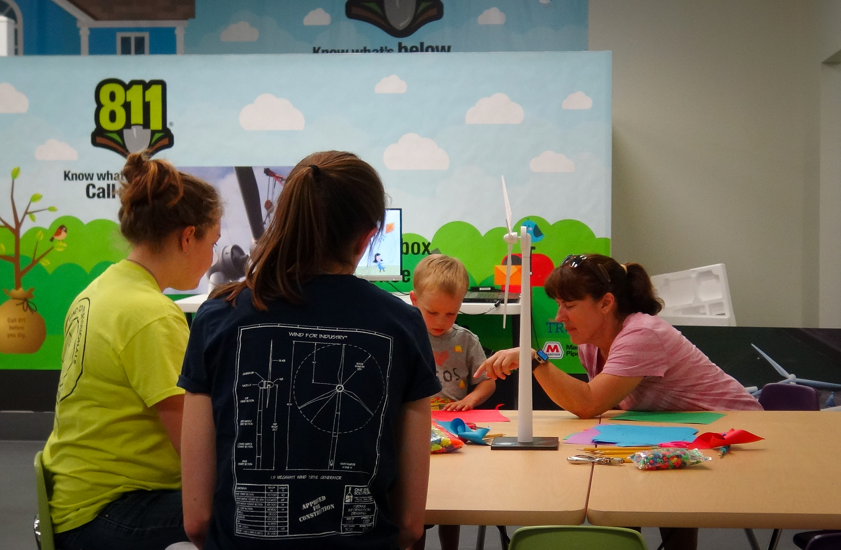
examples
If you take a group photo after a tour/meeting, and there is confidential/proprietary information in the background or there hasn’t been a post created for a One Power social media account…
DON’T POST.
It’s confidential/proprietary or there’s a reason we’re not posting it to our One Power social media accounts.

Slide 23
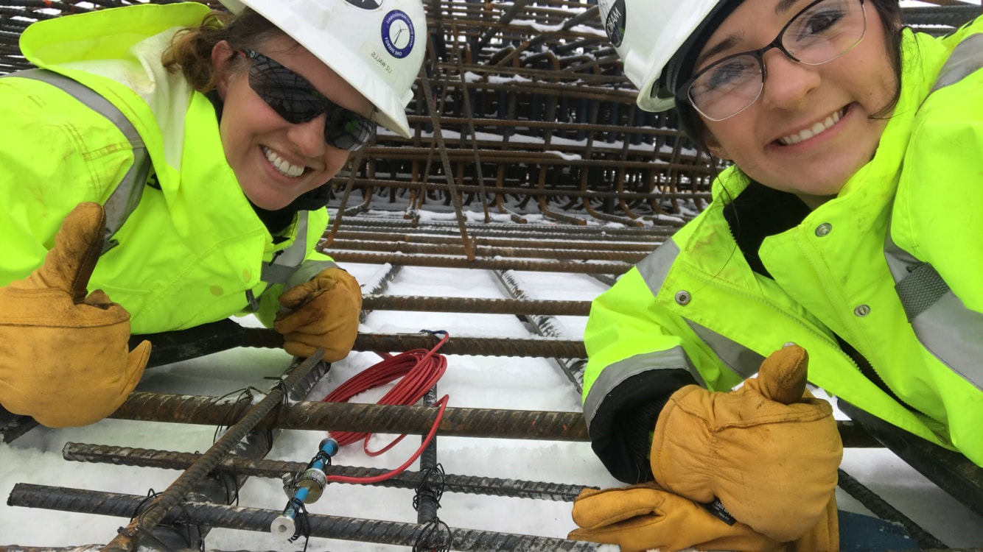
examples
If you safely took a selfie on your work phone* during instrumentation installation while wearing proper PPE…
ASK.
Ask your department head before posting and if it’s approved, email it to social@onepower.com.
*ask your department head to post a photo captured on your work phone.

Slide 24
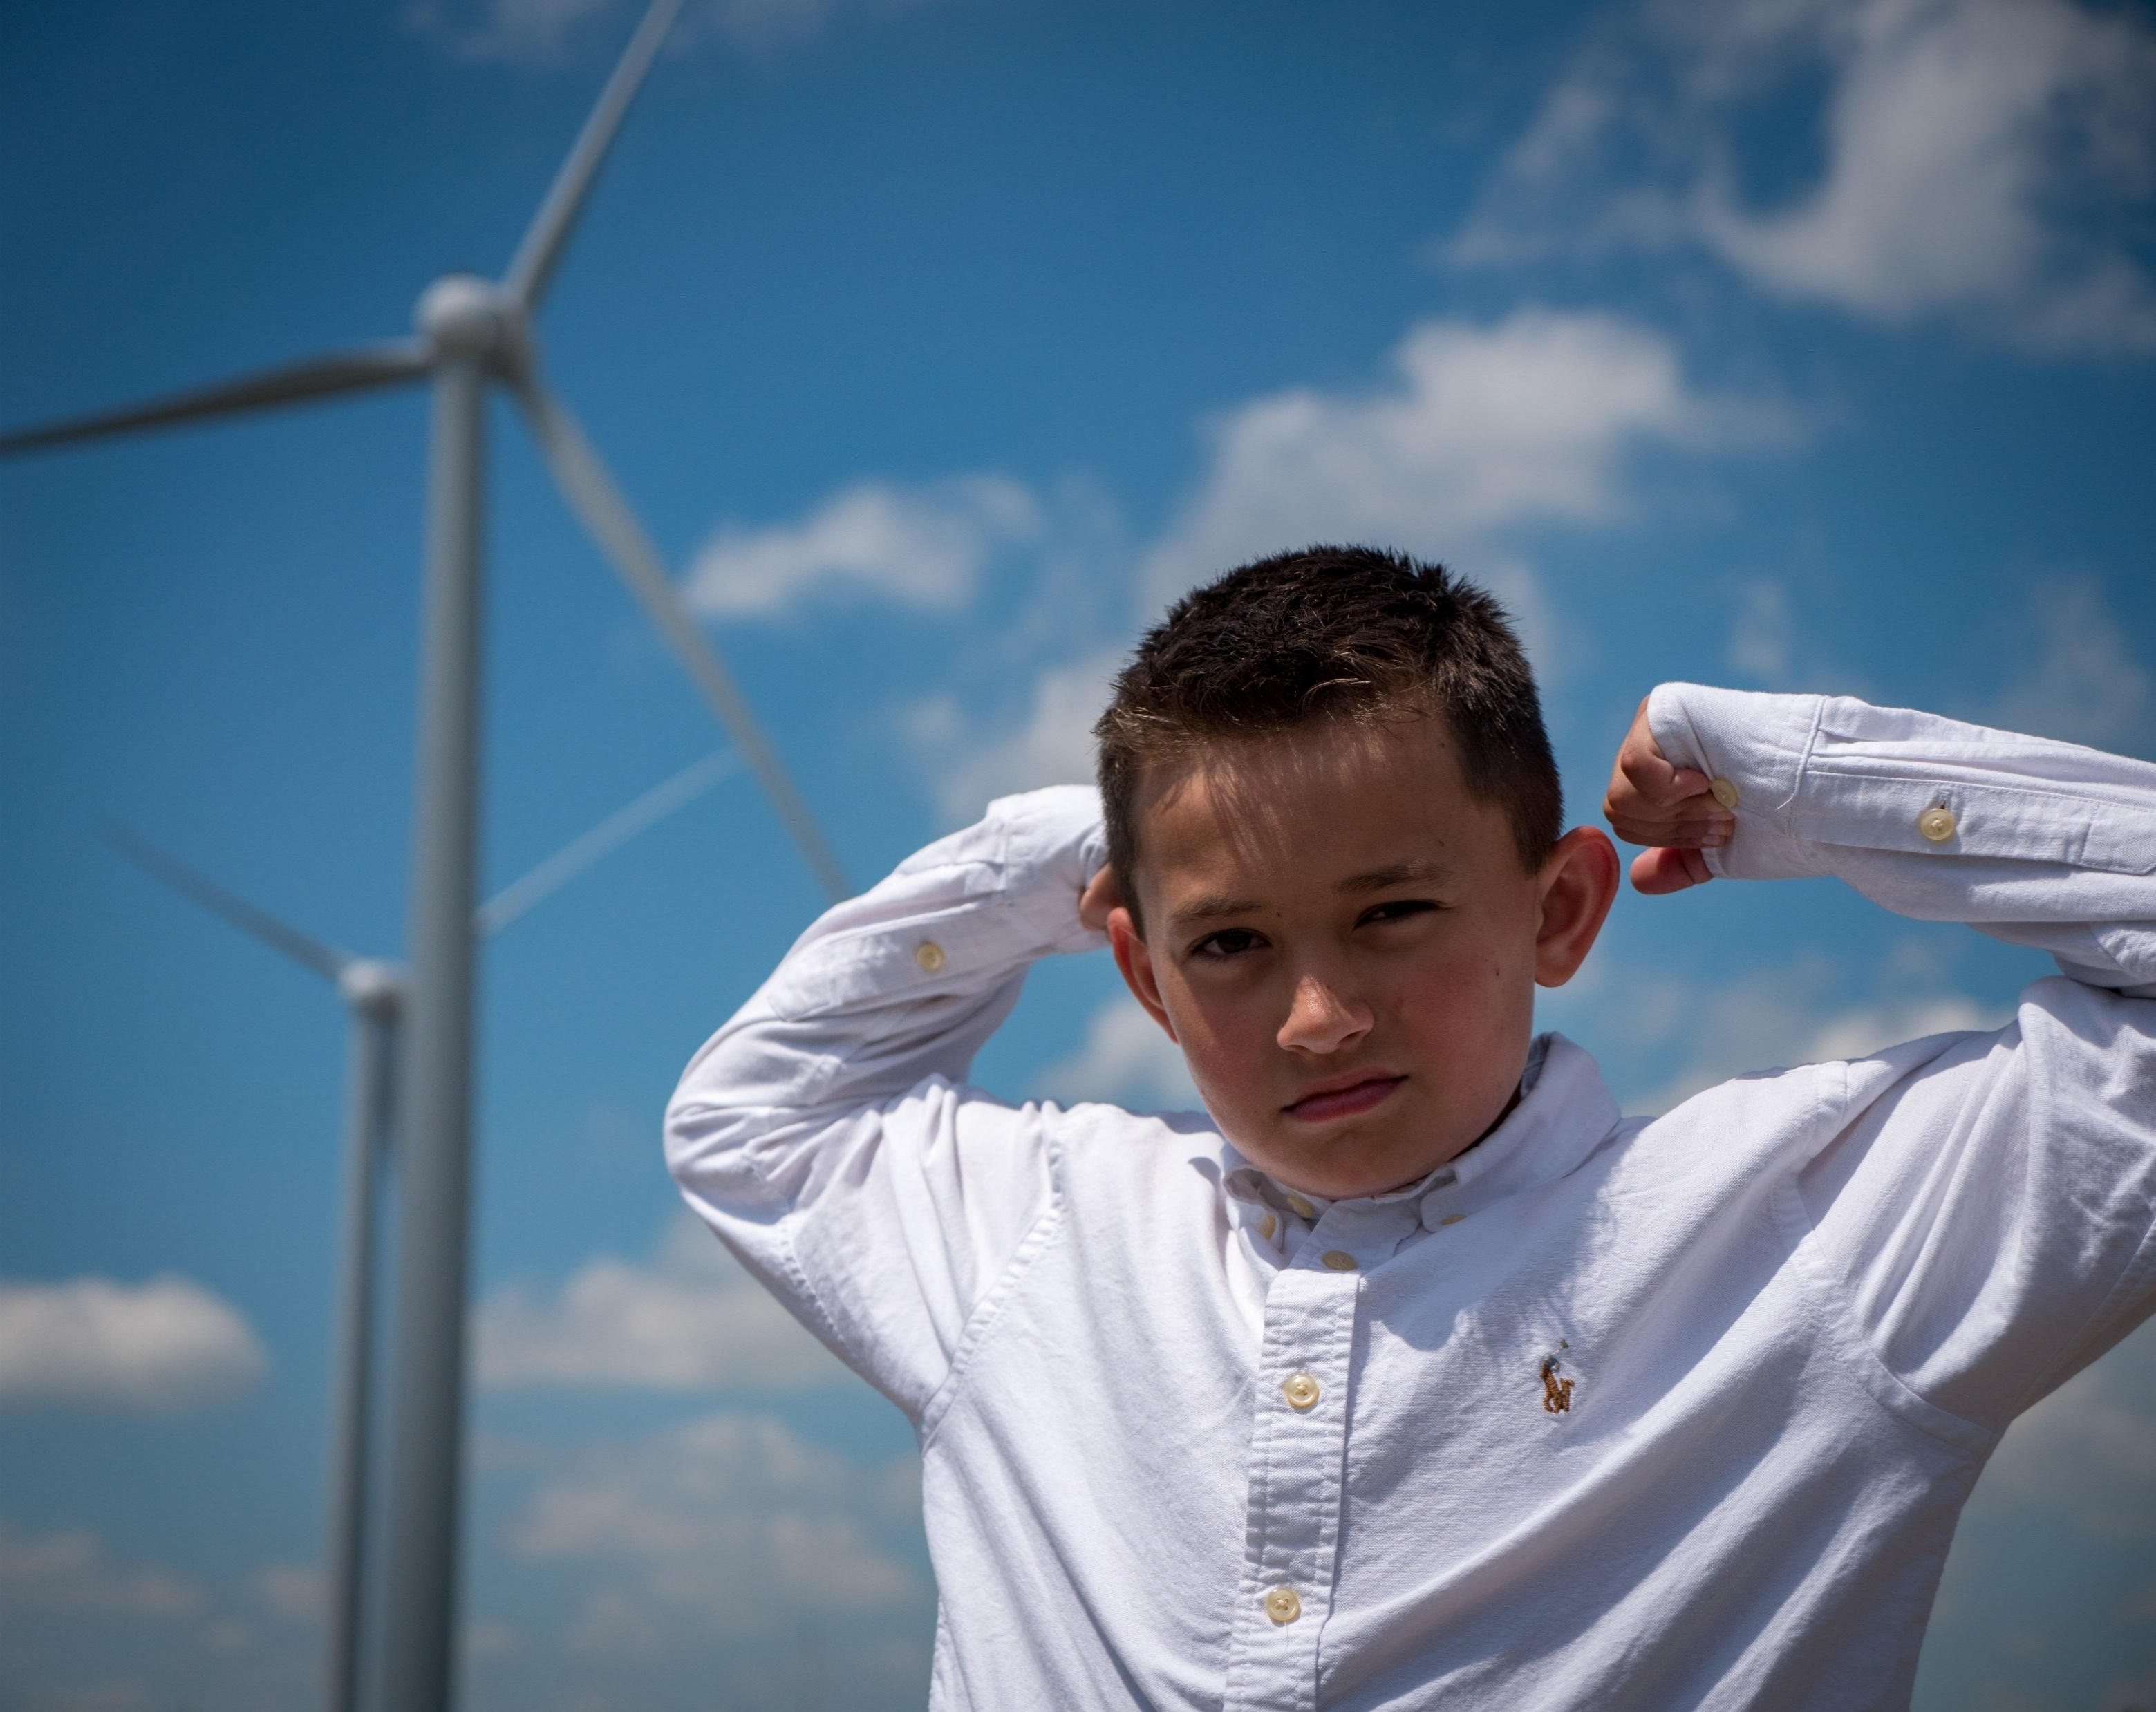
examples
If you bring your child to the NFWC and take a picture of him/her with a turbine in the background…
YES, POST!
And email it to social@onepower.com.

Slide 25
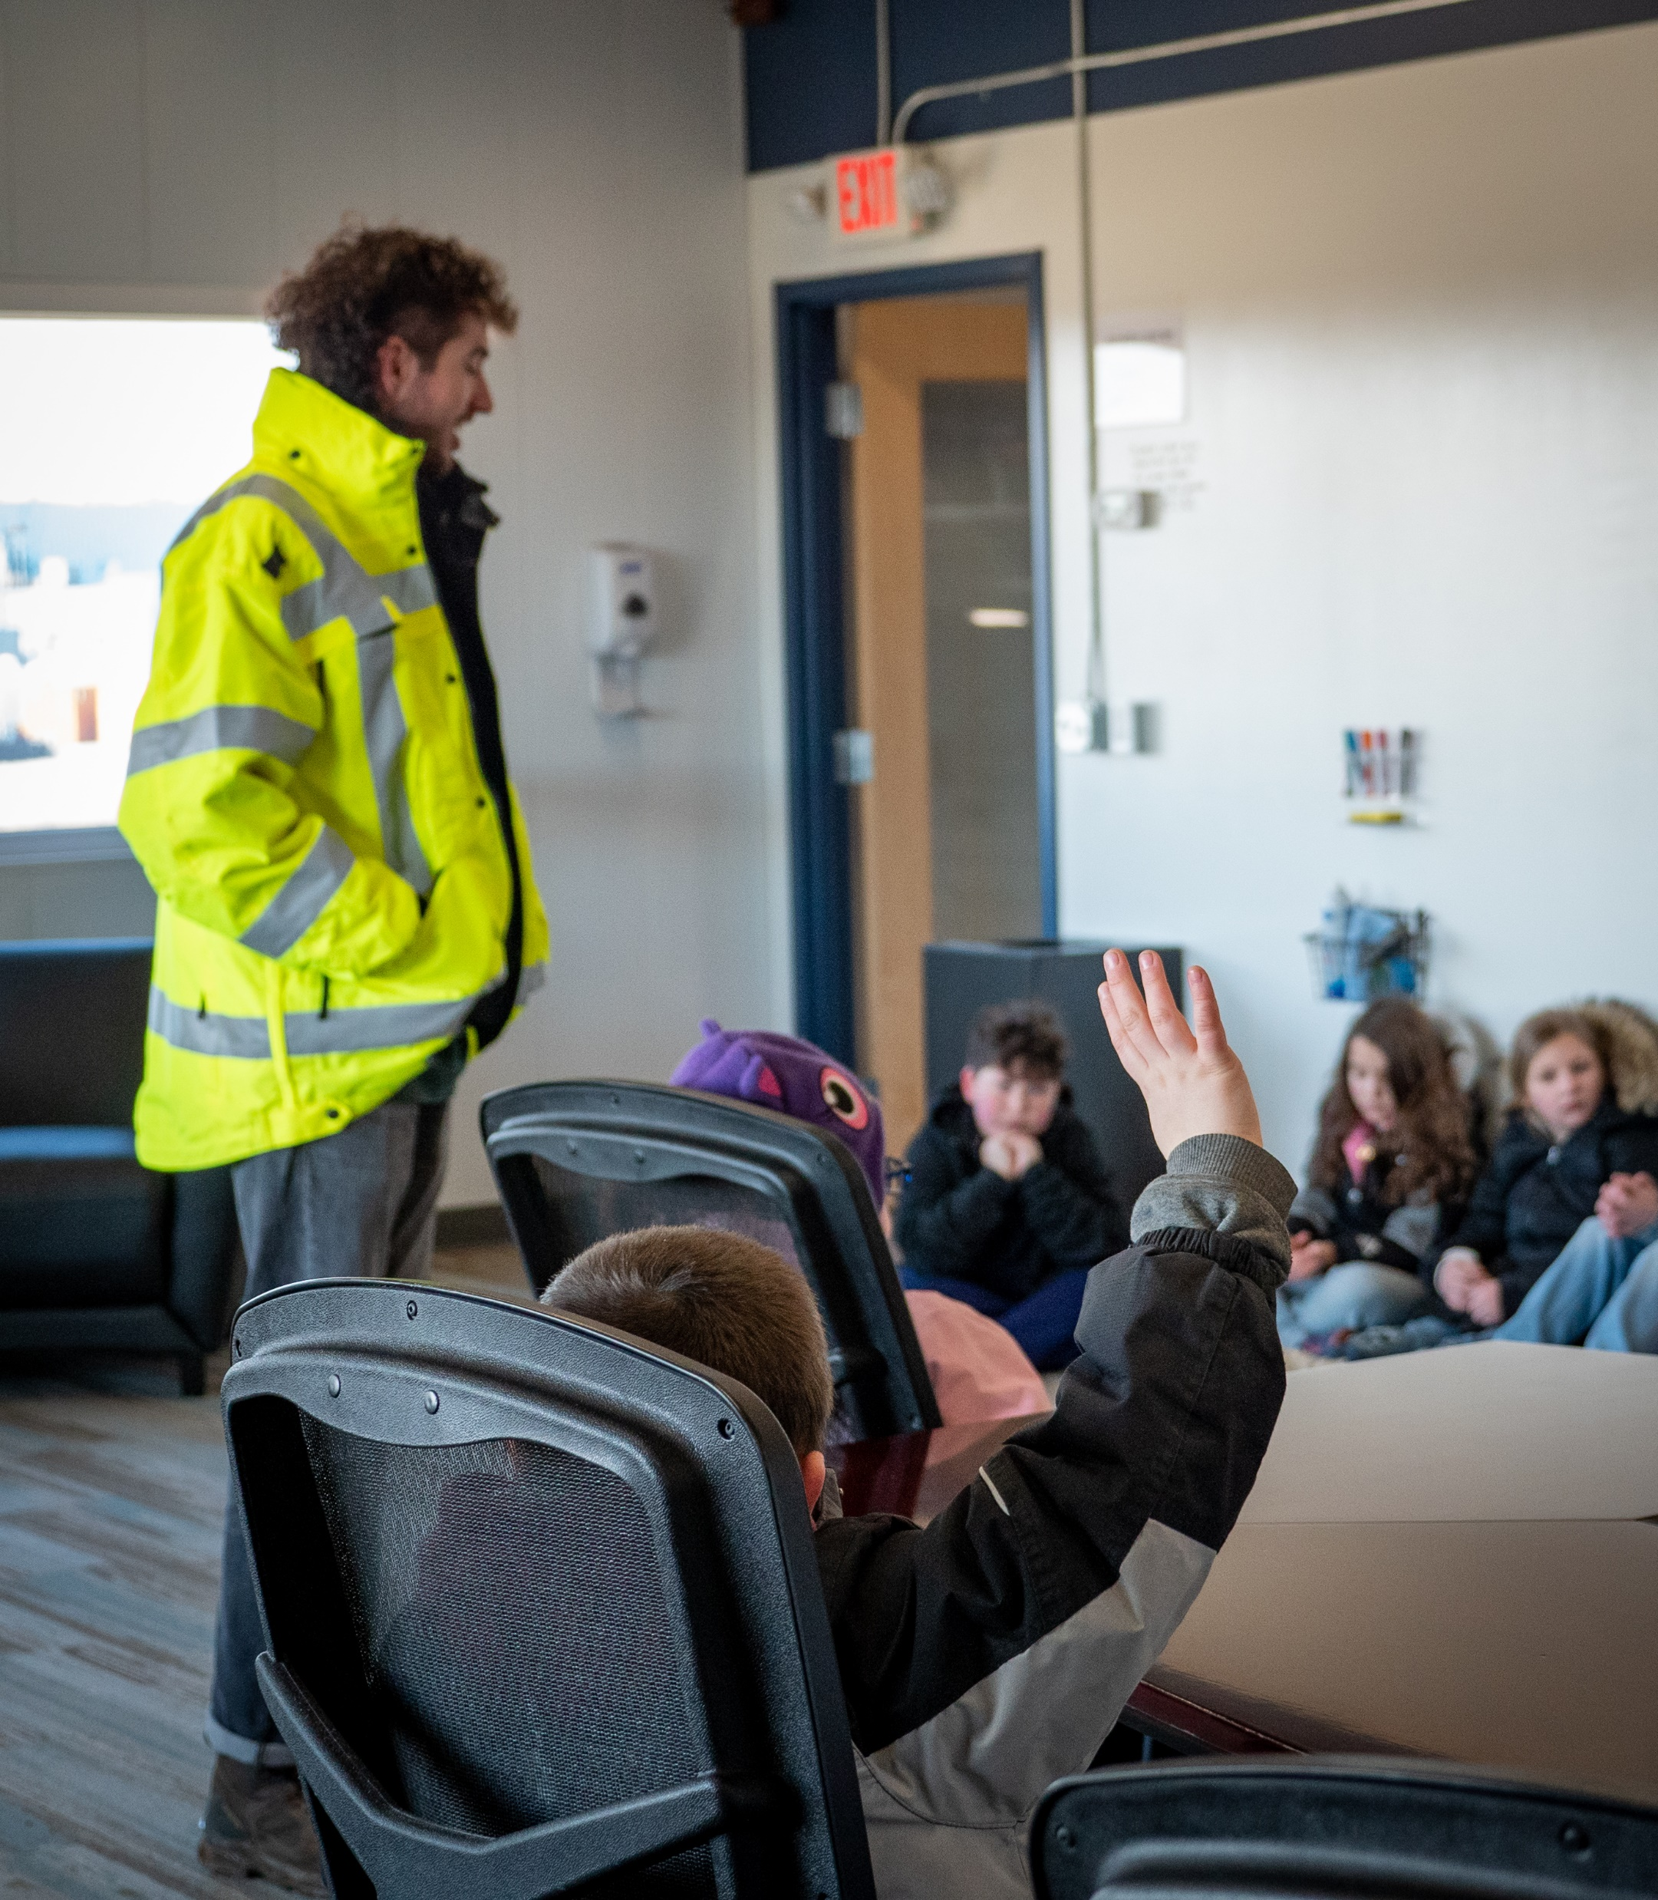
examples
Any questions?
Feel free to reach out to the Storytelling team, or your department head.

