Slide 1
Tower CONNECTIONS
Michelle Kleinau
02/18/2019

Slide 2
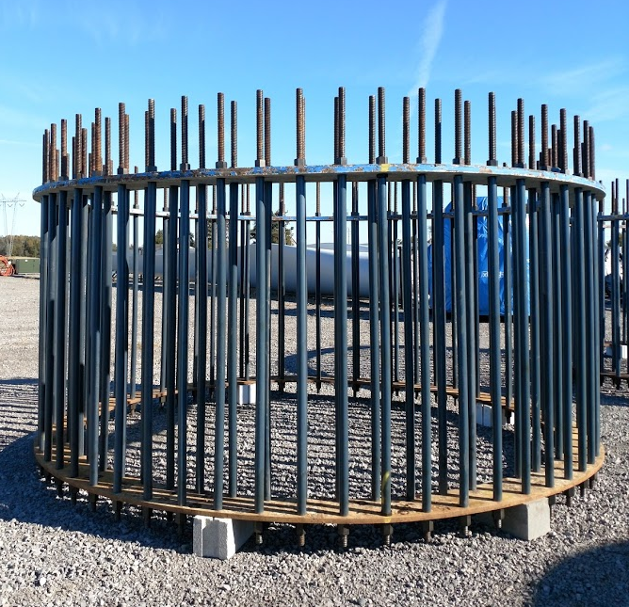
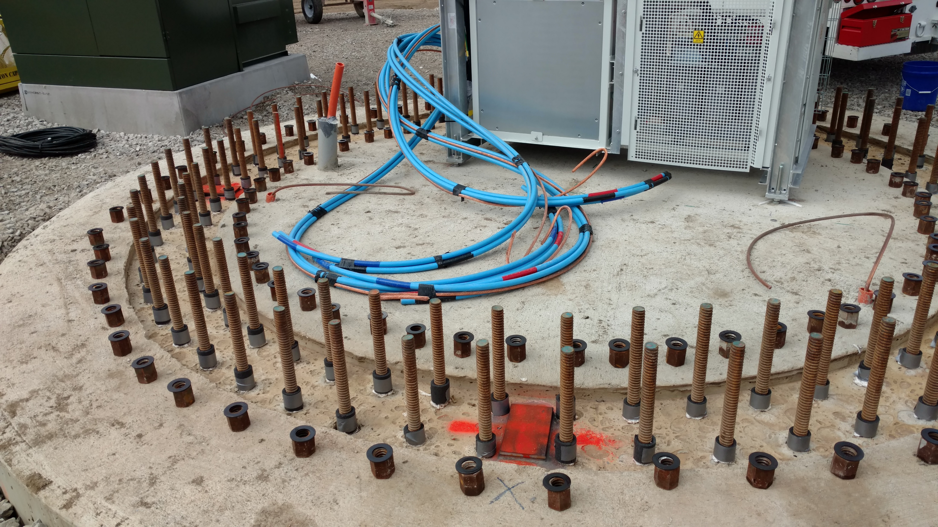
ANCHOR BOLTS
#11 ASTM A615 Grade 75 – per RRC SE1810019 S-2

Slide 3
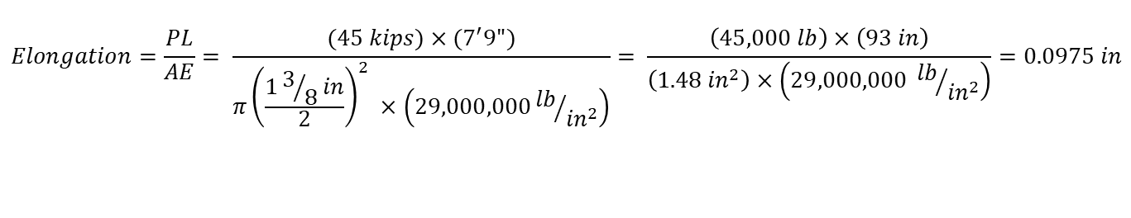
TENSION PROCEDURE
Requirements – per RRC SE181001
  Min grout strength prior to tension: 3,500 psi (RRC S-7)
  Post-tension: 45 kips +10/-0 kips tolerance (RRC S-4)
$$Elongation=\frac{PL}{AE}= \frac{(45 kips)×(7^{′}9")}{π{\left(\frac{13/8in}{2}\right)}^{2} ×\left(29,000,000{lb}/{{in}^{2}}\right)}= \frac{\left(45,000 lb\right)×\left(93 in\right)}{\left(1.48 {in}^{2}\right)×\left(29,000,000 {lb}/{{in}^{2}}\right)}=0.0975 in$$
$$Jack Pressure \left(P\right)=\frac{Required Tension \left(F\right)}{Effective Jack Area \left(A\right)}= \frac{(45 kips)}{2×\left(6.49 {in}^{2}\right)}= \frac{(45,000 lb)}{\left(12.98 {in}^{2}\right)}=3,467 psi$$
$$Max Jack Pressure \left(P_{max}\right)=\frac{Max Tension \left(F_{max}\right)}{Effective Jack Area \left(A\right)}= \frac{(55 kips)}{2×\left(6.49 {in}^{2}\right)}= \frac{(55,000 lb)}{\left(12.98 {in}^{2}\right)}=4,237 psi$$
In Application:
  Desired elongation: 0.1”
  Pressure setting: 3,500 psi

Slide 4
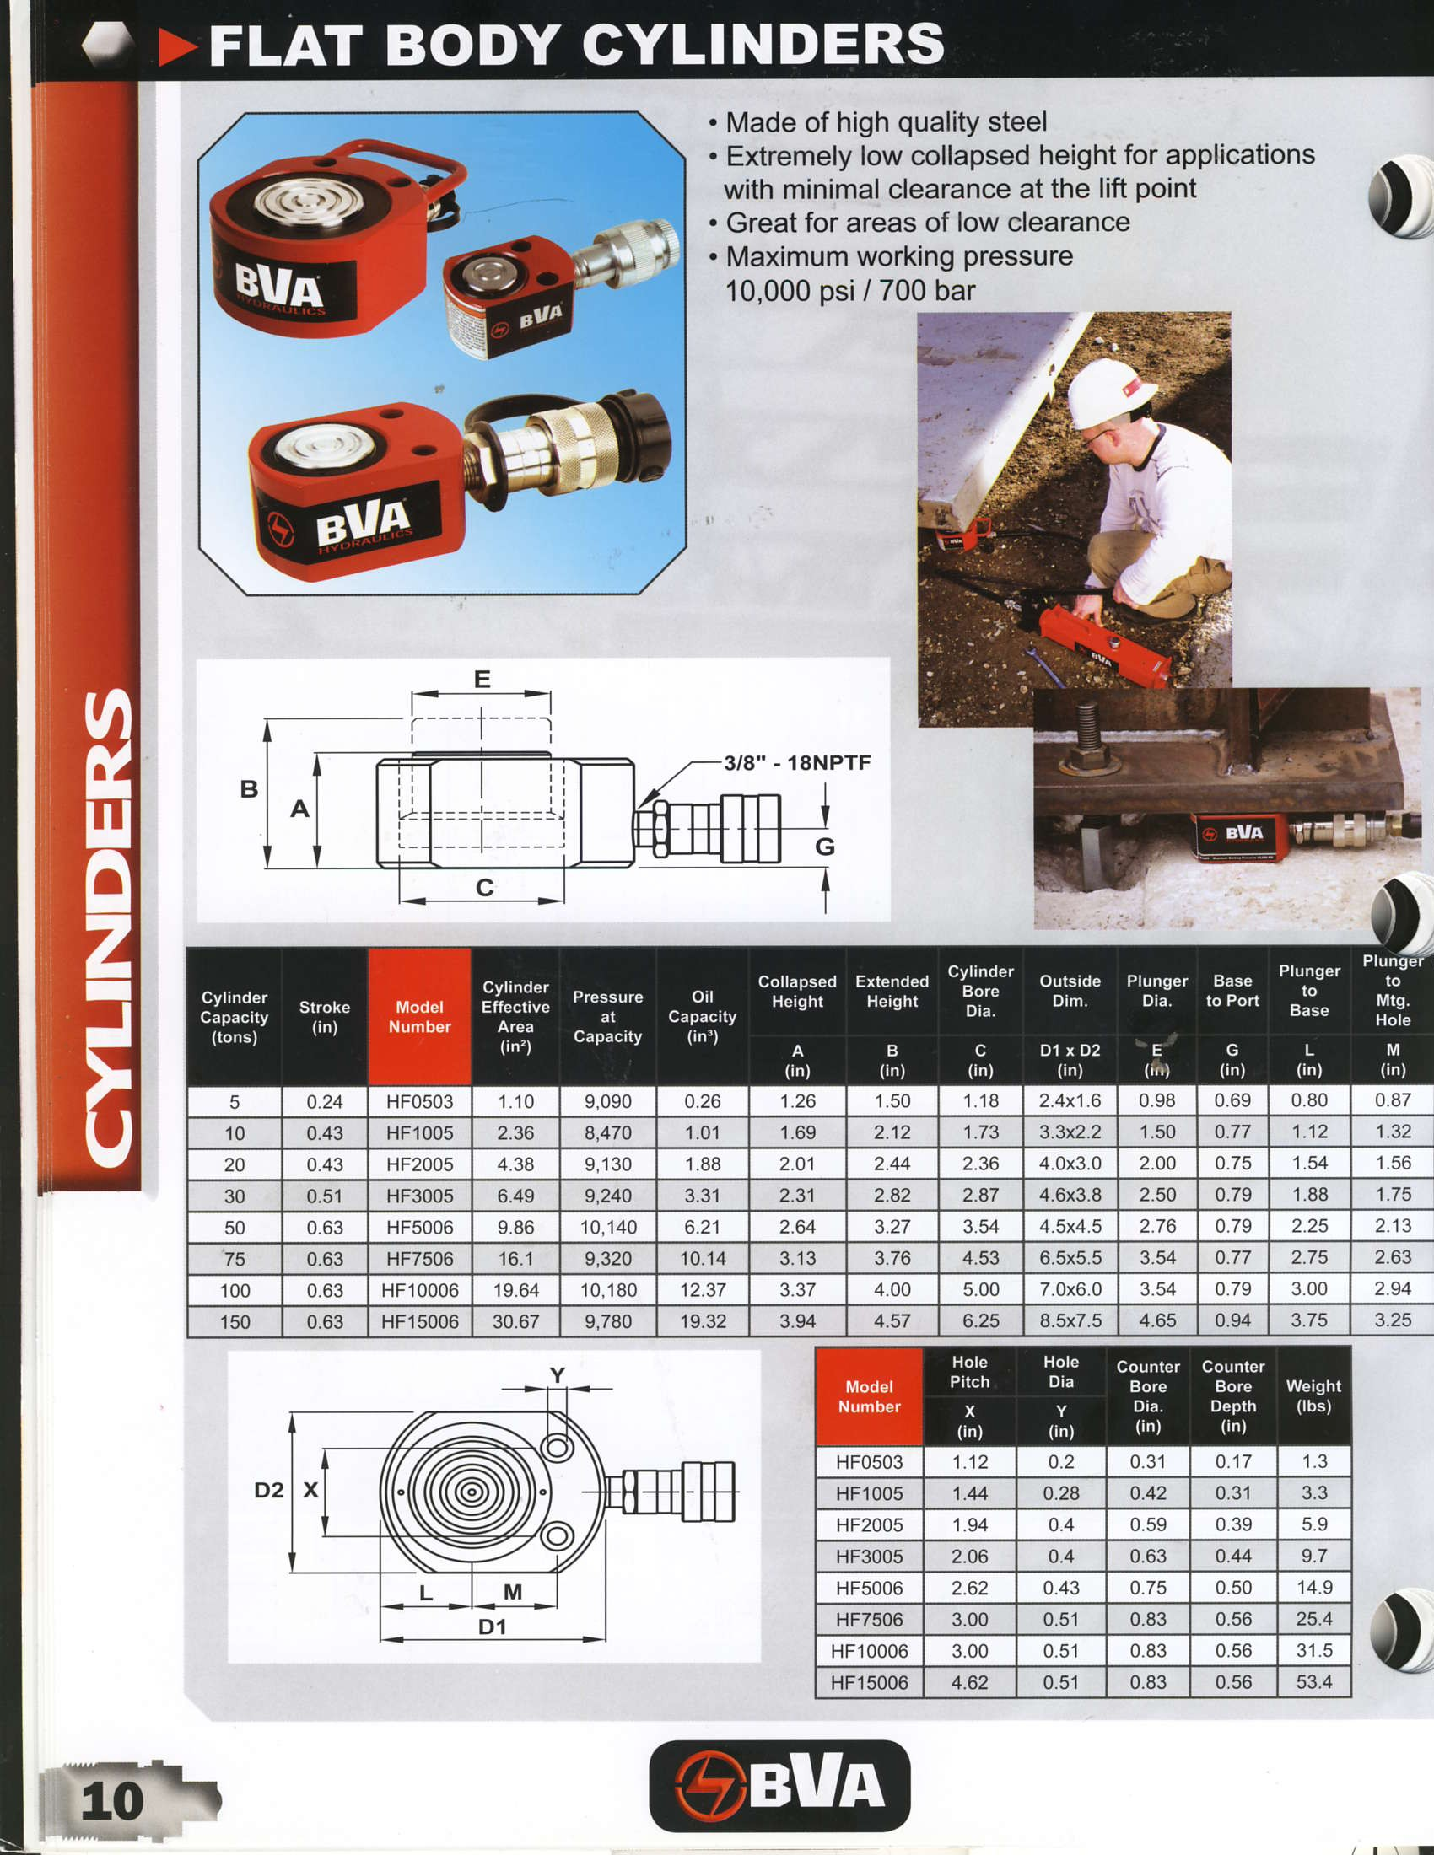

Slide 5
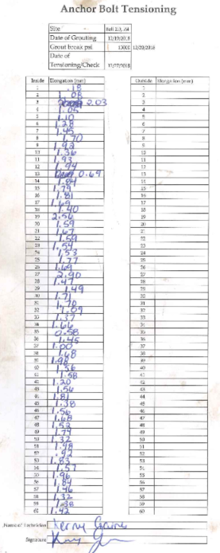
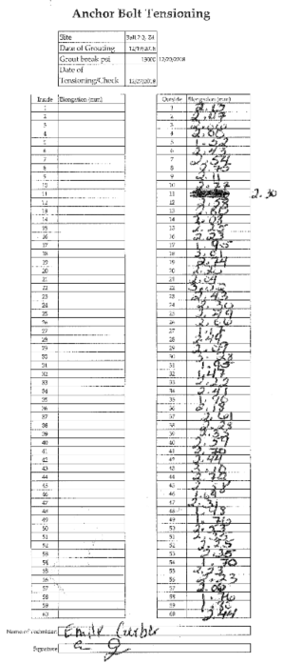
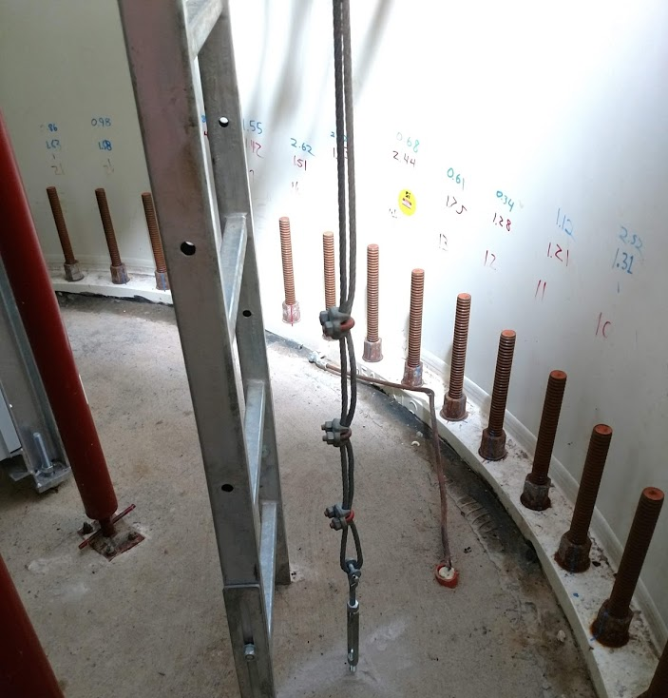
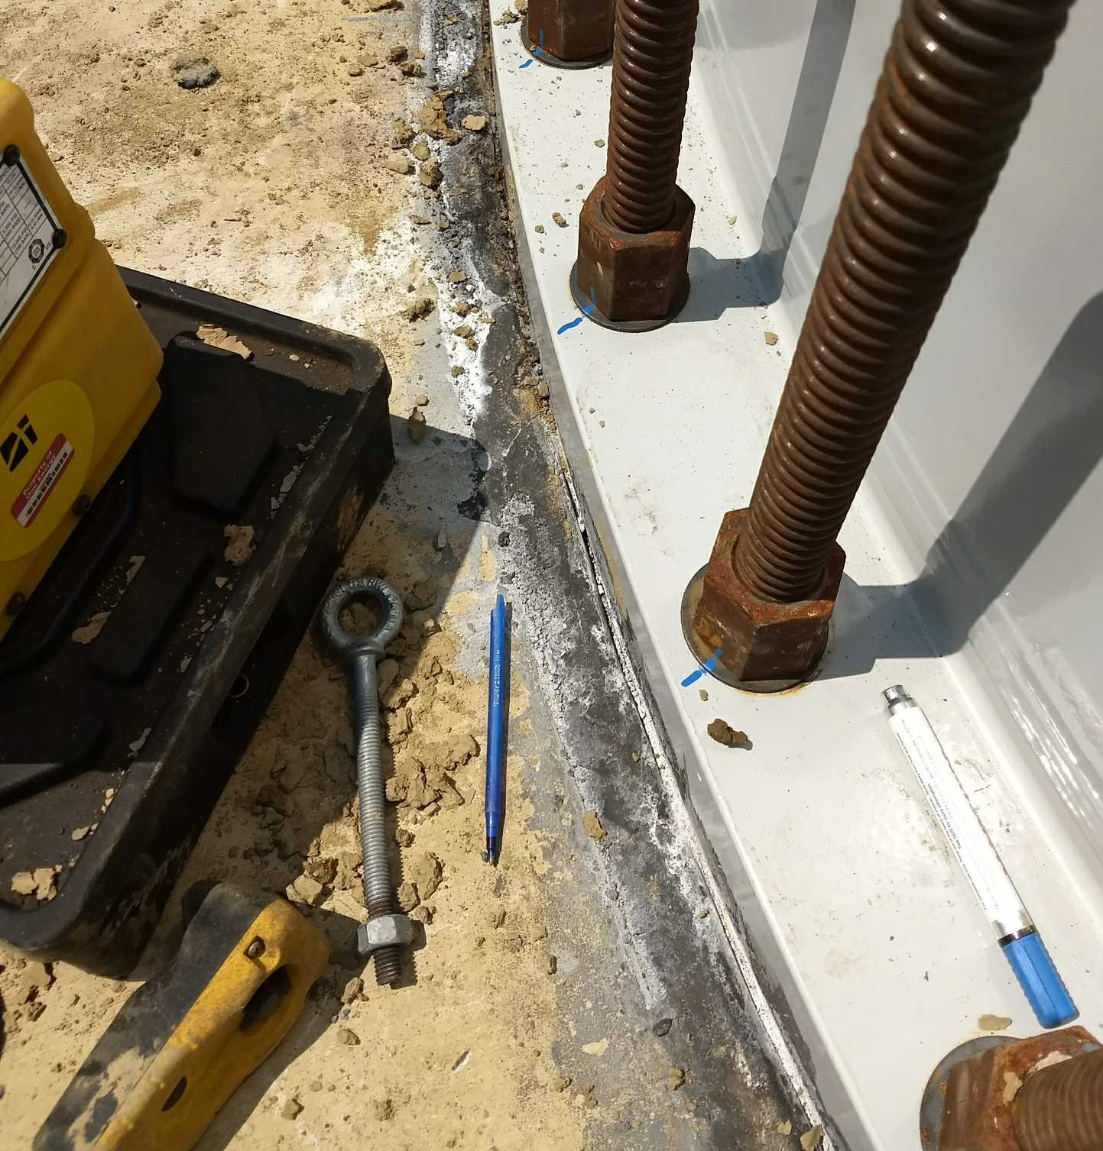
TENSION REPORT

Slide 6
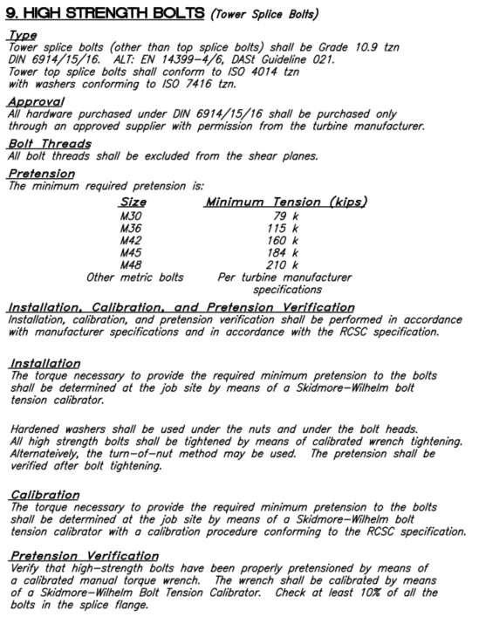
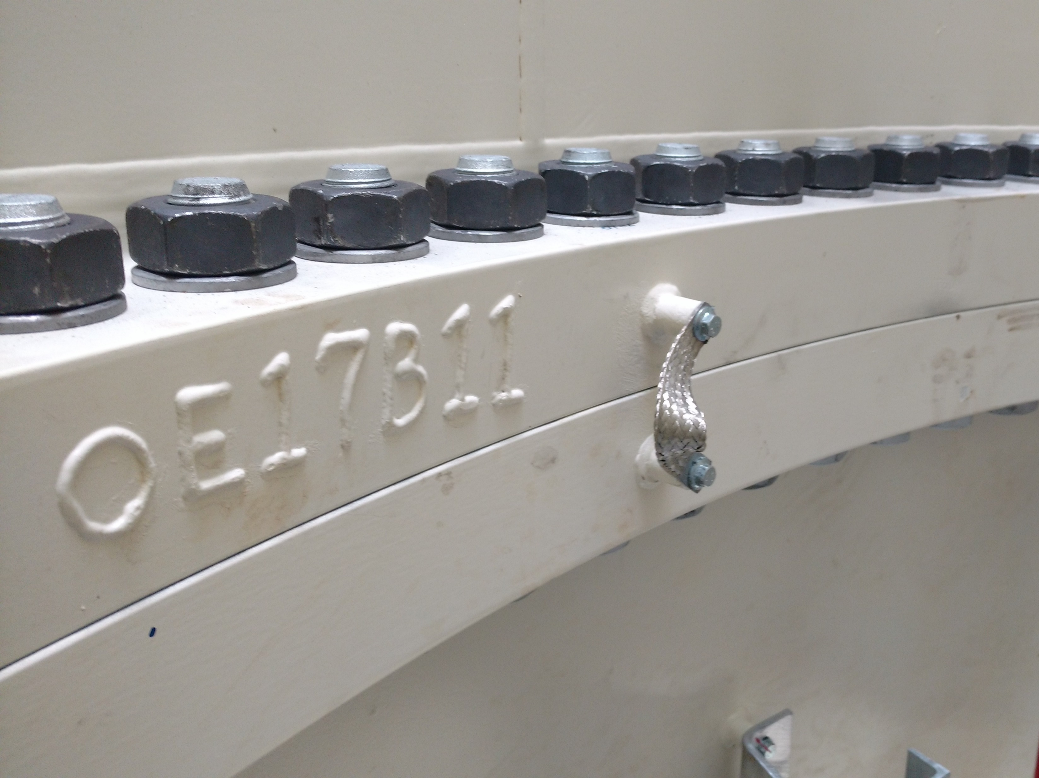
TOWER SPLICE BOLTS
Per Agbayani HH80M-00.20.4.305.24-ver2C

Slide 7
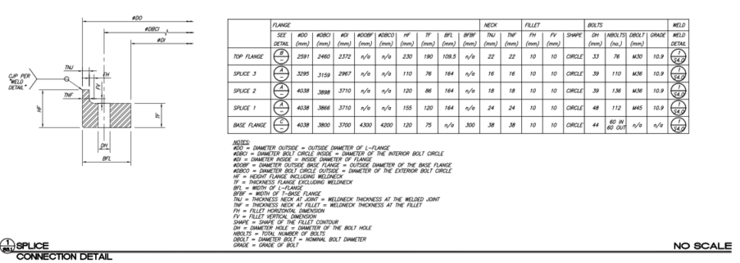
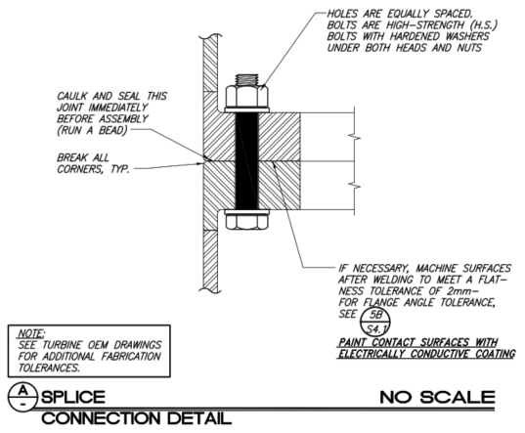
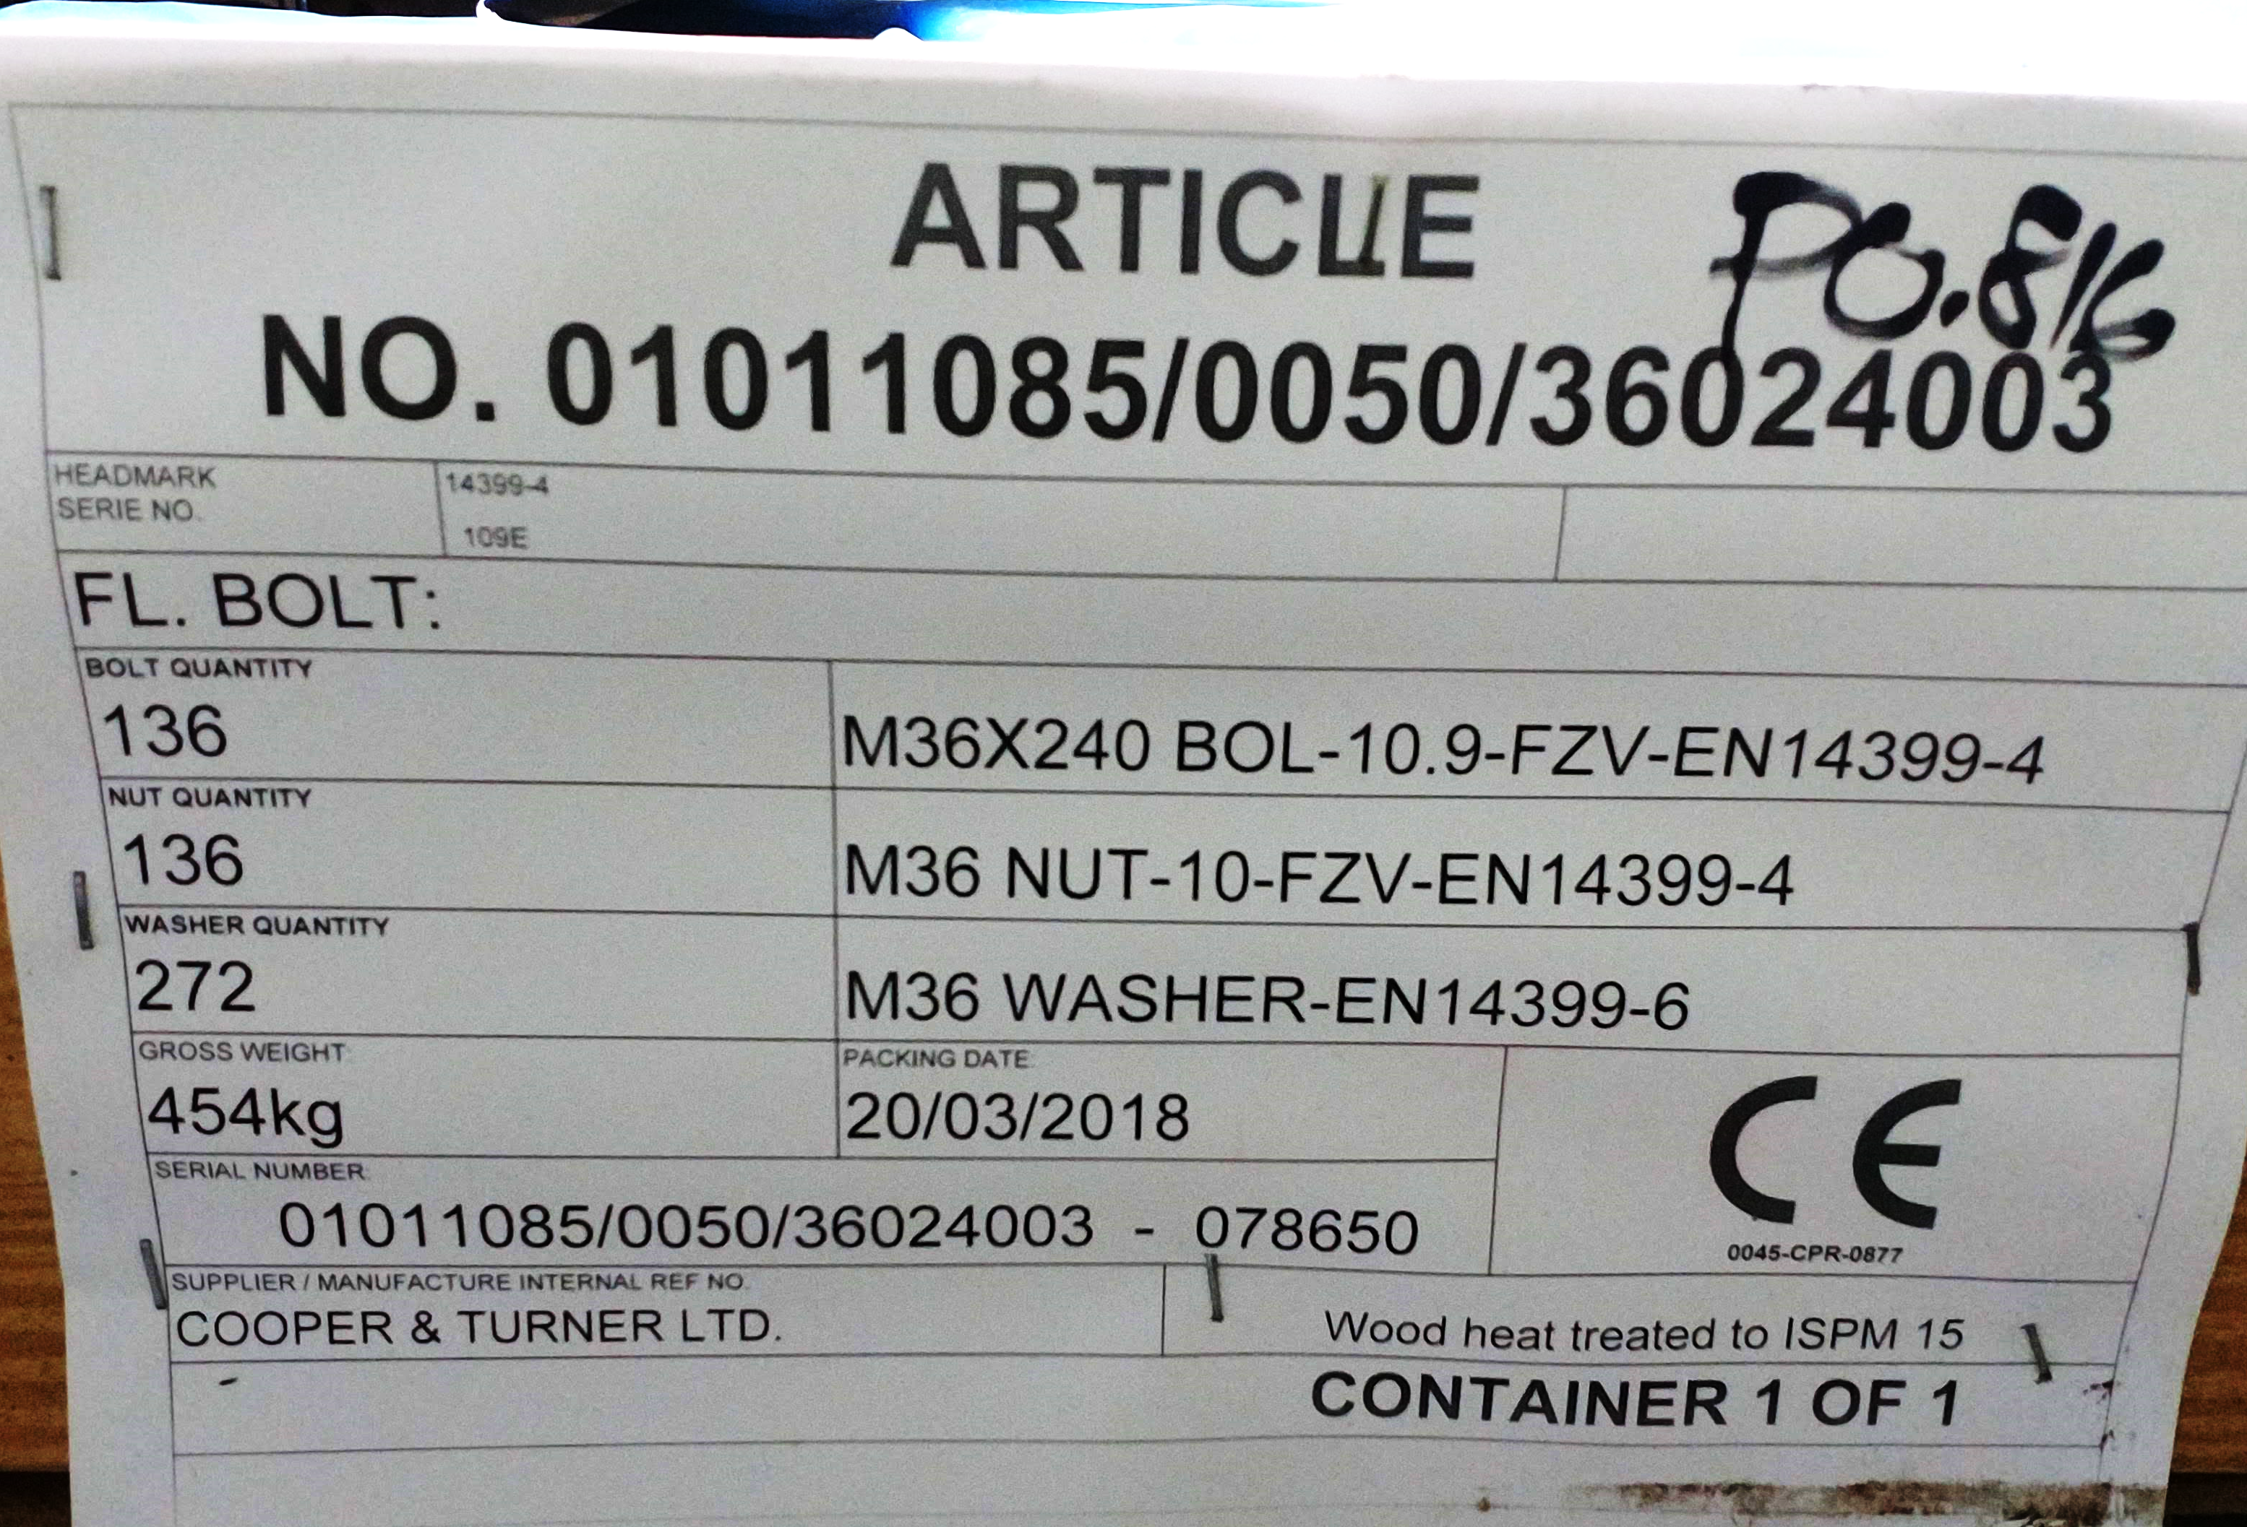
SPLICE DETAILS

Slide 8
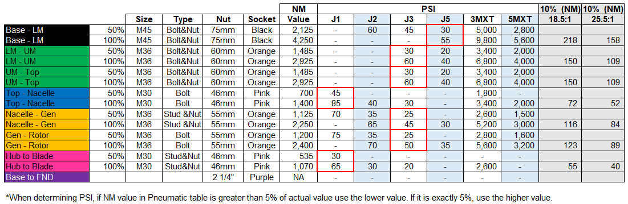
TORQUE GUIDE

Slide 9
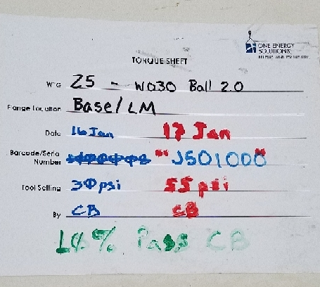
TORQUE REPORT

Slide 10
Questions?

