Slide 1
One Energy portal
&
Pulse Secure
Jordan Swift
10/19/2018

Slide 2
Typical wind farm
Not secure – Servers on Public Facing IPs

Slide 3
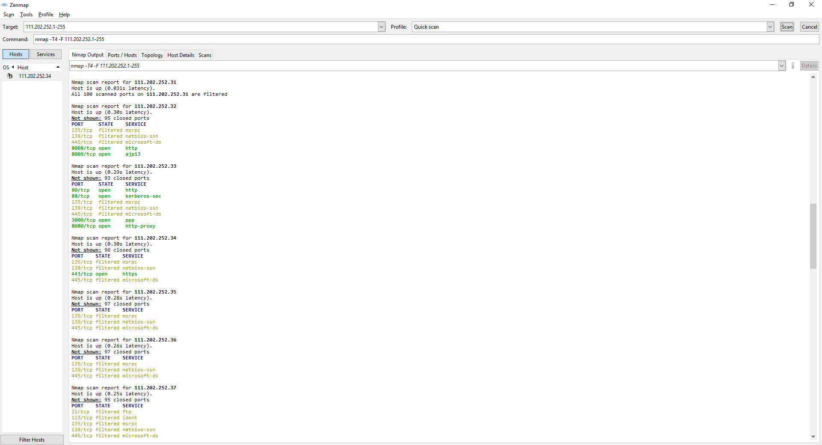
Public facing IP = Hacker’s dream

Slide 4
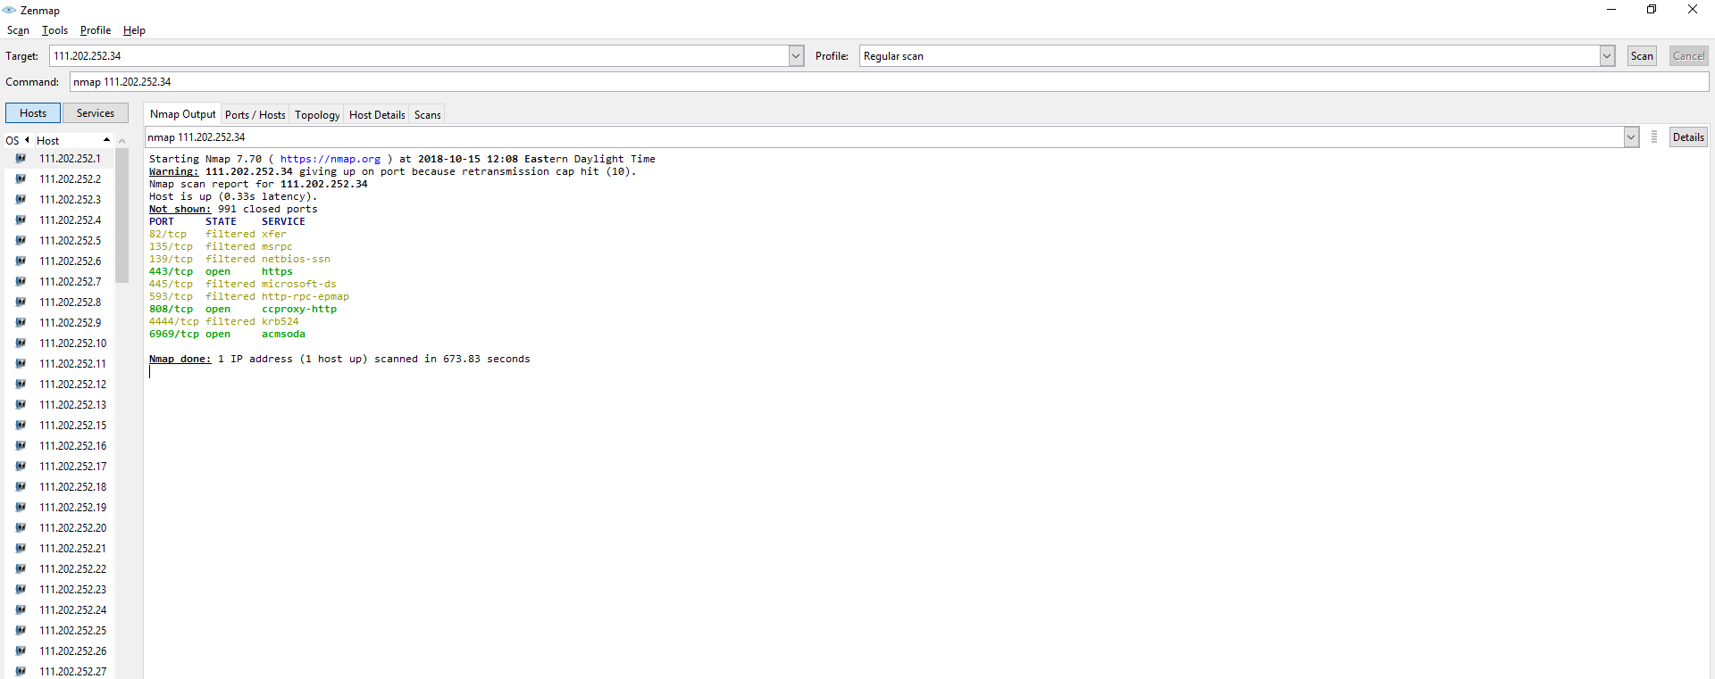
Port scan potential target

Slide 5
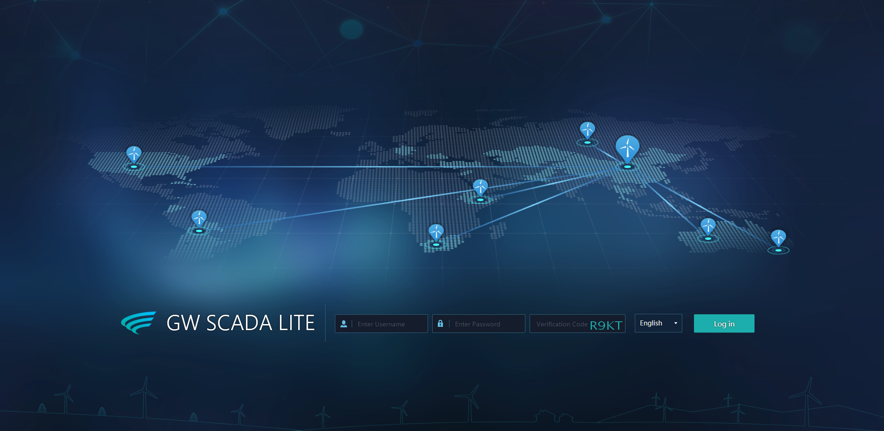
Password cracker for the rest
111.202.252.34:6969

Slide 6
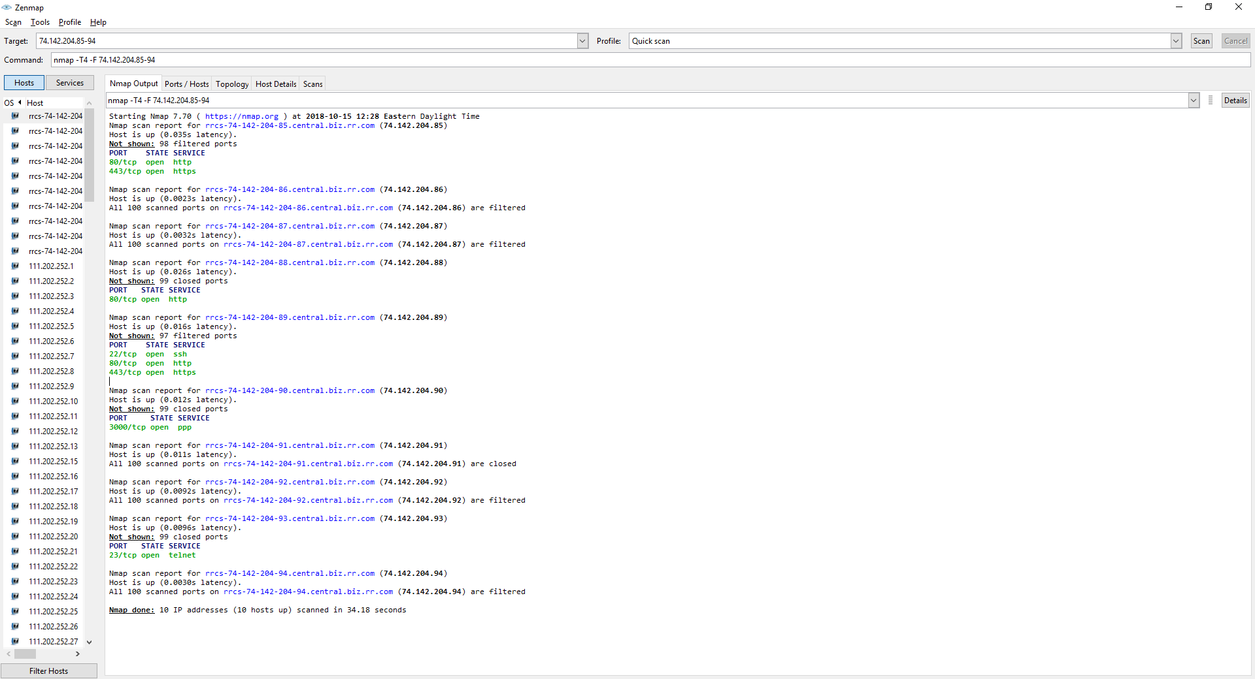
One Energy wind farm - NFWC

Slide 7
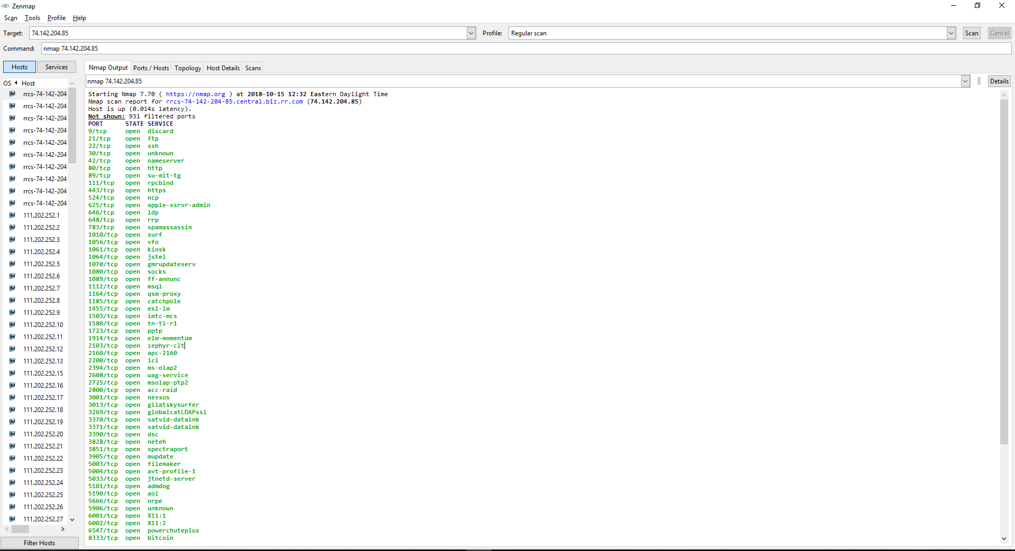
Port scan potential target - ball

Slide 8
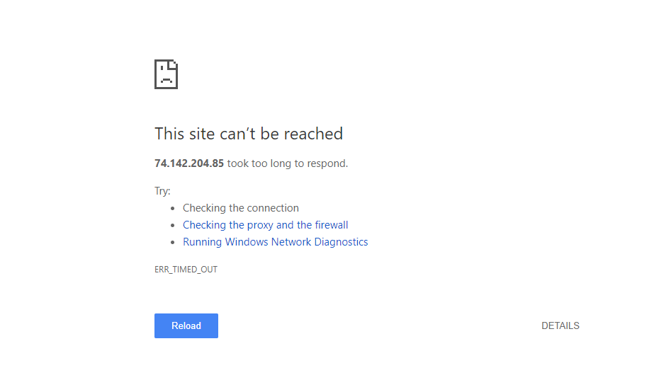
NO Luck despite ports open
74.142.20485:80

Slide 9
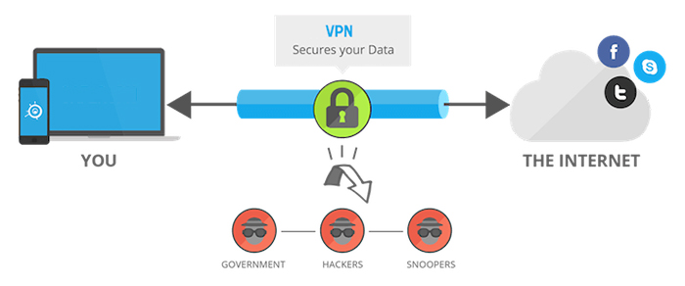
VPN connection
Virtual Private Network (VPN) – establish a virtual point-to-point “tunneling” connection through the use of dedicated connections.
  Tunnel between the local and remote device, and ensures a secure communication between them.
  The VPN connection is only established when the client device authenticates itself on the VPN server

Slide 10
This would work?
A VPN connection would need to be made for accessing each project. Problem: Only 1 VPN connection per computer. Cooper and Haviland are an example of this

Slide 11
Dynamic Multipoint VPN
Allows “spokes” to communicate directly with each other over the internet.
Each location has a configuration to connect to the VPN device (hub).
Once user login into the hub they have the ability to access all “spokes” from their location without multiple VPN connections.

Slide 12
One Energy Projects - spokes
A VPN connection can be made to central location with in Bluffton. That box is already had VPN connections to all other projects. This allows for all projects to be accessed through one connection – Pulse Portal

Slide 13
One Energy project layout

Slide 14
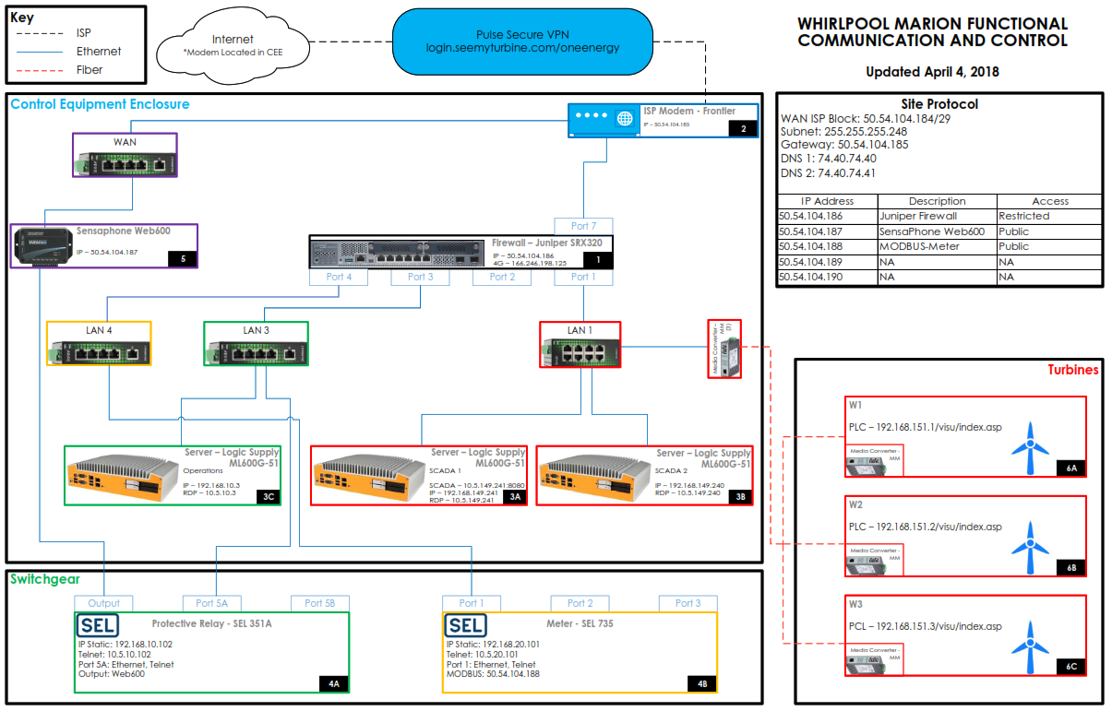
One Energy project Networking diagram

Slide 15
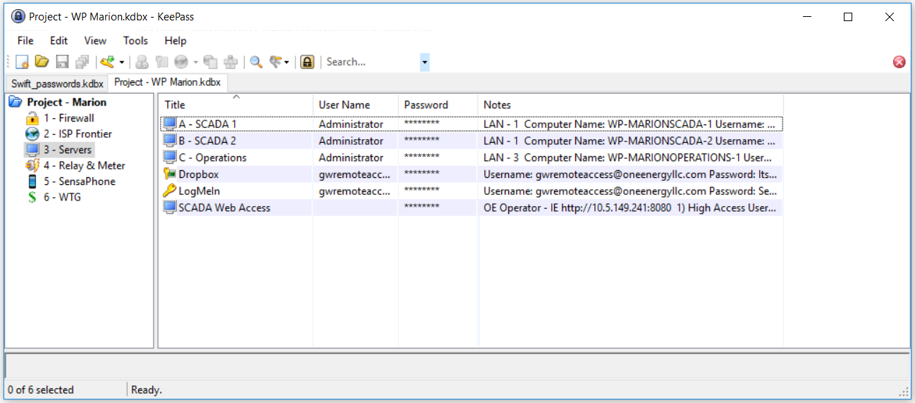
KEYpass is your friend

Slide 16
One Energy Roles
ROLE | 2F | Accessibility
OE Low | No | LAN 1 Web Access Only (SCADA)
OE High | Yes | LAN 1 All Access and LAN 2 Web Access
OE Camera | No | LAN 2 Web Access
OE Operator | No | LAN 1, LAN 2, LAN 3, and LAN 4 Unrestricted
Goldwind Low | No | LAN 1 Web Access Only (SCADA)
Goldwind High | Yes | LAN 1 All Access & PLC Access
Goldwind Admin | Yes | LAN 1 All Access
Customer SCADA | No | LAN 1 Web Access Only (SCADA)

Slide 17
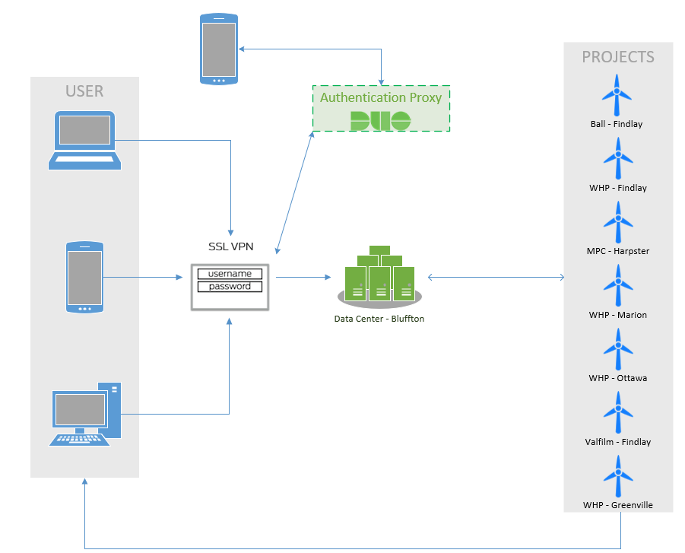
Last Curveball – DUO (2F)

Slide 18
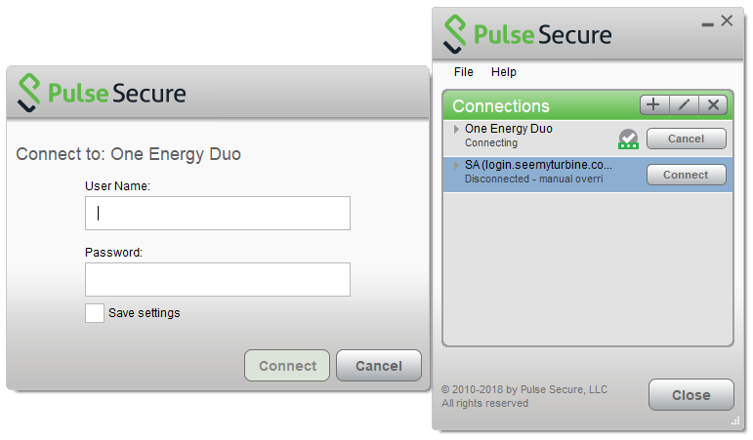
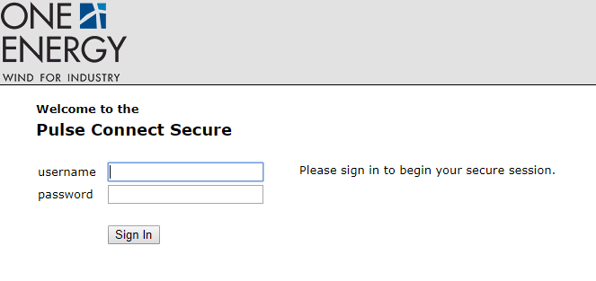
Logging into Pulse Secure/ONE Energy portal
Pulse Secure
Open Pulse Connect Secure
Username/Password
One Energy Portal
login.seemyturbine.com/oneenergyduo
Username/Password

Slide 19
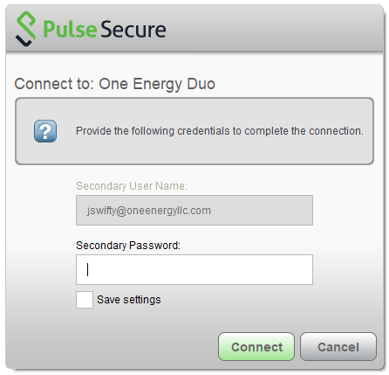
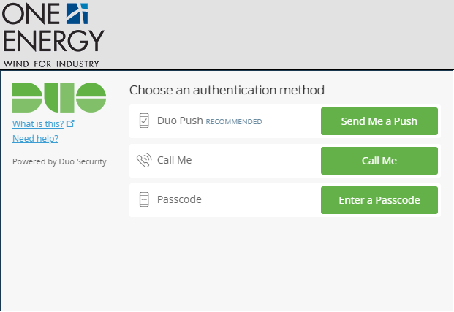
Logging into Pulse Secure/ONE Energy portal
Pulse Secure
Type “Push”, “Call”, or Enter Duo Passcode
One Energy Portal
Click 1 of the 3 options

Slide 20
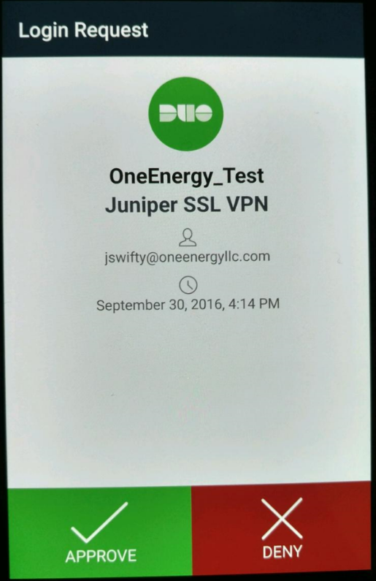
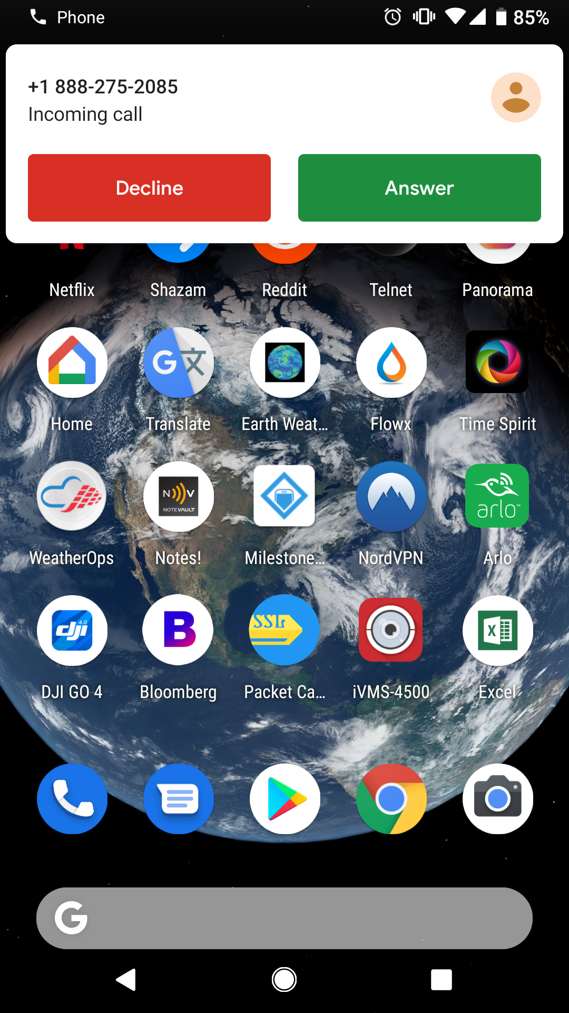
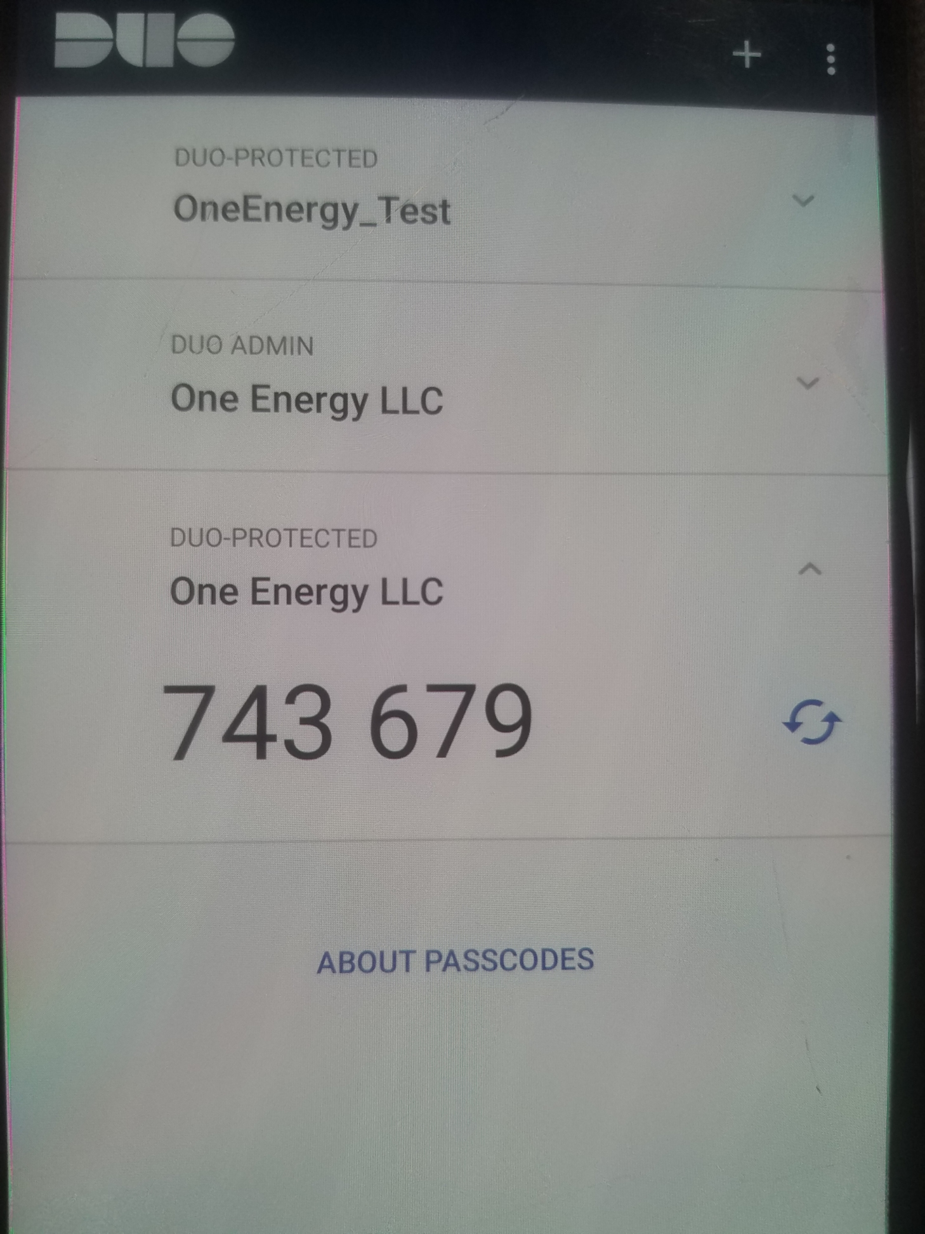
Logging into Pulse Secure/ONE Energy portal
Push
Call
Passcode

Slide 21
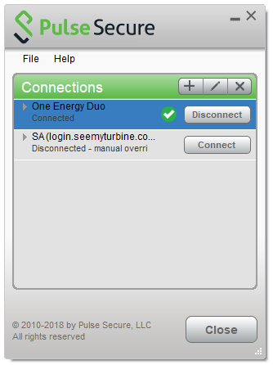
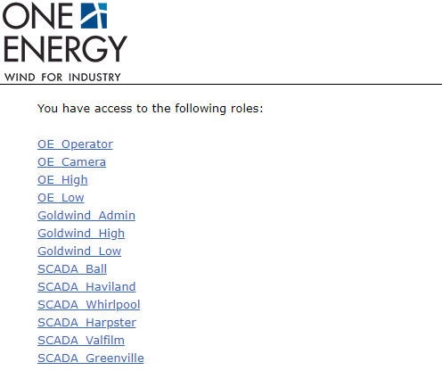
Logging into Pulse Secure/ONE Energy portal
Pulse Secure
Decide what Role to Access
One Energy Portal
Decide what Role to Access

Slide 22
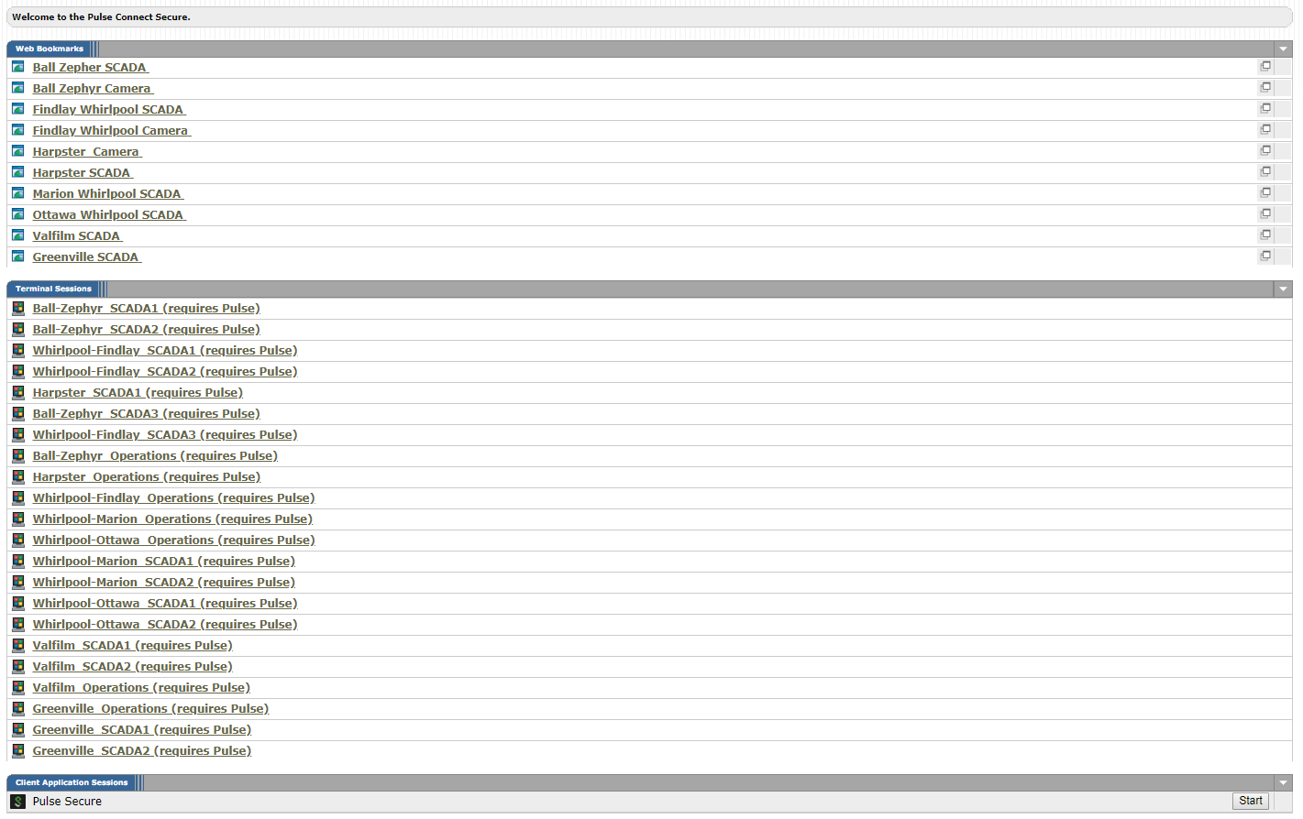

Logging into Pulse Secure/ONE Energy portal
Pulse Secure
Accessed Bluffton Hub – 10.1.2.1
One Energy Portal
Accessed One Energy Portal

Slide 23
Accessing SCADA
Pulse Secure
Input IP Address into Internet Browser
One Energy Portal
Click SCADA Bookmark

Slide 24
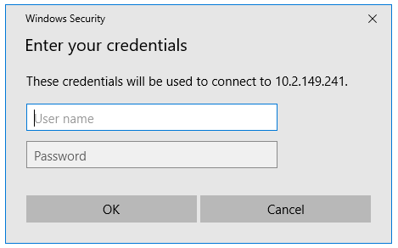
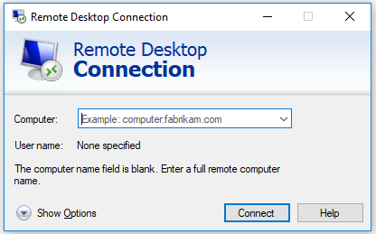
Remote access into Project server
Pulse Secure
Open RDP Protocol
Input Computer Name (IP Address)
Input Username/Password
One Energy Portal
Click Terminal Session
Input Username/Password

Slide 25
Accessing Turbine PLC
Pulse Secure
Input IP Address into Internet Browser
One Energy Portal
Click PLC Bookmark

Slide 26
Accessing Security system
Pulse Secure
Input IP Address into Internet Browser
One Energy Portal
Click Camera Bookmark

Slide 27
Accessing relay/meter
Pulse Secure
Open AcSELerator Quickset
Input Relay/Meter IP Address
Input ACC and 2AC password
One Energy Portal
Access Operations Server - RDP
Open AcSELerator Quickset on the local Computer
Input Relay/Meter IP address – local IP
Input ACC and 2AC password

Slide 28
Inside the Control equipment enclosure

Slide 29
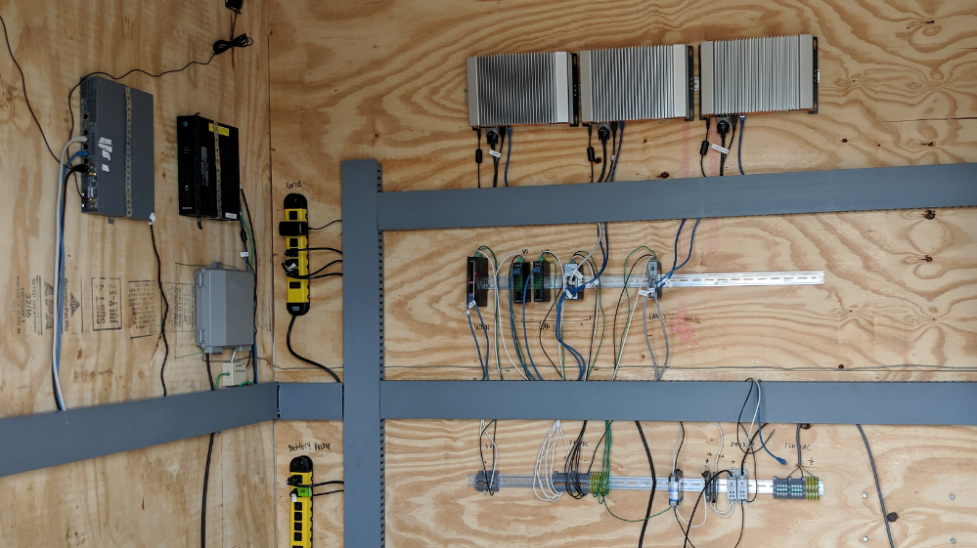
LAN 1 – Port 1
LAN 2 – Port 2
LAN 3 – Port 3
LAN 4 – Port 4
WAN – Port 0
ISP – Port 5

Slide 30
Connection in CEE
LAN 1 = SCADA (Port 1)
  IP = 192.168.149.1 /22
  Subnet = 255.255.252.0
LAN 2 = Security (Port 2)
  IP = 192.168.95.1/28
  Subnet = 255.255.255.240
LAN 3 = System Operator (Port 3)
  IP = 192.168.10.1/24
  Subnet = 255.255.255.0
LAN 4 = MODBUS (Port 4)
  IP = 192.168.20.1/24
  Subnet = 255.255.255.0

Slide 31
Changing your Computer IP
Normally your computer is set up for DHCP
  Dynamic Host Configuration Protocol
  Automatically provides a host with its IP address and other related configuration information – subnet mask, default gateway, and DNS.
  Reliable IP address configuration
  Reduced network administration
What is your IP?
  IPCONFIG /all

Slide 32
Changing your Computer IP
Project Firewall’s are not set up for DHCP
  Will need to statically assign network settings to your computer
Will need to Statically assigned IP Address
  Dedicated IP address assigned to your machine
What is your IP?
  IPCONFIG /all

Slide 33
Changing your Computer IP
Control Panel
  Network and Internet
    Network and Sharing Center
      Change adapter settings
        Right click on “Connection” and Select “Properties”
          Click on Internet Protocol Version 4 (TCP/IPv4)
            Select “Properties”
              Click “Use the following IP address”
                Input IP configuration and click “Ok”
Right Click on Ethernet/Wi-Fi
  Open Network & Internet Settings
    Change adapter settings
      Right click on “Connection” and Select “Properties”
        Click on Internet Protocol Version 4 (TCP/IPv4)
          Select “Properties”
            Click “Use the following IP address”
              Input IP configuration and click “Ok”

Slide 34
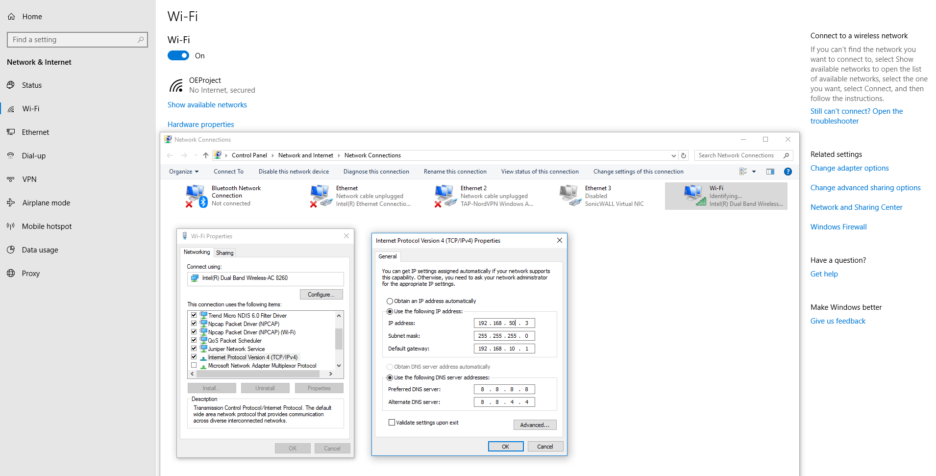
OE Project
IP Configuration:
IP Address:
  192.168.50.2-255
Subnet mask:
  255.255.255.0
Default Gateway
  192.168.10.1
Preferred DNS server:
  8.8.8.8
Alternate DNS server:
  8.8.4.4

Slide 35
Questions

