Slide 1
Production Reports
Erica Johnson
10/29/2018

Slide 2
Agenda
Pulling SCADA Data
Running Report
Meter Data
Downtime/Availability
Fleet Summary
Sending Reports

Slide 3
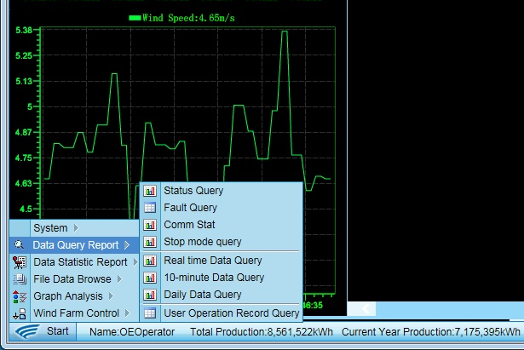
Pulling SCADA DATA
Daily Data Query
10 Minute Data Query
Stop Mode Query
Comm Stat

Slide 4
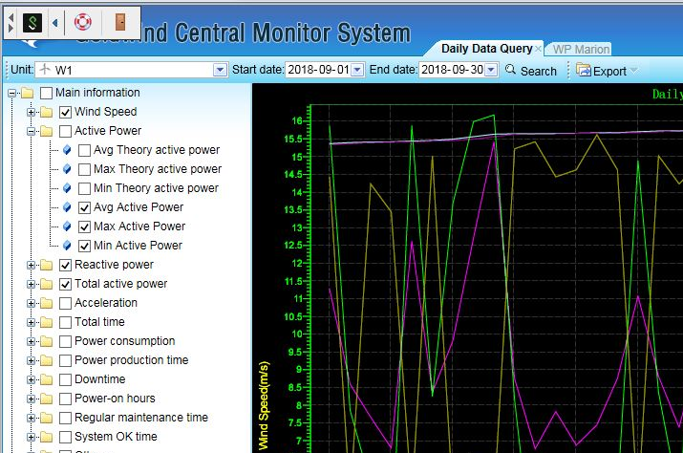
Pulling SCADA DATA – Daily & 10 Minute
Select dates of last month
  Cooper/Haviland 1st - 1st
  All others 1st – Last
Wind Speed, Active Power, Reactive Power, Total Active power

Slide 5
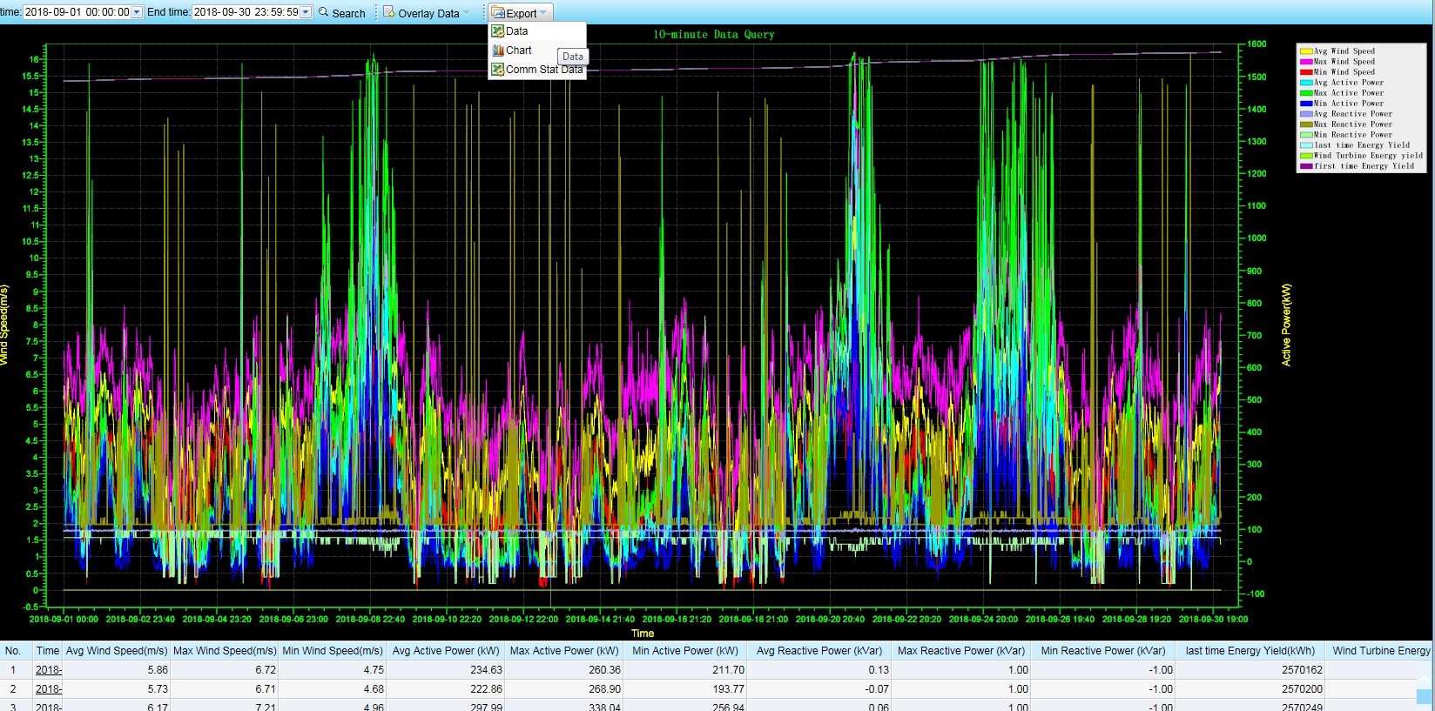
Pulling Scada Data – Daily & 10 Minute

Slide 6
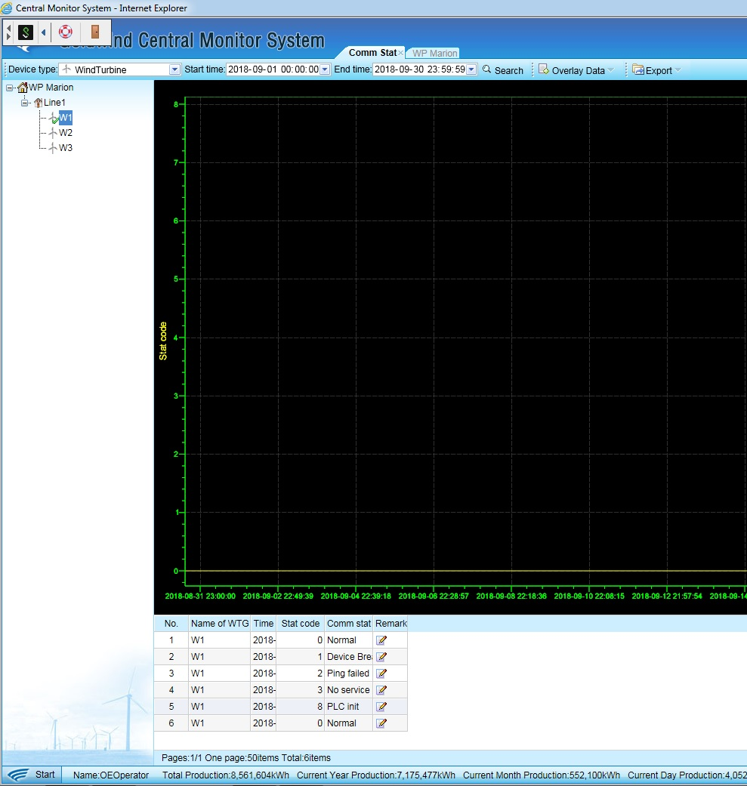
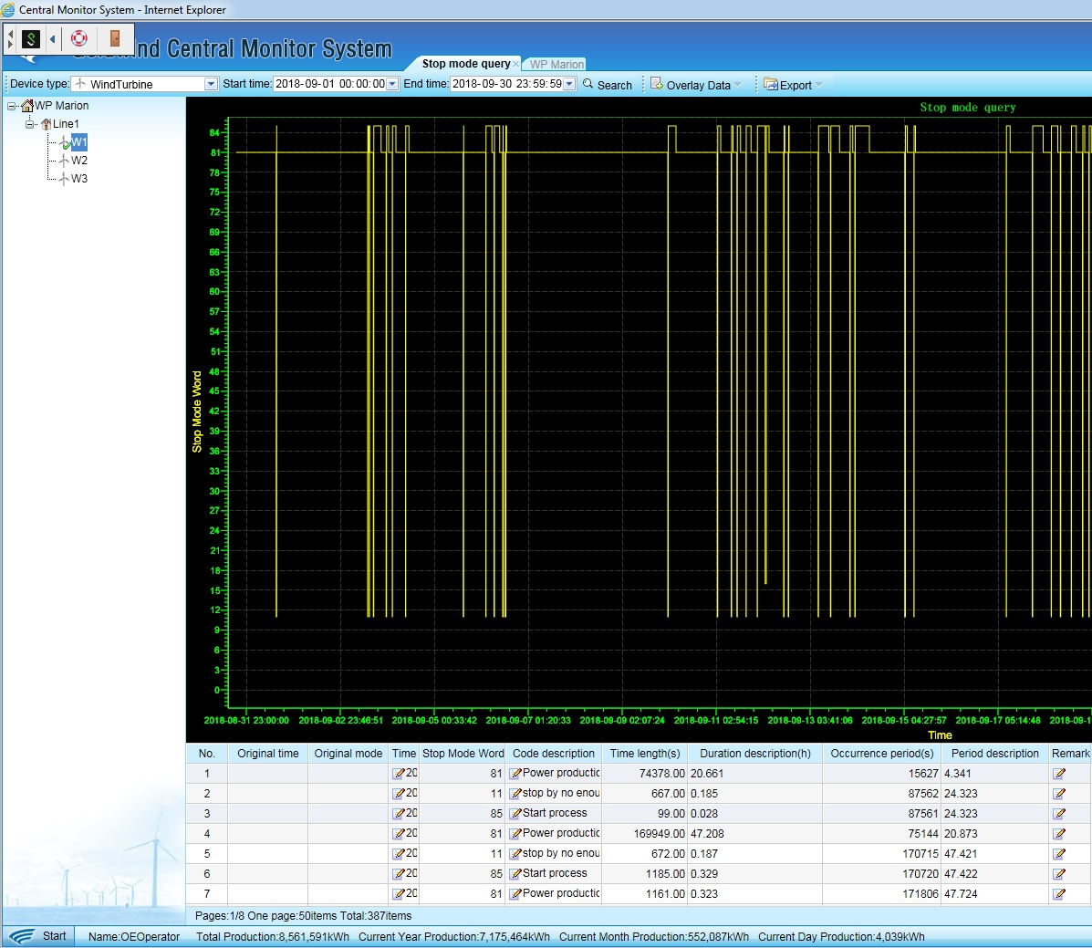
Pulling SCADA Data – Comm Stat & Stop Mode

Slide 7
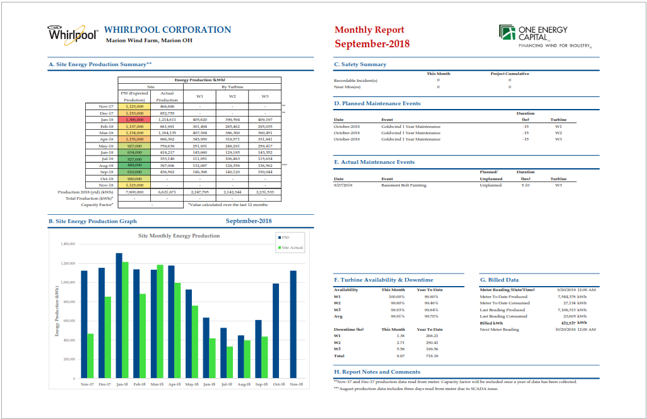
Building the Report

Slide 8
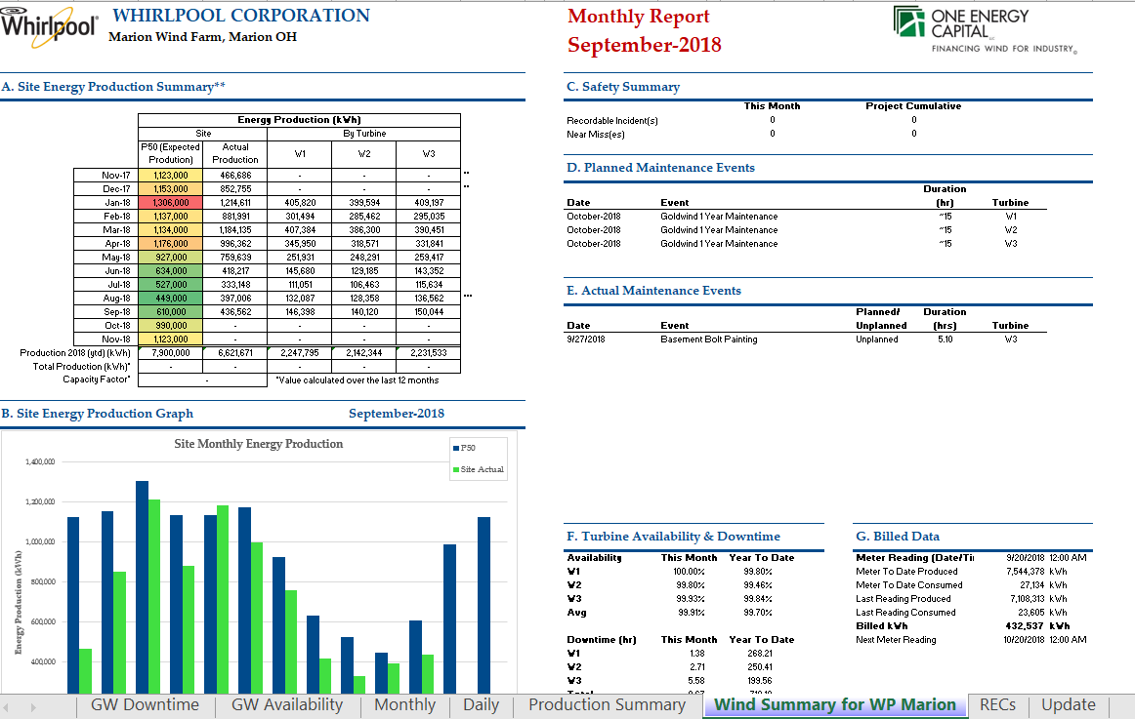
Building The Report

Slide 9
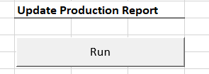
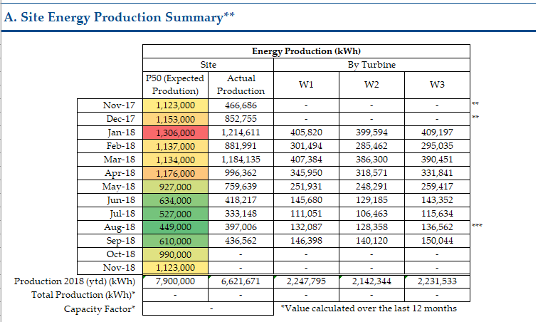
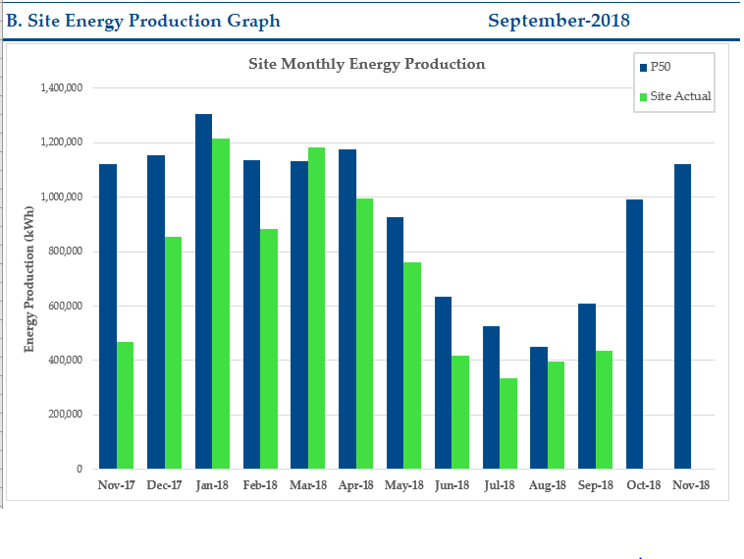
Running the Report
Report Macro pulls in Daily Data

Slide 10
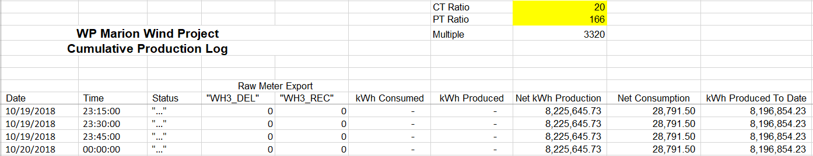
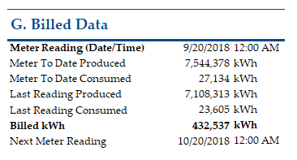
Meter Data
Jordan & Ben read meters for PPA projects

Slide 11
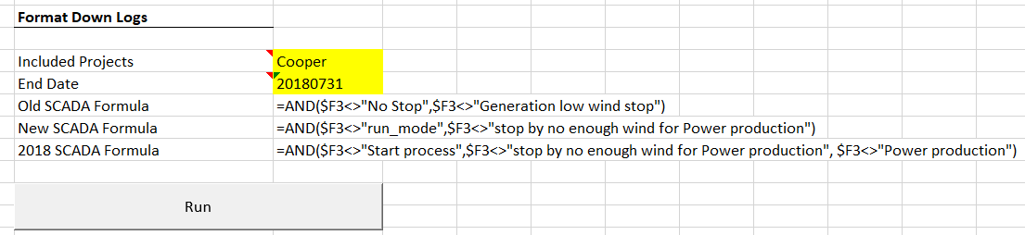
Downtime/Availability
Format Downlogs Excel Tool
Old Formula: Cooper, Haviland
New Formula: Harpster, WP – Findlay, Zephyr
2018 Formula: WP – Marion, WP – Ottawa

Slide 12
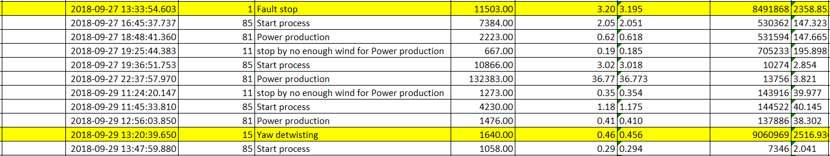
Downtime/Availability
Logging Downtime
  Yaw lubrication, yaw detwisting, Turbine limit power run, low wind speed, etc. not logged

Slide 13
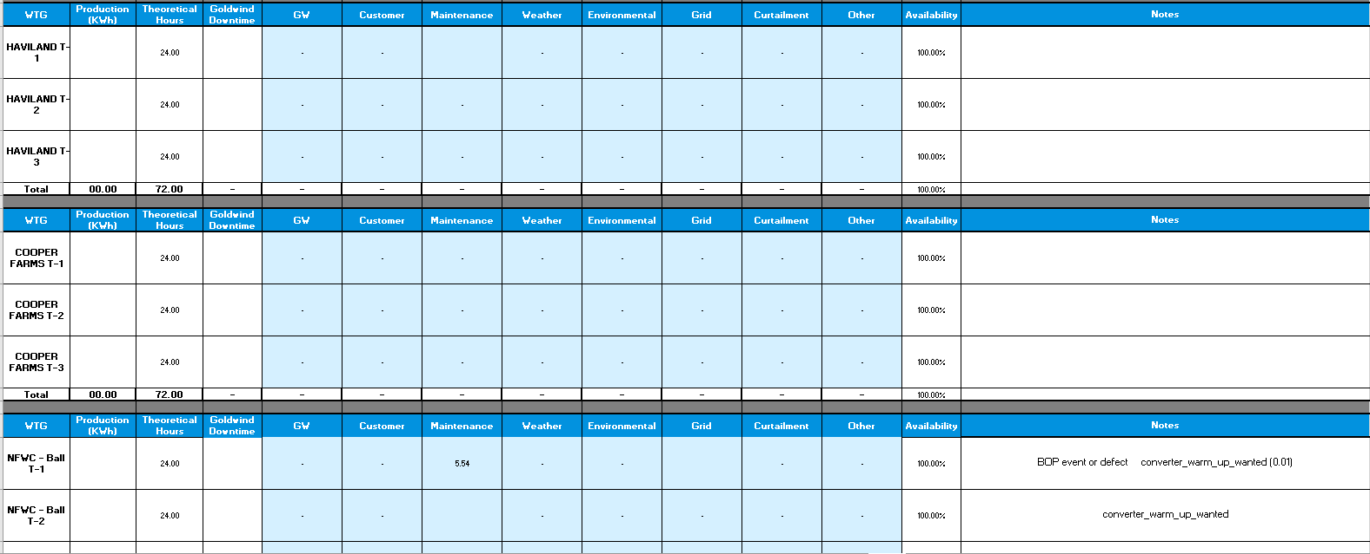
Downtime/Availability
Ohio Daily Availability Tracker

Slide 14
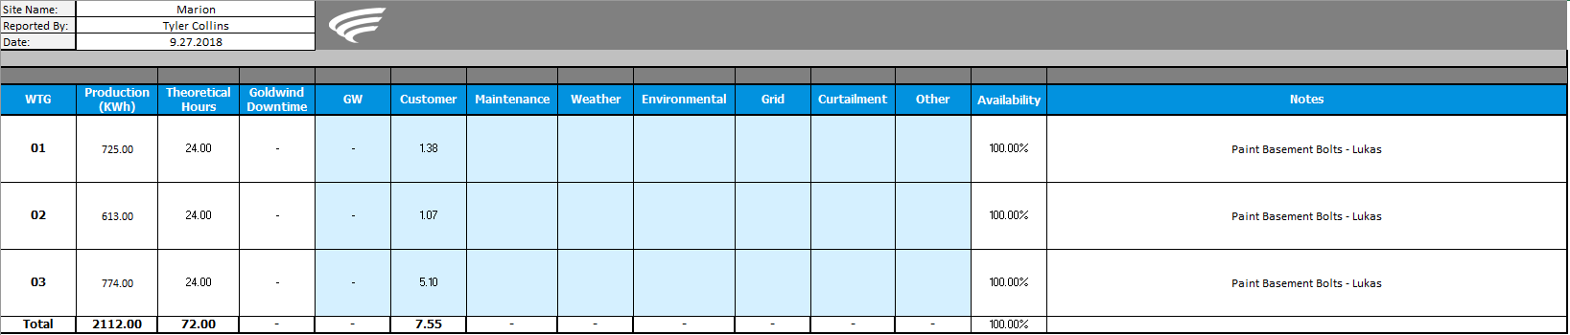
Downtime/Availability
Comparing OE & Goldwind Downtime Logs
  Is downtime being logged appropriately?

Slide 15
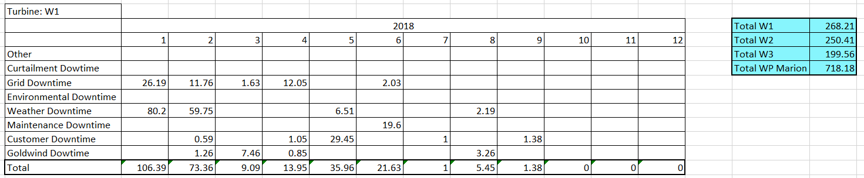
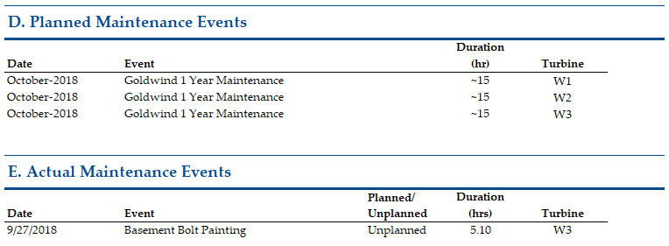
Downtime/Availability
Adding downtime to report

Slide 16
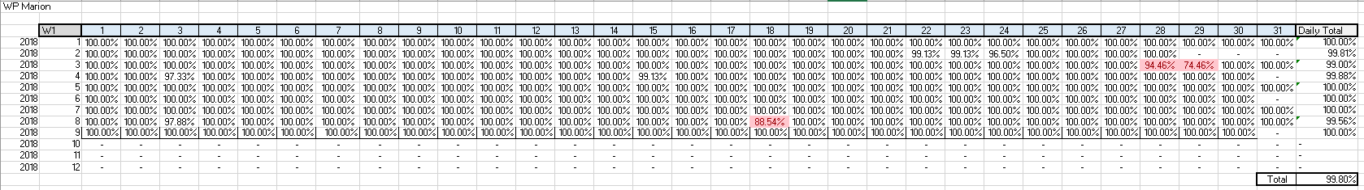
Downtime/Availability
Adding availability to report

Slide 17
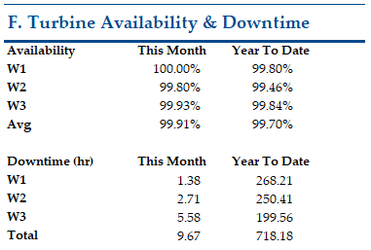
Downtime/Availability
Adding availability to report
  Does one turbine have more downtime than the others?
  Is Goldwind meeting contractual availability?

Slide 18
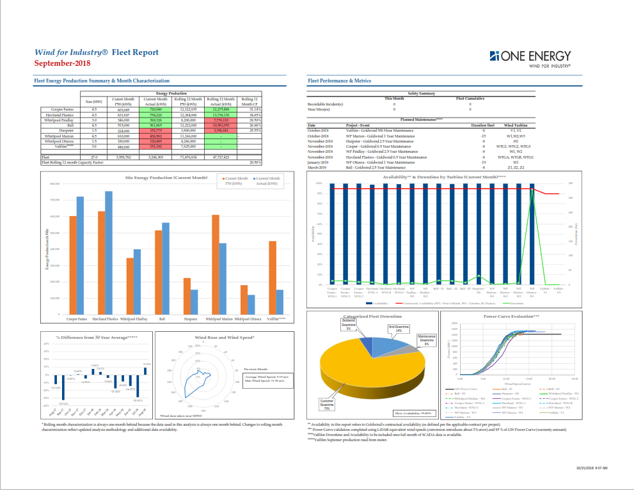
Fleet Summary

Slide 19
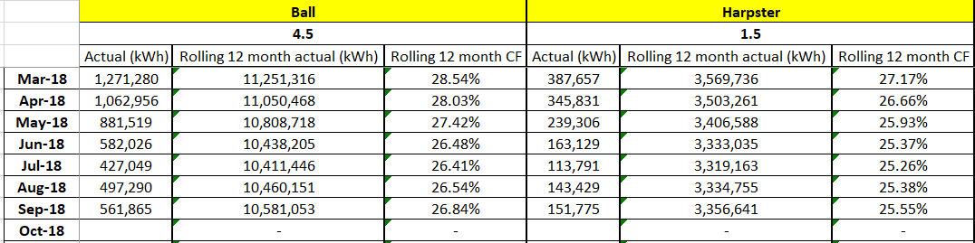
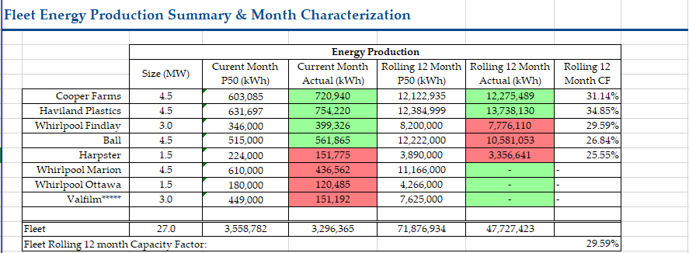
Fleet summary - Production

Slide 20
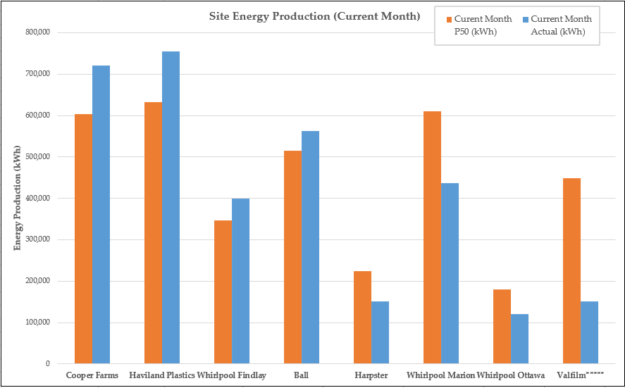
Fleet summary – Production

Slide 21
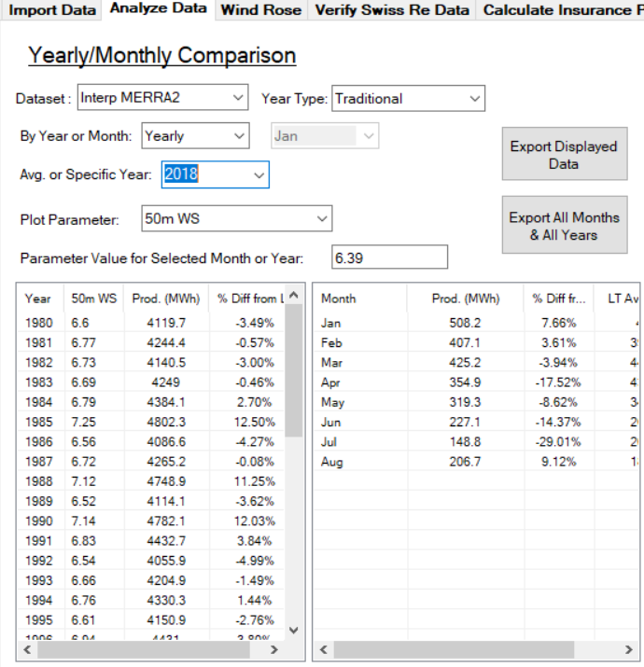
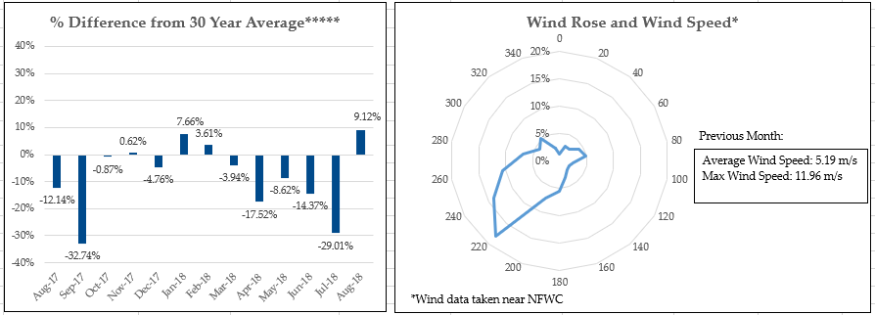
Fleet summary – Month characterization
NFWC MERRA2 node data

Slide 22
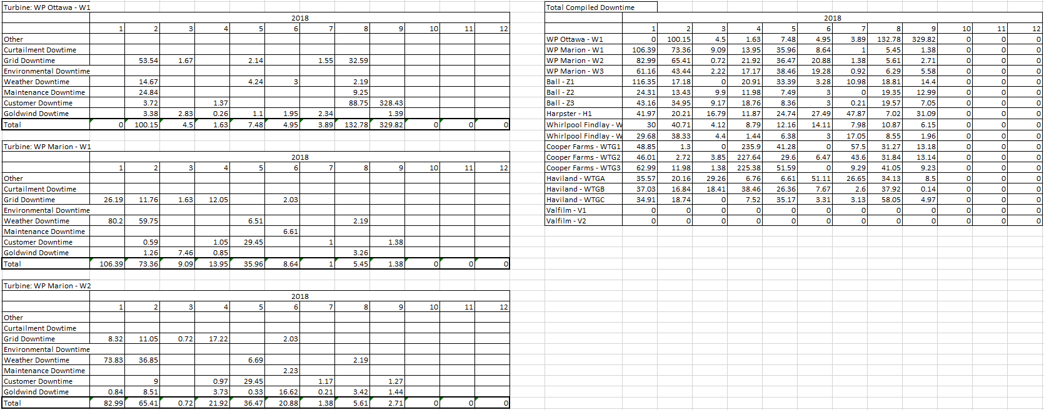
Fleet Summary – downtime/Availability

Slide 23
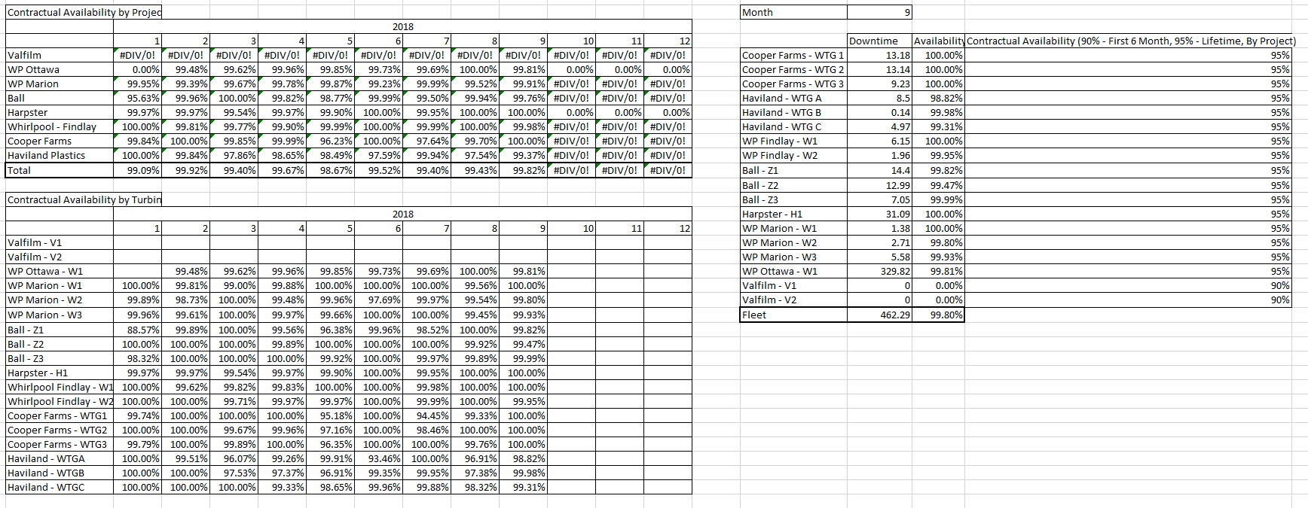
Fleet Summary – downtime/Availability

Slide 24
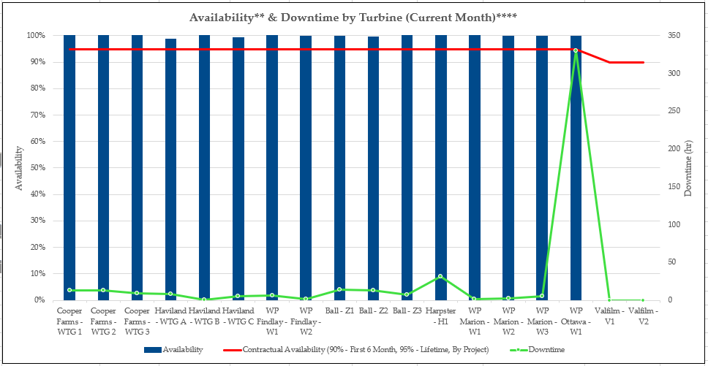
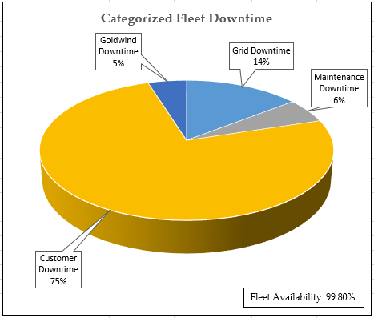
Fleet summary – Downtime/Availability

Slide 25
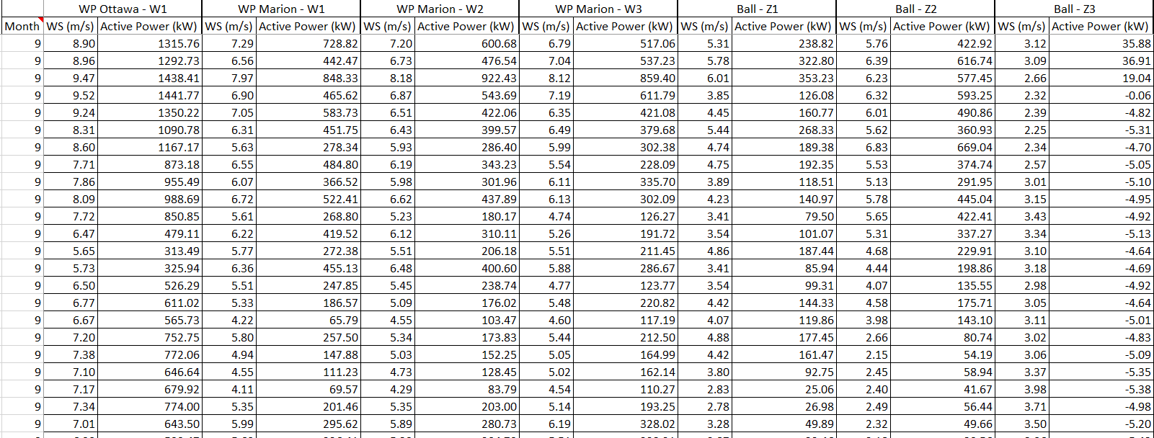
Fleet summary – Power curve
Raw Data

Slide 26
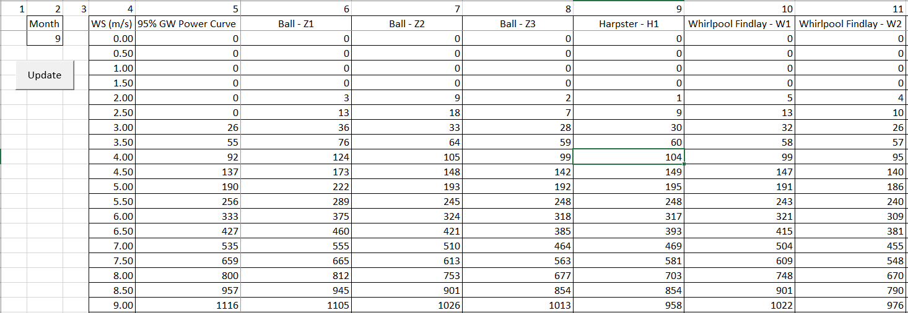
Fleet Summary – Power curve
Power Curve Validation
  Nacelle wind speed to LiDAR equivalent

Slide 27
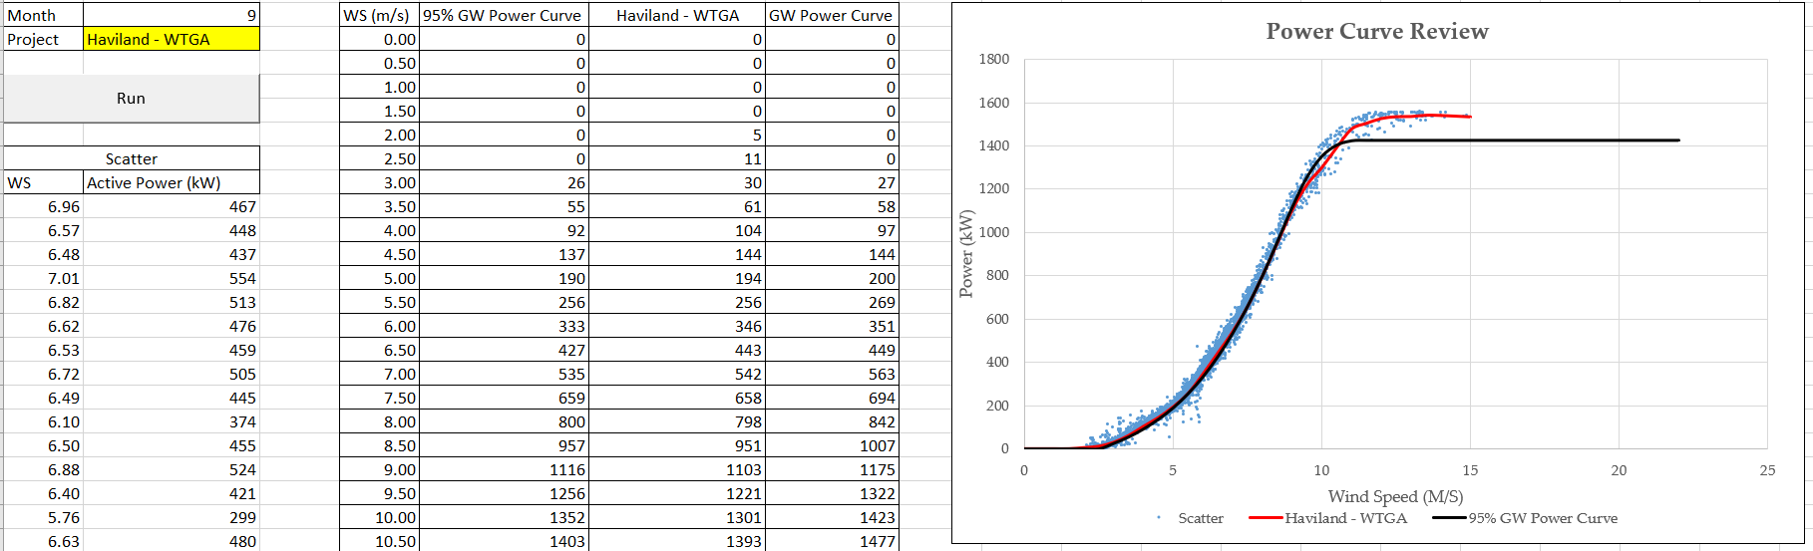
Fleet Summary – Power curve
Power Curve Review

Slide 28
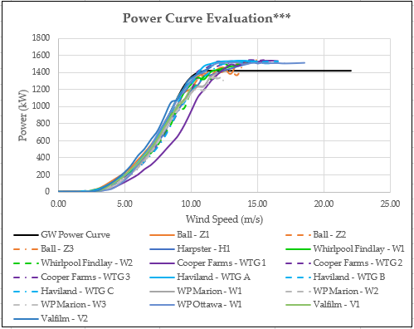
Fleet Summary – Power Curve
Report plot

Slide 29
Sending Reports
Check of numbers
  Is one turbine of a project significantly better/worse than others?
Report Formatting
  Notes updated/accurate, planned downtime current, all charts/tables legible
Send to Mij to be sent out to customers
Send to intranet@ to be posted

