Slide 1
On-Call Meteorologists and System Operators
Jessica Grosso
January 14, 2019

Slide 2
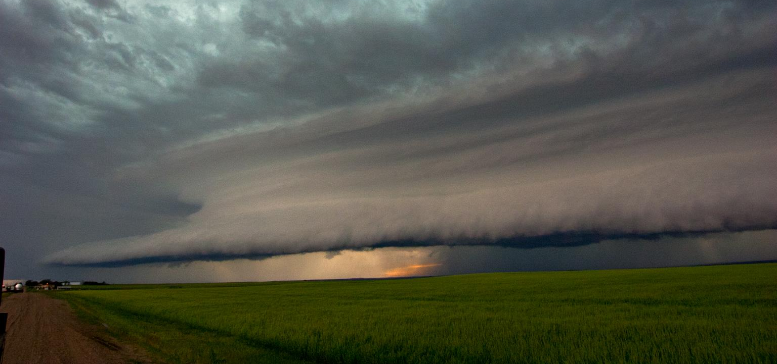
Outline
GOAL: To enable the system operators to know when to watch for weather events, what to do during weather events, and what to expect out of your on-call meteorologist
What is wind?
Weather basics
Weather Events: Icing
  Forecasting
  Impact to Projects
  System Operator Action Plan
  Working with On-Call Meteorologist
Weather Events: Severe Storms
  Forecasting
  Impact to Projects
  System Operator Action Plan
  Working with On-Call Meteorologist

Slide 3
System Operators
GOAL:
To enable the system operators to know:
When weather risks are present
What to do during weather events
What to expect out of your on-call meteorologist

Slide 4
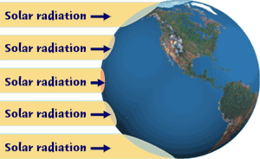
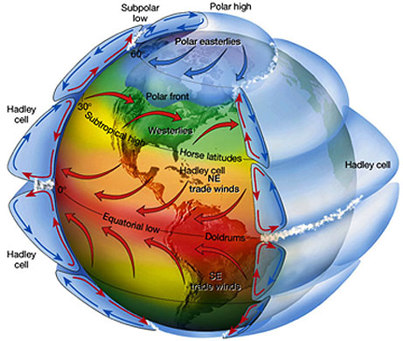
What is wind
Differential heating of the earth’s surface from the equator to the poles creates
Pressure differences cause air to circulate on a global scale
Everything wants to be in equilibrium

Slide 5
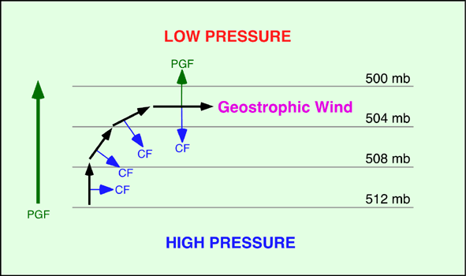
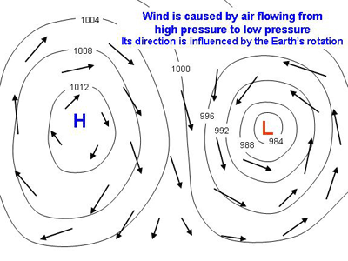
What is wind
To be in equilibrium, air wants to flow from high to low (pressure gradient force, PGF)
Can’t flow in a straight line due to Coriolis force and surface friction
Wind flow around a low pressure: counter-clockwise
Wind flow around a high pressure: clockwise
(northern hemisphere)

Slide 6
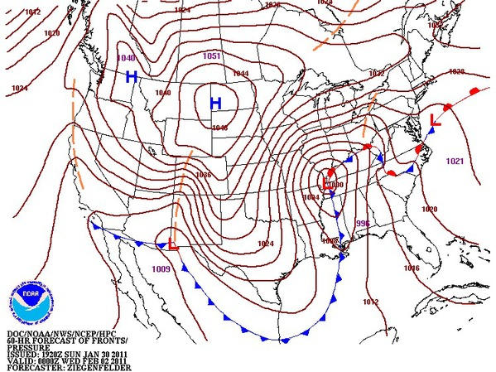
What is wind
Isobar = line of constant pressure
Stronger PGF when isobars are closer together (larger gradient in same area, therefore larger force)
Stronger winds when strong PGF
Since pressure and temperature are related, strong PGF also means large temperature changes
Strong winds typically associated with frontal boundaries (cold fronts, warm fronts) and the storms associated with them

Slide 7

WEATHER BASICS

Slide 8
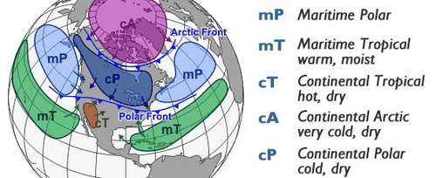
Weather Basics: Air masses
Air mass: large body of air with uniform temperature and humidity
  Named by two words, one is relative to the temperature and one is relative to the humidity
    If the air mass originates over water, it’s moist and uses the word Maritime. If it originates over land, it’s dry and uses the word Continental
    If the air mass originates near equator, it’s hot and uses the word Tropical. If it originates in the mid-latitudes, it’s cold and uses the word Polar
  Secret air mass #5: originates over land near the poles. Dry and super cold

Slide 9
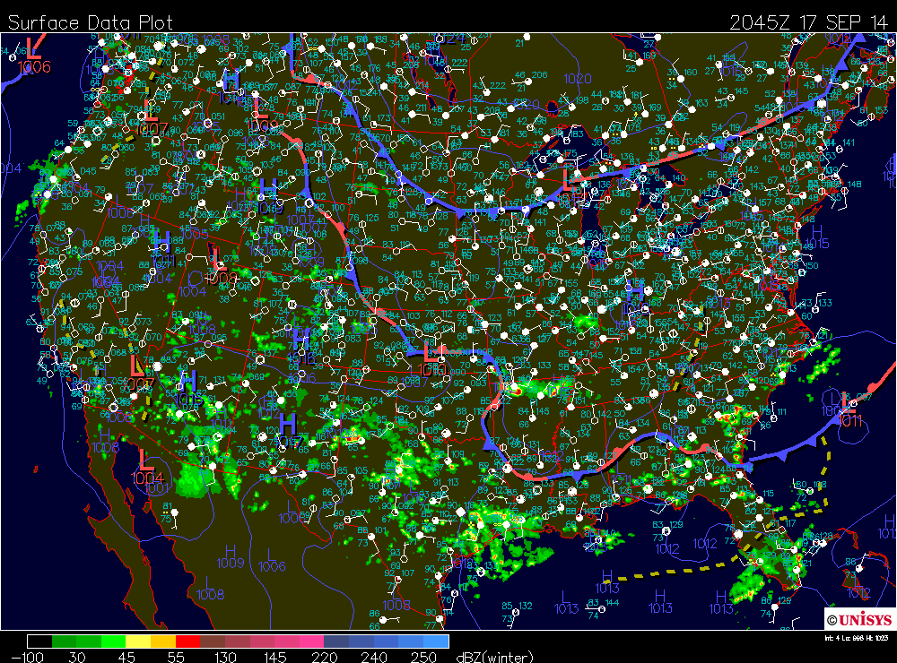
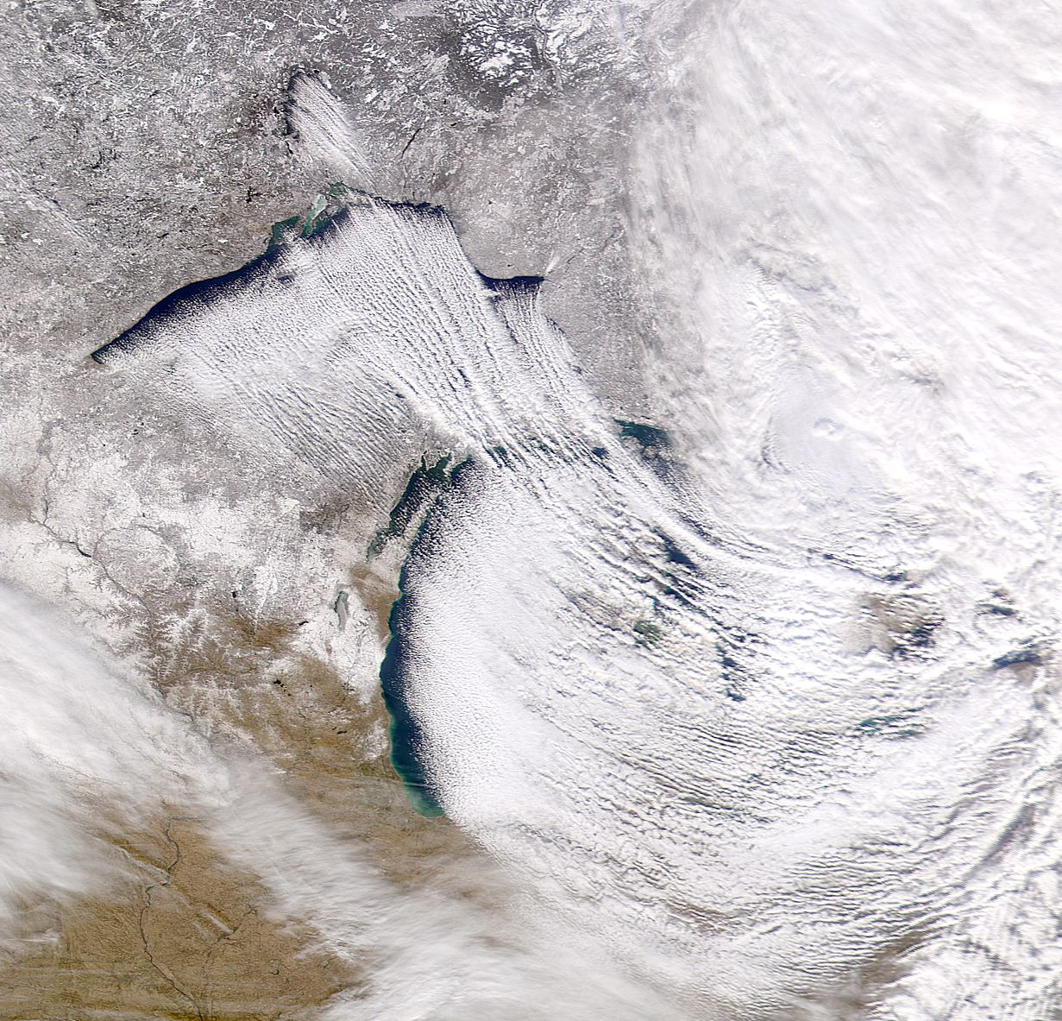
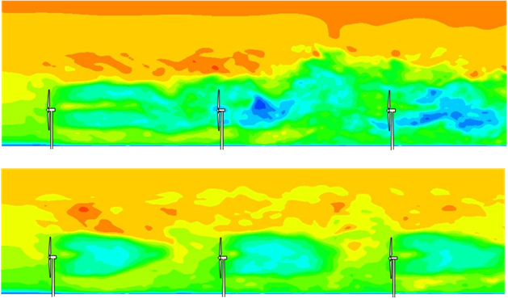
Weather Basics: Scale
Synoptic Scale
Mesoscale
Microscale
~1,000 km +
Low and high pressure systems
5-1,000 km
Sea-land breezes
Lake effect snow
< 1 km
Turbulence

Slide 10
Weather Basics: Scales of wind
Synoptic Scale: general circulation of winds globally
We have prevailing westerlies in our latitudes

Slide 11
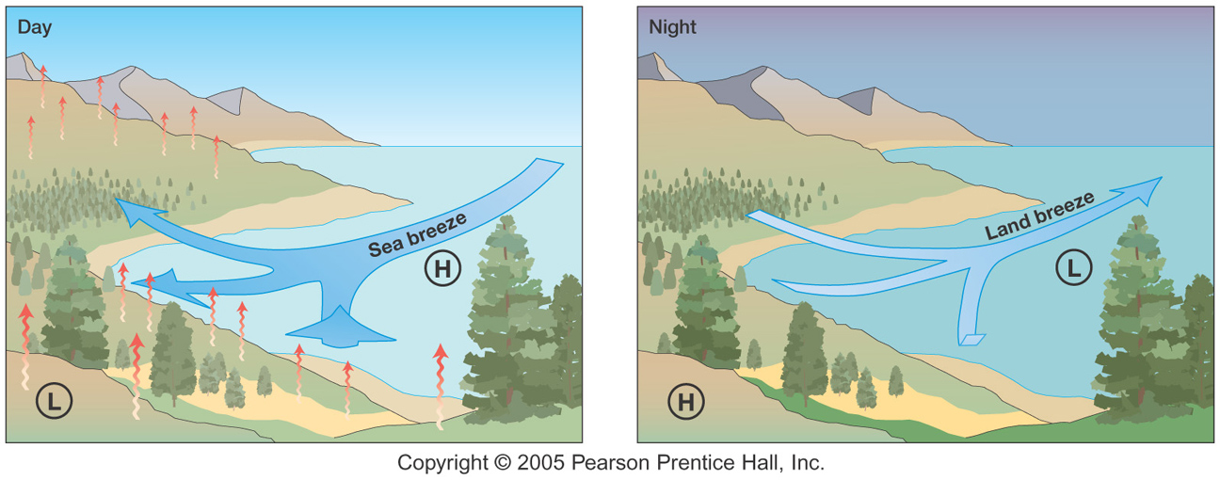
Weather Basics: Scales of wind
Mesoscale
Sea Breezes
Land Breezes
Day-time
  Land heats up faster than water
  Creates low pressure on land
  Wind flow is from high to low (water to land)
Night-time
  Land cools down more than water
  Creates low pressure over water
  Wind flow is from high to low (land to water)
11

Slide 12
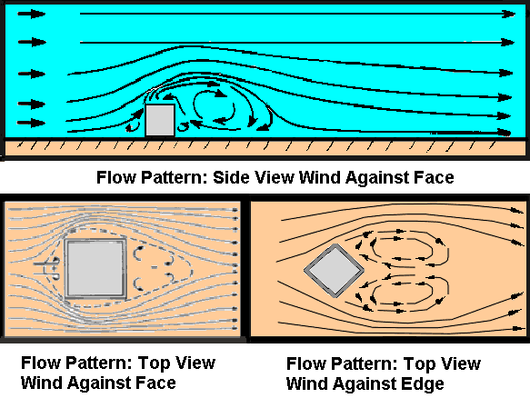
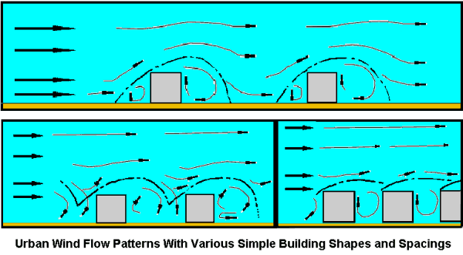
Weather Basics: Scales of wind
Microscale
  Turbine wake
  Wind flow around buildings or obstacles

Slide 13
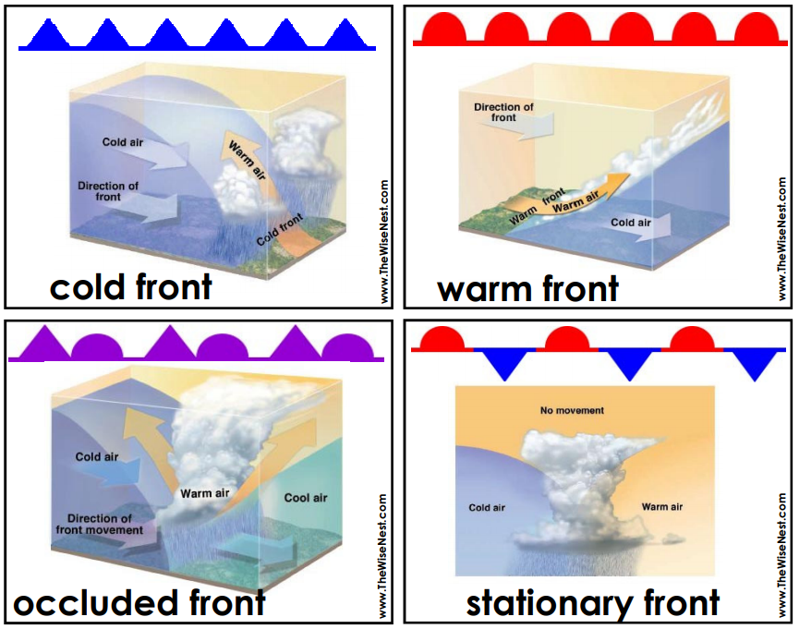
Weather basics: fronts
Front: boundary separating two air masses
  Most weather stuff happens along these boundaries
Cold
  Cold air overtaking warm air
Warm
  Warm air creeping up on cold air from behind and flowing over cold air
Occluded
  When a cold front catches up with a warm front
Stationary
  All air masses are happy where they are and don’t want to move

Slide 14
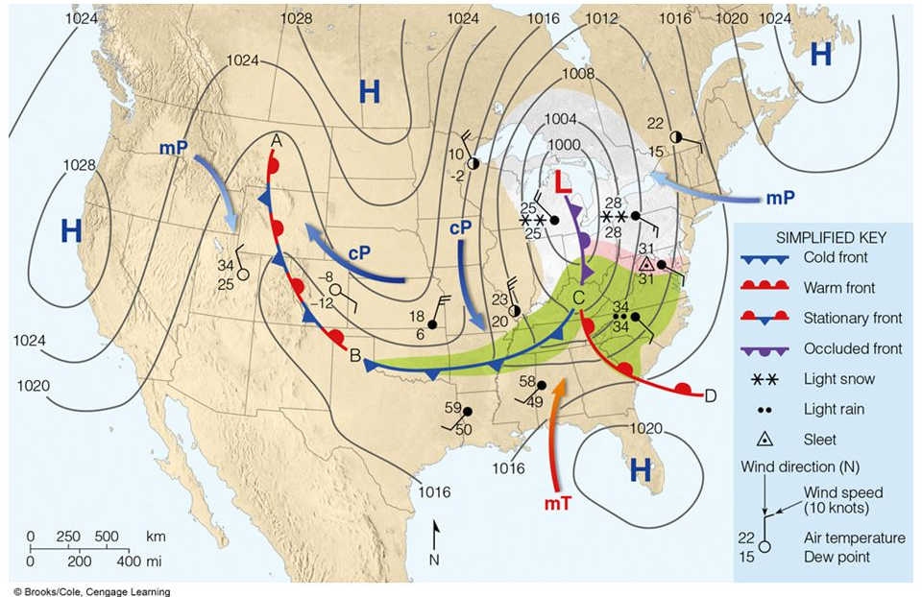
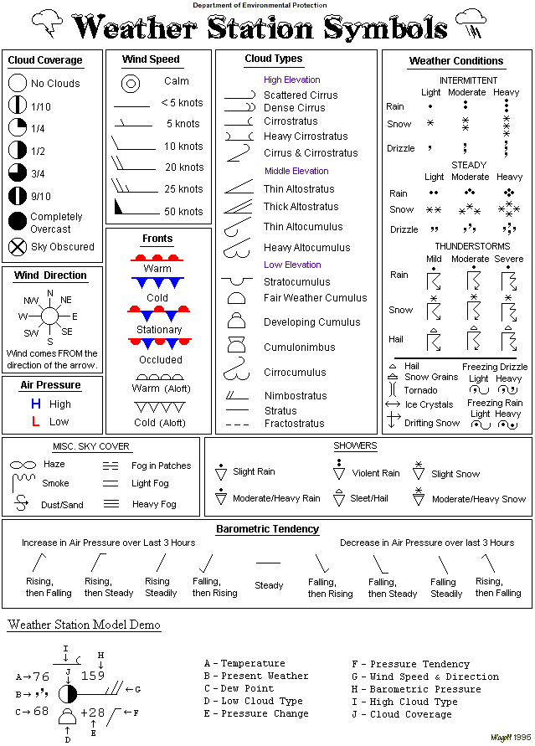
Weather basics: Reading weather maps

Slide 15
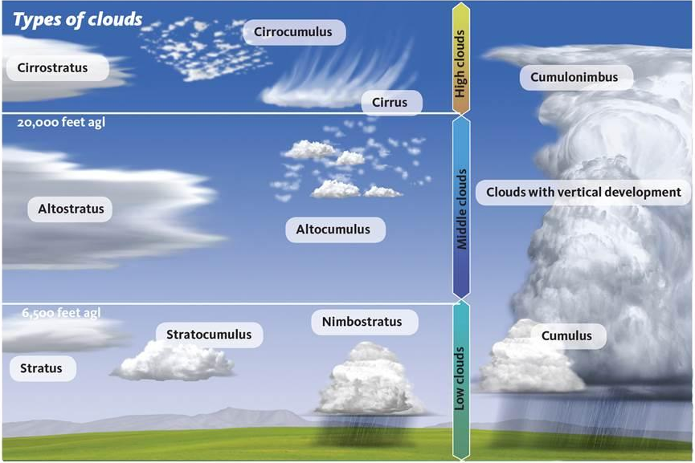
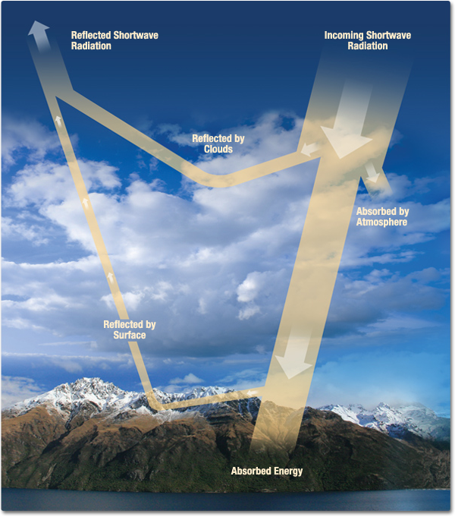
Weather Basics: Clouds
Notes:
Talk about all the different types of clouds first, general characteristics (nimbo = rain; alto = mid-level; cumu = puffy; etc)
Low thick clouds reflect solar radiation
High clouds let solar radiation in but end up trapping some outgoing infrared radiation, warming the surface

Slide 16
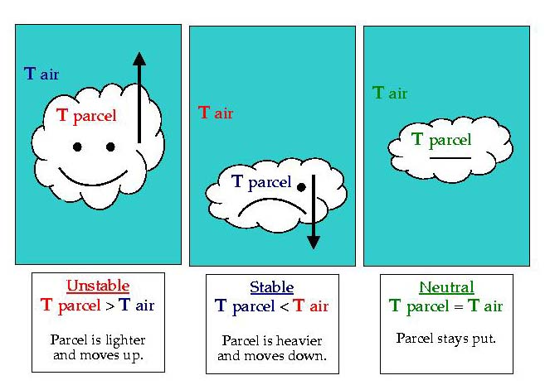
Weather basics: clouds
Physics
Basic cloud droplet formation
  Aerosols are available in the atmosphere (called Cloud Condensation Nuclei (CCN))
  Air parcel ends up holding as much water vapor as it possibly can (saturated)
  Hits that point and then the water vapor condenses onto CCN, creating droplet
    Level this happens is called the Lifting Condensation Level (LCL)

Slide 17
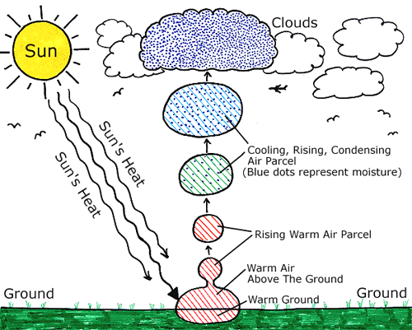
Weather basics: clouds
Physics
Many ways for the air parcel to reach saturation
Cooling parcel to dew point
Adding extra water vapor to parcel
Supersaturation
Supercooling
Collision-coalescence
Bergeron Process

Slide 18
Weather basics: clouds
Physics
How do we get the parcel to rise and cool to create clouds?
Adiabatic Cooling
  Frontal lift
  Convective lift
  Orographic lift
Non-adiabatic Cooling

Slide 19

Weather basics: clouds
Physics
Adiabatic Cooling: Frontal Lift
T_{d}

Slide 20

Weather basics: Clouds
Physics
Adiabatic Cooling: Convective Lift

Slide 21
Weather basics: Clouds
Physics
Adiabatic Cooling: Convective Lift
T_{d}

Slide 22
Weather basics: clouds
Physics
Adiabatic Cooling: Orographic Lift

Slide 23
Weather basics: clouds
Physics
Adiabatic Cooling: Orographic Lift
T_{d}

Slide 24
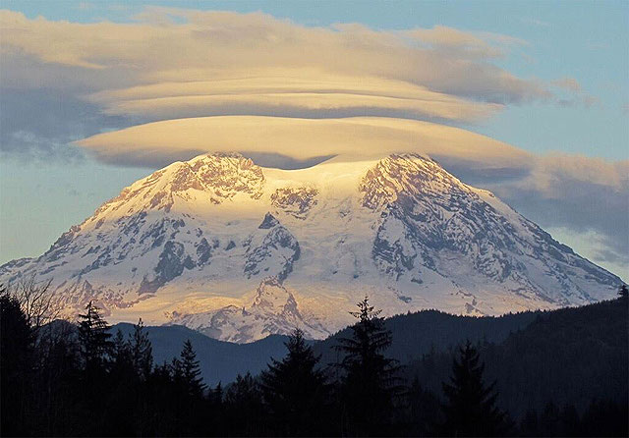
Weather basics: Clouds
Physics
Orographic Lift:
  Lenticular Clouds

Slide 25
Weather Basics: clouds
Physics
Last notes about cloud development
  The more drastic the difference between the surrounding air and the parcel, the more forceful the parcel will move upwards
    Stronger fronts (large temperature gradients) will result in faster vertical velocity of the parcel
    Intense solar heating of the surface will result in faster vertical velocity
      CAPE/CIN is related (more on this later)
    Faster moving air mass towards mountain will result in faster vertical velocity
  The more forceful the upward movement, the higher the clouds can build

Slide 26
Weather Basics: Clouds
Precipitation
Big picture of how precip forms:

Slide 27
Weather Basics: Clouds
Precipitation
Big picture of how precip forms:

Slide 28
WEATHER EVENTS:
ICING

Slide 29
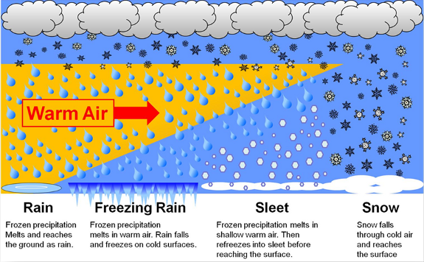
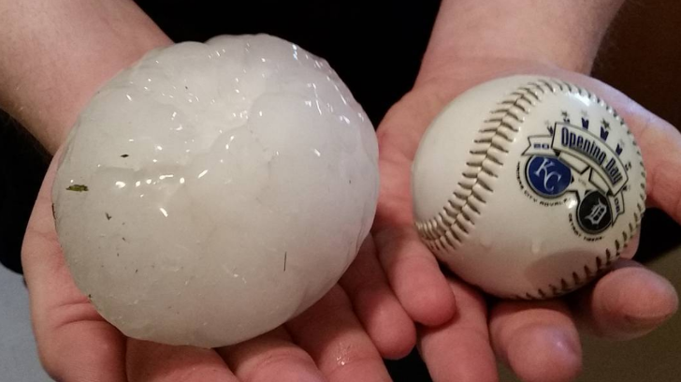
Weather events: icing
Depending on temperature profile, types of CCN, and vertical velocity, different types of precip can occur
Hail
Ice crystal trying to fall
Outer layer melts as it falls, collects more droplets
Updraft pushes it back up
Cools, freezes
Gets heavy enough again to try to fall
Updraft pushes it back up
Continues until updraft is not strong enough to push hail back up

Slide 30

Weather events: icing
Freezing rain and sleet are particularly important to OE
Freezing rain or sleet can freeze into ice on impact of the turbine blades
  The ice starts to melt. The blades are spinning. You know the rest.

Slide 31
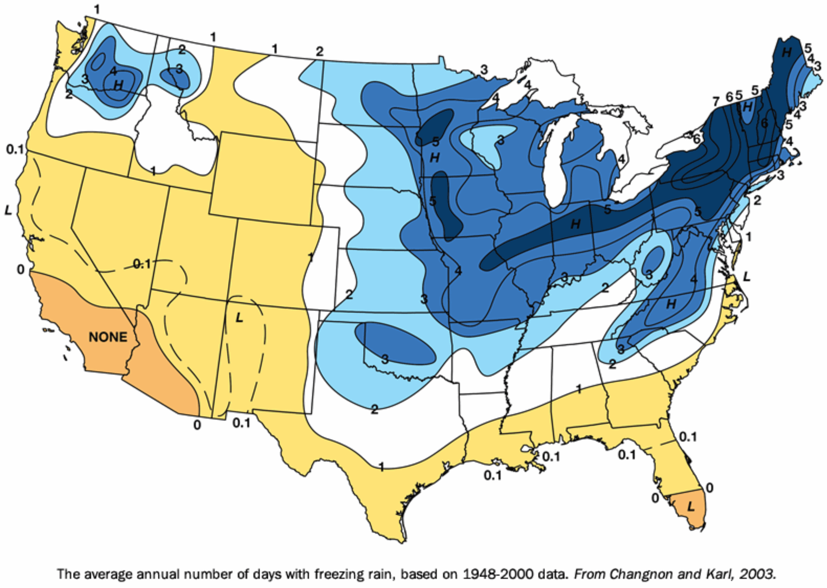
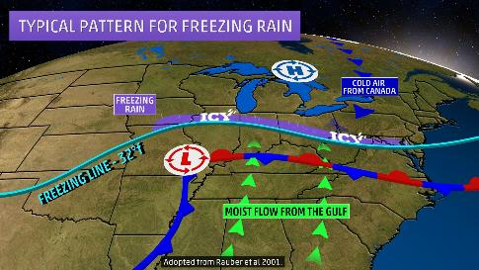
Forecasting: Icing
Freezing rain occurs when a warm layer moves over a cold layer

Slide 32
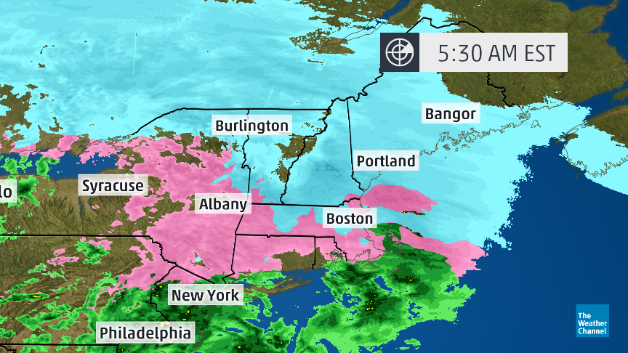
Forecasting: Icing
What you can do:
  Watch radar
  Watch for alerts from ice sensor, Weather Ops
  Watch for freezing rain/wintery mix events in the 7 day forecast
Pink = wintery mix
Switch over between rain and snow and potential for icing

Slide 33
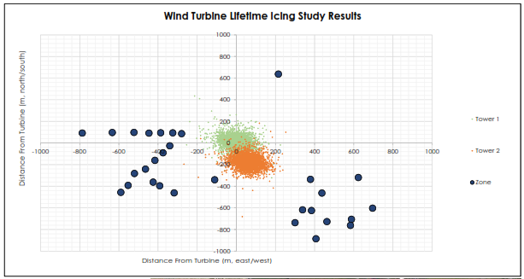
Impact to projects: Icing
Why do we care?
  Decreased energy production due to increased weight on turbine blades
  Increased loading on the turbine
  Ice impacts at nearby houses, roads, parking lots
  Our setbacks were designed for worst case ice throw
  For each project you have to know what turbines pose a risk to

Slide 34
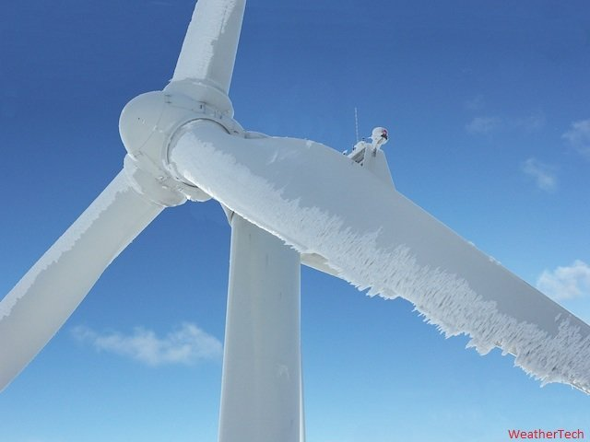
Impact to Projects: icing
Ice can build up on the blades even when there is not a freezing rain event
Leading edge during snow can cause build up
Freezing fog can also cause build up
During all winter weather events think about if ice could be building up on the blades

Slide 35
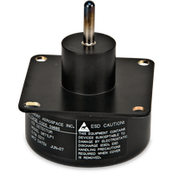
Impact to Projects: icing
Tools to help:
  Ice sensor
    NFWC
    Greenville (coming soon)
  Weather-Ops
    We will get alerts for: winter weather advisory, winter storm watch, heavy snow warning, freezing rain advisory, ice accretion advisory/warning/watch, ice storm warning, sleet advisory, sleet warning, freezing fog advisory
Tools are there to help, not be a crutch. Do not rely on them. Always be aware during winter weather events.

Slide 36
Icing impacts at projects
For each project you must know which turbines pose a risk to the area during icing events
Know what direction the wind is blowing from – this will let you know what areas are at risk of ice throw
Projects with higher risk for ice throw:
  Whirlpool Findlay: W1, W2
  Ball Findlay: Z2, Z3
  Valfilm: V1, V2
  Harpster: none
  Ottawa: none
  Cooper: none
  Haviland: all, but not our call
  Marion: W3
  Greenville: All, depending on wind direction
Are we in construction or have people in the yard at the NFWC?
Always consider where people are!

Slide 37
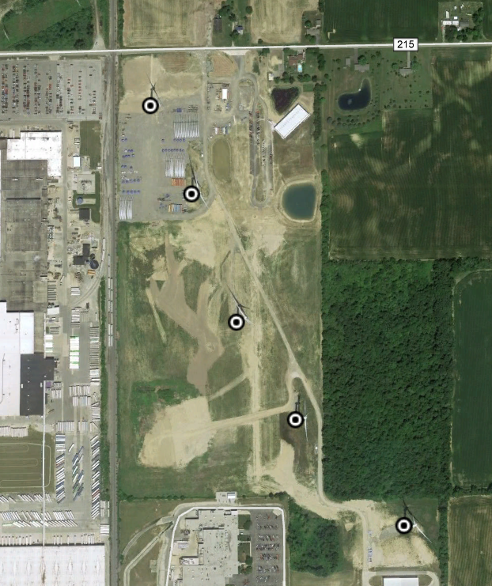
Impact to Projects: icing
NFWC
Risk to OE parking lot from W1 and W2
Risk to Whirlpool parking lot from W1
Risk to anyone in the yard from W1 and W2
Risk to Ball parking lot from Z2
Risk to Ohio Logistics from Z3
Always consider where the wind is coming from.

Slide 38
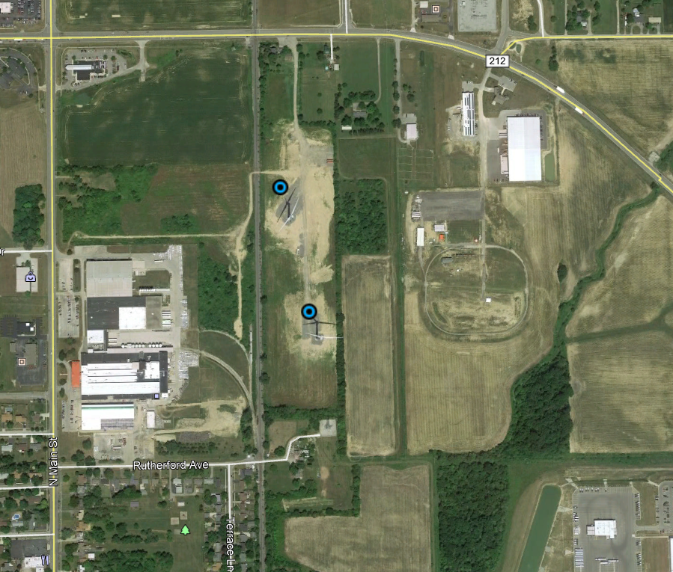
Impact to Projects: icing
Valfilm
Risk to house from V2 (750 feet from house)
Densely populated areas we always want to be aware of
Always consider where the wind is coming from.

Slide 39
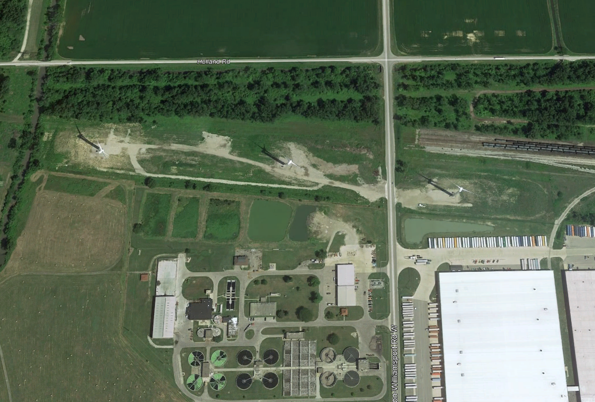
Impact to Projects: icing
Marion
Risk to Whirlpool trucks from W3
Always consider where the wind is coming from.

Slide 40
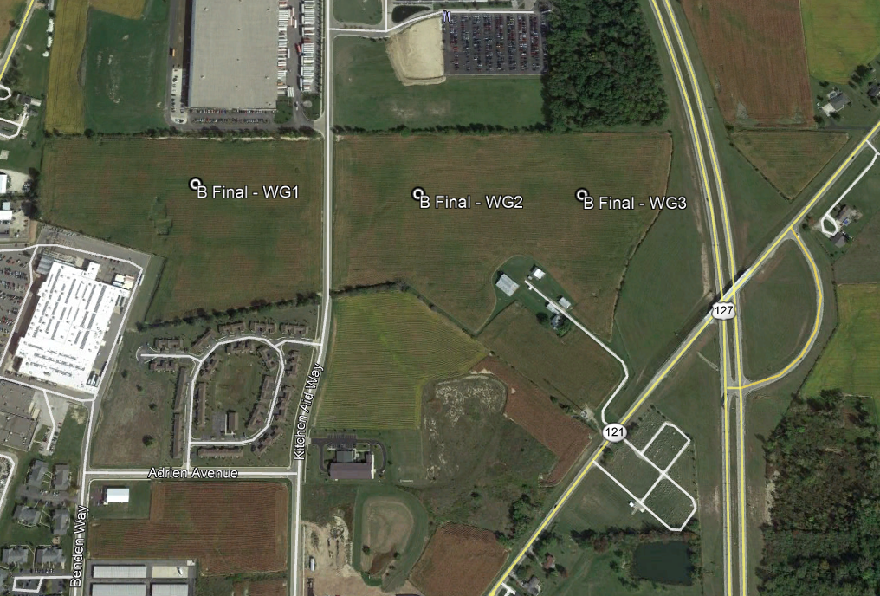
Impact to Projects: icing
Greenville
Risk to Whirlpool parking lot from W2, W3
Risk to US-127 from W3 (if winds from west or south)
Risk to retirement community from W1 (if winds from west)
Always consider where the wind is coming from.

Slide 41
System Operator action plan: Icing
If ice build up is suspected:
  If at the NFWC: take binoculars and go inspect the blades to look for build up
  If at remote projects: check SCADA to see if energy production is less than expected for the wind speeds
  Wind Direction: Determine what direction the wind is coming from (Weather Ops, National Weather Service)
  Shut down turbines: call GWROC to shut down turbines depending on severity of icing and wind direction. Tell them it’s due to icing.
  Start up after event: Ideally you wait until temperatures raise enough for ice to fall directly beneath the blades. Yawing into the sun can help if there are calm winds. If you aren’t positive that all the ice has shed from the blades, perform a controlled start up.

Slide 42
System Operator Action Plan: Controlled Start up
  Controlled Start Up:
  Must have someone on-site (this may change with the new camera situation)
  Make sure you are a safe distance from the turbine but still have a good view
  Call GWROC to turn on one turbine that is a lower risk. Do not do this during shift changes or known times of high traffic near turbines.
  Observe the start up to see if ice is being thrown from the blades and if so, where it is going.
    If pieces of ice are light and “float” down to the ground, and are not traveling into unsafe areas let the turbine continue to run and shed all the ice
    If pieces of ice are large and being thrown long distances or into unsafe areas, turn the turbine off immediately and try again later after temperatures have warmed
  Repeat step 4 for each turbine, one at a time

Slide 43
Interacting with On-Call Meteorologist
During icing events, all System Operators and Meteorologists on-call should be monitoring
On-call meteorologist will:
  Alert the System Operators that an icing event is forecasted, when it is going to occur, and the severity expected (Hangout)
  Be available to the System Operators during the event for questions and updates
It is ultimately the job of the System Operator to make the decision to shut down (at the Meteorologist’s suggestion)
On-Call Meteorologists can have shut down/restart authority if given to them by their System Operator

Slide 44
WEATHER EVENTS:
SEVERE STORMS

Slide 45
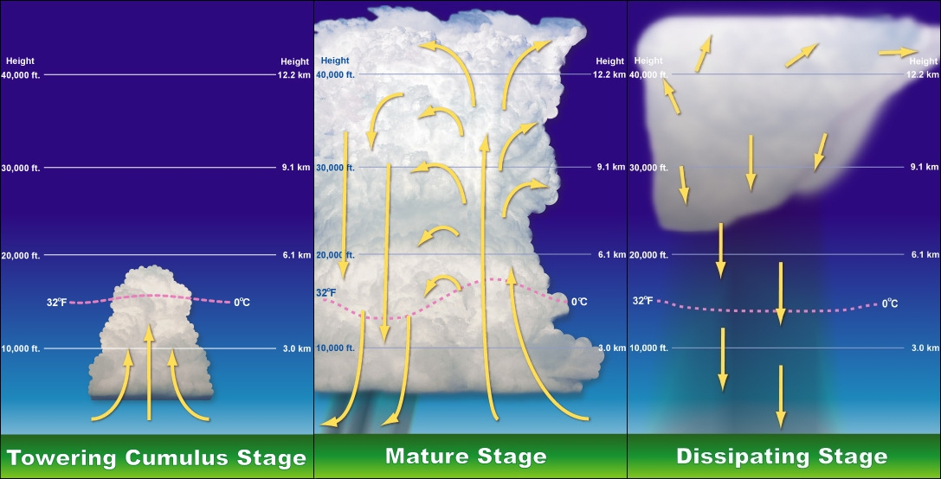
Weather Events: Severe Storms
Strong lifting mechanism
Lots of moisture
Lots of instability
High vertical velocity
Cumulonimbus cloud development

Slide 46
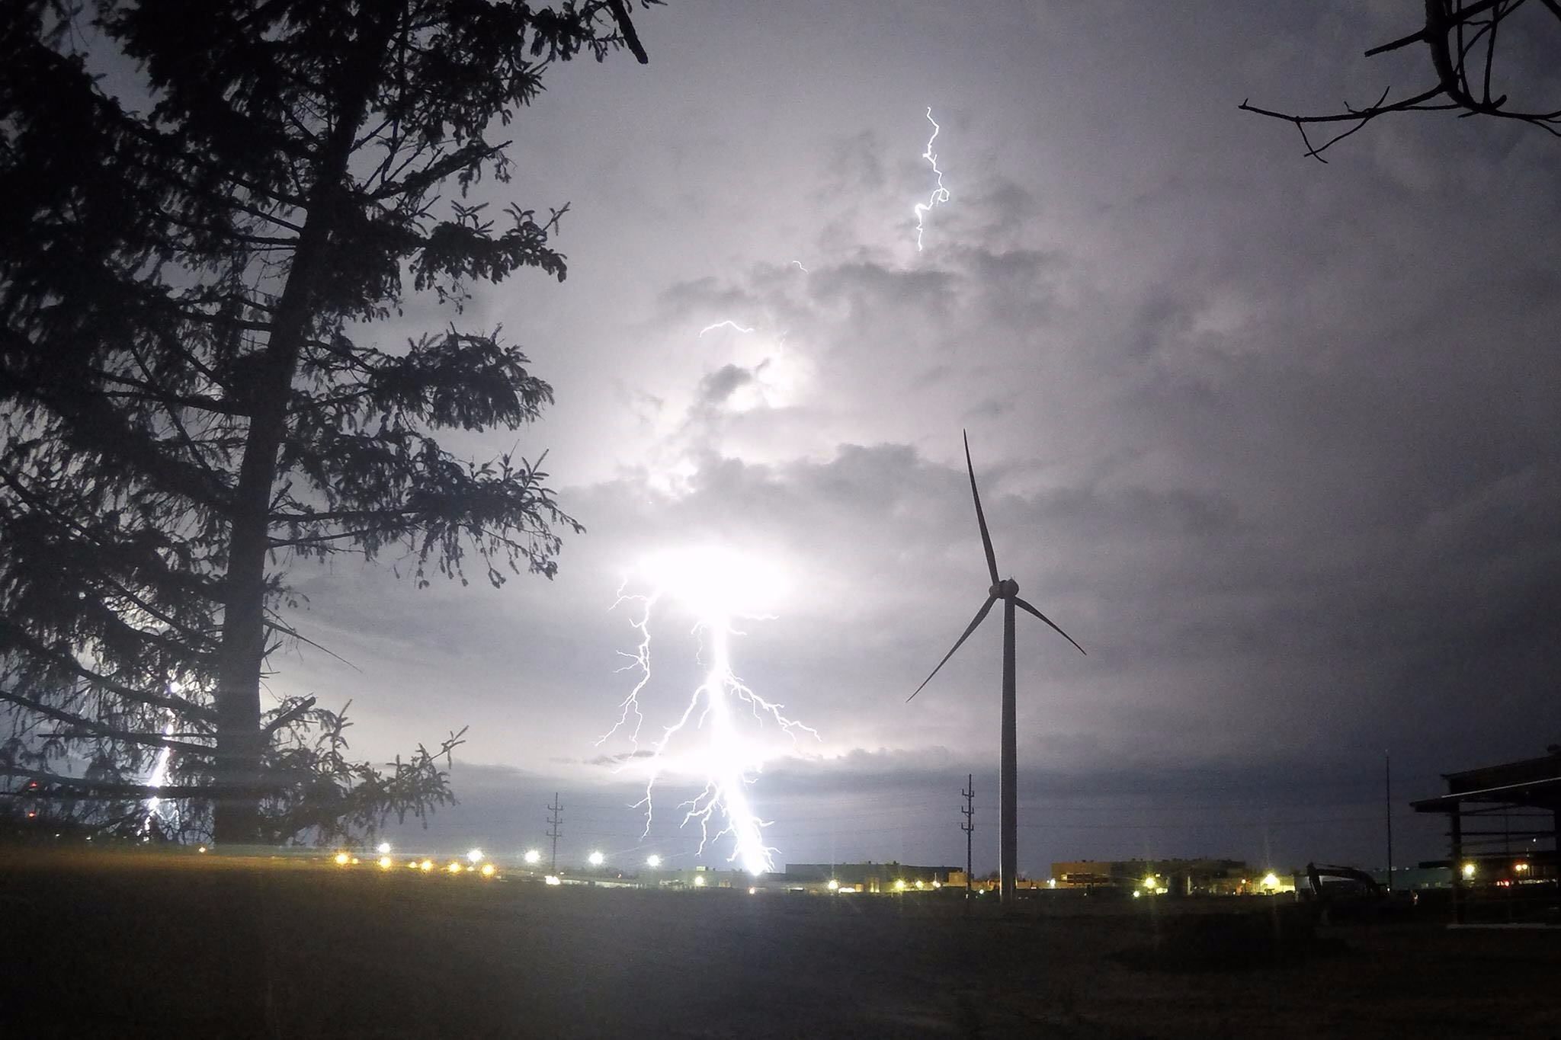
Weather Events: Severe Storms
Why do we care?
  High winds
    Increased loading on the turbines
  Lightning
  Flooding
  Power outages

Slide 47
Weather Events: Severe storms
Straight line winds
Supercells/tornados
Squall line
Derecho
Hurricane
Downbursts
Microbursts
Gust front
Haboob
HIGH WIND EVENTS

Slide 48
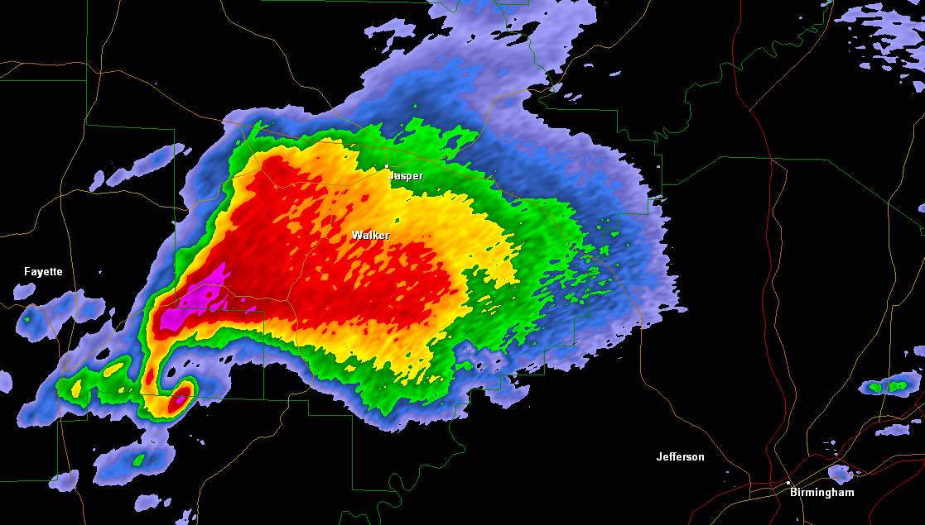
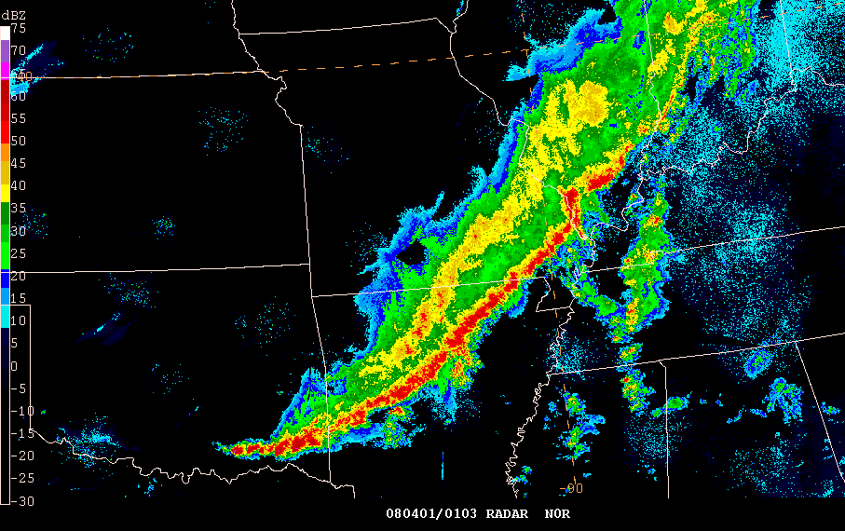
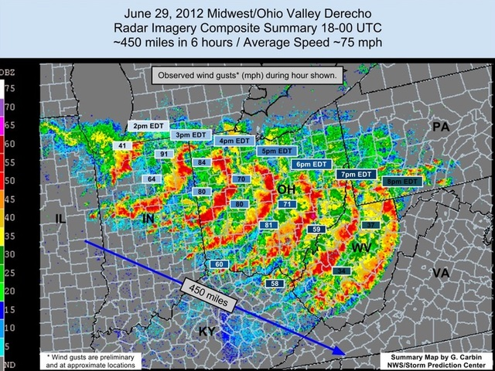
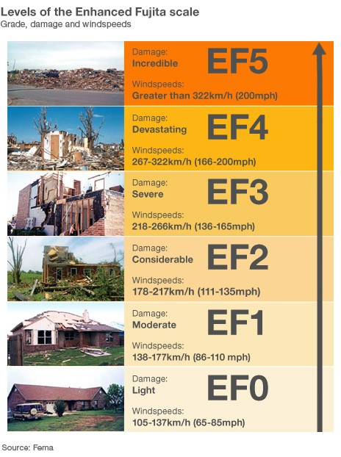
Weather Events: Severe Storms
Super Cells
Most severe storms
Heavy precipitation
Tornadoes possible
Squall Lines
Forms ahead of cold front
Heavy precipitation
Hail
Lightning
Straight line winds
Derecho
Widespread
Long lived storm
75 mph + winds

Slide 49
Forecasting: Severe Storms
Low pressure systems
High pressure gradient (tight isobars)
Frontal Boundaries
Tornado Season: transitional season where cold, dry air from the Rockies meets warm, moist air from the Gulf of Mexico
  March – June

Slide 50
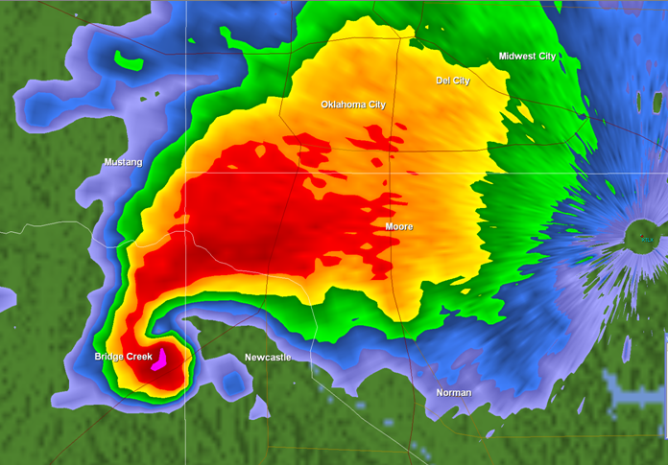
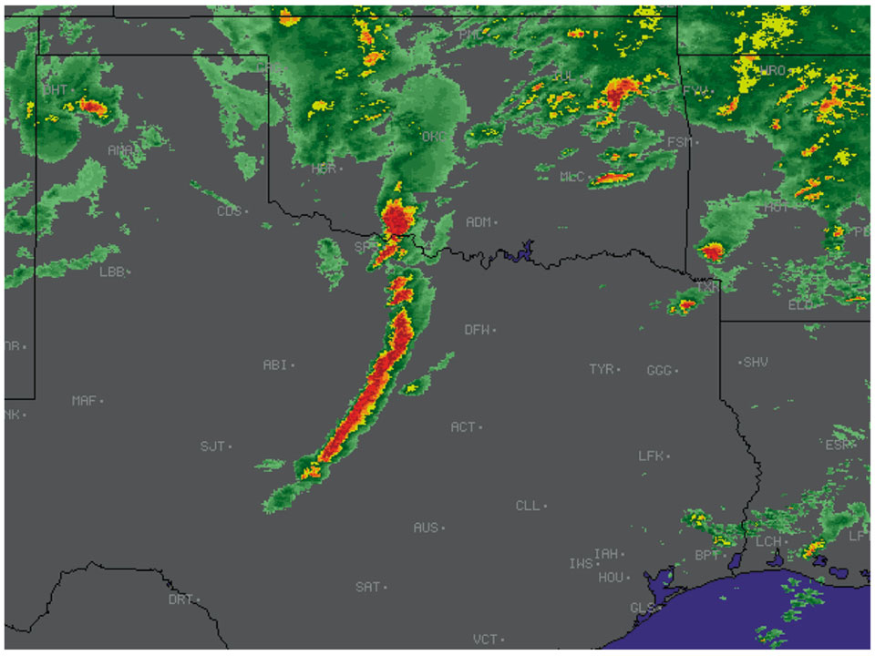
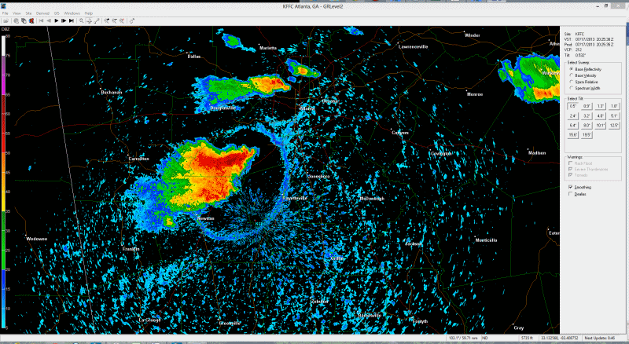
FOrecasting: Severe Storms
Radar signatures
Hook echo (strong rotation, likely a tornado) and debris ball
Strong line of dark red – squall line, likely strong straight line winds
If strong enough, gust fronts can show up on radar ahead of strong storm

Slide 51
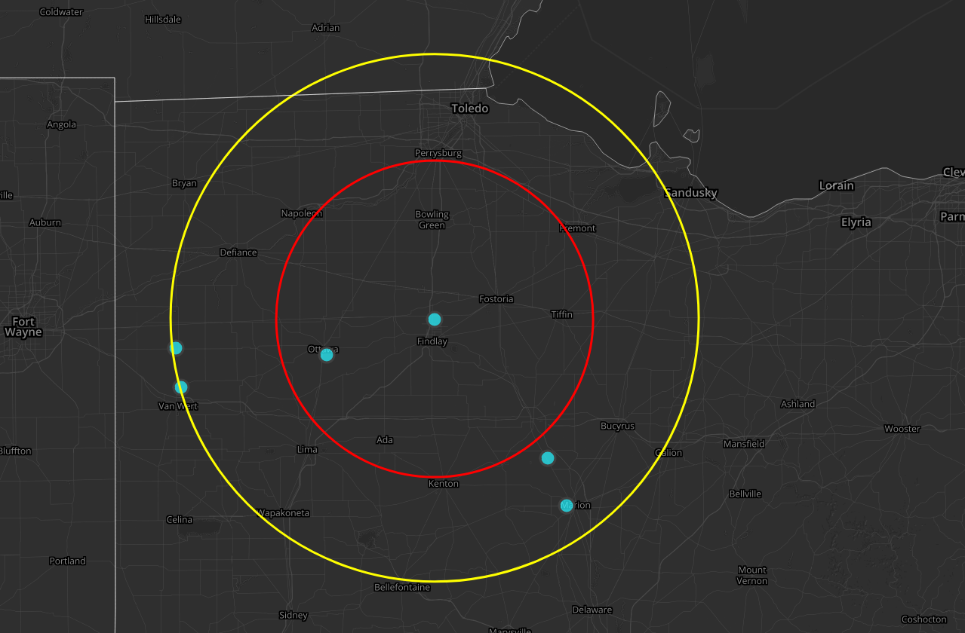
Forecasting: Lightning
Lightning can occur in all storms
For the NFWC or projects in construction:
  Outer ring: 50 miles
  Inner ring: 30 miles
Outer ring is to alert the crews that weather is coming so they can secure site
Inner ring = stop work
Work can resume when there has been no lightning within 30 miles for 30 minutes
  “30 for 30”
50 miles
30 miles

Slide 52
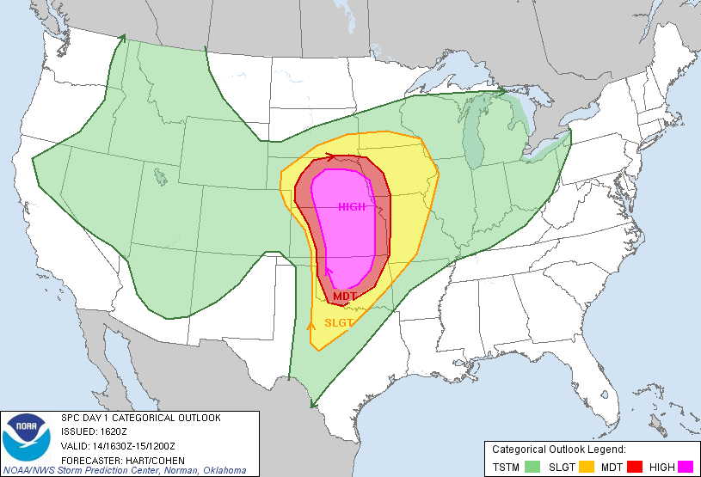
Forecasting: Severe Storms
What you can do:
  Watch radar for severe storms
    Look for radar signatures that would indicate high winds coming
  Use Storm Prediction Center to know when severe weather is expected
    Gives convective outlook for days 1-5
    www.spc.noaa.gov
  Watch for alerts from Weather-Ops

Slide 53
Impact to Projects: Severe Storms
If severe weather imminent, take action, secure sites, make sure everyone is in a safe location
If severe storms leads to high winds, follow shutdown protocol
If in construction, be aware of lightning
WATCH:
Conditions are right for the event to happen.
WARNING:
Event is happening or imminent.

Slide 54
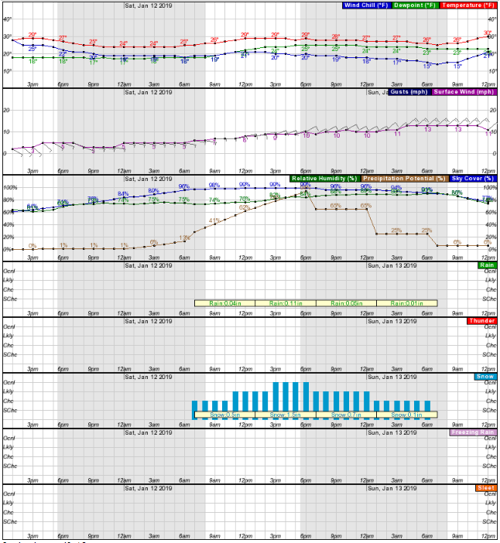
Impact to projects: Severe Storms
Tools:
  OE Weather Stations (NFWC and Greenville)
    Surface wind speed
    Surface wind direction
    Temperature
    Available on your phone
  Storm Prediction Center: www.spc.noaa.gov
    Forecasts for storms
  National Weather Service: www.weather.gov
    Forecasts
    Current conditions at closest NWS Weather Station (wind speed, direction, temperature, precipitation)
  LiDAR:
    If LiDAR deployed near site:
      Vertical wind profile
      Wind shear across rotor

Slide 55
System operator action plan: severe storms
SYSTEM OPERATOR PLAN DURING SEVERE WEATHER
 | Severe Storm |  | Tornado |  | Lightning | High Winds
 | Watch | Warning | Watch | Warning | Within 30 miles
In Construction | Consult On-Call Met | Secure Site | Secure site, Consult On-Call Met | Seek shelter immediately | Stop work until 30 minutes clear | Secure Site
< 500 hr Service Turbines | Consult On-Call Met | Shut Down | Consult On-Call Met | Shut down | - | Sustained > 13 m/s or Gusts > 17 m/s = Shut down
Operating Turbines | Consult On-Call Met | Consult On-Call Met | Consult On-Call Met | Shut Down | - | Sustained > 20 m/s or Gusts > 25 m/s = Shut down

Slide 56
System operator action plan: severe storms
Turbines will shut themselves down at 55 mph sustained
They can gust higher than 55 mph
Severe storm winds behave differently than sustained high wind events (high wind warnings).
  Severe storm winds are much more unstable and have higher shear.
    We will shut down prior to severe storm winds
  Sustained high winds are more uniform.
    Sometimes we will let the turbines shut themselves down for high wind events

Slide 57
Interacting with On-Call Meteorologist
During severe weather events, all System Operators and Meteorologists on-call should be monitoring
On-call meteorologist will:
  Alert the System Operators that a severe weather event is forecasted, when it is going to occur, and the severity expected (Hangout)
  Be available to the System Operators during the event for questions and updates
It is ultimately the job of the System Operator to make the decision to shut down (at the Meteorologist’s suggestion)
On-Call Meteorologists can have shut down/restart authority if given to them by their System Operator

Slide 58
In Summary
If you are on-call as a System Operator it is your job to be aware of weather that may impact the turbine and the safety of those around the turbines
The On-Call Meteorologist will make System Operators aware of forecasted events and be available to answer questions and provide updates during events
It is ultimately the System Operator’s job to make the decision to shut down and restart the turbines

