Slide 1
Monte carlo simulation

Slide 2
Monte Carlo outline
Monte Carlo Simulation
  What it is
  Examples in Daily Life
  How it works
  PDF and CDF
One Energy PPR
  Performance Factors
  Combining PF

Slide 3
What it is
Computerized mathematical technique that allows engineers to account for risk in quantitative analysis and decision making
  Used in finance, project management, ENERGY, manufacturing, engineering, R&D, insurance, transportation, and the environment
Provides a range of possible outcomes and probabilities they will occur for any choice of action:
  Extreme possibilities
  Most conservative decision
  Middle-of-the-road decisions

Slide 4
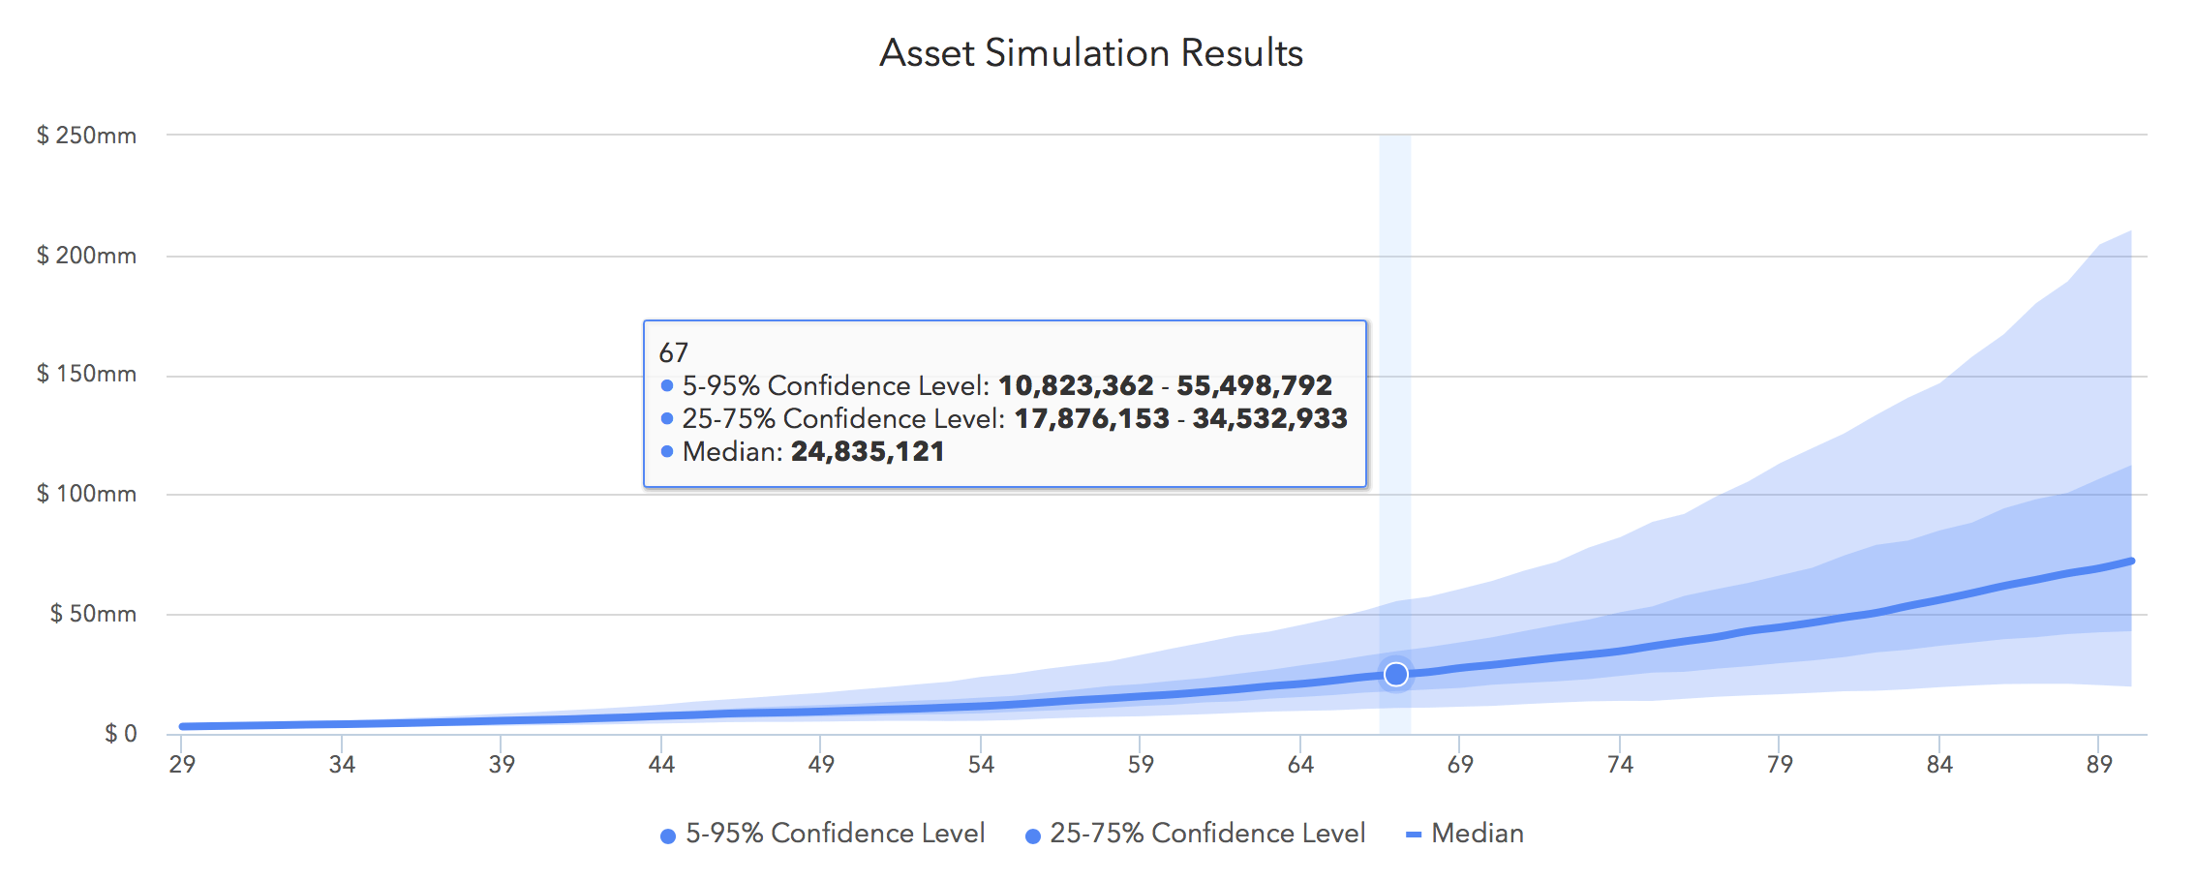
Financial planning

Slide 5
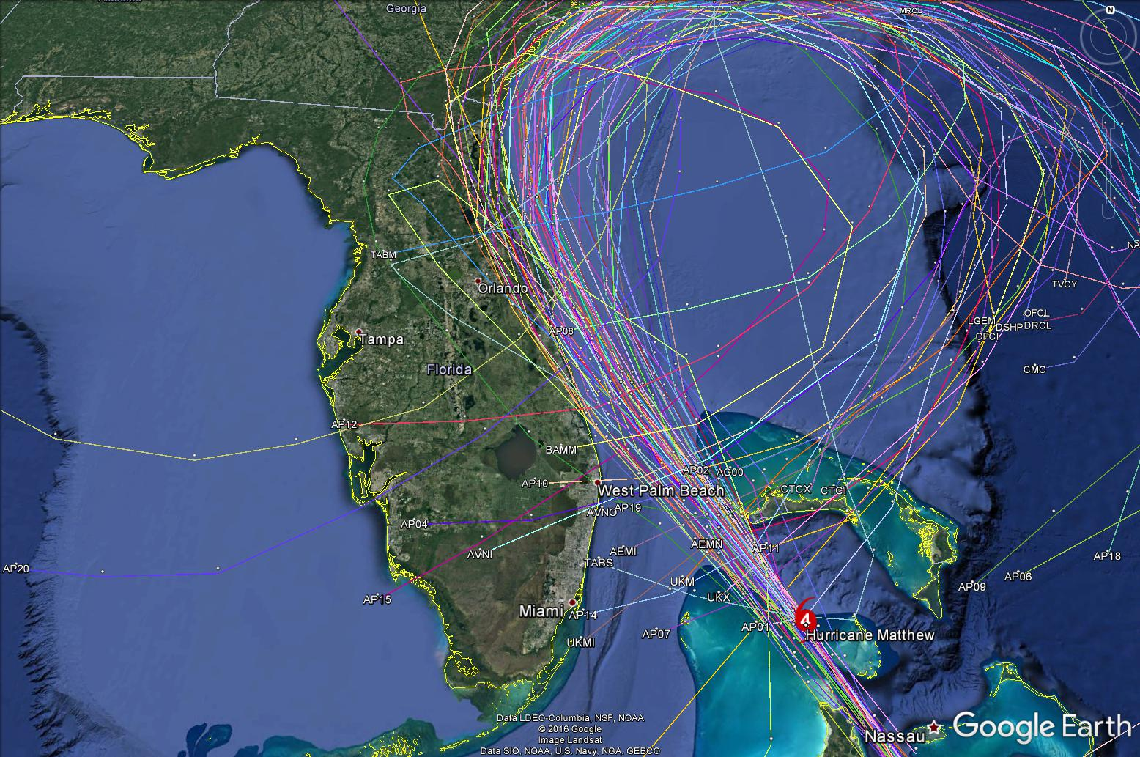
Hurricane Spaghetti model

Slide 6
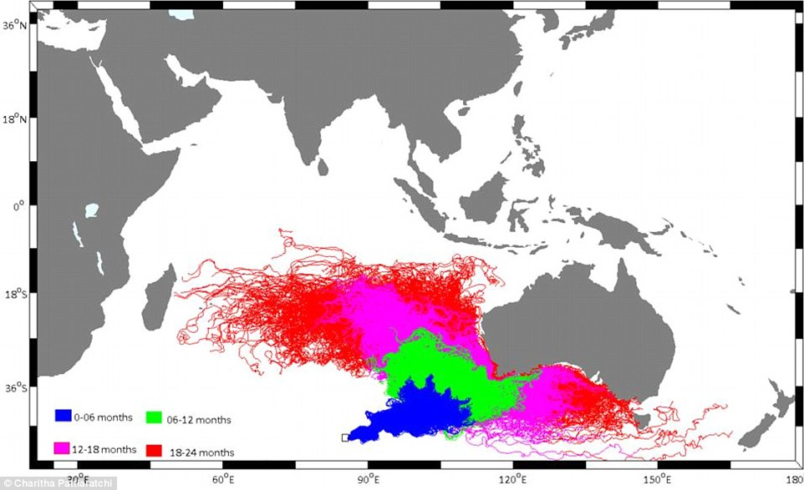
Flight M370 Debris field

Slide 7
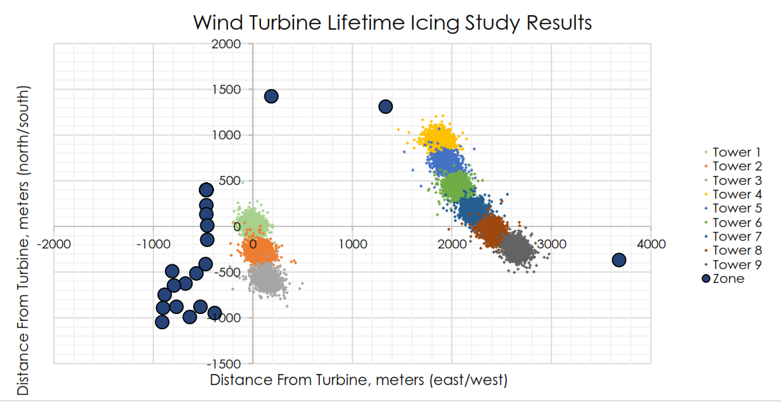

Slide 8
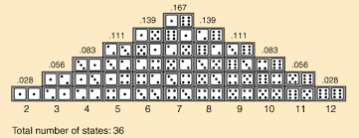
Rolling the dice
Consider calculating the probability of a particular sum of throwing two dice – each die having values one through six
  Probability of rolling seven is equal to 6/36 = 0.167

Slide 9
Rolling the dice
Instead of computing the probability, we could instead throw the dice a hundred times and record how many times each outcome occurs
  Example: Dice totaled seven 18 times (out of 100 rolls) = 18%
  Are these results accurate?
  When is the sample size consider large enough?

Slide 10
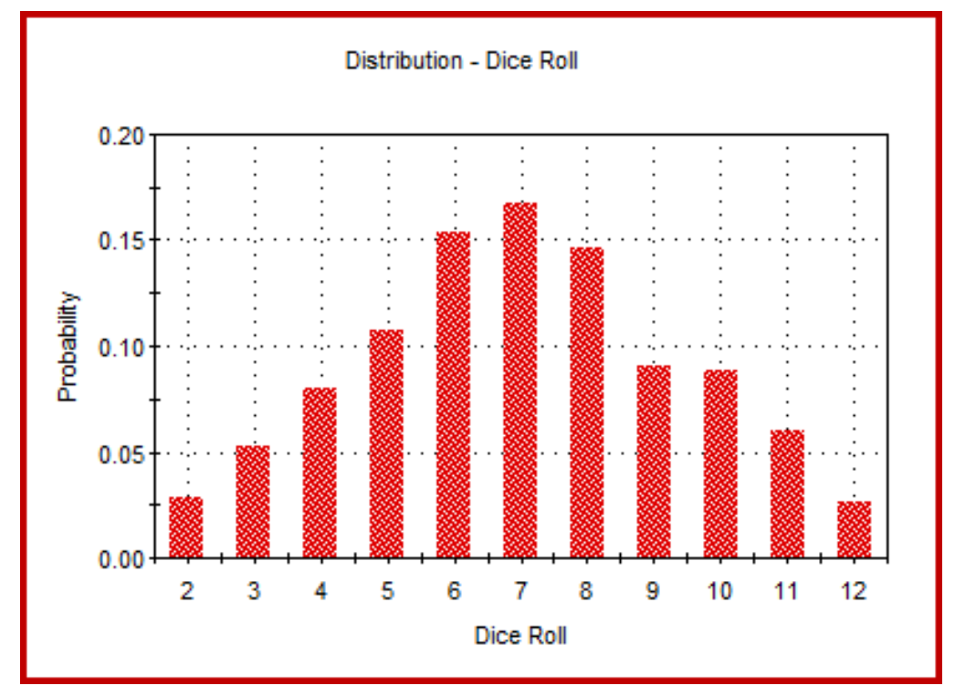
Rolling the dice
Obviously, the more times we rolled the dice, the less approximate our result would be.
  Better to use a computer to simulate rolling the dice 10,000 times (or more) than physically rolling a dice a hundred times
  Output of 10,000 realizations could look like this:
    Monte Carlo!

Slide 11
How it works
Performs risk analysis by building models of possible results by substituting a range of values – probability distribution – for any factor that has uncertainty.
It then calculates results over and over, each time using a different set of random values from the probability functions.
Depending upon the number of uncertainties and ranges specified, a Monte Carlo simulation could involve thousands or millions of recalculations before it is complete.
Provides a comprehensive view of not only what could happen, but how likely it is to happen.

Slide 12
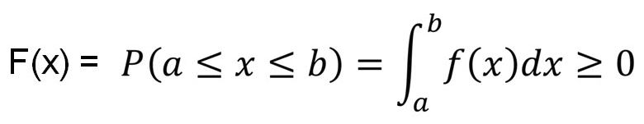

Using probability & Cumulative Distributions
Probability distributions are a realistic way of describing uncertainty in variables of a risk analysis.
  Probability Density Function: a function whose value at any given sample can be interpreted as providing a relative likelihood that the value of occurring.
  Cumulative Distribution Function: the probability that the value takes a value less than or equal to x

Slide 13
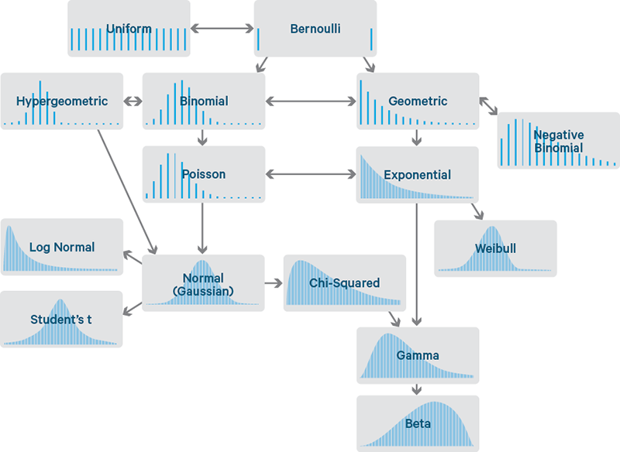
probability Distributions

Slide 14
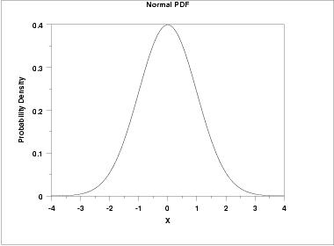
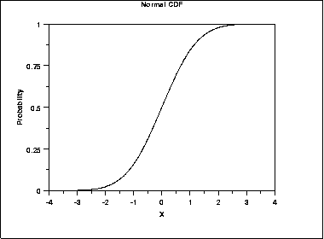
Probability Distribution - Normal

Slide 15
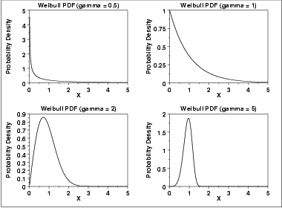
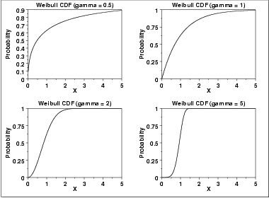
Probability Distribution - weibull

Slide 16
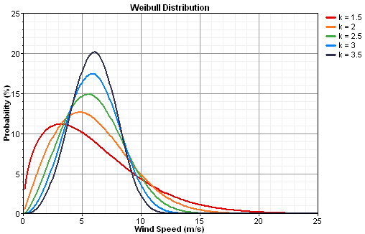
Wind Speed - weibull

Slide 17
Methodology
Values are sampled at random from the input probability distributions.
Each set of samples is called an iteration, and the resulting outcome from that sample is recorded.
Monte Carlo simulations does this XXX number of times, and the result is a probability distribution of possible outcomes.
Provides a comprehensive view of what may happen.
  What could happen and how likely it is to happen.

Slide 18
Advantages
Probabilistic Results: Shows not only what could happen, but how likely each outcome is.
Graphical Results: Easy to create graphs of different outcomes and their chances of occurrence.
Sensitivity Analysis: Allows the analyst to easily see which inputs had the biggest effect on bottom-line results.
Correlation of Inputs: Possible to model interdependent relationships between input variables.

Slide 19
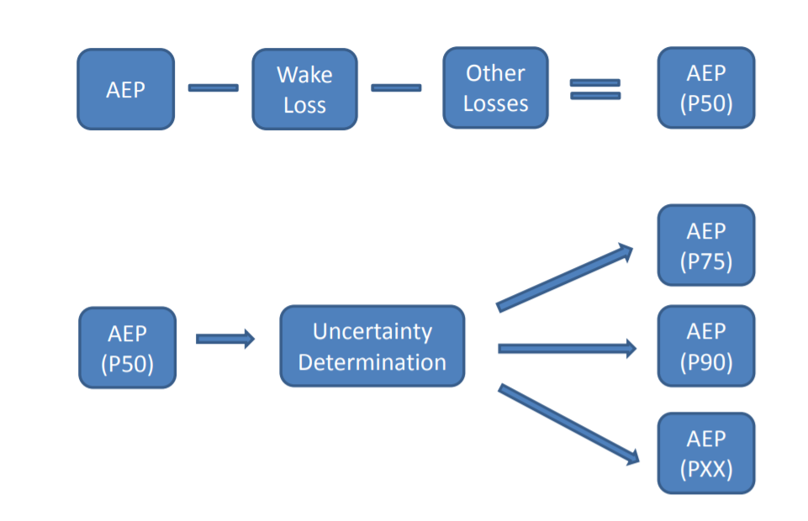
Wind – Calculating Uncertainty
Standard Industry
One Energy

Slide 20
Project Performance Report
An accurate uncertainty and loss analysis for estimating the range of P-Values of Annual Energy Production
  General industry practice uses fixed loses for complicated factors, assume all distributions are normal, and combine distributions using basic equations.
  One Energy’s method for predicting uncertainty involves:
    Summarize findings from WRA previously completed
    Determine distributions for each Performance Factor
    Determine Composite Performance Distribution based on PF distributions
    Apply Composite Performance Distribution to Net Annual Energy Production to obtain the P50 Annual Energy Production
    Determine the Exceedance Table (P50, P75, P90, P95, and P99 AEP and CF
    *OE states that Performance Factors are always a loss in AEP

Slide 21
Project Performance report
Performance Factor (PF): an individual variable with a distribution that determines the variability of energy production.
Std Dev
Mean
NORMAL
PDF
In plain words.. something that can affect energy output of the project. Can be either an increase, decrease, or change the spread of production.
Probability
Each PF has a distribution (PDF) associated with it
  X-axis is energy production (%); y-axis is probability
The distribution can be normal or actual
  Normal: will have a mean and standard deviation
  Actual: will just have values for each x-interval
Based on the specific PF, upper and lower bounds are applied to the distribution
Energy Production (% of Net)
21

Slide 22
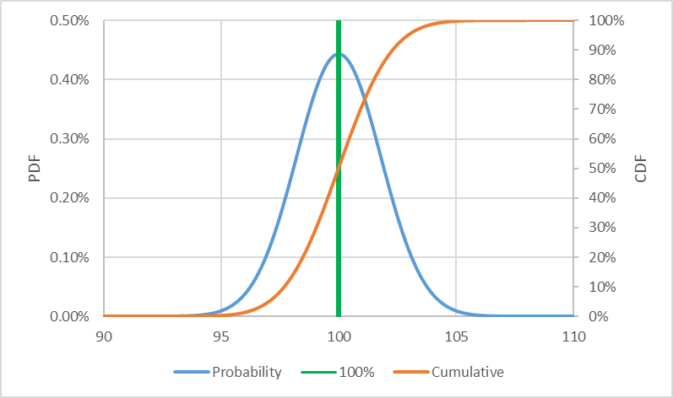
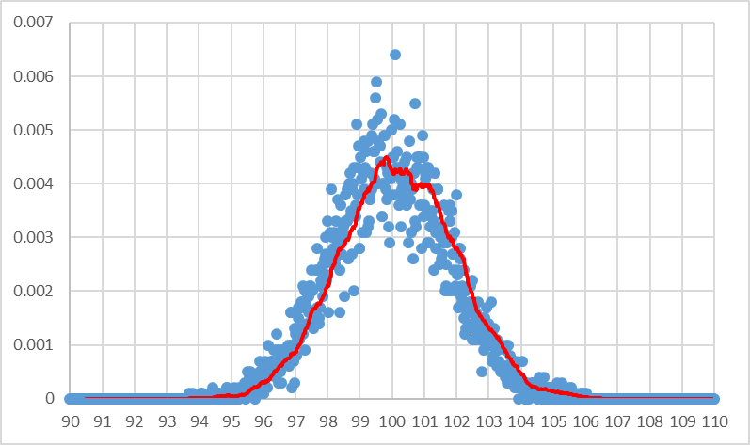
PDF and CDF
Probability and Cumulative Density Function
Monte Carlo Simulation
Excel has a Normal and Weibull Distribution Function
  Inputs are x, mean, and standard deviation (x, alpha, and beta)
  *Upper Bounds and Lower Bounds = Scale Factor
Random number is generated -> Assigned value from CDF -> Translated to “X” Value
  Distribution is created

Slide 23
Combining Performance Factors
PF 1
PF 2
PF 3
PF n
Trial 1
…
rand: 0.5
rand: 0.2
rand: 0.9
rand: 0.6
0.5 = CDF(x_{PF1})
0.2 = CDF(x_{PF2})
0.9 = CDF(x_{PF3})
0.6 = CDF(x_{PFn})
x_{PF1}=100%
x_{PF2}=93%
x_{PF3}=109%
x_{PFn}=102%
1.0
*
0.93
*
1.09
*
…
*
1.02
=
Trial 1 Datapoint Value

Slide 24
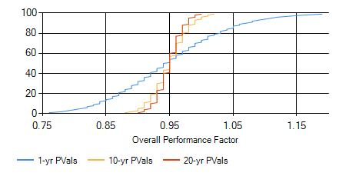
Combining Performance Factors
A new dataset is created with the Datapoint Values found with each trial
ex.
Trial | Datapoint Value
1 | 1.03
2 | 0.97
3 | 0.84
4 | 1.01
.. | ..
.. | ..
99,998 | 1.06
99,999 | 0.98
100,000 | 0.92
From this dataset, we can create its own distribution called the Composite Distribution Function
This is an actual distribution, not normal
Use the CDF of this distribution as scaling factors for the Net AEP, each P-value has a different scale factor

Slide 25
OE Performance Factors (12/01/2018)
1. Turbine Availability | 10. Extreme Wind Speed Downtime
2. Power Curve | 11. Legal/Curtailment
3. Power Curve Degradation | 12. Grid
4. Electrical Collection | 13. Wind Rose Sensitivity
5. Balance of Plant | 14. MCP
6. Data Measurement | 15. Shear Extrapolation
7. Annual Wind Variability | 16. Wind Flow Model
8. Extreme Temperature Downtime | 17. Wake Loss Model
9. Icing Downtime | 18. Catastrophic Event

Slide 26
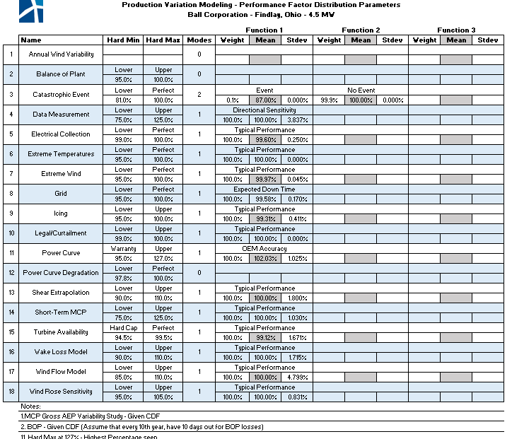
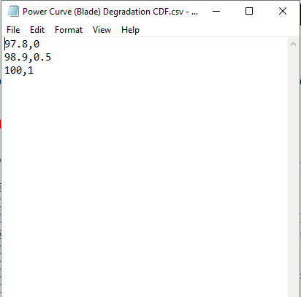
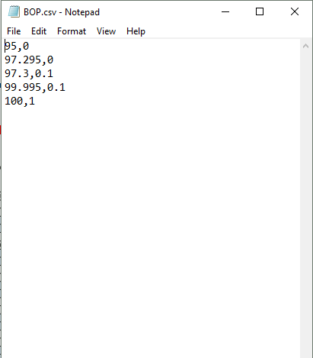
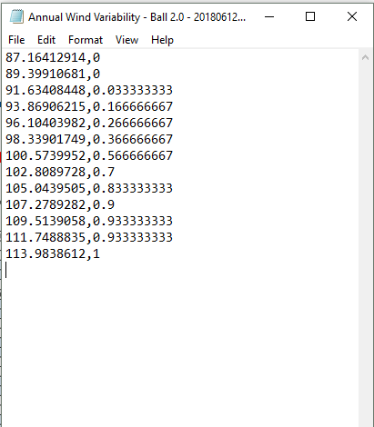
Loss Input Table
PF values for normal distributions
PF .csv files for actual distns
26

Slide 27
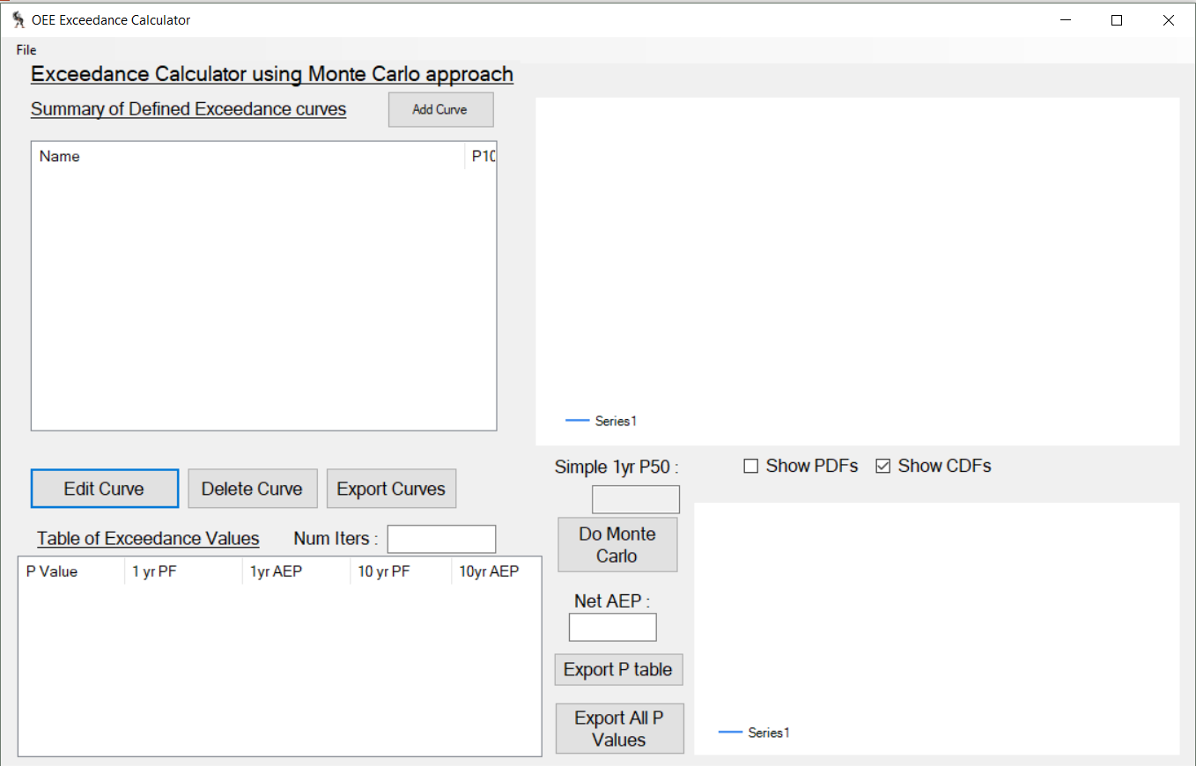
Exceedance Software
\Due Diligence – Resources\Software\Exceedance\CTW.exe
Add in PF distributions individually
27

Slide 28
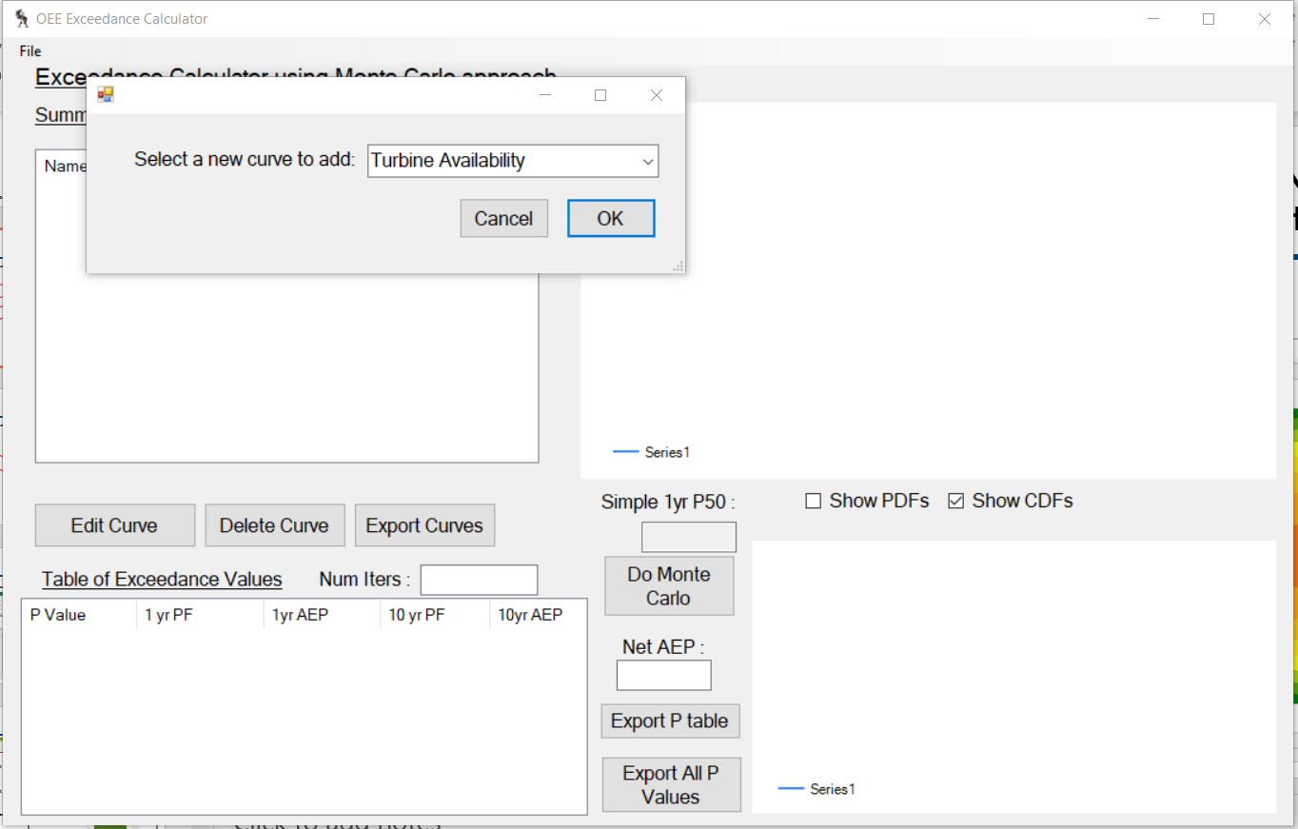
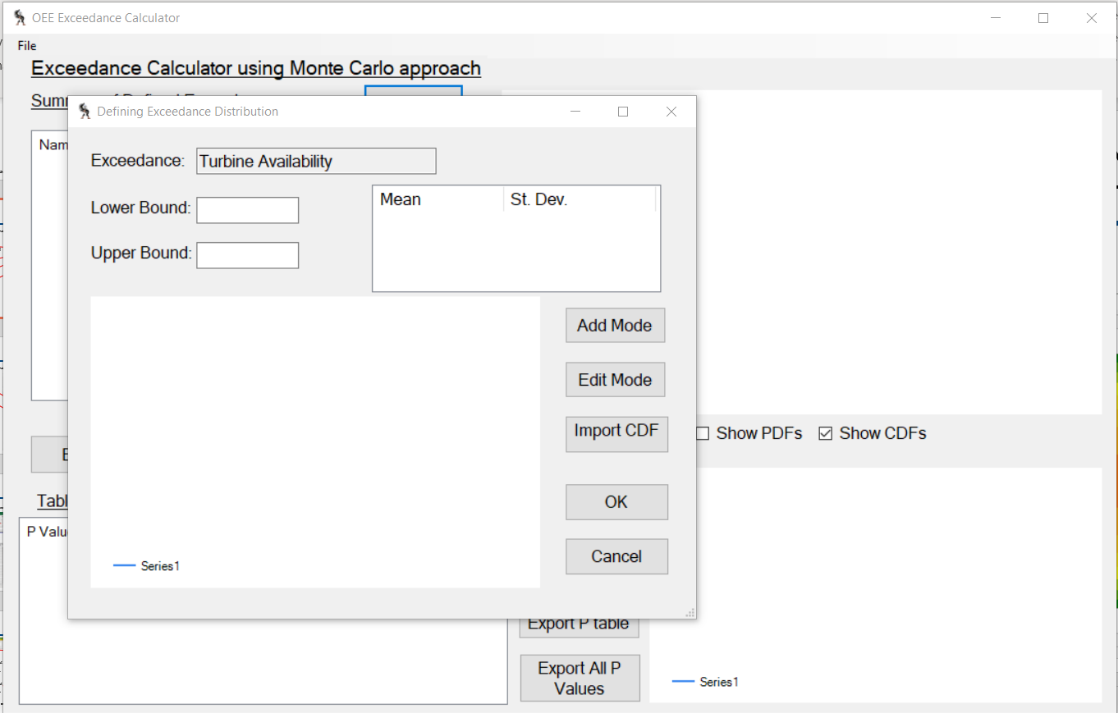
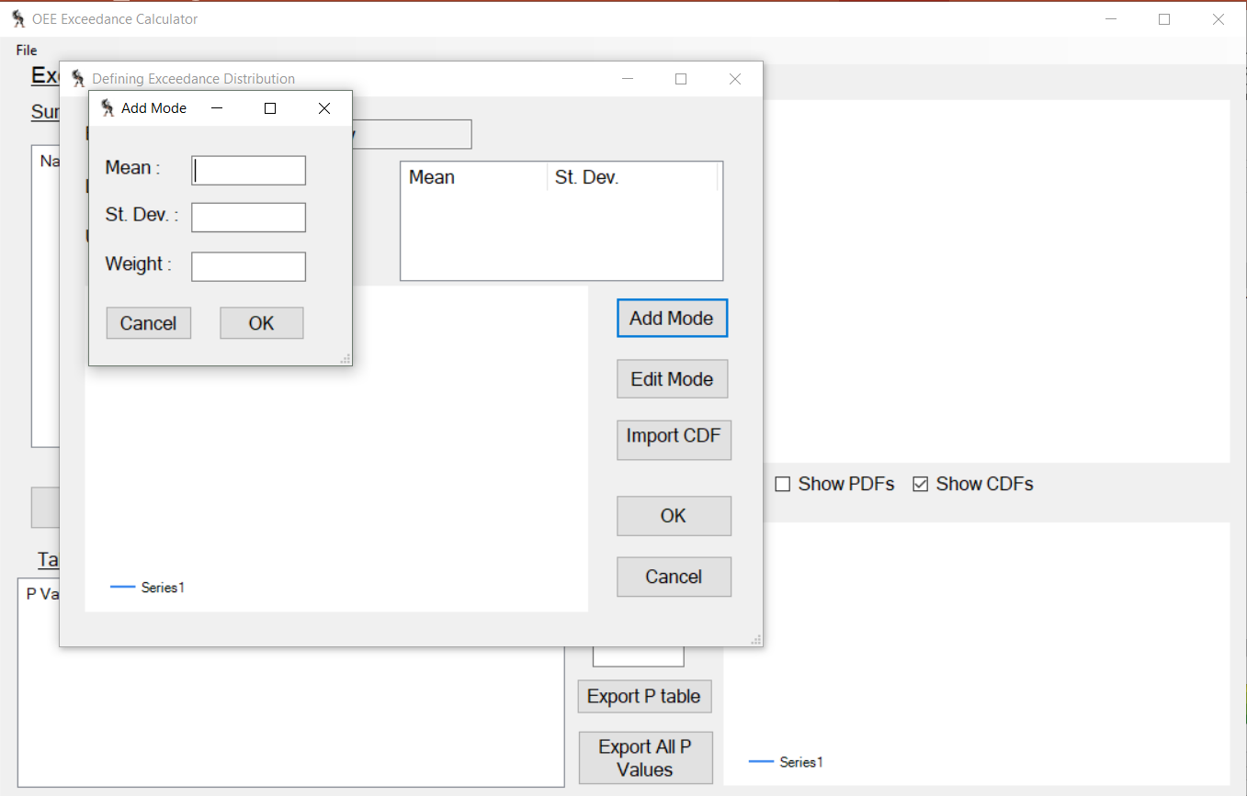
Exceedance Software
Drop-down menu for which PF distribution to add
Insert upper and lower bounds
Click to add a mode
Insert mean and stddev
If only one mode for PF, weight is 100% but put in as decimal
28

Slide 29
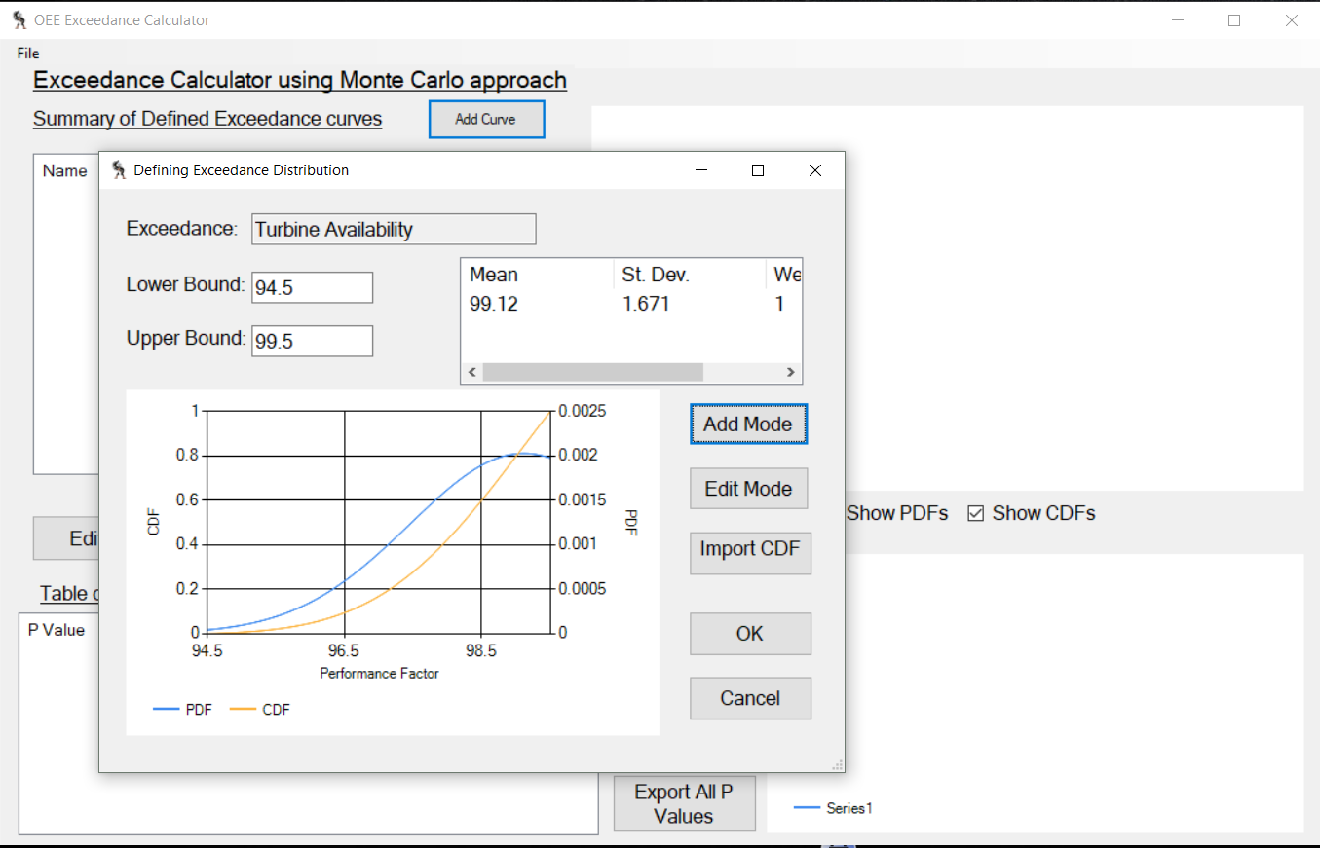
Exceedance Software
Oh no! You had a typo when you were inserting your mean. Edit here
Both the PDF and the CDF of the distribution is plotted
All fixed. This PF is imported and good to go
29

Slide 30
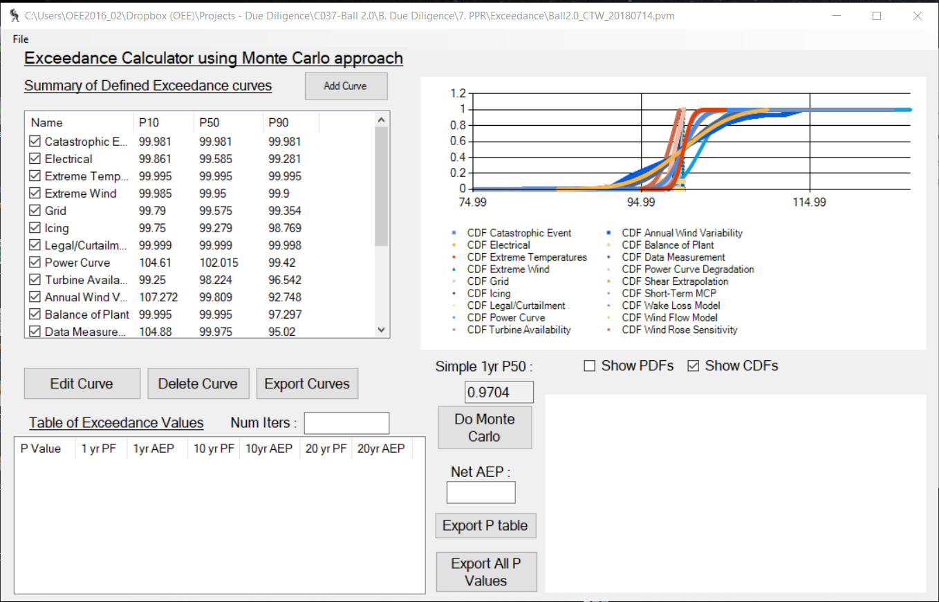
Exceedance Software
After all PFs are input into the software, run the model
Input number of trials for model (100,000)
Run model
Be patient – it takes a few minutes to run
30

Slide 31
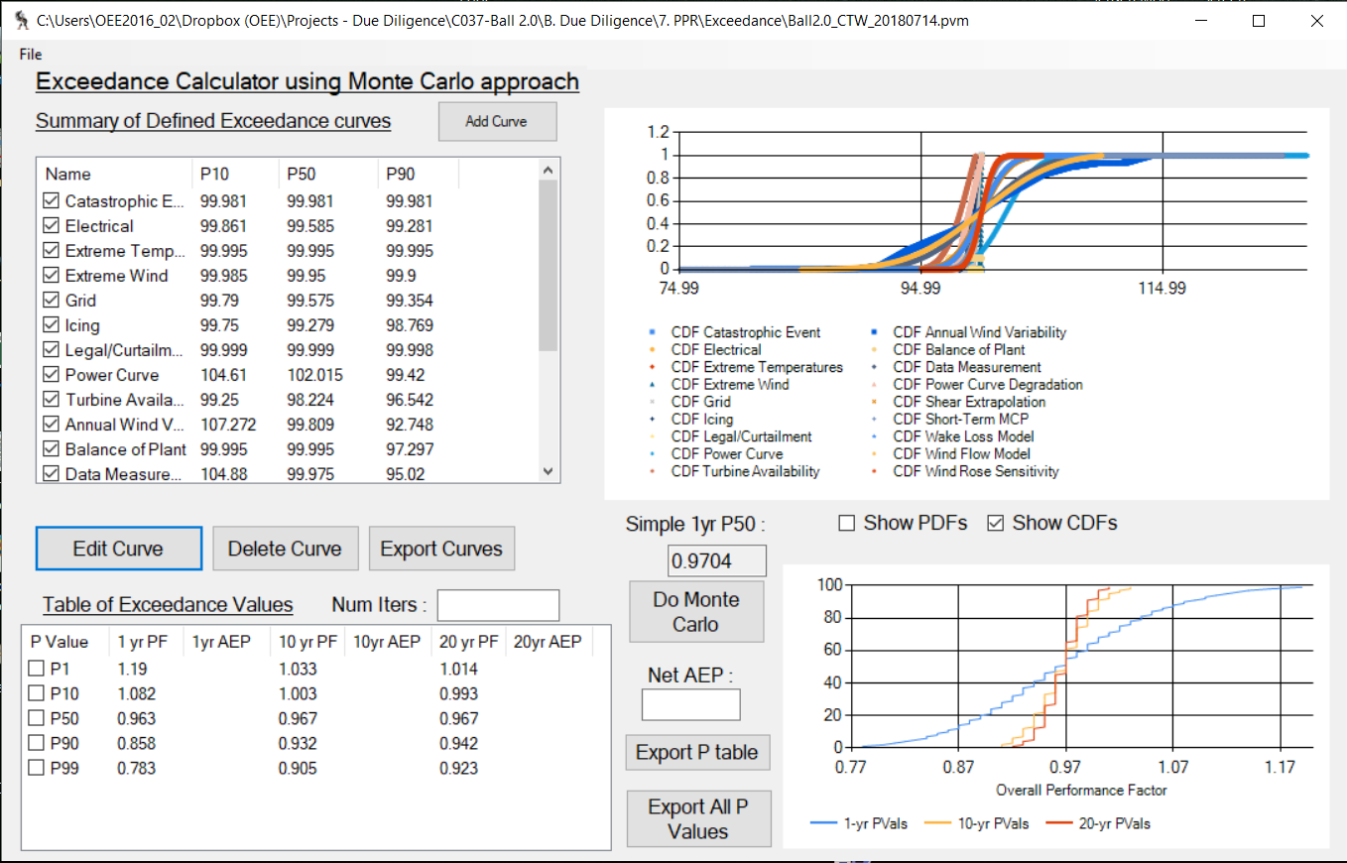
Exceedance Software
Graphical representation of Composite Distribution Fn
Export p-value scaling factors – needed for analysis
SAVE THIS .PVM FILE
31

Slide 32
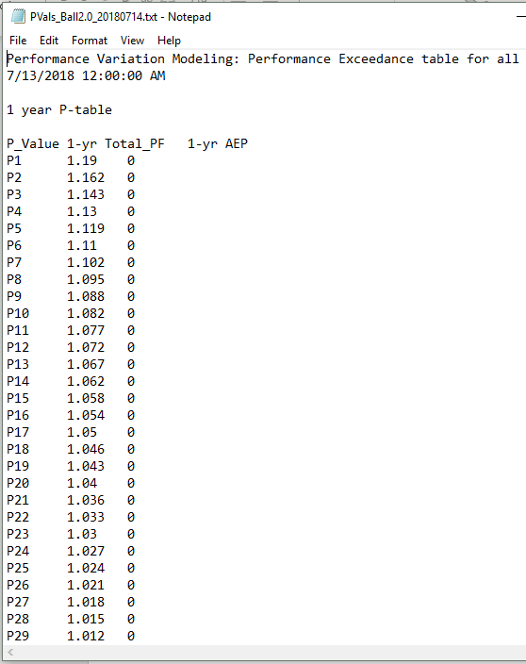
Model Output
Model output
Model output is a scaling factor for each p-value
All scaling factors are then multiplied by the Net AEP value to get the P-value for each interval
Which is why we needed to make sure all uncertainty was in terms energy production!
P-value
Scaling Factor
32

Slide 33
P-Values
P1
P-values: exceedance probabilities for energy production.
In plain words.. the production predicted to be exceeded x% of the time
Example:
A P90 value of 1,000 kWh means that 90% of the time the production will be greater than 1,000 kWh.
P50
The range of p-values also gives us a spread for where we predict energy production to be annually
P99
P50 value is the production value we publish
33

Slide 34
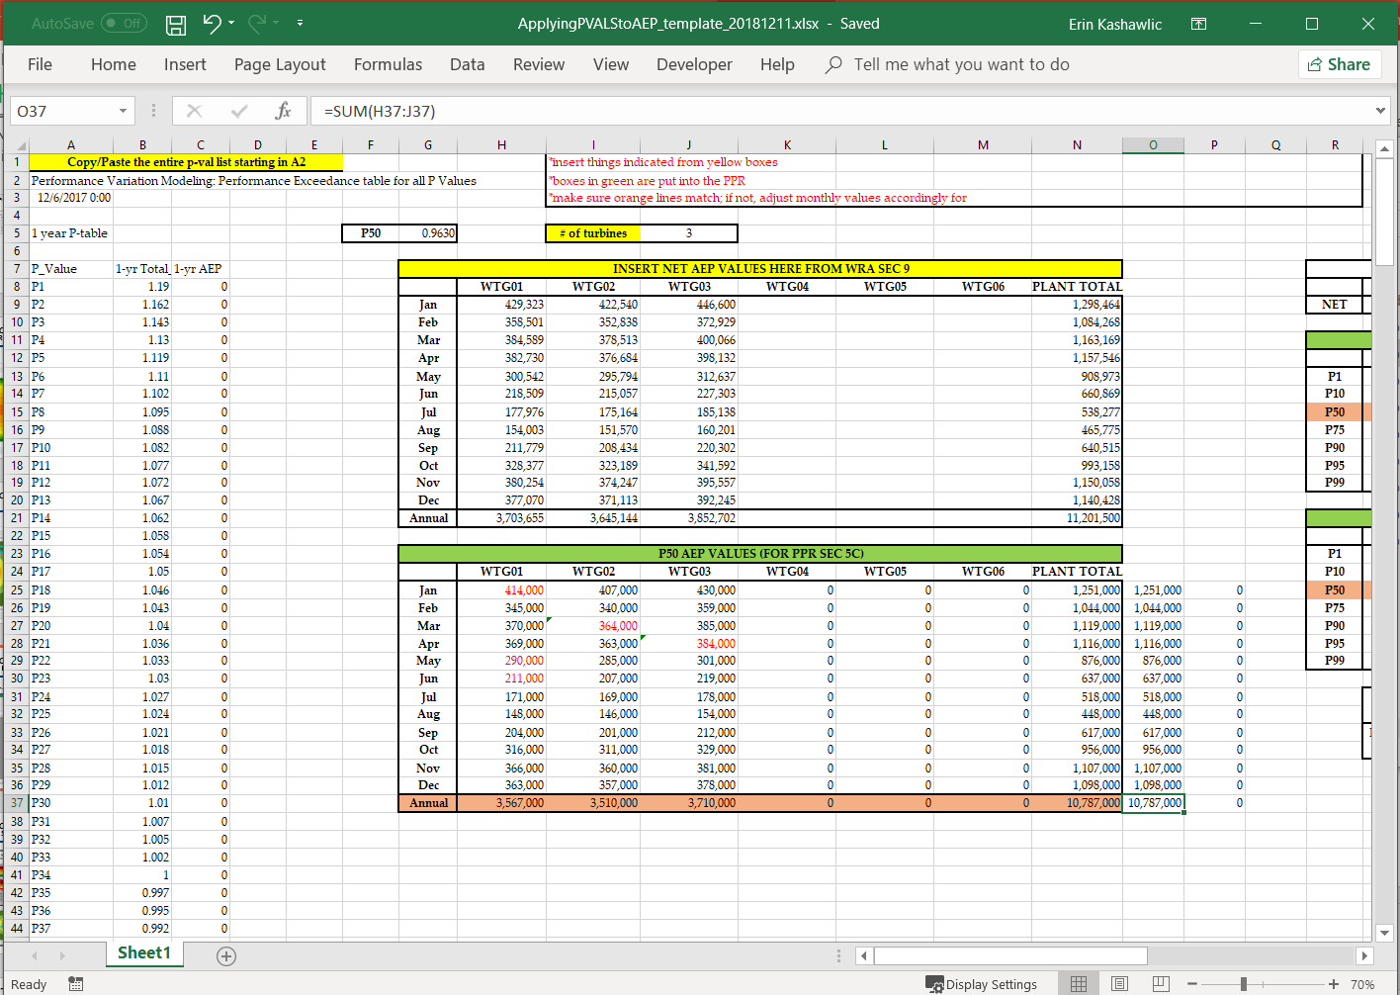
Utilizing Model Outputs
Ctrl-a > ctrl-c in model output file and then ctrl-v into spreadsheet
Specify number of turbines
Insert monthly Net AEP values by turbine from the WRA
34

Slide 35
Questions?
Questions? Comments? Concerns?

Slide 36
Oe performance factors
Turbine Availability
Reason for PF:
How to calc:
OEM availability for turbine. Includes OEM downtime and maintenance.
PF updated annually – will be same mean/stddev for full year for all projects
Based on OE fleet availability statistics
Each turbine for each month become one datapoint; assumed normal dstn
  GW provides availability by turbine by month, used in monthly production reports
  Average of all datapoints is mean
  Standard deviation of all datapoints is stddev
Type of dstn?
Site Specific?
Go above 100%?
Upper Bound?
Lower Bound?
Normal
No
No
99.5%
Minimum availability value
provided by OEM within contract

Slide 37
Oe performance factors
Power Curve
Reason for PF:
How to calc:
OEM contractual power curve may differ than observed production
Internal study is performed to determine how OE fleet is performing annually relative to what the PC claims
Values for mean and stddev must be used from this study
Type of dstn?
Site Specific?
Go above 100%?
Upper Bound?
Lower Bound?
Normal
No
Yes
Max value from observed PC
Minimum value from OEM warranty

Slide 38
Oe performance factors
Power Curve Degradation
Reason for PF:
How to calc:
Wear-and-tear on turbine blades decreases effectiveness in production
Article from WindPower Monthly claims decrease in CF by 0.7 percentage points due to blade degradation
Use spreadsheet template ‘Power Curve Degradation PF template.xlsx’
  Change B11 to the Gross AEP value from WRA
  Copy/paste CDF within box into a new spreadsheet and save as .csv
Type of dstn?
Site Specific?
Go above 100%?
Upper Bound?
Lower Bound?
Uniform
Yes – CF dependent
No
100%
Min value of CDF

Slide 39
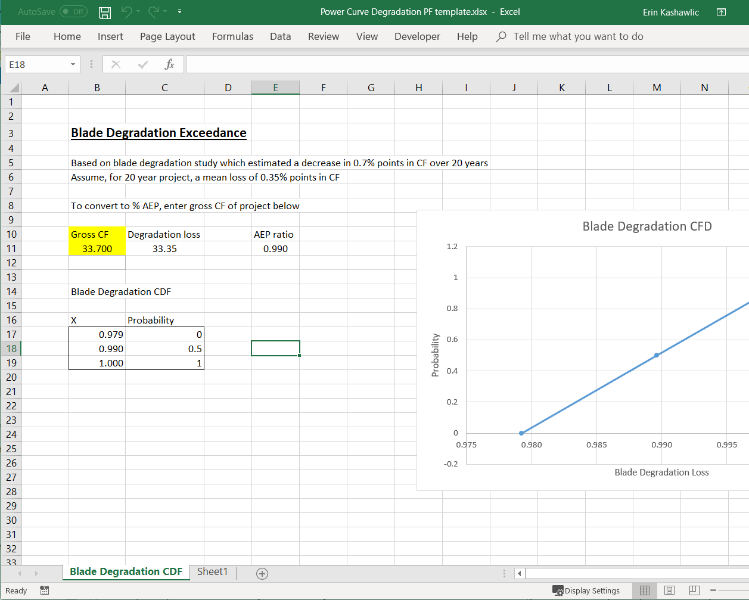
Oe performance factors
Power Curve Degradation
Insert Gross AEP
Copy/paste CDF into new spreadsheet and save as .csv

Slide 40
Oe performance factors
Electrical Collection
Reason for PF:
How to calc:
Takes into account power loss through lines from project to interconnection point
For all WfI projects, taken as a 0.4% straight loss with 0.25% uncertainty.
Mean: 99.6%, StdDev: 0.25%
This value was originally calculated from a power model for the NFWC
An assumption that the project is in the near vicinity of the interconnection and minimal cabling is used has been made
May be updated with project data in future
Type of dstn?
Site Specific?
Go above 100%?
Upper Bound?
Lower Bound?
Normal
Not at this time
No
100%
99%

Slide 41
Oe performance factors
Balance of Plant
Reason for PF:
How to calc:
Takes into account equipment downtime not related to the turbine itself
Does not change
Curve is based on the fact there is a 10% chance for a 10-day downtime event due to BOP
Type of dstn?
Site Specific?
Go above 100%?
Upper Bound?
Lower Bound?
Actual
No
No
100%
95%

Slide 42
Oe performance factors
Data Measurement
Reason for PF:
How to calc:
Uncertainty in the instruments used to record wind data used in analysis
Dependent on primary WRA data source type
MET Tower
  Use ‘Calculating Data Measurement PF template.xlsx’ spreadsheet
    D11 is classification value from Table 1 (most MET towers are NRG #40)
    Put in the avg annual wind speed from WRA into C13
    This gets us uncertainty in wind speed (C15), not energy, so we have to convert
  Spreadsheet ‘Converting WS to AEP Uncertainty.xlsx’
    Copy/paste annual WS and Gross AEP values from WRA ‘Normalized Production’ spreadsheet into C12:D41
    Put WS uncertainty value into H6
    StdDev value is then in K5, mean is assumed to be 100% (no bias)
Type of dstn?
Site Specific?
Go above 100%?
Upper Bound?
Lower Bound?
Normal
Yes
Yes
125%
75%

Slide 43
Oe performance factors
Data Measurement Cont’d
How to calc:
LiDAR
  Manufacturer-provided uncertainty dependent on instrument model
  Typically uncertainty is in wind speed, need to convert to energy
  Spreadsheet ‘Converting WS to AEP Uncertainty.xlsx’
    Copy/paste annual WS and Gross AEP values from WRA ‘Normalized Production’ spreadsheet into C12:D41
    Put WS uncertainty value into H6
    StdDev value is then in K5, mean is assumed to be 100% (no bias)
Note:
If multiple data sources are used (as with Continuum using both MET tower and LiDAR), additional modes may be added
  If multiple MET towers only, use average uncertainty value from each tower as one mode

Slide 44
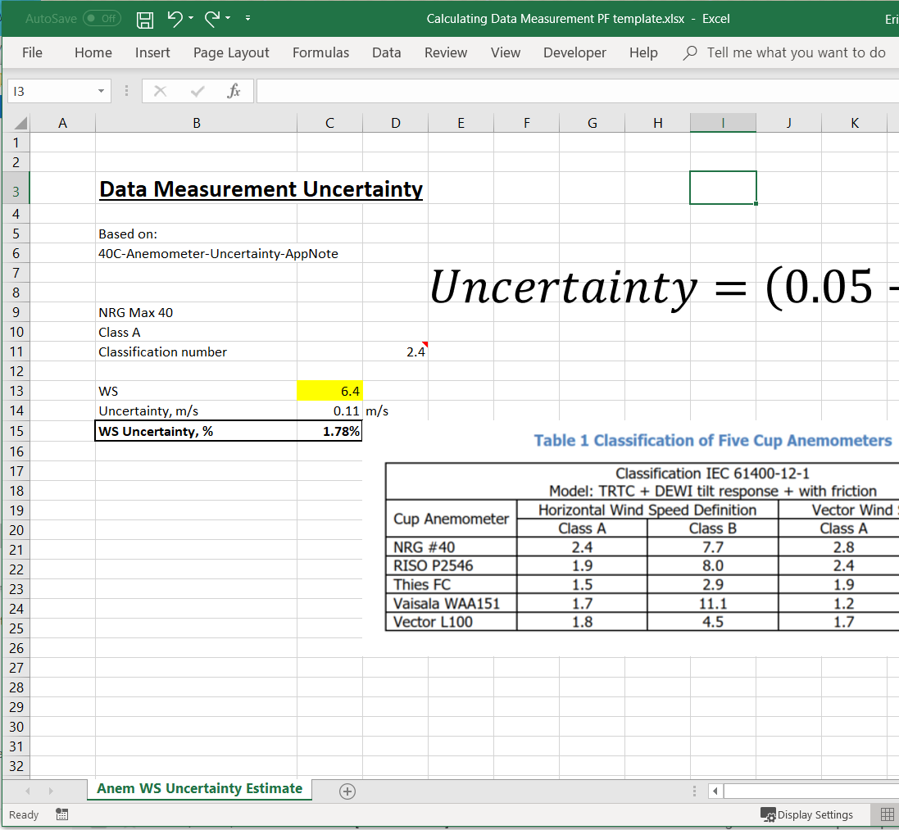
Oe performance factors
Data Measurement Cont’d
Find value from table and insert here
Insert annual average wind speed
Wind speed uncertainty
Need to convert into energy production uncertainty

Slide 45
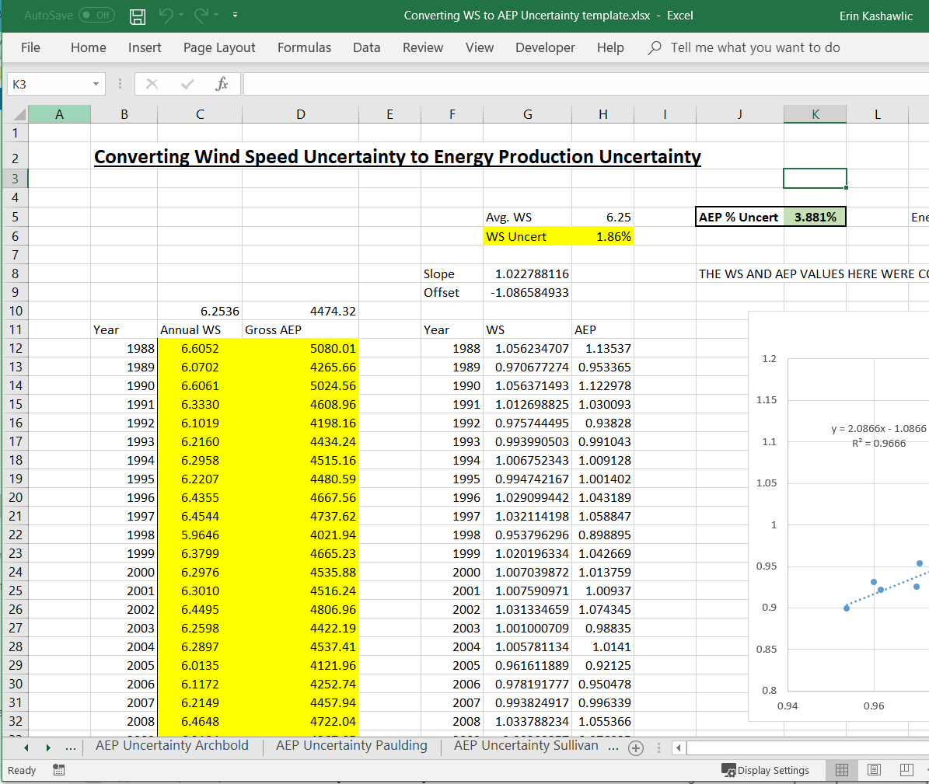
Oe performance factors
Data Measurement Cont’d
Copy/paste annual Gross AEP from Normalized Production spreadsheet
Insert wind speed uncertainty
Energy production uncertainty used in PF

Slide 46
Oe performance factors
Annual Wind Variability
Reason for PF:
How to calc:
To account for wind speed variations throughout the project lifetime
Assume single turbine (no wake effects)
Use the ‘Annual Wind Variability – Gross AEP template.xlsx’ spreadsheet
Copy/paste annual Gross AEP data for one WTG from ‘Normalized Production.xlsx’ used in the WRA portion into ‘Annual Wind Variability’ spreadsheet D11:D40
PDF will be created, look at histogram around Q41. Confirm all data fits in that range. If not, change bin interval in M38
Use values L11:M28 in new spreadsheet and save as .csv
  Column A in .csv should be column L from Annual Wind Variability.xlsx, Col B in .csv is Col M from Annual Wind Variability.xlsx
Type of dstn?
Site Specific?
Go above 100%?
Upper Bound?
Lower Bound?
Actual
Yes
Yes
NA
NA

Slide 47
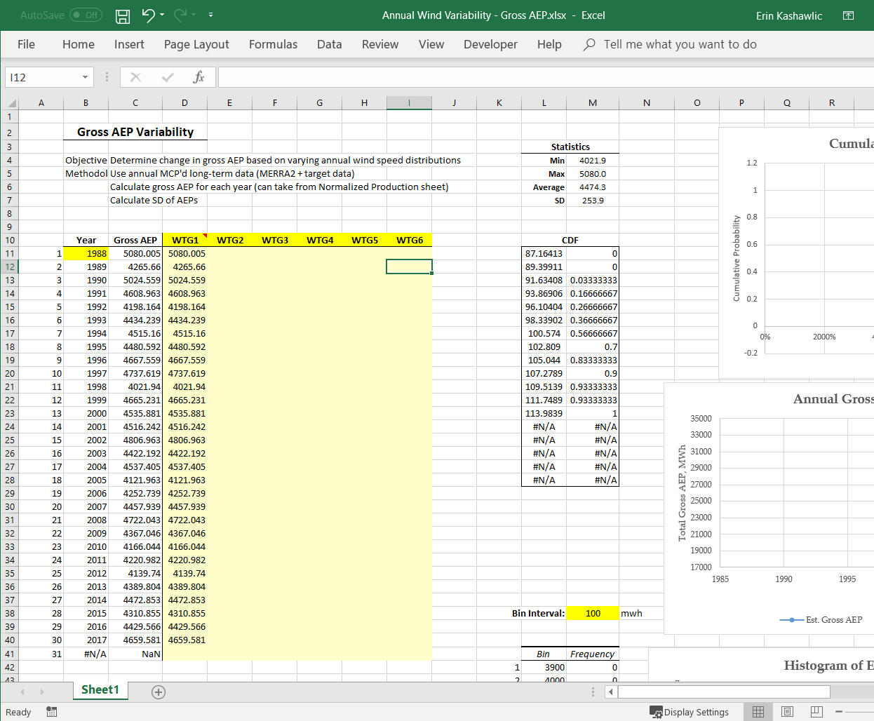
Oe performance factors
Annual Wind Variability
Copy/paste annual Gross AEP from Normalized Production spreadsheet
Histogram of GAEP
Change Bin Interval if needed
Copy/paste CDF into new file and save as .csv

Slide 48
Oe performance factors
Extreme Temperature Downtime
Reason for PF:
How to calc:
Turbines shut down if temperatures get too hot or too cold – we want to account for this downtime
30-years of data at three MERRA2 nodes across the state of OH were used to create the mean and stddev for the PF curve
In OH
  Mean: 100%
  StdDev: 0%
Type of dstn?
Site Specific?
Go above 100%?
Upper Bound?
Lower Bound?
Normal
Region-specific (OH)
No
Note:
100%
95%
Other locations will need additional study to create distribution
Curve values will be updated shortly with additional MERRA2 nodes incorporated into the dataset

Slide 49
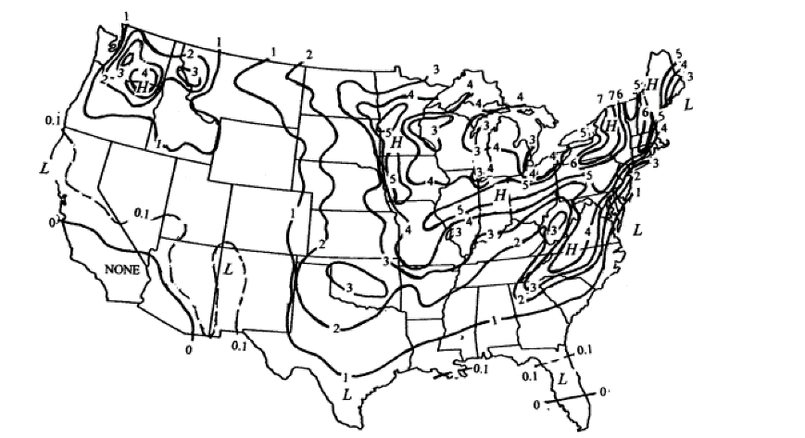
Oe performance factors
Icing Downtime
How to calc:
Reason for PF:
Use figure from Stanley and Karl. Find # icing days, then convert into production lost
Turbine shutdown for icing events – mainly for safety precautions due to ice shedding
Type of dstn?
Site Specific?
Go above 100%?
Upper Bound?
Lower Bound?
Normal
Region-specific
No
StdDev is half of the change to the next contour (again, convert into production lost)
100%
95% (dependent on # ice days)
Ex: days = 5
Mean: 1-(5/365) = 98.63%
StdDev: 1.5/365 = 0.411%
Notes:
Make note that will be changing how to calc this with actual data shortly

Slide 50
Oe performance factors
Extreme Wind Speed Downtime
Reason for PF:
How to calc:
Turbines get shut down (either automatically or manually) for high wind speeds
Study was completed using 9 OH MET towers to get distribution values
Region-specific
In OH
  Mean: 99.87%
  StdDev: 0.045%
Type of dstn?
Site Specific?
Go above 100%?
Upper Bound?
Lower Bound?
Normal
Region-specific (OH)
No
100%
Note:
95%
Other locations will need additional study to create distribution

Slide 51
Oe performance factors
Legal/Curtailment
Reason for PF:
How to calc:
To acknowledge that this is a concern in the industry and we take into consideration. WfI projects do not curtail because the projects will always produce regardless of demand.
This PF is basically just saying we are multiplying everything by 1 (no change in mean production value or spread)
Mean 100%
StdDev 0%
Type of dstn?
Site Specific?
Go above 100%?
Upper Bound?
Lower Bound?
Normal
No
No
100%
99%

Slide 52
Oe performance factors
Grid
Reason for PF:
How to calc:
The grid goes down. WfI projects will trip if a grid fault is detected and decrease production
Ernest Orlando Lawrence Berkley National Laboratory document breaks down grid downtime by region
East North Central (all OH and where most of our projects will be)
  Mean 99.94%
  StdDev 0.002%
Type of dstn?
Site Specific?
Go above 100%?
Upper Bound?
Lower Bound?
Normal
Yes (regional)
No
100%
99%

Slide 53
Oe performance factors
Wind Rose Sensitivity
Reason for PF:
How to calc:
Similar to wind speed variability PF, but for wind direction. Wake loss effects should be accounted for when annual direction distributions vary slightly
Use ‘Wake Loss Automator.xlsxm’ spreadsheet to create annual TAB files from MCP’d long-term data
  Copy/paste long-term data into ‘TAB File Creator’ tab starting A6
  Put turbine info into F6:I6
  G30 pull-down menu to Annual TAB files; G31 pull-down menu to DO NOT USE]
  Click ‘Create Annual TAB Files in TAB creation range as txt file…’ button H37ish
  Click ‘Run Wake Loss Model’ E33
  In ‘Wake Results’ tab, average each turbine wake loss percentage by year so there is one wake loss percentage per year
  Take standard deviation of the annual wake loss percentage -> becomes StdDev for PF
Type of dstn?
Site Specific?
Go above 100%?
Upper Bound?
Lower Bound?
Normal
Yes
Yes
105%
95%
Note:
Mean is assumed to be 100% (no bias)
StdDev is 0% if single turbine

Slide 54
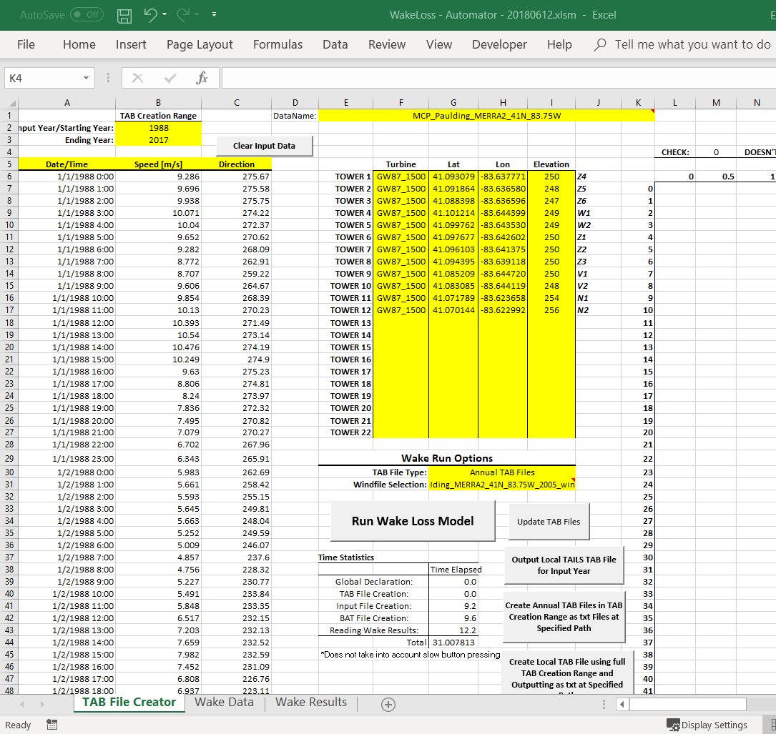
Oe performance factors
Wind Rose Sensitivity
Long-term MCP’d data
Turbine info
Change to ‘Annual TAB Files’
Change to ‘DO NOT USE’
Create Annual TAB files
Run wake model (Jensen)

Slide 55
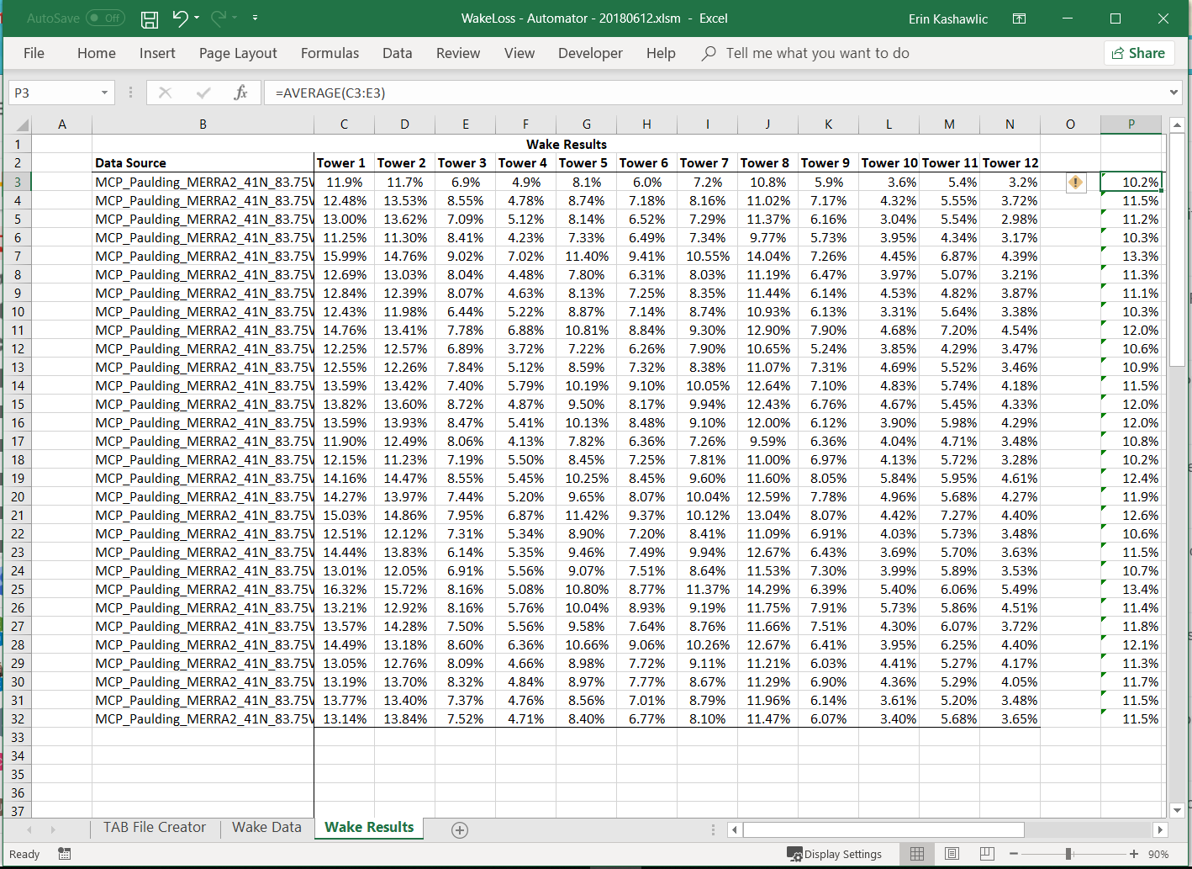
Oe performance factors
Wind Rose Sensitivity
Average all turbines by year
Determine StdDev of the average turbine annual wake loss percentage
This StdDev is the StdDev for the PF

Slide 56
Oe performance factors
Short-Term MCP
Reason for PF:
How to calc:
Uncertainty associated with the MCP algorithm and length of dataset
Study was conducted to determine different uncertainty values in relation to the length of target dataset used in MCP calcs
Use table from documentation and target dataset length to determine stddev
Type of dstn?
Site Specific?
Go above 100%?
Upper Bound?
Lower Bound?
Normal
Yes
Yes
105%
95%
Note:
Mean is assumed to be 100% (no bias)

Slide 57
Oe performance factors
Shear Extrapolation
Reason for PF:
How to calc:
Uncertainty associated with the power law when extrapolating to 80m wind speeds
StdDev for MET tower was determined from an external article
StdDev 1.8%
Type of dstn?
Site Specific?
Go above 100%?
Upper Bound?
Lower Bound?
Normal
Yes
Yes
110%
Note:
90%
Mean is assumed to be 100% (no bias)
Only used when wind speeds are extrapolated to 80m – LiDAR collects data at 80m so the stddev becomes 0%

Slide 58
Oe performance factors
Wind Flow Model
Reason for PF:
How to calc:
Uncertainty in wind flow model. Assumed no bias. Only used when Continuum is used
Internal study was completed with Continuum to determine the uncertainty of the model
StdDev with Continuum 4.92%
Type of dstn?
Site Specific?
Go above 100%?
Upper Bound?
Lower Bound?
Normal
Yes
Yes
110%
Note:
85%
Mean is assumed to be 100% (no bias)
Only used with Continuum. If on-site LiDAR or MET tower, StdDev is 0%

Slide 59
Oe performance factors
Wake Loss Model
Reason for PF:
How to calc:
Uncertainty in wake loss model. Assumed no bias.
Depending on wake loss model, different uncertainty values are used
Jensen (TAILS)
  External article states 15% model uncertainty
  Take project wake loss percentage and multiply by 15% to get StdDev
Type of dstn?
Site Specific?
Go above 100%?
Upper Bound?
Lower Bound?
Normal
Yes
Yes
110%
Note:
85%
Mean is assumed to be 100% (no bias)
Each wake loss model will require a different StdDev. OE only uses Jensen right now

Slide 60
Oe performance factors
Catastrophic Event
Reason for PF:
How to calc:
Major shit happens that affects turbine runtime. If enough production is lost due to major event, insurance kicks in.
It’s the 1:1,000 chance a catastrophic event occurs
Two modes because dependent
  Mode 1: event occurs
    Mean 87% (insurance)
    StdDev 0%
    Weight 0.1% (probability this occurs)
  Mode 2: event does not occur
    Mean 100%
    StdDev 0%
    Weight 99.9% (probability this does not occur)
Type of dstn?
Site Specific?
Go above 100%?
Upper Bound?
Lower Bound?
Normal
No
No
100%
81%

