Slide 1
Lidars and instrumentation at one energy

Slide 2
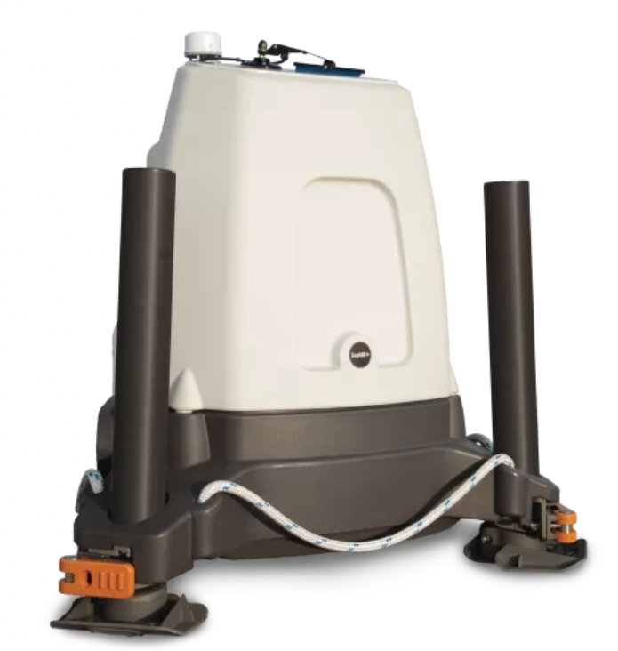
Zephir Lidar overview
LiDAR: Light Detection and Ranging
One Energy uses the ZephIR LiDAR and currently rent-to-owns 3 of them
The ZX300 (previously known as ZephIR 300) is a continuous wave LiDAR system
One of the most worked with LiDARs in the industry and has been extensively validated

Slide 3
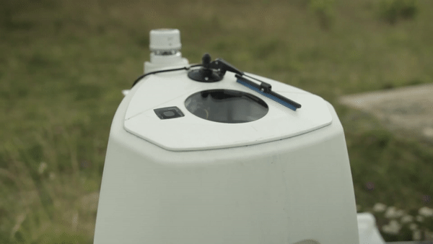
ZEPHIR LiDAR
Aerosol: Any suspended particle or liquid droplet in the atmosphere
Shoots beam of light into the air and measures backscatter from aerosols in the air using both transmitting and receiving antennae
Measures the doppler shift along each beam direction
Infers wind speed using proprietary algorithms
At each measurement height, ZephIR scans around a full 360° disk through the air, obtaining 50 samples from around the scan at equally spaced intervals every 20 milliseconds.

Slide 4
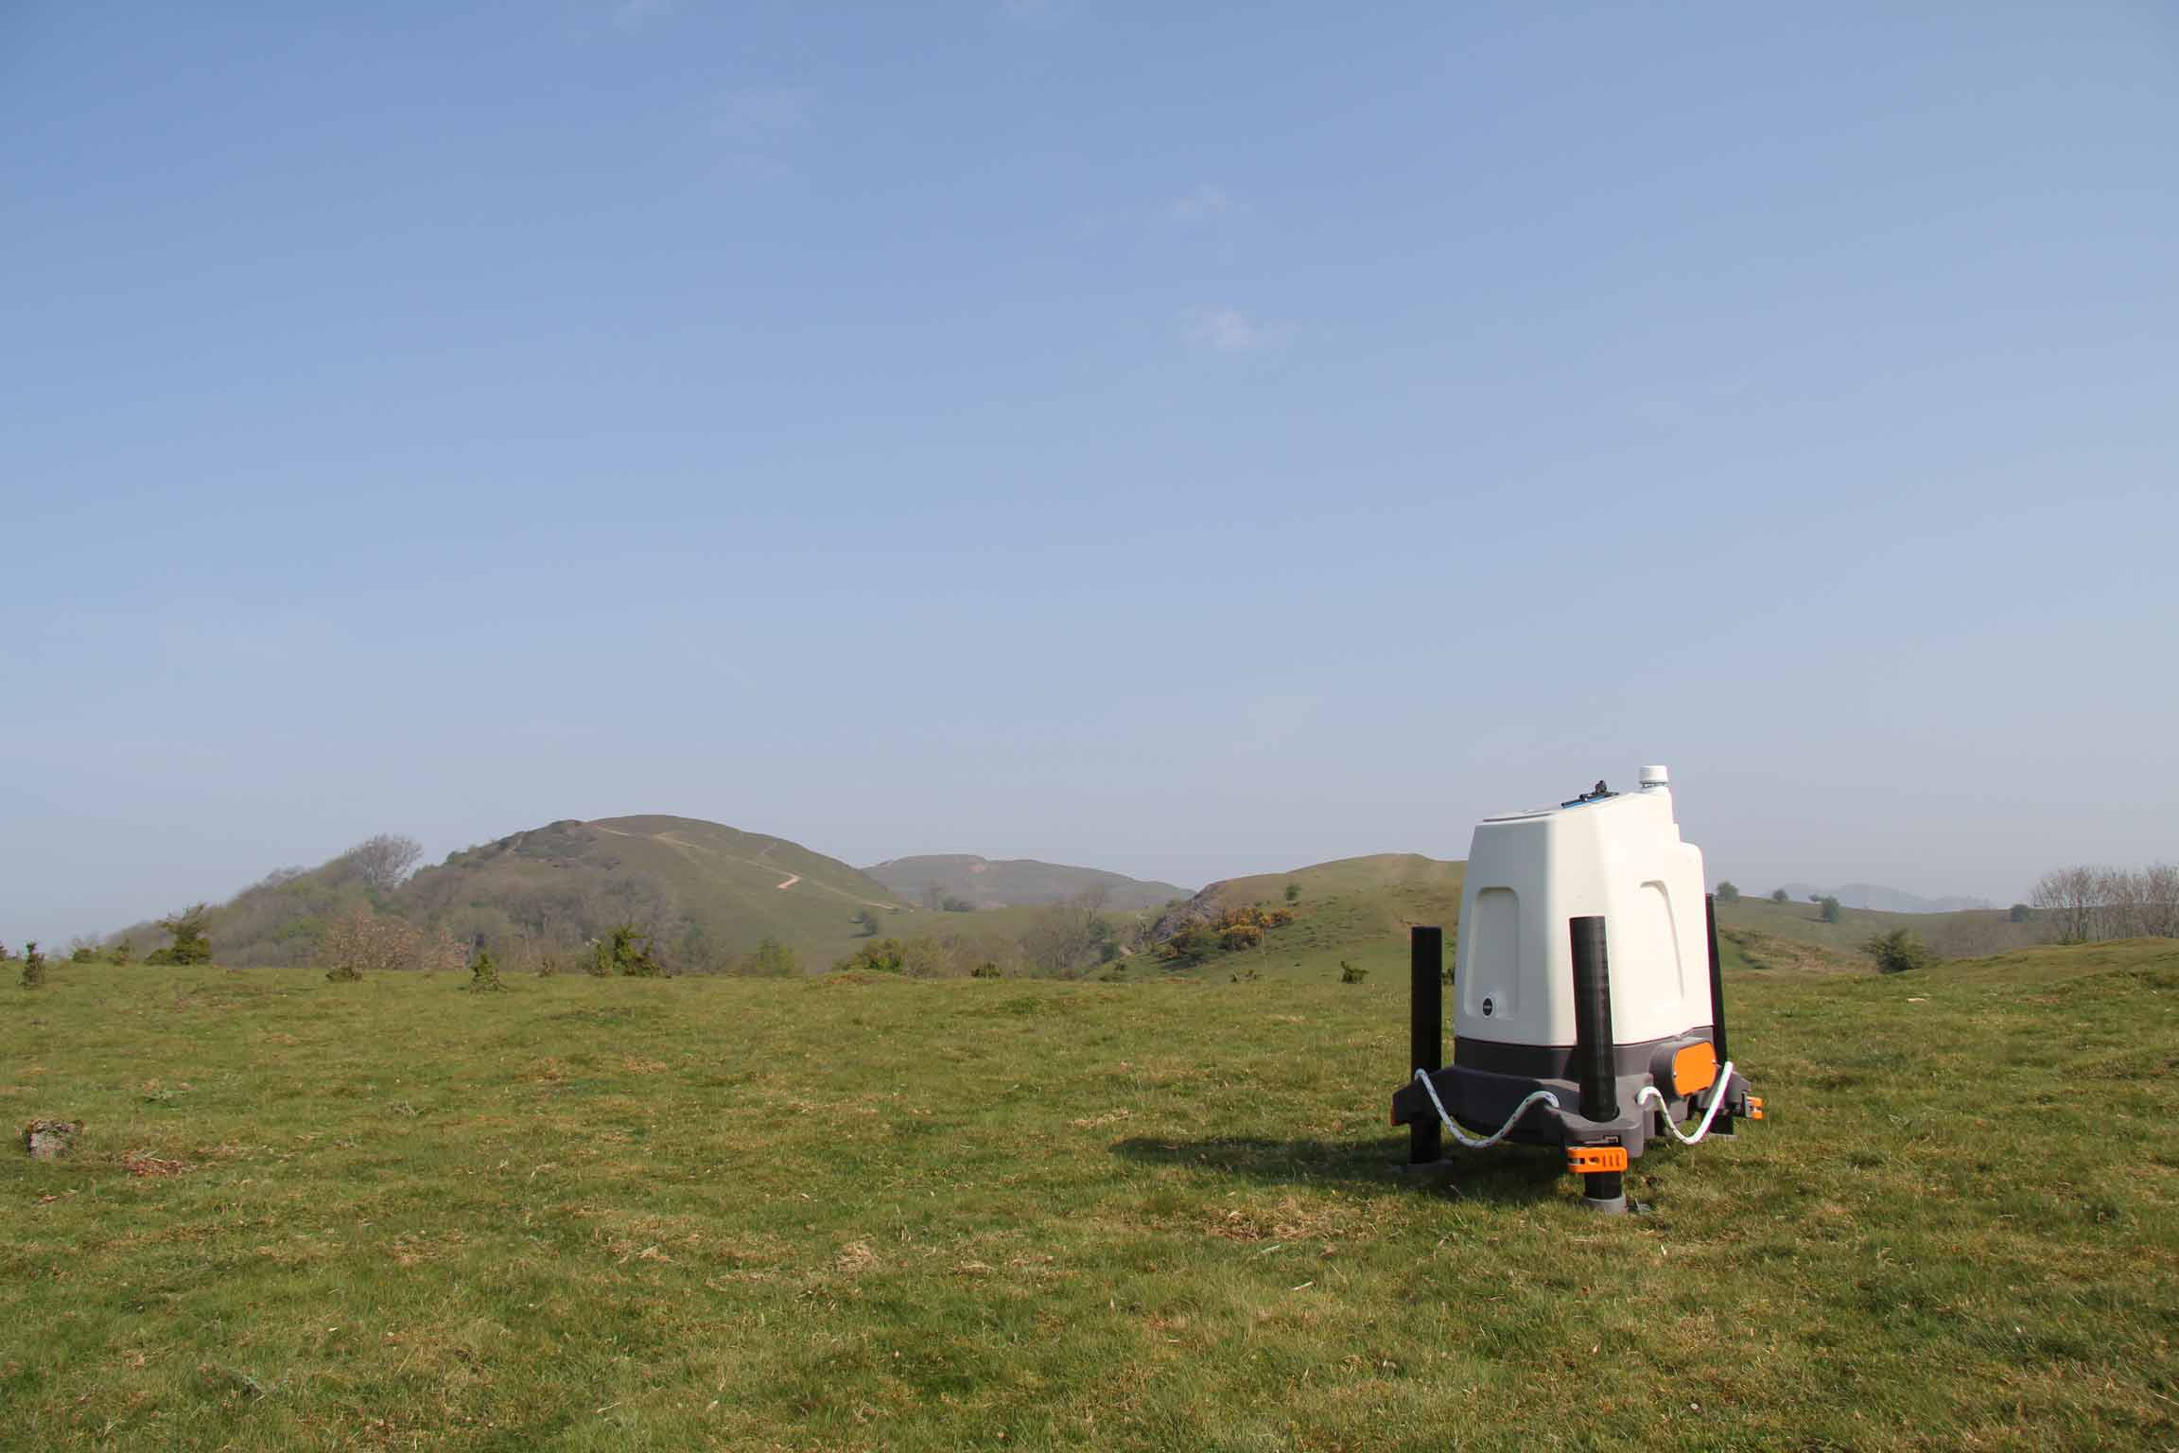
Use cases
LiDARs are used by One Energy to provide flexibility and affordable on-site measurement capabilities
Different Use Cases:
May be used to take on-site measurements at sites without appropriately representative data
  Wind Resource Assessments
  Site Characterization
To assess and validate the operating
power curve of currently operating
turbines
Perform R&D projects which may
require on-site measurements

Slide 5
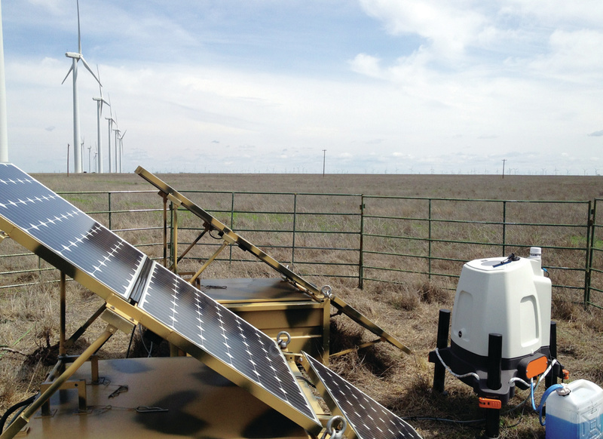
History of use

Slide 6
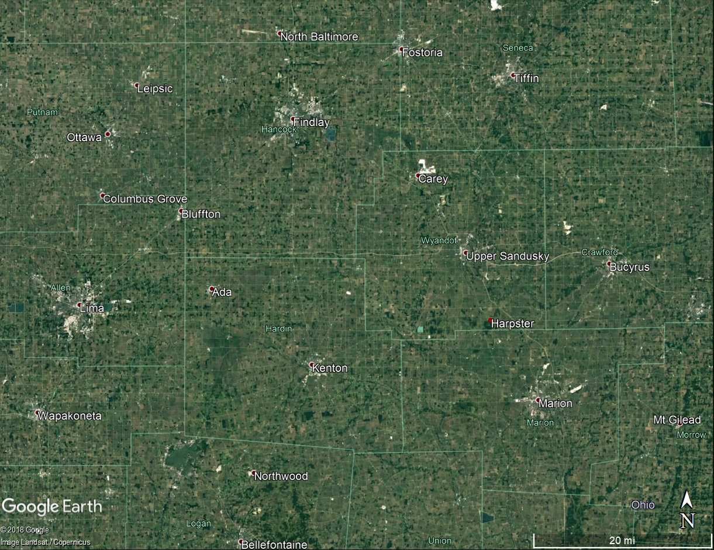
liDAR 355

Slide 7
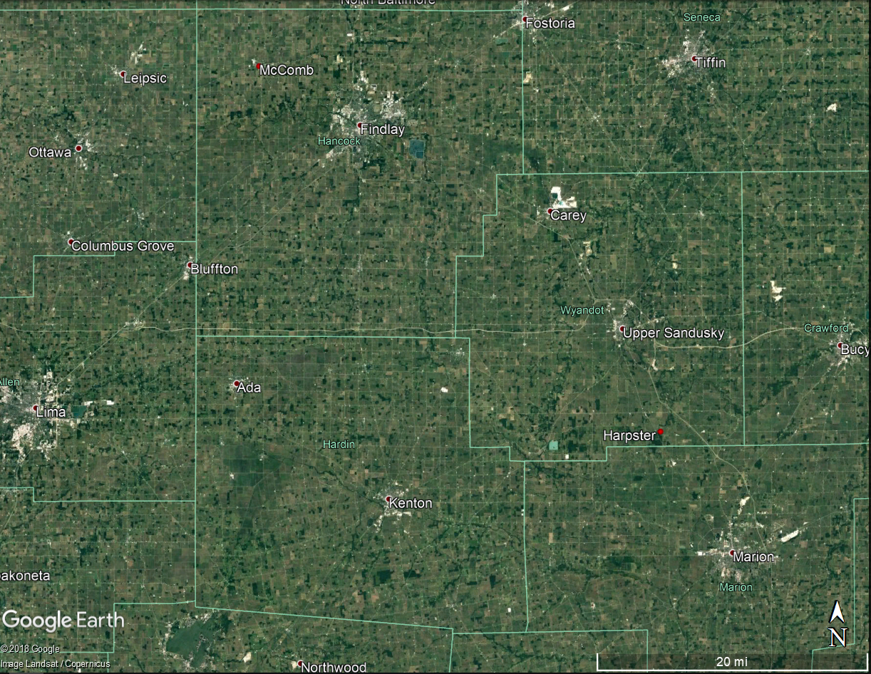
liDAR 375

Slide 8
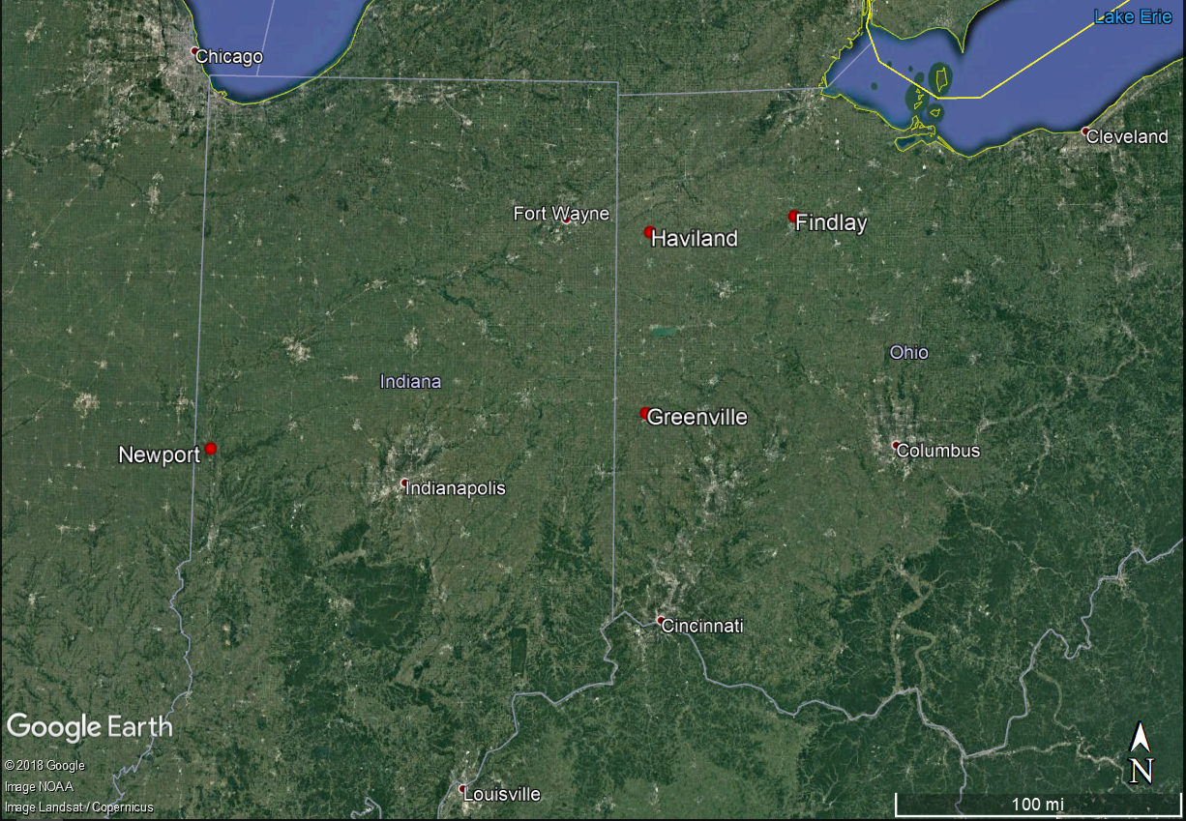
LIDAR 517

Slide 9
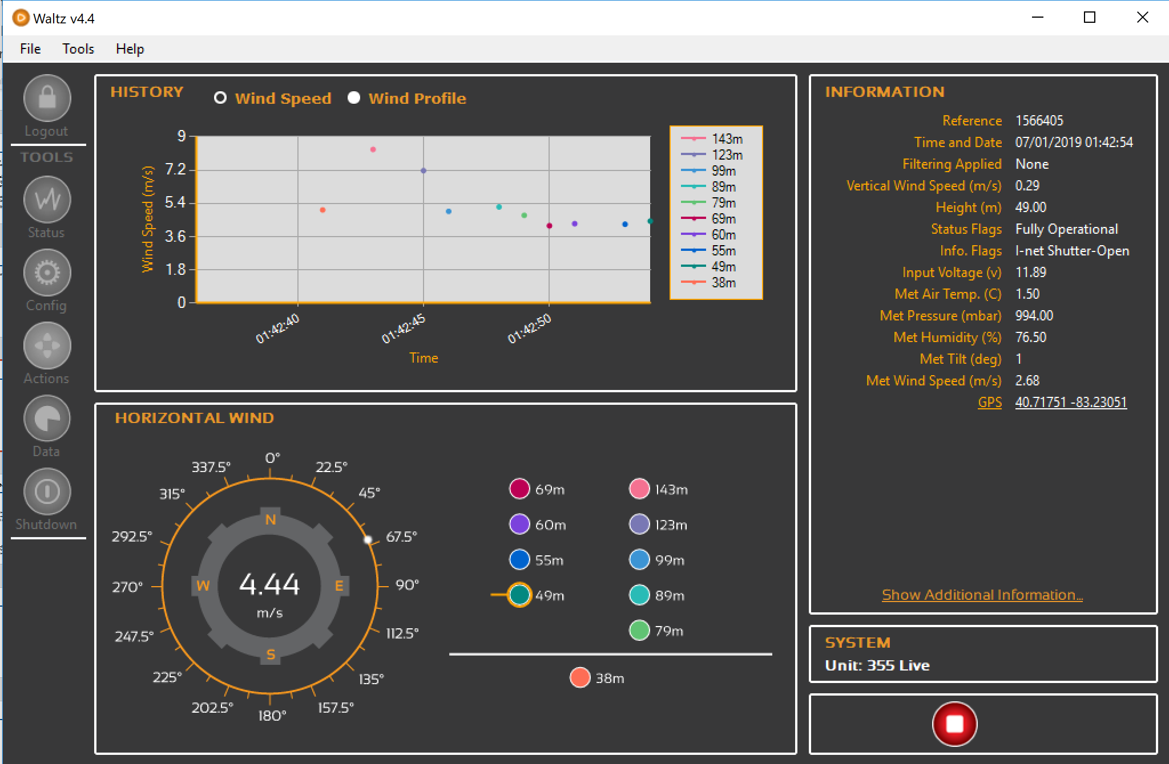
waltz

Slide 10
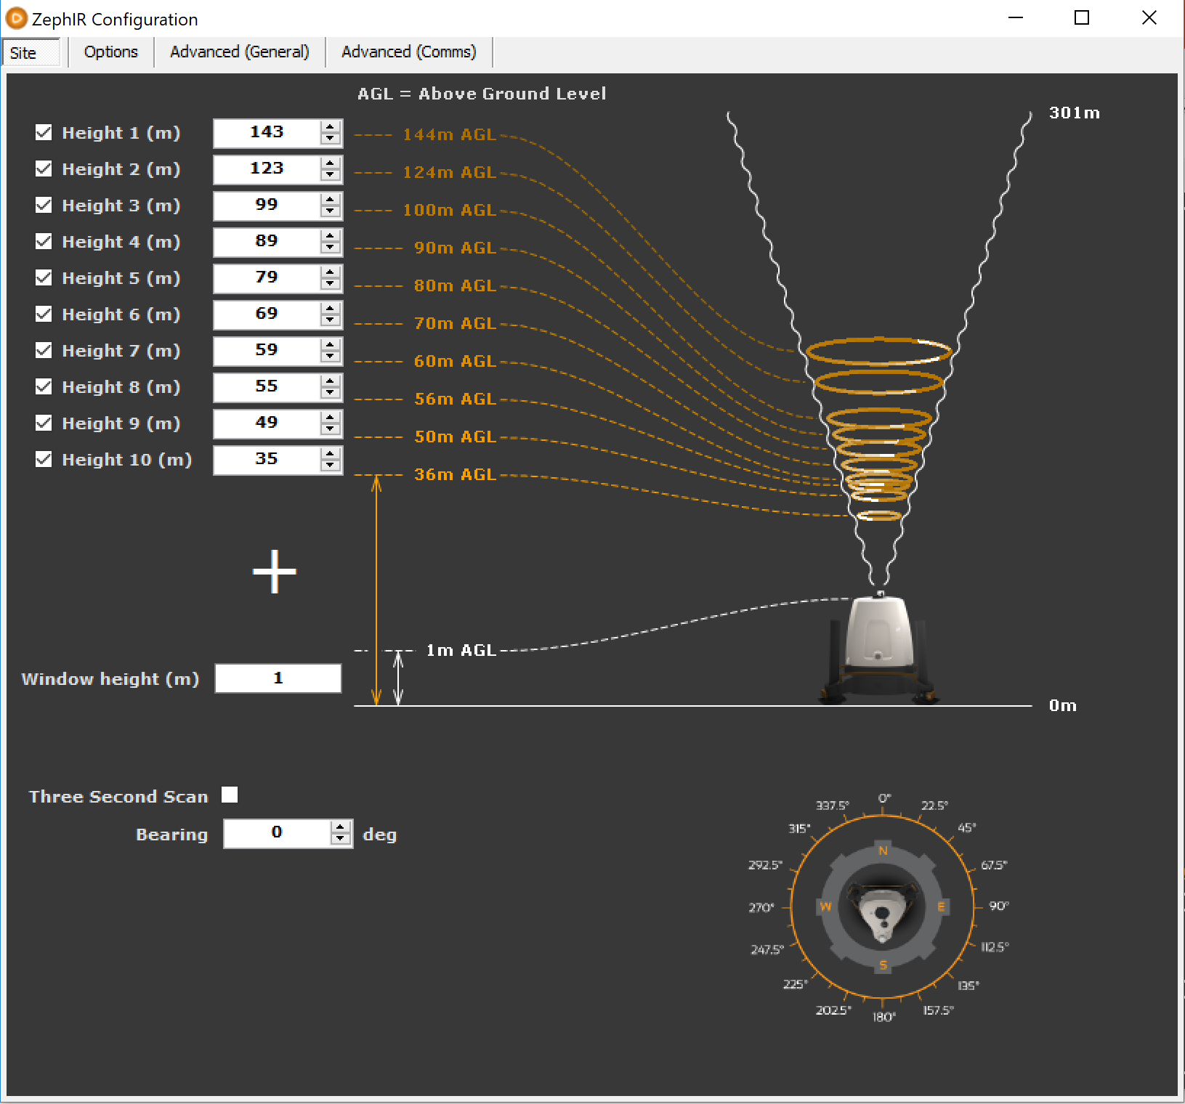
waltz
The ZephIR can measure at 11 different heights
  10 are customizable
Can measure from 10m to 200m (32’ – 656’)
All heights are measured at 1 m above the input height due to the window height of the ZephIR (~1 m)

Slide 11
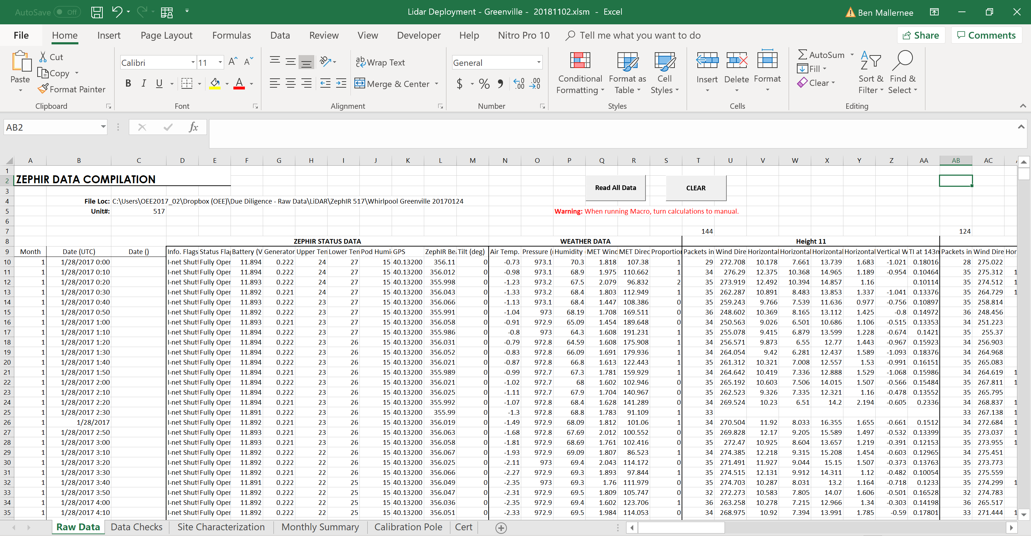
Data download

Slide 12
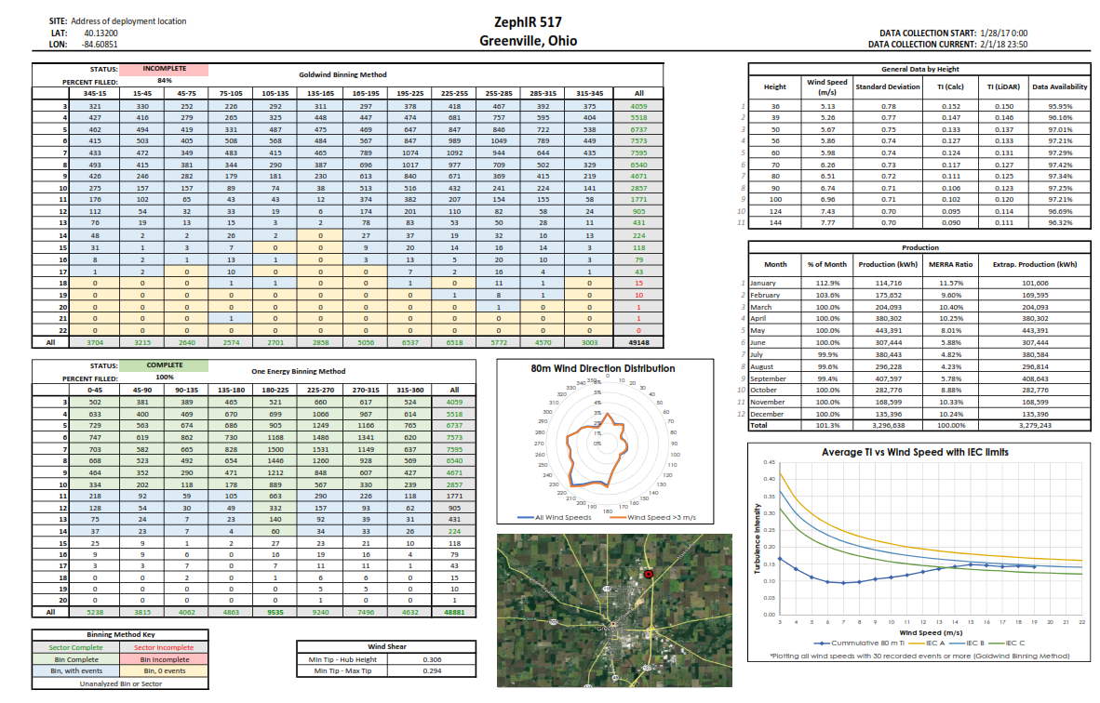
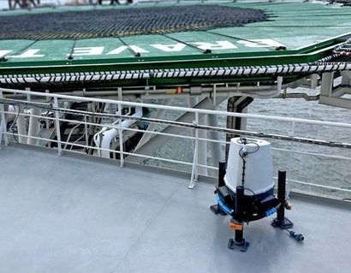
Data Summary

Slide 13
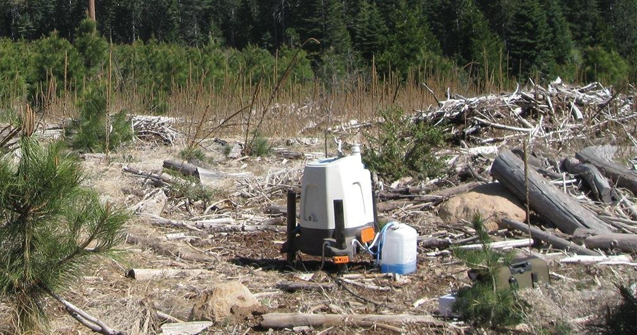
Lidar calibration
Before and after each deployment, the LiDAR must be calibrated to validate performance
This is achieved using a calibration pole installed in December, 2016
The calibration pole holds a sonic anemometer, two cup anemometers, and two wind vanes installed at approximately 30m
Wind speed and wind direction is
correlated to the sonic for
calibration
  The cup anemometers and
  wind vanes are used as a backup

Slide 14
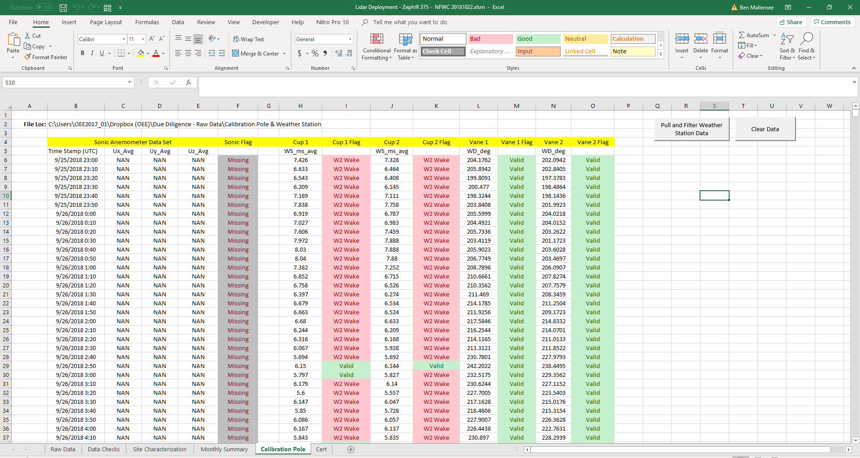
Calibration

Slide 15
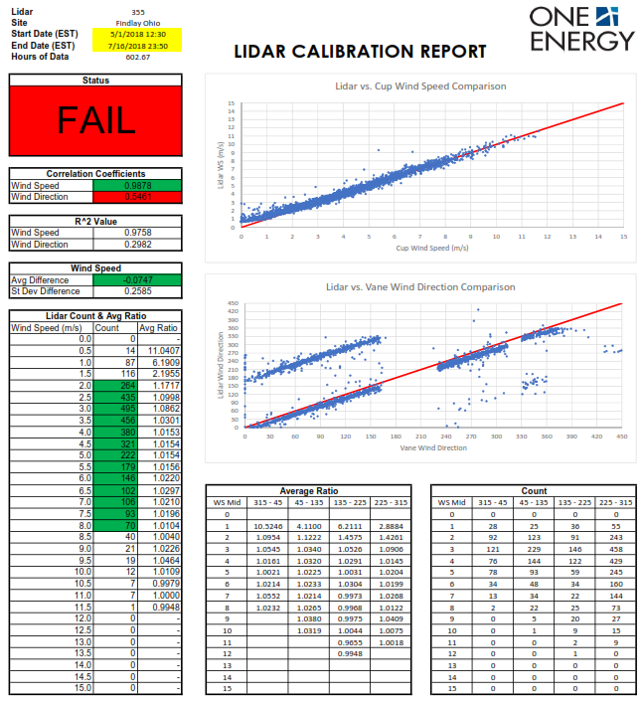
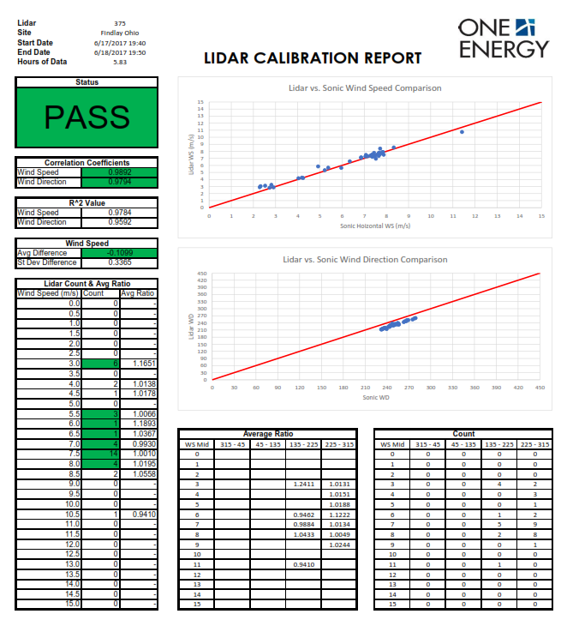
calibration

Slide 16
Instrumentation & OE
GLINDA
  RM Young Wind Monitor
  Goodrich 087L1H1 – Freezing Rain Sensor
  CS106 – Barometric Pressure
  HC2S3 – Temperature and Relative Humidity
Calibration Pole
  Wind Vane
  Cup Anemometer
  Sonic Anemometer
WP Greenville
  METSENS600 – Wind Speed, Wind Direction, Temperature, Pressure, Relative Humidity, Rainfall Total, Rainfall Intensity
  Goodrich 087L1H1 – Freezing Rain Sensor
Notes:
C:\Users\OEE2017_02\Dropbox (OEE)\Library - Product Literature\Weather Station

Slide 17
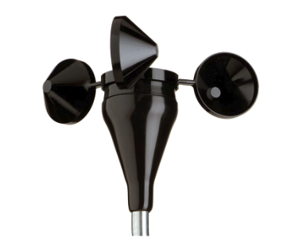
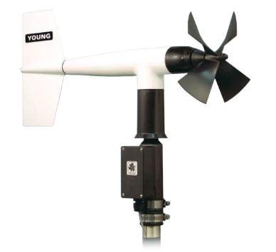
cup Anemometer
Cup anemometers measure wind speed
A rod is attached to the turning access of the cups (or blades) and is forced to spin when the wind turns the cups
The anemometer counts the # of rotations during a period of time and converts it to a WS using a transfer function
NRG 40C Anemometers on the calibration pole
  Industry standard
RM Young Wind Anemometer on GLINDA

Slide 18
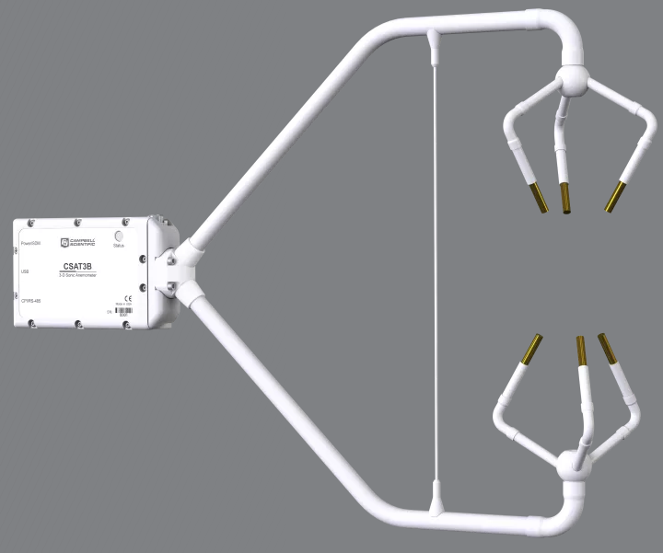
Sonic anemometer
Sonic anemometers measured wind speed and wind direction
The speed of wind (or the speed of air molecules) affects the speed of sound
Sonic anemometers transmit high frequency sound to themselves over a distance and measure the time it took to receive each signal (from transmitter to receiver)
Wind speed and wind direction are important to OE when characterizing a site. Allows remote observation of surface level winds.
CSAT3B Three-Dimensional Sonic Aneometer mounted on calibration pole

Slide 19
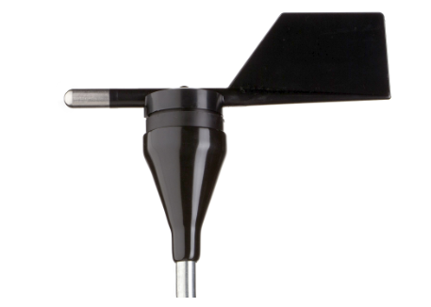
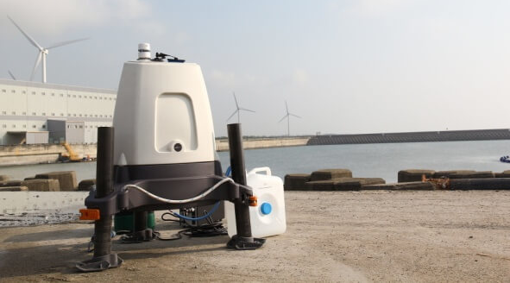
Wind vane
Wind vanes measure wind direction
A wind vane points in the direction the wind is coming from
Equal mass, but unequal surface area allows the wind vane to turn freely with the wind
A constant DC excitation voltage is applied to the potentiometer and it produces an analog voltage output directly proportional to the wind direction
NRG 200P Wind Vane
RM Young Wind Monitor

Slide 20
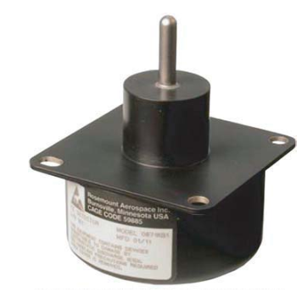
Freezing rain sensor
This freezing rain sensor detects the presence of icing condition
Using a probe vibrating at ultrasonic frequencies, the sensor is able to detect ice accumulation
When ice accumulates on the probe, the added mass causes the vibrating frequency to decrease and trigger an event
An event is triggered a .5mm ice accretion and a 24 VDC heater is activate to melt the ice on the probe
This sensor allows One Energy to detect icing conditions which may affect turbine operation
0871Lh1 – Freezing Rain Sensor

Slide 21
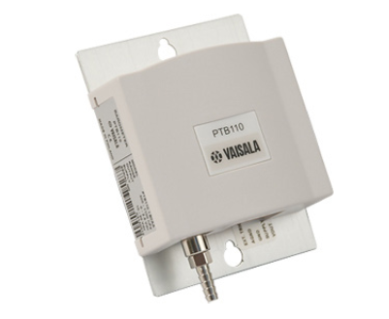
Barometer
Barometers measure pressure
BAROCAP is a micromechanical sensor that uses dimensional changes in its silicon membrane to measure pressure.
As the surrounding pressure increases or decreases, the membrane bends, thereby increasing or decreasing the height of the vacuum gap inside the sensor.
The opposite sides of the vacuum gap act as electrodes, and as the distance between the two electrodes changes, the sensor capacitance changes.
The capacitance is measured and converted into a pressure reading.
CS106 Barometric Pressure Sensor
  Uses Vaisala Barocap Silicon Capacitive Pressure Sensor
  Measures 500-1100 mb
Ripped from: https://www.vaisala.com/sites/default/files/documents/CEN-TIA-BAROCAP-Technology-description-B210845EN-B.pdf

Slide 22
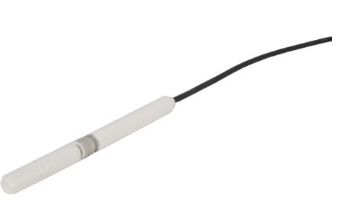
Temperature & ReLative humidity sensor
Uses a resistance temperature detector (RTD) to measure temperature
  RTDs are composed of materials that change their resistance as a function of temperature
  Resistance is measured and converted to temperature
Uses a Capacitive Humidity Sensor to measure relative humidity
  Capacitor consisting of hygroscopic dielectric material placed between a pair of electrodes
  The dielectric material varies at a rate that is related to the change in relative humidity
  This causes the capacitance to change and is thusly measured and used to estimate relative humidity
HC2S3 – Temperature and Relative Humidity Probe
Hygroscopic: tending to absorb moisture from the air
Reference: https://www.rotronic.com/media/productattachments/files/c/a/capacitive_humidity_sensor_final.pdf

Slide 23
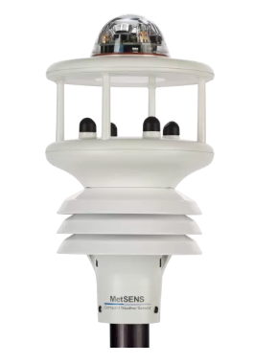
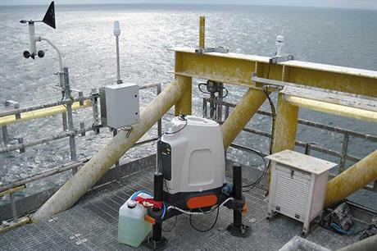
METSENS600
Measures wind speed, wind direction, temperature, pressure, relative humidity, rainfall total, rainfall intensity
List of individual sensors not available
  Most are very likely to be similar to those already discussed
Precipitation sensor measures the rainfall amount and intensity
  It uses an optical sensor
  Transmits an infra-red beam, which bounces off the inner optical service between transmitters and receivers.
  Rain drops change the intensity of the beams and allows it to be measured
METSENS600
Reference: https://www.omniinstruments.co.uk/gmx100-rain-sensor.html

Slide 24
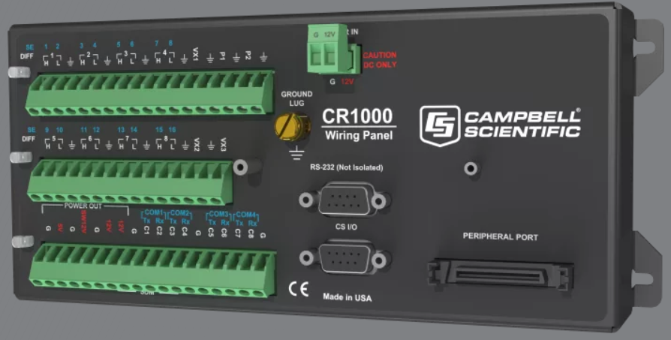
Cr1000 Datalogger
Dataloggers communicate with external sensors, powers external sensors, stores their inputs, processes them, and transmits them to a destination
The CR1000
  Has a CPU, analog/digital inputs, analog/digital outputs, and memory
  Is controlled with an operating system designed to run scripts written in CRBasic
The CR1000 acts as the brain to GLINDA
CR1000 Measurement and Control Datalogger

Slide 25
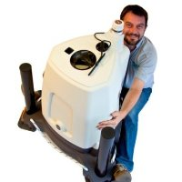
Future of our weather instrumentation
As we continue to expand, we will have project sites further and further away from our center of operations
The increased difficultly of effectively operating projects at a distance will lead to more installations of remote weather stations.
Understanding the local weather conditions will alleviate uncertainty stemming from icing and extreme wind conditions

Slide 26
Lidars and instrumentation

