Slide 1
Initial Evaluations
Erica Johnson
March 4, 2019

Slide 2
Contents
IE Flowchart
Changes to IE process
Good and bad projects
What makes a good customer

Slide 3
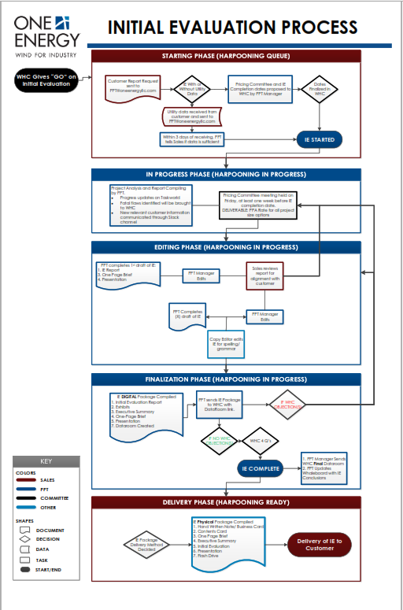
IE flowchart
IE has gotten more in-depth. All information for customer to make decision on project is presented.
Flowchart approved Jan-2019
Streamlines process so all teams are on same page
Notes:
Pull up flowchart so it can be seen – note different colors as different teams/drivers

Slide 4
IE Stages
Starting – Sales collecting data, sending to PPT
In Progress – PPT compiling data, siting, project goes to Pricing
Editing – PPT writes report, goes through PPT Manager, Sales, & Copy Editor edits
Finalization – PPT sends digital copies to Whale Hunting for comments
Delivery – Marketing prepares physical package, Sales delivers

Slide 5
Major changes – PPT Process
Fleshed out Taskworld – 86 total tasks
Added ‘Commercial Implications’ section to report
  Financial Analysis
  Corporate Responsibility (carbon reduction, marketing)
  Risks (OE takes majority of risks involved)
  Customer resources – what OE needs from customer from project

Slide 6
Major Changes – Risks Section
Development, Engineering, Procurement, Construction
  OE takes all risks associated with PPA and CAPEX
Turbine Operation
  Turbines have warranty, OE has insurance
  Under PPA, if turbines are down OE is losing profits
Market
  Customer assumes risk of lower savings
Facility Closure/Sale
  Turbines attached to facility
Reliability
  Facility never disconnected from grid
Wind Resource
  CAPEX: OE has insurance policy
  PPA: OE assumes risk, won’t be paid for power not produced

Slide 7
Major changes - editing
Added Sales review, second round of PPT Manager edits
Copy Editor last so all updates get read

Slide 8
Major Changes – physical delivery
Marketing in charge of printing and putting together physical documents
Sales in charge of delivery
Physical package contents:
  OE box
  Hand written note – Adam
  Contents card
  One Page Brief
  Executive Summary
  IE
  Presentation
  Flash drive containing digital copies

Slide 9
Major Changes – Digital Delivery
Contents of USB drive:
  Materials in Packet
    One Page Brief
    Executive Summary
    Report: All Combined, Report Only, Exhibits Only
    Presentation (PDF)
  Raw Data
    Financial Calculators
      PPA Calculator
      Tiered Pricing Structure
    Presentation (.ppt)
  Videos (dataroom only)

Slide 10
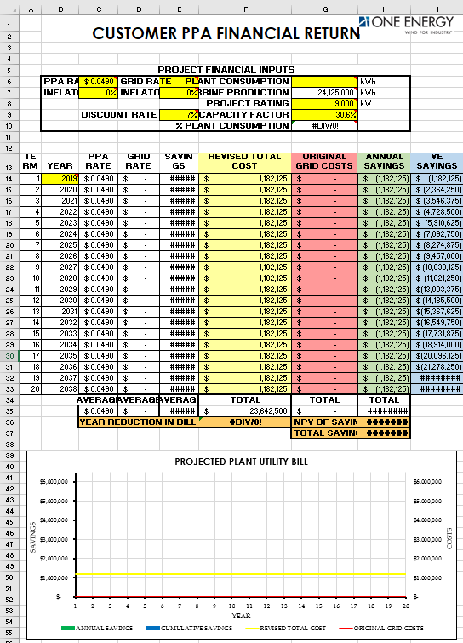
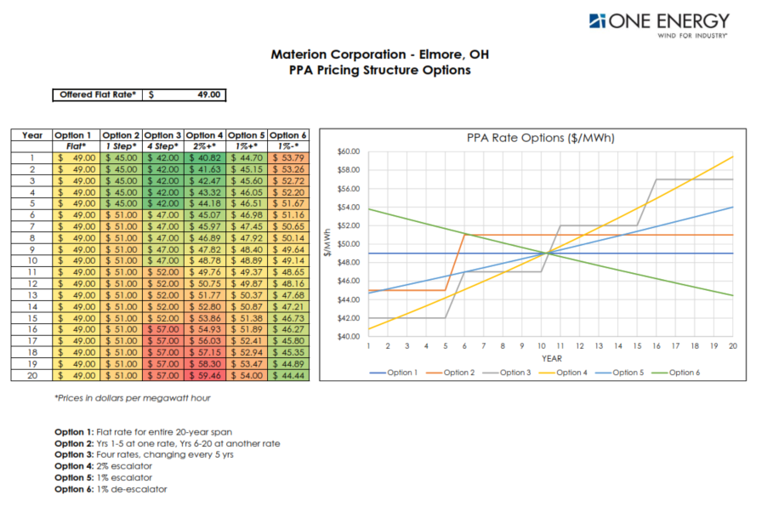
Financial Calculators

Slide 11
The Ideal Project
Wind resource of > 29% NCF
Public utility with a MCOE that we can compete with
Located in Ohio
No FAA issues
Available siting land on customer property/contiguous property
No zoning
2+ turbines

Slide 12
Where does risk come from?
Any deviation from ‘ideal project’ adds risk and leads to a higher PPA rate
Final pricing is done in IE stage – if we uncover a change in wind resource, land, etc. we take the lost income

Slide 13
Project Flags
Red flags: showstopper, project cannot move forward. Project is deemed technical failure.
Yellow flags: project is more complicated, not as attractive

Slide 14
Red Flags
Typically identified during In Progress stage:
No land to site
Siting land is not suitable for turbines
Not able to work with zoning process
FAA clearance
Pricing committee can choose not to price a project.

Slide 15
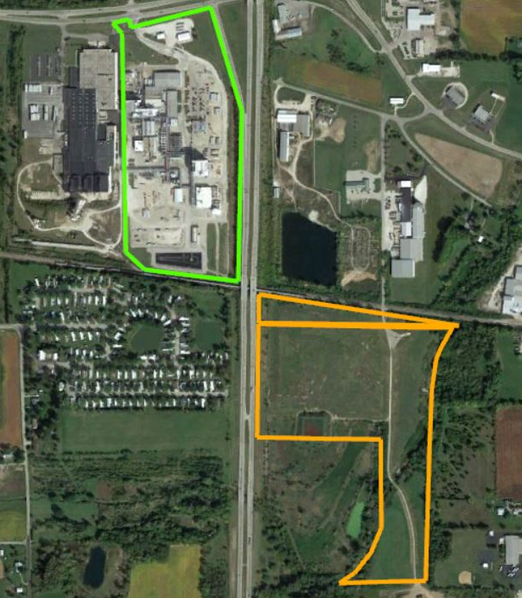
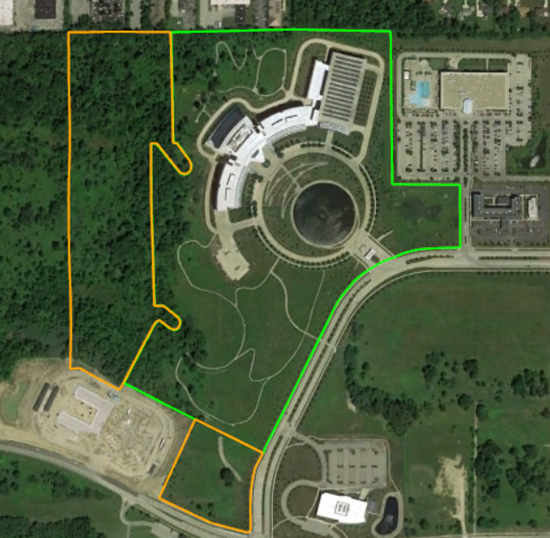
Technical Failures
Notes:
BASF – landfill
Eaton – low CF (24%), restrictive zoning (have to be on same parcel), heliport

Slide 16
Yellow flags
Muni/coop
Strict zoning regulations
Potential FAA issue
Minimal land, non-contiguous land, lots of neighbors
Any of these items would make a project less attractive to OE, would not want to hunt as aggressively.

Slide 17
projects vs customers
Projects are how we make money
A customer can have many projects
Finding and attracting good customers is how we will continue to grow

Slide 18
A Good Customer
Multiple viable sites
Clear approval process
Understands value of fixed PPA
Fits OE underwriting policy
  Good credit rating
  Long operating history
Ex: Ball, Whirlpool

Slide 19
Customer Yellow Flags
Energy consultant
Has previous wind experience
Recent ownership changes
Government/non-profit
Doesn’t mean we won’t consider a project, but most likely won’t pursue as aggressively

Slide 20

Whale book
Field book detailing OE’s whale hunting process
Dropbox/00 OE Reference Guides

Slide 21
Questions?

