Slide 1
easypower
Andrew rapin

Slide 2
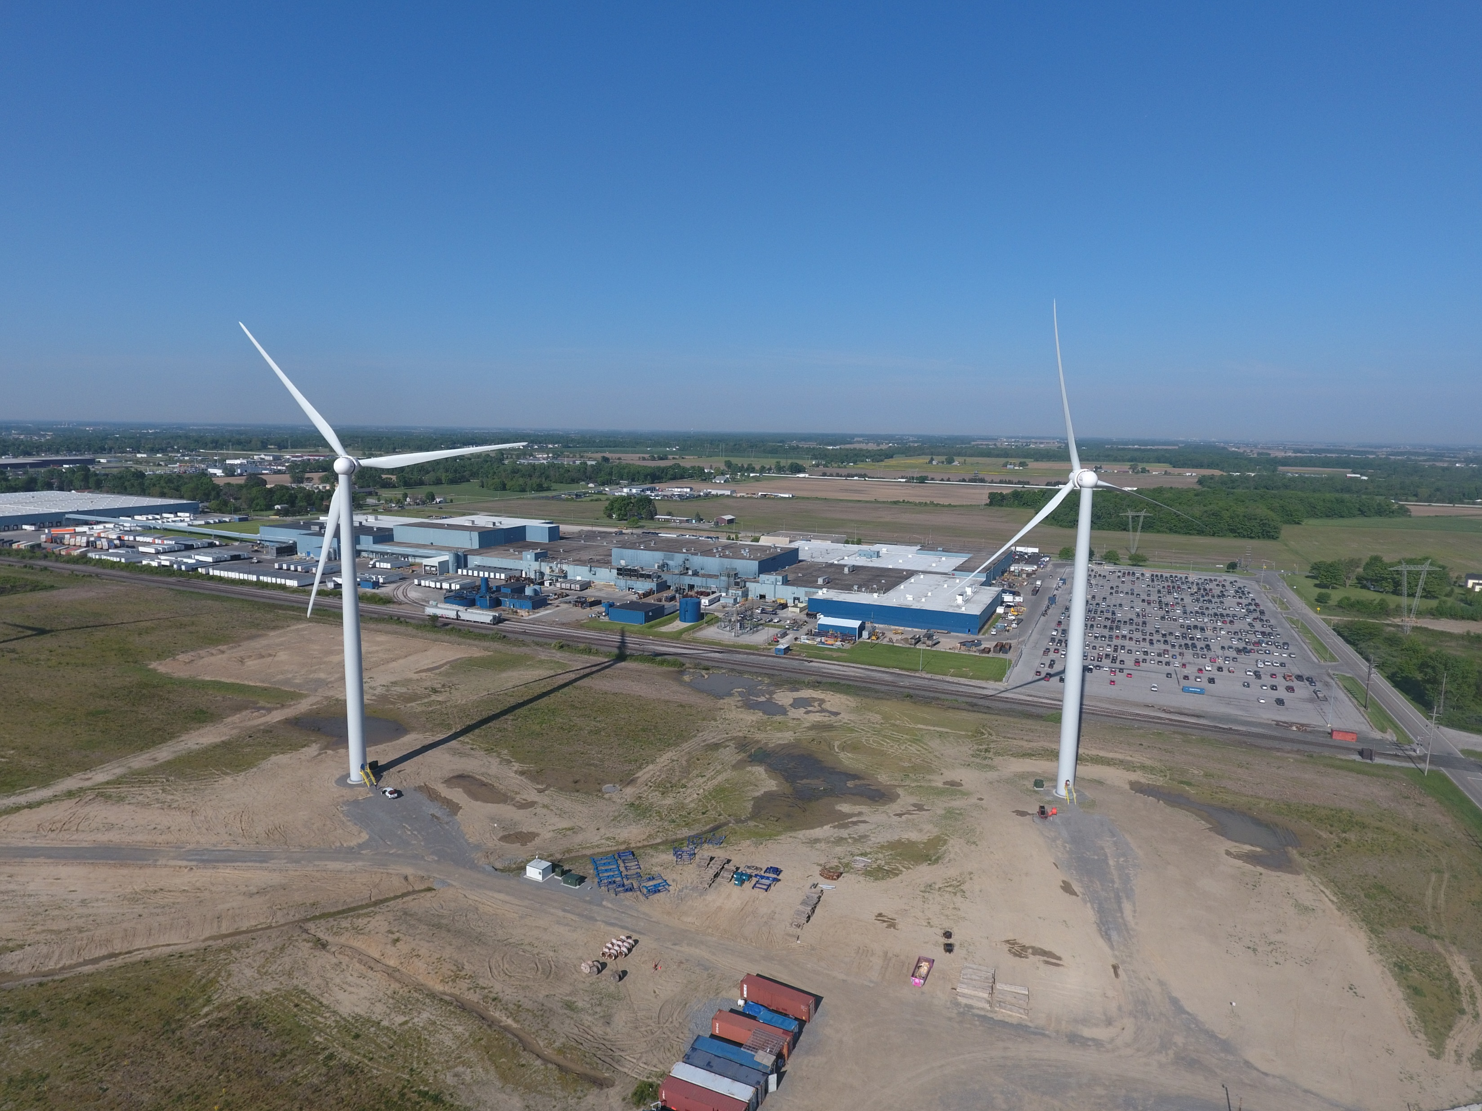
outline
Overview and background information
How to build an EasyPower one line demo
TCC (Time Current Curve) generation
Fault review and modeling

Slide 3

Easypower
Software built to design, analyze, and model electrical power systems
Can be used to perform device coordination
Can be used for arc flash analysis
https://www.easypower.com/resources/videos

Slide 4

How does it work
Can use ANSI or IEC-60909 standard for short circuit analysis
Using these methods we can perform short circuit and coordination studies
Power Flow studies are performed using the Current Injection Method
Notes:
ANSI accepted in the US, IEC international and democratic

Slide 5
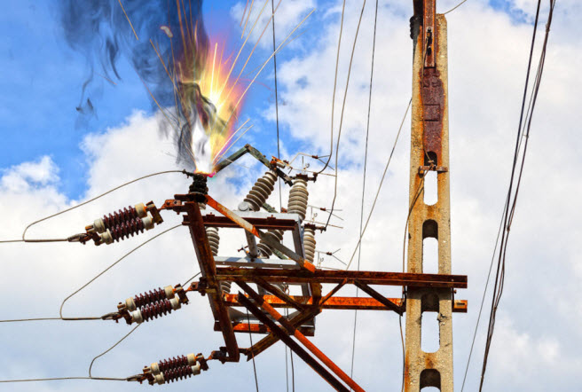
Short Circuit analysis
A short circuit or fault analysis tells us how much fault current an electrical power system is capable of producing
This governs our protection device scheme for a project

Slide 6

Why do we care?
Interconnection applications require coordination at the application stage
Modeling of faults we observe in the field
Managed HV

Slide 7
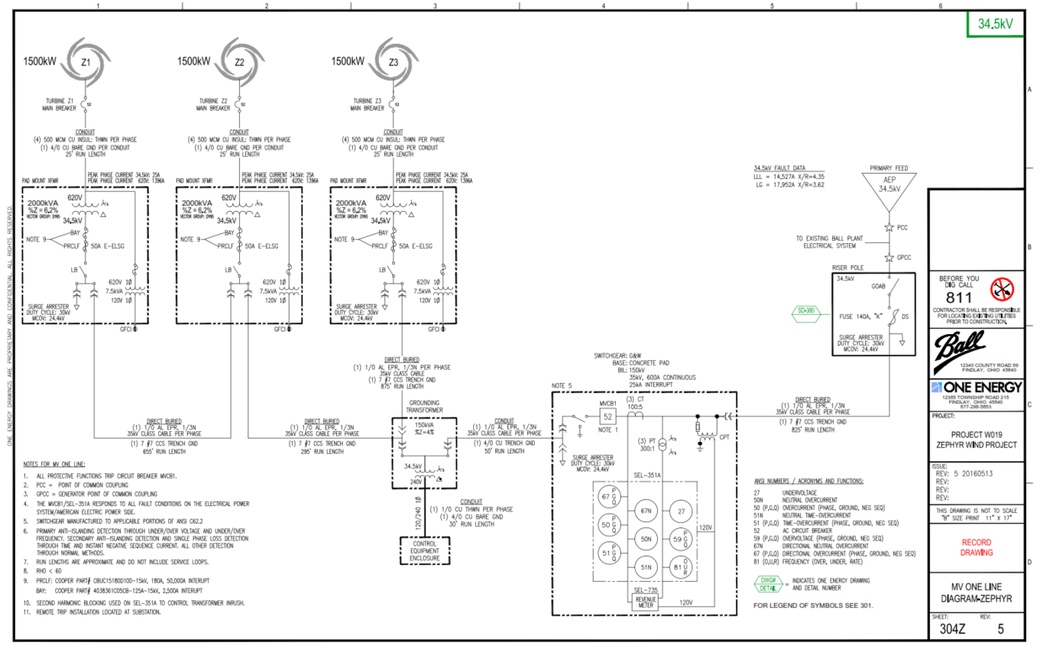
one-Line drawing

Slide 8
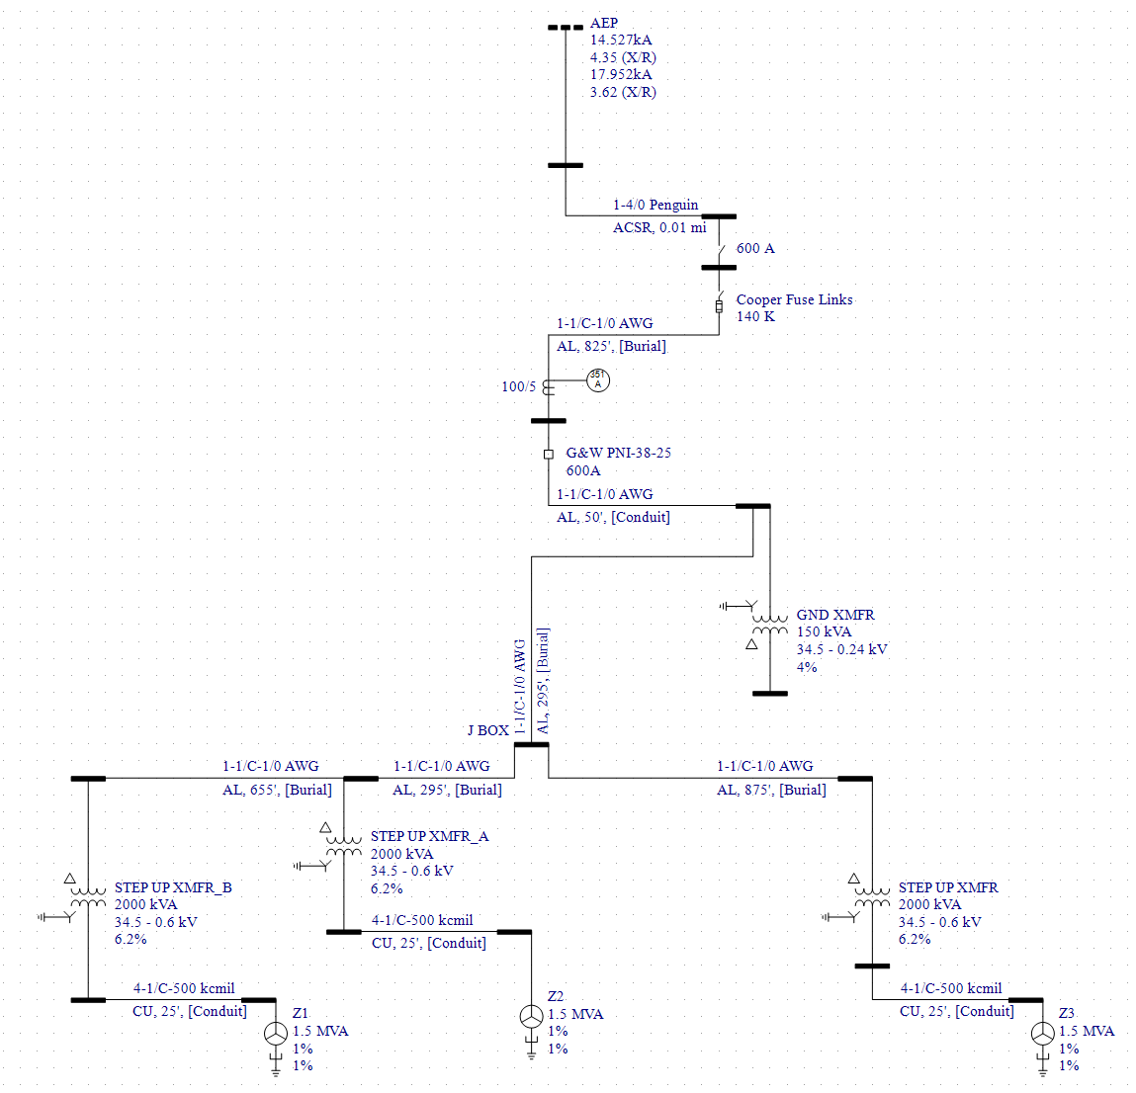
Easypower one-line

Slide 9
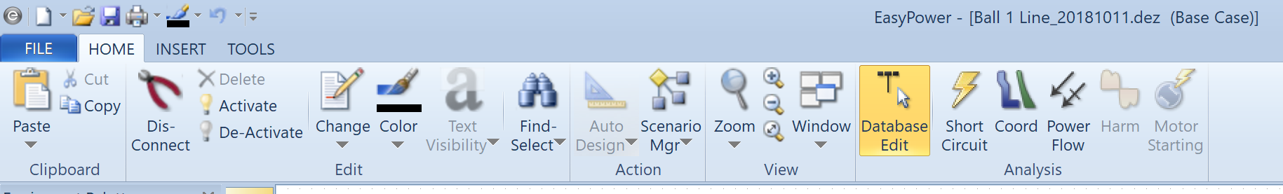
Easypower - Ui

Slide 10
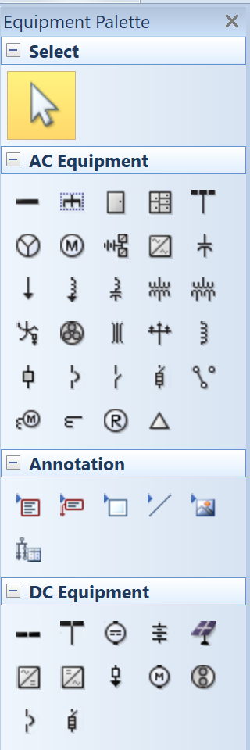
Easypower – database edit

Slide 11
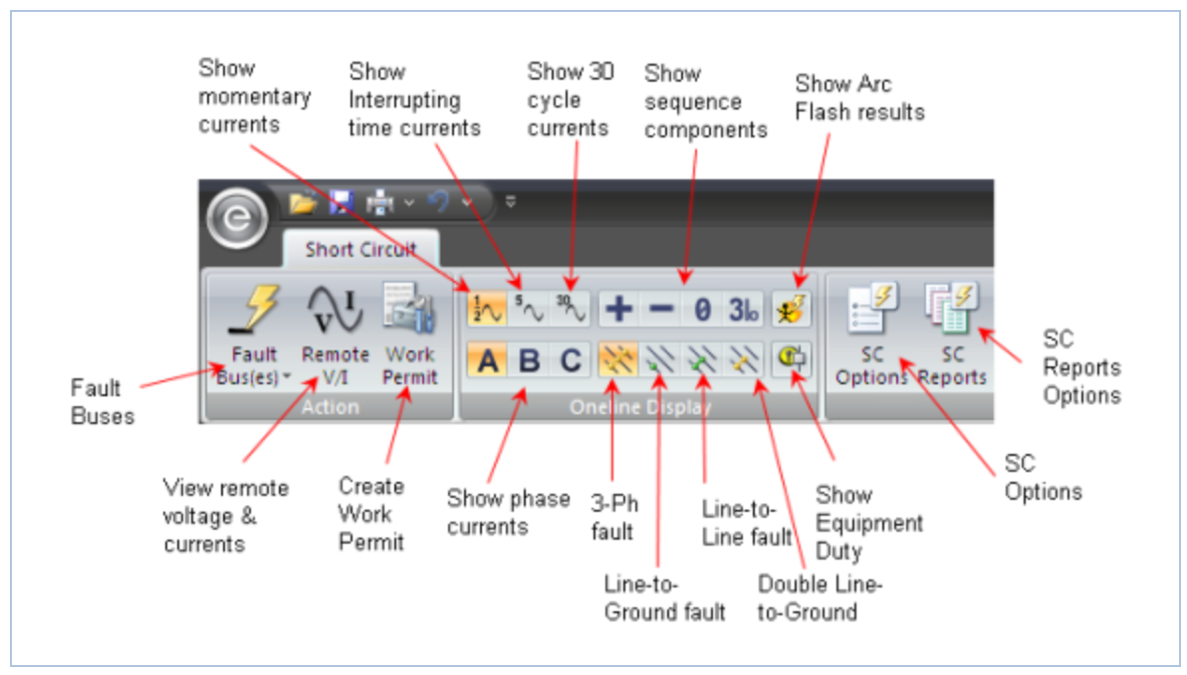
Easypower – short circuit
Photo Credit: Easypower User Manual
Notes:
Sequence components show unbalanced parts of fault

Slide 12
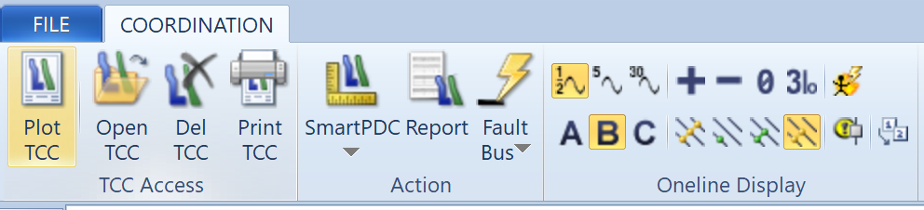
Easypower - coordination

Slide 13
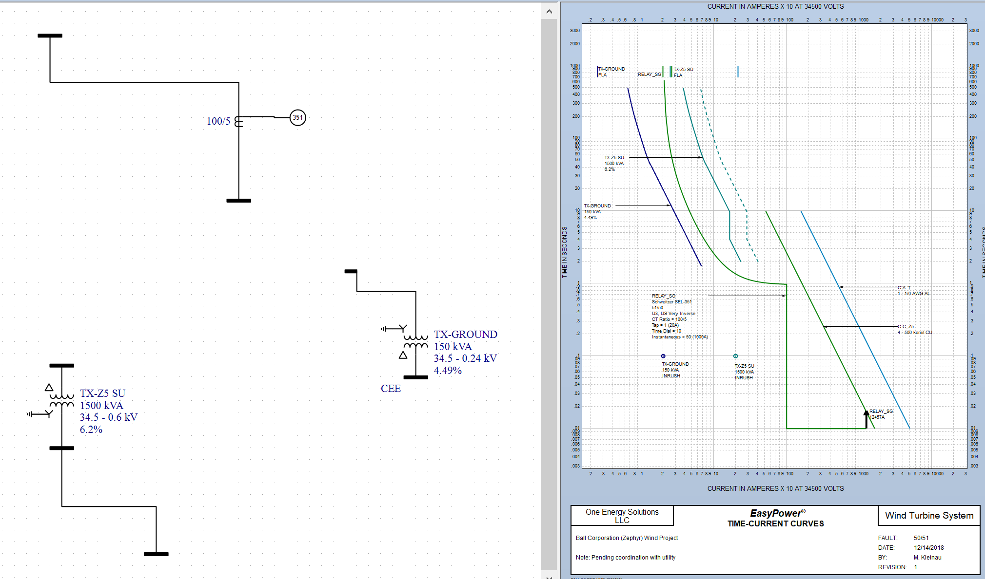
Easypower - coordination

Slide 14
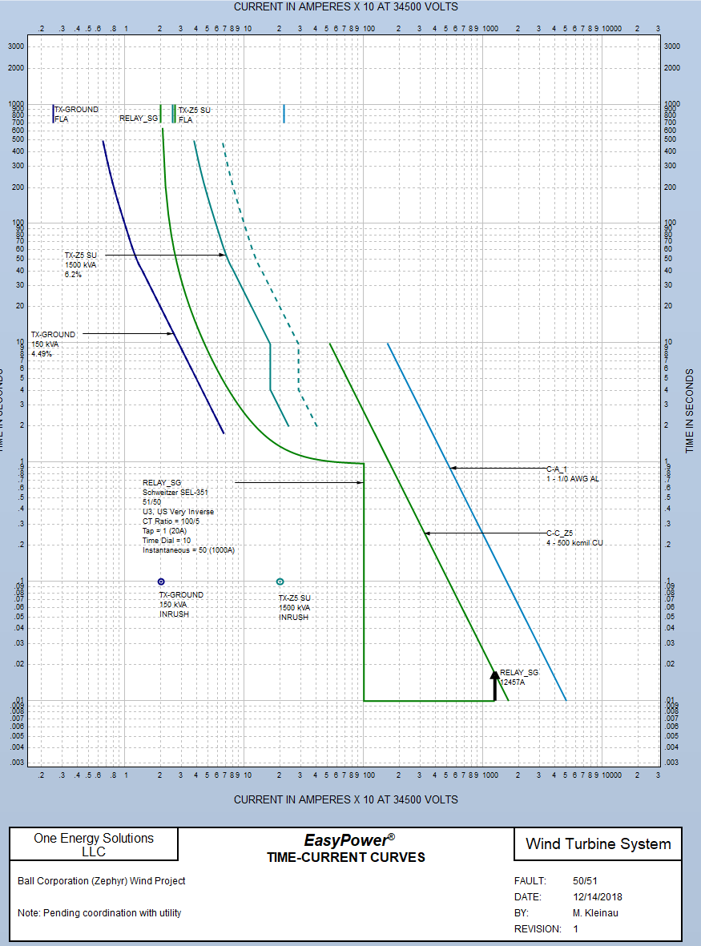
Easypower - coordination

Slide 15
Thank you | questions?

