Slide 1
Advanced Data Analysis in Excel

Slide 2
Data Analysis outline
Why do we analyze data?
  Looking for trends in data
  Looking for relationships between datasets/parameters
  Comparing measured vs. theoretical values (i.e. measured vs. manufacturer’s power curve)
Today, we will focus on data analysis in Excel:
  Basic navigation short-cuts and naming arrays
  Basic functions and logic functions
  Linear Regression analysis
  Advanced functions
  Conditional formatting
  Probability distributions
We will be going through exercises along the way:
  Open file: “Dropbox (OEE)\Skunk Tank\Training\Adv Data Analysis\Lidar and Turbine data.xlsx
  Save to your personal folder or Desktop
It is noted that there are many different ways to analyze data
  The methods and approaches presented here are not the only ways
  For each exercise, we’ll compare notes and discuss the different approaches
  Let’s learn from one another and have some fun!

Slide 3
Basic Navigation Shortcuts
CTRL-Down/Up/Left/Right
  Moves selected cell in arrow direction
CTRL-Shift-Down/Up/Left/Right
  Selects all cells in arrow direction
Double-click on cell bottom corner
  Copies cell contents to all cells beneath
Copy and then CTRL-D/U/L/R and Paste
  Copies all selected cell contents to all newly selected cells
CTRL-D
  Copies contents of top cell to all cells beneath it

Slide 4
Name Manager
Often, it is useful to assign names to different arrays of data
  Can then reference data array by name in formulas
  Use descriptive (but brief) names
  Formulas -> Name Manager
Exercise 1:
Use Name Manager to assign names to:
Timestamp
Lidar WS
Lidar WD
Nacelle WS
Nacelle WD
Turbine power

Slide 5
Basic Functions
Count(Cell Range)
  Returns count of all numbers in selected range
Sum(Cell Range)
  Returns sum of numbers in selected range
Average(Cell Range)
  Returns mean of numbers in selected range
Stdev.s(Cell Rane)
  Returns standard deviation of numbers
Exercise 2:
Find the following values:
1) Total count of Lidar WS
2) Total count of turbine power
3) Sum of counts
4) Average and Standard deviation of Lidar WS
5) Average and Standard deviation of Nacelle WS

Slide 6
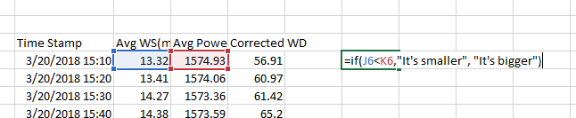
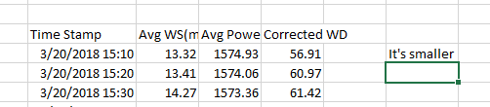
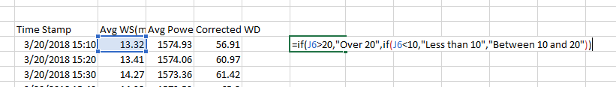
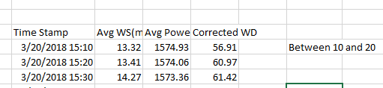
Logic Functions
Simple If Statement: If(Condition, Result if True, Result if False)
If/Else Statement: If(Condition, Result if True, If(Condition, Result if True, Result if False))

Slide 7
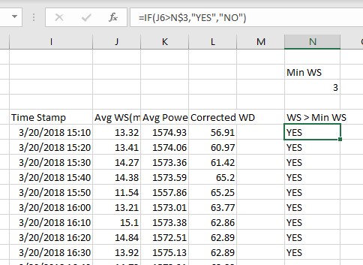
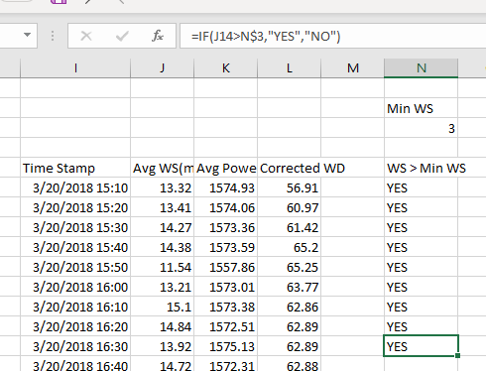
Locking Cell References
Lock cell reference in formula using $
  When you copy the formula to other cells, the referenced cell doesn’t move
  Put $ ahead of letter to lock the referenced column or ahead of number to lock the referenced row

Slide 8
Logic Functions Cont’d
If Statement with Multiple Conditions
  If(And(Condition1, Condition2), Result if True, Result if False)
    Both conditions must be met for result to be true
  If(Or(Condition1, Condition2), Result if True, Result if False)
    At least one condition must be met for result to be true
Exercise 3:
Create new column showing whether the Lidar WS is greater than Nacelle WS
Create column containing Lidar WS when Lidar WD is 180 – 270 degs. (Make 180 and 270 referenced cells)

Slide 9
Linear Regression ANalysis
Often, we may be curious about the correlation and linear regression relationship between two variables
Excel linear regression equations:
  Correl(Range1, Range2)
    Finds correlation coefficient, R, between the two variables
  Rsq(Range1, Range2)
    Finds R²
  Slope(Range1, Range2)
  Intercept(Range1, Range2)
Exercise 4:
Find correlation coefficient, R, and R² between Lidar and Nacelle WS
Find slope and intercept of linear regression between Lidar and Nacelle WS
Confirm by creating a scatterplot and fitting a best-fit line

Slide 10
More Advanced (and super useful) FUnctions
Countifs(Range1, Criteria1, Range2, Criteria2, etc)
  Returns total count where all criteria are met
Averageifs(Range to average, Criteria range 1, Criteria1, Criteria Range2, Criteria2, etc)
  Returns average of range where all criteria are met
Sumifs(Range to sum, Criteria range 1, Criteria1, Criteria Range2, Criteria2, etc)
  Returns sum of range where all criteria are met
Iferror(Formula, Value if formula throws an error)
  Use if formula could throw an error

Slide 11
Assigning Bin or Index to Data
When analyzing wind data, often we want to examine trends on an yearly, monthly, or hourly basis or by wind speed, wind direction, etc.
  Useful to assign bin number with the following functions
For time-based bins, use:
  Year(Date)
  Month(Date)
  Hour(Date)
For wind speed bins, use:
  Round(Value/Bin_size, 0)
For wind direction bins, use:
  If(Round(Value/Bin_size, 0) = Num_Bins, 0, Round(Value/Bin_size,0))
Exercise 5:
Create columns with hour, Lidar WS, and Lidar WD bin indices. Use bin sizes 1 m/s and 22.5 degs.
Calculate the Lidar WS count for each WS (up to 25 m/s) and WD bin.
Make a plot of WS distribution for WD bin = 247.5 degs.
Make a plot wind rose for WS = 6.
Calculate the average nacelle WS and average Lidar WS in each Lidar WS bin between specified start/end dates.
Make a plot of average nacelle vs Lidar WS. Add a 1:1 line.

Slide 12
Conditional Formatting
To highlight trends in calculated values, you can use Color Scale Conditional Formatting.
  Home->Conditional Formatting->Color Scales
To identify outliers or a specific value, you can use Highlight Cell Rules Conditional Formatting
  Home->Conditional Formatting->Highlight Cells Rule
Exercise 6:
Calculate average hourly Lidar WS and Nacelle WS when WD bin index = 8.
Use conditional formatting to show trends in wind speed
Use conditional formatting to highlight average hourly wind speeds less than a specified value.

Slide 13

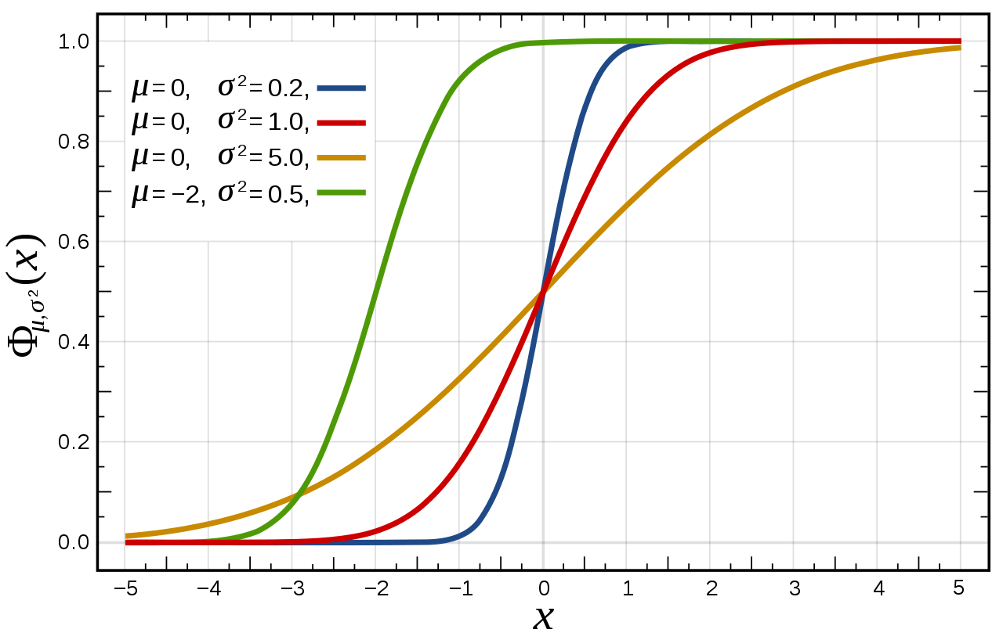


probability Distributions
Quick review of Probability Density Functions (PDFs) and Cumulative Distribution Functions (CDFs)
PDF
P values = Probability that the value will be exceeded.
Example for P10 WS:
  WS in a distribution will be greater than P10 WS 10% of time
CDF

Slide 14
probability Distributions cont’d
Sometimes, it’s useful to create a normal distribution probability function.
  Use function: Norm.Dist(X, Average, Standard deviation, ‘False’ for Probability Density Function or ‘True for Cumulative Distribution Function)
Exercise 7:
Create normal PDF and CDF using Lidar WS average and standard deviation for WD = 247.5 (bin = 11).
Make plots of PDF and CDF

Slide 15
probability Distributions cont’d 2
Often, it’s more useful to analyze the actual distributions
  Use Countifs function to create histogram (i.e. Exercise 5)
  Find sum of all bin counts
  Normalize data counts by sum to form PDF
  CDF is found by summing the PDF values <= each bin
    i.e CDF_{i} = CDF_{i-1} + PDF_{i}
Exercise 8:
Convert histograms created in Exercise 5 into PDFs
Calculate CDFs.
Plot PDF and CDF for WD = 247.5 degs.

Slide 16
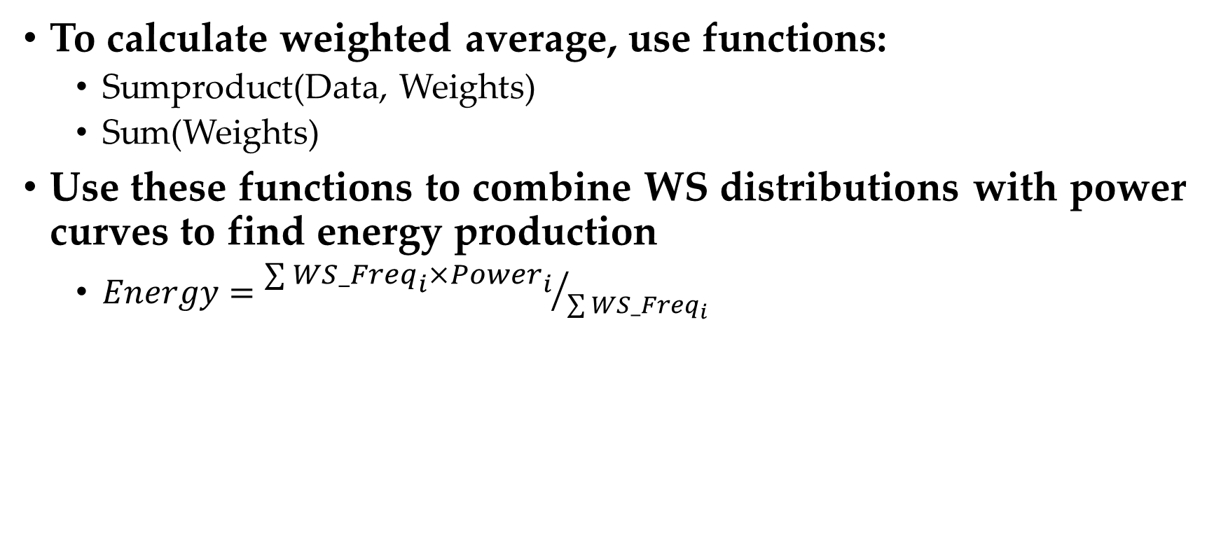
Weighted Averages
To calculate weighted average, use functions:
  Sumproduct(Data, Weights)
  Sum(Weights)
Use these functions to combine WS distributions with power curves to find energy production
  $Energy={\sum{{WS_Freq}_{i}×{Power}_{i}}}/{\sum{{WS_Freq}_{i}}}$
Exercise 9:
Calculate overall WS distribution (combine wind rose with WS frequency at each WS)
Calculate overall WS
Calculate energy production from each sector.

Slide 17
Finally, for fun, let’s look at a measured power curve!
Exercise 10:
Create measured power curve and compare to Goldwind’s.

Slide 18
Other Excel Tricks and Tips
Double-click between two columns or rows to automatically size the column/row
If you have two datasets to compare that don’t have identical timestamps, use this tool to create time series with no missing time intervals:
  Dropbox (OEE)\Due Diligence - Resources\Tools\Fill In Missing Data.xlsm
Vlookup and Hlookup can be useful
What else?

