Slide 1
SOCIAL MEDIA ANALYTICS 2022
MEGAN DUFRESNE
08/24/23

Slide 2
Table of contents
This is an overview of One Energy’s social media data from 2022, broken down by platform. In this presentation, you’ll find details on the five best-performing and the three lowest-performing posts for the year, along with performance summaries.
Pg. 3 – Analytics Intro
Pg. 4 – Analytics Terms
Pg. 5 – Social Media Series Descriptions
Pg. 6 – Facebook Overview
Pg. 10 – Instagram Overview
Pg. 15 – LinkedIn Overview
Pg. 19 – YouTube Overview
Pg. 23 – Performance Summary

Slide 3






Analytics Intro
This presentation includes an overview of each of our social media platforms and our different social media series to allow for a side-by-side comparison of how different social media posts perform on each platform. With this, we can view which types of posts are performing well and which types of posts are not, as well as which platforms contribute to each post’s performance.
The main metrics used to determine a post’s performance are Reach and Engagement. Reach indicates how many people are seeing our posts and Engagement indicates how well our content is connecting with these people. These two metrics can inform us on what platforms and which types of posts to spend more time and energy to receive the most return on investment (ROI).
The social media platforms analyzed in this presentation include Facebook, Instagram, LinkedIn, and YouTube. Twitter was purposely not included because of its consistently low engagement and Threads wasn’t released until July of this year.
Social platforms analyzed:
Other platforms:
@oneenergyinc
@oneenergywind
@oneenergywind
@oneenergywind
@oneenergyenterprisesinc
@oneenergywind

Slide 4
Analytics terms
Content – the OE social media series and form of media
Reach (Impressions) – views when the post is at least 50% on screen, or when it is clicked, whichever comes first
Total Engagement (Clicks) – the sum of all interactions with a post (when someone clicks on the post and all likes, comments, shares, reactions, etc.)
  % of Reach – total engagement divided by Reach – the total amount of interactions compared to how many people actually saw the post
Engagement Breakdown – the number of each type of Click that contributes to the Total Engagement (Includes: likes, comments, shares, links clicked, subscribers (YouTube), and reactions (i.e. clapping hands, heart, smiling face, and angry face) (Facebook)
Avg. View Duration (YouTube) – the average amount of time an account watched the video before clicking off the page

Slide 5
Social media series Descriptions
Climb To The Top (CTTT) – video series showcasing OE employees and their professional journey leading up to their experience at OE
Science Shorts (SS) – educational video series targeted to elementary and middle school students teaching topics involving STEM
Wind View (WV) – weekly photo (and some video) series showcasing what we do at OE
Wind Study (WS) – written series targeted to middle and high school students challenging them with questions regarding topics in STEM and example problems we may face during the job at OE. Answers to the problems are provided within the week for students to check their scores.
Day In The Life (DITL) – newest video series capturing interesting events from different departments that happen from day to day at OE
Technician Talks (TT) – video series from our construction team encompassing different safety features and programs integrated into OE’s culture
Executive Thoughts (ET) – written series by OE’s leadership team that brings together their opinions and insights about different topics as an executive of the company
Evergreen – photo or video series of impactful quotes from OE employees that are from previous written and video content

Slide 6
Facebook
@oneenergywind
995 followers
Audience consists of community members, educators, and customers.
Remains a useful platform to share relevant local information such as scholarship ceremonies, educational tours, or customer project announcements.
5 Best-Performing Posts | 3 Lowest-Performing Posts

Slide 7
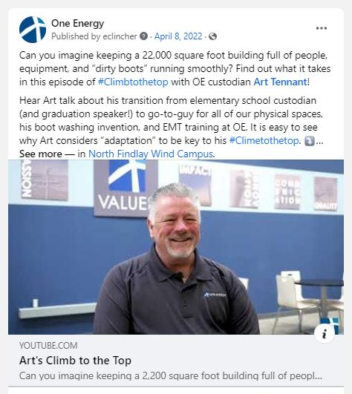
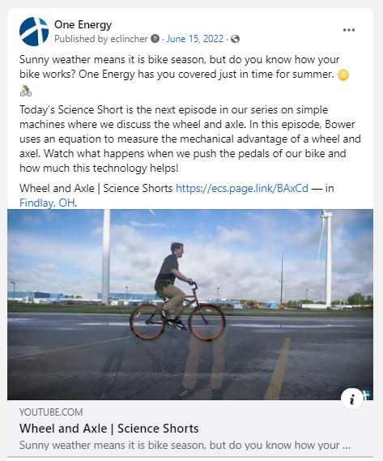
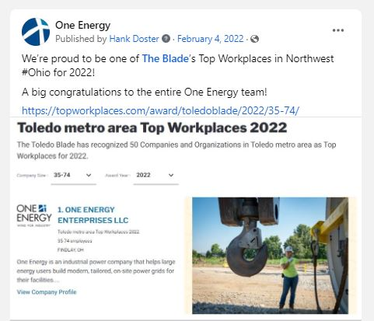
5 Best-performing posts facebook
Content: CTTT Video
Reach: 1,637
Total Engagement: 888 (54% of Reach)
Of the 888 clicks:
447 reactions (50%)
166 comments (19%)
14 shares (2%)
261 links clicked (29%)
Content: Top Workplace Article
Reach: 1,225
Total Engagement: 55 (4.5% of Reach)
Of the 55 clicks:
38 reactions (69%)
3 comments (6%)
4 shares (7%)
10 links clicked (18%)
Content: SS Video
Reach: 1,173
Total Engagement: 244 (20% of Reach)
Of the 244 clicks:
113 reactions (47%)
25 comments (10%)
3 shares (1%)
103 links clicked (42%)
Why we think this performed well:
Art is tagged in the post
Art’s well-known in the community
Why we think this performed well:
Tagged Toledo Blade
Feel-good topic
Why we think this performed well:
Engaging video/thumbnail
Maybe the topic of bicycles

Slide 8
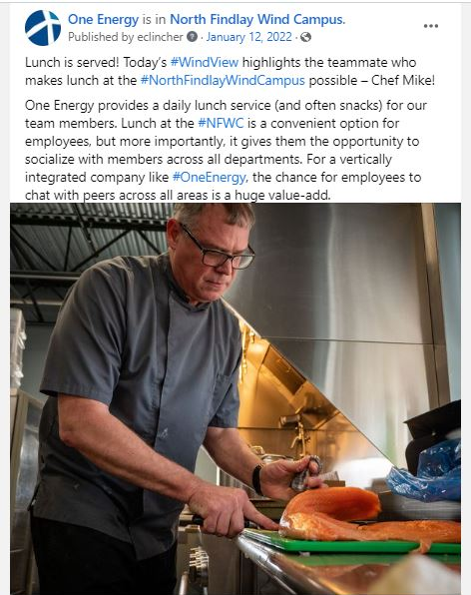
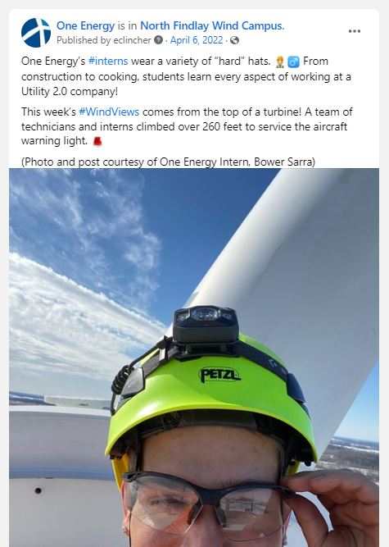
5 Best-performing posts facebook
Content: WV Photo
Reach: 1,141
Total Engagement: 46 (4% of Reach)
Of the 46 clicks:
38 reactions (83%)
2 comments (4%)
6 shares (13%)
Content: WV Photo
Reach: 1,107
Total Engagement: 78 (7% of Reach)
Of the 78 clicks:
69 reactions (89%)
5 comments (6%)
4 shares (5%)
Why we think this performed well:
Chef Mike’s reputation
Personal interest story
Good-looking food
Why we think this performed well:
Unique viewpoint
Photo/content gives the photo an authentic and real/personal touch

Slide 9
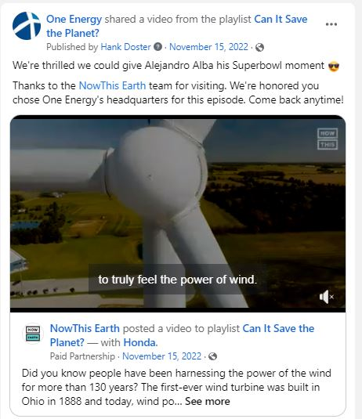
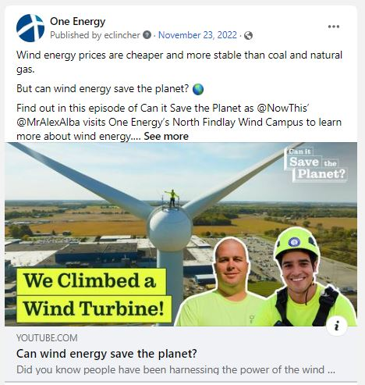
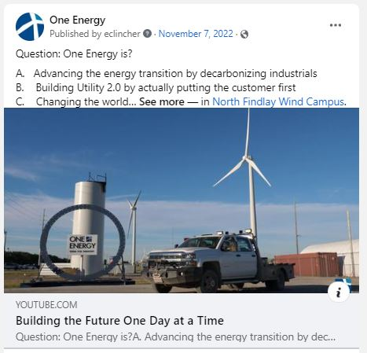
3 lowest-performing posts facebook
Content: Can It Save the Planet Video
Reach: 81
Total Engagement: 4 (5% of Reach)
Of the 4 clicks:
4 reactions (100%)
0 comments/shares
Content: Can It Save the Planet YT Video
Reach: 82
Total Engagement: 3 (4% of Reach)
Of the 3 clicks:
2 reactions (67%)
1 link clicked (33%)
0 comments/shares
Content: OE YouTube Video
Reach: 86
Total Engagement: 3 (3% of Reach)
Of the 3 clicks:
2 reactions (67%)
1 links clicked (33%)
0 comments/shares
Why we think this didn’t perform well:
We’re sharing someone else’s video
Might not have been the best time for top engagement
Why we think this didn’t perform well:
Not entirely sure
Alejandro isn’t super well-known
Why we think this didn’t perform well:
Copy is lacking personal touch
Topic isn’t relatable
Non-engaging thumbnail

Slide 10
Instagram
@oneenergywind
1,324 followers
Audience consists of younger individuals, influencers, and company promotions.
Remains a photography platform where people post eye-catching photos as well as interesting and creative content.
5 Best-Performing Posts | 3 Lowest-Performing Posts

Slide 11
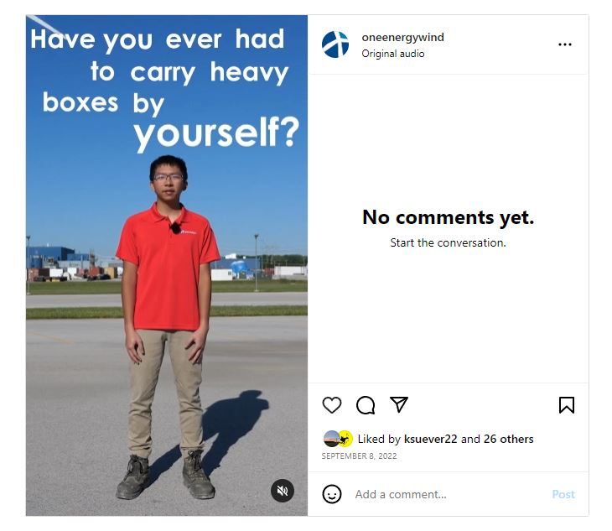
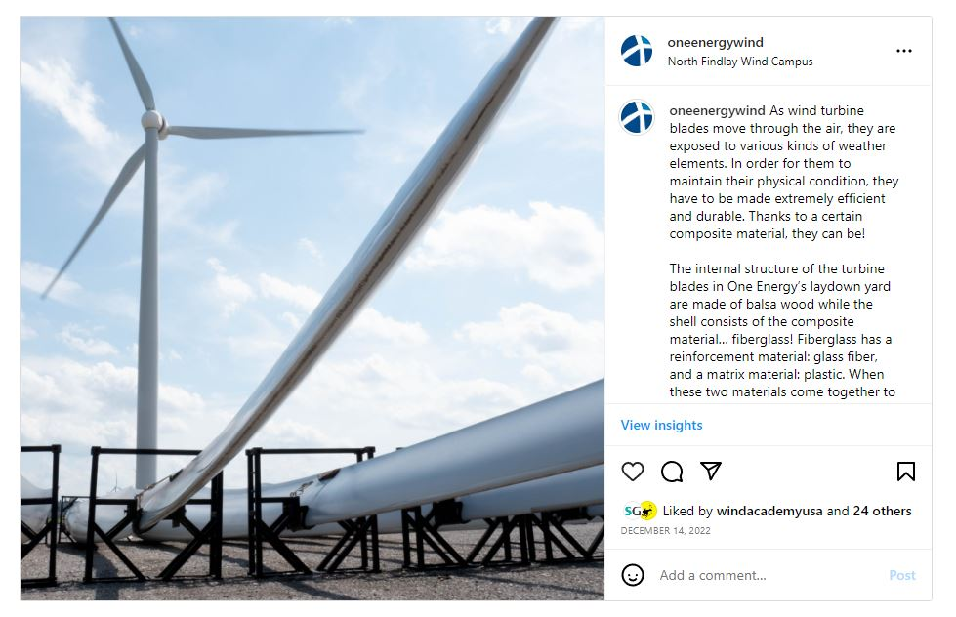
5 Best-performing posts instagram
Content: SS Teaser Video
Reach: 1,668
Total Engagement: 27 (1.6% of Reach)
Of the 27 clicks:
27 likes (100%)
0 comments/shares
Content: WV Photo
Reach: 605
Total Engagement: 26 (4.3% of Reach)
Of the 26 clicks:
25 likes (96%)
1 comment (4%)
0 shares
Why we think this performed well:
Utilizing new actors like interns
First time we did subtitle tracking
Why we think this performed well:
Unique view-point

Slide 12
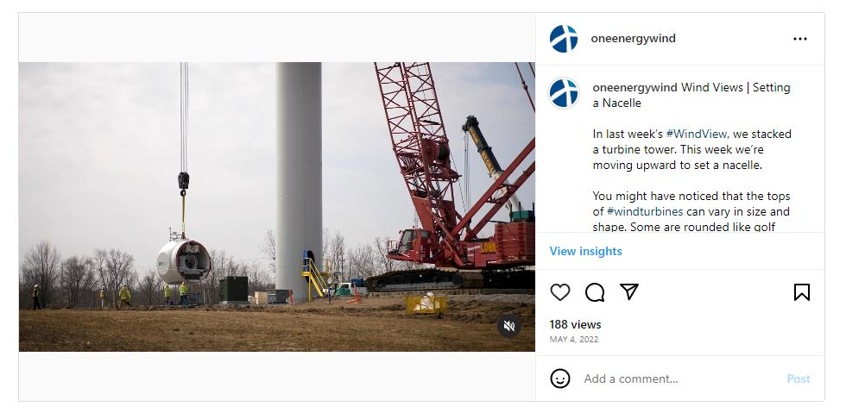
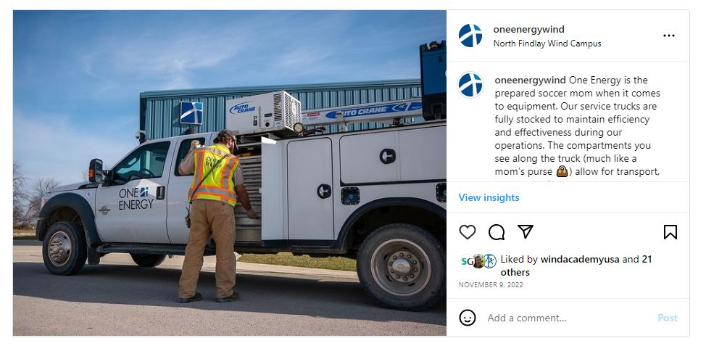
5 Best-performing posts instagram
Content: WV Photo
Reach: 527
Total Engagement: 32 (6% of Reach)
Of the 32 clicks:
30 likes (94%)
1 comment (3%)
1 share (3%)
Content: WV Photo
Reach: 520
Total Engagement: 23 (4.4% of Reach)
Of the 23 clicks:
22 likes (96%)
1 comment (4%)
0 share
Why we think this performed well:
Unique imagery
Why we think this performed well:
Interesting Equipment
Well framed

Slide 13
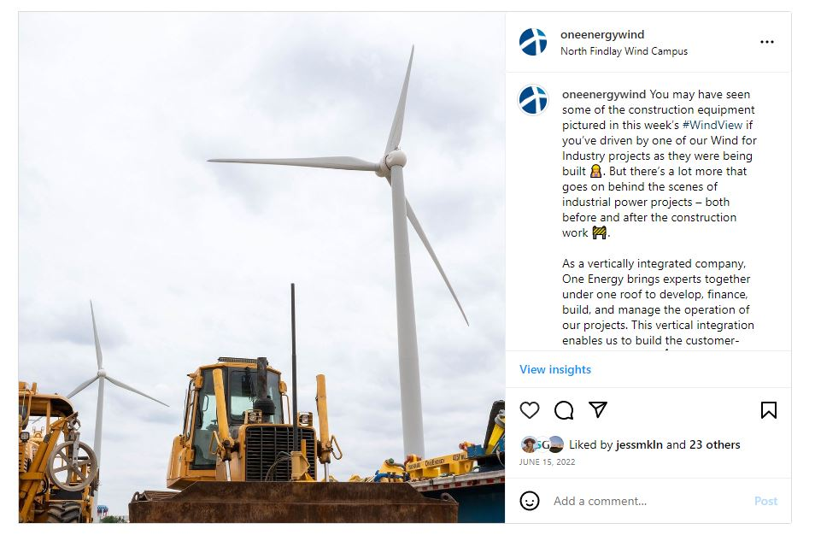
5 Best-performing posts instagram
Content: WV Photo
Reach: 419
Total Engagement: 28 (6.7% of Reach)
Of the 28 clicks:
24 likes (86%)
3 comments (11%)
1 share (3%)
Why we think this performed well:
Unique view-point
Eye-catching photo framing

Slide 14
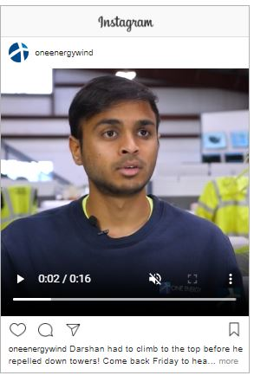
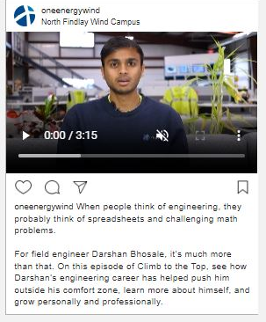
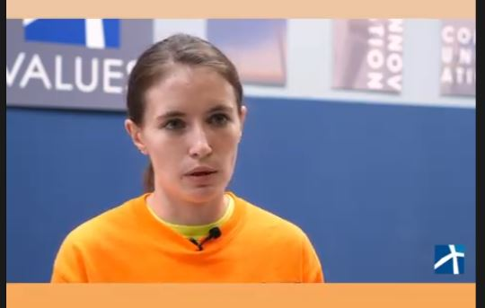
3 lowest-performing posts
instagram
Content: CTTT Reel
Reach: 109
Total Engagement: 0
Of the 0 clicks:
0 likes/shares/comments
Content: CTTT Reel
Reach: 121
Total Engagement: 15 (12% of Reach)
Of the 15 clicks:
13 likes (87%)
1 comment (6.5%)
1 share (6.5%)
Content: CTTT Video
Reach: 129
Total Engagement: 16 (12% of Reach)
Of the 16 clicks:
15 likes (94%)
1 comment (6%)
0 shares
Why we think this didn’t perform well:
Slow to engage content
Why we think this didn’t perform well:
Slow to engage content
Why we think this didn’t perform well:
Slow to engage content

Slide 15
Linkedin
@oneenergyenterprisesinc
2,001 followers
Audience consists of professional individuals and corporate accounts.
Useful platform to provide local professionals, customers, and investors with company updates, and accomplishments, and thought leadership.
Also useful as a recruiting tool to showcase our company culture, growth opportunities, and values.
5 Best-Performing Posts | 3 Lowest-Performing Posts
*July 2022 – July 2023 Metrics

Slide 16
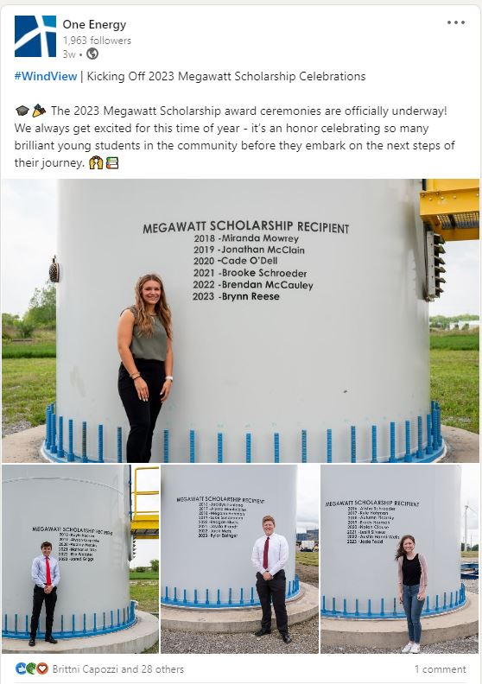
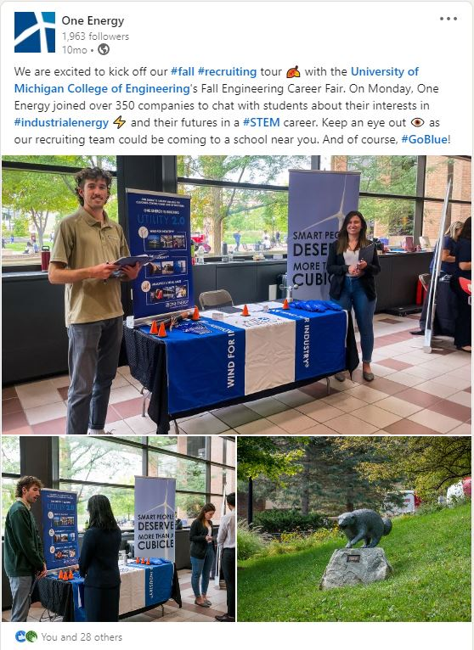
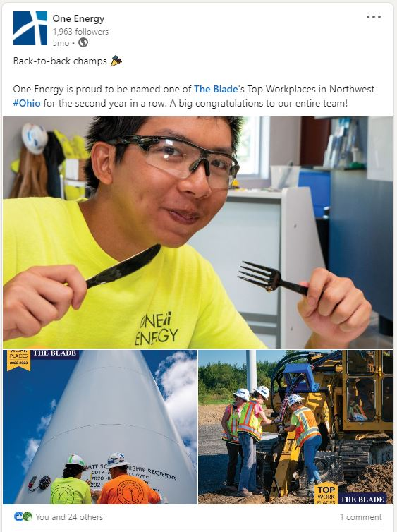
5 Best-performing posts linkedin
Content: MWS Photos
Reach: 1,216
Total Engagement: 357 (32% of Reach)
Of the 357 clicks:
31 reactions (8.7%)
1 comment (.3%)
0 shares
Content: Job Fair Photos
Reach: 1,077
Total Engagement: 187 (20% of Reach)
Of the 187 clicks:
29 reactions (15.5%)
0 comments
0 shares
Content: Top Workplace Photos
Reach: 1,029
Total Engagement: 143 (16.5% of Reach)
Of the 143 clicks:
25 reactions (17.5%)
1 comment (.7%)
0 shares
Why we think this performed well:
Supporting local community
Having multiple photos of students
Why we think this performed well:
Tagged the career fair event and the school hosting – huge audience with schools
Why we think this performed well:
Tagged the Toledo Blade
Unique, people-centric photos

Slide 17
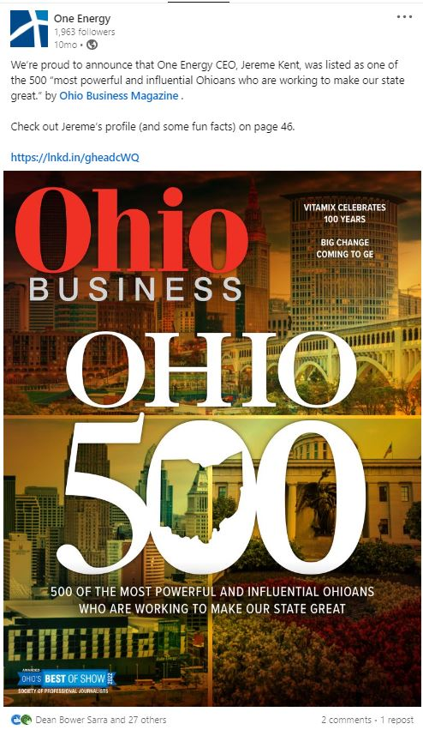
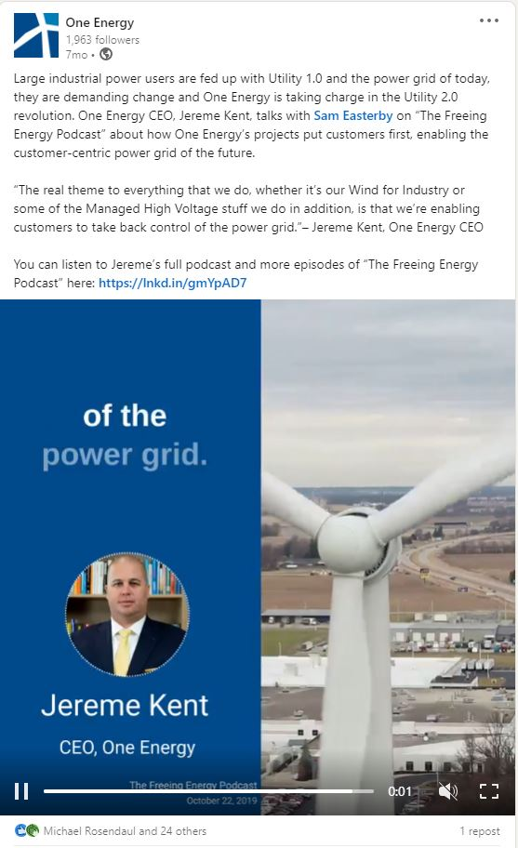
5 Best-performing posts linkedin
Content: Ohio Business Magazine Article
Reach: 981
Total Engagement: 62 (9.5% of Reach)
Of the 62 clicks:
28 reactions (45%)
2 comments (3%)
1 share (1.5%)
Content: Evergreen Video Clip
Reach: 936
Total Engagement: 18 (4.7% of Reach)
Of the 18 clicks:
25 reactions (139%)
0 comments
1 share (5.5%)
Why we think this performed well:
Tagged Ohio Business Magazine
Why we think this performed well:
Visually engaging
Impactful messaging

Slide 18
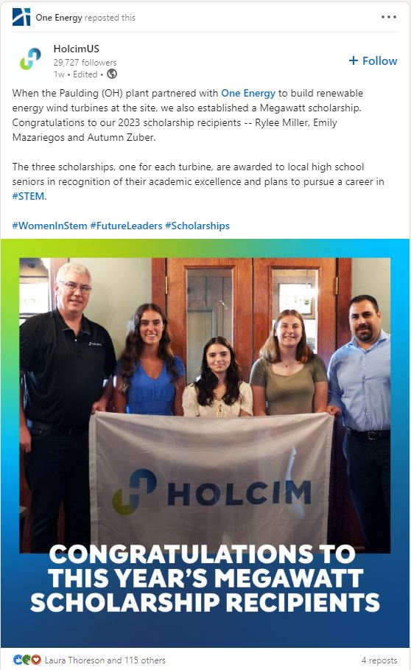
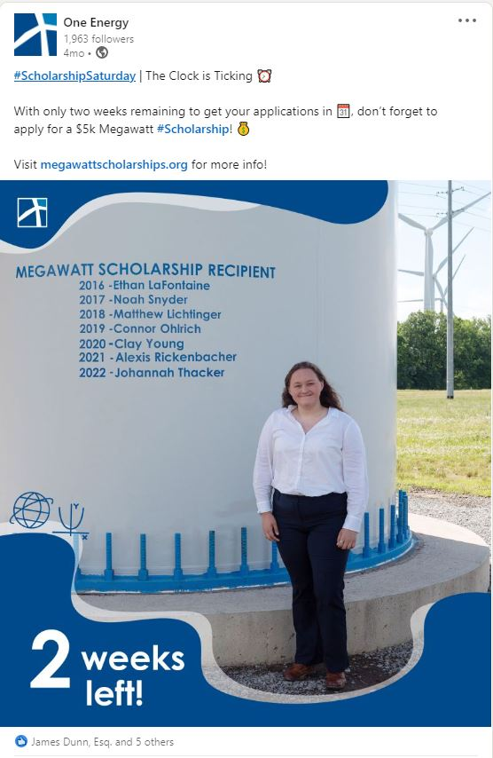
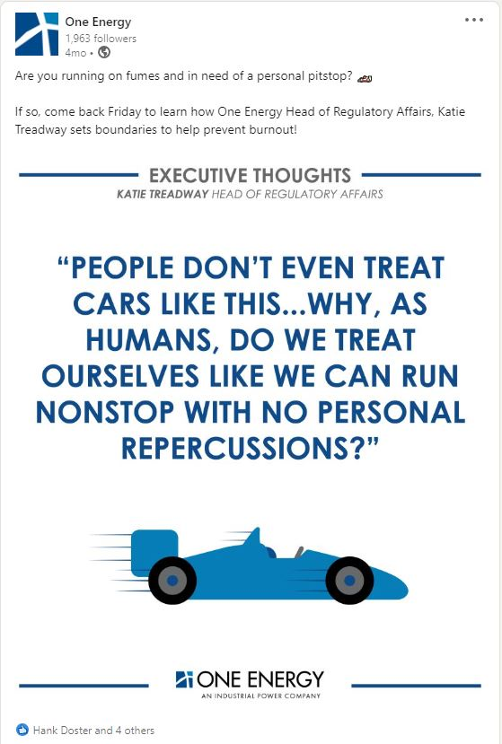
3 lowest-performing posts linkedin
Content: MWS Repost
Reach: 261
Total Engagement: 5 (3.8% of Reach)
Of the 5 clicks:
0 likes/comments/shares
Content: MWS Photo
Reach: 208
Total Engagement: 6 (4% of Reach)
Of the 6 clicks:
6 likes (100%)
0 comments
0 shares
Content: ET Graphic
Reach: 212
Total Engagement: 5 (6% of Reach)
Of the 5 clicks:
5 likes (100%)
0 comments
0 shares
Why we think this didn’t perform well:
Not a very engaging photo
Why we think this didn’t perform well:
Not an eye-catching photo
Why we think this didn’t perform well:
Lack of context

Slide 19
Youtube
@oneenergyinc
434 subscribers | 106 videos
Audience consists of everyone: the general public, investors, customers, community members, etc.
Platform continues to grow with new users and video content daily
Top contender to reach people with video content
5 Best Performing Posts | 3 Lowest Performing Posts
*Lifetime Metrics

Slide 20
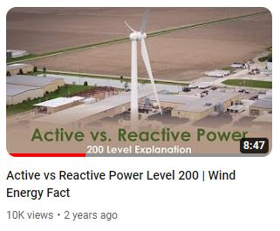
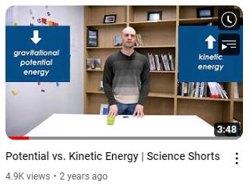
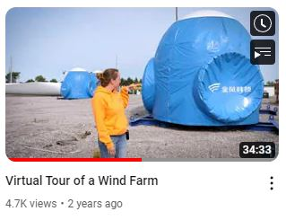
5 Best-performing posts
Youtube
Content: Educational Video
Reach: 197.8k
Click-through-rate: 3.3% of Reach
Views: 10,075
Watch Time: 571 hours
Avg. View Duration: 3:24 (38.7% of vid)
Engagement Breakdown:
224 likes
10 dislikes
10 comments
91 shares
+203 subscribers
Content: SS Video
Reach: 104.6k
Click-through-rate: 2.8% of Reach
Views: 4,952
Watch Time: 114.8 hours
Avg. View Duration: 1:23 (36.6% of vid)
Engagement Breakdown:
46 likes
3 dislikes
3 comments
64 shares
+33 subscribers
Content: SS Video
Reach: 38.9k
Click-through-rate: 5% of Reach
Views: 4,774
Watch Time: 522.9 hours
Avg. View Duration: 6:34 (19% of vid)
Engagement Breakdown:
40 likes
3 dislikes
5 comments
80 shares
+28 subscribers
Why we think this performed well:
Unique approach/content
Like a field trip
Why we think this performed well:
Common topic for students
Why we think this performed well:
Common topic for students
Notes:
Left it as “Engagement Breakdown” instead of “Of the 5 Clicks:” because I don’t have a specific number of clicks. Just the % rate.

Slide 21
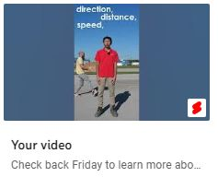
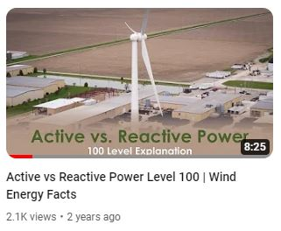
5 Best-performing posts youtube
Content: SS Teaser Video
Reach: -
Click-through-rate: -
Views: 1,283
Watch Time: 6 hours
Avg. View Duration: 0:16 (89% of vid)
Engagement Breakdown:
23 likes
2 dislikes
2 comments
0 shares
+5 subscribers
Content: Educational Video
Reach: 38.9k
Click-through-rate: 3.4% of Reach
Views: 2,142
Watch Time: 93.2 hours
Avg. View Duration: 2:36 (31% of vid)
Engagement Breakdown:
48 likes
0 dislikes
1 comments
14 shares
+31 subscribers
Why we think this performed well:
Utilizing new actors like interns
First time we did subtitle tracking
Why we think this performed well:
Common topic for students/educators

Slide 22
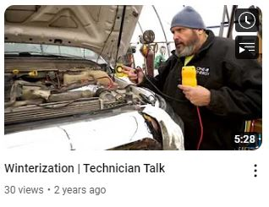
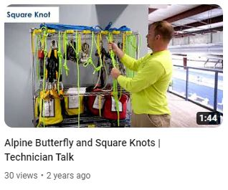
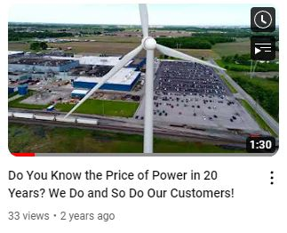
3 lowest-performing posts youtube
Content: TT Video
Reach: 610
Click-through-rate: 3.3% of Reach
Views: 30
Watch Time: .8 hours
Avg. View Duration: 1:36
Engagement Breakdown:
1 likes
0 dislikes
0 comments
3 shares
+0 subscribers
Content: TT Video
Reach: 709
Click-through-rate: 3% of Reach
Views: 30
Watch Time: .5 hours
Avg. View Duration: 1:09
Engagement Breakdown:
2 likes
0 dislikes
1 comment
2 shares
+0 subscribers
Content: General Marketing Video
Reach: 473
Click-through-rate: 2.75% of Reach
Views: 33
Watch Time: .5 hours
Avg. View Duration: 1:03
Engagement Breakdown:
0 likes
0 dislikes
0 comments
0 shares
+0 subscribers
Why we think this didn’t perform well:
Very niche topic
Why we think this didn’t perform well:
Very niche topic
Why we think this didn’t perform well:
Copy is lacking personal touch
Non-engaging thumbnail

Slide 23
summary
What is working:
Tagging outside accounts – exposes posts to a larger audience and increases brand recognition
Human interest stories/celebrating employees
Feel-good/accomplishment content
Eye-catching photography/videography
Maintaining platform-specific content expectations: interesting and creative photography content for Instagram, serious and career-oriented content for LinkedIn, carousels for Instagram
Educational content and Science Shorts – maintaining our “Professor” voice
23

Slide 24
summary
What needs work:
  Consider why our audience should care, some content isn’t connecting with our audience – doesn’t inspire engagement
  Topics can be too niche
  Tone might be too empty/corporate
Lack of visually interesting content/graphics – not catching people’s attention
Production quality could be improved
Accessibility/UX – i.e. subtitles
24

Slide 25
summary
Moving Forward:
Continue creating and posting platform-specific content
Keep leaning into personal the people behind the company posts
Rework or eliminate Technician Talks series
Create more attractive/ professional video content by taking time and resources to plan the stage, gather props, flesh out new ideas
Continue creating on-screen visuals for more engagement and understandability – subtitles, animations, photo and video examples and demonstrations
Consider: What will make them stop for a few seconds to read our post, or better yet, even Like it?
  Utilize engaging thumbnails
Inspire younger audiences to learn about OE’s technological advancements – increase their knowledge and potential impact on the world as they get older
25

