Slide 1
Heating the Quonset hut
Josh Short
12/17/21

Slide 2




The Issue
Working in the Quonset Hut during the winter is extremely cold.

Slide 3
Assessment and budget
Heating the Quonset Hut can be done in the following three phases:
  Phase I – Propane Tank Concrete Pad and Gas Line
  Phase II – Insulation
  Phase III – Heating Unit
Budget: $10,000 - $20,000

Slide 4
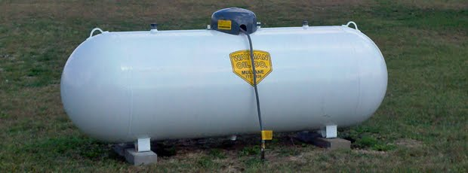
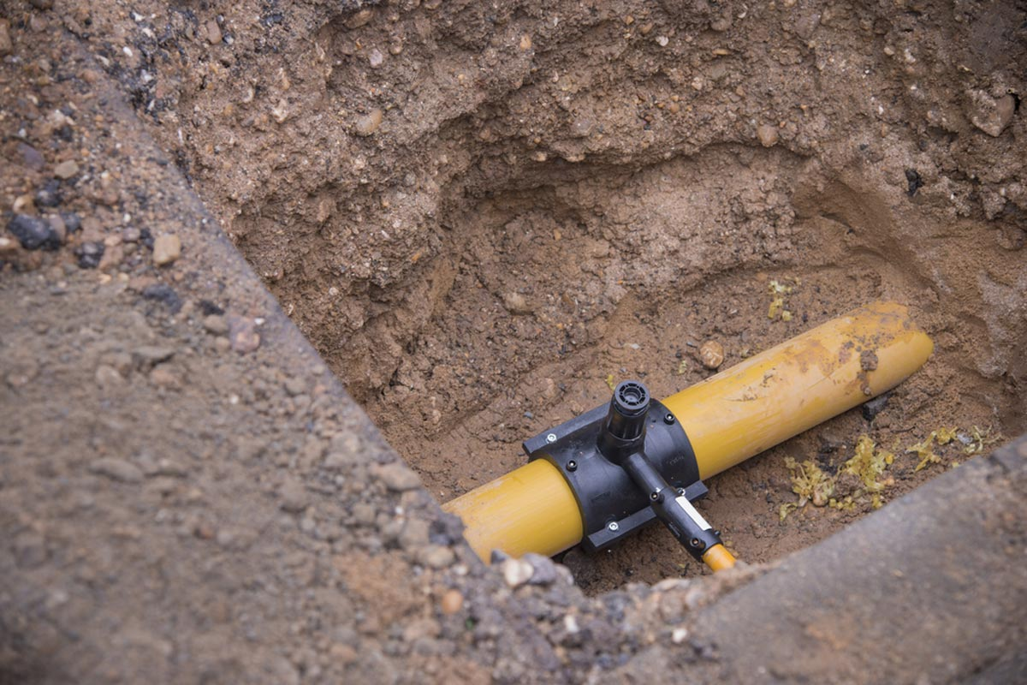
Phase 1
Gas line
Propane Tank & Concrete Pads

Slide 5
Phase I quotes
Digging Gas Line – OE time: $100/hr x # workers = $400
$100 x 2 people x 2 hrs = $400
Gas Line – Piping Material: $402.57
https://propanewarehouse.com/shop/propane-hoses/propane-flex-lines/propane-flex-line/ (high estimate)
Concrete Pads – 2 10-lb bags Quikrete: $5.56
https://www.lowes.com/pd/QUIKRETE-10-lb-High-Strength-Concrete-Mix/3006114?cm_mmc=shp-_-c-_-prd-_-bdm-_-ggl-_-LIA_BDM_210_Concrete-Block-_-3006114-_-local-_-0-_-0&ds_rl=1286981&gclid=Cj0KCQiAweaNBhDEARIsAJ5hwbcTSqxlIo7e_bB-BW58mvJTRAASLdSHmob1wb0_D7mm_vInvnrFnZYaAhbeEALw_wcB&gclsrc=aw.ds
Propane Tank – Refurbished 250 gallon: $799.00
https://www.thriftypropane.com/purchasetank
Propane – price per gallon: $1.89 / gal x 250 gal = $472.50 first fill
Propane – price per gallon: $2.29 / gal x 250 gal = $572.50 / fill
Suburban Propane (419-422-4373) : Call back when ready because price may fluctuate give or take $50 to total.

Slide 6
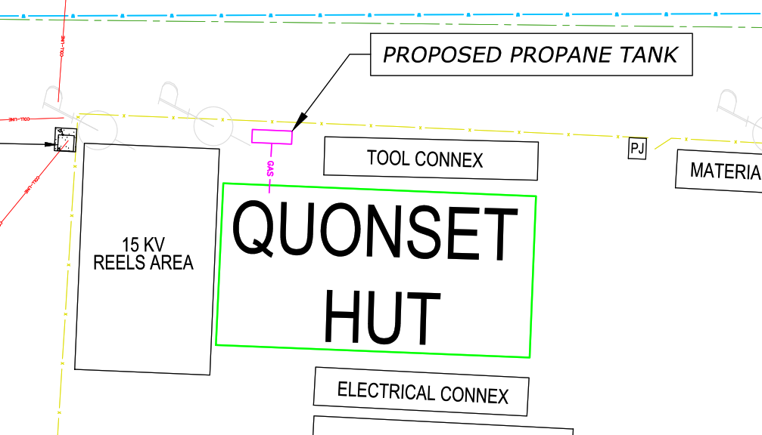
Phase I Site layout

Slide 7
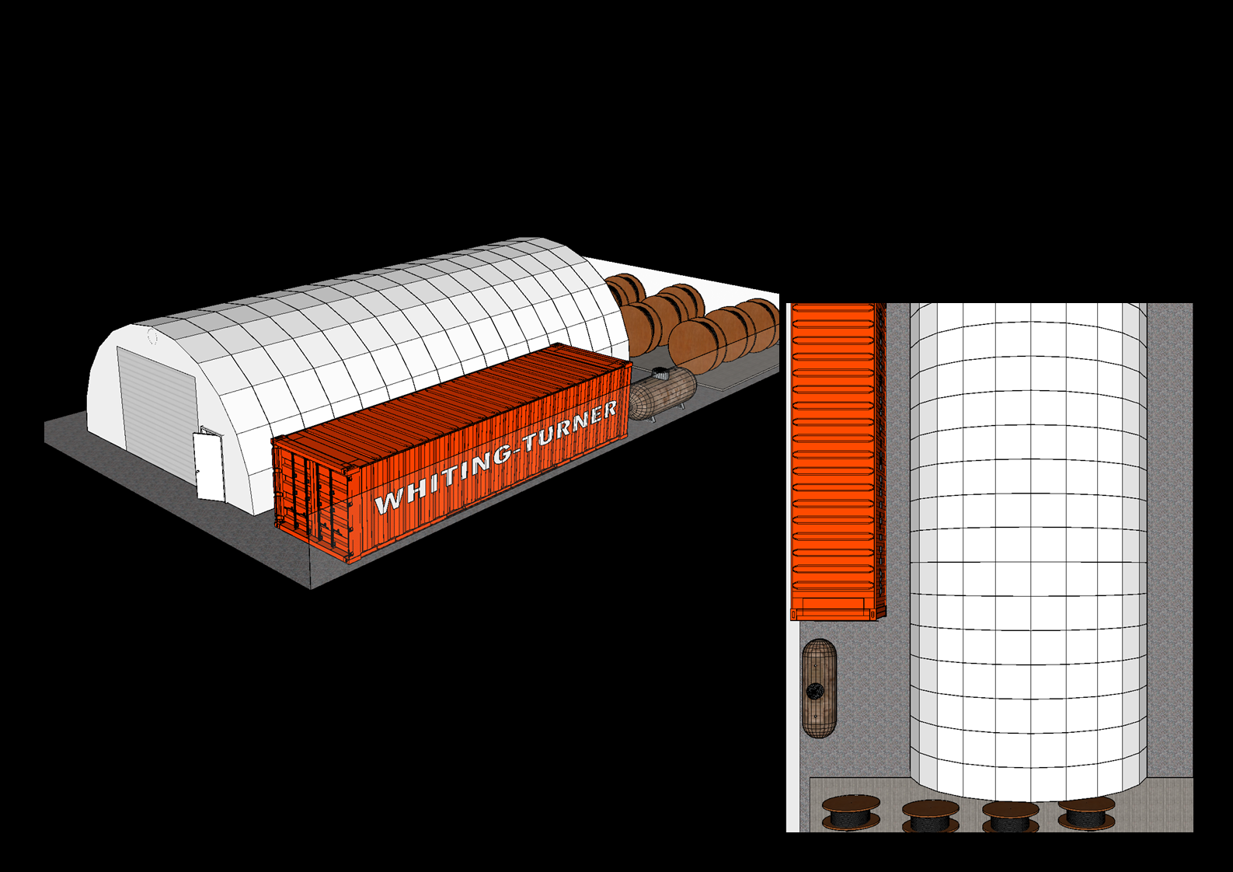
Phase I model

Slide 8
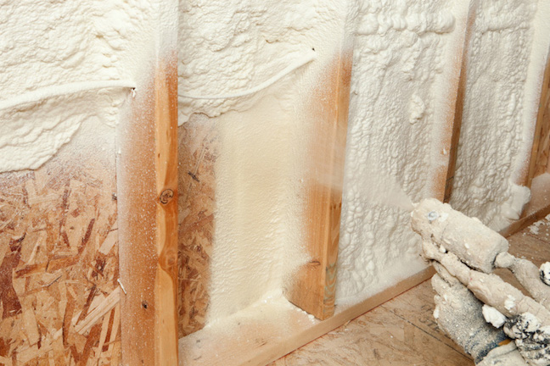
Phase II
Insulation

Slide 9
Phase II Quotes
Clearing Quonset Hut – OE Time $100/hr x # workers = $1,200
$100 x 3 people x 4 hrs = $1,200
Enersol insulation installation - $6,500
Note: Enersol would need to do an onsite evaluation of the Quonset Hut to provide a written quote. The quote giving was based of the dimensions and square footage of the Quonset Hut.

Slide 10
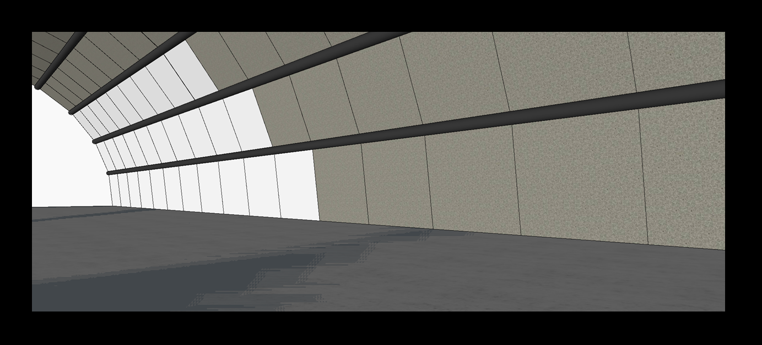
Phase II Model

Slide 11
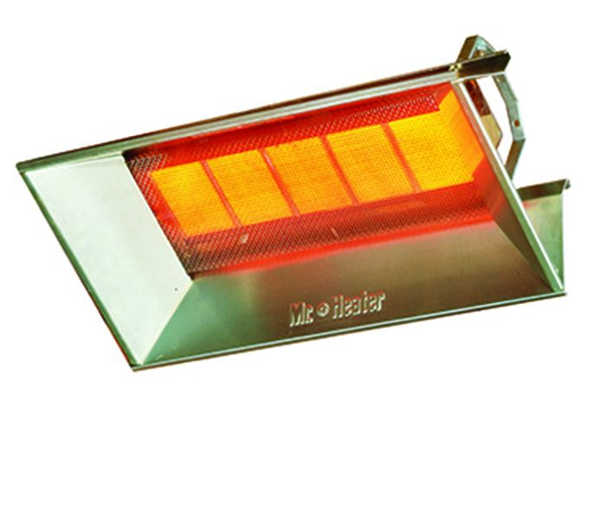
Phase III
Heating Unit

Slide 12
Phase III Quotes
Heating Unit – 40,000 BTU High Intensity Propane Radiant Workshop Heater: $497.67
https://www.mrheater.com/40-000-btu-high-intensity-lp-radiant-workshop-heater.html
Heater Specs:
40,000 BTU per hour
For use with propane gas
Heats up to 1000 sq. ft.
For use in buildings with 12 to 15 ft ceilings
Efficient infrared heat that directly heats people and objects which in turn heats surrounding air to desired temperature
Includes adjustable thermostat for individually controlled warmth and all necessary brackets and hardware
No electricity required
Easy to install
No moving parts to service
Quiet, clean, odor-free operation
Non-corrosive materials used throughout construction

Slide 13
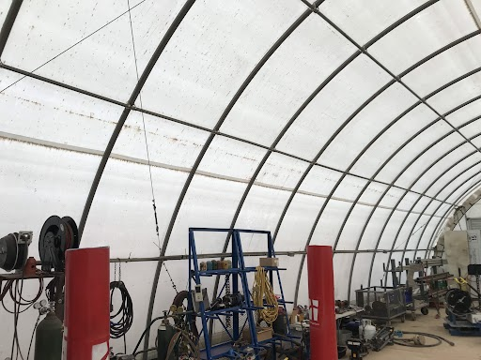
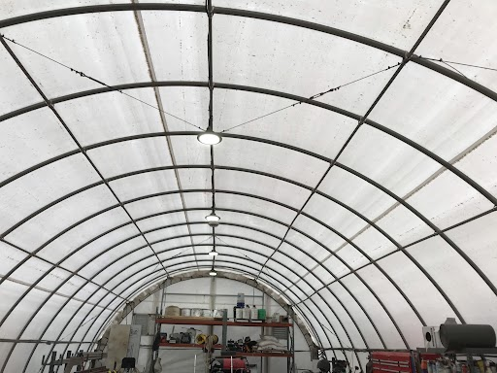
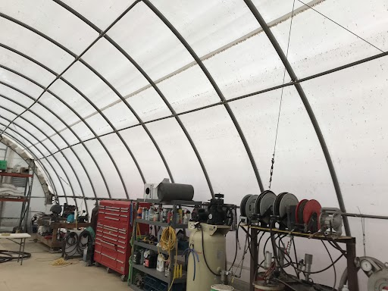
Phase III Location

Slide 14
Net total cost
The total was found using the sum of the following quotes:
$100/hr x # workers = $100 x 2 people x 2 hrs = $400
$402.57
$5.56
$799.00
$472.50 first fill then $572.50 / fill
$100/hr x # workers = $100 x 3 people x 4 hrs = $1,200
$6,500
$497.67
Net Total: $11,956.93

Slide 15
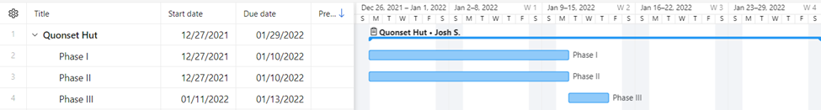
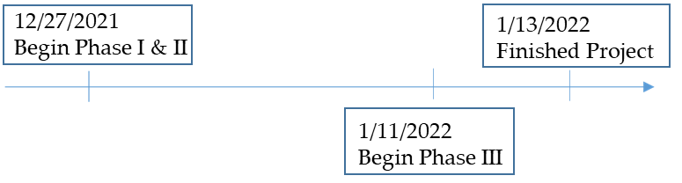
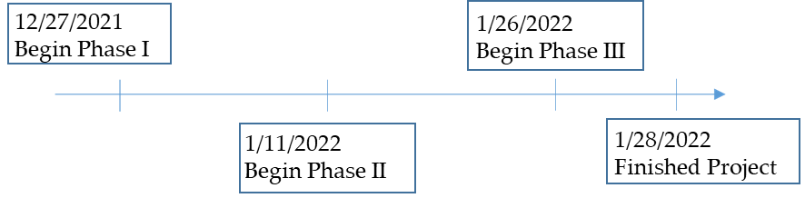
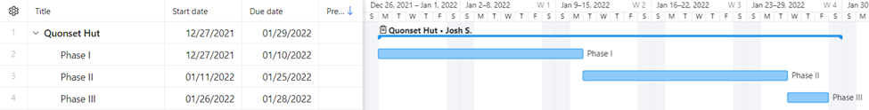
TimeLine & gantt chart
Recommended Option
Secondary Option

Slide 16
Next steps
Determine project start date
Figure out how much time can be dedicated to the project at a time
Start procurement of materials and equipment
Begin Phase I

