Slide 1
Written communication
the oe way
Hank Doster & Jessica Makolin
20220215

Slide 2
outline
Brief Intros
Best Practices for Writing (and Editing)
Storytelling’s All-Time #1 Tip for Becoming a Better Writer

Slide 3
BRIEF INTROS

Slide 4


Brief intros
Hank Doster
Corporate Communications Manager
Jessica Makolin
Director of Special Projects

Slide 5
BEST PRACTICES

Slide 6

Best practices: how to write (and edit)
Start with “why”
Consider your audience
Things to keep in mind
Editing / quality control
Resources / if you get stuck

Slide 7

Start with “why”
Why are you writing / creating this?
What’s the purpose / goal of the document?
What do you want to communicate?
What are the key takeaways for the reader?

Slide 8

Consider your audience
Tone
Formality (or lack thereof)
Technical details
Jargon, acronyms
Level of expertise
What do they care about?
What do they need to know?

Slide 9

Things to keep in mind
Accuracy
Coherence
Clarity
Consistency
Brevity

Slide 10
Things to keep in mind – Accuracy
Accuracy – Is it correct?
Numbers, data, math, etc.
Addresses, job titles
Grammar, typos
Conclusions

Slide 11

Things to keep in mind – COHERENCE
Coherence – Does it make sense?

Slide 12
Things to keep in mind – cLARITY
Clarity – Is it clear?
Is the message (or language) vague?
Is anything left open to interpretation?
Is there ambiguity that can or should be removed?

Slide 13


Things to keep in mind – CONSISTENCY
Consistency – Is it uniform?
  Across the One Energy brand
  Within the document itself

Slide 14
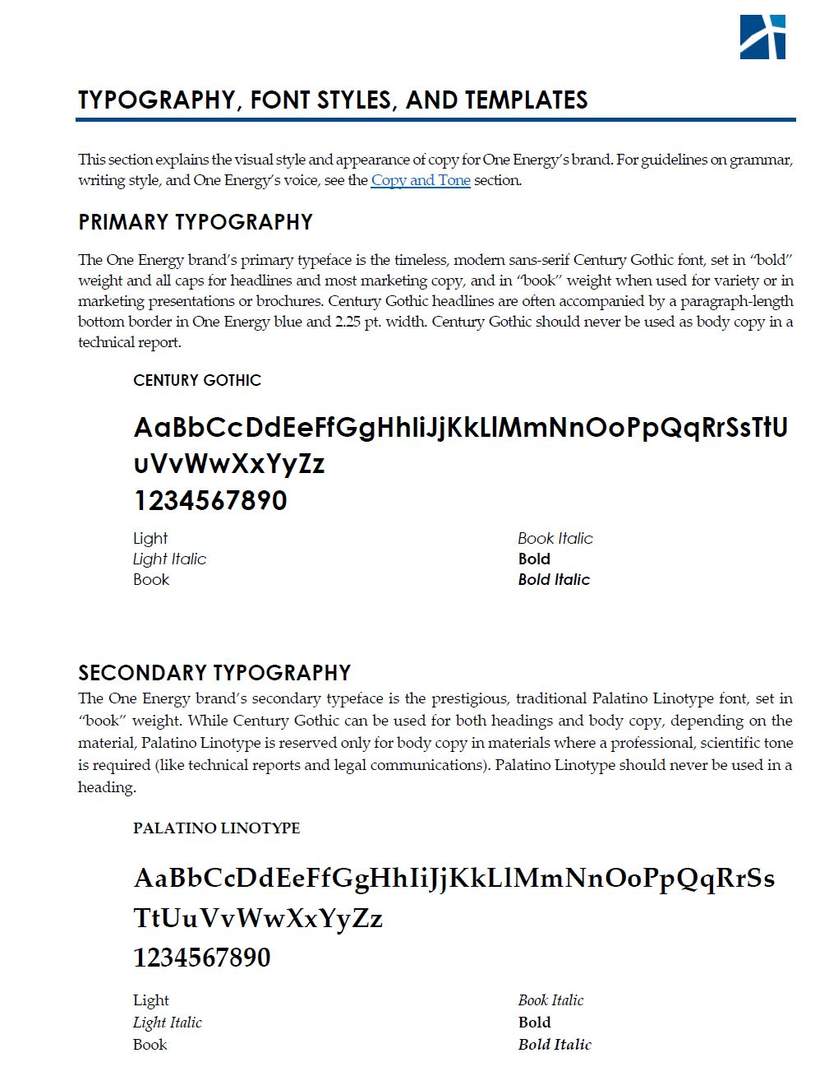
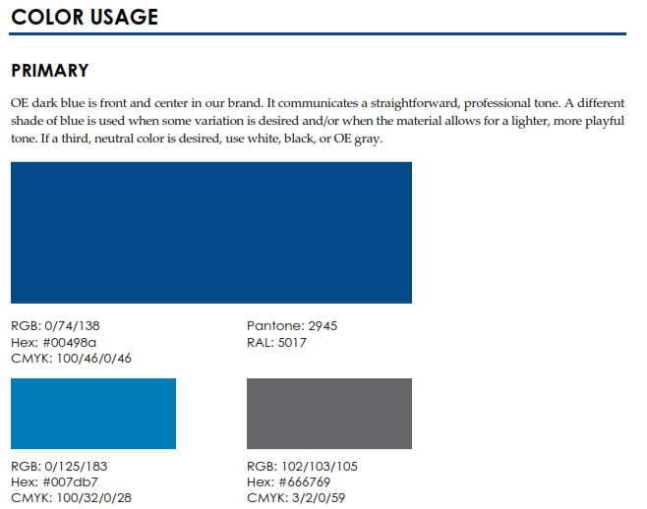


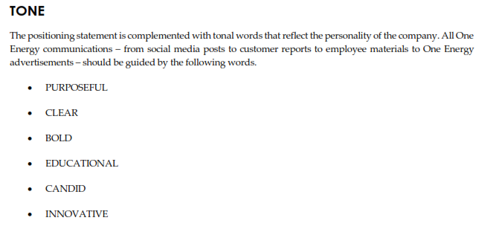

Things to keep in mind – consistency – CONT.
Consistency – across the One Energy brand
  Appearance (logos, colors, format, typography, etc.)
  Tone
The Branding & Style Guide is your friend!
(on DB at: Marketing - Approved Templates\Brand Style Guide – and on the Intranet)

Slide 15
Things to keep in mind – consistency – CONT.
Consistency – within the document
  Tone
  Point of view (first-person, third-person, etc.)
  Tense (present, past)
  Punctuation
  Titles
  Trademarks (Wind for Industry®, ManagedHVTM)
  Consult the Branding and Style Guide, but when in doubt, select a style and stick to it

Slide 16
Things to keep in mind – consistency – CONT.
Consistency – within the document examples
  “20-year fixed rate” or “utility-scale turbines” vs.
  “20 year fixed rate” or “utility scale turbines”*
  “transformers, substations, and service trucks” vs.
  “transformers, substations and service trucks”*
  “we deploy” vs. “One Energy deploys” or “the Company deploys”^
  “we deploy” vs. “we will deploy” vs. “we deployed”⁺
  * Note that for the first two bullets, the bolded versions are correct.
  ^ For the third bullet, usage depends on formality of document, but must be consistent throughout.
  ⁺ For the last bullet, usage will depend, but in most cases should be consistent throughout.

Slide 17
Things to keep in mind – consistency – CONT.
Consistency – template usage
  Is there a template for this?
  If yes, find it – then ask yourself:
    Does this template successfully communicate the necessary message(s)?
    Is it appropriate for your target audience?
    Is it accurate, coherent, clear, consistent, and brief (or as brief as possible)?
    Are there ways to improve upon the existing document?
  When in doubt, ask for feedback

Slide 18
Things to keep in mind – BREVITY
Brevity – Is it concise?
  Is there a more direct way to say it?
  Is there a shorter way to say it?
  Do the details currently included matter to the reader / audience?
  Does the information currently included raise more questions than it answers?
  Keep it simple, friends

Slide 19
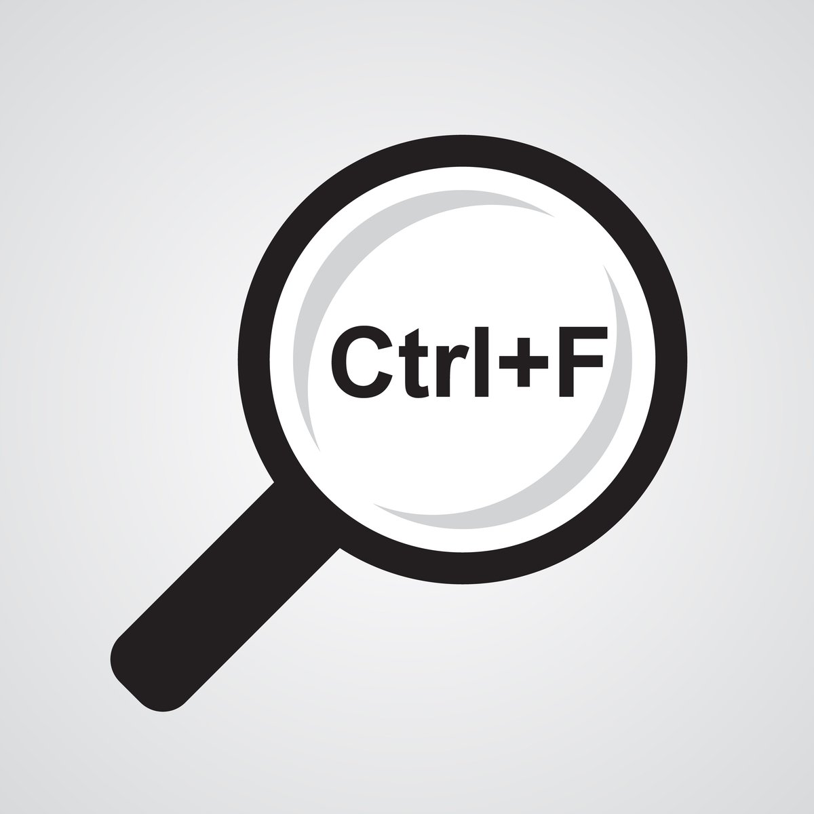

Editing / quality control
Circle back to “why”
Revisit your audience
  Tone
  Expertise
Remember: accuracy, coherence, clarity, consistency, and brevity
Carve out more time than you think you need
Make “CTRL + F” your friend
Refer to the Branding & Style Guide (punctuation, frequently used terms, etc.)
Print your work and mark it up!
Done editing? Review it once…and then review it again!

Slide 20
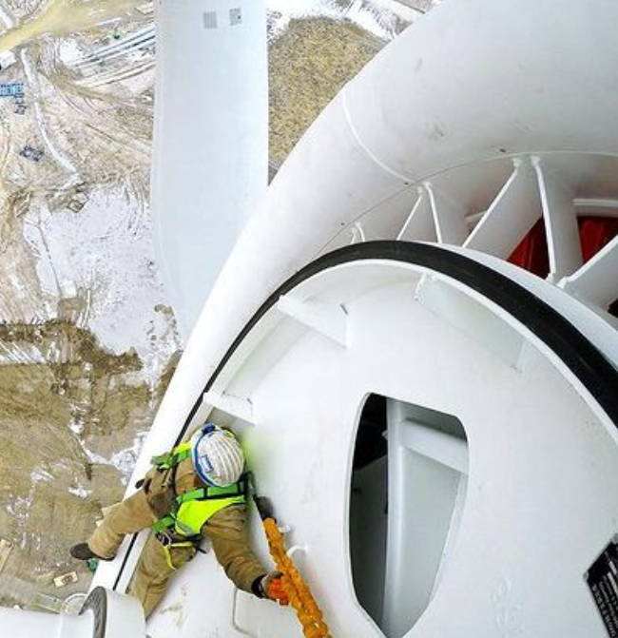
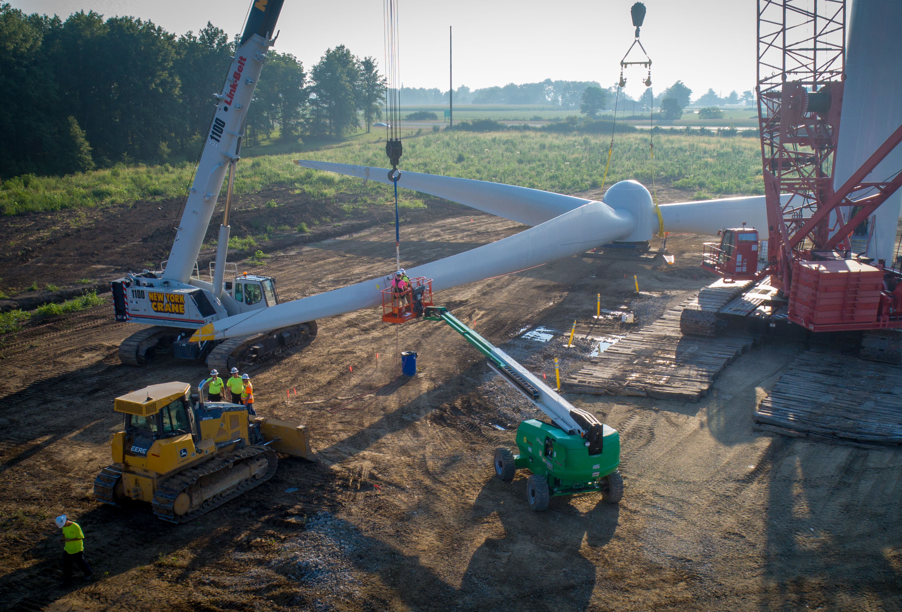

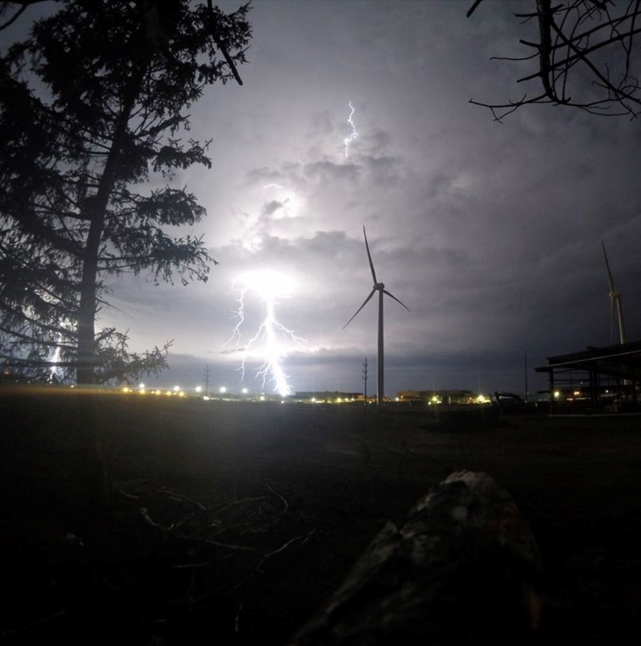
Editing / quality control – cont.
Watch out for flags
  Safety
  Ambiguity
  Opportunities for misinterpretation
  Audience - community members, investor perspective(s)

Slide 21
Resources / if you get stuck
Grammarly
Read your work out loud
Refer to the Branding and Style Guide
Re-work the sentence to avoid the issue
  Ex 1: if you’re tripped up by a word or punctuation (for example customers’) rephrase the sentence to eliminate your problem word or phrasing
  Ex 2: avoid tricky topics or flags
    “Wind turbine construction can be a dangerous activity if not properly trained.”
    “At One Energy, we prioritize and provide top-of-line training to ensure the safety of our team and projects.”
Google
Phone a friend
Just write

Slide 22

Resources cont.
Make a list (mental or written) of mistakes you frequently make
Revisit this list when crafting a new document, or updating from a template

Slide 23
STORYTELLING’S ALL-TIME #1 TIP FOR BECOMING A BETTER WRITER

Slide 24
Write more!!!

Slide 25

Bonus tips for becoming a better writer
Tip #2: Edit often
  Your work
  Your colleague’s work
Tip #3: Ask for feedback
  Don’t be afraid to ask questions
    Ask your teammates
    Ask colleagues with different expertise
    Ask your managers
    Ask Storytelling

Slide 26
Questions?

