Slide 1
3D Printing Basics
Darshan Bhosale
10/12/2021

Slide 2
Content
What is 3D printing?
  Types of 3D printers
  Terminology
    Support structures
    Infill
    Print orientation
  3D printing process
Using the Lulzbot 3D printer
  Setting it up
  Common issues
Applications

Slide 3
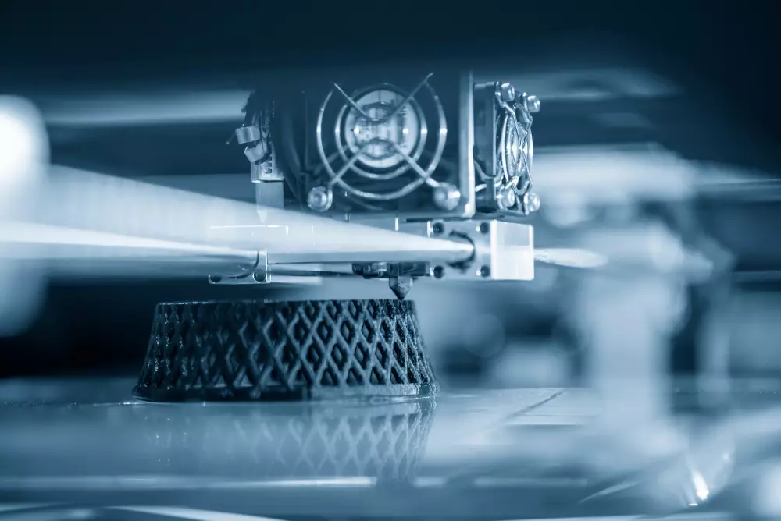
What is 3D printing?
A process that produces three dimensional objects using an additive layer-based process
What is additive manufacturing?
  Additive vs subtractive manufacturing
Layer-based approach
  Printing one layer at a time
  Almost all 3D printers utilize this method
Notes:
Important to remember 3 dimensional objects, additive process, layer based approach
We all know what 3 dimensional objects or structures are but what does additive mean
It refers to additive manufacturing.
Additive manufacturing is where you add material to create an object. 3d printing, directed energy deposition etc
In contrast is subtractive manufacturing, where you remove material to end up with a finished object. Example: milling, turning, cnc machining
And the 3rd thing defining a 3d printer is a layer based approach.
This means the printer will print a single layer at a time. It does this by slicing the 3d object into multiple layers
So essentially the printer is only working on a single 2d layer at a time. Once completed it moves to the next layer
And almost all 3d printers utilize this approach

Slide 4
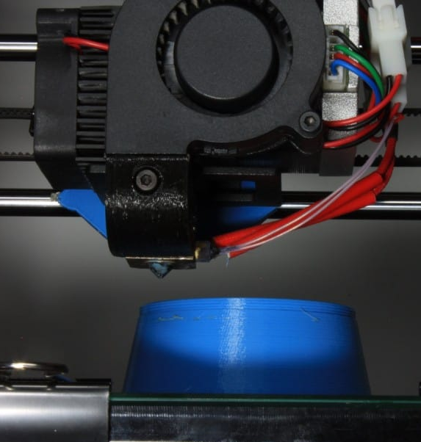
Types of 3d printers
3 basic types of printers:
  Fused Deposition Modelling (FDM) or Fused Filament Fabrication (FFF)
  Stereolithography (SLA)
  Selective Laser Sintering (SLS) or Selective Laser Melting (SLM)
Different Use Cases
  Hobbyist
  Professional
  Industrial
Notes:
Moving on to the types of 3d printers, there are 3 basic types: starting with fdm or fused deposition modelling. This is also called fff or fused filament fabrication sometimes.
Both of these refer to the same process
The second process is SLA or stereolithography
And finally, SLS or SLM, selective laser sintering or selective laser melting
The biggest difference between these processes is how they’re used
Generally, FDM printers tend to be used more by hobbyists or people curious about 3d printing.
Mainly because of ease of use and low cost
SLA printers are used more by professional model makers or product designers looking for some serious prototyping.
SLA printers provide better reliability or durability meaning parts last longer. They also have a better surface finish and accuracy.
SLS or SLM printers tend to be more industrial in nature. They are not at all entry-level devices. Parts they produce are manufacturing grade in some cases.

Slide 5
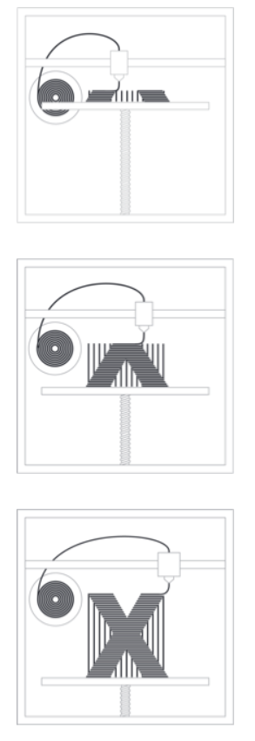
Fused deposition modelling
One of the most common and affordable type of printing process
Thermoplastic material is extruded through a heated nozzle and deposited layer-by-layer
Other than base polymer materials, can also use composite filaments
Notes:
One of the most common and affordable type of printing process, mainly because it’s so simple.
The way it works is the material is passed through a nozzle. This nozzle heats up the material, enough to make it malleable and then deposits in a 2d layer. Once the material cools it solidifies, creating a 3d structure. The printer then moves on to the next 2d layer.
Fdm printers can also print with a variety of materials other than basic polymers, so things like carbon fibre filaments or wood filaments.

Slide 6
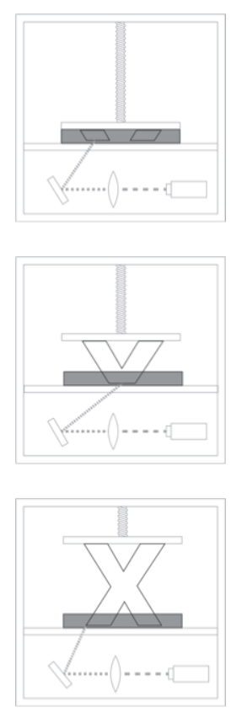
Stereolithography
Uses liquid resin as raw material to print objects
Laser selectively cures parts of the liquid resin
As the resin cures, it hardens
Provide exceptional detail
Requires washing and UV curing as post-processing
Notes:
These printers use liquid resin as raw material to print objects from. The way this works is you have a chamber full of some resin and a laser positioned underneath it. The laser selectively shines on certain regions and cures the resin in those areas. It does this until the entire layer is hardened. Once that is done the print head pulls the print up and a new layer of resin occupies that space, ready to be cured.
Because this process uses a laser, it provides exceptional detail and resolution in the prints.
The only disadvantage is that this process most often requires some post processing. Mainly washing and uv curing. The washing is to get rid of any excess uncured resin on the object and uv curing is to finalize the curing process.
The resins can be toxic and so you need to be careful when handling or disposing them.

Slide 7
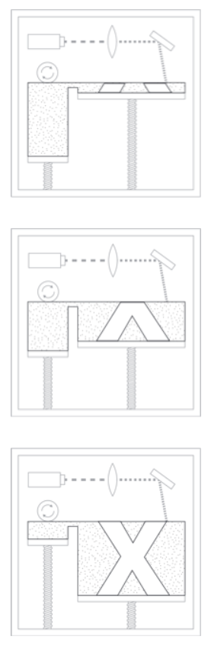
Selective laser sintering
SLS mainly used with plastic, glass or ceramic materials
A layer of powdered material is put down and sintered using a laser
The process is repeated till the part is finished
Capable of producing highly intricate parts
Process is expensive and required expertise to use
Notes:
SLS is mainly used with plastic, glass or ceramic materials. If metal or metal alloys are used, then the process is called selective laser melting. Inside a SLS printer you have a powder reserve where the material is stored. Some of this is then laid down on the print platform and a laser then sinters or atomically fuses these powder particles together. Then a new layer is laid down on top this sintered layer and the laser sinters again. This continues till the part is completed.
Because of the way it works it is capable of producing extremely intricate parts.
The only drawback is that the machines are often expensive, and require some level of expertise to operate.
One company selling the machine for ~$18,000 and the full setup for around $30,000
Mostly industrial uses.

Slide 8
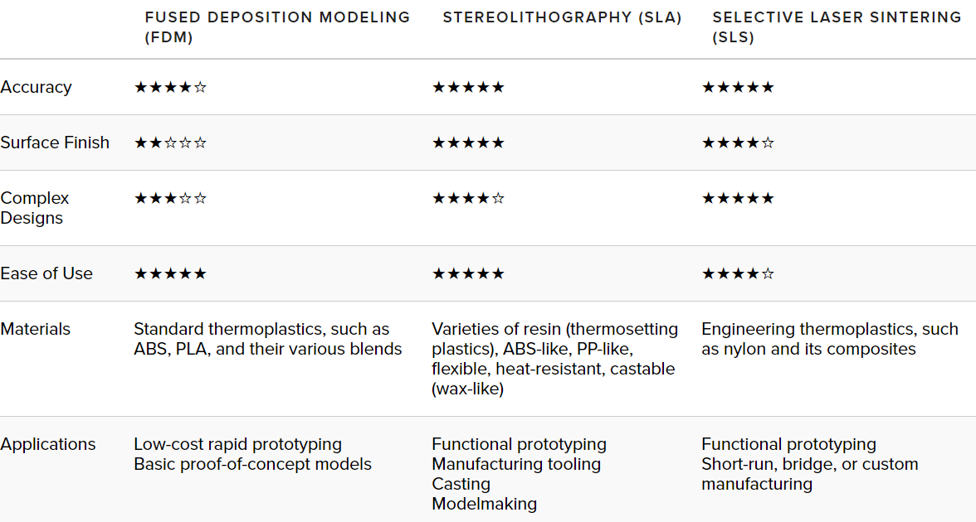
Process comparison
Notes:
I took this from a company’s website that makes SLA printers which is why the SLA is shown as the best performer here but if you disregard that, then you’ll notice that the FDM is probably the easiest to use.
The SLA provides the best surface finish and the SLS is capable of producing complex designs.
They all work with a variety of different material.
Their applications are also different. There is no clear answer as to the best type of printer. It depends on your use case or what you plan on printing.

Slide 9
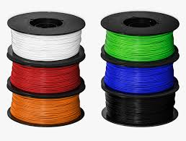
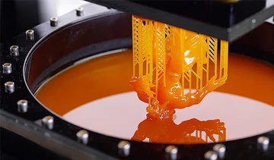
terminology
Filament: spool of material used in printing the object. Liquid resin for SLA printers and powdered material for SLS printers.
Notes:
Filament comes in a variety of color and material.
SLA printers have liquid resin as their raw material

Slide 10
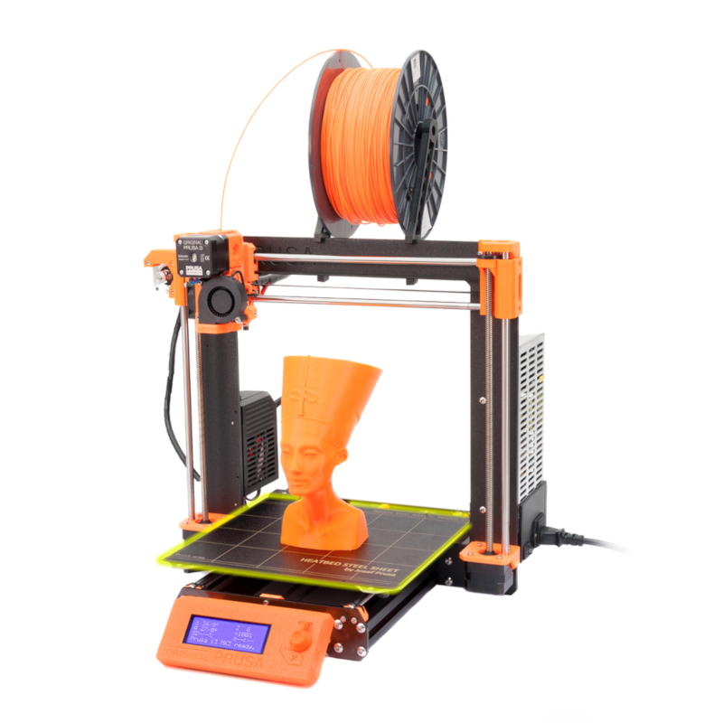
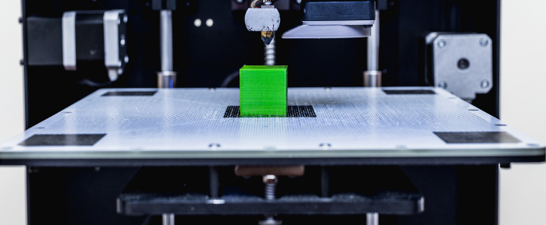
terminology
Print Platform/Build Platform: heated print bed/base on which the print is created
Notes:
Come with automatic leveling or some that you have to manually level each time.
Some print beds can be heated as well, helps with print adhesion

Slide 11
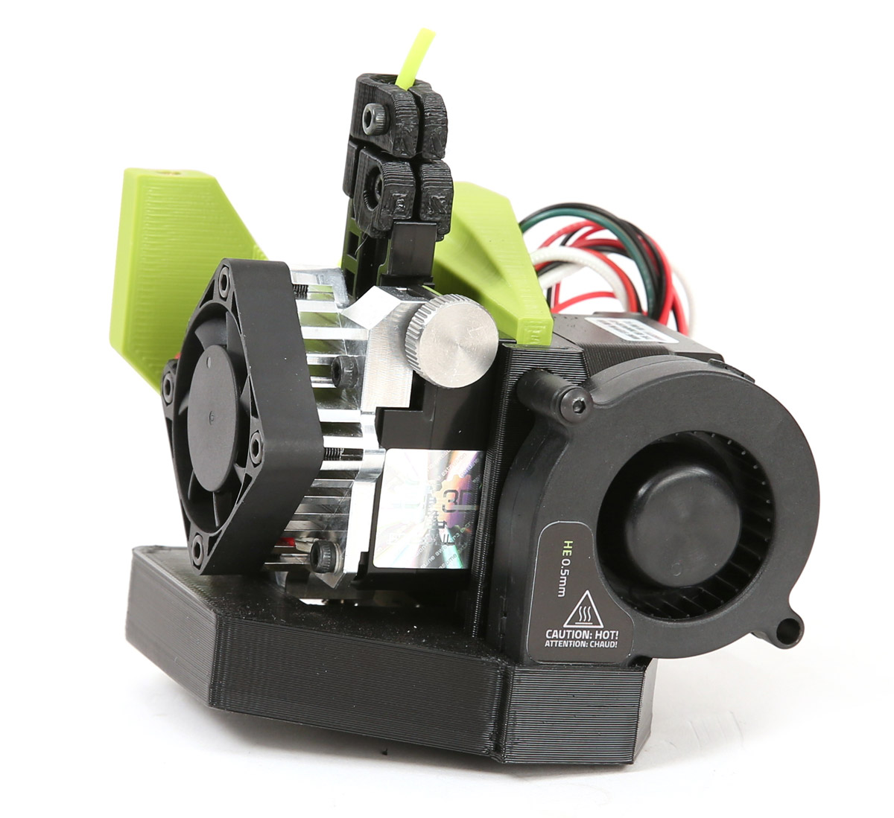
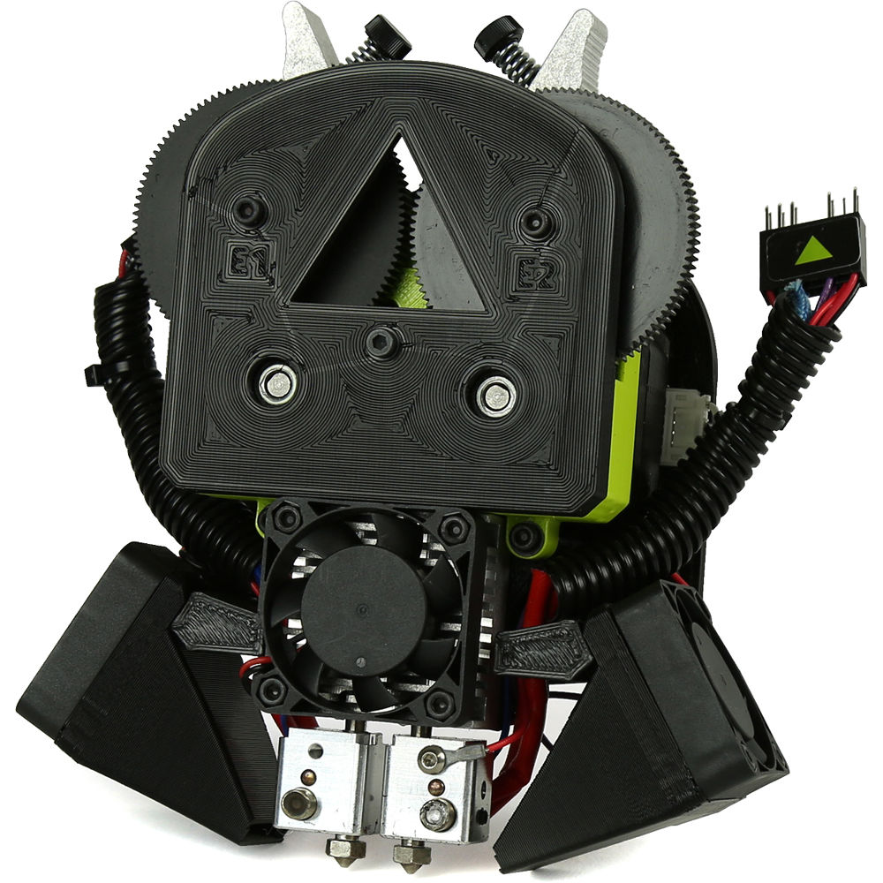
terminology
Toolhead: the combined extruder and nozzle assembly in the case of FDM printers. Extruder pushes filament through, and the nozzle heats it up
Notes:
Extruder grips the filament and pushes it through the nozzle. The nozzle is heated to make the filament material malleable.
A bunch of fans on these.
Some are to cool the nozzle, some to cool the print.
Image on the right is a dual extruder. Can print 2 colors at the same time, can print solid and flexible material together.
Can also print soluble supports with one extruder and regular material with the other.

Slide 12
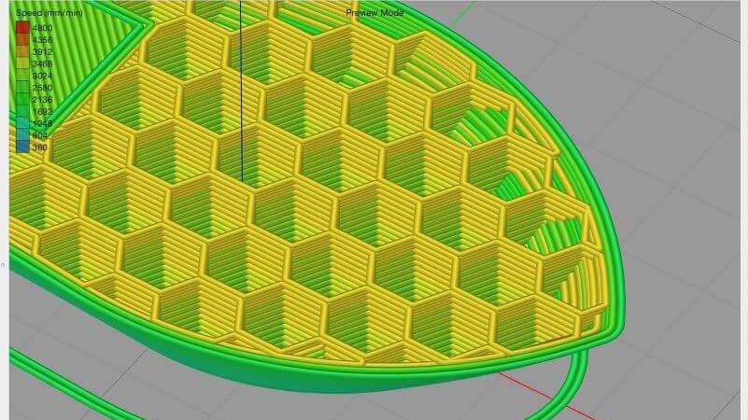
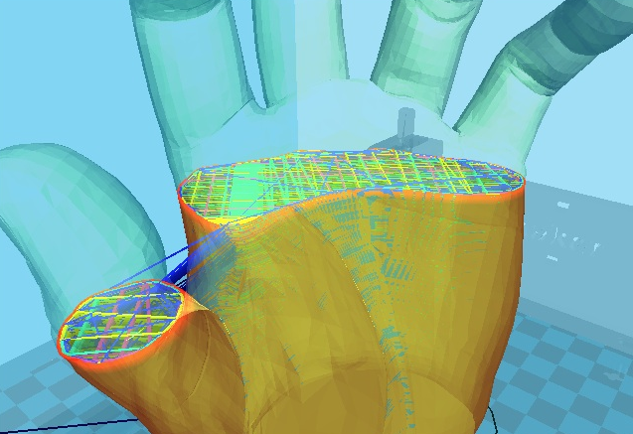
terminology
Slicer: software that converts the 3D object into multiple layers. Each layer provides a tool path for the toolhead to follow. It also adds other instructions such as tool head temp, bed temp etc.
Notes:
Slicer divides part into multiple layers and plans a tool path for the toolhead to follow.
Can view inside the model to see the infill pattern
Shows what support structures will look like, what orientation the part is in

Slide 13
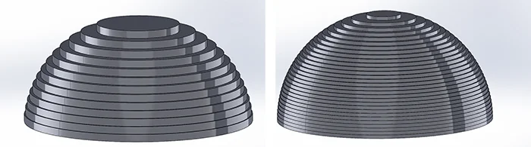
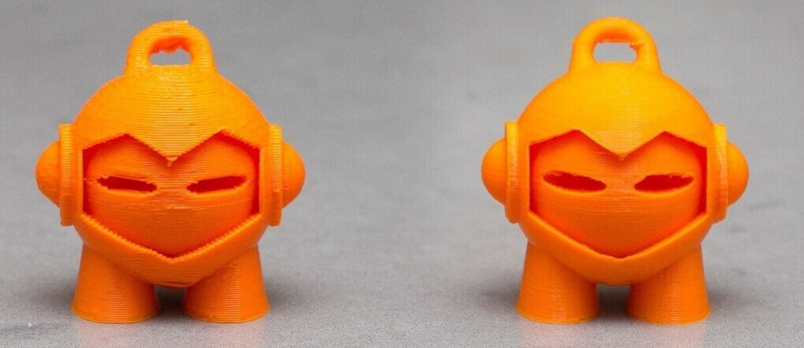
terminology
Layer resolution: refers to how thick a layer can be printed. Thinner layers offer better surface finish but take longer to print.
Notes:
Talks about how thick each printed layer is.
Printers offering a smaller layer resolution will produce better quality prints
Thinner layers offer better surface finish but take longer to print

Slide 14
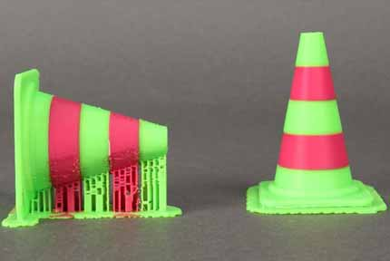
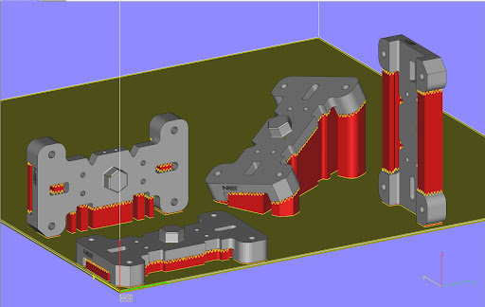
terminology
Print orientation: describes how the print is positioned on the print bed. Orientation can affect overall print time and quality.
Notes:
Print orientation matters a lot.
How you orient objects can influence, print quality and time
Orientation also done to fit multiple parts in a limited space
Also think about internal channels when positioning objects

Slide 15
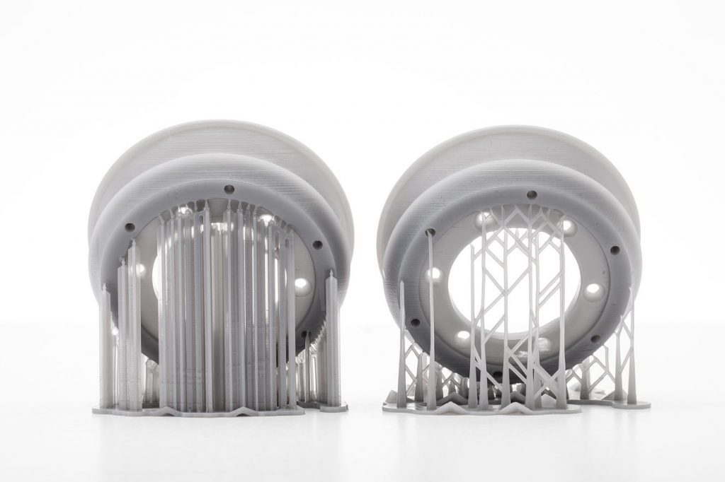
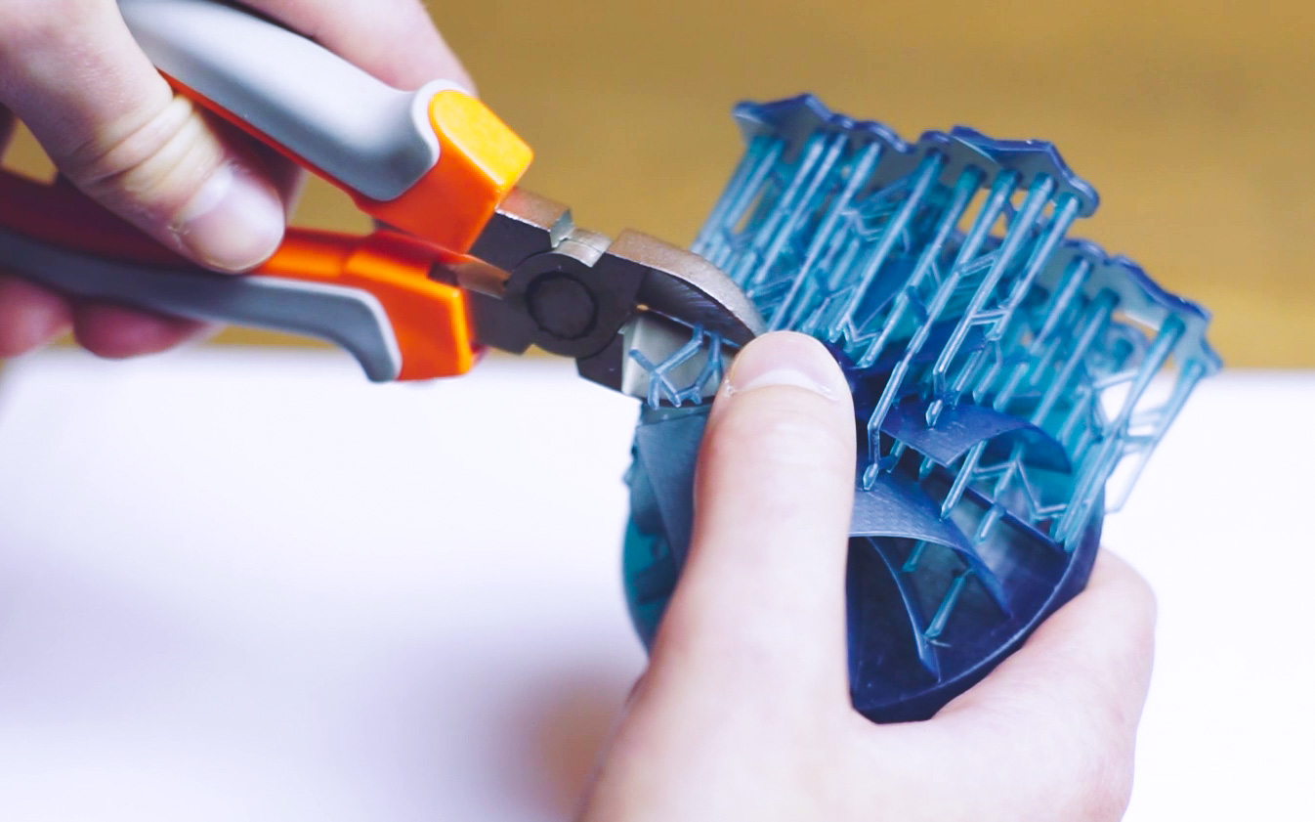
terminology
Support structures: used in supporting overhangs. Usually break away easily. Some methods utilize dissolvable supports.
Notes:
Support structures support the actual printed object.
Support density can be changed to increase/decrease print time
Supports usually printed slower
Some supports can be snapped off or can be dissolved

Slide 16
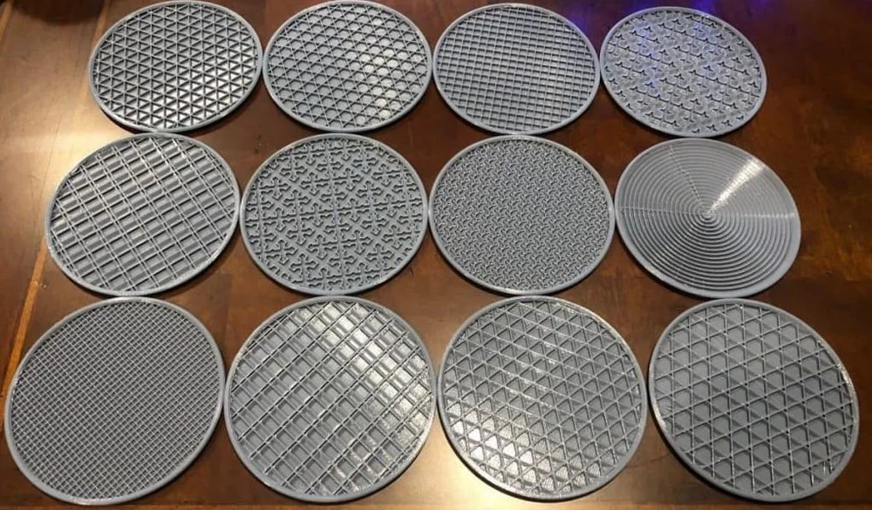
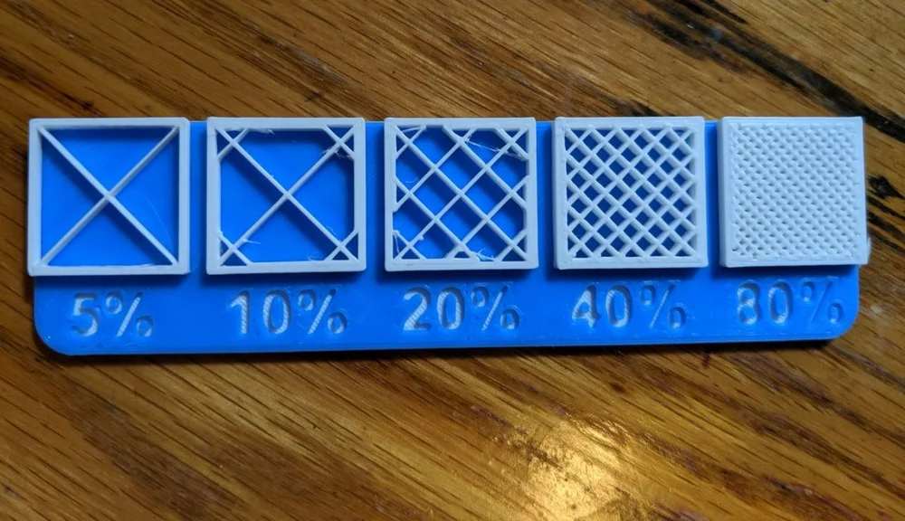
terminology
Infill: material that exists inside the printed object. Can choose from multiple infill densities and patterns. These affect weight, print time, strength, flexibility and material used.
Notes:
Material that makes up the inside of the printed object
Can choose from multiple patterns and densities
based on what you choose, can affect the weight, strength, print time, flexibility how much material you use

Slide 17
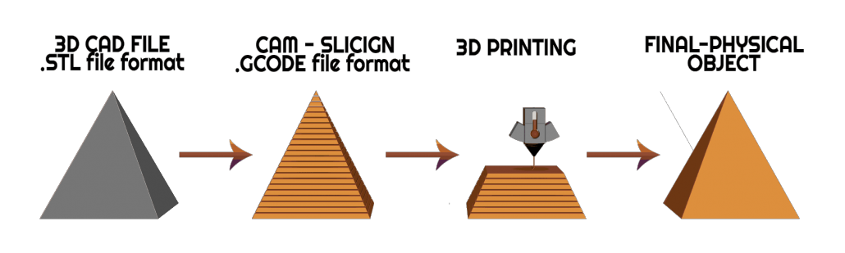
3D Printing process
Create 3D object using CAD software
Export to the slicing software
Alter print settings
Print and post-process

Slide 18
Lulzbot printing process
Demo after the presentation

Slide 19
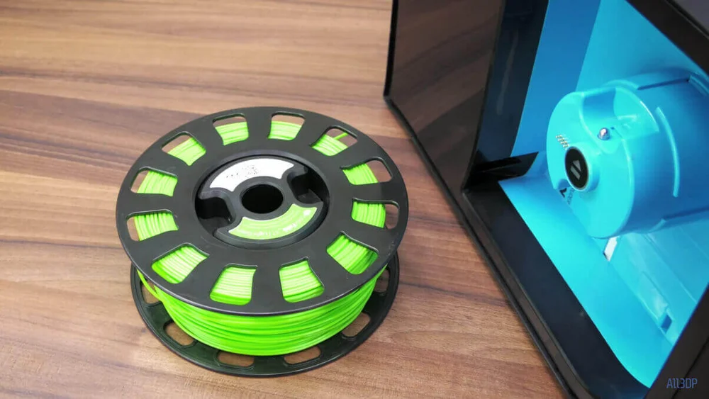
Common issues
Out of filament: make sure to have enough filament to print your part. Load new reel if in doubt.
Notes:
Make sure to have enough filament
Don’t want to start print and have the filament run out mid-process
Some printers automatically stop printing when out of filament

Slide 20
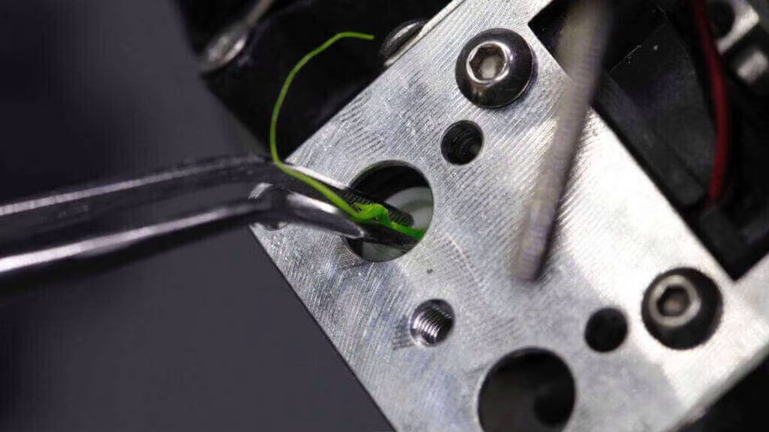
Common issues
Blocked nozzle: can occur if filament snaps and a small piece is stuck inside. Always make sure to extrude before starting print.
Notes:
Blocked nozzle can occur for multiple reasons
Nozzle stops extruding material out
Can be if small filament is stuck inside
can occur in between material changes. Previous material with different heat settings gets stuck and carbonizes inside
Make sure nozzle can extrude before starting print

Slide 21
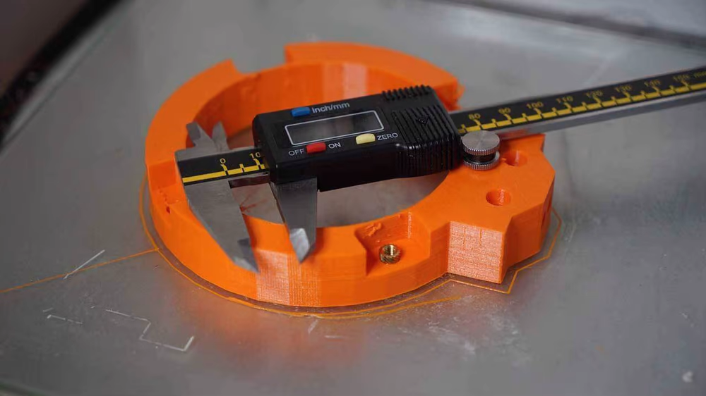
Common issues
Dimensional accuracy: parts don’t fit together. Make sure all units are correct. Choose appropriate print quality settings. Allow enough tolerance to account for material expansion and contraction. Make test prints if required.
Notes:
Parts come out with slightly different dimensions and don’t fit together
Check model before printing
Choose correct print settings, low quality, high quality. These have different error margins
Account for material expansion through heating and cooling
Do test prints if possible

Slide 22
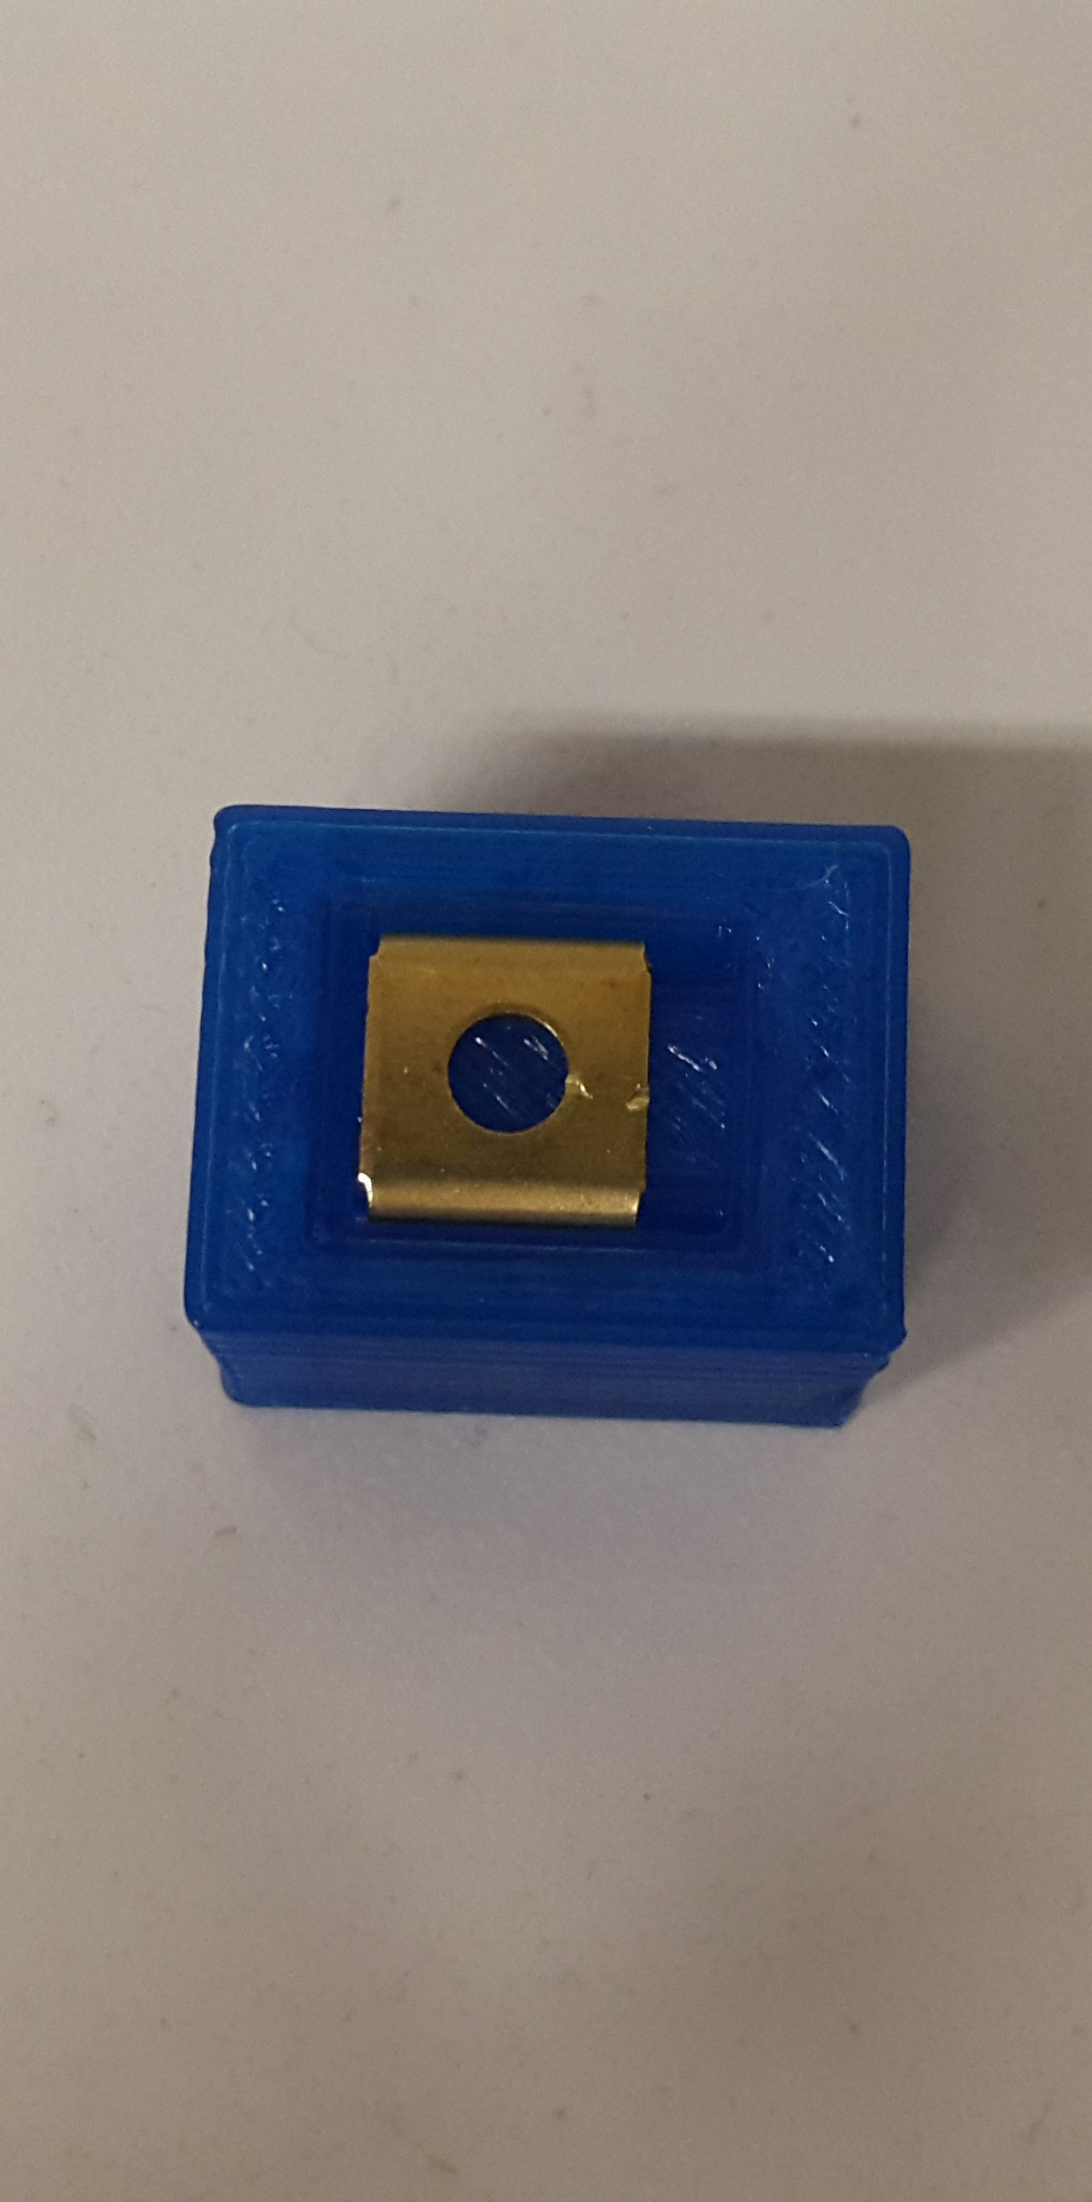
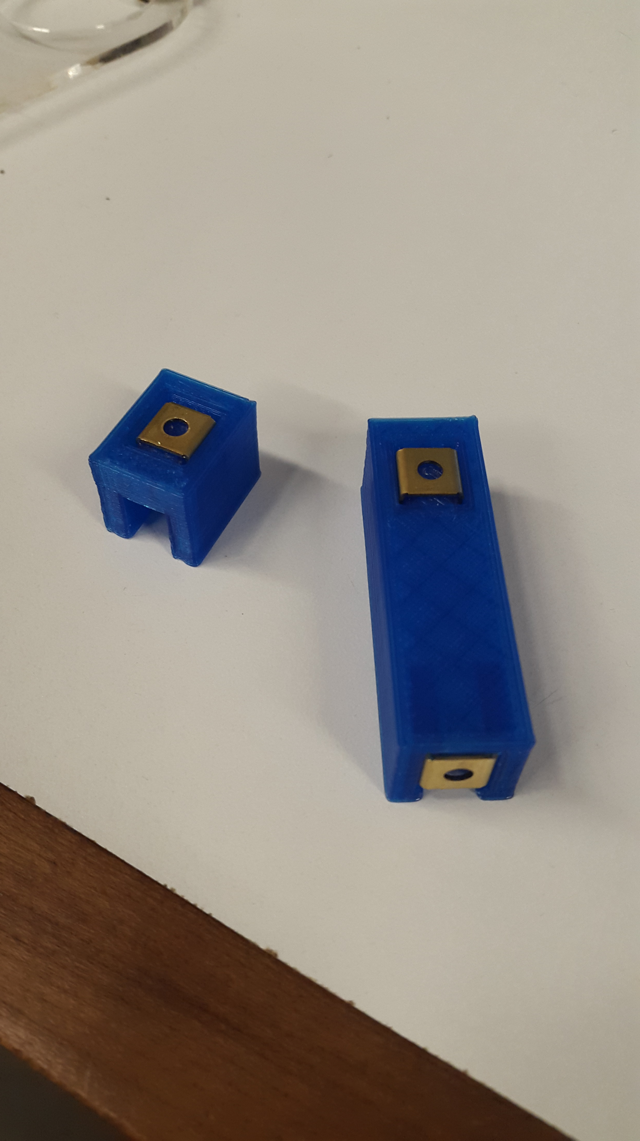
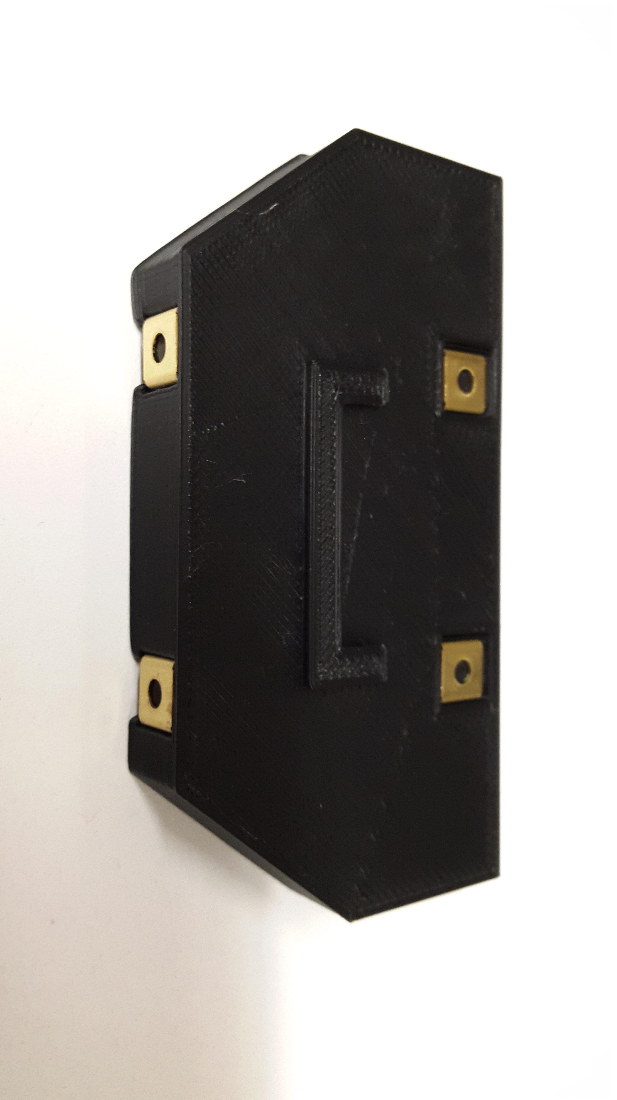
TEST prints

Slide 23
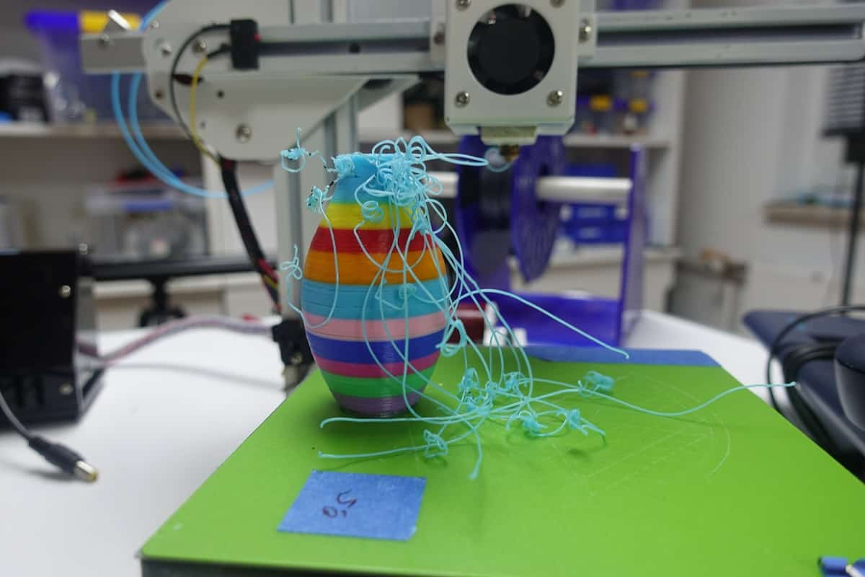
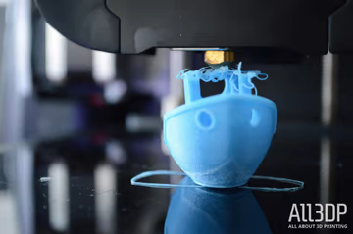
Common issues
Adhesion issues: print does not stick to the print platform. Can lead to lost time and failed prints. Provide maximum contact with print bed through orientation and build plate adhesion.
Notes:
print does not stick to the print bed due to poor adhesion
Nozzle has enough friction to move the print away
Provide maximum contact surface
Adjust print bed temp based on material

Slide 24
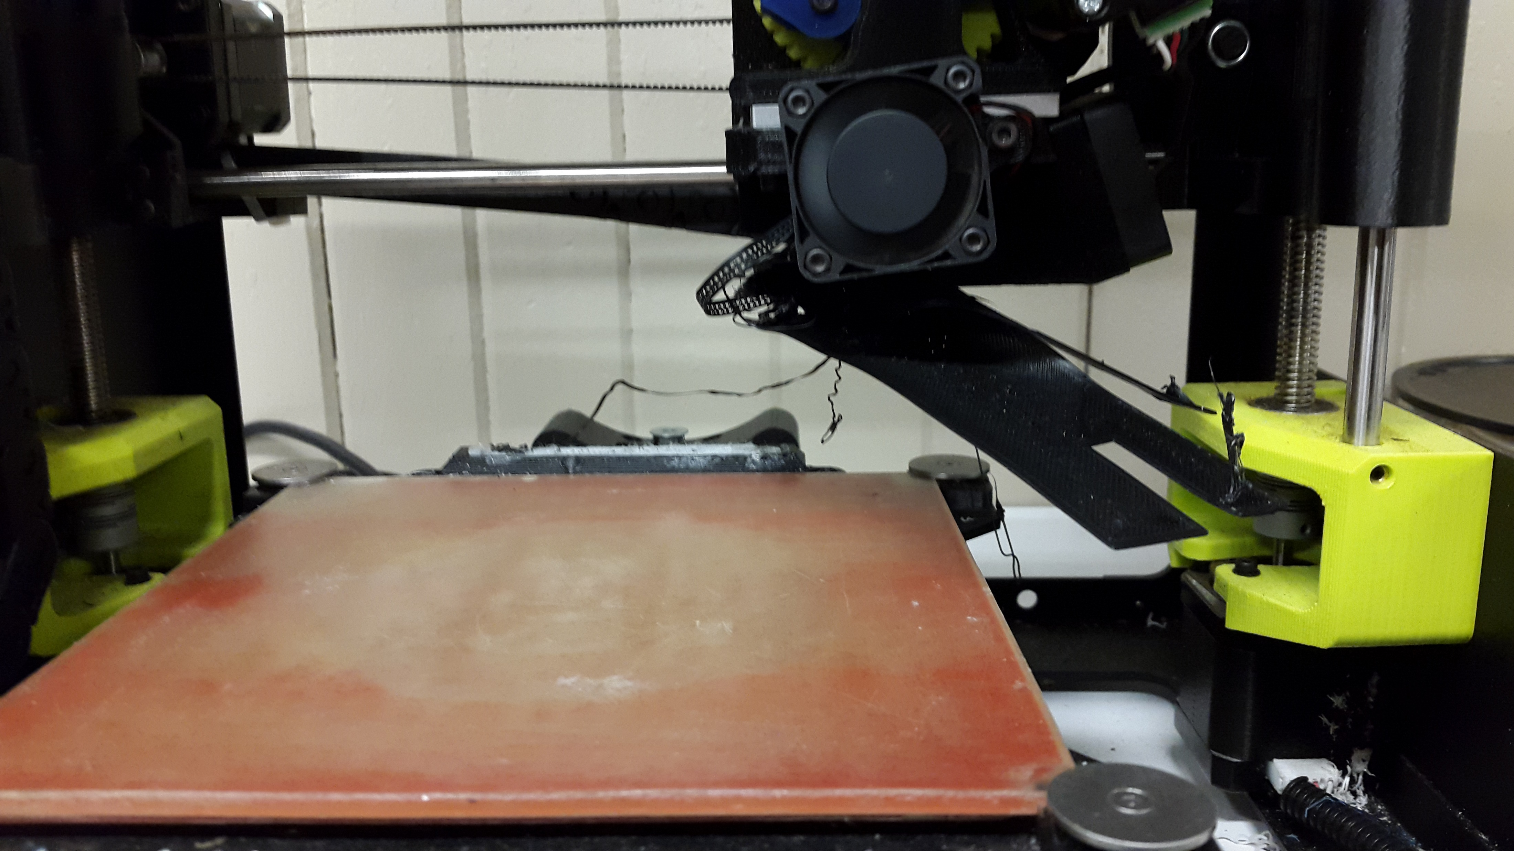
ADHESION ISSUES

Slide 25
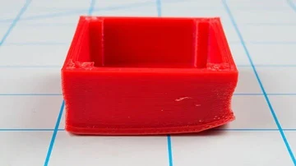
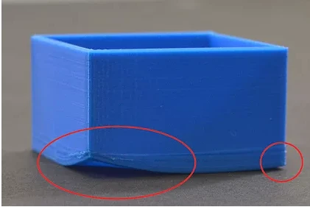
Common issues
Warping: print base layer bends upwards and loses contact with print bed. Occurs due to rapid cooling of the print. Use a heated print platform. Adjust print platform temp settings.
Notes:
Parts bend upwards at the edges due to rapid cooling
Use a heated print bed if possible
Adjust bed temp settings
Increase print bed adhesion

Slide 26
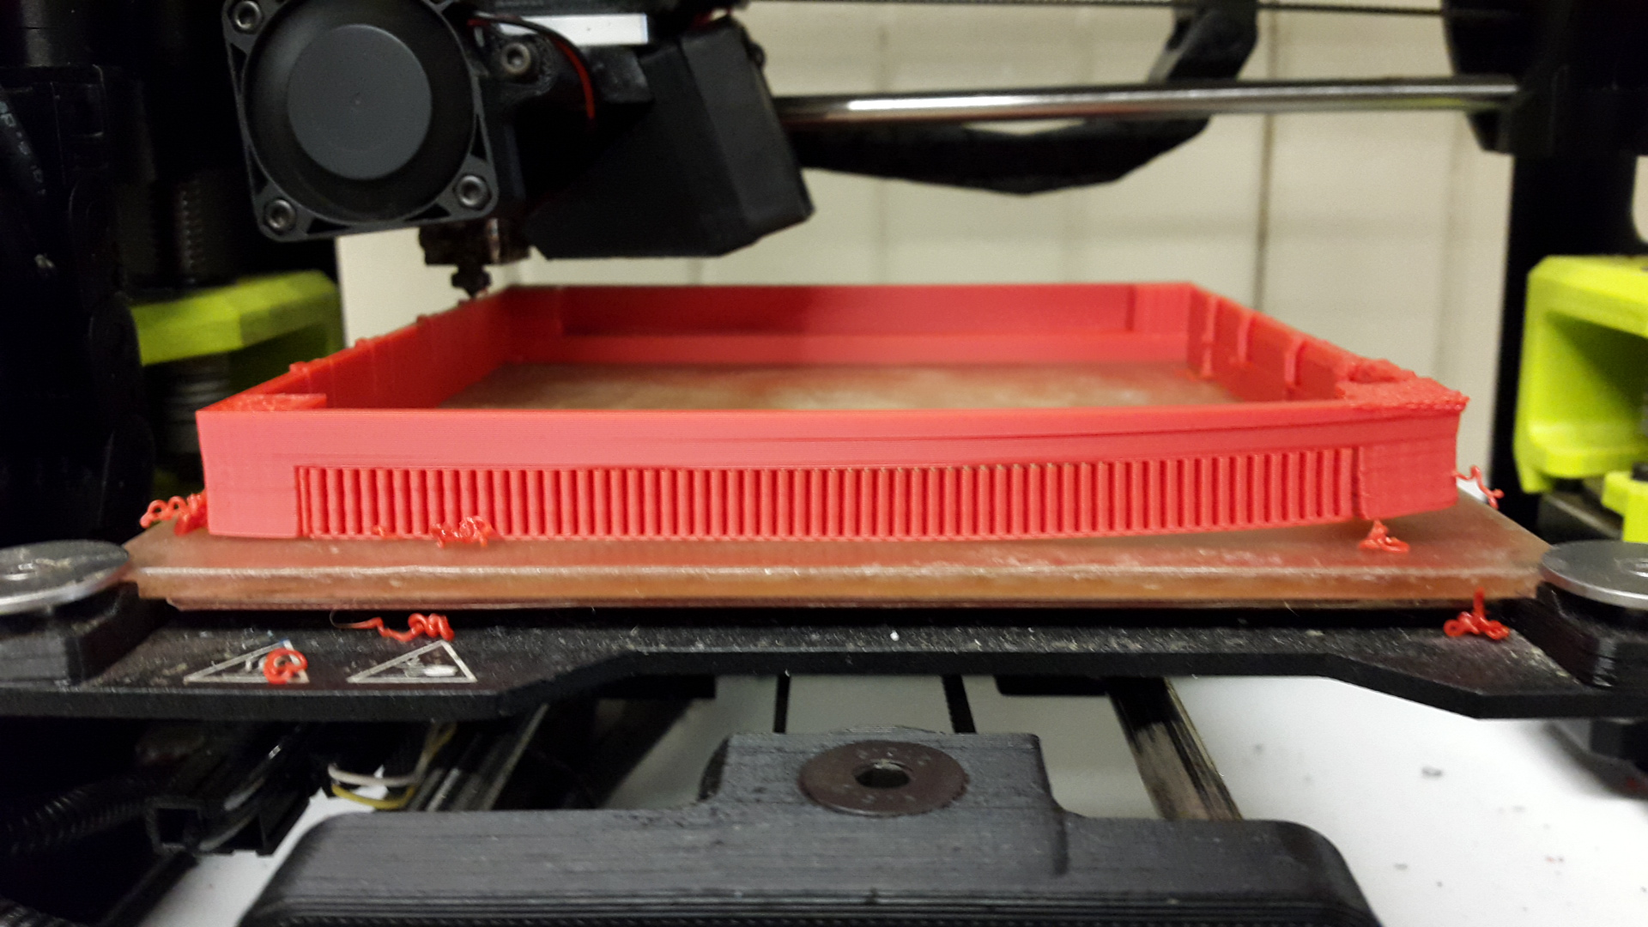
WARPING

Slide 27
applications
Rocket Parts – Relativity Space
Houses – Icon
Food – Cocoa Press
Bioprinting – Allevi
Wind Industry - GE
Notes:
Wind Industry – largest binder jet 3d printer to make sand molds to cast nacelle components

Slide 28
Thank you!
[Name]
[Date]

