Slide 1
Infrasound First Steps
Spencer Rinebolt
12/17/2021

Slide 2
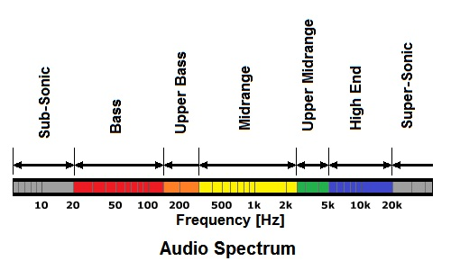
What is Infrasound?
The term infrasound was coined about 2 centuries ago, influenced by the terms infrared and ultraviolet which was then adopted to describe light
It was later adopted as the label for “sub-audible” sound which is in the range of 0Hz-20Hz

Slide 3
Common misconceptions of infrasound
The most common misconception of infrasound is that it is “sub-audible”, this however is not the case because the frequency of a sound is not the main thing that contributes to its audibility, instead the intensity or amplitude in decibels (dB) is the driving factor
“Supernature” by Lyall Watson from 1973 is a great example of misinformation spreading like wildfire, within it the author states that a technician helping in previous infrasonic studies done by French researcher Gavreau, “fell down dead on the spot” after trial running an infrasound generator
“Supernature” also proposes that two of those same infrasonic generators “focused on a point even five miles away [could] produce a resonance that can knock a building down as effectively as a major earthquake”

Slide 4
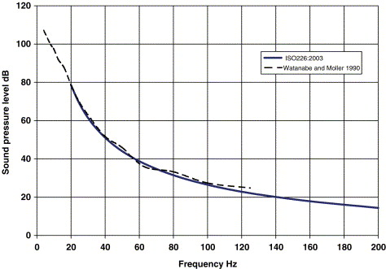
A simple explanation on audibility
The perceived volume of the sound comes primarily from the intensity of the sound in dB
  Frequency is well known for adjusting the pitch of the sound, but it does affect the volume as well
The graph to the right shows the hearing threshold at various frequencies combining both ISO 226:2003 and the curve created by Watanabe and Moller in 1990
Notes:
Credit for the graph goes to Geoff Leventhall, author of “What is infrasound?”

Slide 5
Why it matters to One Energy
Wind turbines produce infrasound which has been the cause of some headaches for the wind industry, with wild ideas such as this one spouted by former President Donald Trump at a National Republican Congressional Committee “If you have a windmill anywhere near your house, congratulations, your house just went down 75% in value. And they say the noise causes cancer.”
Ideas such as these make community approval harder to get, so by having information on our turbine's infrasound production, we can help quell any potential community fear

Slide 6


What goes into Turbine noise generation
The noise that turbines generate can fall into two main categories:
  Aerodynamic Sound: the sound of the blades moving through the air
  Mechanical Sound: the sound generated by the machinery and electrical equipment
Along with the noise the turbines generate the way it propagates changes with the temperature and wind shear
  When ground temperatures are higher than the air temperature the sound refracts upward, and the inverse is true
  As wind shear increases the upwind sound levels decrease while downwind increase
A report done by Hosei University in Tokyo, found that using the equation f=RZ/60 (where R=rpm & Z=# of blades) provided an accurate infrasonic area to look for

Slide 7
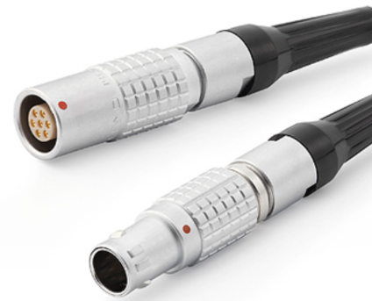
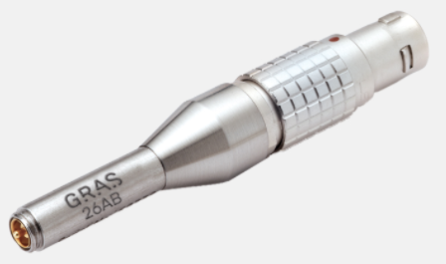
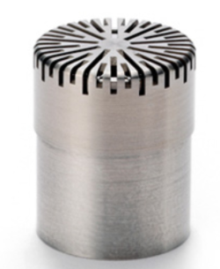
Equipment Required to measure infrasound
While One Energy does have a sound meter, it is only able to read in the area of 16Hz-16kHz which only hits the upper end of the infrasonic range
In order to accurately measure infrasound, we are going to need a low frequency microphone and a wind screen. Then we need a preamplifier, analyzer input module, or sound level meter that is compatible with the microphone
Notes:
Pictured (L>R): Gras 26AB Preamplifier, GRAS 40AN Low Frequency Microphone, GRAS AA0047 LEMO 7-pin cable

Slide 8
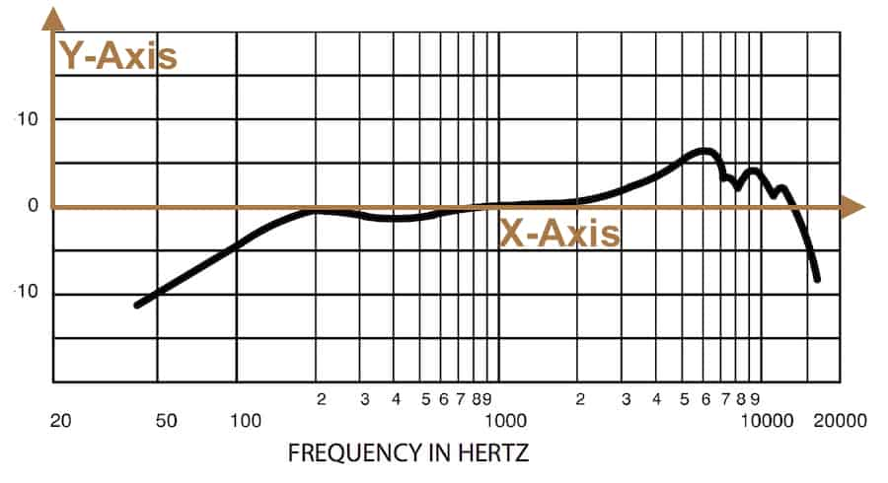
Understanding Microphones for Infrasound
The graph below is a microphone frequency response graph; the x-axis is the frequency, and the y-axis is relative sensitivity
Whenever the line passes below the x-axis the microphone is less sensitive at the frequency
Then whenever the line is above the x-axis the microphone is more sensitive at that frequency

Slide 9
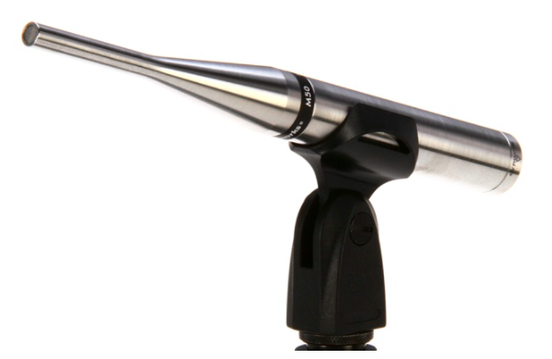
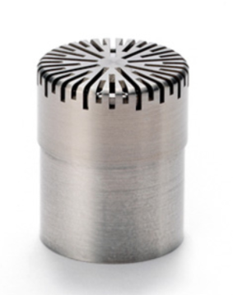
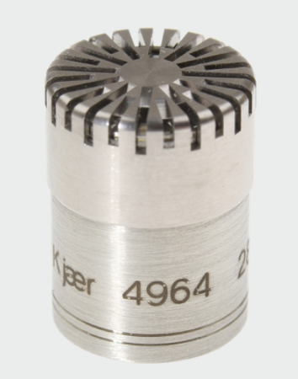
Microphones Up for Consideration
Earthworks M50
Freq. Range:
  3Hz-50kHz
Max dB:
  140dB SPL
Price:
  $1,299.00
GRAS 40AN ½”
Freq. Range:
  0.5Hz-20kHz
Max dB:
  149dB SPL
Price:
  Quote
Bruel & Kjaer Type 4964
Freq. Range:
  0.02Hz-20kHz
Max dB:
  146dB SPL
Price:
  Quote
Notes:
Pictures (L>R): Earthworks M50 50kHz Omnidirectional Measurement Microphone, GRAS 40AN ½” Ext. Polarized Free-field Microphone, Low Frequency, Bruel & Kjaer ½-Inch Infrasound Microphone Prepolarized

Slide 10
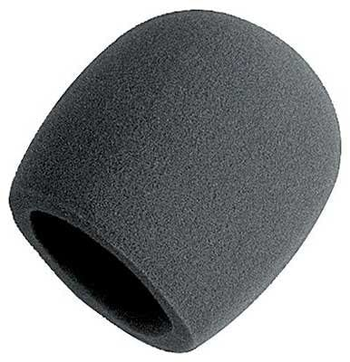
Fabricating a Wind Screen for infrasound
While researching I came across an article talking about how wind screens can adversely affect infrasound measurements, so I looked into modified wind screens that work better for this measurement type
  First thing I came across was a semi porous shroud developed by NASA
  Second was creating a double wind screen, think double paned window
  Third would be to bury it in the ground and covering it with a permeable material but that would hinder out low end pickup
  Lastly, I came across a NASA article that mentions how 8 lb/ft³ polyurethane foam in a cylindrical shape works very well

Slide 11
preamplifier, analyzer input module, or sound level meter
Currently I am yet to select any preamplifiers, analyzer input modules, or sound level meters for the desired microphones
The reason for this is I would like to consult with somebody with more expertise in the field and the audio experts I have reached out to thus far have little to no knowledge on specifically infrasound and the equipment associated with measuring it

Slide 12
Next Steps: Research
The next steps for this project would be to consult with more audio experts to make sure we are making an educated decision on the correct preamplifier, analyzer input module, or sound level meter for the microphone we choose
While speaking to that specialist, inquiring about additional options for wind screens would also prove beneficial

Slide 13
Next Steps: Study
After all the materials have been acquired the next step would be to perform the infrasound study
I believe in order to get useful data from this study we should have multiple 12-24hr data collection periods at varying distances from a turbine (potentially reuse the house at Z6)
  Trying at least two different wind screens would also be beneficial

Slide 14

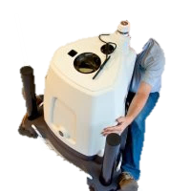
Questions?
Questions? Comments? Concerns?

